Slide 1
Beam Emission Spectroscopy Örs Asztalos, Gábor Anda, Dániel Dunai Miklós Vécsei, Sándor Zoletnik, Péter Balázs

Slide 2
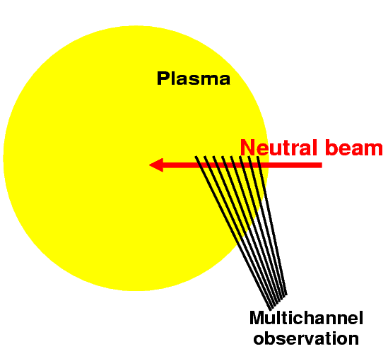
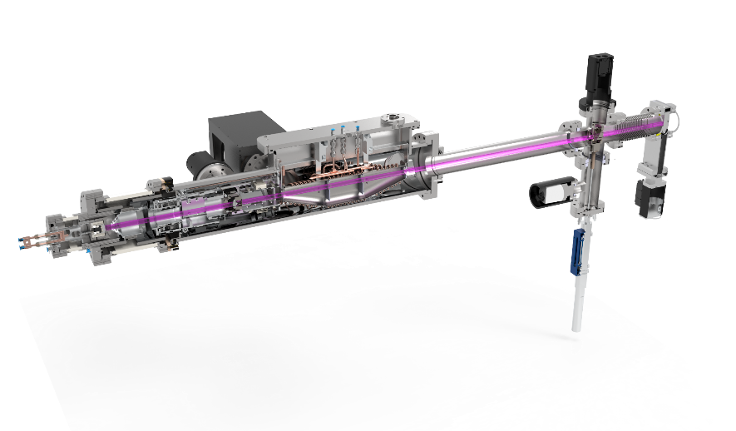
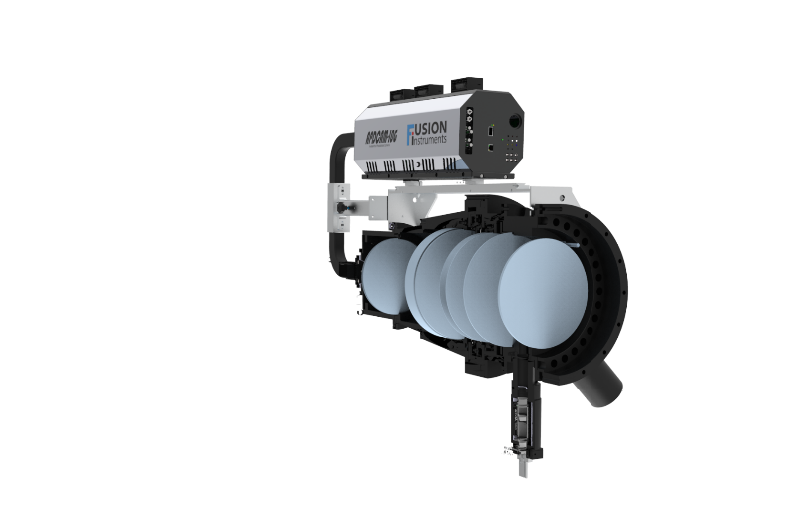
Beam Emission Spectroscopy - Basics
Beam Emission Spectroscopy
Collisionally-excited, Doppler-shifted neutral beam fluorescence (visible range)
~cm spatial and ~μsec temporal resolution aimed
Narrow alkali diagnostics beam
Few cm width
Limited penetration (SOL, edge)
Non-perturbative diagnostic
Installed on: JET, AUG, W7-X, KSTAR, EAST, Compass, DIII-D
Applications:
Density profiles up to 100 kHz
inter-ELM profiles.
Turbulence – SOL and edge
Density shoulder studies
Fast transient events – ELMs, ELM filaments, LH transition
High power wide heating Deuterium beam
15-40 cm width
Deep penetration (core, edge)
Only beam heated plasma scenarios
Installed on: MAST, KSTAR, EAST, DIII-D, LHD, NSTX
Applications:
2D Turbulence imaging - core and edge
Fast transient events – ELMs, ELM filaments, LH transition
2D flows

Slide 3
Alkali beam - status
Diagnostics feasibility studies for Alkali beam and Heating beam Beam Emission Spectroscopy diagnostics were completed in 2016.
Deliverable – update the feasibility study with the latest scenario calculations
Update the feasibility study with synthetic diagnostics results from JOREK (may be from GENE, HESEL)
Project plan and cost estimate for a turbulence imaging BES diagnostic
Update the research plan based on the results of the feasibility study
JT-60SA – Alkali BES
Asztalos et al: Fusion Engineering and Design 123 (2017) 861–864
Giruzzi et al: Nuclear Fusion 57 (2017) 085001
JT-60SA team has experience with Li beam operation (JT-60U)
Lithium beam is in the Research plan
Japanese conceptual study has been done utilizing the old JT-60U system
Input and information was kindly provided by K. Kamiya in 2015:
It is planned to be developed after the first plasma (2-3 years later)
If there is sufficient fund EU could proceed to the detailed design

Slide 4
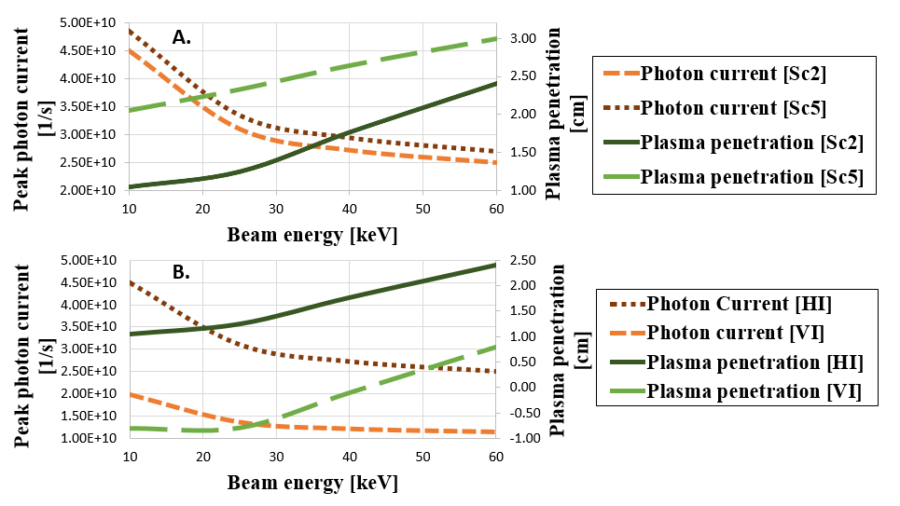
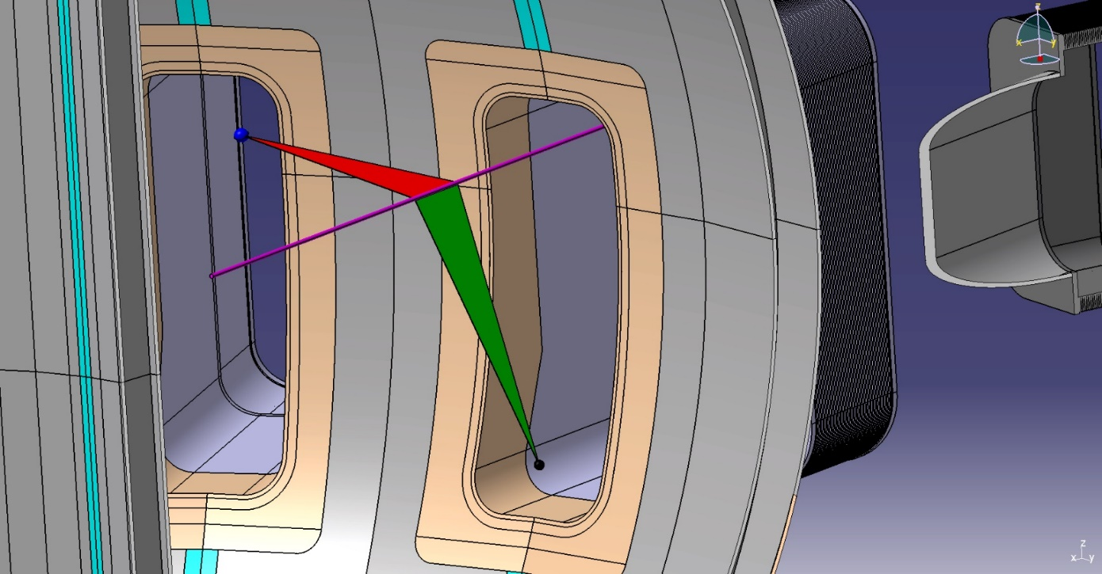
Alkali beam – Advanced Physics considerations
Advanced physics considerations: fluctuation measurement
1D vs. 2D observation geometries:
Green Observation geometry: - Horizontal injection scenario (proposed) P-18 (1D measurement)
Red Observation geometry: - Toroidal observation scenario (proposed by EK) P-17 (2D measurement)
Both provide sufficient light levels → high SNR for
fast density profile reconstruction demonstrated
2D system features spatial resolution of : 2 cm radial and 1.5 cm vertical
1D and 2D system performance is almost identical
with 2D slightly lower but sufficient SNR for fast measurements
P-17
P-18

Slide 5
Alkali beam – Advanced Physics considerations
Advanced physics considerations: fluctuation measurement
RENATE BES synthetic diagnostic + JOREK non-linear MHD:
Red Observation geometry: - Toroidal observation scenario (proposed by EK) P-17 (2D measurement)
Study of ELM burst and non-linear MHD activity leading up to (precursor physics)
Synthetic diagnostic measurement included noise modelling
Velocity of ELM burst ~ 550 m/s → can be measured at expected signal quality

Slide 6
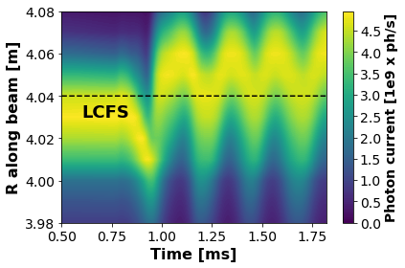
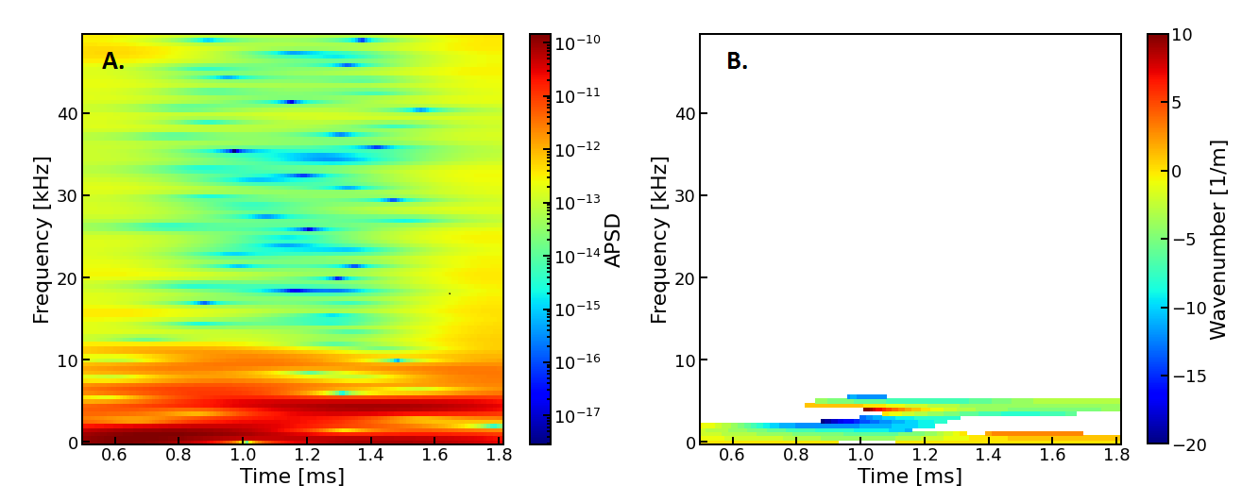
Alkali beam – Advanced Physics considerations
Advanced physics considerations: fluctuation measurement
RENATE BES synthetic diagnostic + JOREK non-linear MHD (from S.Pamela):
Red Observation geometry: - Toroidal observation scenario (proposed by EK) P-17 (2D measurement)
Study of toroidal mode number leading up to ELM burst
JOREK simulations with forced mode – number n = 6 → 14 featuring rotating plasma and not rotating plasma

Slide 7
Alkali beam – Advanced Physics considerations
Advanced physics considerations: fluctuation measurement
RENATE BES synthetic diagnostic + JOREK non-linear MHD:
Red Observation geometry: - Toroidal observation scenario (proposed by EK) P-17 (2D measurement)
Study of toroidal mode number leading up to ELM burst
JOREK simulations with forced mode – number n = 6 → 14 featuring rotating plasma and not rotating plasma
LINEAR agreement in Expected and Synthetically measured mode numbers !!

Slide 8
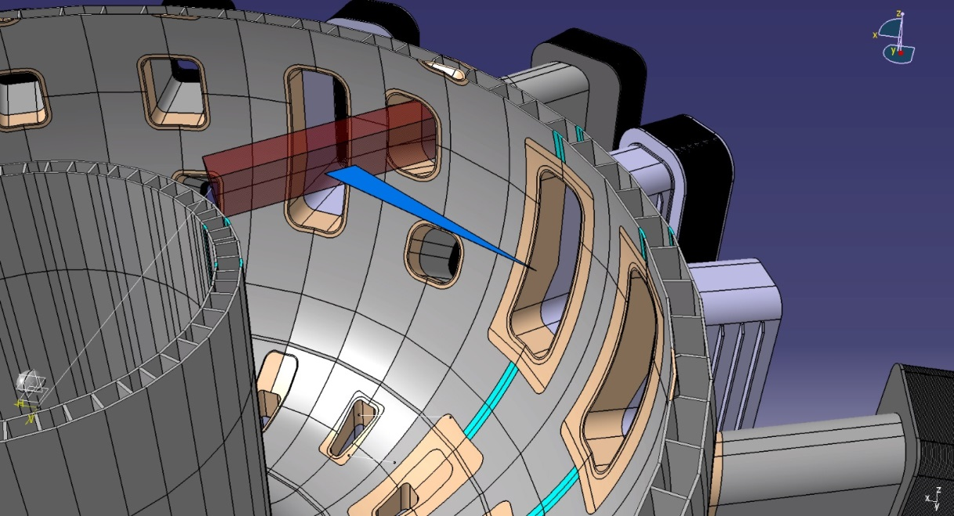
Heating beam - BES
DBES – Set-up 8B beam on port 16. Observation on P-17
The BES needs large first mirror to collect sufficient light.

Slide 9
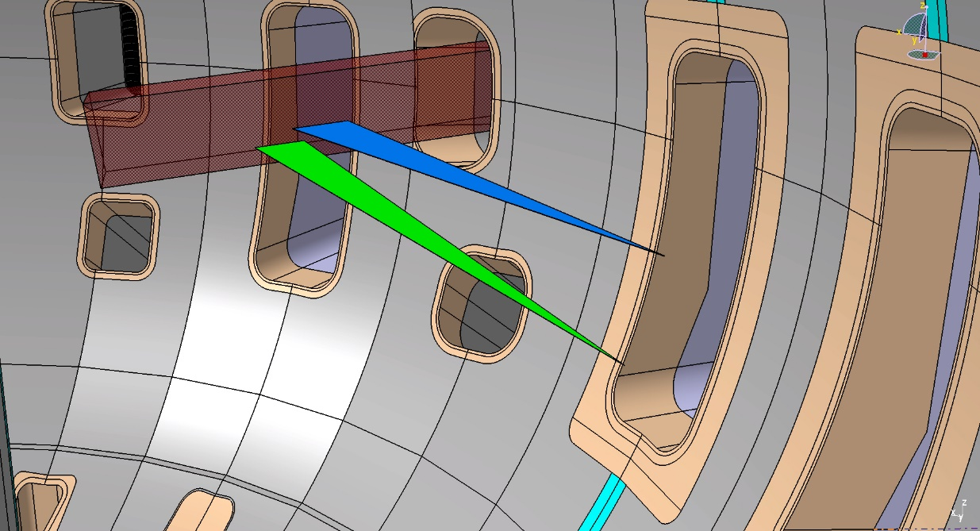
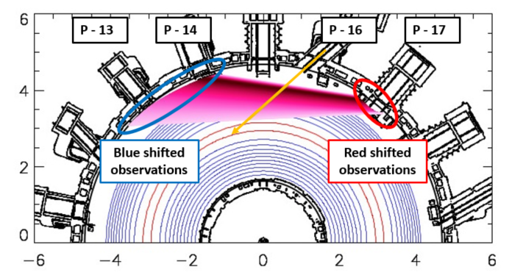
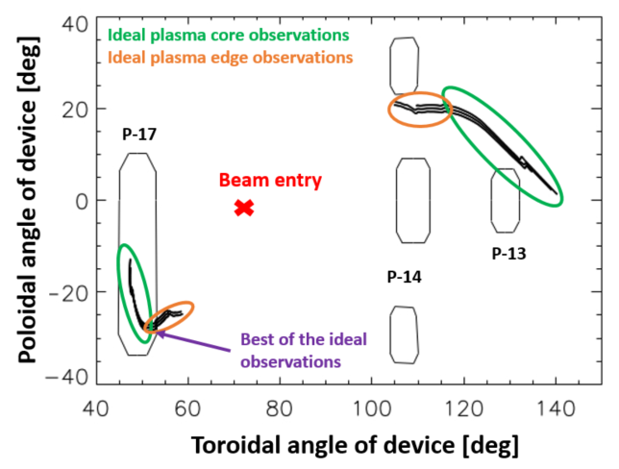
Heating beam - BES
P-17
Synthetic diagnostics was developed to calculate the achievable diagnostic quality to any beam any observation position.
There are possible options for a BES diagnostics
A less optimal position could be still sufficiently good for only edge or core measurements
Physics driven requirements are needed:
What is not good for ITG turbulence can be still OK for larger structures (ELM precursor, MHD modes, etc.)

Slide 10
Ideal heating beam - BES
All ideal Heating beam BES systems:
NBI system | Port for observation | Observed region of plasma | Spatial resolution [radial/vertical][mm/mm] | Doppler shift [nm] | Photon current [ph/s] | SNR [-]
T-NBI 7A | P – 17 | Core | 20.3 / 16.6 | 6.65 | 2.2 x 1E10 | 33.2
T-NBI 7B | P – 17 | Core | 15.1 / 6.6 | 5.85 | 2.8 x 1E10 | 37.4
T-NBI 7B | P – 14 | Edge | 3.9 / 4.1 | -5.12 | 2.6 x 1E10 | 36.1
T-NBI 8A | P – 17 | Core | 10.2 / 4 | 4.31 | 2.8 x 1E10 | 37.4
T-NBI 8A | P – 14 | Core | 20.8 / 16.3 | -5.89 | 6.4 x 1E9 | 17.9
T-NBI 8B | P – 17 | Edge | 13 / 5.3 | 4.93 | 2.2 x 1E10 | 33.2
T-NBI 9A | P – 3 | Core | 13.3 / 7.5 | 5.00 | 1.4 x 1E10 | 26.5
T-NBI 9A | P – 6 | Edge | 14.5 / 7.9 | -6.10 | 2.9 x 1E10 | 38.1
T-NBI 9A | P – 5 | Core | 12.8 / 13.5 | -6.89 | 6.9 x 1E9 | 18.6
T-NBI 9B | P – 3 | Core | 12.3 / 5.7 | 5.00 | 2.6 x 1E10 | 36.1
T-NBI 9B | P – 6 | Edge | 13.3 / 6.7 | -4.63 | 3.0 x 1E10 | 38.8
T-NBI 10A | P – 5 | Edge | 18.6 / 7.1 | -6.45 | 3.4 x 1E10 | 41.2
T-NBI 10B | P – 5 | Edge | 10.7 / 4.7 | -5.88 | 2.9 x 1E10 | 38.1
**
*
Our recommendations:
Fiscally conservative: if observation geometry sharing is possible with MSE then option: *
Ideal observation: Blue Doppler shifted observation on P-14 of beam T-NBI 7B: **

Slide 11
Summary
Summary and plans:
Alkali BES system:
For SOL + Edge observations Li is advised as beam material
P-18 observation geometry: Basic physics (fast density reconstruction) + limited Advanced physics
P-17 observation geometry: Basic + Advanced physics (fast density reconstruction + 2D view of non-linear MHD, turbulence and flows in the SOL + EDGE)
JOREK simulations show LiBES capabilities to resolve ELM bursts and Mode numbers.
Heating BES system:
13 ideal observation geometries were found.
EK Team recommends 2 observation geometries:
P-17 Edge observation of TNBI – 8B – possibly shared with MSE
P-14 Edge observation of TNBI – 7B
The final and more detailed results are underway and to be presented and publish at 32nd SOFT:
Asztalos et al. “Feasibility of fluctuation BES measurements on JT-60SA” ,
More modelling is underway done by HESEL and JOREK.
Project plan and cost estimate for a turbulence imaging BES diagnostic

