Slide 1
Density fluctuations measurements using
Ultra-Fast Sweeping Reflectometry
F. Clairet
CEA - IRFM Cadarache

Slide 2
Density fluctuations
n_{e} = <n_{e}> + δn_{e}
Fluctuations
  Amplitude : δn/n
  Size : wavenumber k
  Temporal evolution : frequency spectrum S(f)

Slide 3
Outline
Ultra-fast frequency sweeping reflectometry
Requirements for JT-60SA
R&D project

Slide 4
Ultra-fast frequency sweeping reflectometer
Schematic
Clairet et al. RSI 2017
Microwave
source
plasma
Antenna
F
F
Consecutive sweeps
Emission
F₂
Reflection
F+
Φ
Mixer
VCO
F₁
Reception
F
time
RF
IF
OL
Φ
Detector
A.cos
Φ
S(t) = A(t).e^{iΦ(t)}
I.Q.
A.sin
Φ
Performances (obtained on WEST)
Heterodyne detection : S/N > 30 dB
Sweeping time : 1 µs (dead time 0.25 µs)

Slide 5
Scientific objectives
F
1 + 0.25 µs (fs=800 kHz)
time
~ 2000 fixed frequencies
Frequency sweep
Fluctuation spectra profile
Density profile
Density profiles & Fluctuation spectra
(high radial (mm) and temporal (µs) resolution)

Slide 6
Physics of turbulence & instabilities
L-I-H transition
CEA reflectometer moved to AUG during 3 years…
Medvedeva et al. PPCF 2017&2019
I-phase
L-mode
H-mode
δn/n
n_{e}(r)
Turbulent frequency spectra
L-mode
I-phase
H-mode
(dB)
➔ Broadband and coherent modes, zonal flows, ELMs, filaments…

Slide 7
Ultra-fast frequency sweeping reflectometry
Requirements for JT-60SA
R&D project

Slide 8
JT-60SA : Frequency bands
JT-60SA
R = 3 m
a = 1.18 m
B = 2.3 T
3 frequency bandwidths are required
Q-band (33-50 GHz)
V-band (50-75 GHz)
W-band (75-110 GHz)
Similarities with JET
Simulation with n_{e}(0) = 5 10¹⁹m⁻³
W
V
Q
Q, V and W-bands in X-mode provides edge measurement.
Q and V bands in O-mode would allow core access for high density plasmas.

Slide 9
Signal Acquisition
Signal frequency (also called beat frequency) :
F_{b} = τ x dF/dt (τ : wave propagation time)
Simulation with a sweep time = 1 us
- : X-mode
-- : O-mode
Q-band
V-band
W-band
Expected signal bandwidth +/- 300 MHz
➔ Recommanded acquisition sampling rate : 1 Gs/s

Slide 10
Ultra-fast frequency sweeping reflectometry
Requirements for JT-60SA
R&D project

Slide 11
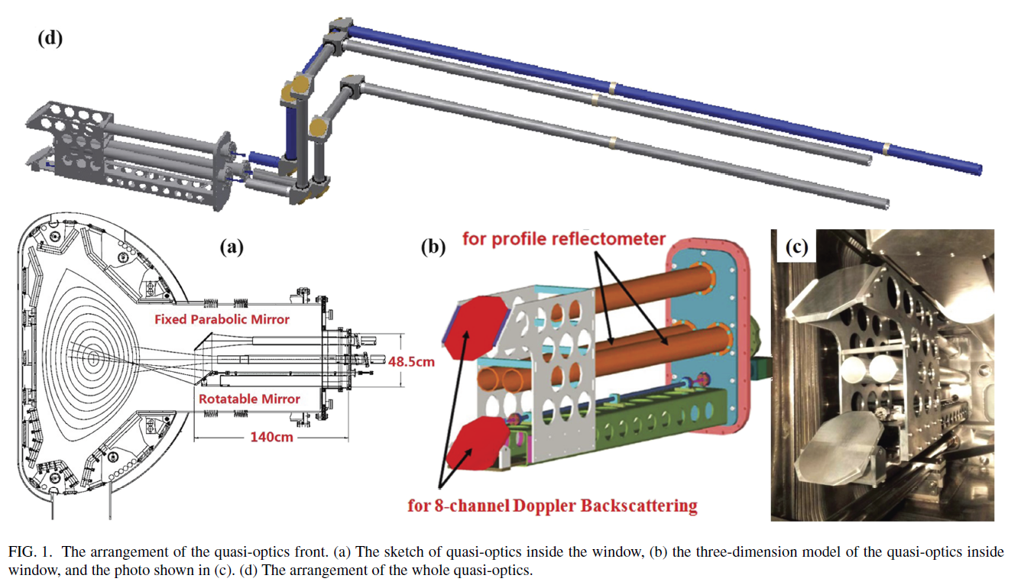
Reflectometry on EAST (as illustrated example)
Space shared between FM-CW and Doppler reflectometry
(Q and V bands)
Hu et al. RSI 2017

Slide 12
Tasks definition for 2022
Study where and how to install the diagnostic on JT60-SA
Retrieve the tokamak 3D design (catia) to find a port access.
Study of the waveguide route with type of waveguides and antennas.
Analysis of a possible space sharing with the Doppler system with CIEMAT.
Cost estimate of the whole system (microwave components, electronic, acquisition, waveguides…).
Define a collaboration with QST and CIEMAT.

Slide 13

DRF
IRFM
WEST
Thank you
Commissariat à l’énergie atomique et aux énergies alternatives
Centre de Cadarache | 13108 Saint Paul Lez Durance Cedex
T. +33 (0)4 42 25 46 59 | F. +33 (0)4 42 25 64 21
  Etablissement public à caractère industriel et commercial | RCS Paris B 775 685 019

