Slide 1
EDICAM visible camera system Tamás Szepesi for the EU and JA EDICAM teams

Slide 2
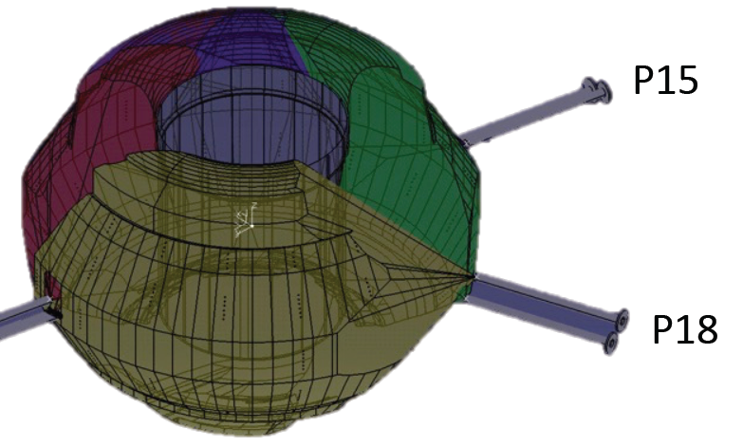
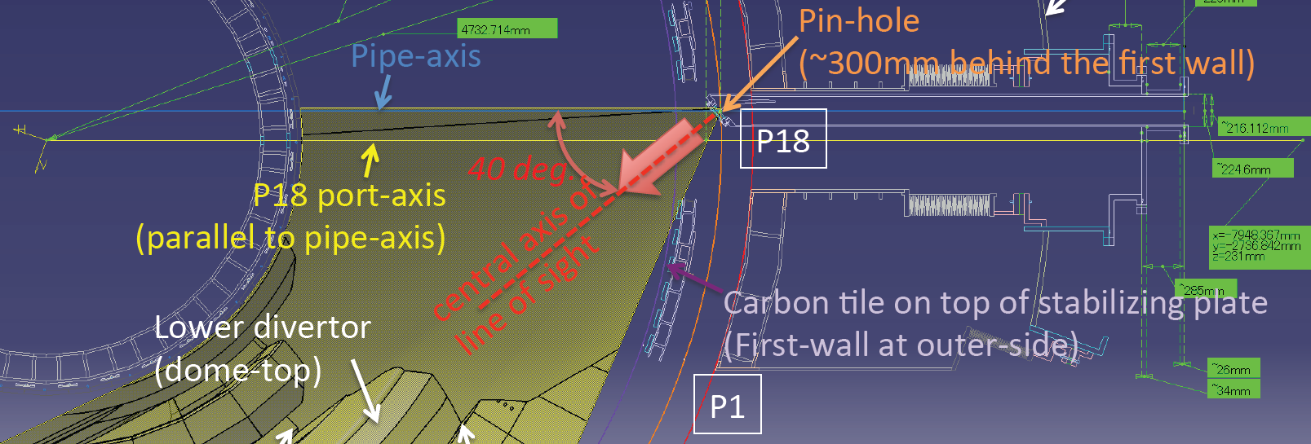
EDICAM overview – Design parameters
Single channel wide-angle fast video diagnostics
Features
Field-of-view: 80° (wide-angle)
Tangential view
Temporal resolution: 100 Hz @ 1.3 Mp (1280x1024)
→ max. 400 Hz full frame, up to 20 kHz for ROIs
Spatial resolution: better than 13 mm (over 3-8 m distance)
T. Szepesi The EDICAM system | WPSA Coordination Meeting 2022.05.04. 2

Slide 3
EDICAM overview – Camera capabilities
Advanced camera control: multiple ROIs
Define several regions to be observed
different size and position
independent timing (frame rate)
up to 6 ROIs can be defined
Real-time features and image processing capabilities
All data is flowing through an FPGA (≈ fast chip) → offers real-time image processing
events: intensity threshold on image, time, external input (TTL)
→ events are detected automatically in real-time
actions: start/stop ROI readout, external trigger (TTL)
→ actions are performed autmatically in real-time
ROI 1
ROI 2
CMOS chip
Modular design:
camera head + FPGA card
Small
Durable
Image processing
Events
cam.head
FPGA
10 Gbit/s fiber link
T. Szepesi The EDICAM system | WPSA Coordination Meeting 2022.05.04. 3

Slide 4
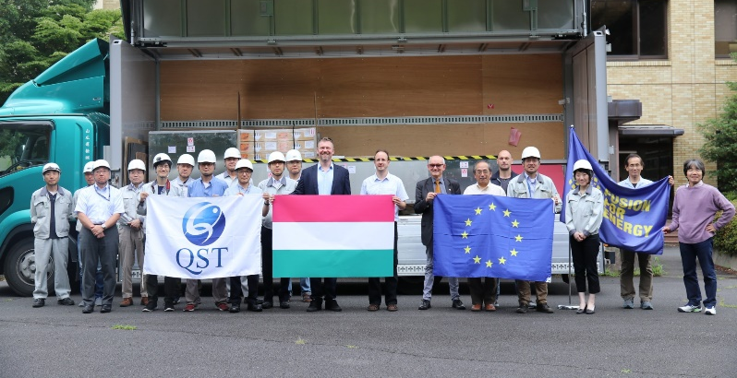
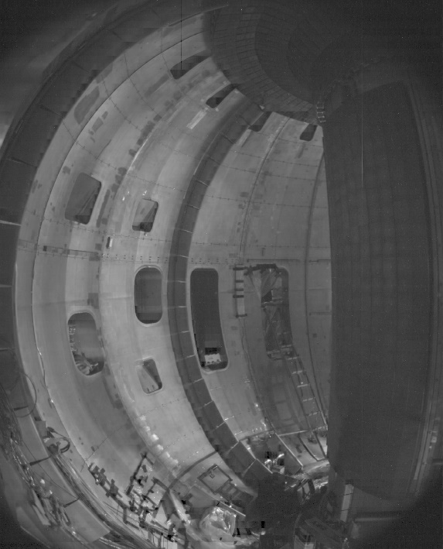
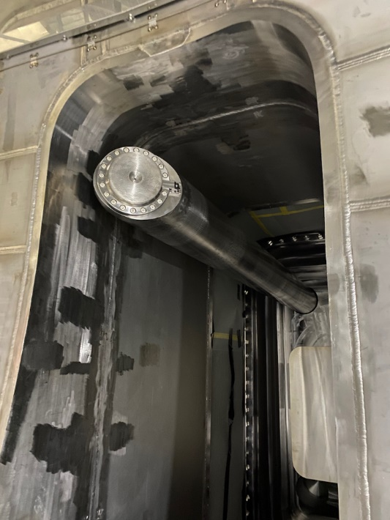
Project timeline
Completion
acceptance tests passed / 11 July 2019
delivered to Naka / 22 July 2019
Installation
port plug installed / 10 April 2020
first in-vessel images / 16 April 2020
first high-quality images / 14 May 2020
Commissioning
individual linkage test / Nov 2019
4x integrated linkage tests in 2020
→ in last one overperform specifications
software update / March 2021
5th integrated linke test in 2022
All tests were passed, EDICAM is ready for operation.
T. Szepesi The EDICAM system | WPSA Coordination Meeting 2022.05.04. 4

Slide 5
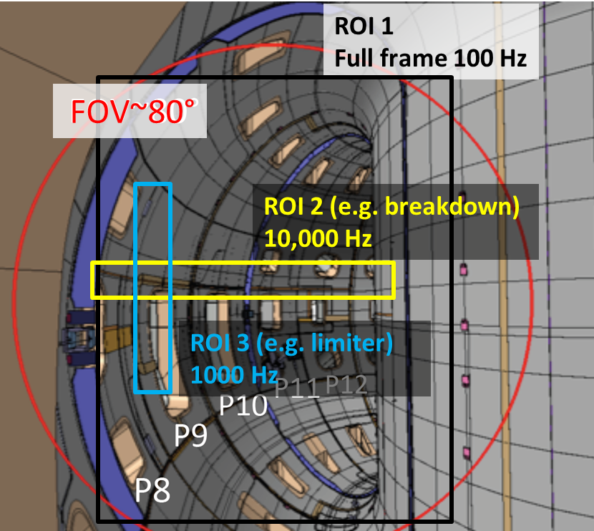
Planned work 2022 and beyond
Participation in the Integrated Commissioning
on-site presence throughout the campaign (?)
operation of the camera
help to commission the tokamak
observe breakdown
determine plasma size and position
observe radiation collapse / disruption
detect ECRH shinethrough
detect hot-spots, UFOs
observe radiation during ECWC
test and exploit camera functionality
Longer term upgrade
change of camera receiver card (outdated, no spare)
change control PC operating system from Win7 to Ubuntu
→ originally planned for 2022, but don’t want to do it before IC
T. Szepesi The EDICAM system | WPSA Coordination Meeting 2022.05.04. 5

Slide 6
Publication plan
Publications in the past
2019: poster on ISFNT
description of the whole system
2020: paper in Fusion Enginering and Design 153, 111505
all details of the system incl. port plug, vacuum, mechanics, optics
Planned publications
conference and/or journal paper on the first results
T. Szepesi The EDICAM system | WPSA Coordination Meeting 2022.05.04. 6

Slide 7
Thank you for your attention!

