Slide 1
Task 2 : Actions needed to setup effective remote participation to JT-60SA
Presented by F. Imbeaux (CEA)
Task contributors : H. Ancher (CEA), G. Di Tommasi (CREATE), C. Fuchs (IPP), G. Manduchi (RFX), A. Winter (IPP)

Slide 2
What tools are needed to setup effective remote participation to JT-60SA ?
Previous reports have been written in 2018
Establishing a development plan for the EU remote experiment centre (WPSA report EFDA_D_2NJLES)
Technical requirements for EU remote control room (WPSA report EFDA_D_2N39XB)
Use cases for the EU remote experiment centre (WPSA report EFDA_D_2NJ8JK)
We propose to
Provide a status update on the actions recommended at the time (policy and technical aspects)
Examine wether recently made available software and facilities fulfill the requirements
Recommend possible new actions and set priorities (policy and technical aspects)
Aim at improving remote participation capabilities in view of the JT-60SA commissioning

Slide 3
In an ideal world, remote participation for the JT-60SA integrated commisioning would feature :
Data policy for access, use and publication of JT-60SA data established
Remote participation policy established
Remote data access enabled
Data access tools documented and tested from EU before first plasma
Possibly with an IMAS conversion for interoperability with EU standards
EU Remote Experiment Center available to i) host experimental team physically and ii) serve as a hub to JT-60SA for satellite experiment rooms
For all these items, our task will be to provide status update and trigger actions targeting JT-60SA commissioning
Defining the highest priority actions

Slide 4
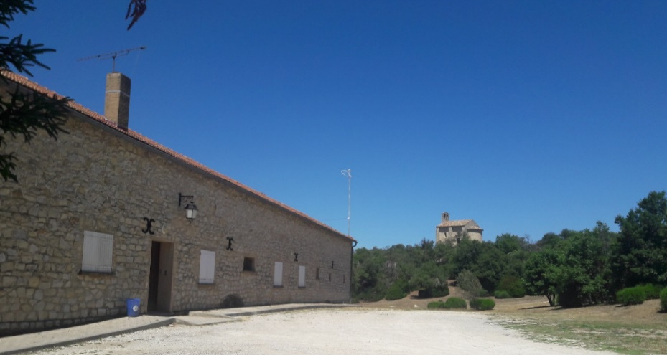
A REC facility has been built at Cadarache in the framework of the Broader Approach
« La Bergerie »
Dedicated building at the Cadarache Castle site (near ITER)
Restaurant and hotel on site
Connection to RENATER
Experiment room for ~18 people
Meeting room, kitchen, …
New immersive software for remote participation
Imminent tests during WEST C6

Slide 5
Perspectives / questions to the audience
Task 2 will produce a report – but may also trigger important actions needed by the experimental teams → interaction needed on a regular basis !
Are there important aspects still missing in view of the commissioning ?
Priorities in view of the commissioning ?
Are there other Remote Experiment Centers available to EUROfusion on the short term ?
Opportunity to participate to the JT-60SA first plasma from La Bergerie ?
Potential difficulties
Getting access to JT-60SA computers for the members of the task
Several uncertainties on policy issues
Level of priority of our task to QST and F4E

