Slide 1


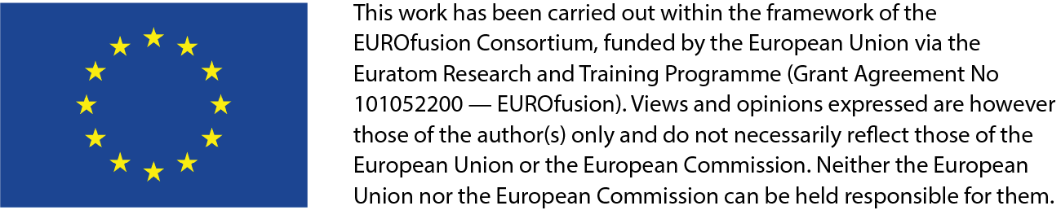
2022 Remote Experimentation Centre Activities
6 May 2022
G. De Tommasi^{1,2}
Task contributors : H. Ancher (CEA), F. Imbeaux (CEA),
C. Fuchs (IPP), A. Winter (IPP), G. Manduchi (RFX)
¹Consorzio CREATE
²Department of Electrical Engineering and Information Technology, University of Naples Federico II, Italy

Slide 2
Contents
REC activities in 2022
  Task 1 - Support to the development of the JT-60SA remote participation tools (Task 1)
  Task 2 - Actions needed to setup effective remote participation to JT-60SA (next presentation by F. Imbeaux)

Slide 3
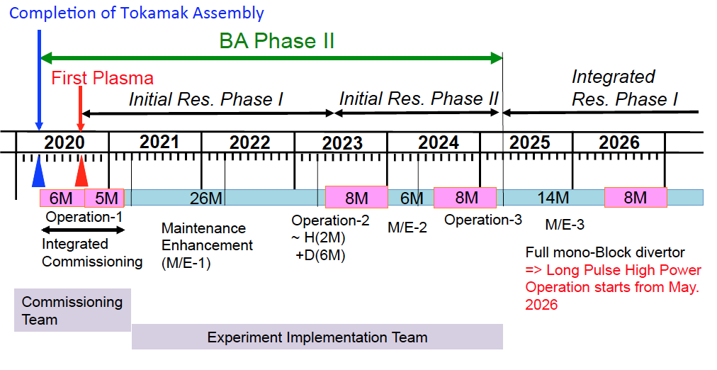
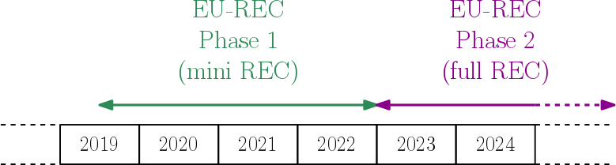
REC under FP8
In 2018 (FP8) REC Working Group setup
  Main Use Cases
  Main Tech Specs and Cost Estimation
  A possible Development Plans
2018 Scenario

Slide 4

IC 2020-2022
COVID-19 came into the picture
Some remote participation tools have been made available by QST (see my previous talk)…
…others are under development…
…however to to realize a successful experiments, it would be nice
  to have members of the experimental team in EU close to each other (human factor)
  to facilitate access to all tools and information related to the device and previous experiments (without struggling with personal devices)

Slide 5
REC 2022 Tasks
Task 1 - Support to the development of the JT-60SA remote participation tools (this presentation)
  Assessment of usability and performance of the JT-60SA remote participation tools
  Support of development of wrappers for the remote data access tools
  Development of an IMAS layer on top of the data access tools to expose a uniform data view
  Contribute to documentation
Task 2 - Actions needed to setup effective remote participation to JT-60SA (next presentation by F. Imbeaux)
  Review of the final report of the EU-REC working group
  Guidelines to setup effective remote participation to JT-60SA

Slide 6
Task 1 - Activities
Assessment of usability and performance of the JT-60SA remote participation tools
  This is a continuous activity
    Participation to the so called data access meetings
    (F4E and QST + 1 EUROfusion representative → G. De Tommasi)
    Various data transfer tests have been performed (also in collaboration with F4E)
    CEA, IPP and RFX task contributors still need access to QST tool
    E. Belonohy recently sent request for additional users to F4E (the process goes through the Implementing Agency)
      Action may be needed by Area Coordinator/PL in the near future if no reply from F4E/QST will be received before June
Support of development of wrappers for the remote data access tools
  Prototype of a Matlab wrapper for the webAPI → other wrappers envisaged
Development of an IMAS layer on top of the data access tools to expose a uniform data view
  Waiting access for other task contributors
Support F4E decision for the funding of the Naka server HW (EU in-cash contribution)
  G. De Tommasi and H. Ancher revised QST proposal

Slide 7
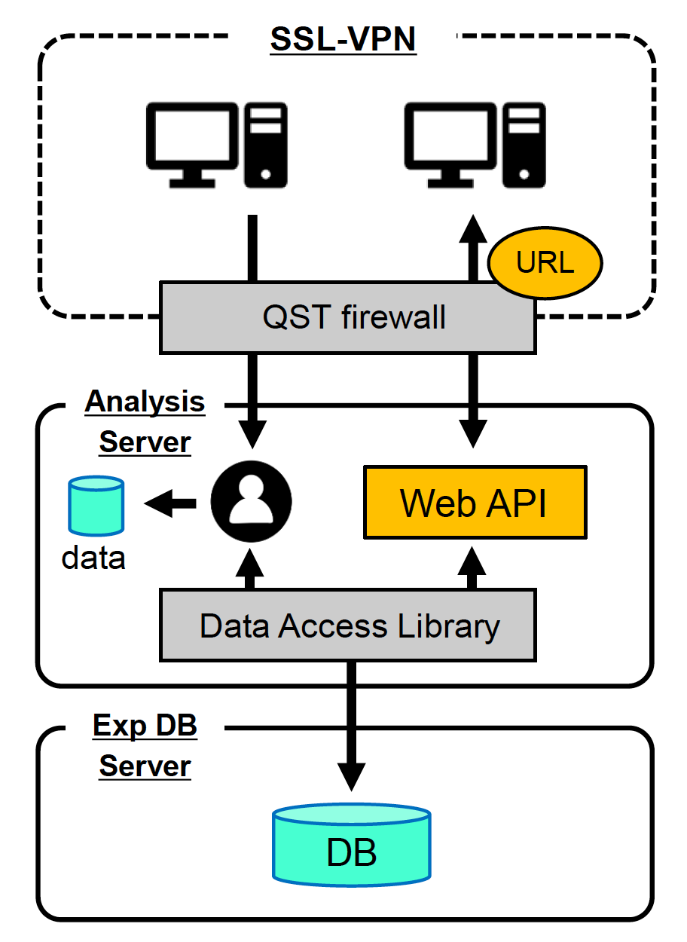
Matlab wrapper for webAPI
Announced by QST at TCM-36 in June 2021 (see Urano-san presentation)
Released in September 2021 to a small group of beta testers (M. Verrecchia, V. Tomarchio, G. De Tommasi)
→ Recently also E. Belonohy and M. Iafrati granted access as well
Connection to SSL-VPN needed anyway
An additional authorization from QST is needed to use this service

Slide 8
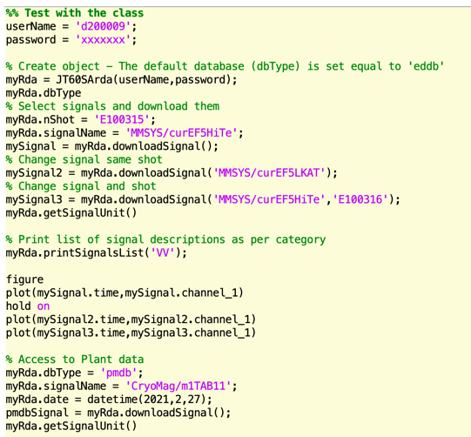
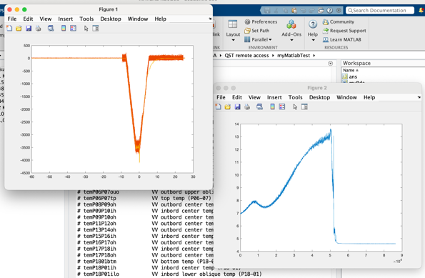
Matlab wrapper for webAPI
A Matlab class that wraps the Web API → implements also a basic local cache
  Can be easily ported to Python and other languages
Tested also on the Naka server
Shared with QST in September 2021 → no feedback received (!)

Slide 9
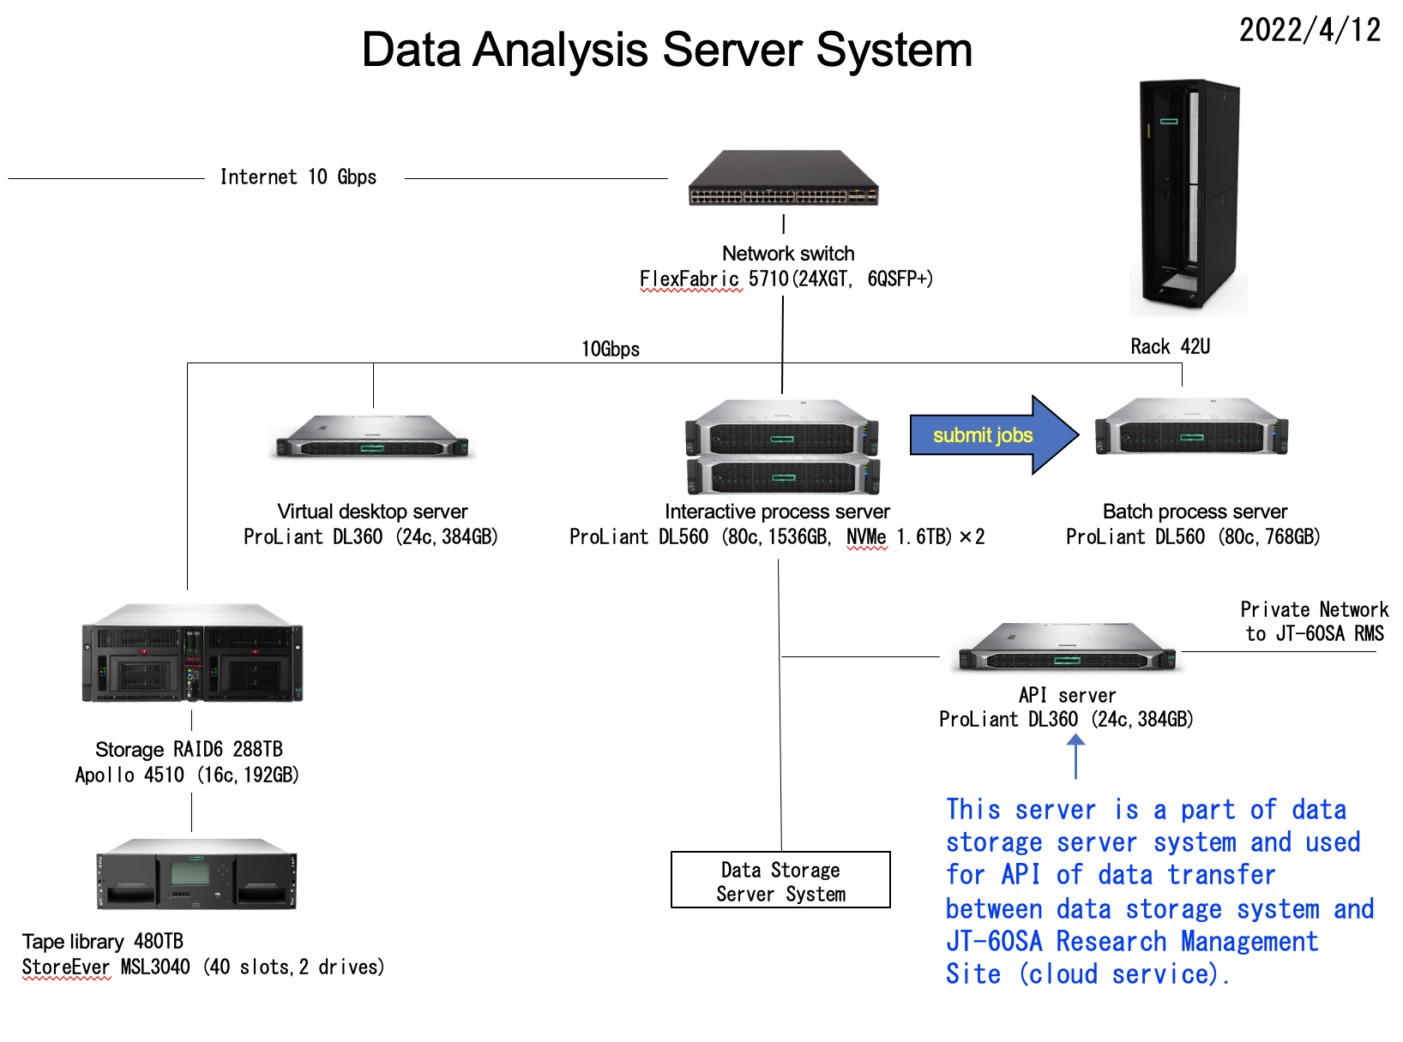
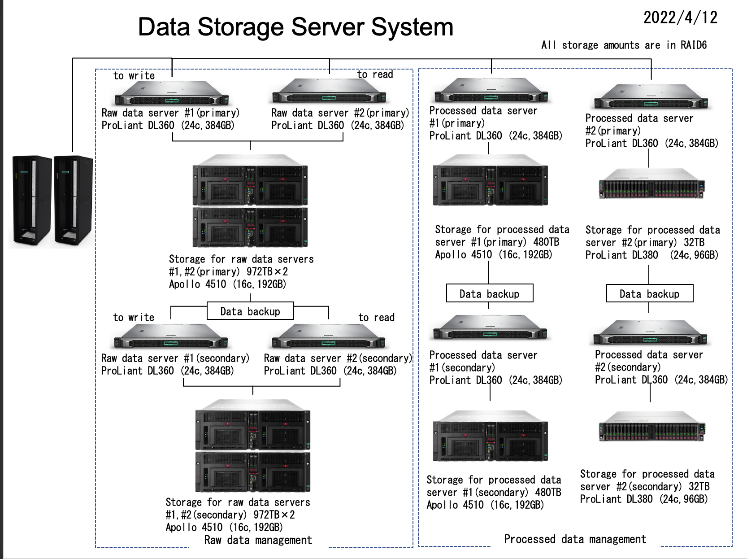
Naka servers

