Slide 1
Update on IMAS activities related to WPPrIO Preparation of ITER Operation FSD 2022-04-12
X. Litaudon, A. Dinklage, G. Falchetto , L. Frassinetti

Slide 2
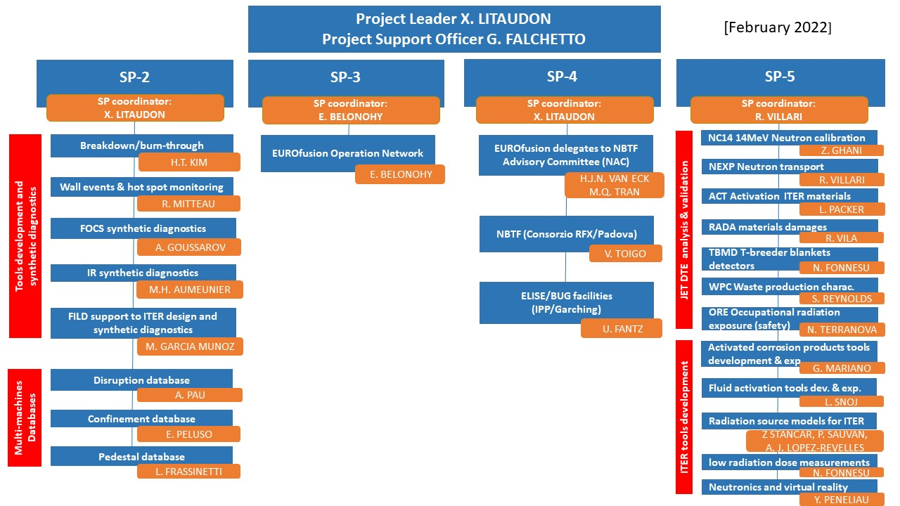
PrIO and IMAS activities
IMAS activities
IMAS database format
under discussion

Slide 3
PrIO Plans: more under WPPrIO wikipages: Preparation of ITER Operation Work Package - EUROfusion MediaWiki (euro-fusion.org)
Development of plasma breakdown/burn-through simulation tools and application for ITER operation
Make the IMAS interface of DYON (with ACH support and link with TSVV11) and map data for coupling to the High Fidelity Pulse Simulator (TSVV11)
Finalise the adaptation of the breakdown simulation workflow CREATE-BD/BKD0/GRAY to IMAS (with ACH support)
Fibre Optic Current Sensor (FOCS)
First release of the simulation code (Python) for the Fiber Optics Current Sensor synthetic diagnostics compatible to IMAS (2022) and finalization in 2023
ITER - FILD: simulations in support to ITER design and synthetic diagnostic
Assess the work to be done for mapping the FILDSIM’s inputs and outputs into IMAS (2022)
IR temperature synthetic diagnostic for ITER real-time application and offline analysis
Integrating IR synthetic diagnostics and associated tools into IMAS as long term activity ( 2023 and beyond)
Databases
Cf next slides

Slide 4
EUROfusion multi-machine databases and IMAS
L. Frassinetti

Slide 5
EUROfusion tokamak multi-machine databases
Three EUROfusion tokamak multi-machine databases (so far):
Confinement (coordinator E. Peluso)
Disruptions (coordinator A. Pau)
Pedestal (coordinator L. Frassinetti) with definitions presented and discussed in the ITPA-PEP meeting
Strong interaction with ITPA (IO)
Plan 2022 and beyond
Store all the databases in IMAS on the EUROfusion Gateway
L. Frassinetti et al.

Slide 6
Work done so far
Script to transfer the 0D variables into IMAS is ready
Language: python
Latest update: November 2021 to reflect the latest IMAS version
About 175 parameters for each entry.
For each parameter, the IMAS summary IDS contains:
*/value: value of the parameter
*/value_error_upper: uncertainty on the parameter
*/source: metadata containing the source of the parameter
The script has been tested for the pedestal database:
3 test shots from JET have been stored in IMAS on the Gateway: /g2lfrass/public/imasdb/pedestalDB_test_nov2021/3/0/
3 test shots from TCV have been stored in IMAS on the Gateway: /g2mvan/public/imasdb/pedestalDB_test_nov2021/3/0
Full TCV pedestal database has been stored in IMAS on the Gateway: /g2mvan/public/imasdb/TCV_PedestalDB/3/0
The full list of IMAS pedestal variables can be found on the WPPrIO wikipages:
https://iterphysicswiki.euro-fusion.org/images/5/59/Pedestal_db_variables_list_on_wiki.pdf
Full pedestal database can be transferred at any time (pending inclusion of Peeling-Ballooning stability data).
L. Frassinetti et al.

Slide 7
2022 and beyond plans
Transfer the whole 0D pedestal database into IMAS
Start testing the transfer to IMAS for the confinement and the disruption databases
Include profiles in the database and extend the scripts to transfer 1D data to IMAS
Store all the databases in IMAS on the EUROfusion Gateway
L. Frassinetti et al.

Slide 8
IMAS version of the stellarator confinement DB
A. Dinklage

Slide 9
Bringing International Stellarator/Heliotron Confinement DataBase (ISCDB) into Interface Data Structures [1/2]
The ISCDB is a joint database effort conducted within the Coordinated Working Group in the IEA Technology Collaboration Programme on Stellarators and Heliotrons.
inclusion of confinement data from Wendelstein 7-X from its initial campaigns with a limiter and a test-divertor unit.
Ongoing activity to map the ISCDB data into the IMAS data structure
Written document has been elaborated recently on the mapping by Andreas Dinklage (Dated: April 1, 2022)
Description and definition of all IMAS data
Lastest version 27 of ISCDB that includes latest W7-X discharges
Unique opportunity to contribute to joint tokamak-stellarator confinement physics with the same language !

Slide 10
Bringing International Stellarator-Heliotron Profile Confinement DataBase (ISCDB) into Interface Data Structures [2/2]
New metadata:
version of IMAS, data dictionary, access layer
parameters for the ISS04 scaling law of the energy confinement time already incorporated (e.g. summary.local.r_eff_norm_2_3.plateau_factor)
Lacking in IMAS - to be agreed in expert meetings -
physics definitions: geometry (RGEO, elongation, …)
days_since_evap, …, PFLUX, peaking_Te, … tauL/R, tauPulse, nTtau, detachment indicator, confinement mode indicator?
Expected confinement time from scalings requires processing of Ip (from IMAS) or q₂₃ (1/rotational transform) at r/a = 2/3
Dictionary IMAS, ITPA DB5.2.3., ISCDB underway
Next step: transfer documentation of W7-X data for CICLOP performance database update (including Kikuchi-diagram update)

Slide 11
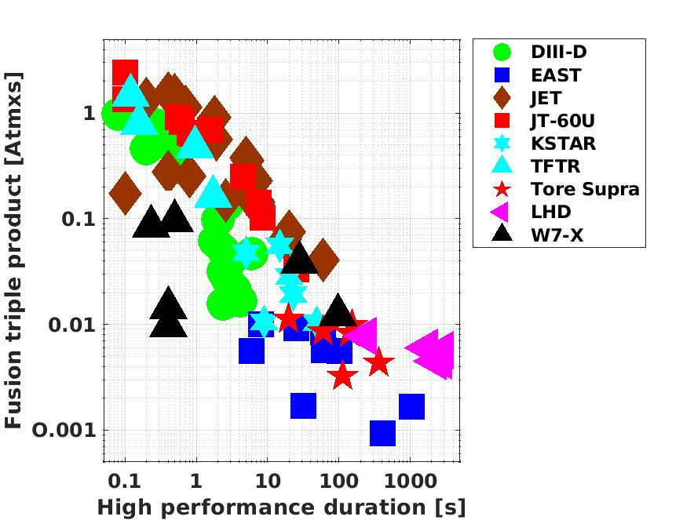
CICLOP database: Fusion triple product versus high performance duration
ITER
Reduction of fusion performance: two orders of magnitude when increasing the plasma duration from one second to 100s (JET DTE2 progress up to 5s not included )

Slide 12
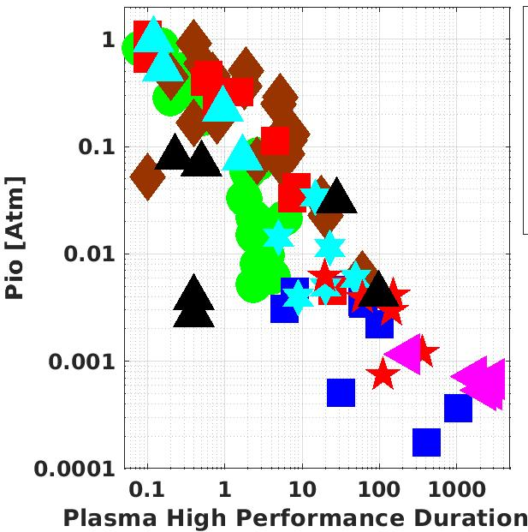
CICLOP database: Core ion temperature/pressure versus duration
?
30s Detached plasma
LPO in dominant electron-heating modes at reduced density (current drive issues for tokamaks ) but with low T_{io} 1 to 3 keV / low pressure for discharges above 100s: progress should be made to increase ion temperature at high density ??

