Slide 1
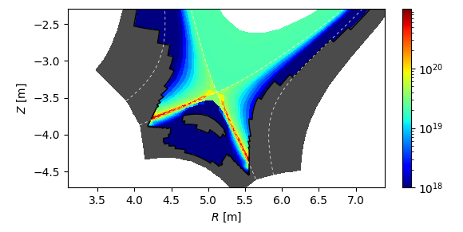
Mask functions for flexible wall geometry
Flexible wall geometry in spite of structured FS-aligned quadrangles grid handled through mask function:$χ=1$ in the wall, $χ=0$ elsewhere
wall seen as staircase by the plasma, alignement necessary at strike-points
No penalization, just auto-detection of mask edges to apply automatically boundary conditions

Slide 2
Boundary conditions in SOLEDGE3X
If $\vec{b}⋅\vec{n}≠0$:
uncentered derivatives wherever needed (somehow automatic with WENO advection) => equivalent to zero second derivative?
zero perpendicular diffusive fluxes
Bohm-Chodurah:
${\vec{v}}_{i}⋅\vec{n}≥c_{s}\vec{b}⋅\vec{n}$ with $c_{s}=\sqrt{\frac{Z_{i}T_{e}+T_{i}}{m_{i}}}$, $n_{e}{\vec{v}}_{e}⋅\vec{n}=\left(\sum_{i}{Z_{i}n_{i}{\vec{v}}_{i}⋅\vec{n}}\right)e^{Λ−\frac{φ}{T_{e}}}$
${\vec{q}}_{e/i}⋅\vec{n}=γ_{e/i} n_{e/i}{\vec{v}}_{e/i}⋅\vec{n}T_{e/i}$ (includes heat conduction contribution)
If $\vec{b}⋅\vec{n}=0$:
Homogeneous Neuman ($\vec{∇}X⋅\vec{n}=0$) for all fields ($N, Γ_{∥}, Τ,W,φ$…)
Control of fluxes:
Zero flux of particles, momentum, energy, charge at core boundary
Buffer (infinite poloial diffusion) region in front of core boundary
Outgoing flux only for particles, energy at wall (if particle flux killed, all other fluxes - including momentum and charge - killed)

Slide 3
Issues and needs
Numerical issues:
sometimes instabilities due to interactions between plasma potential and wall staircase (hence necessity of alignement at places of strong interaction)
Physical issues and needs:
Flow reversal at shallow grazing incidences due to drift contribution to strong => physical?
What BC on large poloidally tangential surfaces?
BC for collisional sheath and multi-species plasmas?
Field concerned by BC needs:
Dirichlet BCs for fluid moments or for their fluxes (particles, momentum/velocity, energy/temperature)

