Slide 1
EUROfusion TSVV-5
Python tool(s) for basic tally reading and line integral calculations
Andreas Holm, Mathias Groth, Vladimir Solokha
– Aalto University

Slide 2
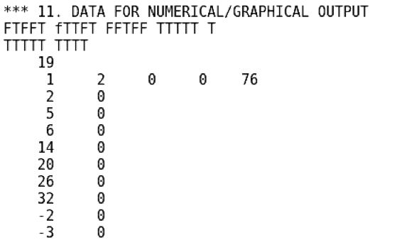
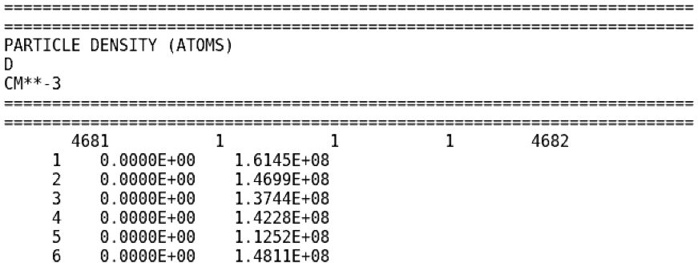
Motivation: standard/unified and (FZJ, TSVV-5) internal vetted Python tool to read out EIRENE tallies
EIRENE internal graphical and numerical output of tallies controlled under block 11
Block 11A for numerical tallies, e.g., output of tally 1 (PDENA, see table 5.3 in EIRENE manual) in fort.76

Slide 3
Motivation: standard/unified and (FZJ, TSVV-5) internal vetted Python tool to read out EIRENE tallies
EIRENE internal graphical and numerical output of tallies controlled under block 11
Block 11A for numerical tallies, e.g., output of tally 1 (PDENA, see table 5.3 in EIRENE manual) in fort.76
Setting PLIDL = T in block 11B prints output files for further processing in external tools (e.g. for FZJ IDL graphics tool)
  Grid information as well as all input (plasma) and output tallies (excluding de-activated ones) are printed on files, one file per tally
  Not all parameters are yet written out, e.g., both Lyman and Balmer emissivities as defined in block 12
  JET EDGE2D-EIRENE cases: 10-15 MB

Slide 4
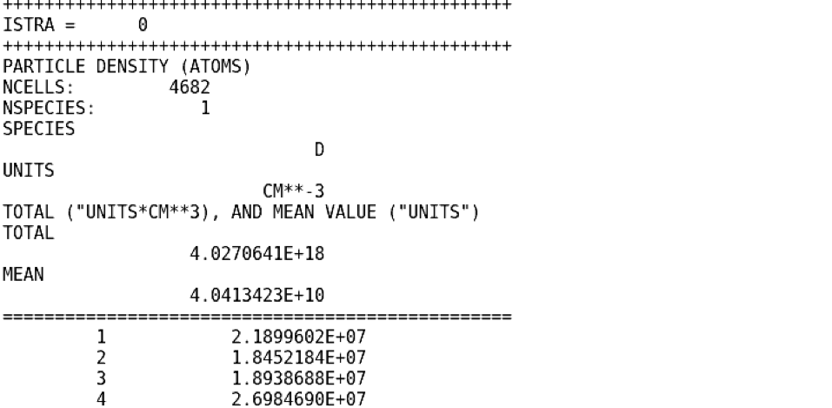
Motivation: standard/unified and (FZJ, TSVV-5) internal vetted Python tool to read out EIRENE tallies
More information in numerical output via PLIDL than when turning on tally output individually
Working with individually written tallies requires (small) modification of read routine

Slide 5
Motivation: standard/unified and (FZJ, TSVV-5) internal vetted Python tool to read out EIRENE tallies
EIRENE internal graphical and numerical output of tallies controlled under block 11
Block 11A for numerical tallies, e.g., output of tally 1 (PDENA, see table 5.3 in EIRENE manual) in fort.76
Setting PLIDL = T in block 11B prints output files for further processing in external tools (e.g. for FZJ IDL graphics tool)
  Volume tallies, post-processed line-integrals for ADDV

Slide 6
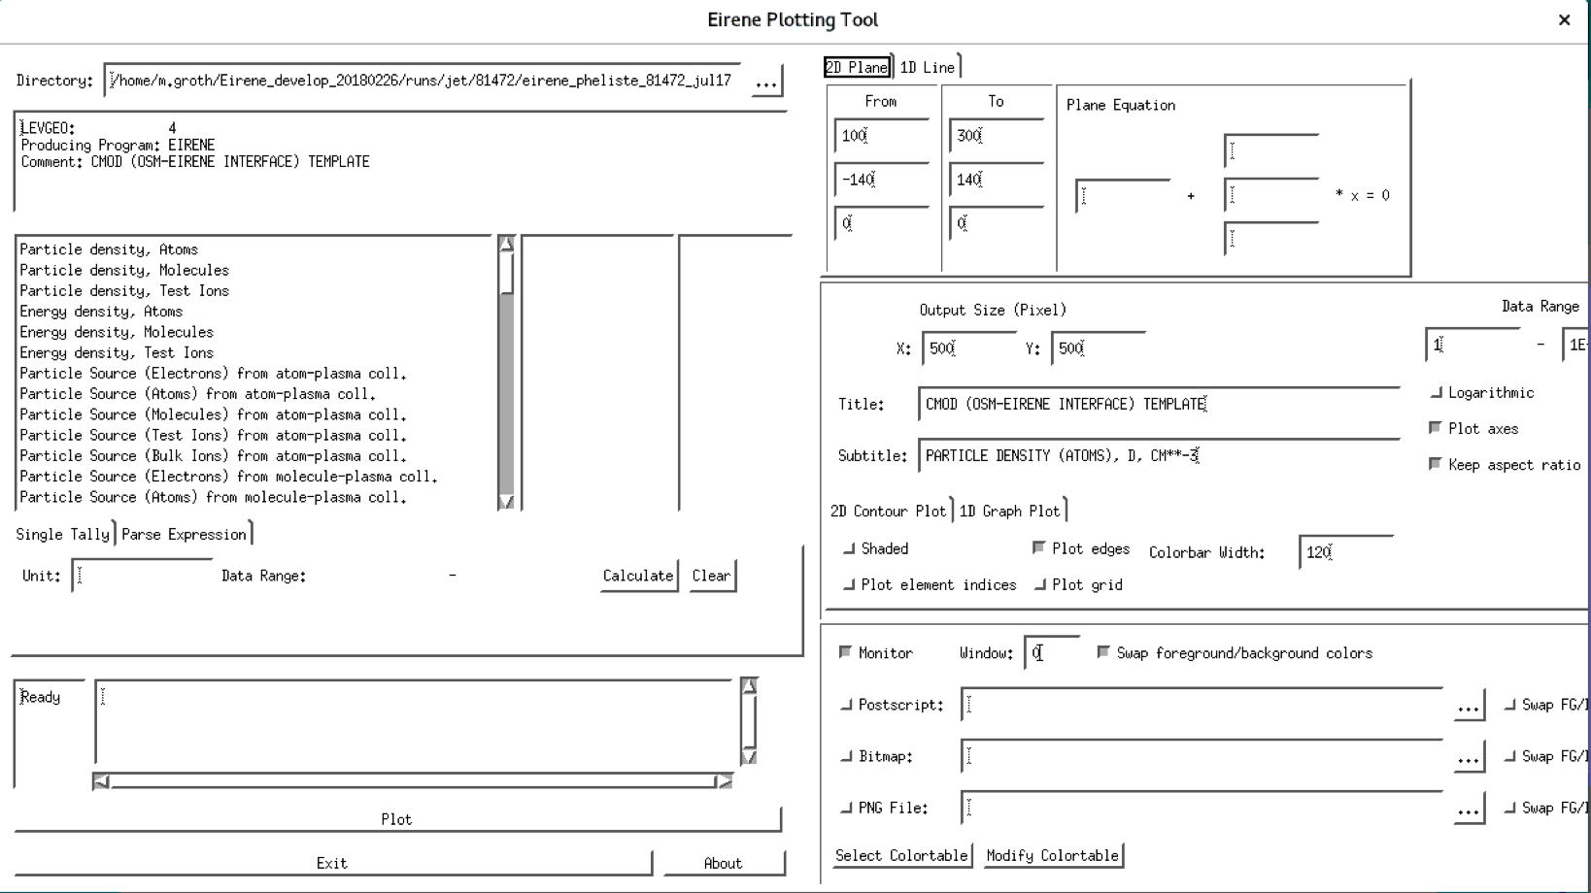
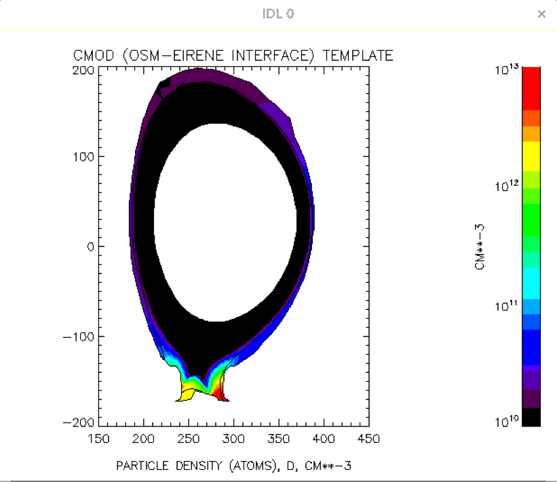
Flexible FZJ internal IDL tool to plot EIRENE tallies, requires IDL license (and FZJ permission)

Slide 7
Motivation: standard/unified and (FZJ, TSVV-5) internal vetted Python tool to read out EIRENE tallies
EIRENE internal graphical and numerical output of tallies controlled under block 11
Block 11A for numerical tallies, e.g., output of tally 1 (PDENA, see table 5.3 in EIRENE manual) in fort.76
Setting PLIDL = T in block 11B prints output files for further processing in external tools (e.g. for FZJ proprietary IDL graphics tool)
FZJ-internal IDL tool to plot EIRENE “IDL” tallies, e.g., volume tallies, post-processed line-integrals
Plotting EIRENE output outside FZJ Linux cluster and further processing of EIRENE tallies requires platform less-dependent tool ⇒ Python

Slide 8
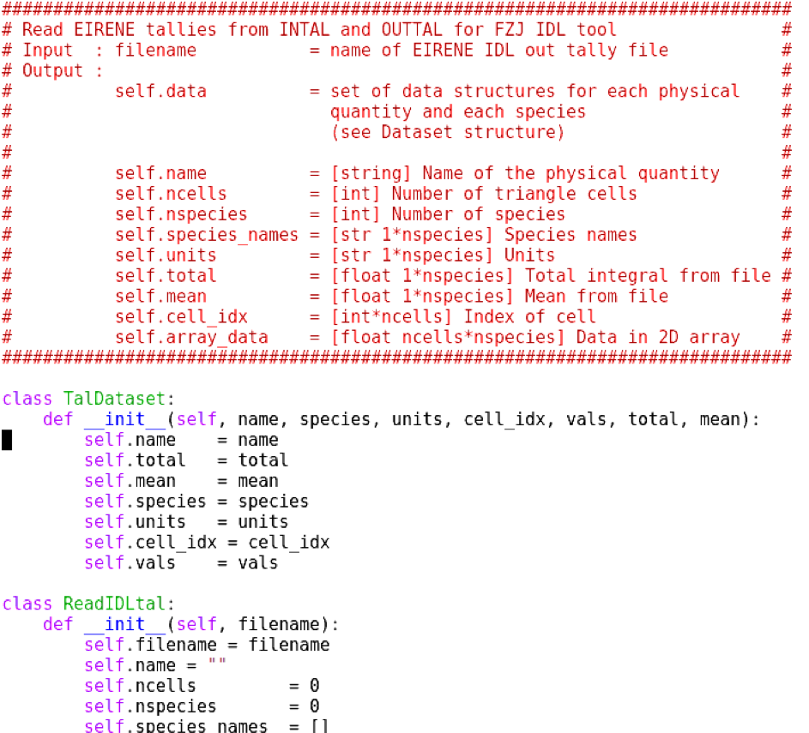
Built Python read routines (classes) around reading “IDL” tallies like FZJ IDL

Slide 9
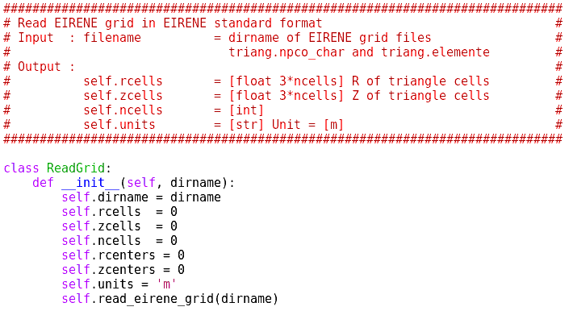
Grid files triang.npco_char and triang.elemente proved to be sufficient to plot grid
Third grid output file for FZJ IDL tool, triang.neighbors, not yet used

Slide 10
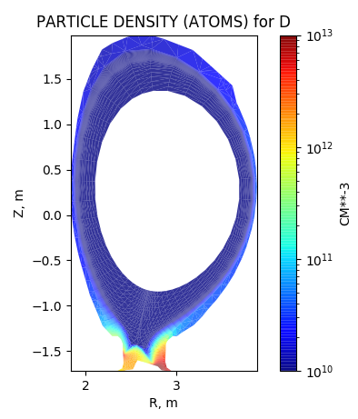
Classes TalDataSet and ReadGrid + Python Matplotlib produce PDENA
Python
FZJ IDL
Volume intal and outtal as in EIRENE manual tables 5.3 and 5.7 ⇒ differences in number of non-zero cells in tallies to be resolved

Slide 11
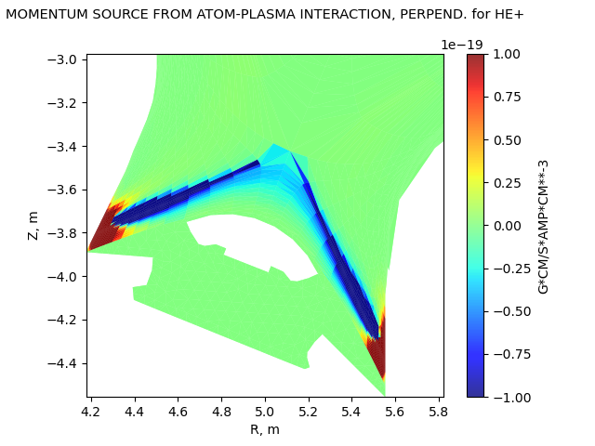
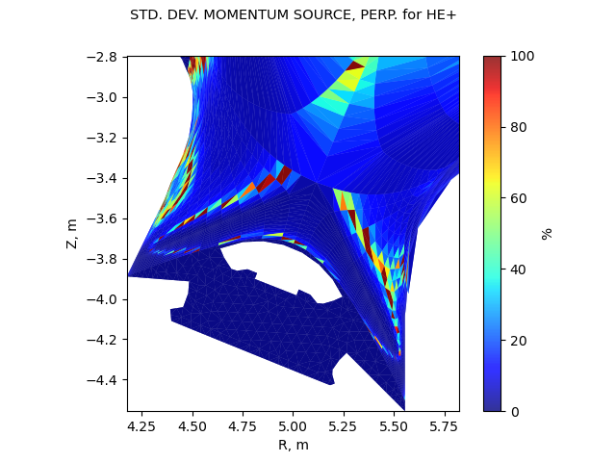
For NSIGVI ≠ 0 in block 9, variances of tally parameters are also produced
Standard deviation
of mean value
Mean value
ISFN Feb 2022

Slide 12
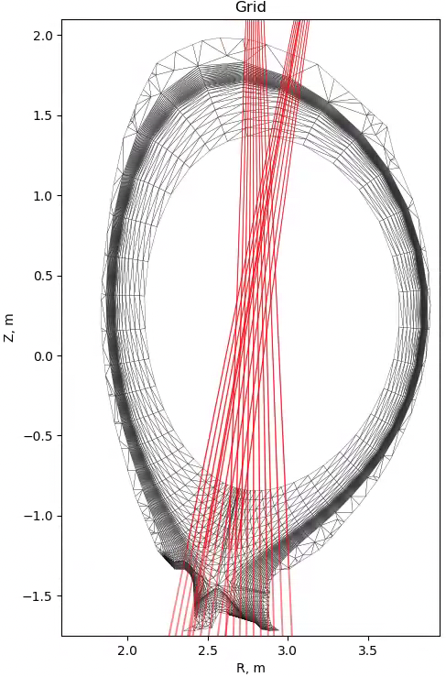
Development of line-integration tools for comparison to spectroscopic measurements
EIRENE internal integration based on pencil beams

Slide 13
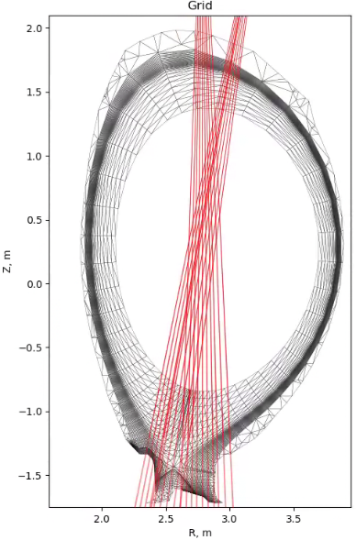
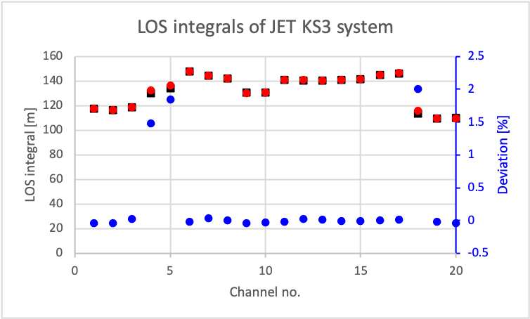
Development of line-integration tools for comparison to spectroscopic measurements
EIRENE internal integration based on pencil beams
Identified issue with LOS crossing EIRENE grid second time in divertor corner

Slide 14
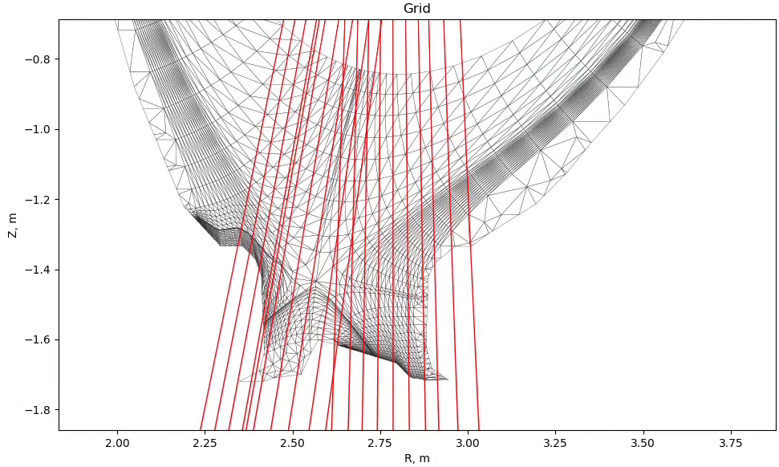
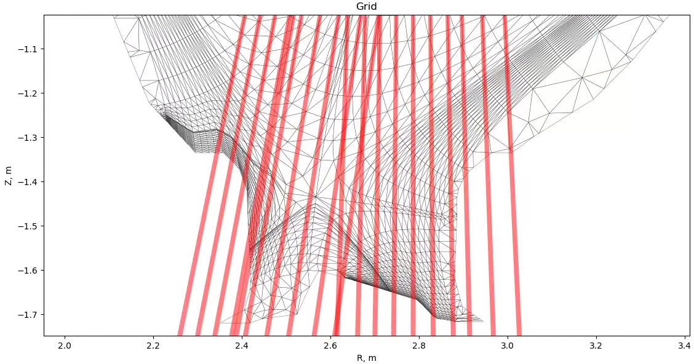
Introduction of etendue in lines-of-sight for comparison to spectroscopic measurements
Connection to SOLPSPY and Pyproc for SOLPS-ITER and EDGE2D-EIRENE
Cherab (for reflections) ⇒ IMAS objects: LOS geometry definition, spectral lines, etc.

Slide 15
Additional ideas, issues on post-processing tool
Routines run on FZJ, JET Heimdall and Aalto Triton Linux clusters
Standalone EIRENE output based on converged EDGE2D-EIRENE cases
Contour/vector plots for magnetic fields, particle (drift) velocities
Variances of tally parameters
Test grid and tally formats from other coupled codes, e.g., SOLPS-ITER, SOLEDEG2D-EIRENE, …
Common plotting routines can be stored in Git repository in addition to basic routines (avoiding duplicate pain/work)
Other tally reading and plotting routines?
Place and maintenance of post-processing routines?
Fidelity check of post-processing routines, i.e., line integration tool?

Slide 16
Issues outside post-processing tools
Modification to EIRENE Fortran routines ⇒ push to which Git repository?
  Sven: angular resolved surface tallies
  Mathias: line-integration tools in scr/diagno and src/user-routines/default-user
Fidelity/consistency check and base-case testing of modified routines?

Slide 17
Minutes re: post-processing tools and Git repository
Custom-made Python routines by Sven (Wiesen), could be also added to Git repository for post-processing routines
URL for Git repository for post-processing routines?
Sven (on general EIRENE output): what output and in what format/structure to store it?
  Currently, grid and tally files are ASCII files → storage as and transfer of ASCII files, IMAS objects?
  Particle distribution currently stored in eirene.out
Dmitriy: Push EIRENE code changes to Jugit EIRENE development branch → Petra: cleanup not yet finished; today, this branch is called the OpenMP branch

