Slide 1
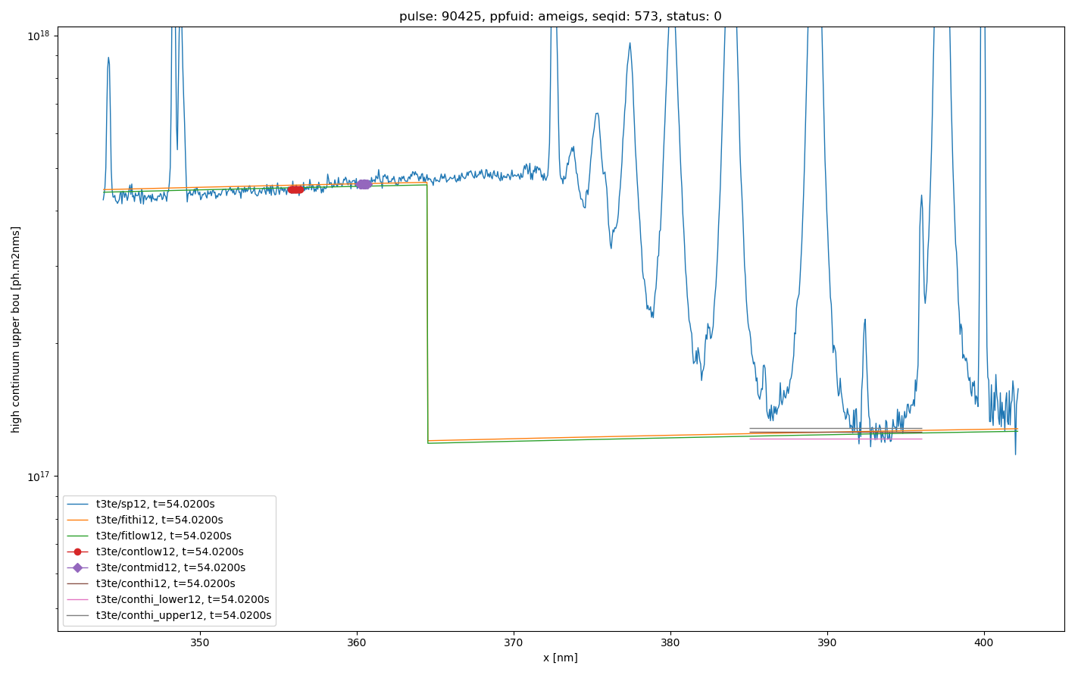
Example clean low wavelength continuum fitting plot (from ppf_view)
Can reproduce plots from analysis program
To check continuum region settings
Verify quality of fit
Low region and average value
D11-2
D7-2
D10-2
D8-2
D9-2
Mid region and average value
Orange is continuum fit using high and mid Green is continuum fit using low and mid
Statcont results plus upper and lower bounds

