Slide 1
Effect of surface roughness on erosion of fusion relevant materials

Slide 2
Espedito Vassallo, Matteo Pedroni, David Dellasega, Matteo Passoni
Mitja Kelemen, Sabina Markelj, Primož Pelicon
Antti Hakola
Andreas Mutzke, Thomas Schwarz-Selinger, Martin Balden

Slide 3
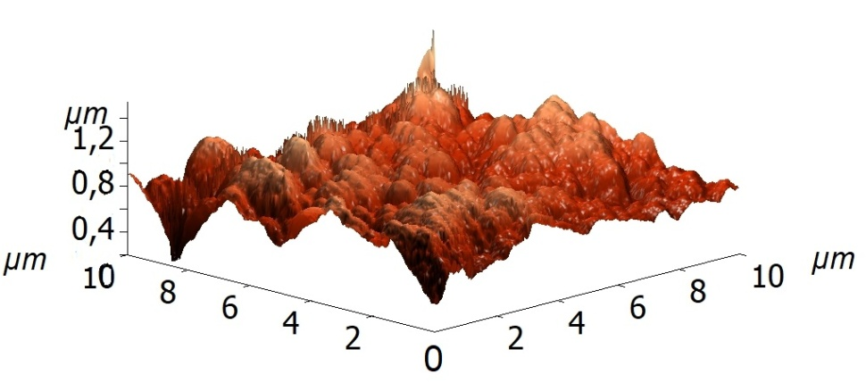
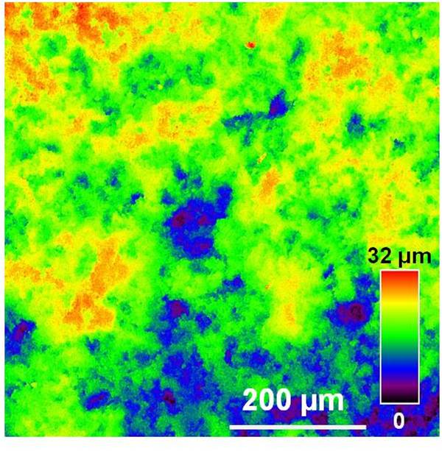
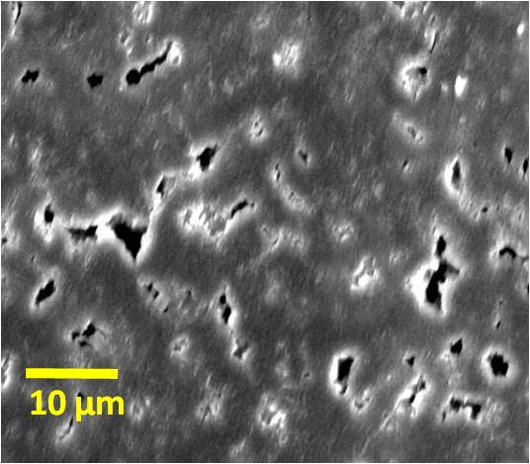
Sample preparation and surface characterization
120 nm thick Mo films were deposited by pulsed laser deposition on mirror polished, plasma etched or sand blasted textured graphite substrates. The surfaces had surface roughness (Ra) from polished surfaces (Ra~ 5 nm) up to very rough surface (Ra~ 2-3 μm) with intermediate Ra~ 110 nm and Ra~ 280 nm.
Mo
Carbon
SEM image of samples with Ra~ 5 nm. The observed holes are visible in black.
AFM image of samples with Ra~ 110 nm. This was used as direct input to SDTrimSP 3D.
CLSM image of samples with Ra~ 2-3 µm. This was used as direct input to SDTrimSP 3D.

Slide 4
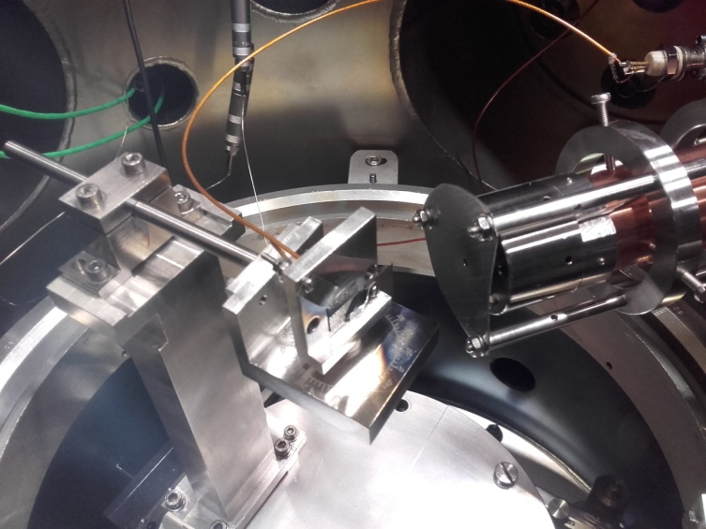
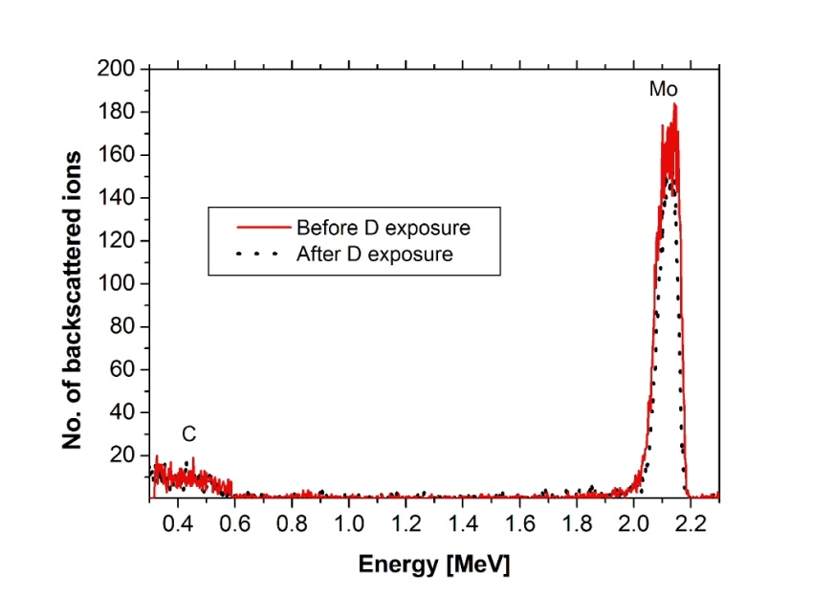
Laboratory experiments
Experimental set-up consists of : - rotating sample support - collimator - electron cyclotron resonance ion gun.
In experiment we use D gas at pressure of 3x10⁻⁴ mbar and acceleration voltage of 3.0 kV.
At this conditions most dominant ion specie is D₃⁺, resulting in 1 keV energy per D ion.
Samples were irradiated with fluence from 1.1 to 1.5 x10²³ D/m² in 8 h period, at angles 0°, 40°, 60° and 70° between ion beam and surface of the sample.
To determine sputter yield the thickness of Mo film was measured with
RBS before and after the exposure to D ions.

Slide 5
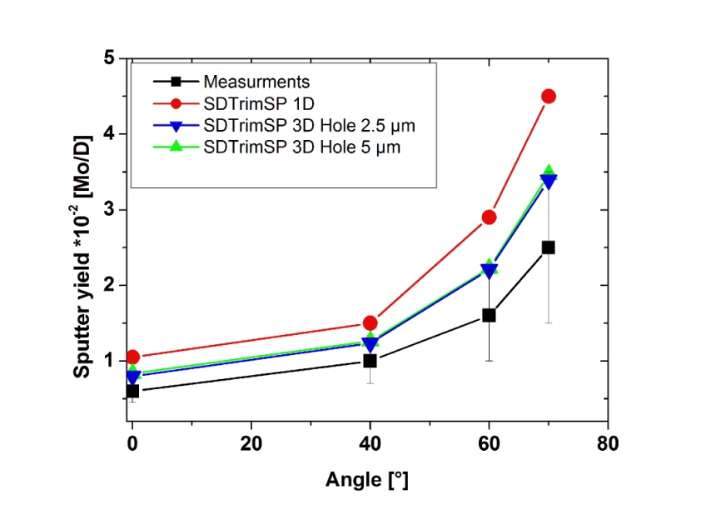
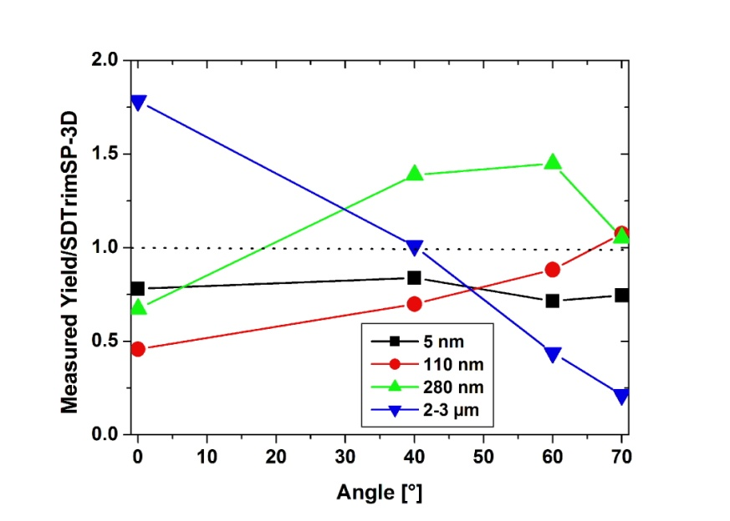
SDTrimSP 3D simulation
Runing SDTrimSP 3D code in static regime vith 10⁶ ions per simulation point.
Surface binding energy E_{s =} 8.45 eV.
As surface topography input we use AFM or CLSM data for samples with Ra~110 nm, 280 nm and 2-3 µm.
Constructed a model of surface for smooth surface with one cubic depression with dimensions of 2.5×2.5×2.5 µm³, on the 10×10 µm² grid for samples with Ra~ 5 nm.

Slide 6
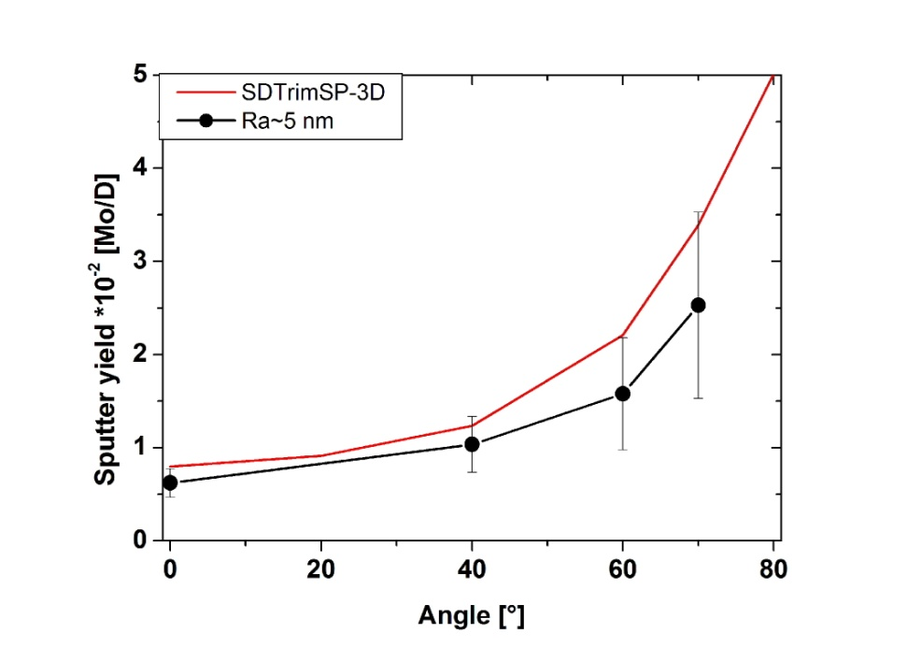
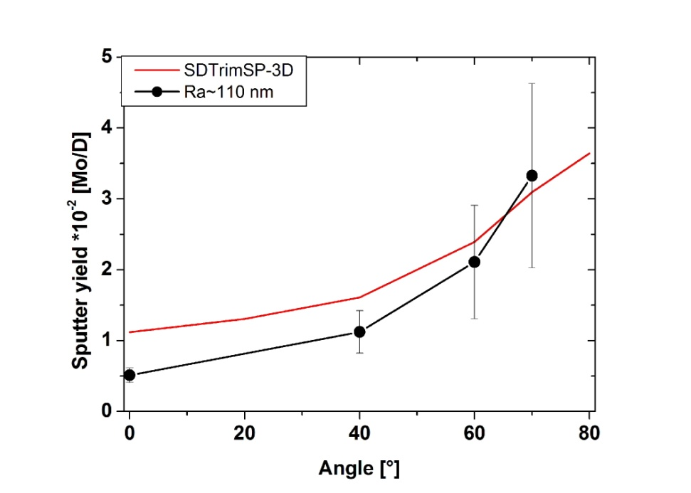
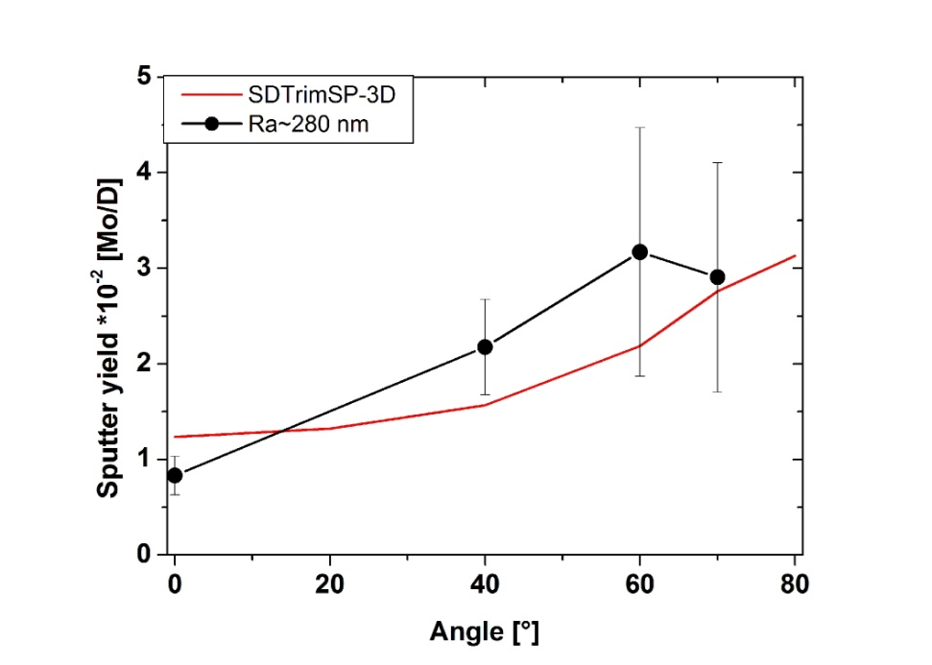
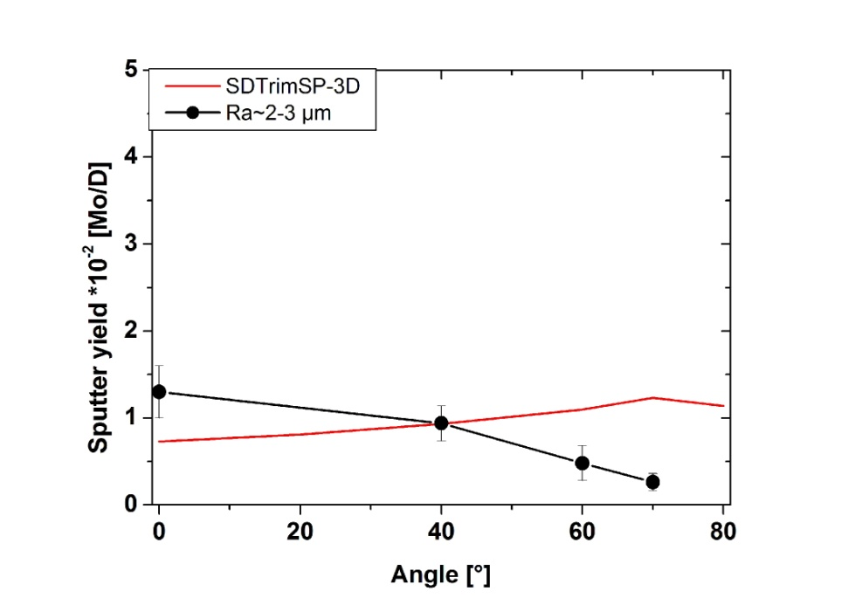
Overviev of results

Slide 7
Conclusions
Limitations of surface tehniques
General conclusion
SEM- detailed reproducibility of all surface features, but no quantitative data -> can not be use as SDTrimSP input.
AFM- detailed reproducibility of surface features with limitation in height difference around 1 µm.-> suitable for samples with intermediate surface roughness.
CLSM- good in reproducing a high difference >100 nm, missing the small futures.-> useful for large value of Ra.
SDTrimSP-3D produce good agreement with the measured angular and roughness dependence of the sputter yield.
Calculated values are slightly higher than the measured. Can be contributed to lack of suface details description in input.-> model for Ra~5 nm.
Additional depositions on macro level.
SDTrimSP still provides a voluble input data for PFC design, however we think that for now it is more advisable to take experimental data for PFC design
Published: Influence of surface roughness on the sputter yield of Mo under keV D ion irradiation
https://doi.org/10.1016/j.jnucmat.2021.153135

