Slide 1





Diploma Thesis
Outline
Fusion@ÖAW
Vienna, Austria
PWIE SP-B Meeting
Surface Roughness & Morphology
Christian Cupak, Paul Szabo, Martina Fellinger and Friedrich Aumayr
TU Wien (Fusion@ÖAW)
May 6th, 2022

Slide 2
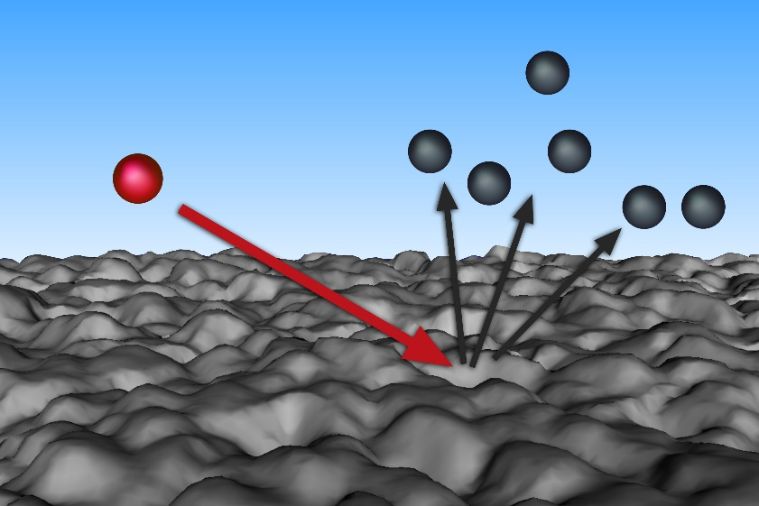
Diploma Thesis
Outline
Outline
Fusion@ÖAW
Vienna, Austria
How to experimentally investigate sputtering of rough surfaces?
-> Tools to study surface topographies at TU Wien
-> Experimental techniques to measure sputter yields of rough surfaces at TU Wien

Slide 3
Diploma Thesis
Outline
Roughness inspection
Fusion@ÖAW
Vienna, Austria
µsurf explorer confocal microscope (CFM, NanoFocus AG)
  up to 512x512 px², 160x160µm² (fixed by 100x objective)
  for very rough surfaces
  Quantitative data (roughness parameters, simulation input)
Cypher-S AFM (Asylum Research)
  up to 1024x1024 px², 30x30 µm² (keep at 1x1 µm² for good pixel size)
  for smooth to medium rough surfaces (RMS < 200 nm)
  Quantitative data
SEM (e.g., UPM, Madrid, Raquel Gonzalez-Arrabal, or USTEM TU Wien)
  High contrast, very detailed also down to sub-nm regime
  Not quantitative
Furthermore elemental composition:
  Mostly IBA (Uppsala Universitet, Sweden, Daniel Primetzhofer)
  XPS, XRF, …
large scale roughness
medium scale roughness
small scale roughness

Slide 4
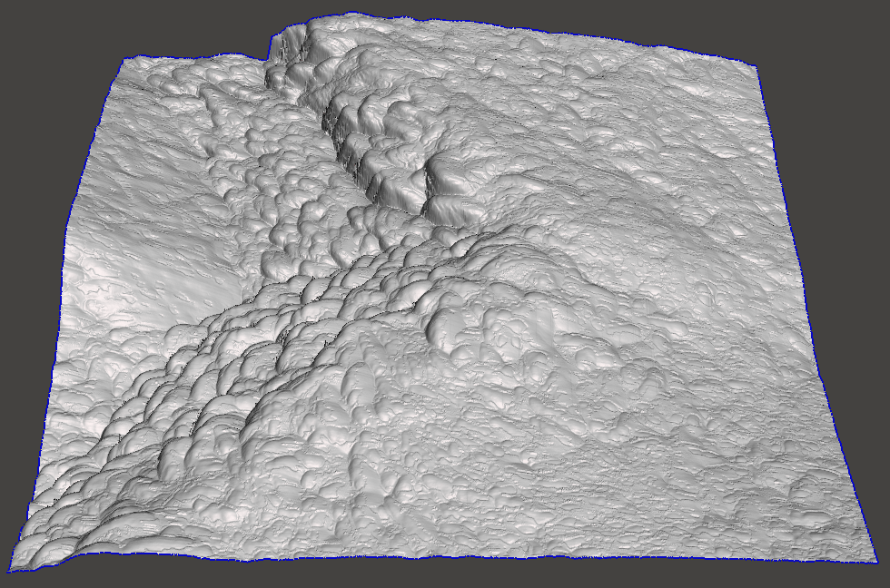
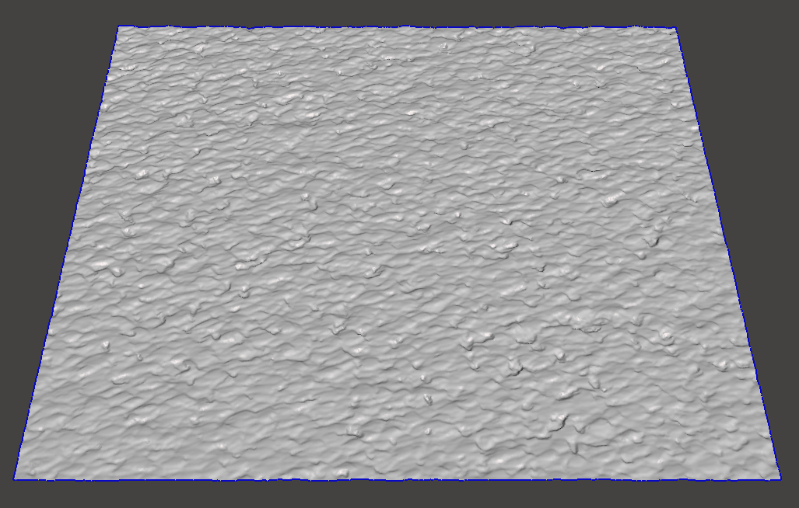


Diploma Thesis
Outline
Roughness inspection
Fusion@ÖAW
Vienna, Austria
Sputtering is an atomistic process
If available, take the method with higher resolution (AFM) to record small scale surface features!
To compensate small lateral image size -> take multiple AFM images
Example: medium rough W sample appears smoother in CFM (lack of resolution)
But: CFM still good tool, if surface is too rough for AFM
AFM
CFM
2 µm
160 µm

Slide 5
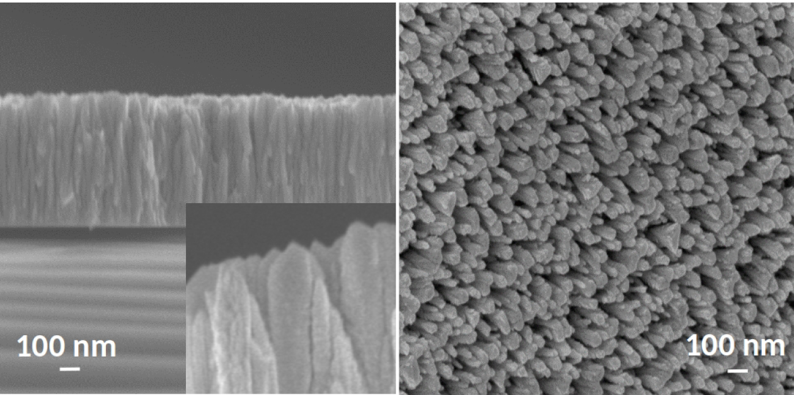
Diploma Thesis
Outline
Roughness inspection
Fusion@ÖAW
Vienna, Austria
Sputtering is an atomistic process
If available, take the method with higher resolution (here SEM) to record small scale surface features!
Some surfaces may even require higher resolution than AFM (tip convolutions etc…)
SEM great tool to get an impression (not quantitative)
SEM
AFM
-> top roughness adequately captured, but AFM tip couldn‘t probe deep channels
-> the investigation of these complex structures is a part of our collaboration with University of Helsinki (A. Lopez-Cazalilla, K. Nordlund…)

Slide 6
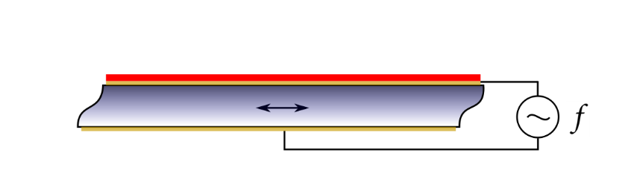
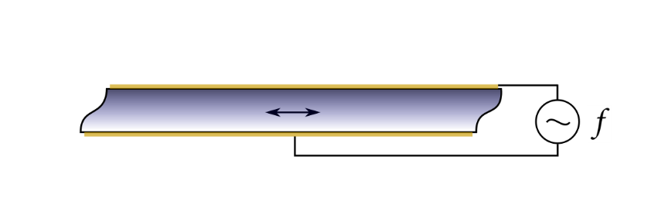
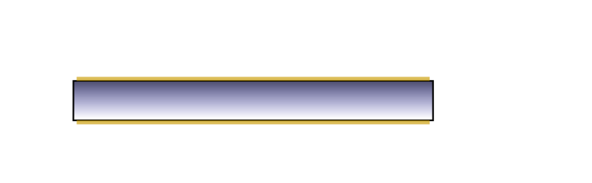
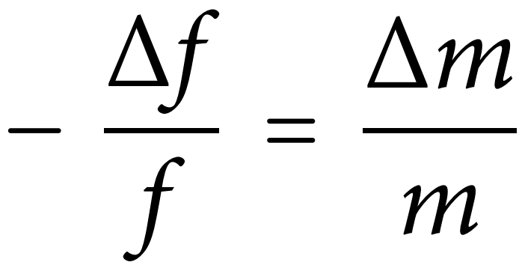
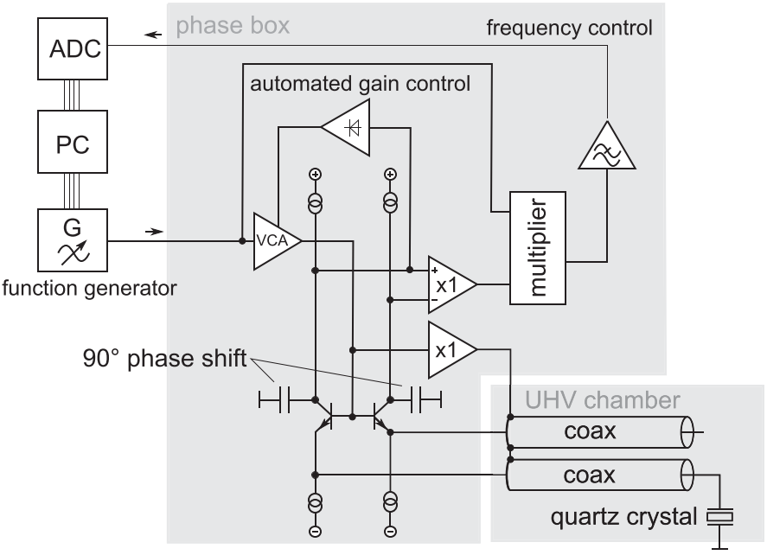
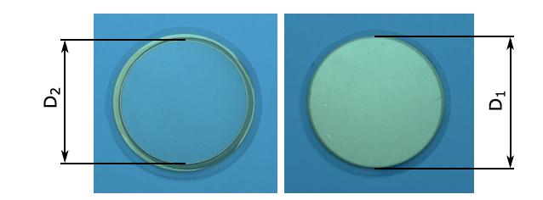
Diploma Thesis
Outline
Sputtering experiments at TU Wien with QCM
Fusion@ÖAW
Vienna, Austria
e.g., W or Be
Au
QCM = Quartz Crystal Microbalance
Sauerbrey [1]
Thin W layer on top -> sputtering experiments
At TU WIEN:
Specialised electronics + SC-cut quartz [2]
≈ 90 pg/cm²/s (3 ⋅ 10⁻⁴ W monolayers/s)
Allows to use low ion fluxes for minimal surface alteration
Target and Catcher configuration
SiO₂
Au
  [R. Stadlmayr et al., Rev. Sci. Instrum. 91 (2020)]
cupak@iap.tuwien.ac.at
[1] G. Sauerbrey, Z. Physik 155 (1959), 206-222
[2] G. Hayderer et al., Rev. Sci. Instrum. 70 (1999), 3696

Slide 7
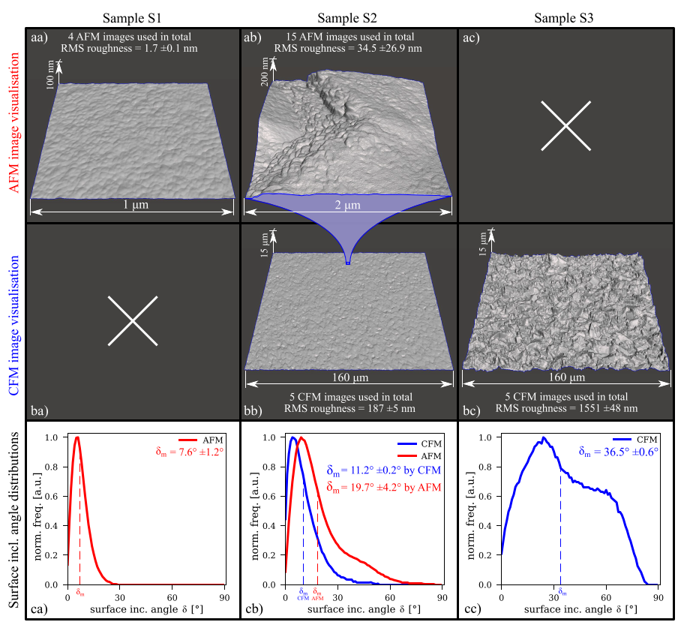
Diploma Thesis
Outline
Sputtering experiments at TU Wien with QCM
Fusion@ÖAW
Vienna, Austria
Example: Study on conventional rough W samples
3 different samples:
S1 = flat, W coated QCM crystal (PVD, IPP Garching)
S2 = rougher, W coated QCM crystal (PVD, IPP Garching)
S3 = very rough, W layer on Si (CVD, FZ Jülich)
Isotropic (conventional) roughness
W purity validated at Uppsala University (VR)
AFM + CFM
Determination of RMS roughness (nm- to µm regime)
Determination of surface inclination angle distribution
-> more details in second presentation
Cupak et al., Appl. Surf. Sci. 570 (2021), 151204

Slide 8
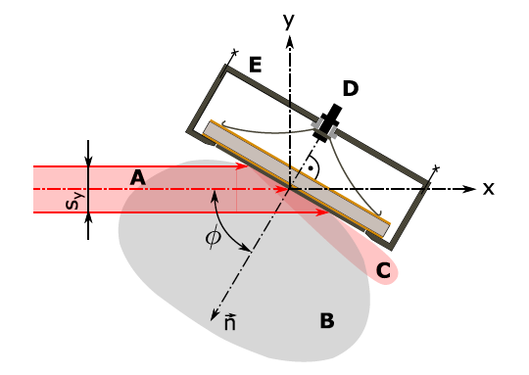
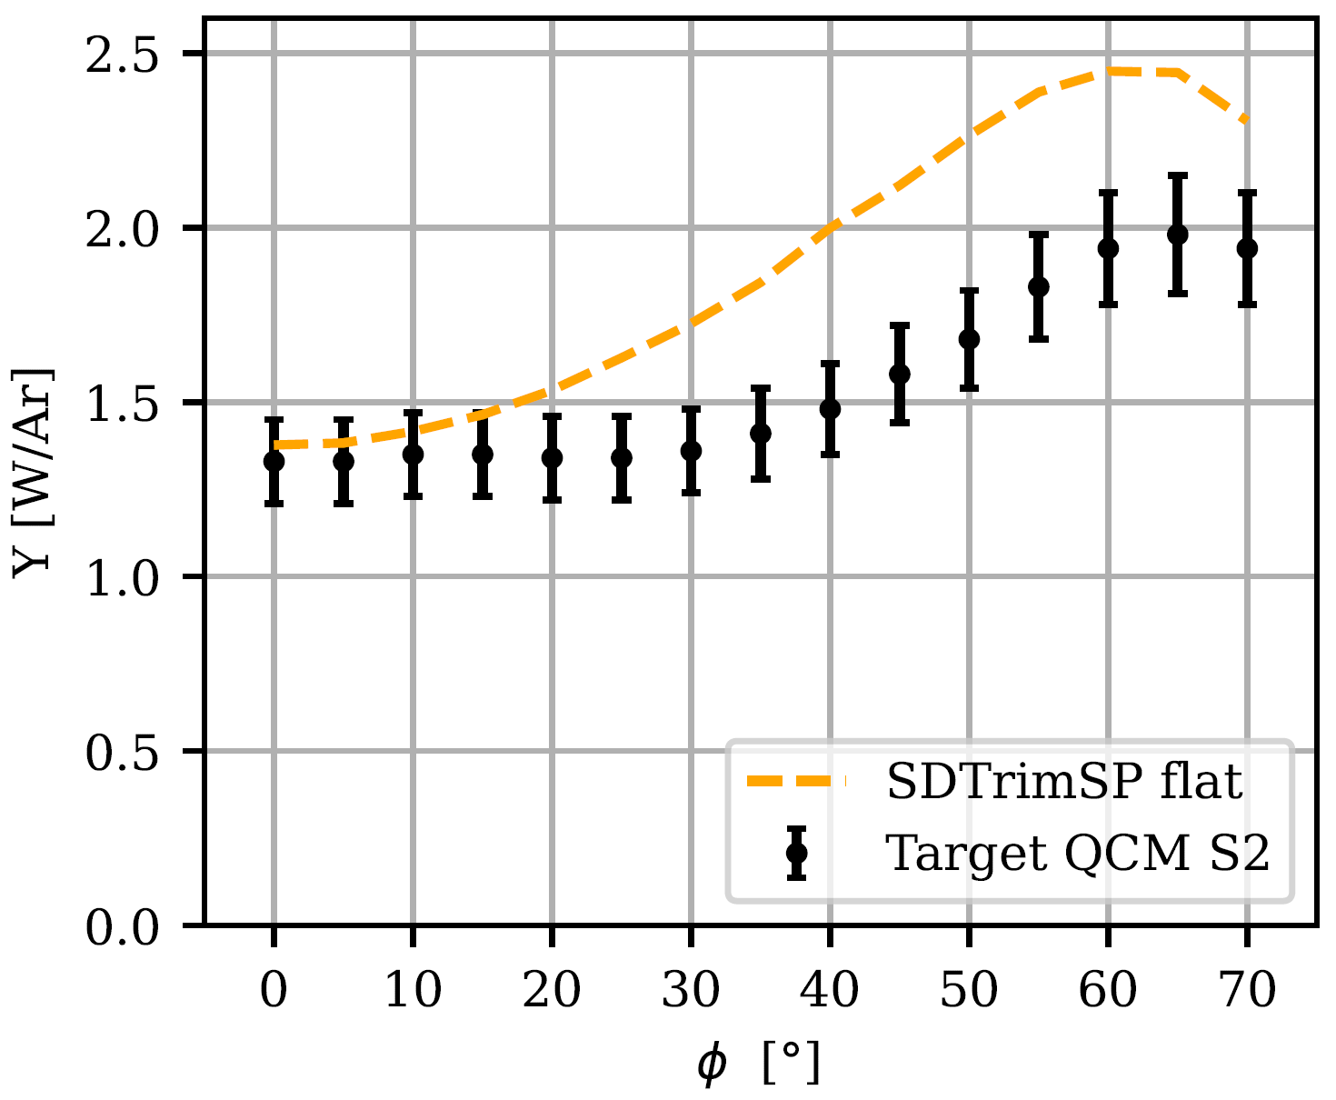
Diploma Thesis
Outline
Sputtering experiments at TU Wien with QCM
Fusion@ÖAW
Vienna, Austria
QCM Sample S2
Angular sweep of target sputter yield, 2keV Ar⁺
Sputter yield for variable
ion incidence angle φ
Classic Target QCM configuration:
A = ion beam, B = sputtered atoms, C = refl. Ions, D = QCM
-> Even nm-scale roughness changes sputter yield
for higher incidence angles
Cupak et al., Appl. Surf. Sci. 570 (2021), 151204

Slide 9
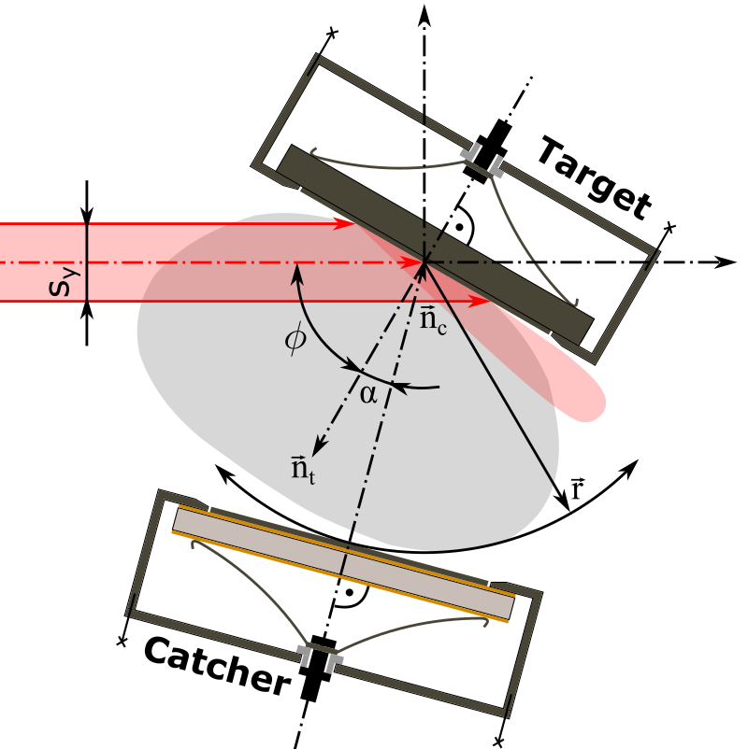
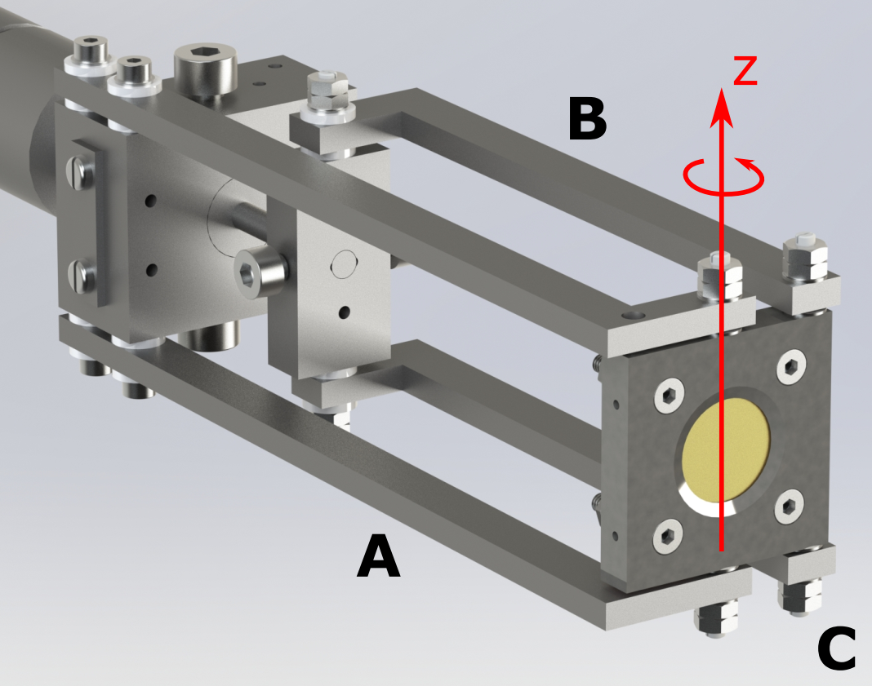
Diploma Thesis
Outline
Sputtering experiments at TU Wien with QCM
Fusion@ÖAW
Vienna, Austria
Catcher QCM
AFM
AFM
Target QCM for direct sputter yield measurement
Catcher QCM to probe angular distribution of sputtered atoms
Sputter yield estimation via Catcher QCM:
First: Target + Catcher QCM used as reference
Then: Catcher QCM + any target sample
Notes:
During the experiments, we utilised 2keV Argon ions generated from a mass filtered SPECS ion source. Fluxes were on the range of 10 to 15, 10 to 16 ions/m²/s.
We used the QCM not only in the classic target QCM configuration, but also as a Catcher. The latter allowed to probe the angular distribution of sputtered atoms, furthermore independent whether the target is a QCM crystal or a bulk target.
This furthermore enabled to estimate the target sputter yield of non-crystal targets, when a calibration reference measurement was conducted before.

Slide 10
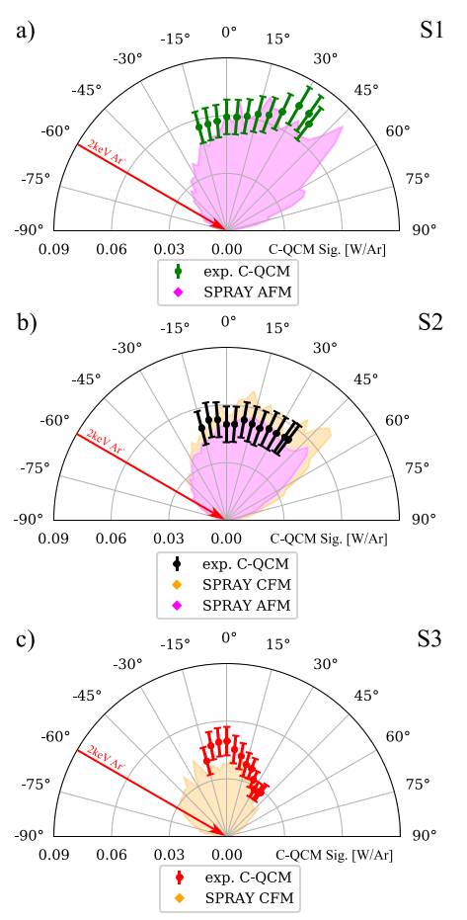
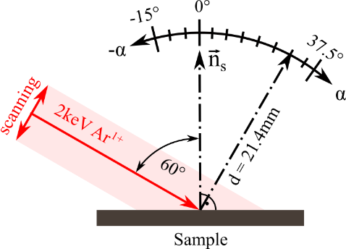
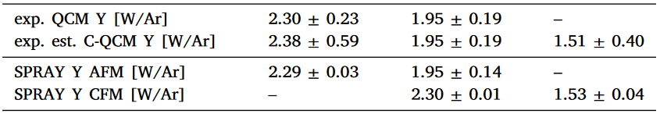
Diploma Thesis
Outline
Sputtering experiments at TU Wien with QCM
Fusion@ÖAW
Vienna, Austria
Samples S1, S2, S3 under 2keV Ar⁺ φ = 60° irradiation
1) Angular emission distribution: Catcher QCM (versus SPRAY code results)
S1
S2
S3
Single knock-on peak
Roughness reduces emission
High roughness -> collimation effect
2) Target sputter yields
S1, S2 direct sputter yields (QCM crystals)
S3 estimated sputter yields
Estimation by Catcher QCM works, but Target QCM is more precise
Catcher investigation usually only for single ion incidence angles
S1
Ref S2
S3
-> more details on SPRAY in SP-D related talk
Cupak et al., Appl. Surf. Sci. 570 (2021), 151204

Slide 11
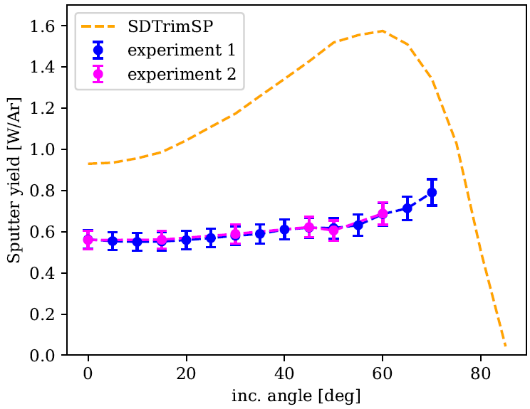
Diploma Thesis
Outline
Sputtering experiments at TU Wien with QCM
Fusion@ÖAW
Vienna, Austria
  Second Example: Nano-columnar W surface sputtering:
  Investigate influence of oriented and columnar structures (NCW) on W sputtering
  Cooperation with UPM Madrid / University of Helsinki: created oriented nanocolumnar W (NCW) structure directly on QCM samples
  Target QCM experiments under Ar ion bombardment at TU Wien
  Compared to flat surface, sputter yield is reduced and dependence on ion incidence angle is decreased
  Even though challenging, creation of complex structures directly on QCM allows to conduct angular sweep studies
QCM 1keV Ar⁺ on NCW
SEM cross-section NCW
SEM top-view NCW
100 nm
100 nm
A. Lopez-Cazalilla & C. Cupak et al. EF-PB: http://users.euro-fusion.org/webapps/pinboard/EFDA-JET/journal/index.html#Document31970

Slide 12
Diploma Thesis
Outline
Summary
Fusion@ÖAW
Vienna, Austria
CFM
AFM
SEM top-view NCW
AFM
AFM
SEM, AFM and CFM available for surface roughness investigation
Target QCM for direct sputter yield measurement
Catcher QCM to probe angular distribution of sputtered atoms
Combination of Target + Catcher QCM -> sputter yield estimation
QCM data good for code benchmarking
100 nm
Notes:
During the experiments, we utilised 2keV Argon ions generated from a mass filtered SPECS ion source. Fluxes were on the range of 10 to 15, 10 to 16 ions/m²/s.
We used the QCM not only in the classic target QCM configuration, but also as a Catcher. The latter allowed to probe the angular distribution of sputtered atoms, furthermore independent whether the target is a QCM crystal or a bulk target.
This furthermore enabled to estimate the target sputter yield of non-crystal targets, when a calibration reference measurement was conducted before.

