Slide 1
Kick-off meeting SP X1 Atomic and molecular processes in attached/detached plasma and sheath
Hennie van der Meiden

Slide 2
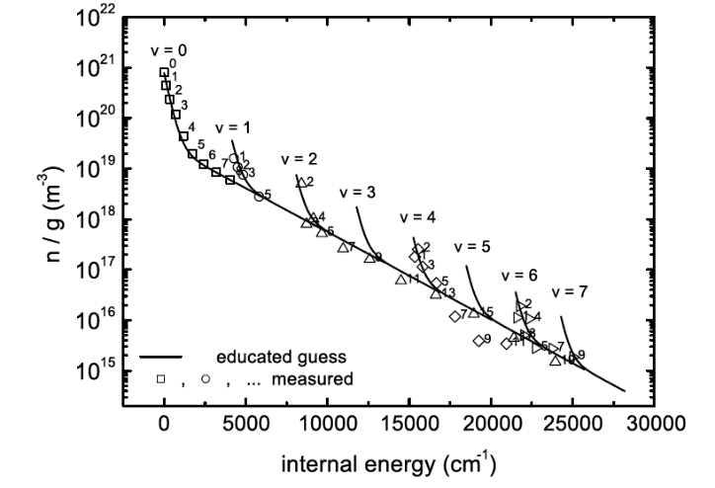
SP X.1: Anouncements
The Dutch proposals on VUV LIF were not granted (Dutch granting organization NWO). We will continue without and will first concentrate on TALIF and as step 2 on CARS and SARS to probe the complete ro-vibrational ground state distribution of H2 and isotopes.
Due to liquid helium delivery problems, required for the SC magnet, Magnum-PSI will start operation in July/August
H₂(v,r) ground state population (TU/e)
Notes:
Facilties: JUST GIVE the integral numbers for the groups
PD: Plasma devices (MAGNUM, PSI-2, UPP, TOMAS, GyM)
HHF: JUDITH, GLADIS, QSPA, OLMAT
Analysis station: Ion beam
If Facilties, Modelling, Link not applicable, remove the lines. I assume that it is EITHER EXPERIMENT or MODELLING, thus 1 more line for TASKS or Deliveables.

Slide 3
SP X.1: Atomic and molecular processes in attached/detached plasmas and sheath effects
Ultimate goal: Deyermination of distribution of ro-vibrationally excited states of H₂ and its isotopes
H₂(v,r) ground state population (TU/e)
Main goal of this meeting:
Status and if required synchronization of the work to be done
Identify possible issues that can cause delays
Notes:
Facilties: JUST GIVE the integral numbers for the groups
PD: Plasma devices (MAGNUM, PSI-2, UPP, TOMAS, GyM)
HHF: JUDITH, GLADIS, QSPA, OLMAT
Analysis station: Ion beam
If Facilties, Modelling, Link not applicable, remove the lines. I assume that it is EITHER EXPERIMENT or MODELLING, thus 1 more line for TASKS or Deliveables.

Slide 4
SP X.1: Detailed describtion tasks and deliverables 2021
Measurement of the atomic density of H(1s) and isotopes: installation TALIF in MAGNUM-PSI. Final design CARS/SARS system for ro-vibrational ground state distribution H₂ in MAGNUM (DIFFER)
VUV passive spectroscopy on H/H₂ and isotopes in MAGNUM-PSI and PSI-2 (FZJ, DIFFER, CU)
Final design LIF in PSI-2 to measure H₂ ro-vibrational ground state distribution (FZJ)
Feasibility study multi-photon LIF to measure ro-vib. ground state distri. of H₂ and isotopes (DCU)
Measure ion/electron properties in the proximity of the target surface (Magnum (ion/electron), UPP (electron)) for accurate power load estimations (DIFFER)
D1: TALIF system installed at MAGNUM-PSI and conceptional design CARS/SARS system for ro-vib. ground state distribution H₂ in MAGNUM-PSI ready (DIFFER)
D2: VUV OES results H/H₂ (DIFFER, FZJ, CU)
D3: Conceptional design LIF for H/H₂ measurements in PSI-2 ready (FZJ)
D4: Results feasibility study multi-photon LIF for ro-vib. ground state distribution H₂(v,J) (DCU)
D5: v_{plasma} measurements (CTS) near the surface as function of n_{e} (input SP D), and ne/Te measurements in UPP (DIFFER)
Notes:
Facilties: JUST GIVE the integral numbers for the groups
PD: Plasma devices (MAGNUM, PSI-2, UPP, TOMAS, GyM)
HHF: JUDITH, GLADIS, QSPA, OLMAT
Analysis station: Ion beam
If Facilties, Modelling, Link not applicable, remove the lines. I assume that it is EITHER EXPERIMENT or MODELLING, thus 1 more line for TASKS or Deliveables.

Slide 5
THE END
Notes:
Facilties: JUST GIVE the integral numbers for the groups
PD: Plasma devices (MAGNUM, PSI-2, UPP, TOMAS, GyM)
HHF: JUDITH, GLADIS, QSPA, OLMAT
Analysis station: Ion beam
If Facilties, Modelling, Link not applicable, remove the lines. I assume that it is EITHER EXPERIMENT or MODELLING, thus 1 more line for TASKS or Deliveables.

Slide 6
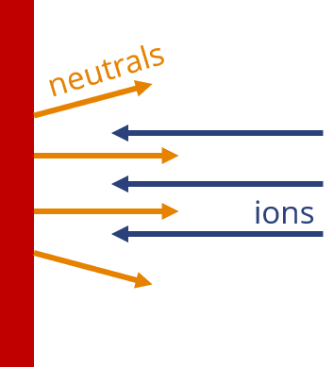
SP X.1: Atomic and molecular processes in attached/detached plasmas and sheath effects ➔ Motivation
Measurement of ro-vibrational distribution and of atomic densities of ground state hydrogen and isotopes. Why?....a few examples
MAR is beneficial for mitigation of plasma power flux/momentum in SOL, but understanding of formation is required. ➔ Ro-vib distribution not known ➔ Reaction rates vary orders of magnitude with ro-vib.
Reaction rates H and isotopes can differ a lot!
Input required for SOL modeling!
H₂(v,r) + H⁺ ➔ H₂⁺ + H(1s)
v=4~1.8eV 13.6 eV ➔ v=0~15.4eV 0 eV
~13.6 eV
Notes:
Facilties: JUST GIVE the integral numbers for the groups
PD: Plasma devices (MAGNUM, PSI-2, UPP, TOMAS, GyM)
HHF: JUDITH, GLADIS, QSPA, OLMAT
Analysis station: Ion beam
If Facilties, Modelling, Link not applicable, remove the lines. I assume that it is EITHER EXPERIMENT or MODELLING, thus 1 more line for TASKS or Deliveables.

