Slide 1
WP PWIE Kickoff meeting SP X1 2022 PWIE.SPX.1-T002-D002: PSI-2: VUV OES results H/H2, Conceptional design LIF for H/H2 and W measurements (FZJ)
M. Reinhart, S. Ertmer, G. Sergienko

Slide 2
Tasks status mid 2022
VUV OES results H/H₂ (FZJ) Deliverable delayed
Conceptional design LIF for H/H2 measurements in PSI-2 ready (FZJ) Deliverable on time

Slide 3
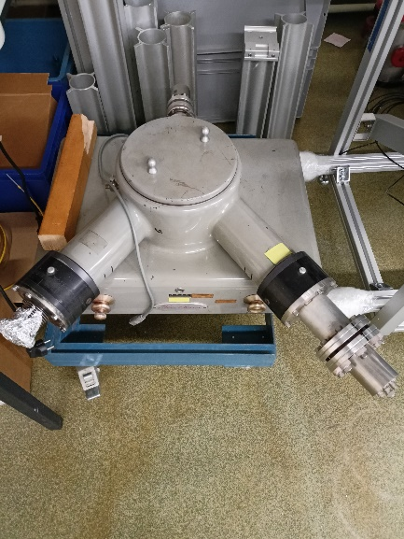
VUV OES results H/H2
Status:
Spectrometer 0.5 m Seya Namioka selected.
Setup ongoing, testing and operation still delayed.
Next steps:
Get spectrometer in operation
Test spectrometer externally
Mount spectrometer at PSI-2
Experiments at PSI-2

Slide 4
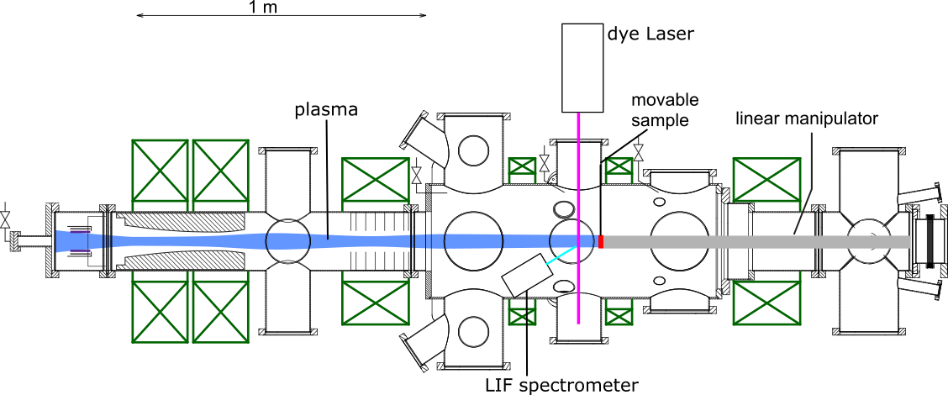
Conceptional design LIF for H/H2 and W measurements
Status:
2021 Task (Conceptual design) completed by Stephan Ertmer as preparation for his ERG in 2022.
Next steps:
Continuation of the work by Stephan Ertmer as part of his ERG
In SPX.1 task: Adaption of results for sputtered tungsten (ERG) also for H/H2

