Slide 1
DIFFER contributions to
SP-X1
Ivo Classen, Hennie van der Meiden, Jordy Vernimmen, Jonathan van den Berg

Slide 2
Deliverables
Near target measurements:
  TS on Magnum and UPP
Passive VUV spectroscopy in Magnum
TALIF on Magnum
  Diagnostic development
  First step towards CARS/VUV-LIF

Slide 3
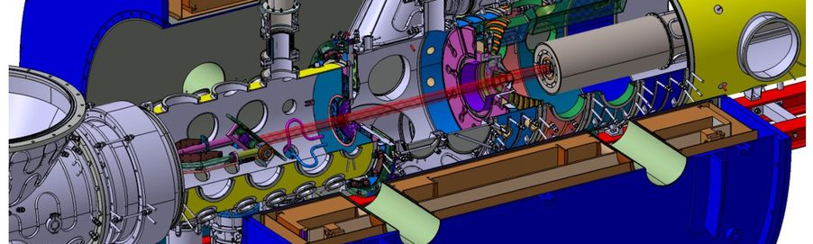
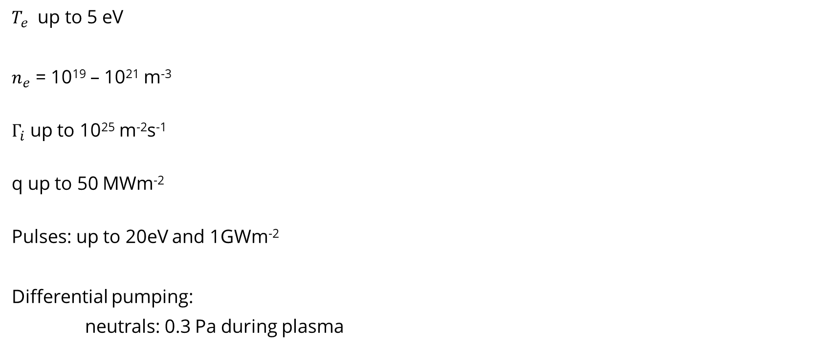
Magnum-PSI
$T_{e}$ up to 5 eV
$n_{e}$ = 10¹⁹ – 10²¹ m⁻³
$Γ_{i}$ up to 10²⁵ m⁻²s⁻¹
q up to 50 MWm⁻²
Pulses: up to 20eV and 1GWm⁻²
Differential pumping:
neutrals: 0.3 Pa during plasma

Slide 4
Section B
Passive VUV spectroscopy in Magnum-PSI
Coming soon to DIFFER: see contribution CU

Slide 5
Section C
Active spectroscopy on Magnum-PSI
COmmisioning: TALIF (atoms)
Future: CARS/VUV-LIF (design ready 2022) (molecules)

Slide 6
Motivation
The ro-vibrational distribution plays a major role:
MAR rate can vary multiple orders of magnitude
Direct measurement difficult, but H₂(r,ν) distribution previously successfully measured in both linear plasmas and tokamaks (no current set-ups)
➔ Build new diagnostic on Magnum-PSI (divertor relevant plasmas) based on proven methods: VUV-LIF and CARS (TU/e, Plexis)
DIFFER will finance this from institute’s budget
From Vankan et al.
6

Slide 7
Active spectroscopy: 3 methods
VUV-LIF based on Stimulated anti-Stokes Raman scattering
(population ν >2,J)
Coherent anti-Stokes Raman spectroscopy (CARS):
(population ν ≤2,J)
Two photon Absorption Laser Induced Fluorescence (TALIF)
(density H atoms in ground state)
7

Slide 8
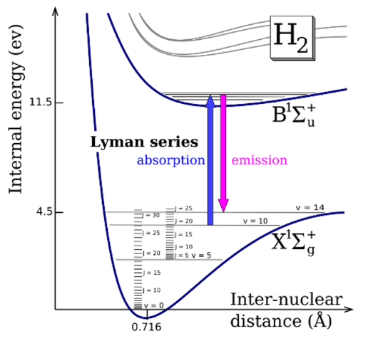
VUV-LIF principle
Excite ground state ro-vib level to electronically excited state
Measure fluorescence signal
Scanning the laser wavelength excites different ro-vib states
110 to 165 nm for ν=0 to ν=14
VUV LIF spectroscopy of H₂ ground state

Slide 9
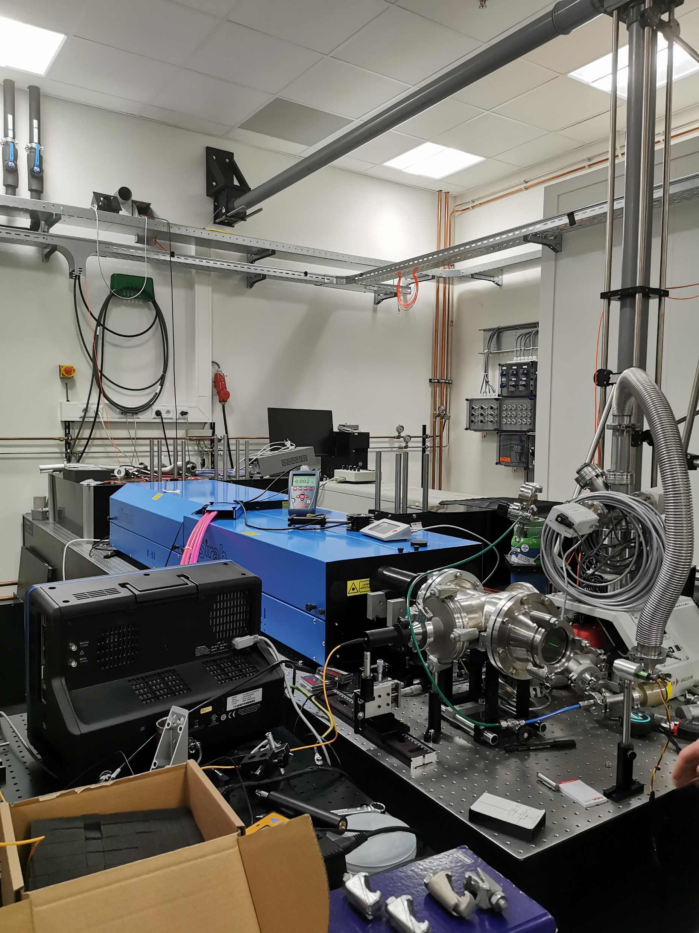
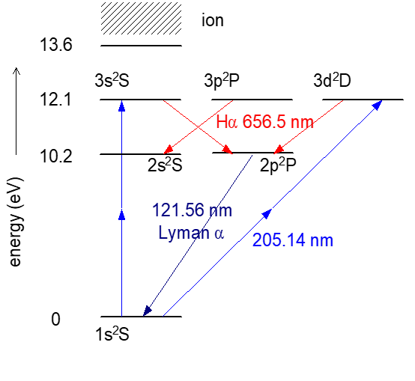
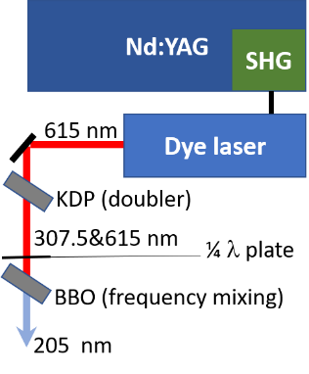
Status TALIF on Magnum-PSI
TALIF:
  Density of atomic H density
  Also applicable to N
  Excitation: 205.14 nm
  (for Ly β absorption with 2 photons)
  Fluorescence: Hα
Dye laser setup operational and generates 205 nm laser light
First attempt to obtain first signals on Krypton gas (check system operation) in May 2022
Plan first try-out for atomic density measurements in Pilot-upgrade: June 2022

Slide 10
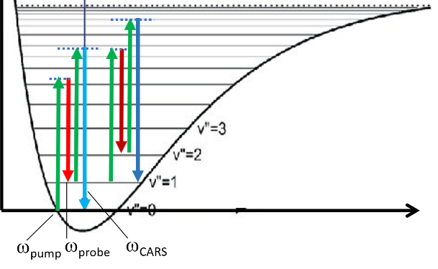
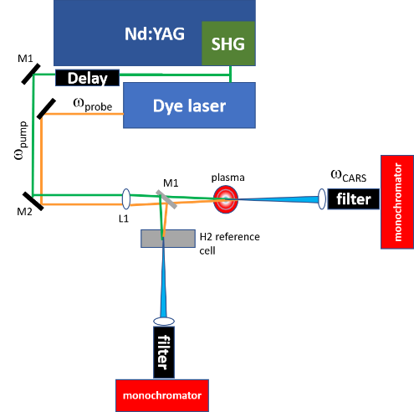
CARS in Magnum-PSI: status
Lower vibrational states (ν<=2) can be measured with CARS
CARS:
4-wave mixing process
660-700 nm probe beam
532 nm pump beam
Dye laser setup operational (assume same laser as TALIF, Nd:YAG should be a seeded type)
Conceptual design in progress:
Installation should start in September 2022
First tests in Magnum-PSI: Q2 2023
10

Slide 11
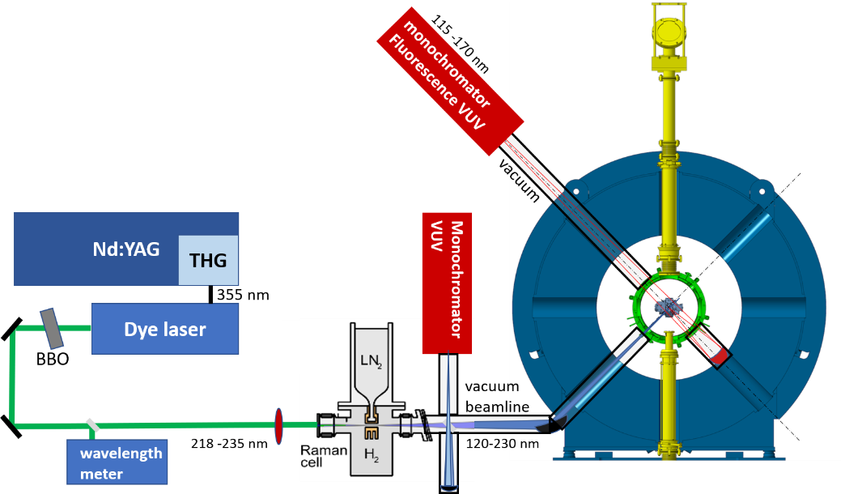
Status VUV-LIF setup
Laser in VUV range
(down to ~ Ly α)
➔ Raman cell (SARS)
In vacuum
VUV monochromators
Conceptual design in progress

Slide 12
Thank you for your attention!

