Slide 1
VR contribution to PWIE SP-X
Per Petersson, Laura Dittrich, Sunwoo Moon, Marek Rubel, Daniel Primetzhofer

Slide 2
Task Specification
Eurofusion PWIE SP-X
ECWC, ICWC, and GDC plasma characterization / Pre- and post-characterization of samples used for cleaning and isotope exchange

Slide 3
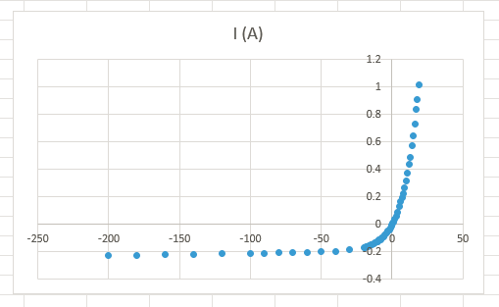
Sample exposure 2022
New set of samples produced and pre-characterized by NRA and ToF-ERDA
Samples exposed in TOMAS 9-20 May
Investigation of effects of bias on the sample:

Slide 4
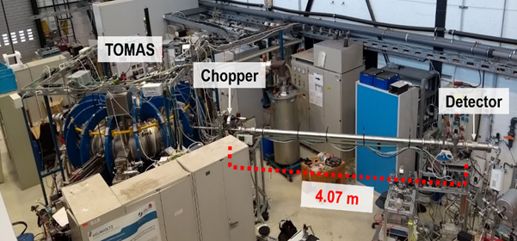
Plasma characterization
Neutral particle analyser

Slide 5
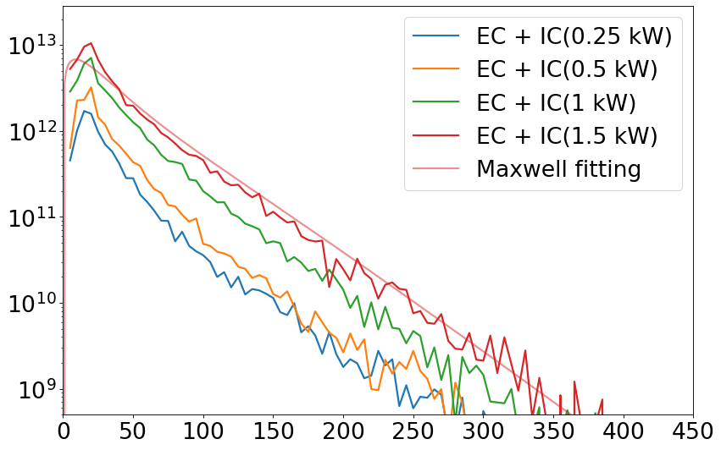
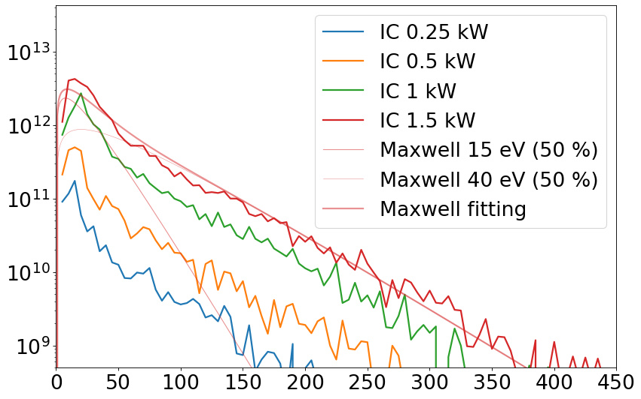
2021-11 Exp. ToF-NPA
Neutral Particles Flux from Hydrogen EC+IC
Neutral Particles Flux from Hydrogen IC
Differential flux (n⁰ cm⁻² s⁻¹)
Differential flux (n⁰ cm⁻² s⁻¹)
Energy (eV)
Energy (eV)
Total flux (10¹⁴ n⁰/cm² s) | IC 0.25 kW | IC 0.5 kW | IC 1 kW | IC 1.5 kW
EC(2 kW) + IC | 5.44 | 9.38 | 23.33 | 38.29
IC only | 0.38 | 1.52 | 8.11 | 18.15
Increase of power generates more neutral particle flux
The energy of neutral particles could be estimated by Maxwell-Boltzmann distribution fitting
EC+IC is fitted to 50% of 15 eV and 50% of 35 eV
IC only is fitted to 50% of 15 eV and 50% of 40 eV

Slide 6
Summary
Starting to have a good set of data from both exposed samples and NPA
Should aim for putting it together
Also looking at other improvements and how it can impact, measurements
Vacuum in NPA
Different types of samples
Methods of biasing the samples (pulsed DC)
Proposal with Tom Wauters for similar investigations in EAST

Slide 7
Thank you!

