Slide 1
TSVV3 project (Edge Fluid Modelling): update et future plans
P. Tamain
In name of the TSVV3 team

Slide 2
Reminder of project structure
TSVV2
TSVV5
TSVV6
Coordinate and rationalize effort
- Task 0: project coordination
- Task 10: evaluate and select approaches
Improve models
- Task 1: gyrofluid models
- Task 2: sheat BCs
- Task 3: reduced turbulence models
Improve codes capabilities
- Task 4: codes optimization
- Task 5: neutrals physics
- Task 6: multi-species plasmas
- Task 7: complex geometry
Validate
- Task 8: IMAS-ification and synthetic diagnostics
- All tasks: test new capabilities against experiments
Disseminate
- Task 9: make verified codes available to WPs
TSVV1
TSVV4
ACHs
ACHs
WPs
WPs
ACHs

Slide 3
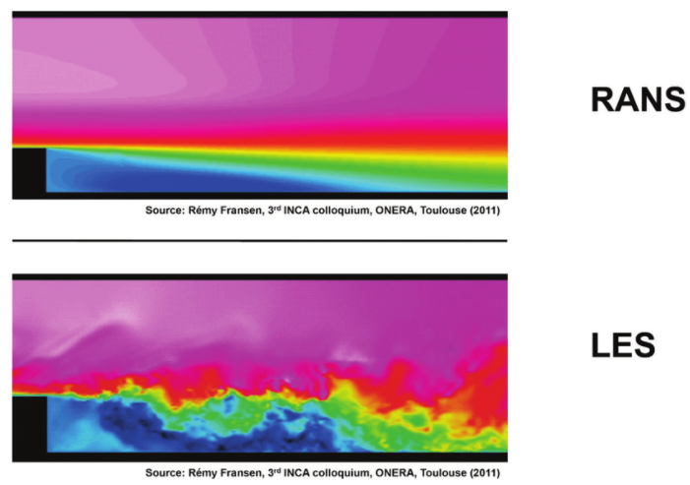
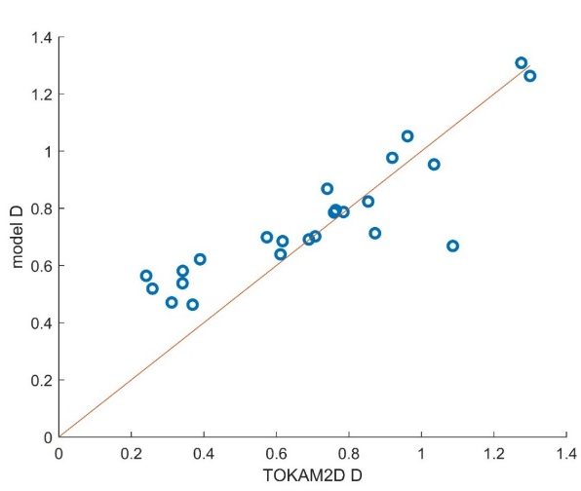
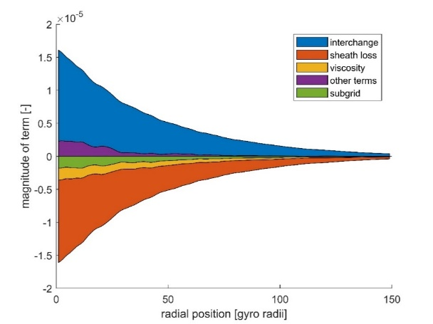

Reduced turbulence models further developed
RANS models = intermediate description of anomalous transport
Direct Simulation of turbulence
RANS models
Mean-field with gradient-diffusion
Following Bufferand’s initial idea [Bufferand, CPP 2016], theory based RANS model derived and closed based on 2D turbulence database
[Coosemans et al., CPP 2022]
$$D\sim \sqrt{κ_{⊥}}$$
Database of TOKAM2D simulations over broad parameter range

Slide 4
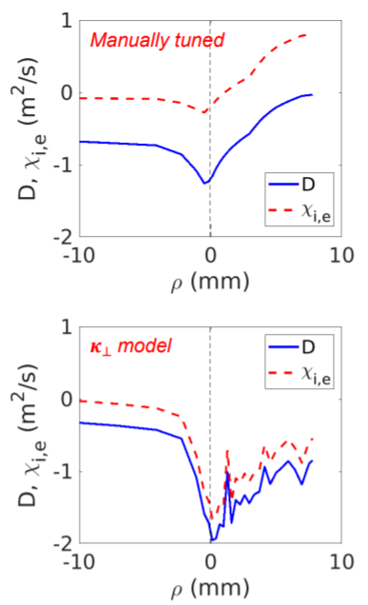
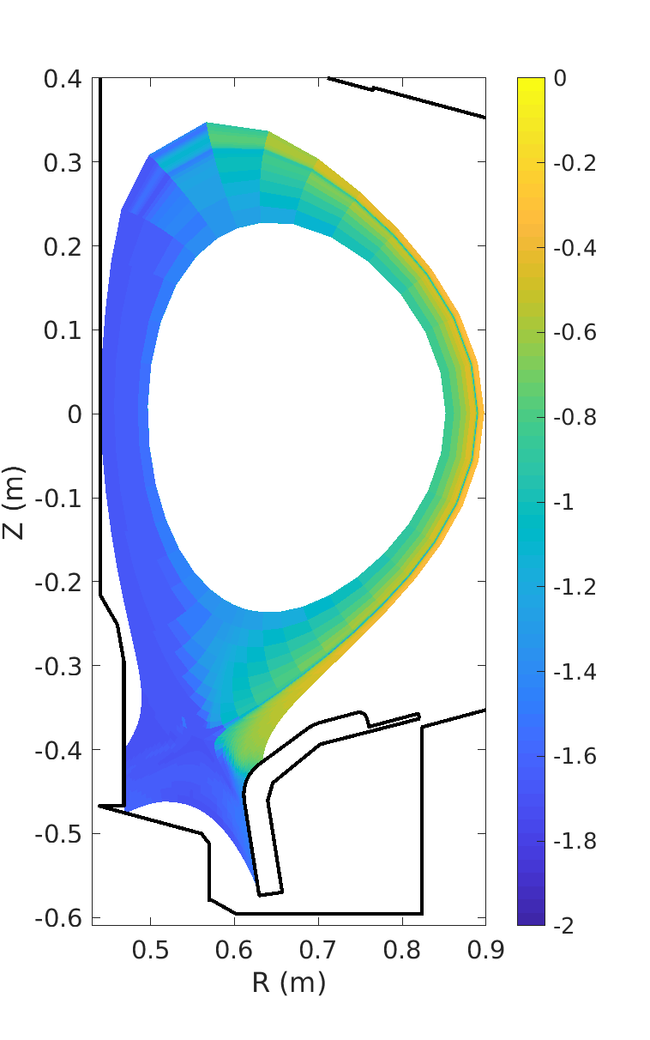
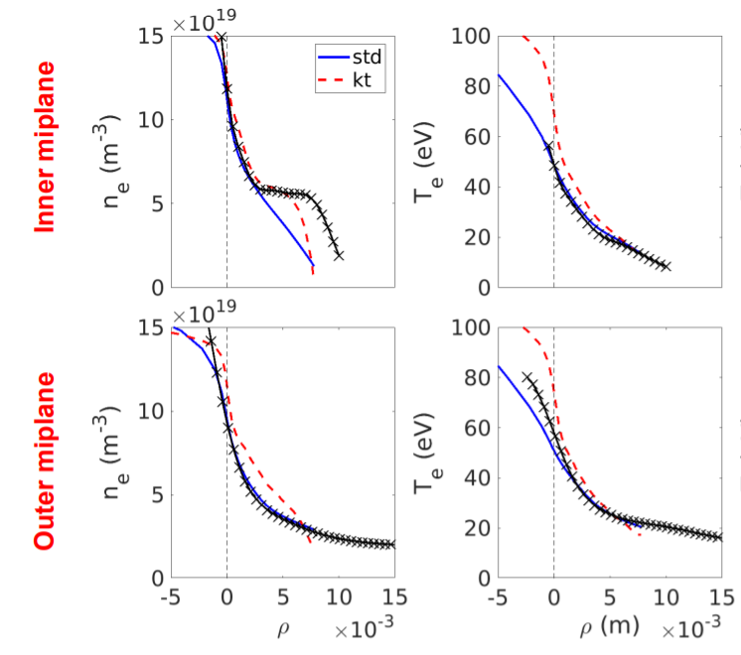
Confrontation to C-mod experiment
Confrontation to C-mod after TCV and WEST ([Baschetti, NF 2021]) with improved model for parallel transport of fluctuations
[Dekeyser, NME 2021; Dekeyser, CPP 2022]
D (log)

Slide 5
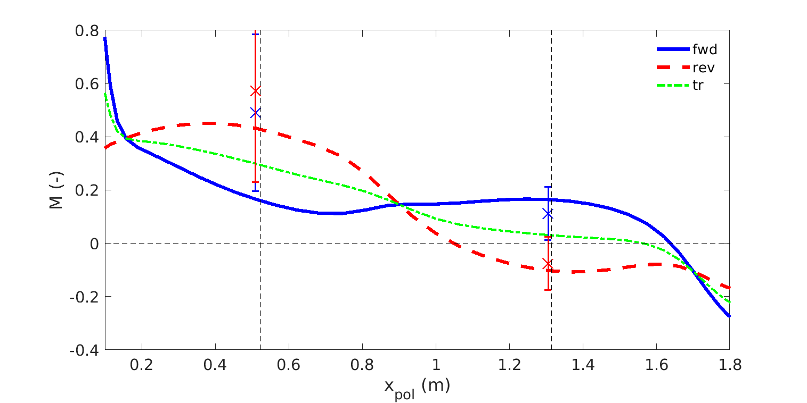
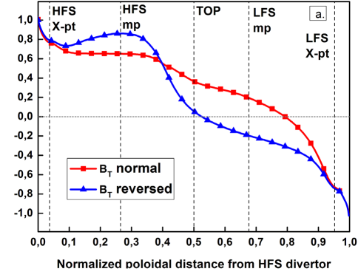
RANS model capture turbulence driven physics
Simulation with drifts + RANS turbulence model with SOLPS ITER recovers qualitatively SOL flow asymmetries
  Still not perfect on HFS (too low amplitude) but only 3D full turbulence simulation could reach such agreement until now
RANS reduced turbulence model
Full turbulence simulation
[Dekeyser, PSI 2022]
[Galassi, NF 2017]

Slide 6
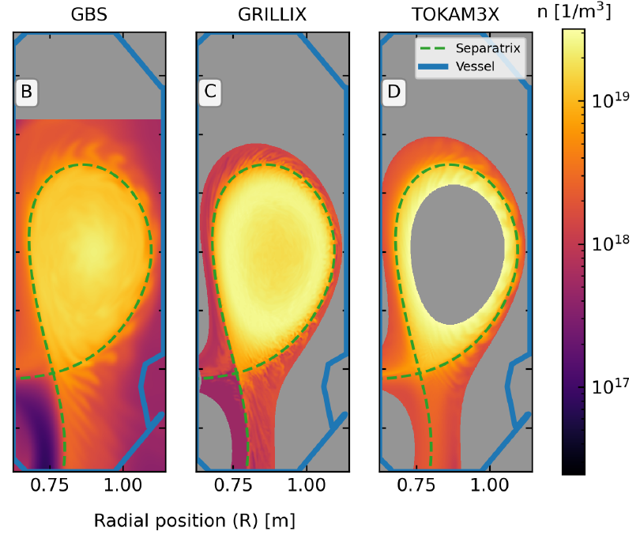
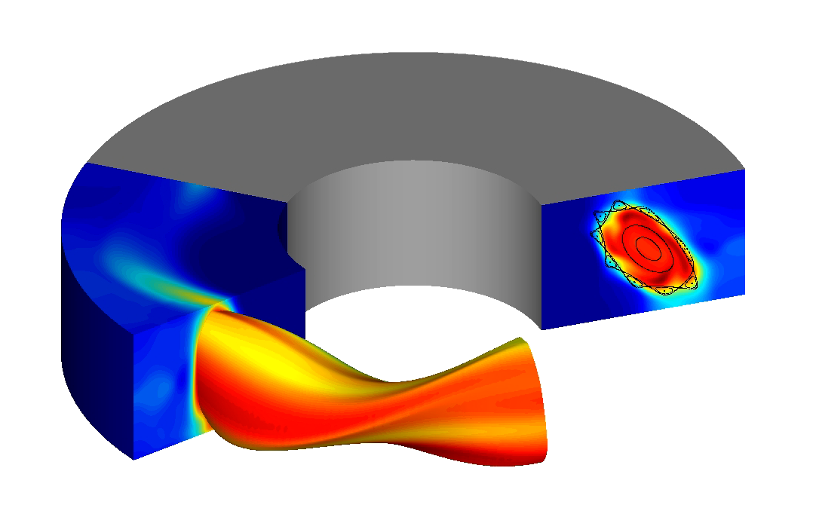
Realistic magnetic geometries now ubiquitous
All contributing edge turbulence codes now routinely run in 2D axisym. realistic magnetic geometries
  Circular limited, single or multiple X-points including snowflake configurations…
  Restricted to attached plasmas, sometimes ad-hoc BCs => numerical method dev. needed to go beyond
[Oliveira, Body et al, NF 2022]
Generalization to 3D configurations
  Demonstration of application to stellarators made with GBS, application to RMPs
  Development started in GRILLIX to do so (FCI helping)
[A. Coelho et al, submitted to Nuclear Fusion,
https://arxiv.org/abs/2201.10871]

Slide 7
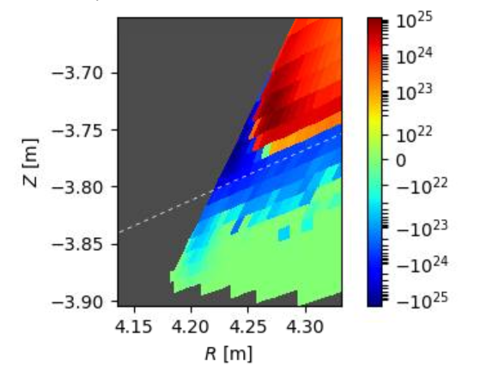
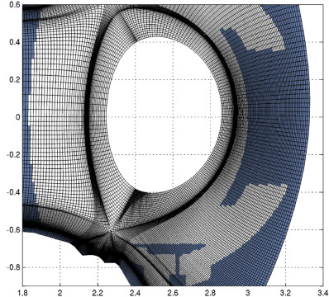
Exploring options to capture the wall geometry
Remaining open question: how to capture the wall geometry precisely?
  Necessary as gradient length can be $≲1mm$ at target plates in high density regimes
©SOLEDGE3X
©SOLEDGE3X
Flux-surface aligned grid in WEST geometry
Electron source (m⁻³.s⁻¹) at ITER inner SP (case #2299)

Slide 8
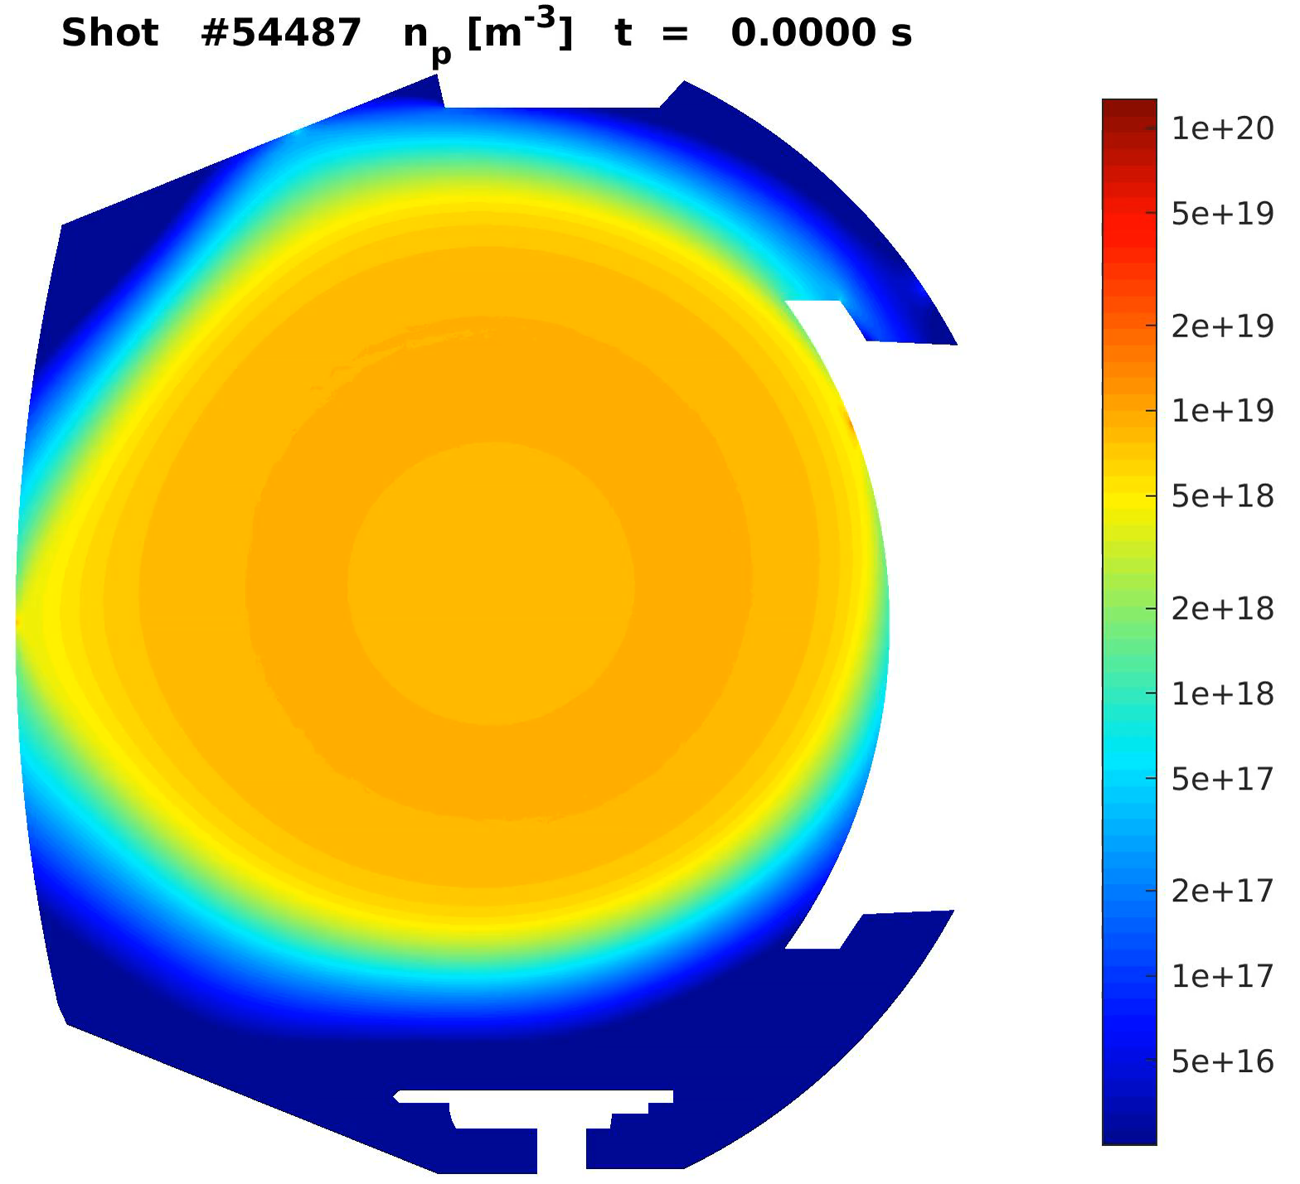
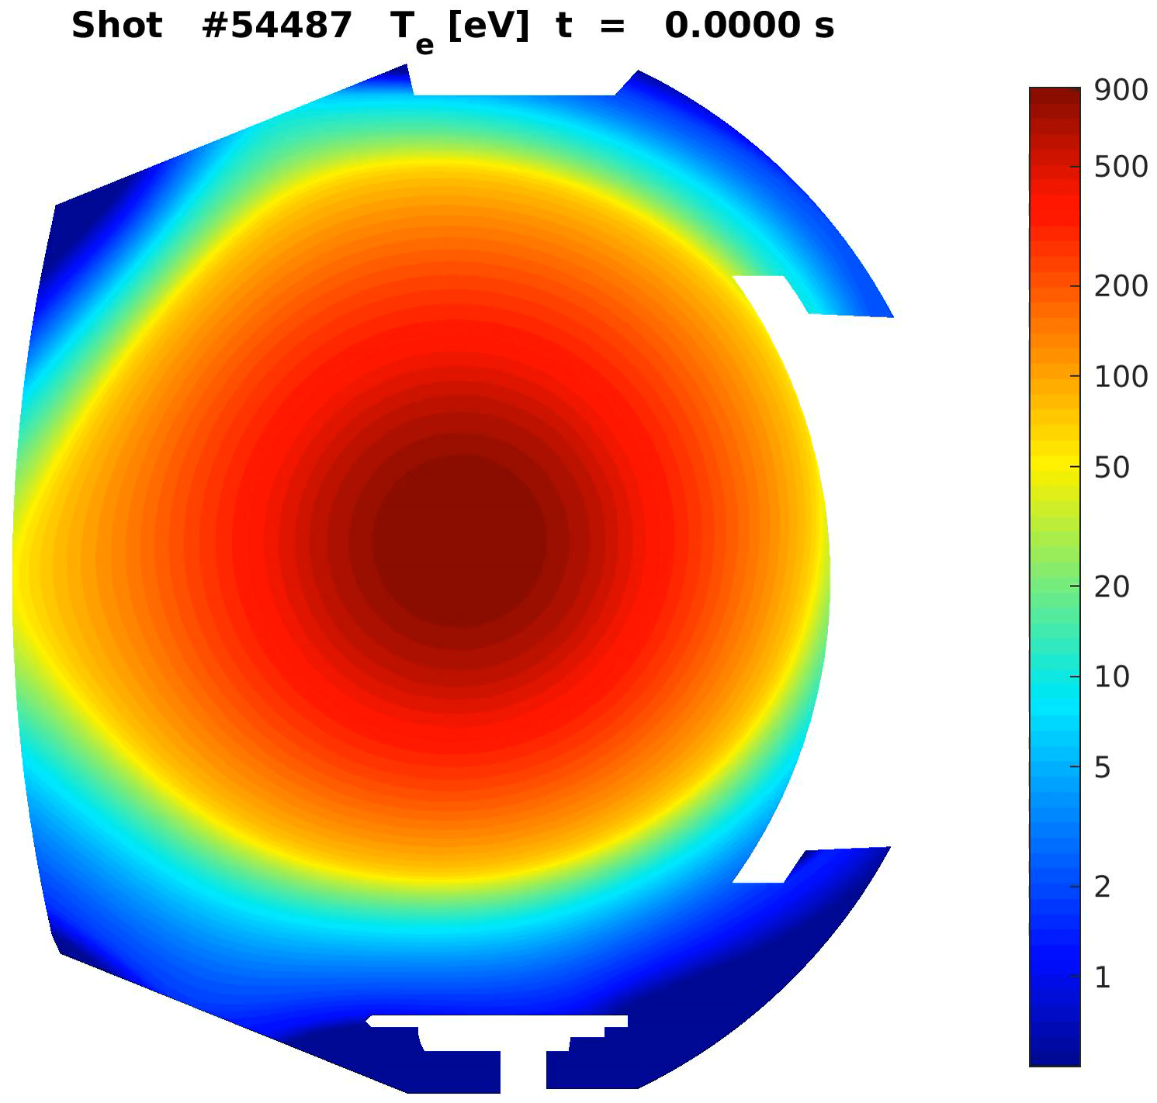
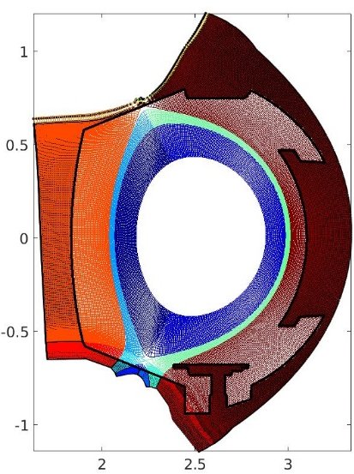
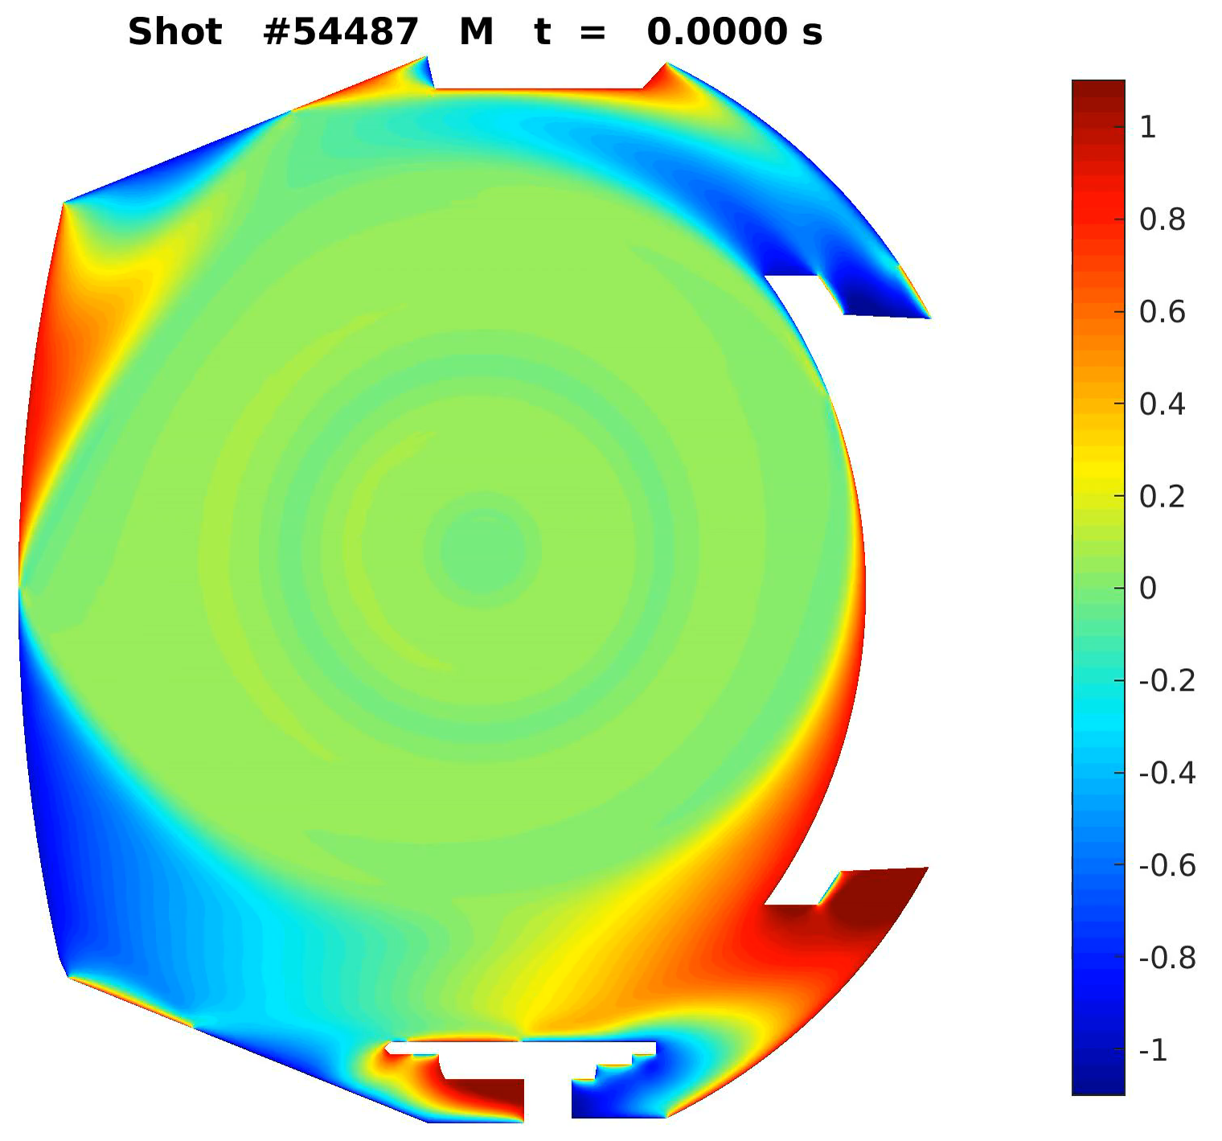
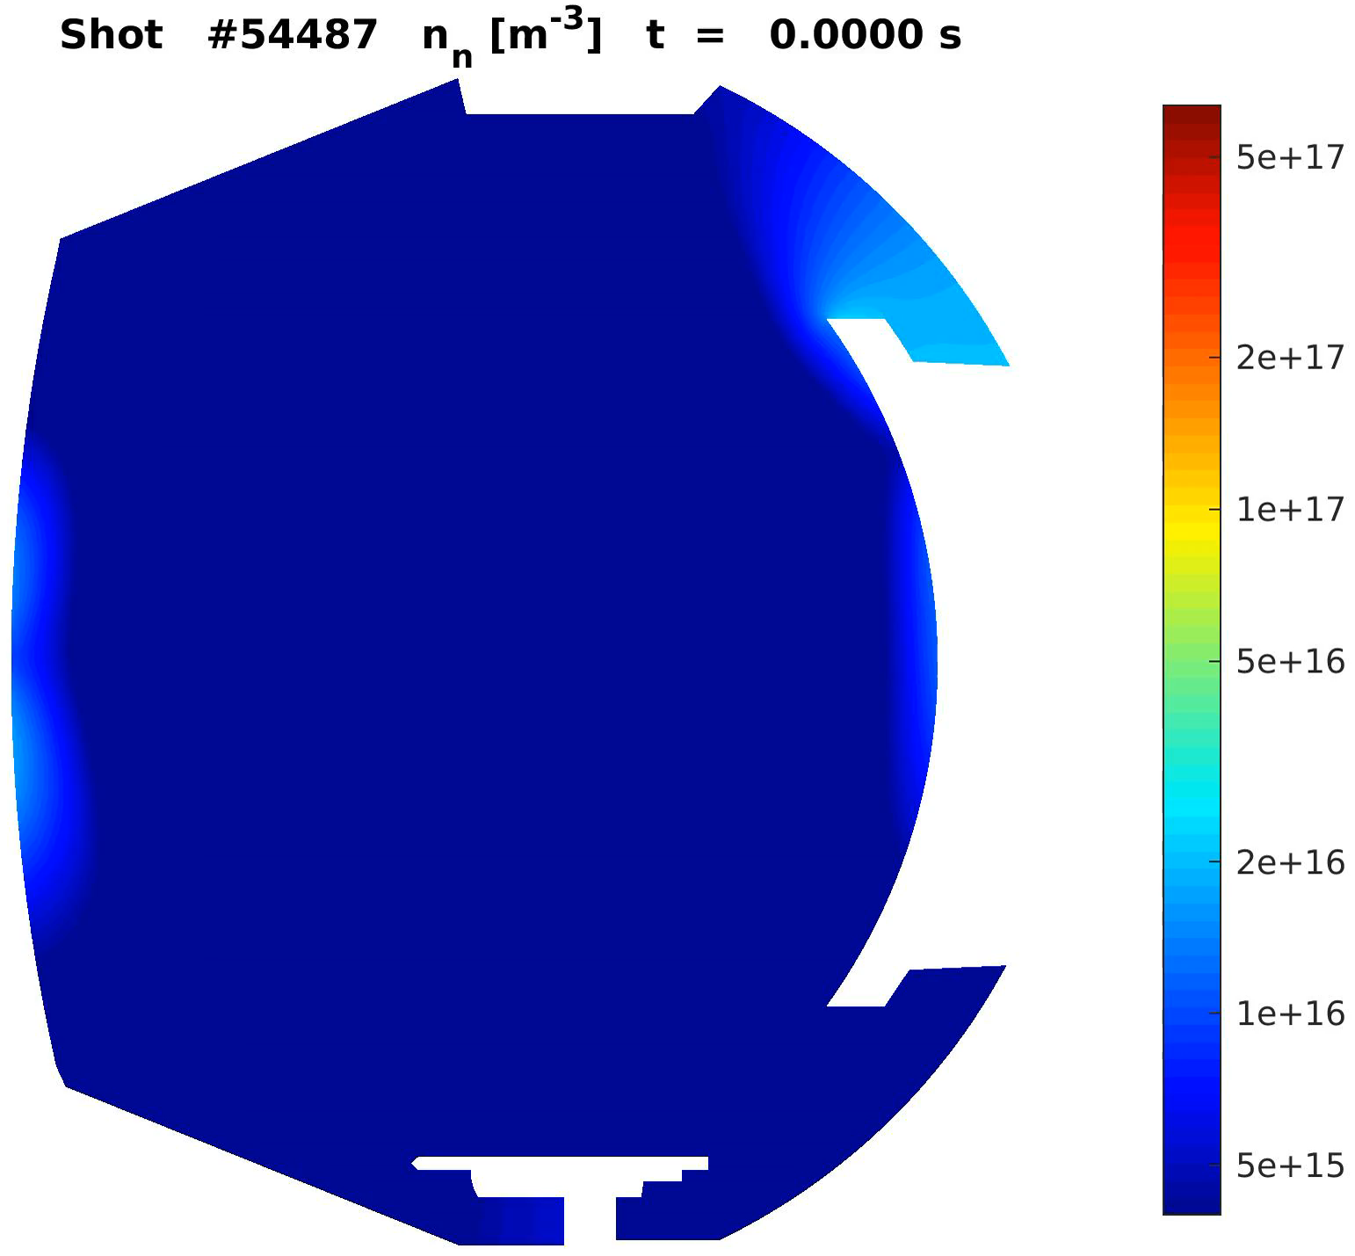




Exploring options to capture the wall geometry
Remaining open question: how to capture the wall geometry precisely?
  Necessary as gradient length can be $≲1mm$ at target plates in high density regimes
Progress along 3 paths, but no method fully fulfils wanted specifications yet
  Mask function + local alignment at strike points (SOLEDGE3X)
  Immersed boundary conditions (GRILLIX)
  Finite Elements (HDG) solver
$$n_{e}$$
$$T_{e}$$
Not tested in full 3D turbulence
Numerical cost could become an issue
Imprecise wall geometry
Ability to capture strong poloidal gradients (detachment)?
Meshing complex
Robustness perfectible
$$M_{∥}$$
$$n_{n}$$
[SOLEDGE3X WEST case with realistic wall]
[courtesy GRILLIX]
[Di Genova, NF’21; Scotto d’Abusco, NF’22]

Slide 9
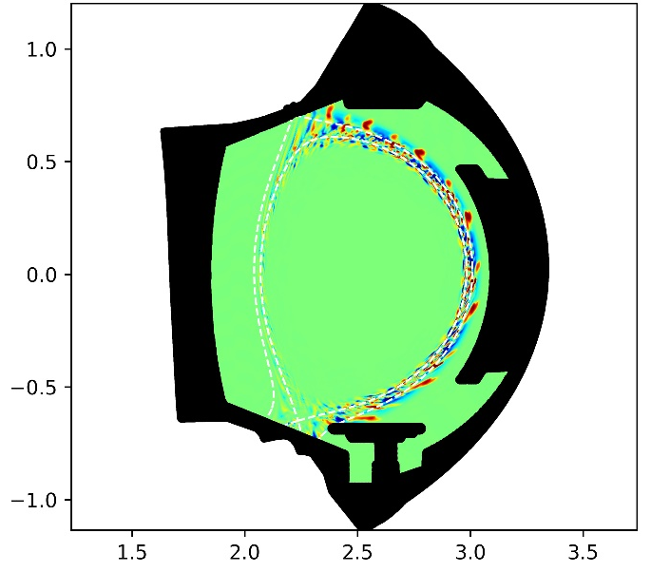


Towards ITER scale simulations
Steady progress towards larger scale cases
Latest advances unlock full scale simulations for low $ρ_{⋆}$ machines ($1/{ρ_{⋆}}≳1500)$
$${\tilde{T}}_{e}$$
SOLEDGE3X WEST simulations at realistic parameters (1e6 x 128 mesh, 64 nodes)
GRILLIX ITER-scale simulation at realistic parameters (11e6 x 16 mesh, 16 nodes)
GBS/GRILLIX/TOKAM3X
TCV simulation (2020)
[Oliveira, Body et al, NF 2022]

Slide 10
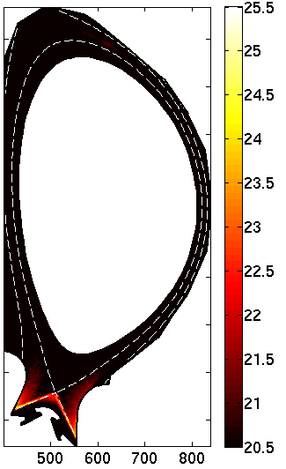
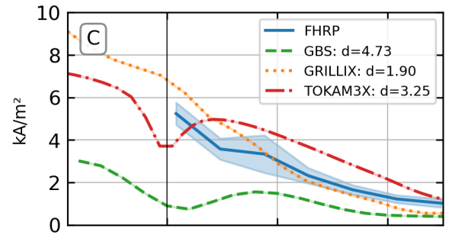
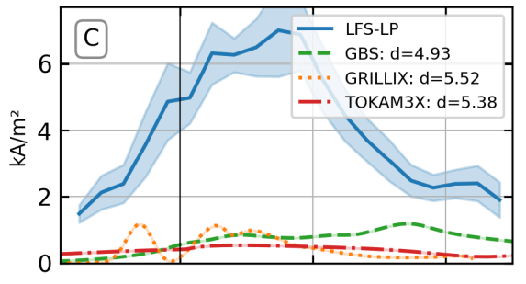



Neutrals as the key point of focus for near future
  Neutrals mandatory for reactor relevant regimes but largely ignored until recently in spite of importance
  Already suspected to be root cause of main discrepancies between codes and experiment in TCVX21 validation
  High priority for all TSVV3 codes with several routes explored
Gas puff!
S_{n} in ITER SOLEDGE2D-EIRENE simulation (log₁₀(m⁻³.s⁻¹))
[Oliveira, Body et al., NF 2022]
$\tilde{J_{sat}}$ OMP
$\tilde{J_{sat}}$ LFS target

Slide 11
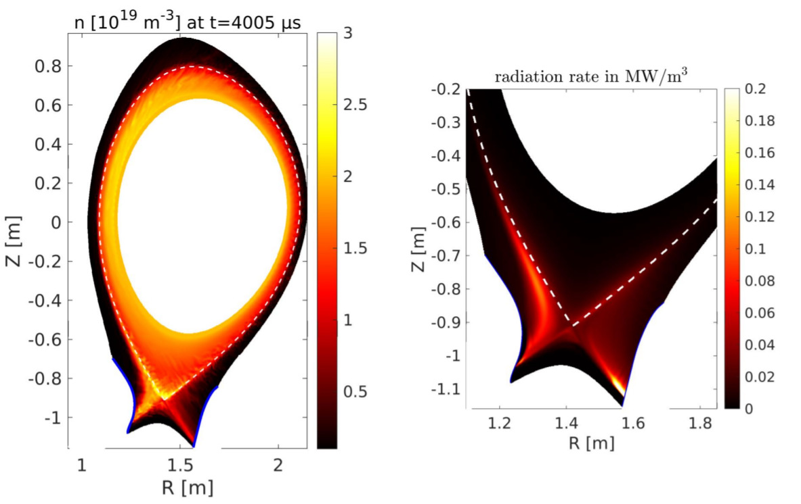
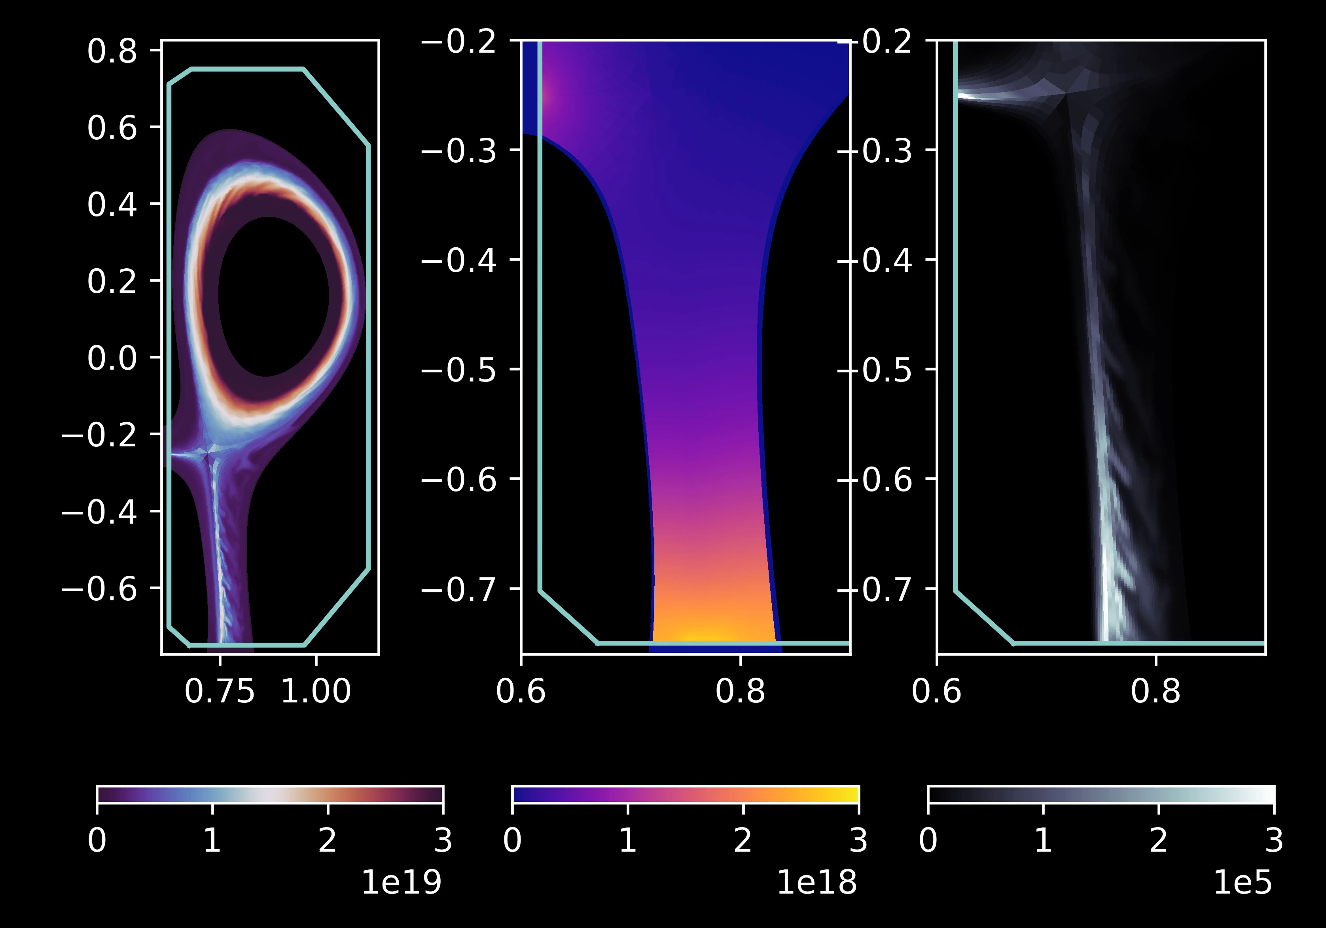
Fluid neutrals in turbulence simulations
  Rudimentary fluid neutrals models implemented in 3D turbulence codes GRILLIX and SOLEDGE3X and applied to WPTE machines
n_{e}
n_{D0}
P_{rad}
SOLEDGE3X / TCV
[Bufferand, CPP 2021; Bufferand, NF 2021]
GRILLIX / AUG [Zholobenko, NF 2021]

Slide 12
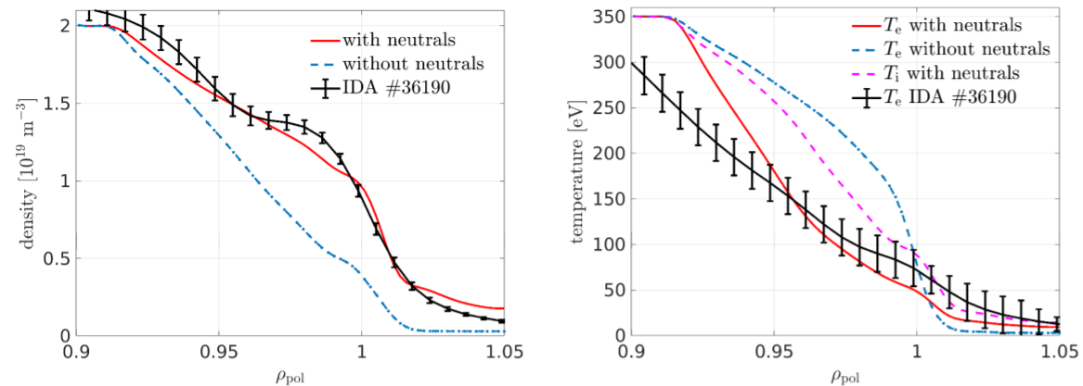
A better match thanks to neutrals
  Even in low-density attached conditions and with coarse neutrals model, neutrals improve comparison with experiments
  Refined fluid neutrals model being implemented in collaboration with TSVV5 to open high-recycling regimes
[Zholobenko, NF 2021]

Slide 13
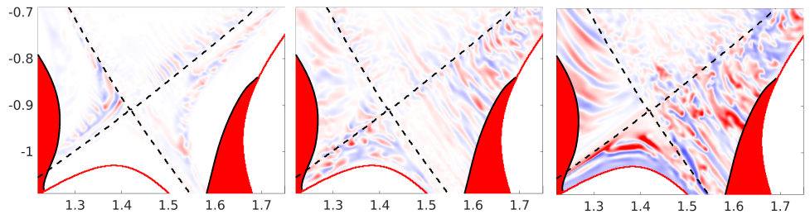
Neutrals impact on turbulence
  Divertor neutral density scans exhibits experimental trends on turbulence properties:
    Larger turbulence structures with faster radial propagation
Increasing divertor neutrals density / collisionality
[Zholobenko, PSI 2022]

Slide 14
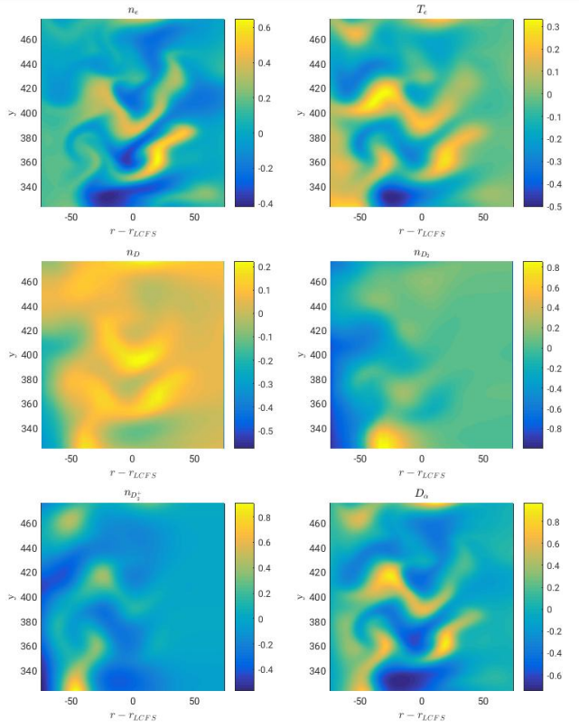
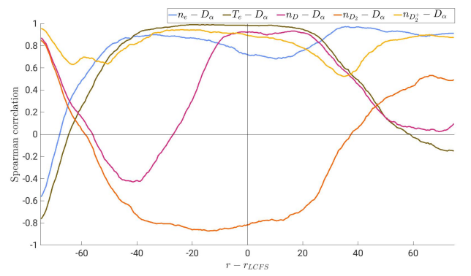


Kinetic neutrals become a reality - GBS
  GP imaging analyzed in GBS simulation with kinetic neutrals
    Excellent correlation between n_{e}, T_{e} and D_{α} except in far SOL and core
$$n_{e}$$
$$D_{α}$$
[Coroado, submitted to PoP; pinboard id: 30771]

Slide 15
Kinetic neutrals become a reality – SOLEDGE3X
  SOLEDGE3X coupled to full ITER-relevant Kotov kinetic neutrals model and compared to SOLPS results up to detachment on ITER PFPO-1 cases
    Many lessons learnt in terms of numerical scheme robustness in stiff cases
    Extension to 3D now straight forward an on-going
SOLPS
SOLEDGE3X

Slide 16
WPTE experiment proposal
Proposal at last WPTE call: Plasma-molecular interactions for divertor detachment in low-field discharges (https://wiki.euro-fusion.org/wiki/MARdetachment_lowfield)
  Combined TCV / WEST proposal with modelling support from TSVV3 codes (GBS and SOLEDGE3X for the moment, GRILLIX to join soon) – PI: Davide Mancini
  Objectives: 1- analyse impact of density regimes on turbulent transport
    2- database for turbulence codes validation in high density regimes (~TCV-X21)
[Oliveira, Body et al., NF 2022]

Slide 17
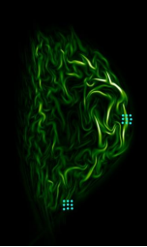
Facilitating comparison with experiments
Action started to port I/O of codes to IMAS
  Decision to do it via wrappers (e.g, Python) not internally
  Step 1: commonly agreed definition of needs in terms of data input / output - done
  Step 2: identify need or not for new IDSs (existing incomplete “edge turbulence” IDS) – on-going
Progress on synthetic diagnostics
  Standard for embedded Langmuir probes synthetic diagnostics defined and being implemented
  Coupling to standard libraries (e.g. CHERAB) through IMAS
Langmuir probes in FELTOR (illustration)

Slide 18
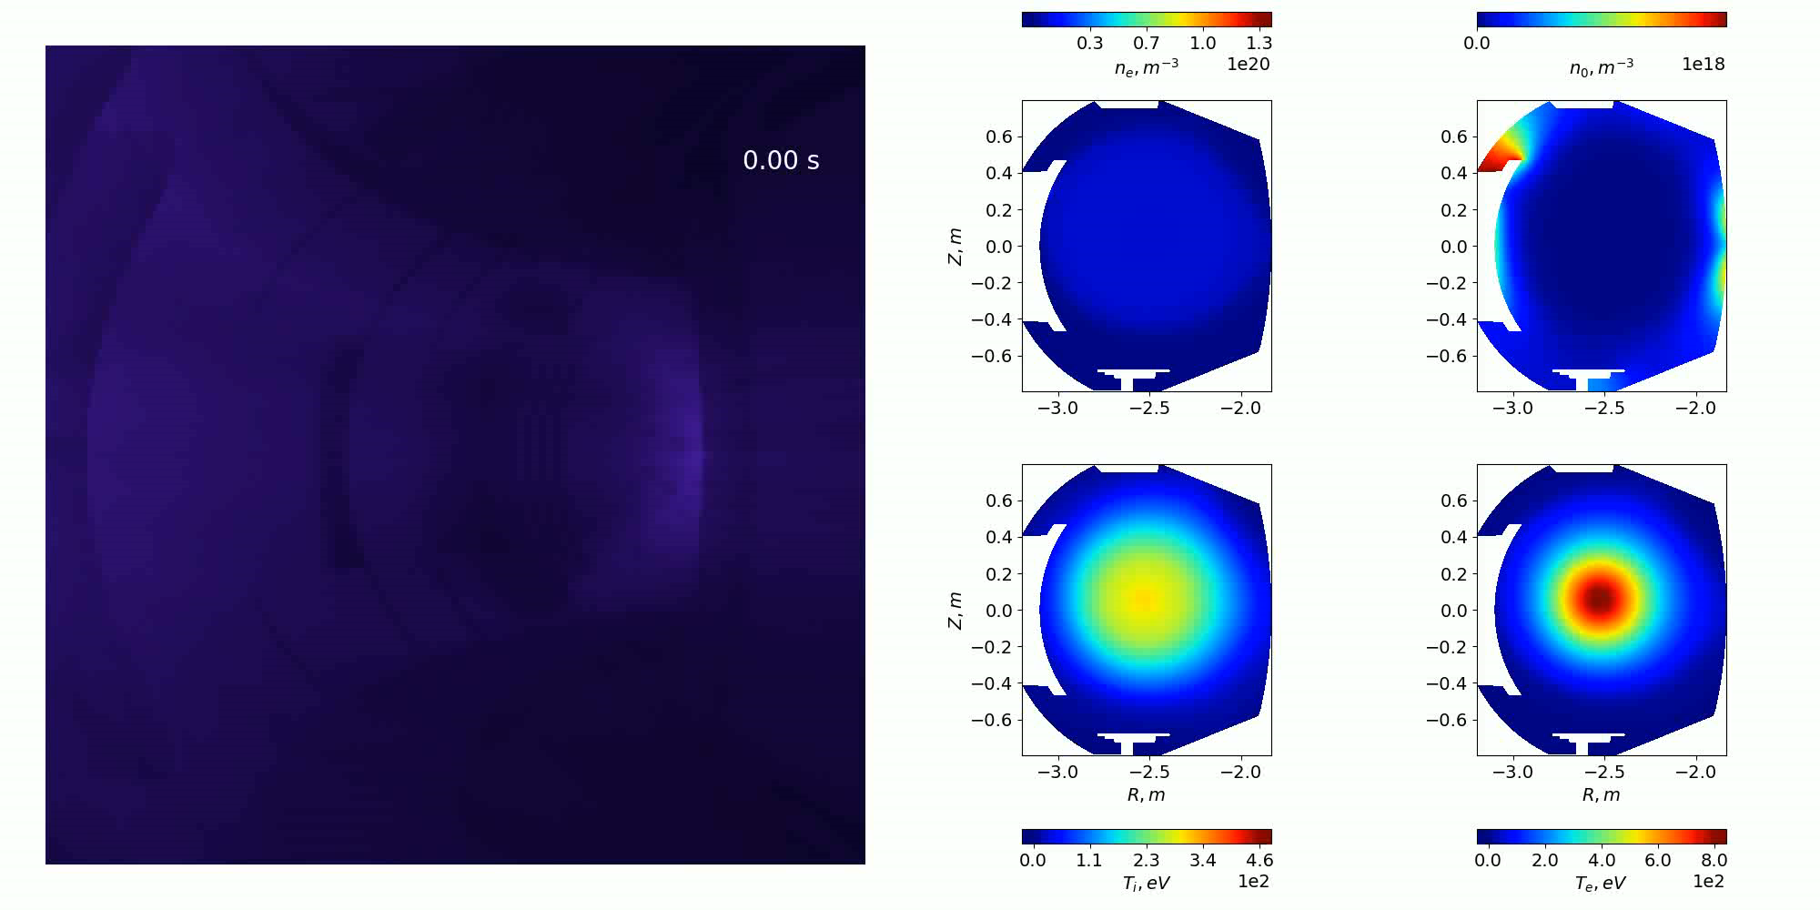
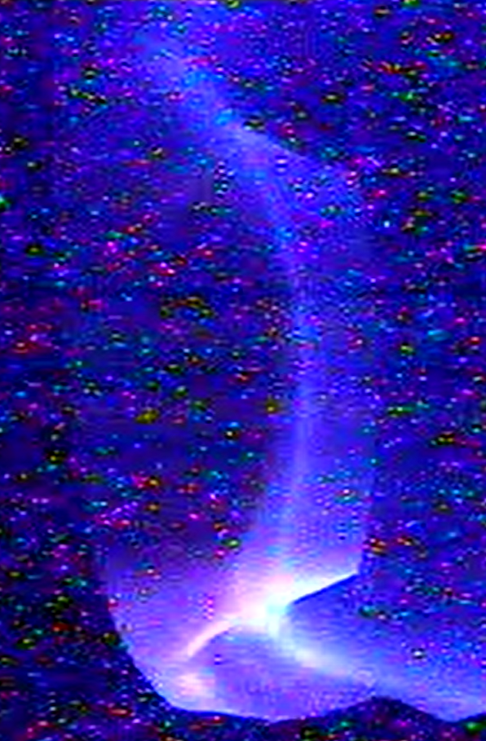
A first application: WEST visible camera
WEST pulse
© SOLEDGE-HDG
[Courtesy A. Medvedeva, M2P2 laboratory]

Slide 19
Providing codes to the community
TSVV3 codes accessible to Gateway users
  EBC: https://gitlab.eufus.psnc.pl/tsvv3/ebc
  GBS: https://gitlab.eufus.psnc.pl/gbs/gbs-mirror
  SOLEDGE3X: https://gitlab.eufus.psnc.pl/tsvv3/soledge3x
  GRILLIX and FELTOR: up-coming soon (FELTOR already @ https://github.com/feltor-dev/feltor)
Full documentation soon available for each code
Progressive deployment of modern development methods to ensure quality of delivered tool

Slide 20
Conclusion
Progress of edge fluid codes hierarchy along several fronts :
  2D mean-field codes: key features of turbulence physics captured by reduced turbulence model at negligible cost
  Turbulence codes:
    integration of neutrals and multi-species physics
    realistic magnetic geometry now available in all codes
    realistic wall geometry partly available but no silver bullet yet (stability, cost…)
    code performances progressing steadily
Tools developed and available to ease code usage and comparison with experiments
Codes coming to maturity for comparison with experiments
  most WPTE machines accessible at full scale (COMPASS, TCV, ASDEX)
  WPTE proposal similar to TCVX21 experiment to benchmark progress against high density regime discharges

Slide 21
Additional slides

Slide 22
Key achievements since last meeting
New physics available in edge turbulence codes: neutrals physics, impurities
  Relevant regimes for reactors, showed to improve comparison with experiments
Theoretical developments: gyro-fluid models, collisional sheath boundary conditions
  Progressive implementation in numerical tools started
Intermediate step in hierarchy of transport models: RANS turbulence models
  Available in common transport codes, first results of confrontation to experiments
Numerical optimization towards ITER scale simulations in collaboration with ACHs
  Profiling performed and recommendation made, solutions proposed to common bottlenecks
  ITER scale simulations attempted
Novel approaches to handle geometry: immersed BCs, curvilinear coordinates, HDG
  Demonstrated capability to handle realistic magnetic geometries including stellarator
Development of tools to ease cross-code and code-experiments comparisons
  synthetic diagnostics, definition of IMAS IDSs for edge turbulence on-going
Adoption of modern collaborative development methods
  publically accessible repos., CI in place => ready for porting on gateway when infrastructure ready

Slide 23
Progress in gyro-fluid models
Successfully derived and published full-F gyro-fluid conservation-of-currents equation including comparison to drift-fluid model :
  R. Gerru et al “Conservation of currents in reduced full-F electromagnetic kinetic and ﬂuid models” PPCF (2022) Accepted manuscript: https://doi.org/10.1088/1361-6587/ac55f6
Derivation of systematic method to transpose fluid-drift equation into gyro-fluid framework
  Fundamental step towards integrating collisional terms and neutrals physics in gyro-fluid models
  Provides closure “as good as” existing fluid closures (~Zhdanov) for gyro-fluid models

Slide 24
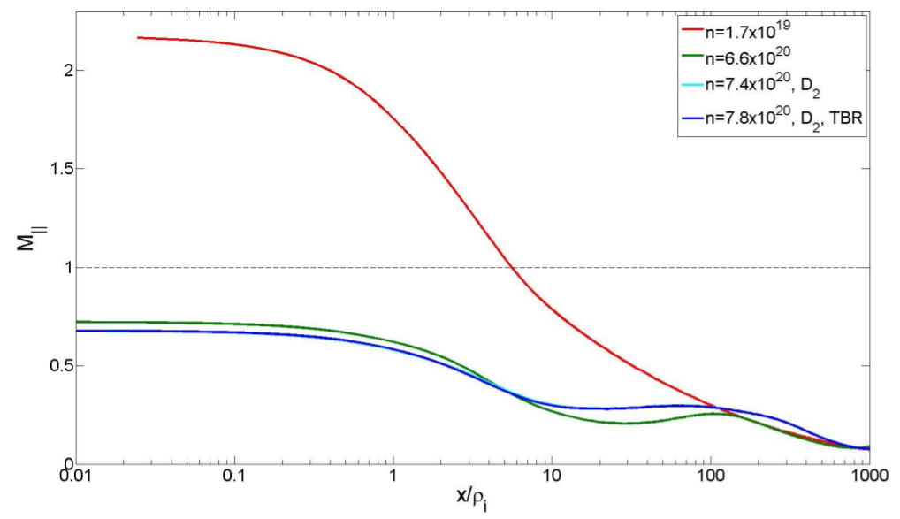
Bohm BCs invalid at high collisionality
  Kinetic SOL simulations in ITER conditions with BIT1 code: plasma subsonic up to the wall at high colisionality = violation of Bohm BCs
    due to collisions (e-i and n-i)
[Tskhakaya, EPS 2021]

Slide 25
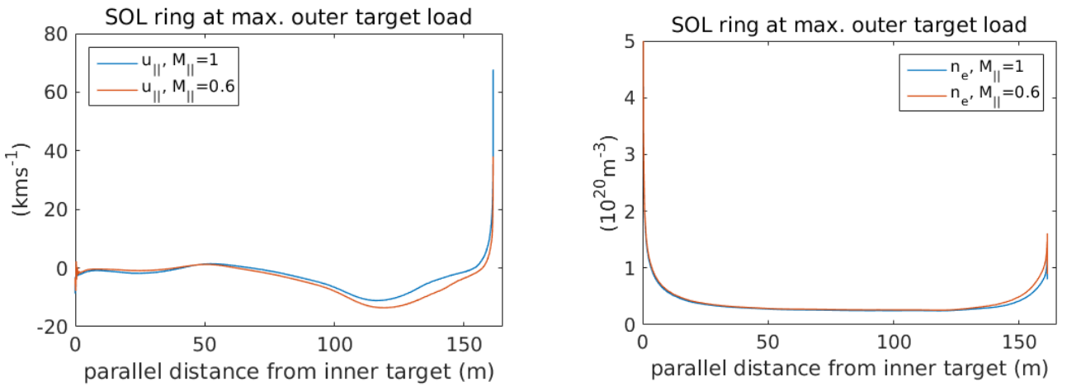


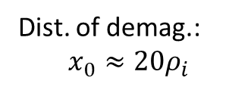

Revised model for BC tested in SOLPS
$$α=V_{∥}^{D}/V_{∥}^{D+}$$
  Analytical model fits well PIC data:
$$χ=\frac{\left(ν_{mt}\left(1−α\right)+ν_{ei}\right)x_{0}}{2c_{s}\sin{θ}}$$
Dist. of demag.:
$$x_{0}≈20ρ_{i}$$
$$M_{∥}=1+χ−\sqrt{χ^{2}+2χ}$$
[Tskhakaya, EPS 2021;
D. Moulton, ISFN 09/2021]
Ion-atom momentum transfer frequency
Incidence angle
  First application in SOLPS => 60% difference in target density, likely to impact divertor regimes
  Generalization to multi-species plasmas on-going

Slide 26
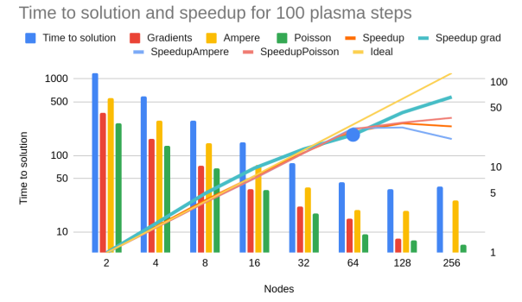
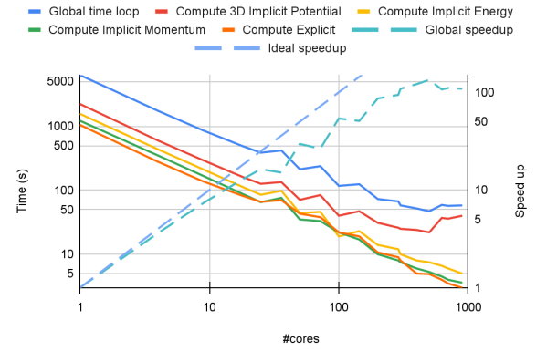
Codes performance optimization
Strong collaboration with ACH focusing on:
  Implicit solvers optimization (common botteleneck) => HYPRE as attractive option (good perf., hybrid paralleization, GPU version (AMGX))
  Codes profiling completed, started implementing recommendations => essentially porting to GPU, but also load balance optimizations…
[https://wiki.euro-fusion.org/images/9/9f/Report_2021_TSVV3_ACH_EPFL_Task4_code_optimization.pdf]
GBS scaling report
SOLEDGE3X scaling report

Slide 27
Zhdanov closure in SOLEDGE3X
  Limits of Braginskii closure: close to unit mass and density ratios
    Not applicable to D-T plasmas among others
  Zhdanov closure implemented in SOLEDGE3X and applied to JET D-T-Ne disharges
    D/T far from uniform with possible implications for exhaust
[Bufferand, PPCF, in press, https://doi.org/10.1088/1361-6587/ac4fac]

Slide 28
Beyond the Zhdanov closure
  Several limitations to Zhdanov’s closure: single ion temperature, small departure from mass-average flow velocity
  On-going theoretical developments to go beyond these limitations
    Practically implementable generalization of Zhdanov’s closure
    On-going implementation in FELTOR, GRILLIX and SOLEDGE3X
[Raghunathan, PPCF, in press, https://doi.org/10.1088/1361-6587/ac414d]

