Slide 1
Kick-off meeting SP X2 Optimization of laser-based surface analysis diagnostics
Hennie van der Meiden

Slide 2
SP X.2: Optimization of laser-based surface analysis diagnostics
Announcements
Accelerator DIFFER operational
Magnum-PSI due to helium delivery problems probably operational in August/September (in-situ LIBS (2021 and 2022) still to be done)
PSI-2 operational?
Samples: DIFFER received from Matteo (amorphous WO(15%)) and Eduard (W on Mo) samples. 12 in total for LIBS sessions only
Update LIBS in JET? (after this presentation)
Notes:
Facilties: JUST GIVE the integral numbers for the groups
PD: Plasma devices (MAGNUM, PSI-2, UPP, TOMAS, GyM)
HHF: JUDITH, GLADIS, QSPA, OLMAT
Analysis station: Ion beam
If Facilties, Modelling, Link not applicable, remove the lines. I assume that it is EITHER EXPERIMENT or MODELLING, thus 1 more line for TASKS or Deliveables.

Slide 3
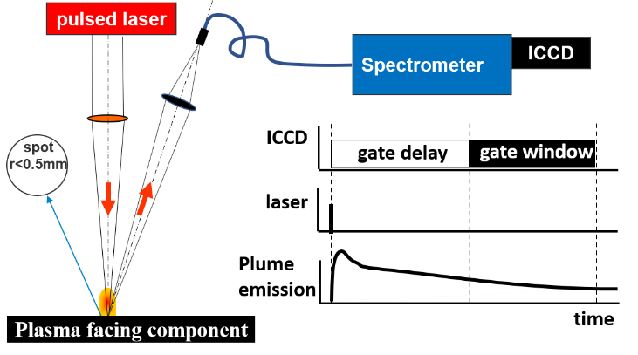
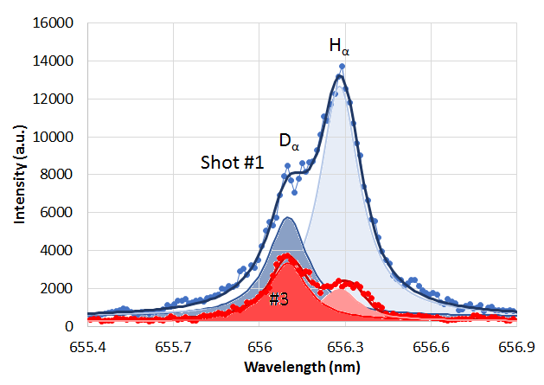
SP X.2: Optimization of laser-based surface analysis diagnostics
Where do we stand with LIBS development?
D-retention monitoring, with CF-LIBS is accurate up to 100 mbar air.
>100 mbar: line distinguishability is difficult. - Better adjustment of detection delay (gate window) is beneficial
- DP-LIBS shows good potential for improving line distinguishability
Helium detection by LIBS is still a problem, higher Te plume required…but is this feasible?
AUG
challenge: line separation
Notes:
Facilties: JUST GIVE the integral numbers for the groups
PD: Plasma devices (MAGNUM, PSI-2, UPP, TOMAS, GyM)
HHF: JUDITH, GLADIS, QSPA, OLMAT
Analysis station: Ion beam
If Facilties, Modelling, Link not applicable, remove the lines. I assume that it is EITHER EXPERIMENT or MODELLING, thus 1 more line for TASKS or Deliveables.

Slide 4
SP X.2: Optimization of laser-based surface analysis diagnostics
Main tasks for this year 2022:
Optimized conditions for LIBS in absolute content and depth resolution at pressures up to 1 bar air
Absolute quantification of D and composition in Be-mixed layers (with depth resolution)
Influence of T_{surface} and impurities (seeding products) on absolute fuel retention and outgassing values
Obtain CF-LIBS results for DP-LIBS
Improve analysis (machine learning)
Notes:
Facilties: JUST GIVE the integral numbers for the groups
PD: Plasma devices (MAGNUM, PSI-2, UPP, TOMAS, GyM)
HHF: JUDITH, GLADIS, QSPA, OLMAT
Analysis station: Ion beam
If Facilties, Modelling, Link not applicable, remove the lines. I assume that it is EITHER EXPERIMENT or MODELLING, thus 1 more line for TASKS or Deliveables.

Slide 5
SP X.2: Deliverables 2022
Deliverable ID | Deliverable Title
D001, D005, D011, D015, D020 | Comparison of ps vs. ns LIBS: absolute content and composition
D002, D006 | Comparison SP vs. DP LIBS, or alternative LIBS signal enhancement methods: absolute fuel content in W samples and composition
D003, D007, D012, D016, D021 | (CF)-LIBS (ps/ns or SP/DP) on samples from different toroidal devices: absolute content and composition (in depth)
D010 | Report on LIBS analysis by application of machine learning algorithm
D013, D017 | Analysis of Be containing coatings with (CF)-LIBS: absolute content and composition
D004, D008, D018 | (CF)-LIBS results He loaded samples and surface modifications
D009, D014, D019, D022 | Reference measurements of outgassing, recycling, and retention after D plasma loading: absolute content and composition in W and reference samples
Notes:
Facilties: JUST GIVE the integral numbers for the groups
PD: Plasma devices (MAGNUM, PSI-2, UPP, TOMAS, GyM)
HHF: JUDITH, GLADIS, QSPA, OLMAT
Analysis station: Ion beam
If Facilties, Modelling, Link not applicable, remove the lines. I assume that it is EITHER EXPERIMENT or MODELLING, thus 1 more line for TASKS or Deliveables.

Slide 6
Short update LIBS in JET
Do you have the resources to do both SP X2 tasks and activities for LIBS in JET?
Notes:
Facilties: JUST GIVE the integral numbers for the groups
PD: Plasma devices (MAGNUM, PSI-2, UPP, TOMAS, GyM)
HHF: JUDITH, GLADIS, QSPA, OLMAT
Analysis station: Ion beam
If Facilties, Modelling, Link not applicable, remove the lines. I assume that it is EITHER EXPERIMENT or MODELLING, thus 1 more line for TASKS or Deliveables.

