Slide 1
WP PWIE SP X2 Kick-off meeting May 25 2022
G. Sergienko, E. Wüst, R. Yi
FZJ

Slide 2
FZJ tasks for 2022
Investigate erosion/deposition/fuel retention (including He) by in situ (CF)-LIBS and NRA/RBS in MAGNUM, LIBS, LAMIS, and LIA-QMS/EDX in PSI-2 with subjects of interest: outgassing, recycling, and role of impurities (O, N), Tsurface, and implantation energy on retention (DIFFER, FZJ, UT), LAMIS qualification for W7-X application (FZJ)
Comparison ps vs. ns LIBS regarding absolute composition and D content in reference and ITER-relevant coatings which can include impurities (FZJ, CU, UT, ISSPUL, CEA)
Comparison Single Pulse vs. Double Pulse LIBS (or alternative LIBS signal enhancement methods) regarding absolute material composition and D content in ITER- and DEMO-relevant W including self-damage W and reference coatings. (FZJ, ENEA, CEA)
(CF-) LIBS (ps, ns SP or DP) on samples (if available) from different devices (tokamaks or W-7X) (collab. SP B) (ISSP UL, CU, UT, VTT, FZJ, ENEA)
CF-LIBS on produced reference samples before and after He loading (FZJ, CU, UT, ENEA)

Slide 3
Outgoing activity
ns-laser (Innolas) has been repaired and reinstall on PSI-2 laser lab but need modification of solenoid control valve for cooling water.
New vacuum chamber for LIBS is under installation in the PSI-2 laser lab.
Optical setup for ns-LIBS in air was installed in the beam line of PSI-2 LIBS system.
New high repetition ps-laser YLPP-25-3-50-R (1030nm, 50kHz-2MHz, pulse duration 2 ps, pulse energy < 35μJ) from IPG photonics was installed in LIBS lab. First measurements were performed.
2D-scanner for IPG laser is under installation and will be ready at June for LIBS measurements in air
Double-Pulse Laser ablation molecular isotopic spectroscopy (LAMIS) of W-7X divertor fingers

Slide 4
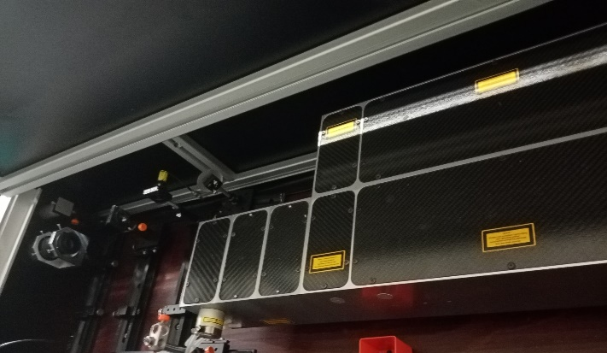
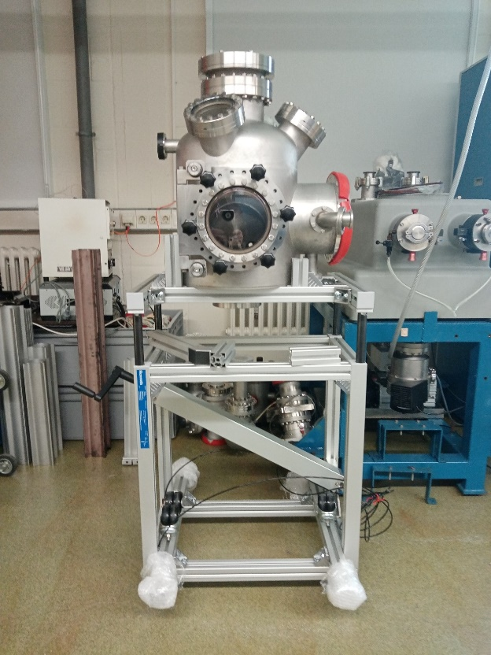
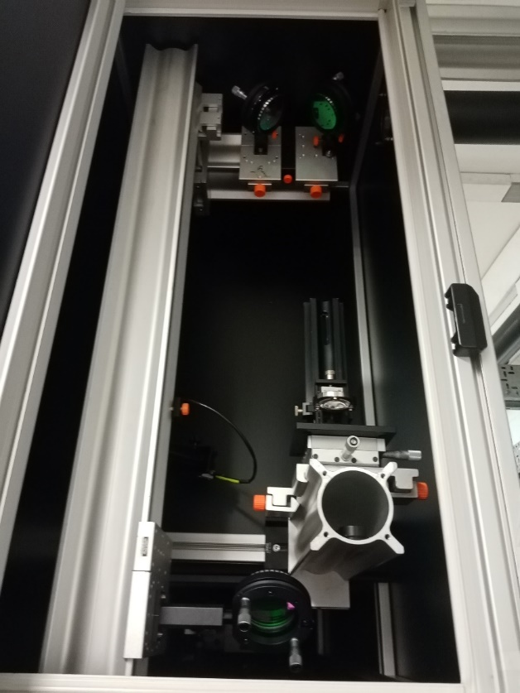
Preparation of ns-LIBS on PSI-2
SpitLight2000 laser
Vacuum chamber
ns-LIBS in air
b
a
near field
far field
c
Laser was repaired and re-adjusted but has problem with a solenoid control valve (it make very loud noise due to hydraulic shocks).The problem is under investigation.
The camera will be combined with McPherson 225 / McPherson 235 spectrometers and will utilize Innolas SpitLight2000 Nd:YAG laser
Focusing lens
Observation mirror optics
Sample XY holder

Slide 5
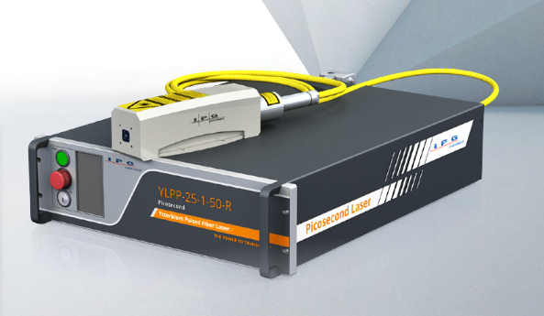
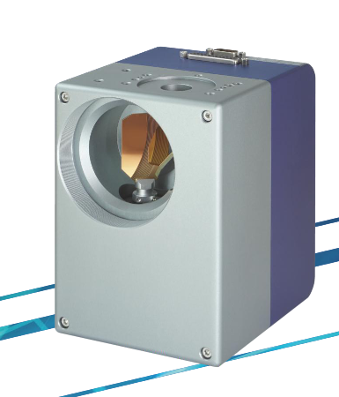
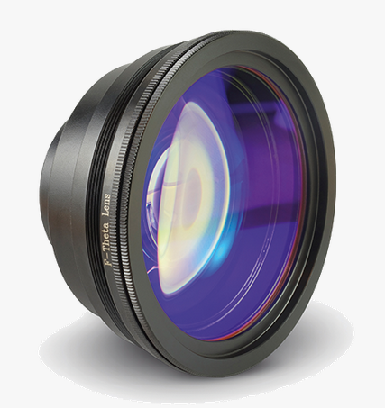
Preparation of high repetition ps-LIBS in LIBS lab
2-Axis Galvo Scan Head
INNOSCAN2-20D-1064
ps-laser model YLPP-25-3-50-R
IPG photonics
Innotech Laser GmbH
λ=1030nm
τ=2ps
f=50kHz-2MHz
E=25-35μJ
F-Theta lens f=500mm D20mm
SH-1064-360-500-20-FS
High repetition ps-laser YLPP-25-3-50-R
Beam expander x10
2-Axis Galvo Scan Head INNOSCAN2-20D-1064
F-Theta lens f=500mm D20mm SH-1064-360-500-20-FS
E1803D All-In-One Scanner Controller (HALaser Systems)

Slide 6
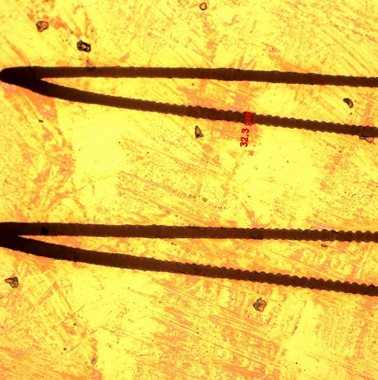
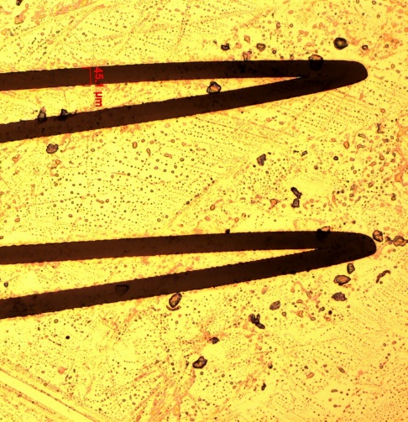
Initial test of fast scanning ps-LIBS
Compact spectrometer measurement
Fe
Al
W
ps-laser
Scanning system
Spectrometer
XYZ stage
exposure time 200ms (10⁴ laser pulses)
F=80 mm
Beam expander
Fe
Laser energy：31 μJ Laser frequency：50k Hz
Mechelle5000
Cu
32.3 μm
45.1 μm
Ablation crater’s diameter ~ 30 - 50 μm
Ablation rate ~ 11.25 nm/pulse
Scan 1
Scan 10
100 μm

Slide 7
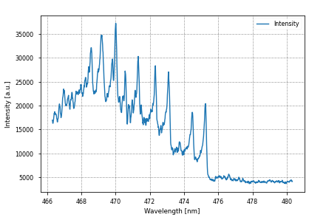
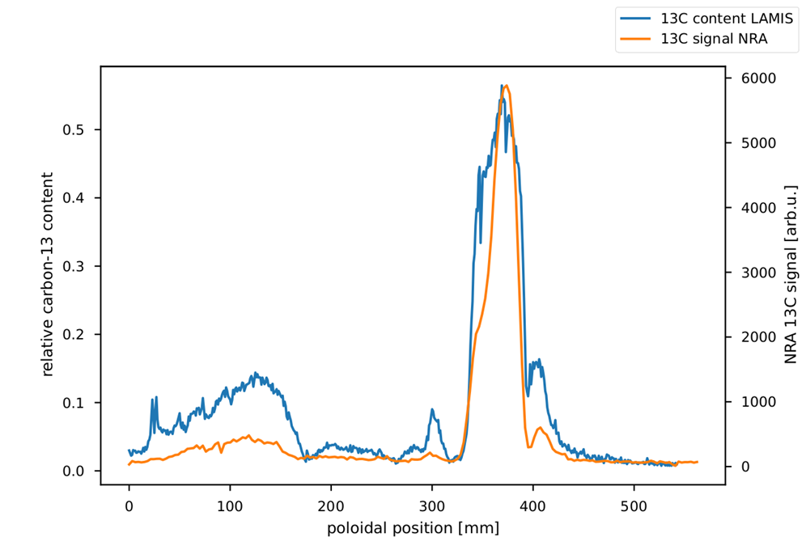
Double-Pulse Laser ablation molecular isotopic spectroscopy (LAMIS)
¹³C¹²C
¹²C₂
¹³C₂
C₂ molecule Swan bands with ∆v=1. Relative intensities give 84% fraction of ¹³C
LAMIS results of near injection (d~223 mm) vs. NRA results of same divertor finger. LAMIS data set shows ¹³C fraction in topmost 400 nm
Double-Pulse Laser ablation molecular isotopic spectroscopy (LAMIS) was set up (ps-laser)
TDU from end of OP1.2b are being analysed for carbon 13 distribution after injection of isotopically marked gas into plasma
First results from divertor finger near injection show same qualitative characteristics as results from nuclear reaction analysis (NRA) of same finger
Further divertor fingers are being analysed; including the one right next to the injection
Simulation of gas injection with ERO2.0 will be compared with these measurements

