Slide 1
WP PWIE SP X.2 KoM
Comenius University Bratislava
A. Marín Roldán, P. Veis
M. Veis, M. Držík, S. Atikukke, S. Soni, O.S. Tripathi

Slide 2
TASKS TO BE PERFORMED IN 2022
Comparison ps vs. ns LIBS regarding absolute composition and D content in reference and ITER-relevant coatings which can include impurities (FZJ, CU, UT, ISSPUL, CEA) → planned measurements on non Be-containing samples using Vacuum UV-NIR LIBS and resonant LIBS (RLIBS) with tunable ns OPO laser
(CF-) LIBS (ps, ns SP or DP) on samples (if available) from different devices (tokamaks or W-7X) (collab. SP B) (ISSP UL, CU, UT, VTT, FZJ, ENEA) → 3x JET samples
(CF-)LIBS on Be containing coatings with different type of fuel content (VTT, UT, CU) → 8x Be-containing samples
CF-LIBS on produced reference samples before and after He loading (FZJ, CU, UT, ENEA) → He observed at low pressures
Be-containing samples campaign at VTT during 12-20th May 2022

Slide 3
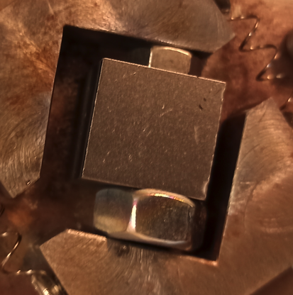
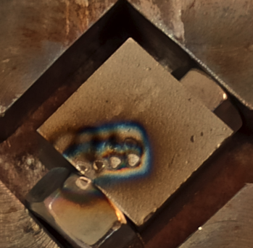
Preliminary results
We measure for the very first time JET samples, observing a good agreement with SIMS results.
SIMS
LIBS

Slide 4
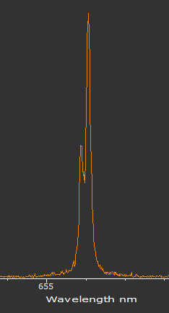
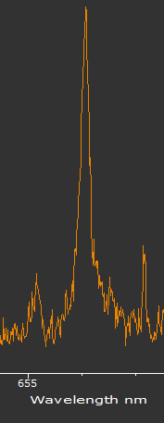
Preliminary results
We observe D in ALL samples, but better resolved at 2 mbar than at 100 mbar.
D @656.1 nm, 100mbar
D @656.1 nm, 2mbar

Slide 5
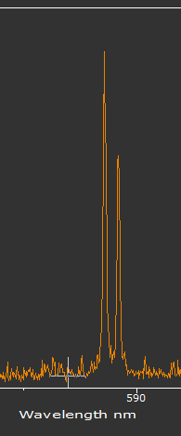
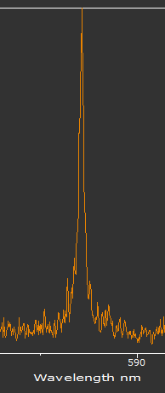
Preliminary results
We observe He in He-loaded samples:
Up to 4 mbar for 2.5 at.% He
Up to 20 mbar for 5 at.% He
In non-He loaded samples, we observed Na impurity
He @587 nm, 2mbar

