Slide 1
Advanced spatially hybrid fluid-kinetic modelling of plasma-edge neutrals
application to ITER cases using SOLPS-ITER
Wim Van Uytven, W. Dekeyser, M. Blommaert, N. Horsten and M. Baelmans
24/6/2022

Slide 2
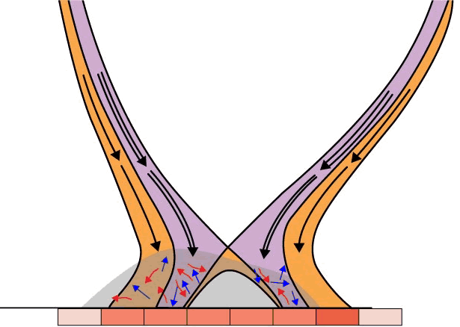
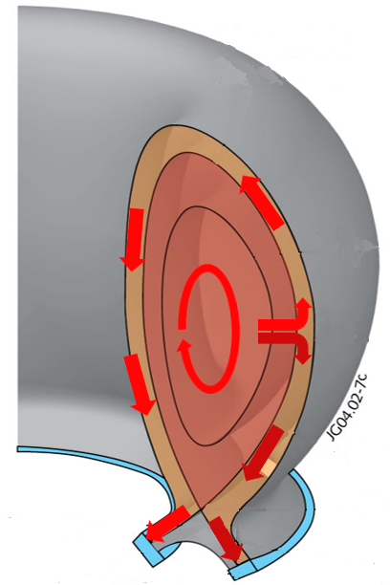
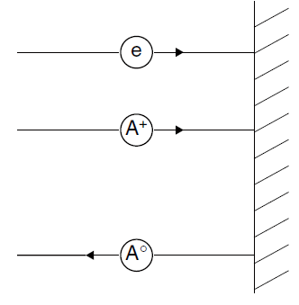
Scope: accurate & efficient neutral modelling
Plasma
(macro-scale
transport)
Neutrals (micro-scale transport)
Electron
Ion
Neutral

Slide 3
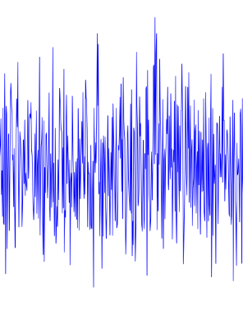
Simulation strategies for neutrals
plasma fluid
finite volumes
B2.5
kinetic neutrals
Monte Carlo
EIRENE
accurate
many different reactions/processes
expensive for dominant CX (CPUt = f(coll))
statistical noise
plasma fluid
finite volumes
B2.5
fluid neutrals
finite volumes
B2.5
faster
no statistical noise
limited reactions (no molecules in B2.5)
validity = f(coll.)
→ best of both worlds through hybrid fluid-kinetic methods?
Notes:
+ interessant voor optimalisatie, transient, …

Slide 4
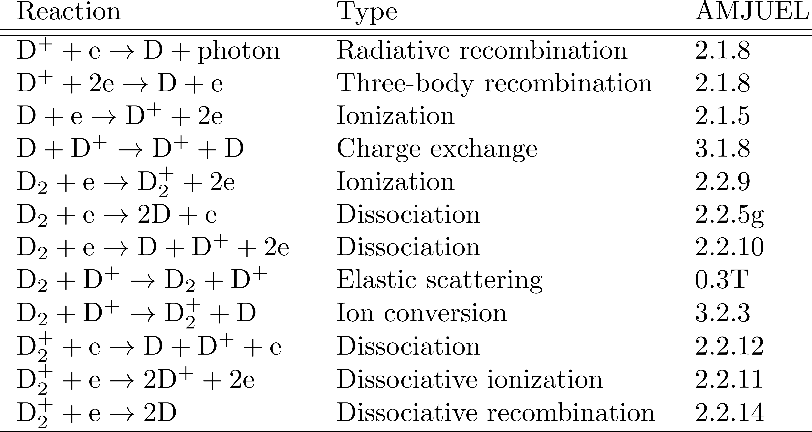
Atomic and molecular reactions
Neutral atoms
Neutral molecules
Molecular ions
For now: no atom-atom, atom-molecule or molecule-molecule reactions → linear transport problem

Slide 5
Advanced fluid neutral models (atoms only)
Continuity, parallel momentum, and energy equation
Transport coefficients: closure based on dominant CX
BCs based on moments of velocity distribution after TRIM recycling + reflection
[Horsten, N., PhD Thesis, 2019] → development in in-house code
[Blommaert, M. et. al (2018). CtPP] → implementation in SOLPS-ITER + benchmark with EIRENE (slab case)
[Van Uytven W. et al (2020). CtPP] → separate T_{n} + full consistency plasma-neutral coupling in SOLPS-ITER (slab case)
[Van Uytven W. et al (2022). NF] → implementation in extended grids SOLPS-ITER + benchmark ITER cases

Slide 6
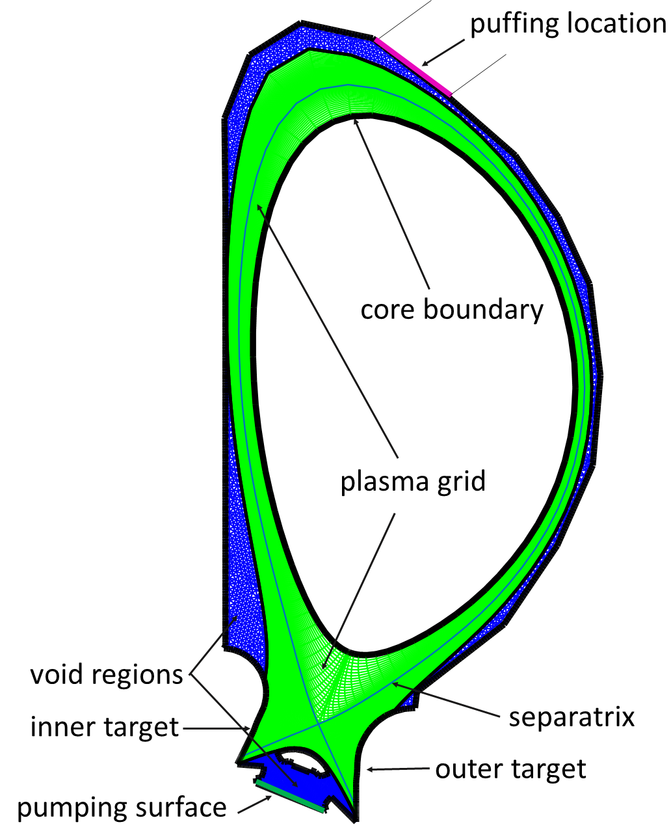
Grids: ITER with voids

Slide 7
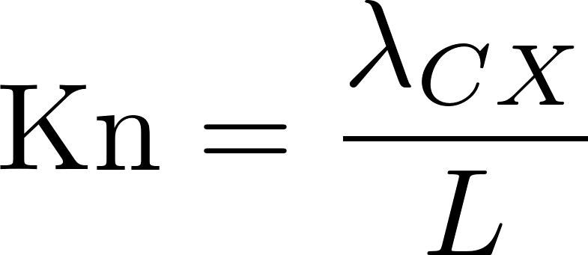
Knudsen number
average CX mean-free path of neutral atoms
macroscopic length scale of the problem
Rules of thumb:
Kn < 0.01 strict validity fluid approach
0.01 < Kn < 0.1 good validity fluid approach
0.1 < Kn < 1 transition to kinetic
Kn > 1 strong kinetic effects
Kn > 10 fully kinetic
Notes:
Omdat anders: additional possible cause of convergence issues in the presence of MV noise, very sensitive to what you take
4 orders of magnitude!

Slide 8
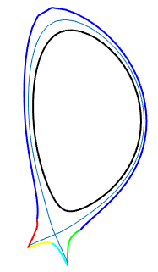
Results AFN: ITER Be-Be (n_{i,c} = 6∙10¹⁹ m⁻³)
Fluid only, no voids
Plasma coupled to kinetic Monte Carlo neutrals (EIRENE)
Plasma coupled to advanced fluid neutrals
Beryllium

Slide 9
Results AFN: ITER W-Be (n_{i,c} = 4∙10¹⁹ m⁻³)
Fluid only, no voids
Plasma coupled to kinetic Monte Carlo neutrals (EIRENE)
Plasma coupled to advanced fluid neutrals
Tungsten
Notes:
Poorer agreement: higher knudsen numbers, highter temperatures: more fast reflection: less 2ev molecules

Slide 10
Shortcomings atom-only fully fluid
Coupling with void regions
No accurate fluid description for molecules
Fluid models not valid in entire divertor / SOL
Spatially hybrid modelling

Slide 11
Hybrid fluid-kinetic modeling: different flavours
Micro-marco (mM)
  N. Horsten, et al., CtPP 2020, 60 (5-6), e201900132
  N. Horsten, et al., JCP 409 2020: 109308.
Spatially hybrid (SpH)
  M. Blommaert, et al., NME 2019, 19, 28–33.
  N. Horsten, et al., NME 2021, 27, 100969.
Condensation-evaporation
  M. Valentinuzzi, et al., NME 2019, 18, 41–45.
(Multi-Level) Kinetic-diffusion Monte Carlo ((ML-)KDMC)
  B. Mortier, et al. arXiv 2020 preprint arXiv:2012.08985.
  B. Mortier, et al. JCP 2021: 110736.
This work
Notes:
Wat hier mondeling vertellen?

Slide 12
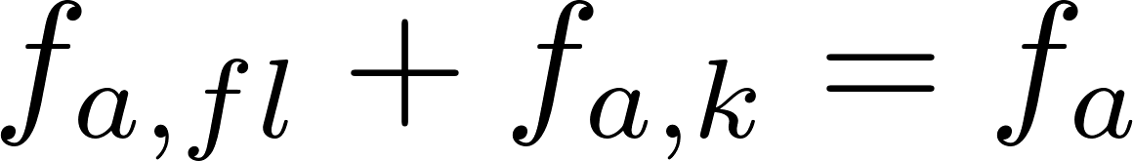
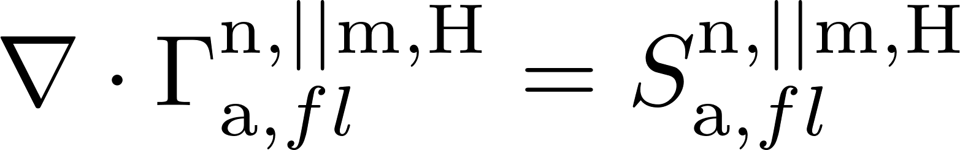
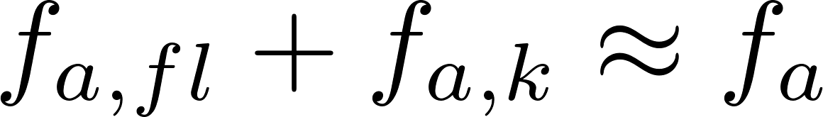
Spatially hybrid: general
Split equation in fluid and kinetic part
If
+
then
We may need/want fluid and kinetic parts to communicate
+
Apply fluid closure for fluid part
Notes:
Split-up is based on sources. Fluid and kinetic co-exist in the domain.

Slide 13
Shortcomings atom-only fully fluid
Coupling with void regions
No accurate fluid description for molecules
Fluid models not valid in entire divertor / SOL

Slide 14
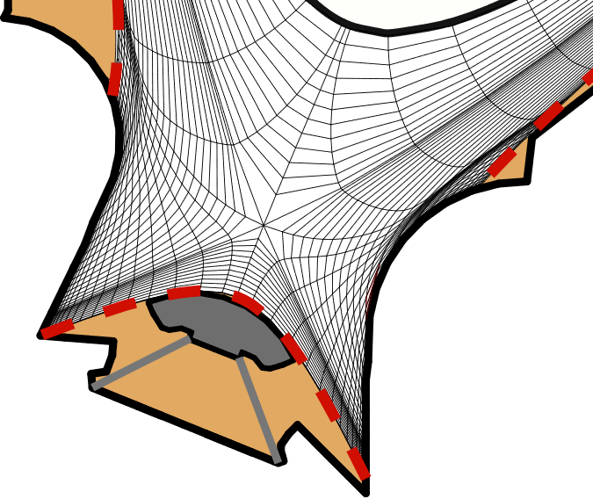

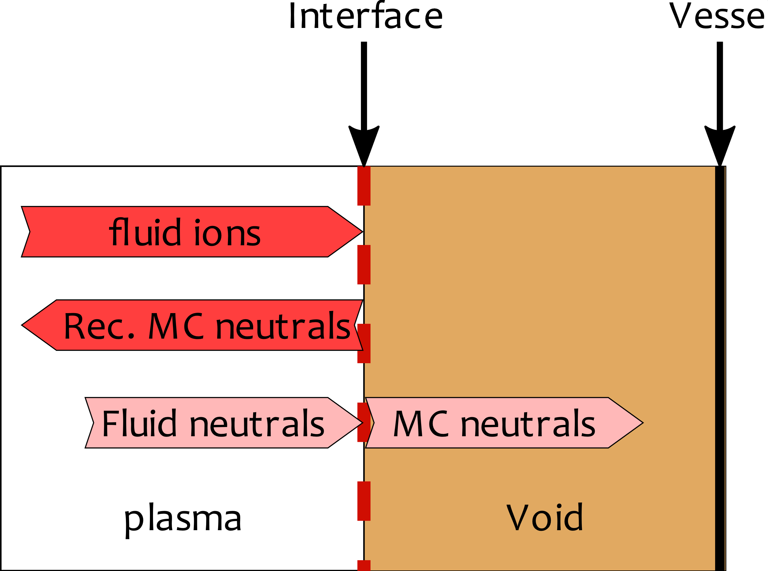

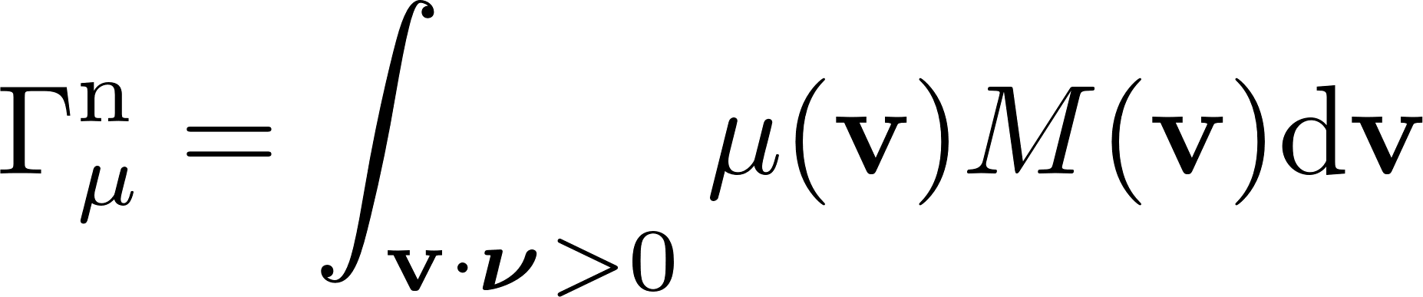
Spatially hybrid: plasma-void interface
Fluid ➔ kinetic
Surface source in EIRENE sampled from truncated Maxwellian fluid neutral distribution
interface
vessel
Kinetic neutrals are followed until ionization
Fluid neutral boundary condition
Moments of Maxwellian ➔ imposed fluxes
[M. Blommaert et al., PSI 2018]

Slide 15
Shortcomings atom-only fully fluid
Coupling with void regions
No accurate fluid description for molecules
Fluid models not valid in entire divertor / SOL

Slide 16
Inclusion of molecules
No validated fluid model for molecules exists at this point
Treat molecules fully kinetically
Focus on treatment of atoms from dissociation [N. Horsten et al., PSI 2020]
  everywhere fluid: higher speed-up, less accuracy
  everywhere kinetic: less speed-up, higher accuracy
Notes:
Niet de dominante CX botsing van de atomen

Slide 17
Shortcomings atom-only fully fluid
Coupling with void regions
No accurate fluid description for molecules
Fluid models not valid in entire divertor / SOL

Slide 18
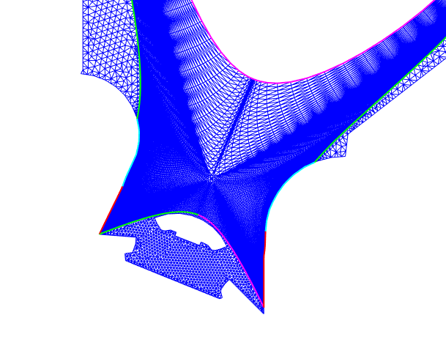
Generalized spatially hybrid
Kn. too high
fluid neutrals
kinetic neutrals
plasma
kinetic neutrals
Kn. OK
fluid neutrals
fluid neutrals
plasma
fluid neutrals
Notes:
Hier ga ik later op verder
Dit is toegestaan door lineariteit van de vergelijkkingen

Slide 19
Remaining issue spatially hybrid
Kinetic neutral atoms born from
  plasma-void interfaces
  dissociating molecules
  kinetic parts of targets
can still end up ondergoing a lot of collisons
→ ‘condense’ kinetic atoms in high CX regions to the fluid neutral population

Slide 20
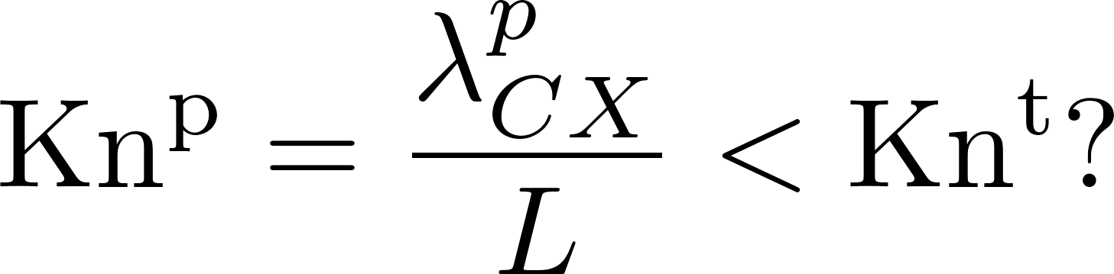
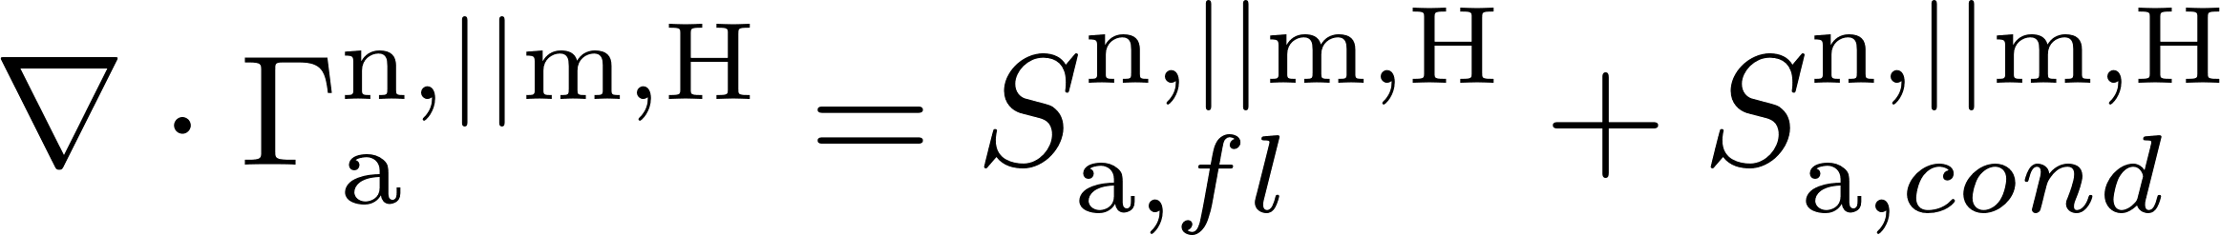

Kinetic→fluid condensation
Knudsen number of kinetic particle
user-def. transition threshold
After each CX reaction:
no
continue particle tracing
→ terminate EIRENE trajectory
→ transfer mass/mom/ene to fluid neutrals
yes
Fluid neutral fluxes
Condensing kinetic atoms
we now also create noise on fluid neutral population
Interaction plasma ↔ fluid neutrals

Slide 21







Spatially hybrid with kinetic→fluid condensation
plasma fluid
finite volumes
B2.5
$$Γ_{i,inc}^{}$$
$$S_{pl→a,fl}^{n,||m,H}$$
fluid neutrals
finite volumes
B2.5
$$S_{a→pl,fl}^{n,||m,H}$$
$$Γ_{i,inc}^{}$$
$$S_{a→pl,k}^{n,||m,H}$$
$$S_{a,cond}^{n,||m,H}$$
$$Γ_{a,inc}^{}$$
kinetic neutrals
Monte Carlo
EIRENE

Slide 22
Kinetic→fluid condensation
Investigate Kn^{t} on a broad scale: Kn^{t} = 0.1, 1, 10 and 100
Interpretation as first-flight model
  first few collisions are the ones where atom distribution still deviates most from plasma Maxwellian
  useful first-flight information still captured with Kn^{t} > Kn^{t,phys}

Slide 23
Inclusion of molecules
No validated fluid model for molecules exists at this point
Treat molecules fully kinetically
Focus on treatment of atoms from dissociation
  everywhere fluid: higher speed-up, less accuracy
  everywhere kinetic: less speed-up, higher accuracy
  now: launch everywhere kinetic, atoms will condense to fluid in high CX regions
Notes:
Niet de dominante CX botsing van de atomen

Slide 24
Variants for target BCs
HYB-1: fluid atoms, kinetic molecules
HYB-2: kinetic relaunch
ions & fluid neutrals
ions & fluid neutrals
B2.5
TRIM_{fl}
EIRENE
TRIM
fluid neutral atoms
kinetic neutral atoms
kinetic neutral molecules
kinetic neutral molecules
[N. Horsten et al. PSI 2020]
HYB-3: automated selection of fluid or kinetic approach
Kn > Kn^{b} ? → HYB-2
Kn < Kn^{b} ? → HYB-1
For now: Kn^{b} = 0.1

Slide 25
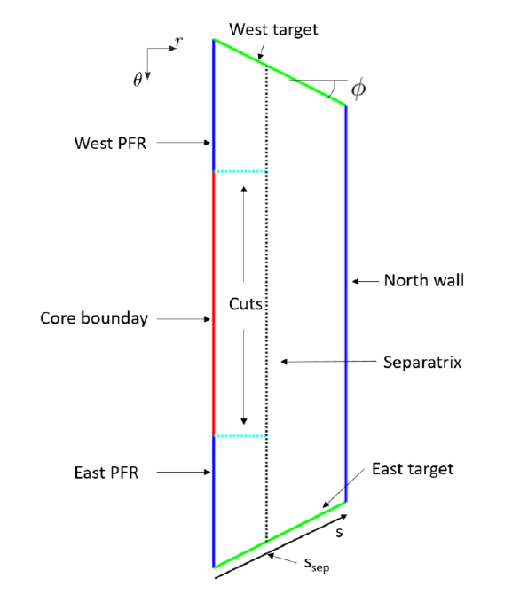
Results: trapezoidal slab case (incl. molecules)

Slide 26
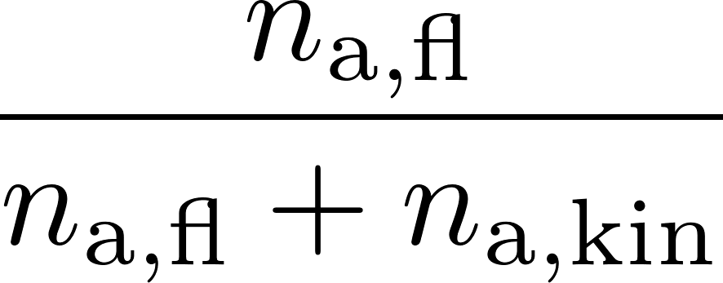
Fluid fraction trapezoidal slabs

Slide 27
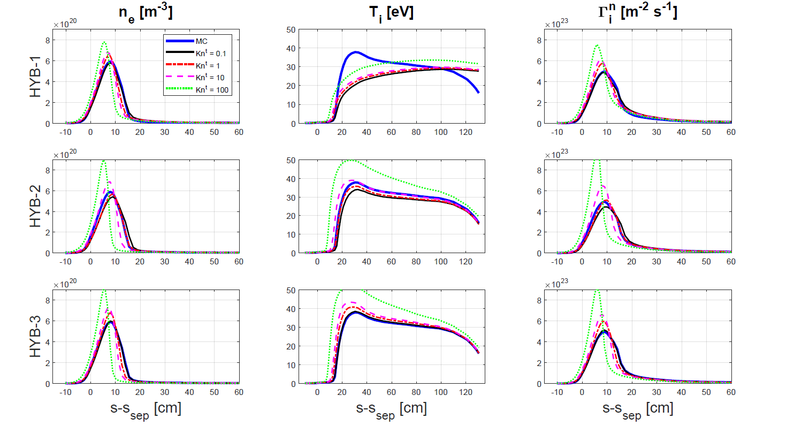
Results: ITER with voids (incl. molecules)

Slide 28
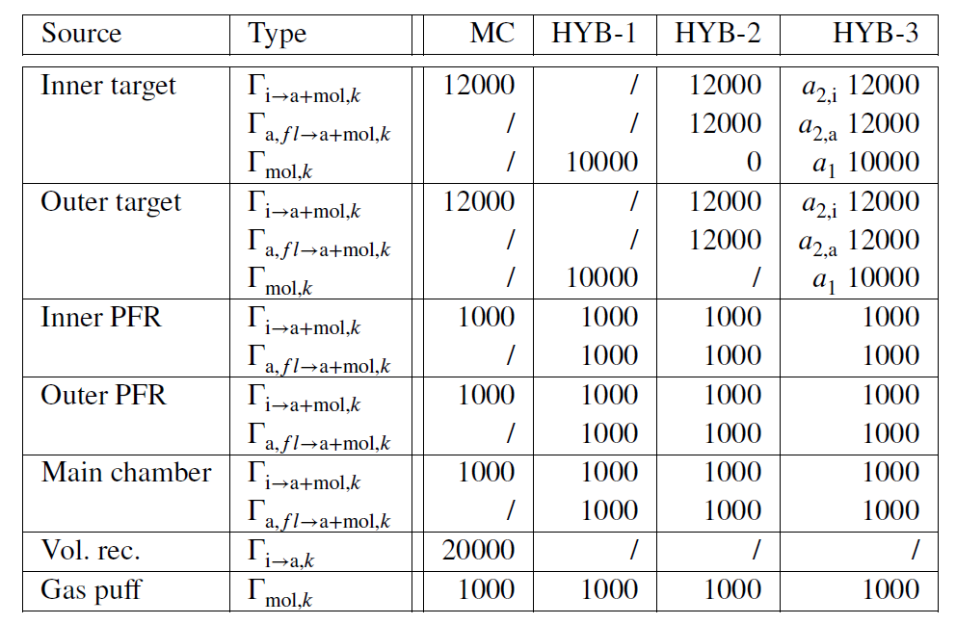
“Naive” particle distribution

Slide 29
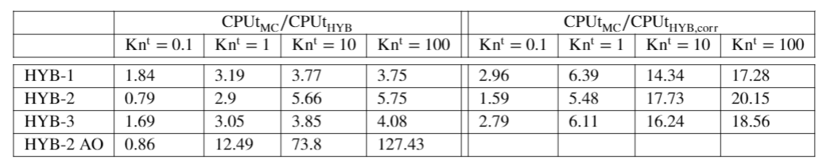
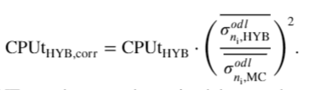
Speed-up and noise
Noise-corrected speed-up
PD from previous slide
Standard deviation in statistically steady-state, average over all cells in outer divertor leg
Conclusions made in PET2021
kinetic molecules take up most of remaining CPUt in hybrid methods for Kn^{t} ≥ 1
very large speed-ups for atom-only
good speed-ups for equal noise at target with molecules

Slide 30
Bias issue hybrid methods
→ the model error is actually lower than previously shown
→ similar results for all cases
→ bias error due to insufficient particles at PFR voids

Slide 31
Bias issue hybrid methods
Flux of fluid neutrals launched into voids is 10x larger than incident ion flux on targets
→ hybrid may need more particles than MC to keep noise on plasma AND fluid neutrals
sufficiently low everywhere
Notes:
+ number of numerical experiments to determine cause

Slide 32
Neutral solution on fixed BG (HYB-1)
Upstream
radial cell #
radial cell #
Problem starts from fluid neutral density upstream near PF boundary

Slide 33
Speed-up and noise reduction
For similar number of particles
  10-100x speed-up for cases with only atoms
  3-5x speed-up for cases with molecules
  noise reduction in the vicinity of the strikepoint
  a lot more noise where neutrals from PFR voids condense
    → bias error
Redo analysis with P proportional to fluxes for HYB
  back to cases with only atoms
  Only Kn^{t} = 0 and Kn^{t} = 10

Slide 34
New particle distribution
#particles / stratum ~ incident flux
→ hybrid without condensation needs 2x less particles or similar
→ hybrid with condensation needs 2-5x more particles

Slide 35
Speed-up for AO case with new PD
→ 1-3.3x speed-up for this particle choice

Slide 36
Results for new PD
No condensation

Slide 37
Results for new PD
With condensation

Slide 38
Noise reduction plasma
→ huge reduction of noise on plasma variables, mainly close to target
Notes:
Het probleem ligt bij de ruis op de brontemen door condensatie, kan niet rechtstreeks met plasma vergeleken worden

Slide 39
Results for new PD
→ even with #P/stratum ~flux, HYB with condensation still runs into bias error sooner than full MC!

Slide 40
Noise on particle sources

Slide 41
Things that did not resolve bias issue
Minimum # collisions before condensation
Condense with a probability < 1
Turn off source rescaling
Implementation of condensation process as reaction instead of in collide.f
  Use track-length estimator instead of collision estimator
  (but still analog simulation!)

Slide 42
Evaluation advanced SpH method
Simplest hybrid method
Compact implementation
No convergence issues encountered
Acceptable model error (± 10%)
No more long-lived kinetic atoms
User freedom speed-up vs. accuracy (Kn^{t}, HYB-1/2/3)
Large speed-ups (x10-100), at least for similar #particles + atoms only
Less rigorous than micro-macro
Statistics of the method needs more attention
Accessible for plasma-edge community
we now also create noise on fluid neutral population

Slide 43
Future work
Solution for molecules needed
  More detachment → molecules more important
  Molecules will become bottleneck, regardless of speed-up for atoms
Statistical analysis
MC procedures which are optimal for absorption-dominated?
  Non-analog simulations? See e.g. PhD Bert Mortier
Test method on (partially) detached DEMO cases

Slide 44
Thank you for your attention
Questions?
Wim Van Uytven
Division Meeting, 18/5/2021

Slide 45
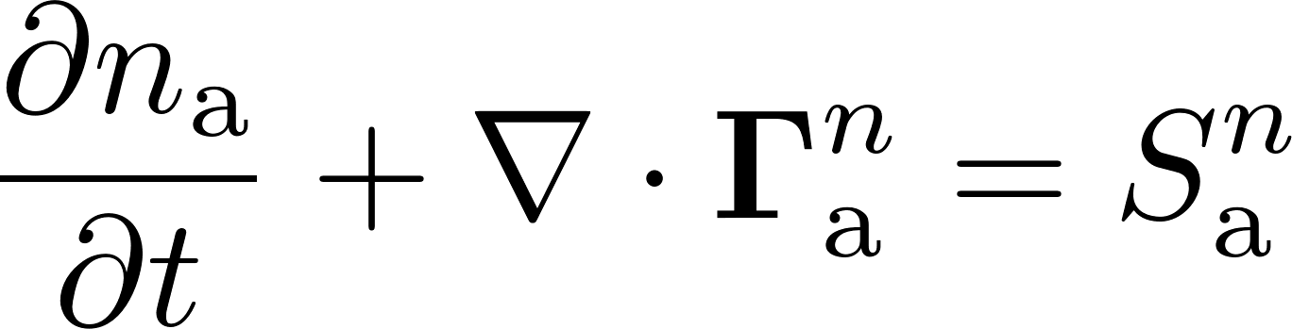
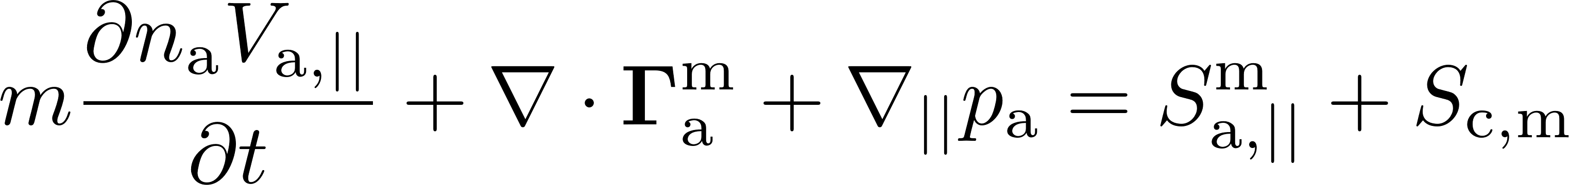
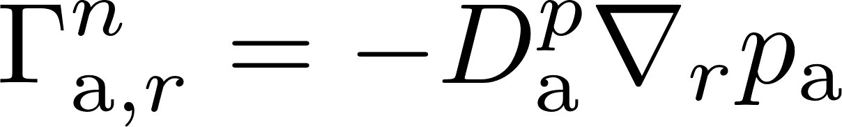
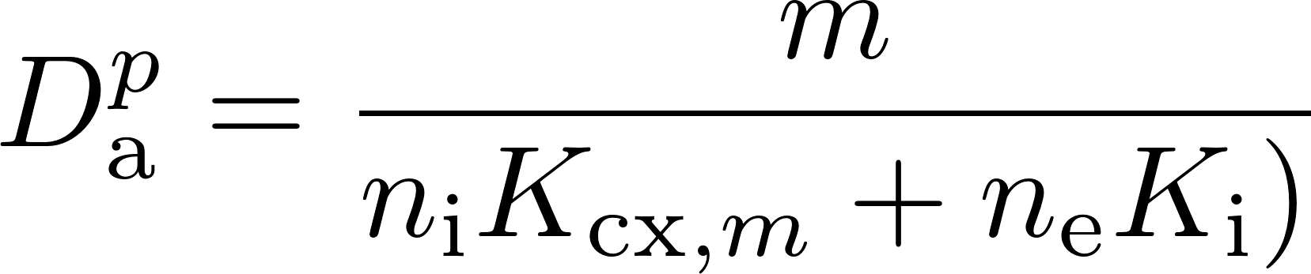
AFN transport model
Continuity
Parallel momentum

Slide 46
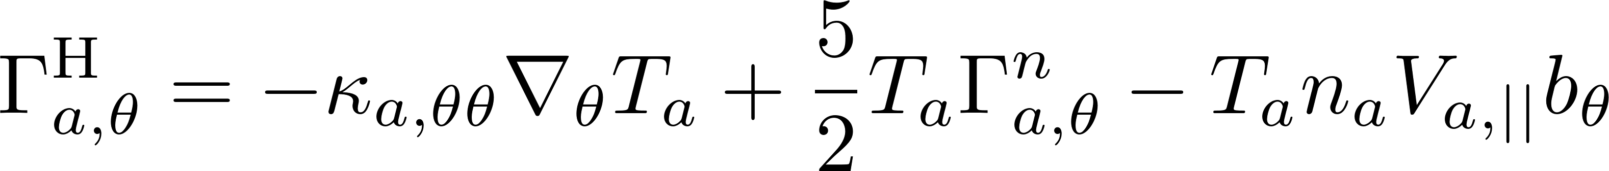
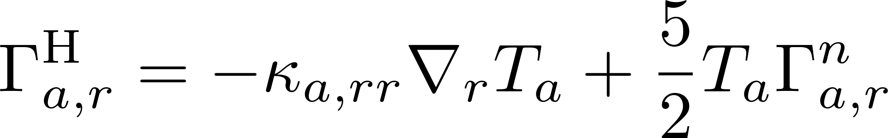
AFN transport model
Energy
Notes:
Internal energy equation + option to solve Ti and Tn together
p grad V term !!!!!!

Slide 47
Numerical experiment to narrow down problem origin…(HYB-2 Kn^{t}=10)
→ bias originates mainly from fluid neutral density?

Slide 48


AFN boundary conditions
calculation of fluid boundary fluxes based on estimated neutral velocity distriubtion and TRIM database (reflection kernel from EIRENE)
[Horsten, N., PhD Thesis, 2019]
Notes:
Gedrag trim database nabootsen

Slide 49
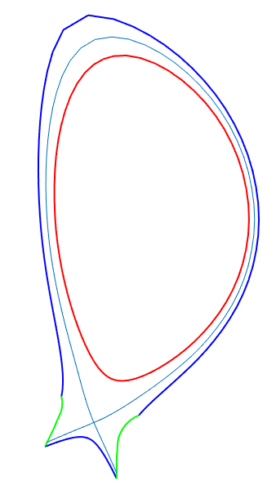
Grids: trapezoidal slab & narrow ITER
Trapezoidal slab
ITER without void regions
10 m
1 m
10 cm
narrow divertor
neutrals “locked up” in closed divertor
large divertor
➔ reduced influence kinetic neutrals
➔ increased influence kinetic neutrals

Slide 50
Results for new PD
#P/strata ~ flux

