Slide 1
TSVV Task 5: “Neutral Gas Dynamics in the Edge” 10.06.2022
Task status overview for internal discussion inside Thrust 2
D. Borodin et al.

Slide 2
Project update (IMS items) - 1
Theory/algorithmic development work on FKH combined with application to verification (mostly slab) cases: generalization AFN model for drifts and n-n collisions; Overview and assessment of techniques to reduce bias, cancellation and modelling errors; etc.
Good progress, several papers and conference contribution, new results (KU Leuven, W. van Uytven) will be presented at next regular VC in 2 weeks.
The support from ACH expected in the original TSVV proposal is yet unclear.
Coding and data management effort on CRMs: new molecular data formats (e.g. ADAS “mdf”) and recent RMPS or CCC data including for various H/D/T isotopes; move on using the IMAS; compile ITER/DEMO-relevant data. A contact with data providing groups for instance through the framework provided by the IAEA A&M data unit (GNAMPP).
Good progress, several presentations and EPS contribution (FZJ, F.Cianfrani), HydKin being reorganized (B.Küppers), established external cooperation with YACORA colleagues (U.Fanz group), Link to AMNS through IMASification is under discussion with ACH.
Isotopes seem to be difficult to account by scalings.
Code reorganisation: test correctness of the “starter-core” modular EIRENE-NGM version for various geometries. Continue applying the modulated version to further CI and “portfolio” cases, provide necessary bug fixes and code generalisations.
Exact point-by-point plan for P.Börner (still no contract!) formulated at Code Camp NOV 2021 and at additional VC
All other coding effort is blocked by necessary preliminary steps (version merge, harmonisation with SOLPS-ITER etc.)
Notes:
BM:
- Added cancellation error and bias inside the boxes
- changed colorscheme of the triangles
- the fact that FKH asymptotically becomes AFN or K and KDMC asymptotically becomes K, are indicated by connecting the blocks
- Added dashed lines to stress that the bottom is a further categorization of the top
- Repeated FKH as a term in the bottom part to show it is the same
- Group the spatial FKH’

Slide 3
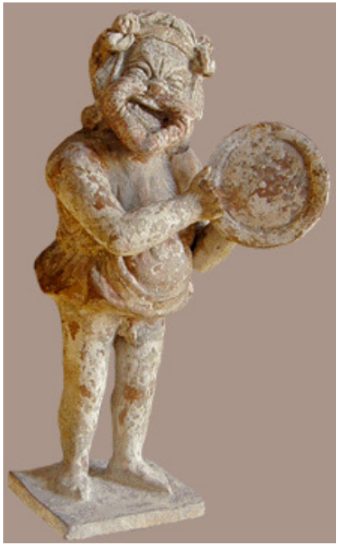
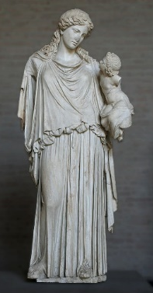
General code development of EIRENE
Main goals and decisions:
Segregating EIRENE into “starter” and a compact, free of most branching “numeric core” ➔ Optimisation for HPC, transparency and ease of use.
Unloading the main loop from branching agreed
Abstractisation of the cell type (removing “geometry” branching)
Abstractisation of A&M reactions + tracking of internal states
Version merging scope agreed including synchronisation with SOLPS-ITER
Uniform coding style (e.g. variable name conventions, use of OOP, etc.)
IMASification strategy defined
ITER participation (X.Bonnin) SOLPS-ITER IMASification experience
Interaction with ACHs (Advanced Computing Hubs)
IMASification (EUROfusion guidelines) and porting of EIRENE at Gateway
EIRENE “toy model” – EIRON and profiling of EIRENE
➔ Test of parallelisation schemes incl. domain decomposition options.
EUDAT-based simulation catalogue
Porftolio of simulation cases
New: IMASification of the simulation grid (GGD objects)
EIRENE Streamlining, Code Camp FZJ (4-10 Nov 2021) · Indico (euro-fusion.org)
Eiron
Eirene

Slide 4
Project update (IMS items) - 2
Start over with HPC-related optimisation for the core (load balancing schemes, domain decomposition etc). Some ACH support is expected in particular for HPC code-performance optimisation.
OpenMP parallesation established (poor scaling, but works) with HLST support, ACH links establisched both to ACH-VTT (Eiron, O.Lappi) and ACH-MPG (H.Leggate ready to continue on HLST path)
Again, much is blocked by P.Börner package delay.
Execute SOLPS-ITER with vibrationally excited hydrogen molecules for and assess their impact on the state of the divertor plasma (JET L-mode). Assess impact of hydrogen isotopes on state of divertor plasma. Utilise CRM post-processors to predict spectroscopic signature of molecules (Fulcher band), for hydrogen, deuterium and tritium.
EIRENE capability to follow vibration states (as separate species) reestablished
CRM development (HydKin + YACORA) including with various resolution on vibrostates in ongoing
Assess state of photon tracing model in current EIRENE version, reactivate photon tracing model in standalone EIRENE simulations, execute simple test runs (slab) and actual tokamak geometries (JET).
Preliminary discussions, presentation from S.Wiesen have taken place in 2021
This subproject will be started later on this year.
Notes:
BM:
- Added cancellation error and bias inside the boxes
- changed colorscheme of the triangles
- the fact that FKH asymptotically becomes AFN or K and KDMC asymptotically becomes K, are indicated by connecting the blocks
- Added dashed lines to stress that the bottom is a further categorization of the top
- Repeated FKH as a term in the bottom part to show it is the same
- Group the spatial FKH’

Slide 5
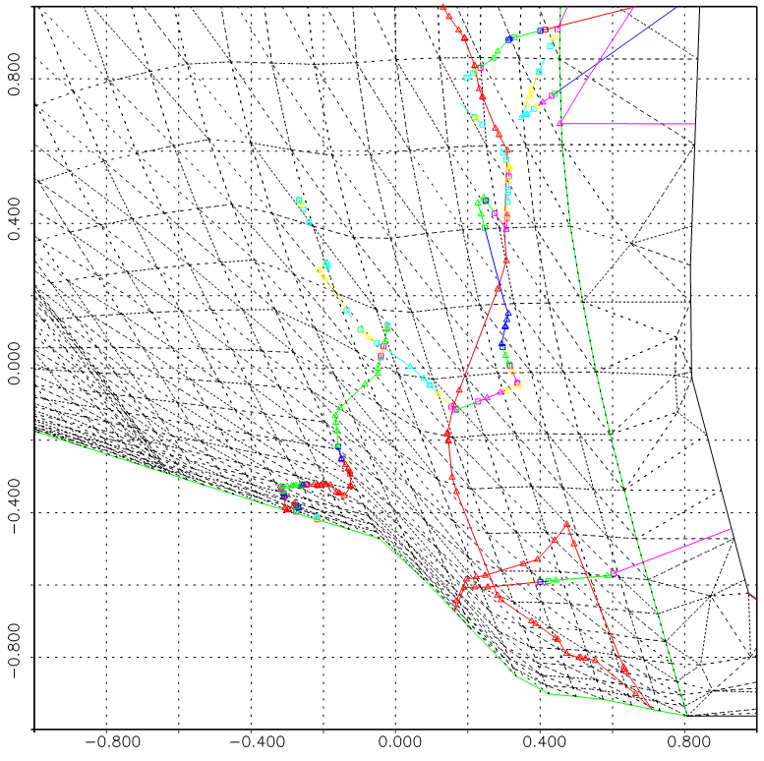
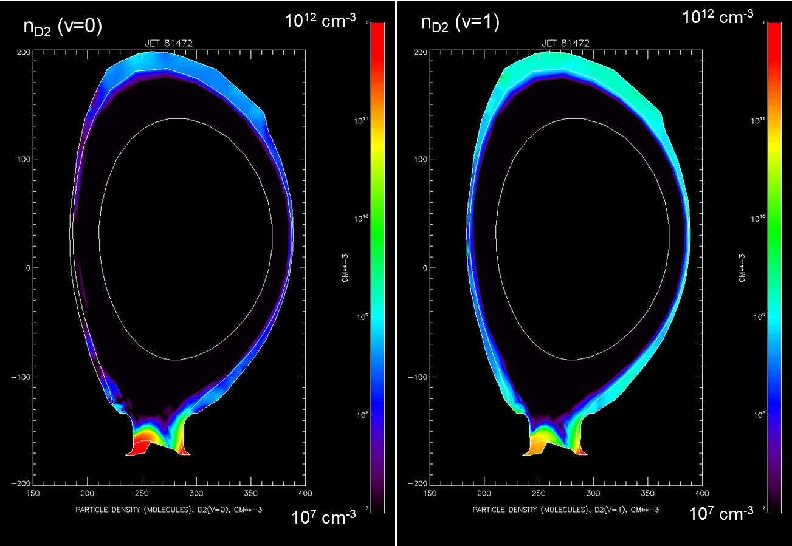
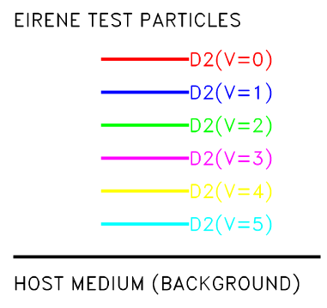
Tracking vibrationally resolved molecular densities in EIRENE
➔ Previous capability recovered!..
Tracks of D₂ molecules transitioning from ground state to v=5 vibrationally excited state
M.Groth, A.Holm

Slide 6
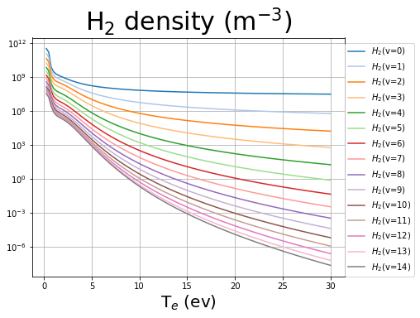
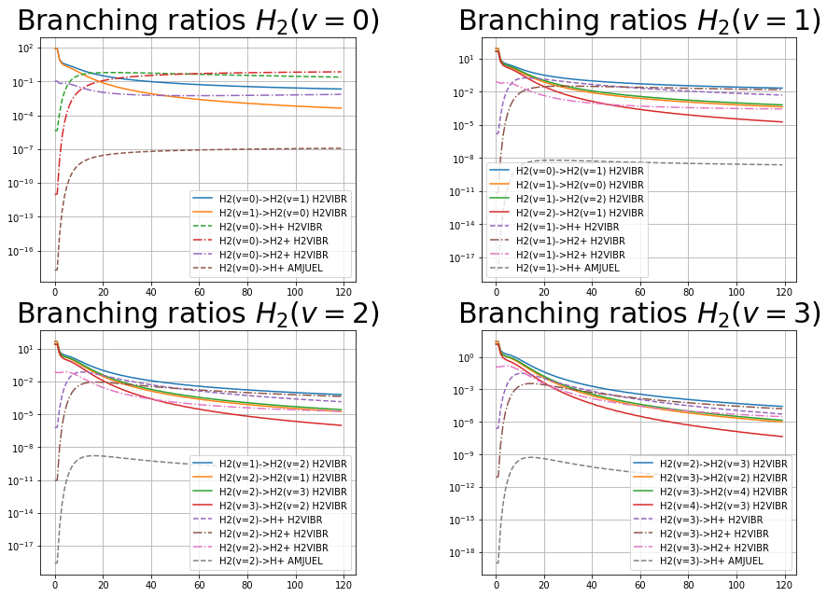
Yacora: inclusion molecular source term
Stationary Yacora run vibrationally resolved:
results
source= 10²¹ m⁻³s⁻¹
small temperature (T<5eV):
density peak
main reactions: vibrational excitation and proton impact
F.Cianfrani

Slide 7
Issues encountered
P.Börner contract is not yet approved, thus critical to the project manpower and expertise is missing
Travel Budget is limited posing a threat that the planned Code Camp in 2022 will not be possible. Also participation in the ITER provides training on extended grids would be worth TSVV-5 support.
Manpower: not all of the positions occupied (KUL, FZJ, potentially Aalto)
Not clear the ACH support for algorithmic development relevant for FKH

Slide 8
Cooperation with other TSVVs, ACH and WPs
Cooperation with ACH-PSNC and ACH-VTT is well established.
H.Leggate ACH-MPG will join this year (parallelisation, continuation of HLST subproject).
Strong link to YACORA group established (related to IAEA A&M data unit (GNAMPP)).
Strong link to ITER (X.Bonnin) and SOLPS-ITER community.
Direct involvement of F.Cianfrani and D.Borodin in WPDC. Simulations in cooperation with WPDES expected this year.
Some joint VCs with TSVVs 3, 4, 6 have taken place in 2021. More definitely needed to establish the cooperation. We need to start over with TSVV-7.
FZJ lawers (A.Storm) and ITER: new EIRENE licence

Slide 9
Summary: TSVV-5 progress and plans
Physics
Fluid-kinetic hybridisation (FKH) development successfully continues
A&M CRM improvement (somewhat preparatory work so far…)
Kinetic ions on the EIRENE side (discussion with TSVV-6)
Establishing simulation cases (validation, ITER, DEMO) – in progress
Code development
Parallelisation: OpenMP-MPI hybrid (related code refactoring done; optimisation and restructuring e.g. domain decomposition are necessary)
Code streamlining (Segregation of the numeric core, etc.) – code camp
Improved I/O (JSON/HDF5), visualisation, IMASification, etc. – in progress.
Organisational items
Repository for simulations (EUDAT?.., using JAC catalogue experience) – concept under development, depends on selection of base system.
New EIRENE license, “infectious open source” (draft discussed with FZJ layers and ITER still in circulation)
Requires communication with other TSVVs
Requires ACH support

Slide 10
EIRENE-NGM-DEVELOPERS (TSVV-5)
D.V. BORODIN, F. Schluck, F.CianFRANI, D. Harting, P.Börner, S. Wiesen
Forschungszentrum Jülich, Institut für Energie- und Klimaforschung – Plasmaphysik, Germany
W. DEKEYSER, S. CARLI, M. BLOMMAERT, N. HORSTEN, W. VAN UYTVEN, M. BAELMANS
KU Leuven, Department of Mechanical Engineering, Belgium
B. MORTIER, G. SAMAEY
KU Leuven, Department of Computer Science,Belgium
Y. Marandet, P. Genesio
Aix-Marseille Univ., France
H. Bufferand
CEA, IRFM, France
E. WESTERHOF, J. GONZALEZ
DIFFER - Dutch Institute for Fundamental Energy Research, Eindhoven, the Netherlands
M. GROTH, A. HOLM
Department of Applied Physics, Aalto University, Espoo, Finland
H. LEGGATE ← HLST, ACH-MPG
DCU
ACH-VTT:
F. Granberg, J. ÅströM,
O.LapPI, …
ACH-IPPLM:
D.YADYKIN
ITER:
X.BonNIN
Eirene with the infant Ploutos

Slide 11
Thanks for the attention!

Slide 12
TSVV-5: Neutral Gas Dynamics in the Edge
Main simulation tool:
EIRENE code (and EIRENE-CFD packages) http://www.eirene.de/
We aim to transform it to IM- and HPC-ready neutral gas module (EIRENE-NGM) suitable for simulations on ITER and DEMO scale with large focus on (semi)detached divertor plasmas
FP-9 deliverables:
Neutral gas code that allows for an efficient use of HPC resources (towards exascale systems and/or HPC booster techniques) through suitable parallelization methods.
Revised and extended physics basis for the neutral gas model. Further development of the underlying collision-radiative model towards the full vibrational resolution for all hydrogen isotopes and specific impurities for seeding.
Improved (in contents and structure) Atomic and Molecular database for volumetric and surface processes. Database access through generalized interfaces to, e.g., atomic, molecular, nuclear and surface (AMNS) physics data.
Interfaces and boundary conditions necessary for future applications; modularization of the neutral gas code to facilitate coupling to computation fluid dynamics (CFD) codes (2D or 3D codes, turbulence codes, time-dependent) and possibly also to gyro-kinetic/gyrofluid plasma codes.
Strategy towards a validated predictive capability for integrated fusion reactor modelling for (semi-)detached divertor plasmas. Liaison with TSVV Tasks 3 and 4.
Neutral gas code that allows for an efficient use of HPC resources (towards exascale systems and/or HPC booster techniques) through suitable parallelization methods.
Revised and extended physics basis for the neutral gas model. Further development of the underlying collision-radiative model towards the full vibrational resolution for all hydrogen isotopes and specific impurities for seeding.
Improved (in contents and structure) Atomic and Molecular database for volumetric and surface processes. Database access through generalized interfaces to, e.g., atomic, molecular, nuclear and surface (AMNS) physics data.
Interfaces and boundary conditions necessary for future applications; modularization of the neutral gas code to facilitate coupling to computation fluid dynamics (CFD) codes (2D or 3D codes, turbulence codes, time-dependent) and possibly also to gyro-kinetic/gyrofluid plasma codes.
Strategy towards a validated predictive capability for integrated fusion reactor modelling for (semi-)detached divertor plasmas. Liaison with TSVV Tasks 3 and 4.
Code performance, parallelization, refactoring, domain decomposition, I/O for HPC, …
Improved physics and features incl. fluid-kinetic hybridisation (FKH) and improved CRMs
Improved AMNS data, both in structure/physics and content
EIRENE as NGM – restructuring, interfaces to other codes, time-dependent runs, kinetic ions
Validation with experiments and test of predictive capabilities for ITER and DEMO

Slide 13
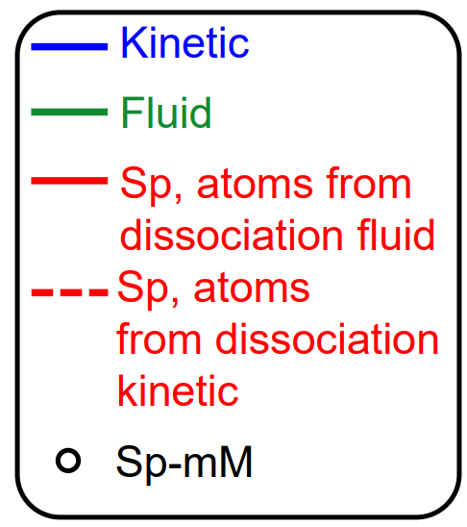
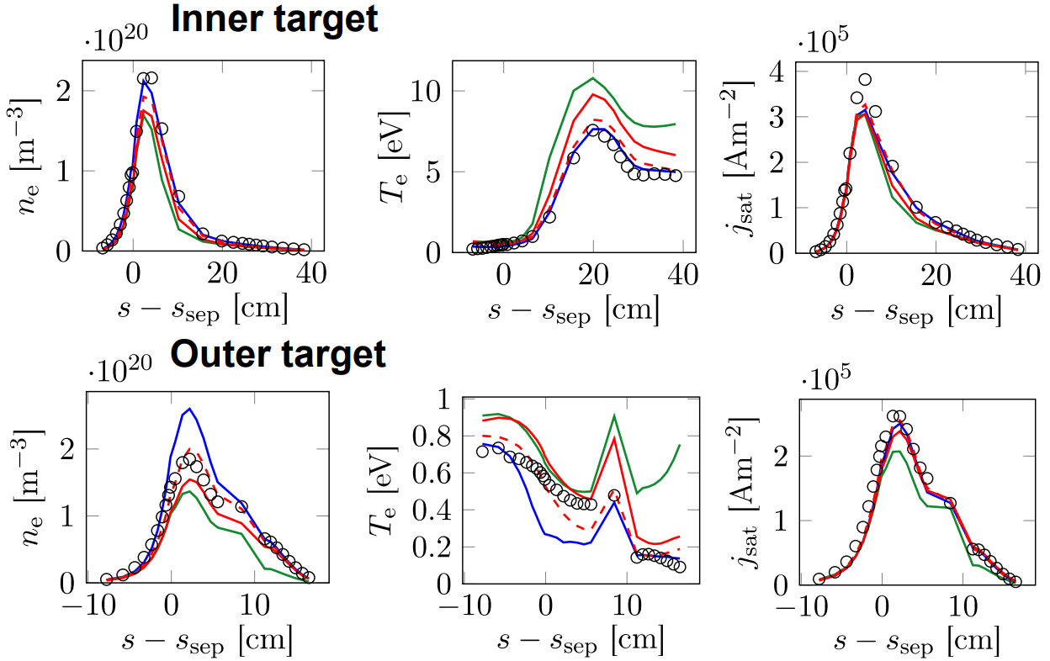
Recent progress with micro-Macro (JET L-mode case)
N.Horsten et al., PET-2021
Purely micro-macro (mM) approach for rectangular slab geometry with fixed background plasma
2021
Micro-macro approach combined with spatially hybrid approach (Sp-mM)
• Realistic geometry with void regions
• Coupling to kinetic molecules
• Coupled plasma-neutral simulations

Slide 14
Crude scheme for the TSVV-5 workflow
D4. Coding
FE model for divertor target and FW
Maintenance
Increased code capabilities
KUL
Modulisation
Time-resolved
CEA
A&M Kinetic ions
Adjoint approach
sensitivity analysis and UQ
FZJ
D1. HPC
NGM with interfaces
Domain decomposition
Optimized parallelisation
High performance
DIFFER
D3. AMNS
reduced models for isotopes in FW, outgassing etc.
AMNS data structure and content
Better quality, resolution, isotope effects, more processes
Aalto
Expected outcome
D2. Physics
F-K Hybridisation
High density and collisionality
CRMs for molecules
Physics of detachment
D5. Testing
Magnum-PSI, detachment in transients
Spectroscopy at JET and MAGMUM
ITER scenario with semi-detachement
DEMO scale and parameters

Slide 15
EIRENE licencing - User Agreement (UA)
Old UA
acknowledgement of FZJ origin of EIRENE, non-military use, non-commercial use, no cost/liability for FZJ, etc.
New UA
Based on copyleft licence (however GPL3.0 occurs to be not suitable).
Similar declarative statements as in the old UA.
More clear statement about the EIRENE-based publications.
Developers and users are divided into “basic” and “associated” ones (AD).
➔ ADs get more rights on decision-making, direct access to the repository, etc.
ADs must keep to the “Developer Code of Conduct” (see at INDICO).
Current status: we wait for the document version from the FZ Jülich lawyers…

Slide 16
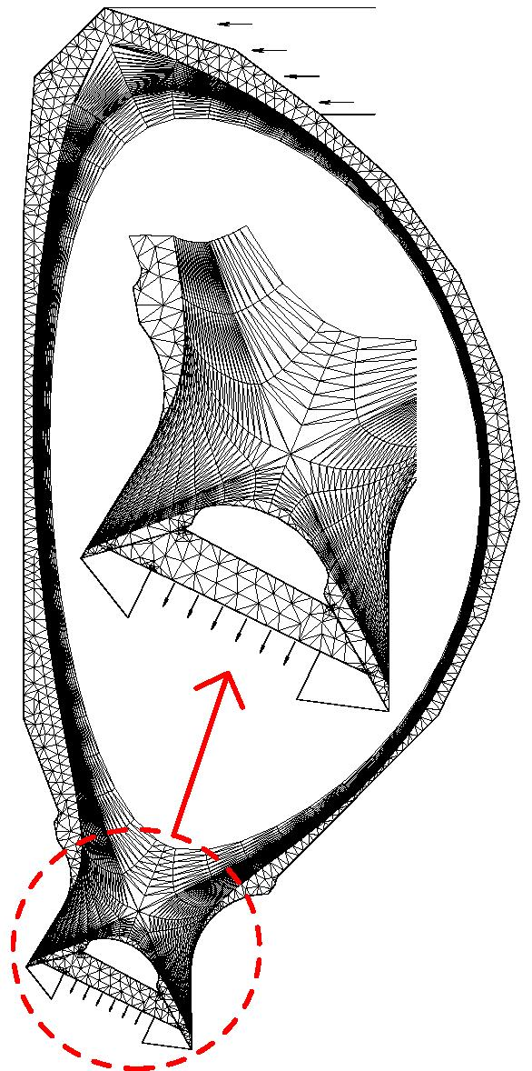
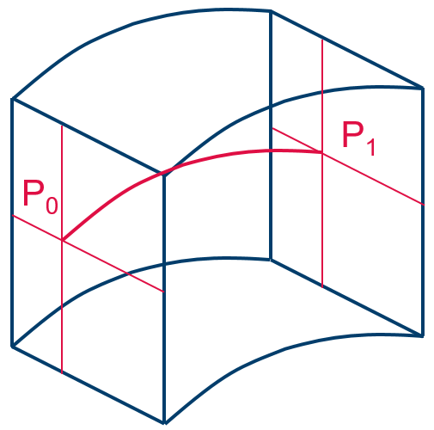
What is EIRENE in a nutshell (e.g. in SOLPS)?..
Macroscopic:
Microscopic:
Plasma flow parameters
EIRENE-NGM: a 3D3v MC multi-species transport code incl. radiation transfer, kinetic
or F-K hybrid.
CFD codes (computational fluid dynamic):
B2, Edge2D, EMC3, SOLEdge3X, etc…
3D EIRENE volume cell
2D or 3D Volume grid (e.g. tetraeder) adopted for current magnetic configuration
Source terms (Particle, Momentum, Energy)
CRMs
(HYDKIN, AMJUEL, ADAS, …)
for atomic and molecular neutrals H,H*,H₂,H₂(v),H₂*,H⁻,H₂⁺,…, impurities
Ionisation, CX, recombination etc.

Slide 17
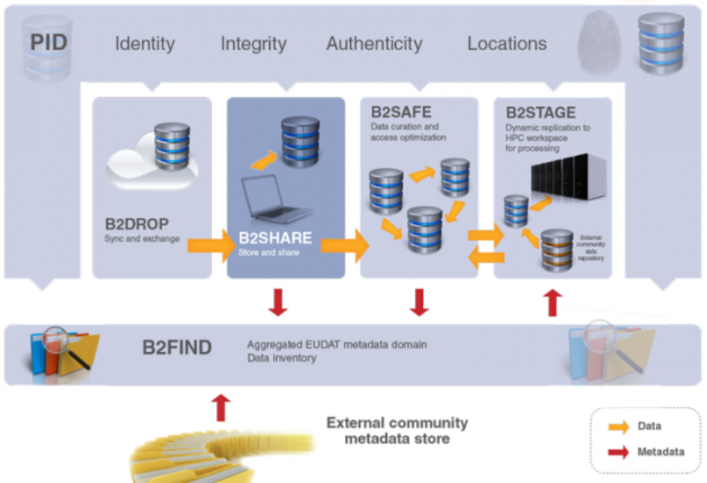
EUDAT for saving EIRENE/NGM runs
https://www.eudat.eu/
Flexible, World-wide access “B2ACCESS“ based on certificate (e.g. FZJ), google ID or EUDAT ID
→ One can define groups of users e.g. “NGM
developers”
B2DROP cloud (20Gb per user!) – sufficient?!. Free and easy to get for any of TSVV participants
B2SAFE – unlimited additional volumes of data in full agreement with organization policies.
B2STAGE: extension of the iRODS system with a GridFTP interface
Consider using SimDB as backbone for organization of folders/catalogs at B2SAFE
We can get support for installing/maintaining the system from Juelich Supercomputing Centre (JSC)
We need to have seamless data transfer with HPC, so our option is “B2STAGE”, however we can also use “B2SHARE” (plus “OOath2” access, versioning) for some of the metadata e.g. instead of SCIEBO
→ B2Drop “NF_NGM” requested, next step is testing . . .

Slide 18
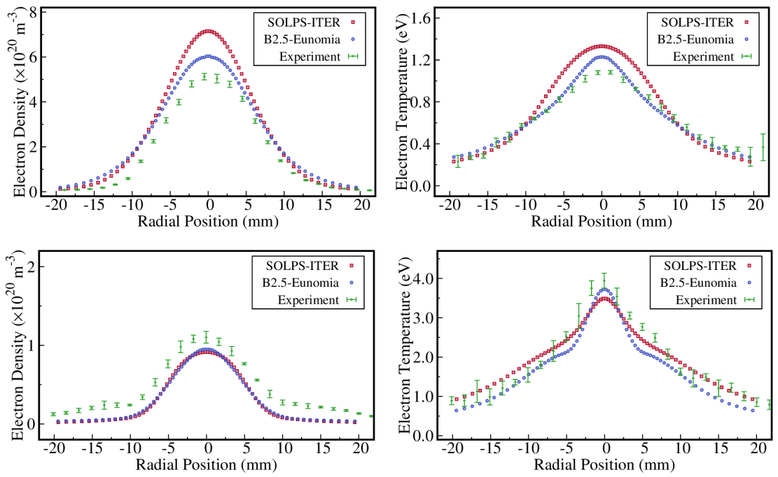
EIRENE application to Magnum-PSI
Comparison with TS profiles near the target
Comparison of SOLPS-ITER (B2.5-EIRENE) with B2.5-ENOMIA
Aim: transfer all the useful development into EIRENE
Main differences are identified to be in CRMs (MAR, EI, EC) – direct comparison is often not possible.
New FEM model for PWI in EIRENE
Aim: treat self-consistently temperature and sputtering, absorption and outgassing, recycling, transients (time-dependent simulations)
High Density Case
Low Density Case
J. Gonzalez, E. Westerhof, et al.,
PET 2021, CPP paper in press

