Slide 1






TSVV 6 – Impurity Sources, Transport, and Screening
Thrust 2 meeting, 10th of June 2022

Slide 2

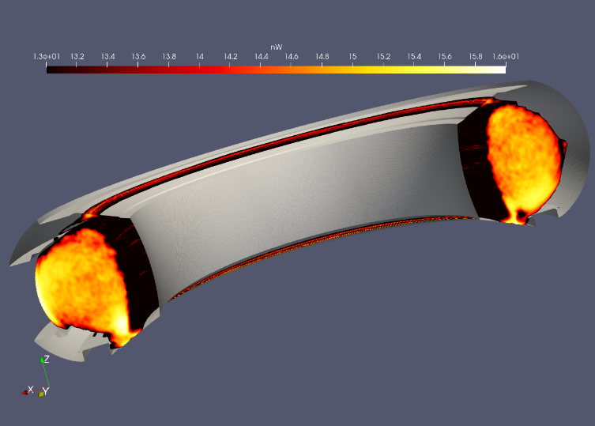
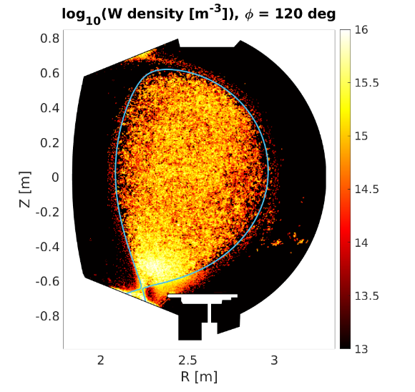
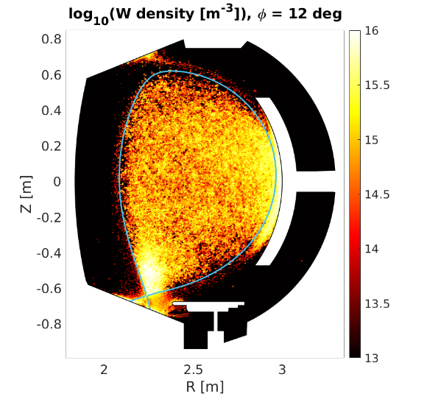
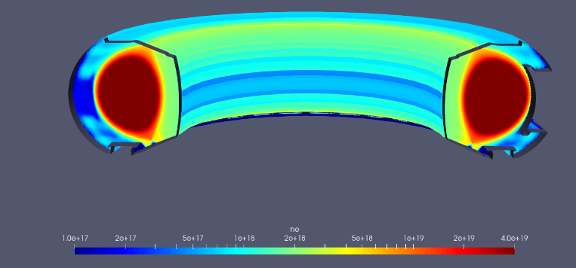
Project update: TASK1 for key deliverable 1: numerical development and verification of SOLEDGE3X, EMC3-EIRENE and ERO2.0 codes
MODELING TRANSPORT OF TUNGSTEN IN A 3D PLASMA BACKGROUND
Milestone June 2022: Develop interface for importing SOLEDGE3X plasma backgrounds into ERO2.0 for W transport
3D simulation with Non-Axysimmetric wall
SOLEDGE plasma background with fluid neutrals
Poloidal maps of W density at two different toroidal angle
3D density map of W obtained with ERO2.0 using the soledge backrgound
Comparison between W transport in 2D vs 3D plasma background (S Di Genova, PSI 2022)

Slide 3
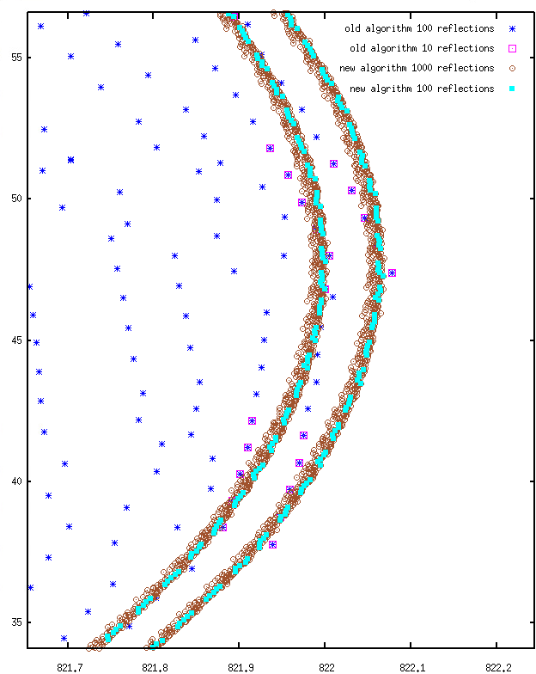
Project update: TASK1 for key deliverable 1: numerical development and verification of SOLEDGE3X, EMC3-EIRENE and ERO2.0 codes
Current Status of EMC3-EIRENE Kinetic Ion Transport Module
New accurate implementation of grad-B and curvature drift-movement
  Completely redesigned core part of KIT with EMC3
  Banana orbit observed
Re-designed treatment of anomalous diffusion
  Add time step limit to avoid huge diffusion steps
Currently still some numerical problems (intersections in pathological cases, …etc)
Examples of new results on banana orbits: very small numerical diffusion

Slide 4
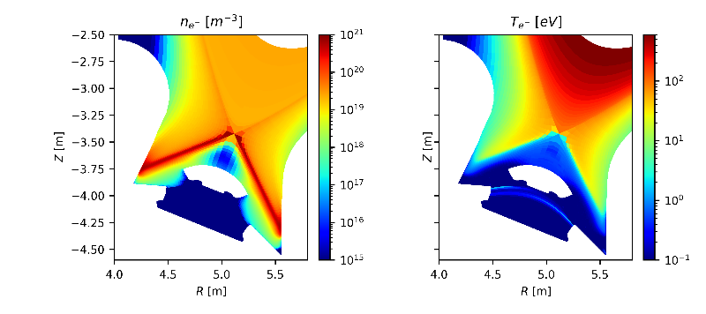
Key Deliverable 2: Assessment of the W influx, W screening, and W transport in ITER plasmas
MILESTONE 2022: 2D Plasma background in semi-detached conditions (no RMP)
Temperature and density in the divertor region
Example of ITER simulations with SOLEDGE in 2D: some improvements on SOLEDGE-EIRENE were necessary to consider properly an ITER case
The same studies ongoing with EMC3-EIRENE coupled with ERO2.0 for W transport

Slide 5
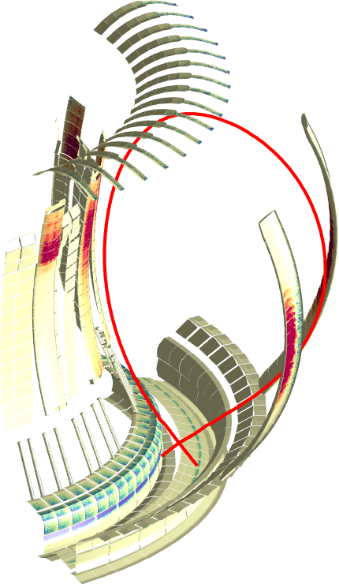
Interaction with other TSVVs + WPs
In connection with old experiments as well as WPTE (recent call), ongoing work and proposals for comparing TSVV 6 modelling tools with experimental results
On W7X with EMC3-EIRENE - ERO2.0
On JET:
  Tungsten erosion and prompt redeposition (proposed by J Romazanov from Julich)
  experiments for core-edge interplay and transport in pedestal region (C Giroud)
On WEST:
  X-point radiator and impact on W sources (N. Fedorczak)
  Double Null magnetic configuration and W sources and transport

Slide 6
Open points / ISsues / Problems
To organize a 2/3 days meeting with all the participants on site (2023, Julich/Cadarache/…?)
It would be useful to meet also during JET/WEST experiments for few days
Waiting for WEST experiments in Double Null configuration (delay due to some issues on the machine)
Good “informal” connection with other TSVVs, do we need more formal meetings?
Waiting for agreement between Eurofusion and Switzerland for participation of our EPFL colleagues (not yet an issue but…)

