Slide 1
Limiter effects in gyrokinetic simulations
G. Di Giannatale^{a)}, P. Donnel^{b)}, E. Lanti ^{a)}, L. Villard^{a)}, A. Bottino^{c)}, S. Brunner^{a)}, B. McMillan^{d)}, A. Mishchenko^{e)}, M. Murugappan^{a)}, T. Schneider^{c)}
^{a)} EPFL, SPC, CH-1015 Lausanne, Switzerland
^{b)} CEA, IRFM, F-13108 Saint-Paul-lez-Durance, France
^{c)} Max-Planck-Institut fur Plasmaphysik, D-85748 Garching, Germany
^{d)} CFSA, Department of Physics, University of Warwick, Coventry CV4 7AL, United Kingdom
^{e)} Max-Planck-Institut fur Plasmaphysik, D-17491 Greifswald, Germany

Slide 2
ORB5 - Code, equations and approximations
ORB5 is a full $f,$EM, flux-driven, global, PIC GK code, recently refactored and ported on GPU (x4 acceleration)
$δf$ splitting used as control variate. The total distribution function is represented as $f=f_{0}(ψ, t)+δf$and only $δf$is discretized using markers.
Leads noise reduction (under PIC-Monte Carlo considerations)
The initial phase space is sampled with markers that represent a portion of the phase space. Such markers are evolved and their orbits are followed during the simulation in the 5D phase space.
Fields solved with B-splines
The solver works in Fourier space. Assuming that the perturbations are almost field aligned it solves the fields for few modes per radial location.

Slide 3
Code, equations and approximations(3) - Equations
The formalism of ORB5 comes from the field-particles Lagrangian.
All the approximations have to be done on the following equation:
Variation with respect to the potential: Quasi neutrality equation
The polarization term does not include full-f physics

Slide 4
Non linear analysis
Model includes: electrostatic turbulence, kinetic trapped electrons, ECRH source ^{A)}, non linear collisional operator ^{B)}, long wavelength approximation for the polarization term, limiter
Limiter contributes twice:
it damps fluctuations in the Vlasov equation
it changes part of the adiabatic response of electrons in the QNE
Simulations are extremely challenging: ECRH source and collisions are treated with random kicks → huge source of noise for a PIC code → almost impossible to reach a quasi steady state condition
Simulation initialized with analytical profiles
When the noise has grown too much we collect the T, n and we start a new simulation with the new profiles (this procedure kills all the phase space structure.. )
The last simulation has been adapted without destroying the phase space structure (no marker resampling)
Almost quasi-steady state has been reached
^{A)} P Donnel et al 2021 Plasma Phys. Control. Fusion 63 064001
^{B)} P Donnel et al 2021 Plasma Phys. Control. Fusion 63 025006

Slide 5
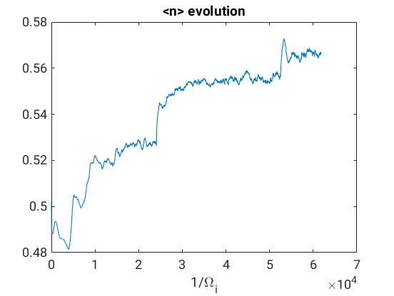
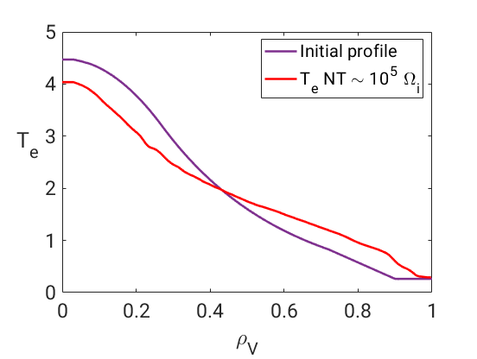
Importance of adaptation
In few months the adaptive scheme (M. Muruguppan) will be available in ORB5
Next to the limiter the $δf$ ordering may fail with particle transport
Adapting the $f_{0}$ leads to different solution next to the limiter (no substantial changes are clearly visible in the core)
First radial point of the SOL
adaptation

Slide 6
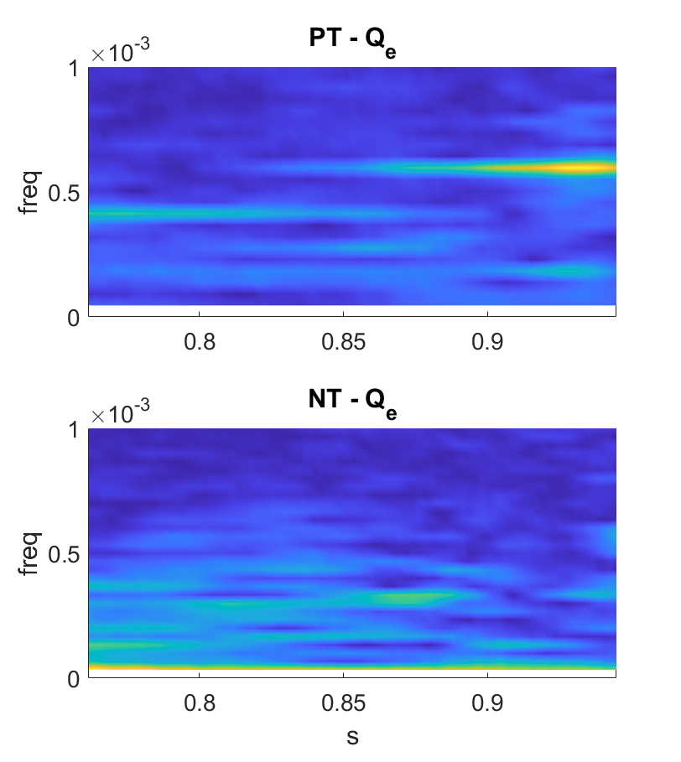
Avalanche mediated transport(1)
Both PT and NT show avalanches triggered at the edge spreading inside.
Triggered at next to the limiter. How big is the role of the limiter?
It seems crucial, fundamental to develop the best possible model

Slide 7
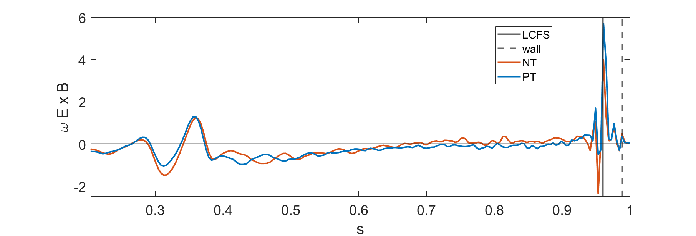
Avalanche mediated transport(1) – ZF sensibility
Both PT and NT show avalanches triggered at the edge spreading inside.
Triggered at next to the limiter. How big is the role of the limiter?
It seems crucial, fundamental to develop the best possible model
ZF shearing rate first run
ZF shearing rate last run

Slide 8
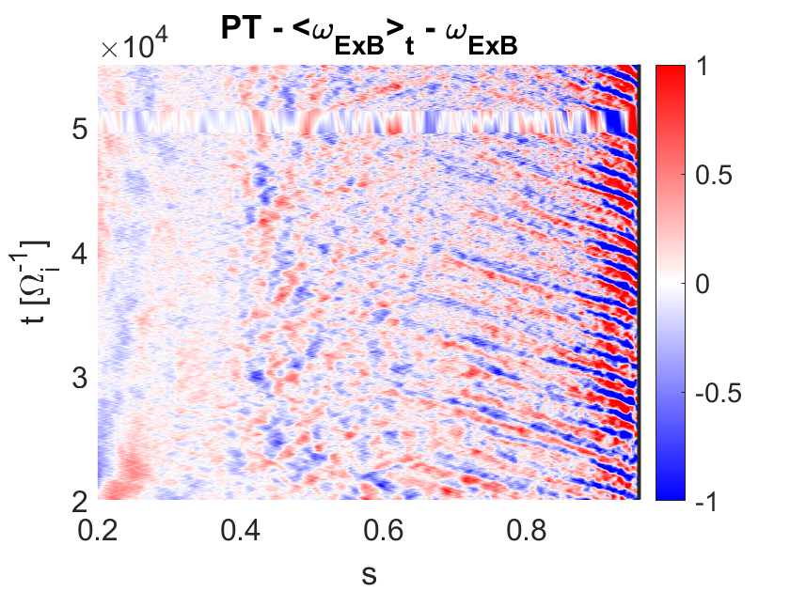
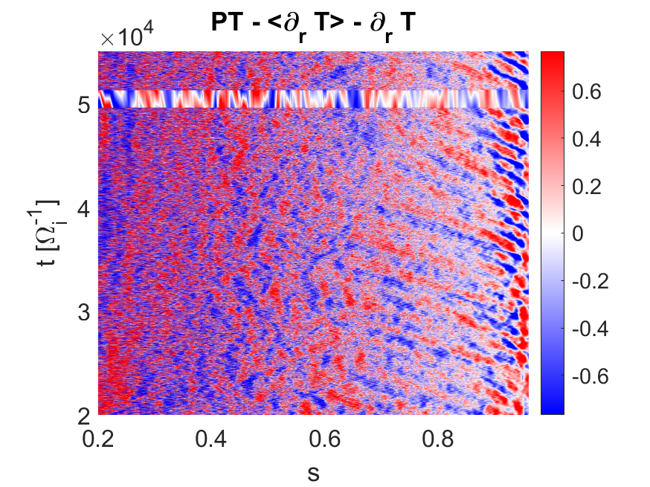
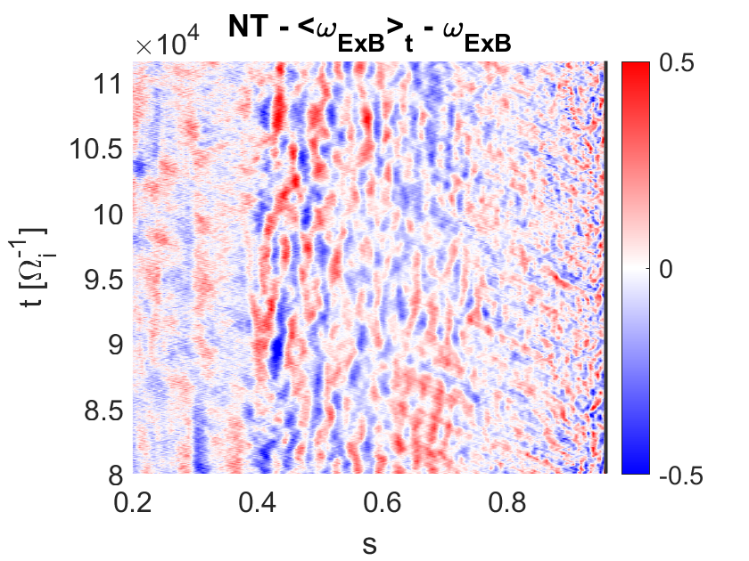
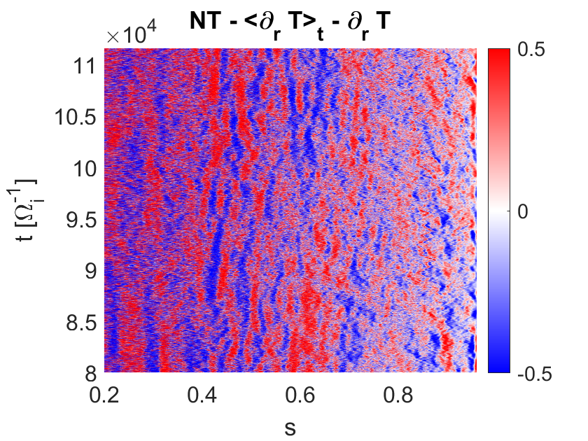
Avalanche mediated transport(2)

Slide 9
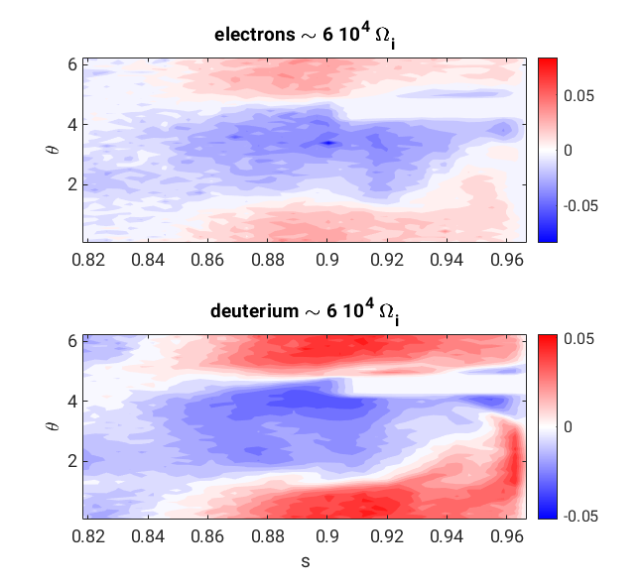
Limiter effects on density
With a more refined look (2D data), an other limiter effects show up: strong symmetry breaking !
This inhomogeneity may trigger the avalanches (?)
Importance of a polarization term in the QNE dealing with 2D density?

Slide 10
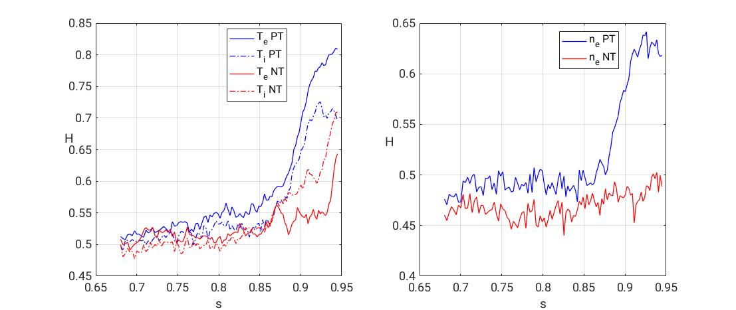
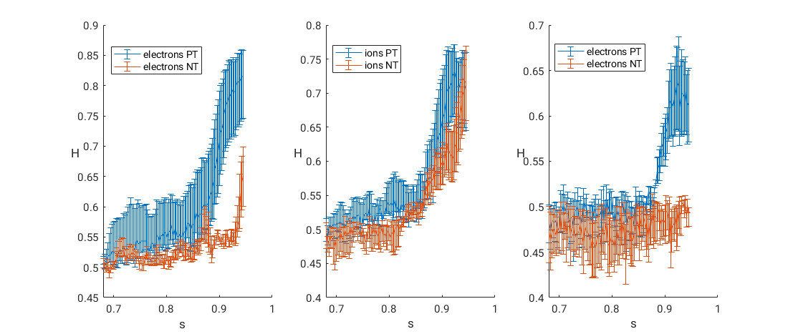
Transport indication – Hurst exponent
Hurst exponent is a coefficient that can be associated to the kind of transport: diffusive (H = 0.5), subdiffusive (H < 0.5), superdiffusive (H > 0.5)
What does make the PT to be more superdiffusive?
different ExB shear ?
coherent frequency of avalanches ?

Slide 11
Attempt to describe the transport with a fractional dynamics
Attempt to describe the limiter-induced non-diffusive dynamics
Non-locality in space and time
Using fractional operators to correlate T and Q
First attempt: splitting the time and the spatial dependence of the pdfs
Rietz derivative $D_{x}^{μ}\left(T\right) vs Q. D_{x}^{1}\left(T\right)=\frac{d}{dx}H\left(T\right)=\frac{d}{dx}∫\frac{T\left(x^{′}\right)}{x−x^{′}} dx′$
$$t [Ω_{i}^{−1}]$$
$$t [Ω_{i}^{−1}]$$
$$t [Ω_{i}^{−1}]$$

Slide 12
Conclusions
The deliverable limiter has been achieved
Strong avalanches
High gradients
Peak of the ExB shear
Symmetry breaking
Benchmark with GYSELA started
Adapting $f_{0}$ may be crucial to keep the $δf ordering$
Inserting 2D dependence of density in polarization term may be important
Super-diffusive transport may be a consequence of the limiter
Why NT and PT react differently ?
Fractional operators seem a promising way to underline the transport process
Proposal for studying the limiter has been accepted: 1.3 Mln node/h available from 1st Oct

Slide 13
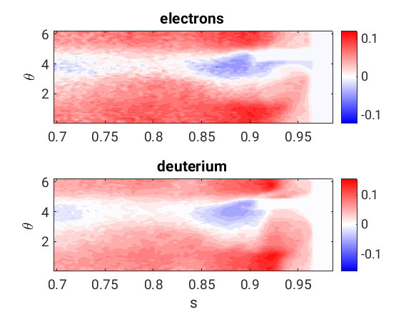

Slide 14
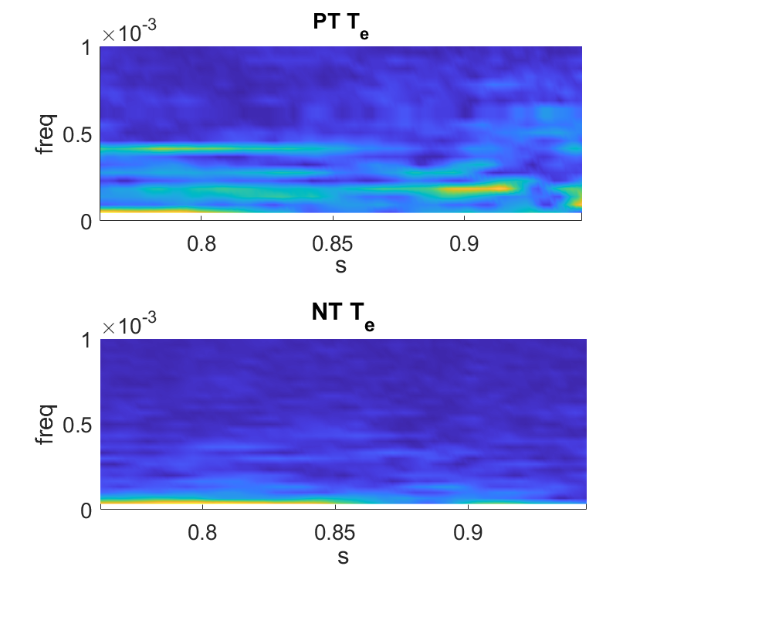
Avalanche mediated transport

