Slide 1
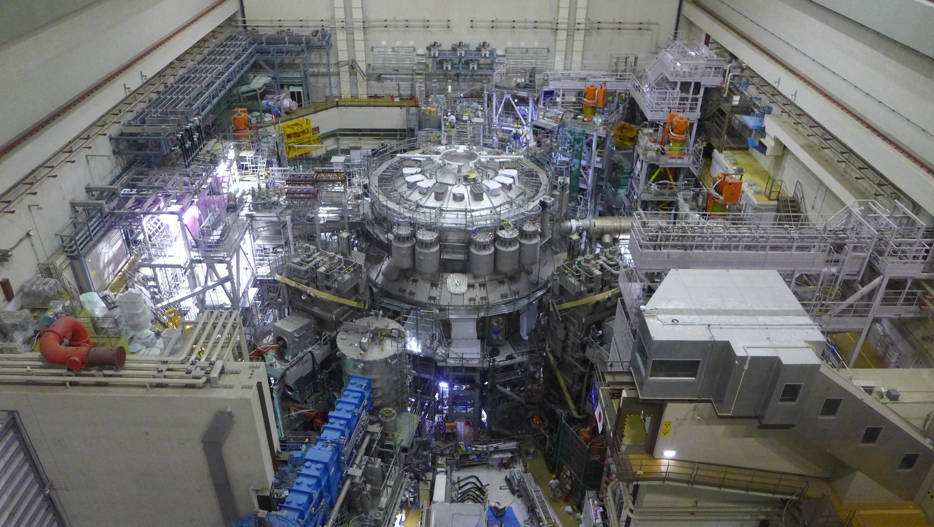
Experiment team
JT-60SA Experiment Team Leaders
J. Garcia, M. Yoshida, H. Urano

Slide 2
Contents
Mission of JT-60SA and link to EUROfusion
Experiment team organization
First steps of the Experiment team
Conclusions

Slide 3
Contents
Mission of JT-60SA and link to EUROfusion
Experiment team organization
First steps of the Experiment team
Conclusions

Slide 4
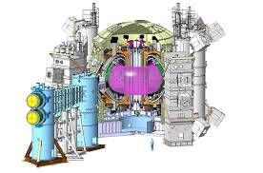
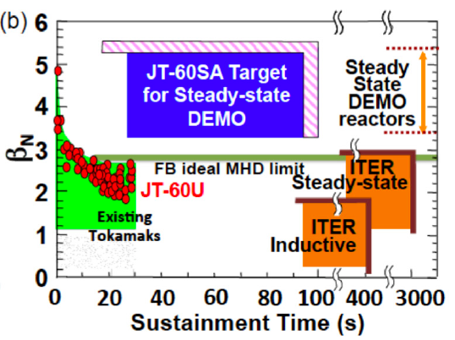
JT-60SA Project for ITER and DEMO
JT-60SA:
Large superconducting: R_{P}~3.0 m, a_{P}~1.2 m
High plasma current: I_{P}/B_{T}=5.5 MA/2.3 T
High power and long pulse: 41 MW × 100 s
Highly shaped: S=q₉₅I_{P}/(a_{P}B_{T}) ~7, A~2.7, k_{x} ~1.9, d_{x} ~0.5
Mission:
Contribute to the early realization of fusion energy by addressing key physics issues for ITER and DEMO
Aim at fully non-inductive steady-state high b_{N} operations above the no-wall ideal MHD stability limits, for long time (~3-4t_{R})

Slide 5
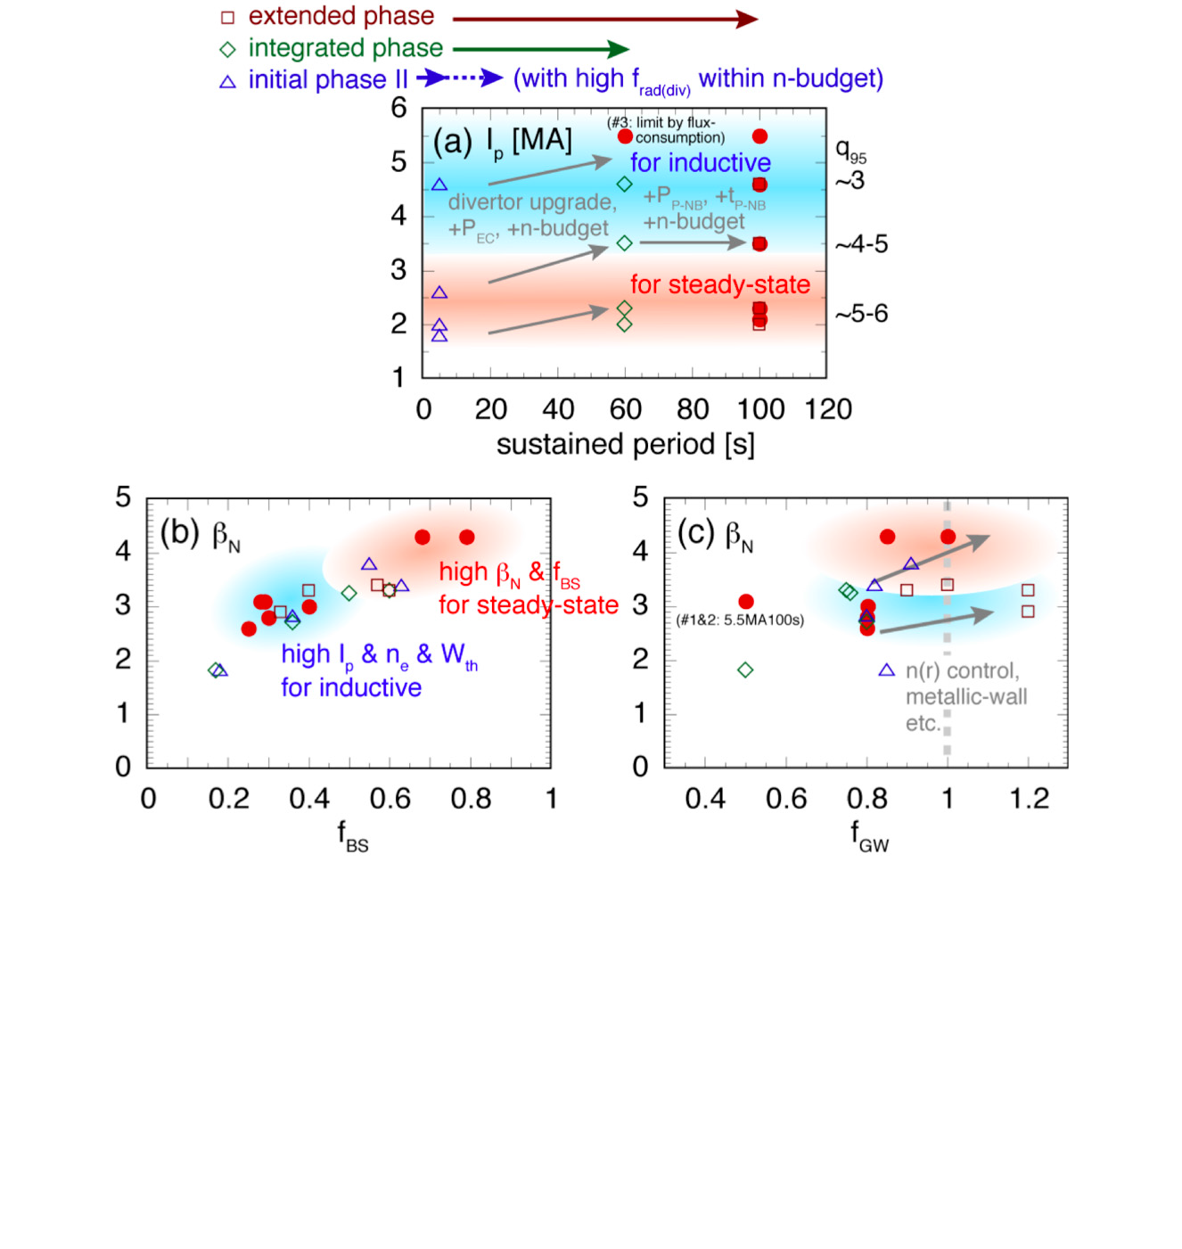
Scenario development
Target plasmas
  ITER standard (q₉₅~3)
  ITER advanced-inductive (q₉₅~4-5)
  DEMO steady-state with 2-3 times of t_{R} (q₉₅~5-6)
Evaluate DEMO design and ITER regime
  Scenario development for the three target plasmas
  Accessible integrated best performance of b_{N}, f_{BS}, H_{98y2}, f_{GW,} …
  Plasma control study in highly self-regulating and burning plasma conditions
    Suggest ITER operation scenarios and control schemes
    Give DEMO concept designs

Slide 6
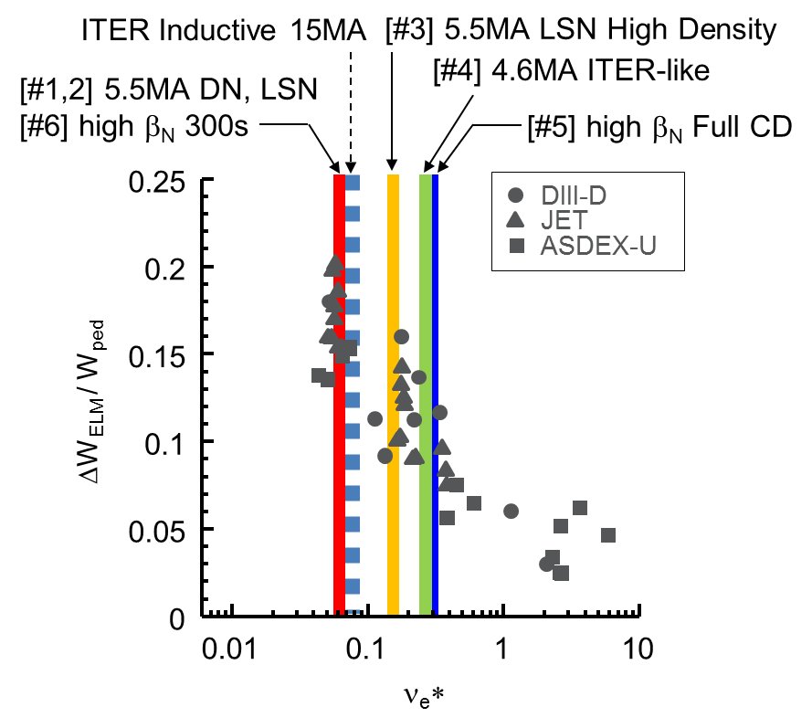
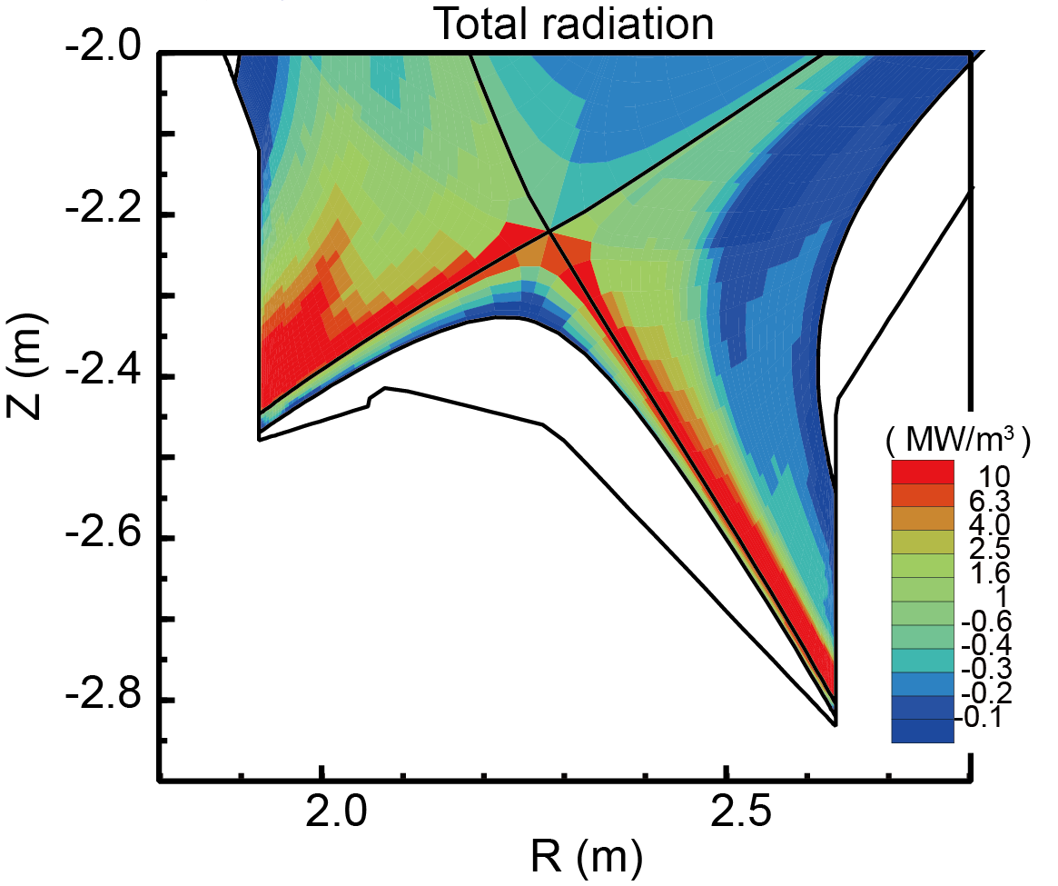
Risk mitigations at high performance plasmas
ELM mitigation and suppression
  at high I_{P} and low n* by RMP, pellets, shape
  QH-mode, small ELM development at low n* and low torque
  Disruption mitigation and avoidance
    in high I_{P} and W_{sto} plasmas
    Runaway electron study
    Operation below MHD stability limit
  Heat and particle handling
    Radiative divertor with impurity seeding at high power and long pulse
    Detached divertor sustainment in V-shaped divertor (C-wall => W-wall)
    Establish risk mitigation schemes in JT-60SA well before ITER

Slide 7
Physics and Control Studies in ITER, DEMO-relevant regimes
Core-edge transport and confinement studies in ITER and DEMO regimes
  Small r*, low n*, high b, strong e-heating
  ITER and DEMO like shapes
MHD mode control by various actuators
  NTM control by ECCD, kinetic profile
  RWM control by stabilizing plate and coils, EP and rotation effects
AE mode and EP mode studies in ITER and DEMO regimes
  Fast ions produced by NNB of 500 keV at I_{p}=5.5 MA,
  Develop models for ITER/DEMO prediction

Slide 8
EUROfusion priorities
Participation of EU scientists to the JT-60Sa scientific programme will be lead by the EU Strategic priorities in the JT-60SA research program
  Development and investigation of high performance scenarios compatible with future W-PFCs.
  Avoidance and mitigation of disruptions and runaways
  Fast ion physics
  Development and validation of high level real-time control strategies

Slide 9
EUROfusion priorities
Participation of EU scientists to the JT-60Sa scientific programme will be lead by the EU Strategic priorities in the JT-60SA research program
  Development and investigation of high performance scenarios compatible with future W-PFCs.
  Avoidance and mitigation of disruptions and runaways
  Fast ion physics
  Development and validation of high level real-time control strategies
Target plasmas
  Complement current European tokamaks
  Explore conditions currently unexplored in Europe

Slide 10
Contents
Mission of JT-60SA and link to EUROfusion
Experiment team organization
First steps of the Experiment team
Conclusions

Slide 11
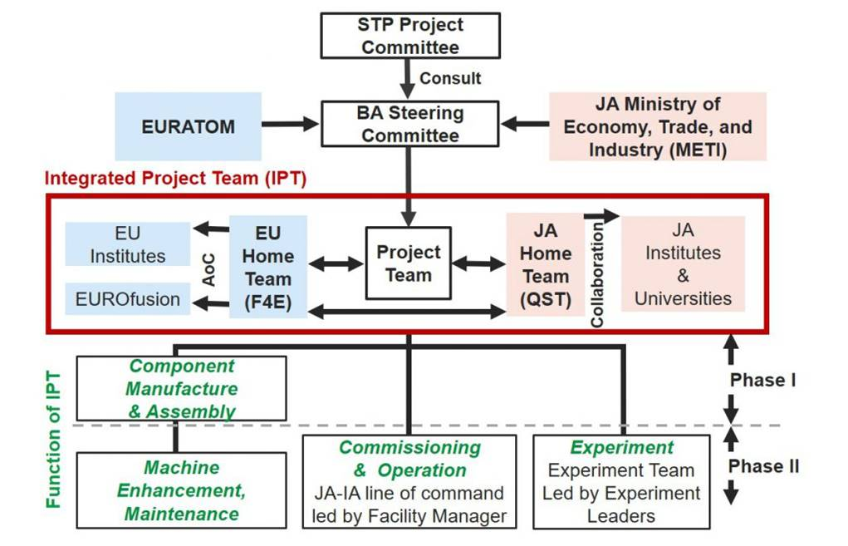
Global structure of the JT-60SA project
https://www.jt60sa.org/wp/

Slide 12
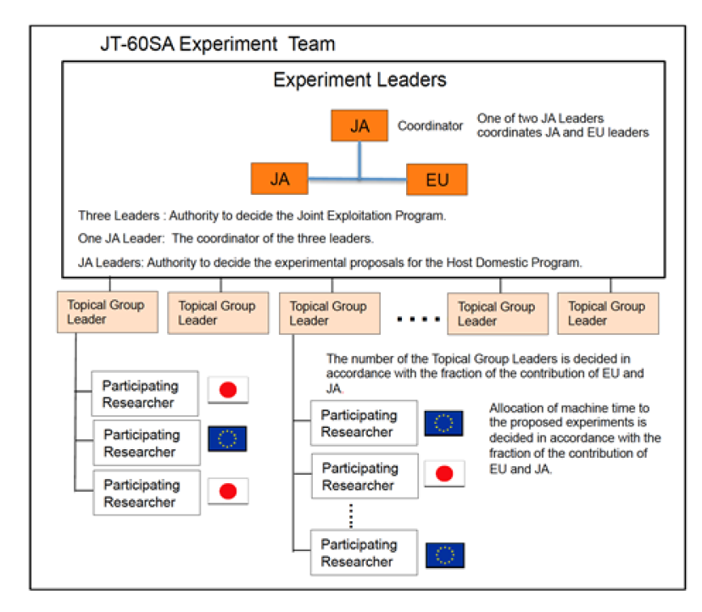
JT-60SA Experiment Team
JT-60SA Project leader and EU and JA Project Managers
https://www.jt60sa.org/wp/
The JT-60SA Experiment Team is the unified Experiment Implementation Structure for the JT-60SA experiment
3 Experiment Leaders
  Maiko Yoshida
  Hajime Urano
  Jeronimo Garcia

Slide 13
JT-60SA Experiment Team: experiment leaders
JT-60SA Project leader and EU and JA Project Managers
Experiment Team Leaders are responsible for:
Jointly develop the Annual Experiment Programme and submit it with the Annual Experiment Report to the Project Managers (PMs) and to the Project Leader (PL)
Jointly assessing, prioritizing, and allocating machine time to experimental proposals
Jointly direct and supervise the Experiment Team in the implementation of the Annual Experiment Programme
Jointly coordinate and validate the publications related to the Experimental Team activity.
Jointly receive, assess and make proposals for machine enhancement from the experiment team
Jointly contribute to the evaluation of the machine enhancement proposals

Slide 14
JT-60SA Experiment Plan Has Been Entrusted
Experiment Leaders
Operation Regime Development
Takuma Wakatsuki (QST, Japan)
MHD Stability and Control
Gianluca Pucella (ENEA, Italy)
Transport and Confinement
Luca Garzotti (UKAEA, UK)
High Energy Particle Behavior
Yevgen Kazakov (LPP-ERM/KMS, Belgium)
Pedestal and Edge Physics
Nobuyuki Aiba (QST, Japan)
Divertor, Scrape Off Layer and Plasma-Material Interaction
Tomohide Nakano (QST, Japan)
Topical group Leaders are responsible for:
  coordinate the scientific discussion of experiment proposals and the execution of the experiments assigned to the Topical Group
  the Experiment Coordinator is assigned by the Topical Group Leader of the topic or by the Experiment Leaders when it is across multiple topics
  the Topical Leader also summarizes the results and reports to the Experiment Leaders.

Slide 15
Specific working groups
Several topics have implications in the Experiment team and operational aspects
Several working groups are being organized:
Working group: Real time control (creation, development) led by the Operation Regime Development TGL with participants from the integrated commissioning team (including F4E).
Working group: Disruption avoidance techniques and disruption database led by MHD Stability and Control TGL with participants from the integrated commissioning team (including F4E).
Working group: Integrated Data Management (Integrated data coherence, data validation chain and software management) under preparation. A meeting will be organized soon.
Working group: Diagnostics (status, requests) under discussion. (the diagnostics are subsystems handled by QST)

Slide 16
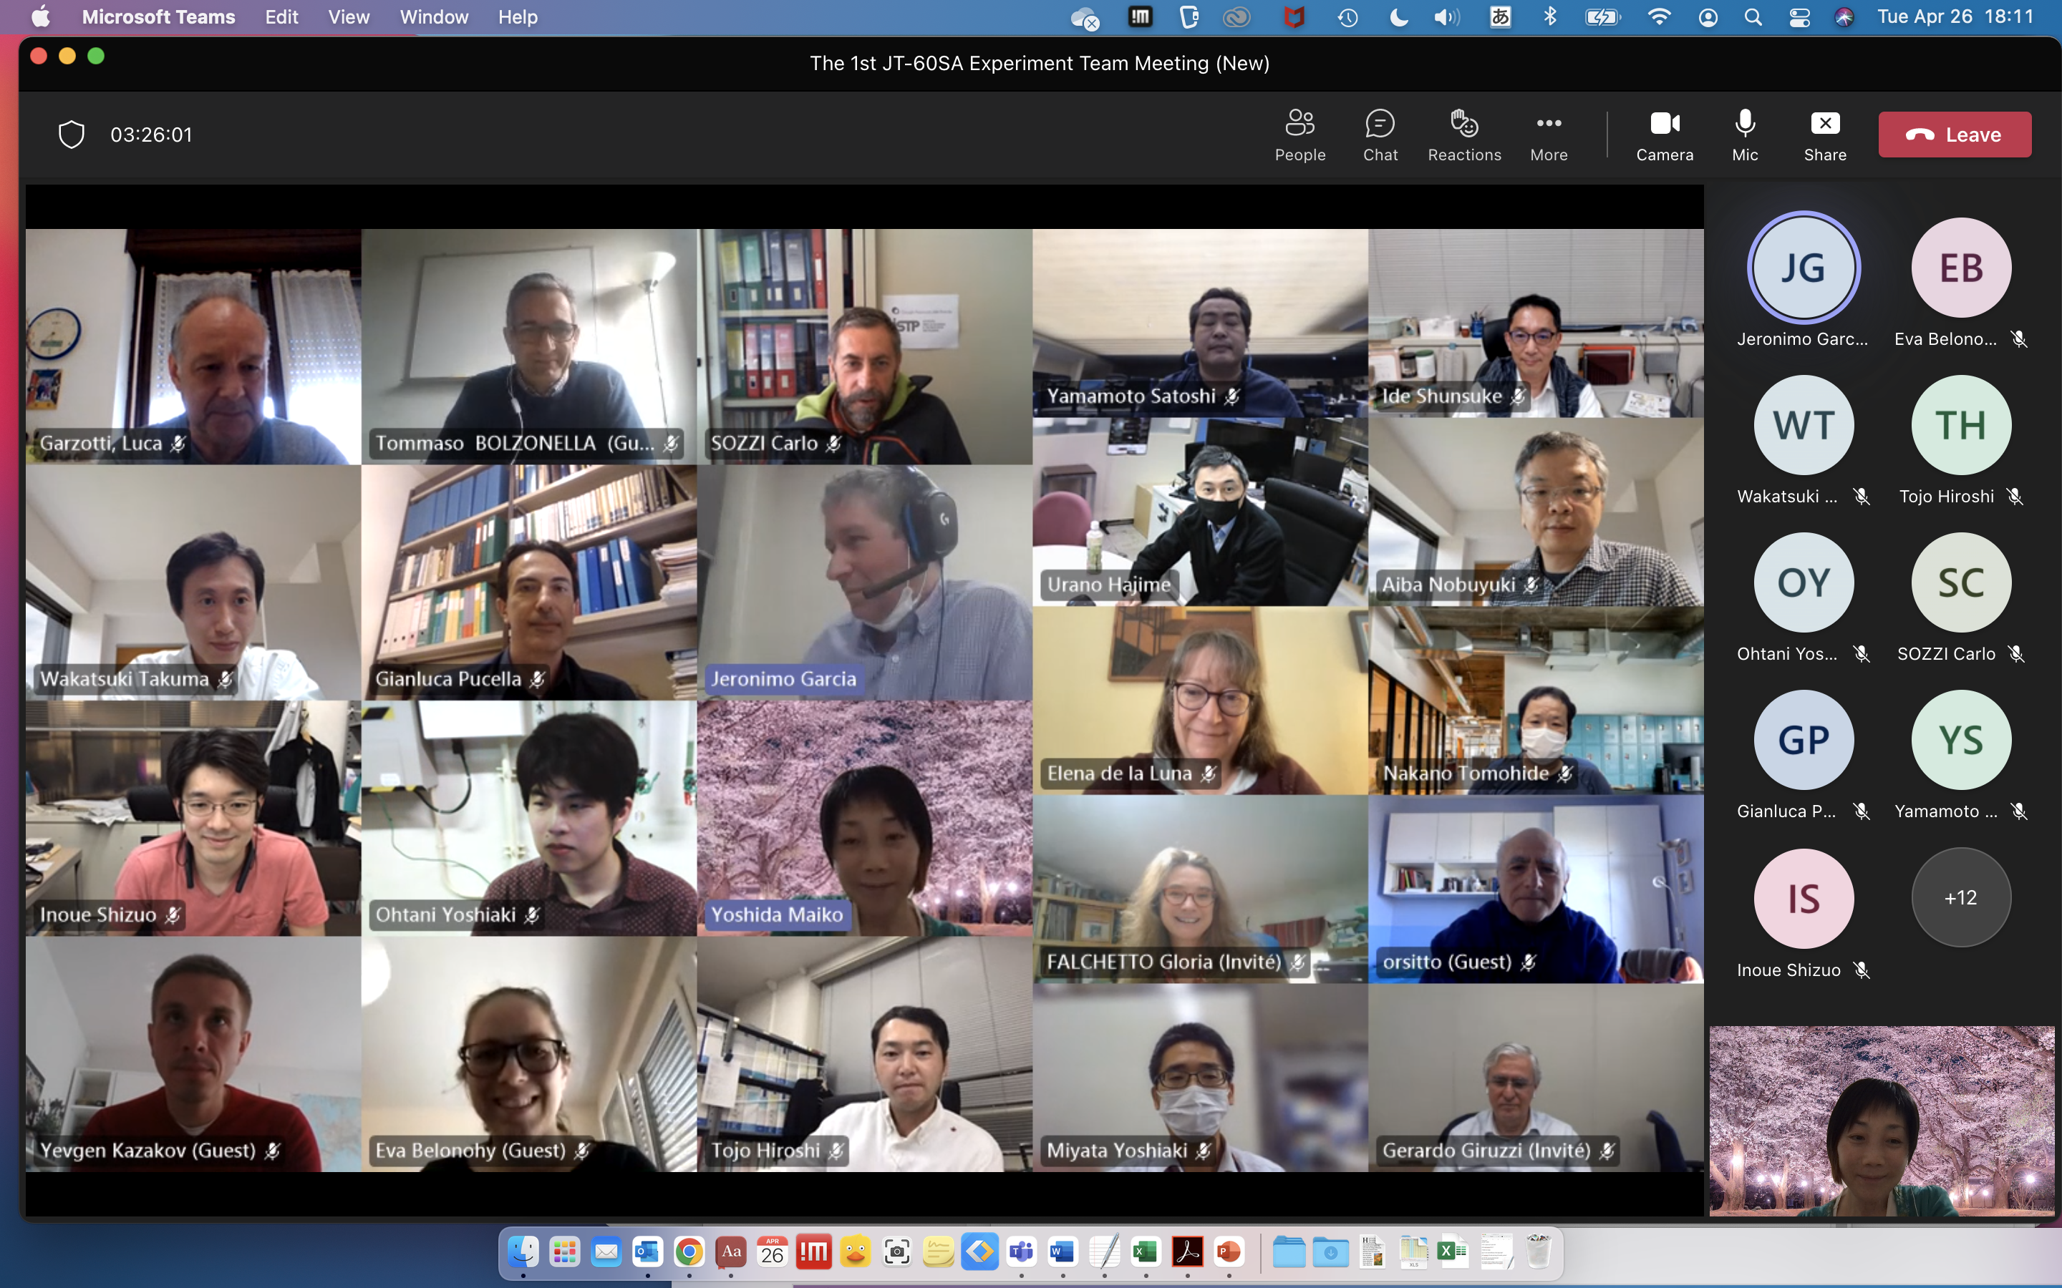
A joint team: First Experiment Team Coordination meeting April 2022

Slide 17
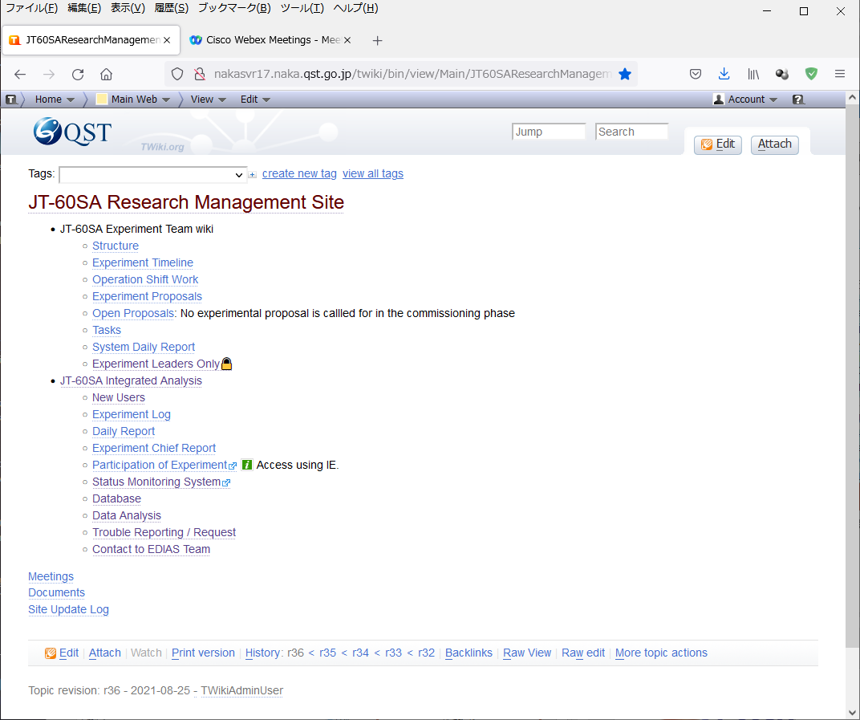
First steps: providing tools for management onsite and offsite
Environment of participation to experiment and data analysis is being developed for as equivalent access as possible between on-premise and remotely
HMI: control and monitor for whole JT-60SA operation
Data Analysis and DB Access Infrastructure
eDAS: basic analysis software
Data Access Library: further advanced analysis
Remote Access: RCA and RDA
JT-60SA RMS: information sharing among participants
JT-60SA Pinboard: effective publication management

Slide 18
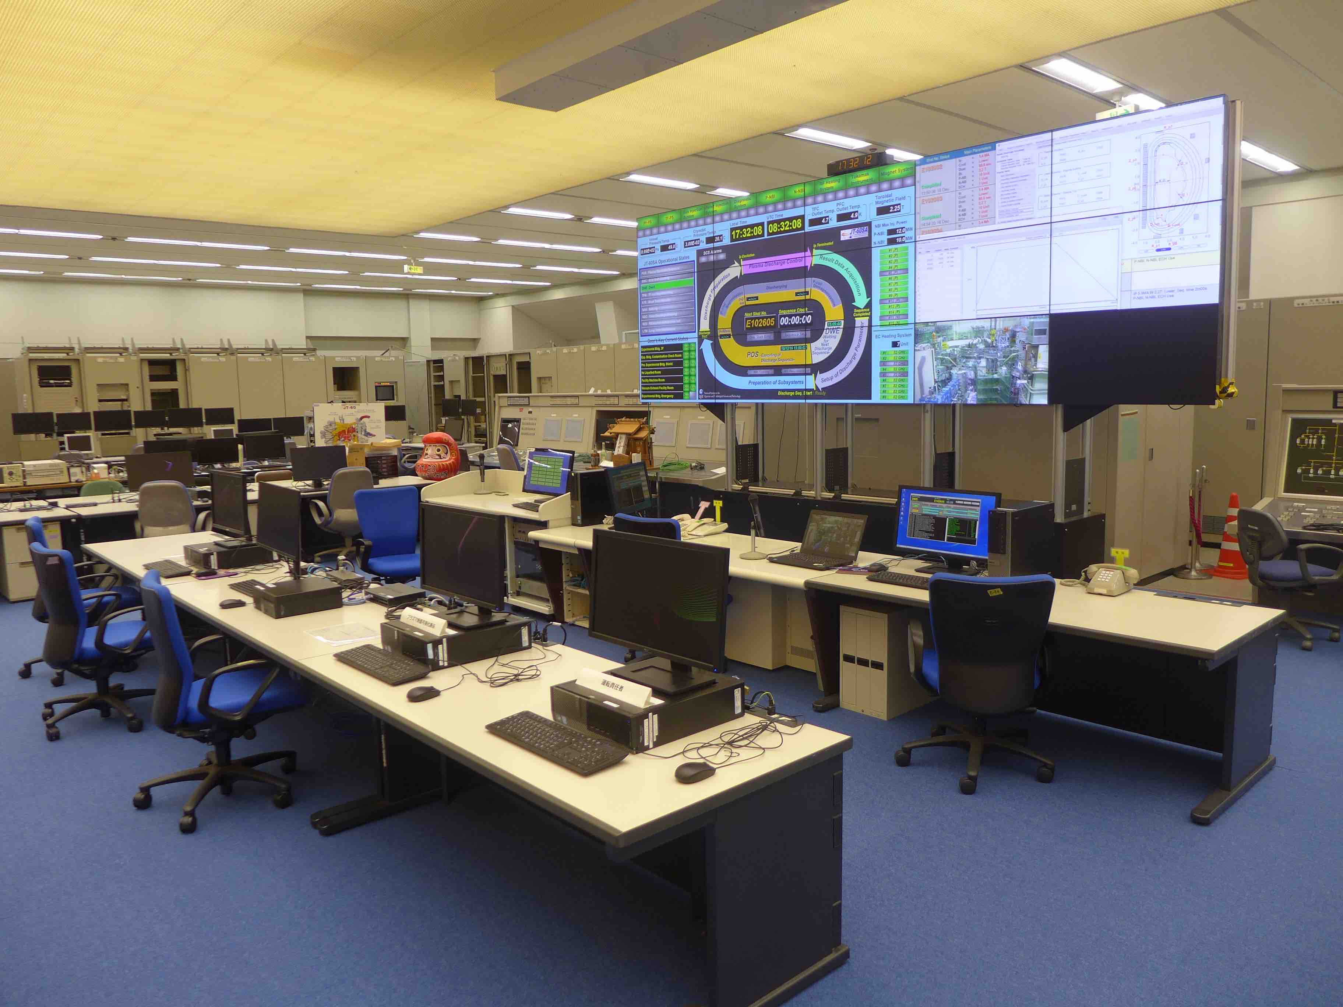
Control Room Structure
Control Room
Facility Manager
FM: Director of Dep. Tokamak System Technology
(Deputy FM : Director of Dep. Advanced Plasma Research)
Operation Manager
Shift Work
Plasma Operation Chief
Exp. proposers
in Experiment Team
Machine Coordinator
Plasma Operator
SCSDAS operation
Power Supply operation
Tokamak
operation
SCM & Cryo. operation
ECRF operation
NBI operation
Diagnostic operation
Plasma Operation Chief: Execute plasma operation requested by Exp proposers. Optimize discharge conditions and shot plan in the day considering subsystem status.
Plasma Operator: Program discharge conditions in Human Machine Interface (HMI) according to Plasma Operation Chief.
Experiment proposers: Design the plasma and shot plan and analyze data, request the shot to Plasma Operation Chief / Plasma Operator.

Slide 19
Contents
Mission of JT-60SA and link to EUROfusion
Experiment team organization
First steps of the Experiment team
Conclusions

Slide 20
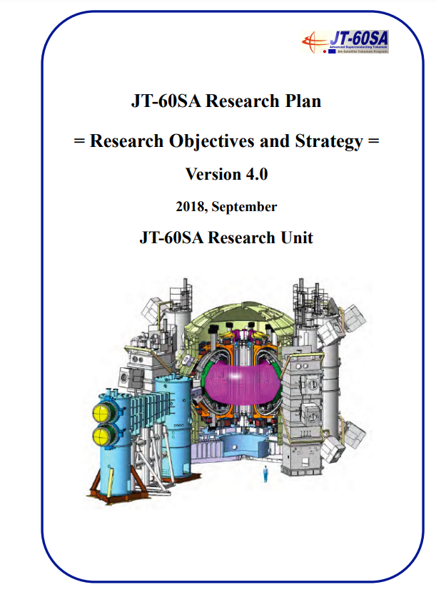
Experiment team: Beyond the research plan
JT-60SA research plan is a key pillar to understand our scientific objectives https://www.jt60sa.org/pdfs/JT-60SA_Res_Plan.pdf
But it is not necessarily written in stone:
  New proposals are welcome
  Experience from other tokamaks is important but we should go beyond
Research plan is giving generic scientific objectives, mainly focus on key goals
Need to define the main scientific topics for the initial campaigns, coherent with
  Required Machine Enhancements
  Analysis and simulation codes available

Slide 21
Experiment Team: first actions
Meetings between EL and each TGL have been held after ETCM(1) in order to discuss the contents of the initial campaigns including potential difficulties with power, current etc
Initial ideas and desirables activities during 2022-2023 discussed
TG meetings will be held before the end of 2022
ETCM(2) to be held end of September early October → Joint discussion between ET and QST and WPSA experts

Slide 22
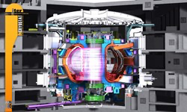
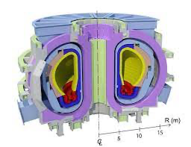
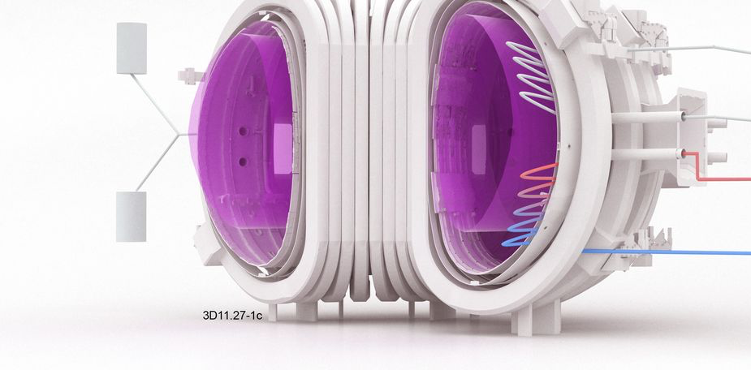
Machine Enhancement - Step by Step -
JT-60SA
ITER
PFPO-1
DEMOs
PFPO-2
FPO-1

Slide 23
Machine Enhancements decision flow
QST or
EU institutes
Diagnostic collaboration under a framework between institutes
Other ITER parties (US, CN, KO, ITER, etc.)
  Propose diagnostics & experiment with QST or EU
  Persons in charge join in Experiment Team
Additional flow for other ITER parties
Express to participate in BA Activities
Project Leaders and Project Managers judge the participation (at BASC)
Approval
Proposer prepares following materials
  Research needs and impact in JT-60SA program
  Design and feasibility studies of the diagnostics
  Available resources (budget and persons) by QST/EUROfusion/F4E/others
Propose
Experiment Team + other experts if necessary discuss the proposal from scientific viewpoint Review of research needs, impact of the diagnostics in dedicated meetings
  Set the priority and plan the new diagnostic installation period
    Comparison with other diagnostics if conflicting
Flow for JA or EU
Experiment Leaders prepare an executive summary for enhancement request
Project Leaders and Project Managers judge the machine enhancement plan
  Design Review Meeting by JA and EU Home Teams and Project Team
  Procurement Arrangement between JA and EU Home Teams (Cost reallocation)
Approval
Manufacture starts under the Home Teams’ or the QST experiment group control.
Notes:
c.f. Guidelines on participation of other ITER Parties in Broader Approach Activities at the level of Research Institutes

Slide 24
Machine Enhancements decision flow
QST or
EU institutes
Diagnostic collaboration under a framework between institutes
Other ITER parties (US, CN, KO, ITER, etc.)
  Propose diagnostics & experiment with QST or EU
  Persons in charge join in Experiment Team
Additional flow for other ITER parties
Express to participate in BA Activities
Project Leaders and Project Managers judge the participation (at BASC)
Approval
Proposer prepares following materials
  Research needs and impact in JT-60SA program
  Design and feasibility studies of the diagnostics
  Available resources (budget and persons) by QST/EUROfusion/F4E/others
Propose
Experiment Team + other experts if necessary discuss the proposal from scientific viewpoint Review of research needs, impact of the diagnostics in dedicated meetings
  Set the priority and plan the new diagnostic installation period
    Comparison with other diagnostics if conflicting
Flow for JA or EU
Experiment Leaders prepare an executive summary for enhancement request
Project Leaders and Project Managers judge the machine enhancement plan
  Design Review Meeting by JA and EU Home Teams and Project Team
  Procurement Arrangement between JA and EU Home Teams (Cost reallocation)
Approval
Manufacture starts under the Home Teams’ or the QST experiment group control.
Notes:
c.f. Guidelines on participation of other ITER Parties in Broader Approach Activities at the level of Research Institutes

Slide 25
Machine Enhancements decision flow
ET leaders are producing a document about ME priorities and recommendations→ September
The document will be transferred to PM/PL who will take the final decision
ET leaders are analysing set of potential upgrades for the machine actuators (input power, ECRH vs ICRH, Impurity powder dropper)
Prioritization will include ME proposed by USA

Slide 26
The role of the Experiment Team
The Experiment team is formed now by EL+TGL
Experiment team will lead the analyses of the IC results after IC→ member list has to be determined for after IC → call for the expression of interest
Call for experiment proposals is expected to happen after IC and 1.5 years before OP2
but many things to do in the meantime for which the experiments team structure can be helpful
  Reinforce collaborative work
  Improve joint leadership
  Exchange of new ideas towards the initial operation phase
  Drive JA-EU sides towards a common goal
  Coordinate joint modelling between JA and EU
  Solve misunderstanding issues
  Interaction with WPSA is essential

Slide 27
Contents
Mission of JT-60SA and link to EUROfusion
Experiment team organization
First steps of the Experiment team
Conclusions

Slide 28
Conclusions
The experiment team structure has been stablished in 2022.
EL+TGL are already appointed
Initial ideas for the first experimental campaigns and diagnostics required already discussed between EL and TGL
Further discussion will be held in specific meetings within the experiment team
Experiment team will be responsible for the IC data analyses and associated publications
Participants on the IC analyses after performing the IC will belong to the experiment team
In the meantime the ET will be useful for:
  Coordinate and favour joint activities
  Propose new ideas
  Improve link with the operator
  Advice about activities in 2022-2023

Slide 29
Back-up

