Slide 1
WPSA Code Management and Simulation Area overview & 2023 main objectives
WPSA Project Planning Meeting, 6-9 September 2022
Gloria FALCHETTO
WPSA Code Management Area Coordinator

Slide 2
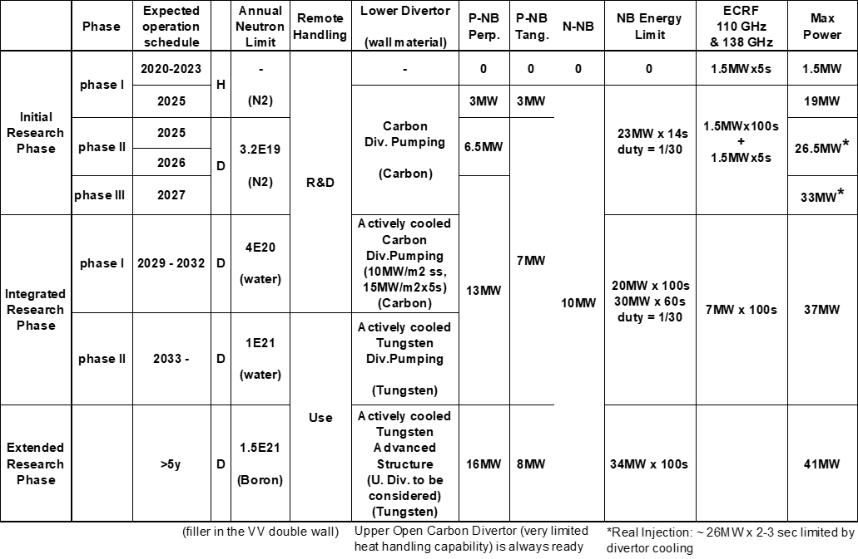
WPSA Code Management and Simulation area strategy
Establish reliable modelling codes, workflows and operation related tools for routine use in JT-60SA scientific exploitation
Modelling support to the enhancements and diagnostics procured by EU
Specific focus on modelling the Initial Research Phase + contribute to Integrated Research Phase wall diagnostics design (F4E/WPDIV)
Updated Project Phases BA SC 29

Slide 3
Code management and modelling activities – 2021-2022
Operation oriented tools and synthetic diagnostics :
Discharge simulator development
Breakdown simulator development & optimization of BD scenarios
Electron Cyclotron Wall Conditioning ECWC simulation tools ready for validation
Integrated Data Analysis tools requirement capture
Proposal for disruption mitigation/avoidance trigger
Visible imaging analysis tools provision (camera tomography, EDICAM)
Assessment of PCI measurement
FILD synthetic diagnostics
Modelling for JT-60SA Initial Research Phase scenarios
Scenario modelling with operationally oriented integrated modelling transport codes
Edge and divertor modelling (C scenarios + wall diagnostics design support)
Energetic Particle stability analysis
MHD stability analysis
RWM control
Non-linear MHD modelling of pellet triggered ELMs
Runaway electron heat loads on PFC
Disruption modelling tools ready for validation
new
new
Relevant EUROfusion wiki page
WPSA.CM Area
Indico:
WPSA General Meeting May 2022
Notes:
The ongoing tasks under the “code management and modelling” area coordinated by Gloria Falchetto within EU project WPSA aiming at supporting JT-60SA scientific exploitation were presented.
On the one side, the development of operation related simulation tools such as the discharge simulator: first METIS CREATE-NL strong coupling has been achieved, although unstable in transient phases, hence an improved coupling method between FBE-transport codes (NICE/METIS) is being implemented.
On the other hand, ongoing modelling focused at addressing initial research phase scenarios: successful Scenario 2 ramp-up modelling with JINTRAC; SOLPS-ITER grid sensitivity study in pure D case assessing suitable reference resolution for benchmarking with SONIC; gyrokinetic Energetic Particle stability analysis (LIGKA) aiming at automated application of the EP workflow to the assessment of EP-stability in ramp-up and steady-state plasmas; non-linear MHD modelling of pellet triggered ELMS (JOREK) in Scenario 4 with reduced pedestal pressure (40kPa); computations preparing for validation of disruption modelling tools (CARMA0NL-CARIDDI) on JT-60SA mechanical data; and, finally, newly started task on simulations of energy deposited by runaway electrons (FLUKA) on PFC.

Slide 4
WPSA.CM Operation related Tasks 2022
TOPIC | Deliverable 2022 |  | Del Owner / Team
 | Plasma operation oriented tools
Plasma discharge simulator | Verified JT-60SA pulse simulator including implementation of current, gaps and vertical stabilization controllers | E. Joffrin JF Artaud C Boulbe B Faugeras (CEA, Univ Nice) M Mattei D Frattolillo et al (ENEA CREATE)
 | Provision of discharge simulator select test cases | W Bin (ENEA CNR Mi) G Giruzzi (CEA)
ECWC modelling | Report on the validation of ECWC code (TOMATOR-1D) on the first data from JT-60SA Integrated Commissioning !pending IC - postponed to 2023 | J Buermans (LPP-ERM-KMS)
Breakdown modelling | Documentation on runs on JT-60SA breakdown using a nonlinear optimization technique. Extended scope in support of IC – simulating limit conditions tbd after Paschen test | Daria Ricci L Figini M Mattei (CNR Mi, ENEA CREATE)
Integrated Data Analysis | Plan for the implementation of IDAV for JT-60SA scientific exploitation – on standby pending dedicated ET meeting with QST | R Fischer D Stieglitz (IPP Garching)
Disruption trigger | Proposal for building parsimonious disruption mitigation/avoidance triggers | Jesùs Vega (CIEMAT) M Gelfusa A Murari R Rossi (ENEA) T Cracinescu (IAP) F Bairaktaris A Papadopulos (NCSRD)

Slide 5
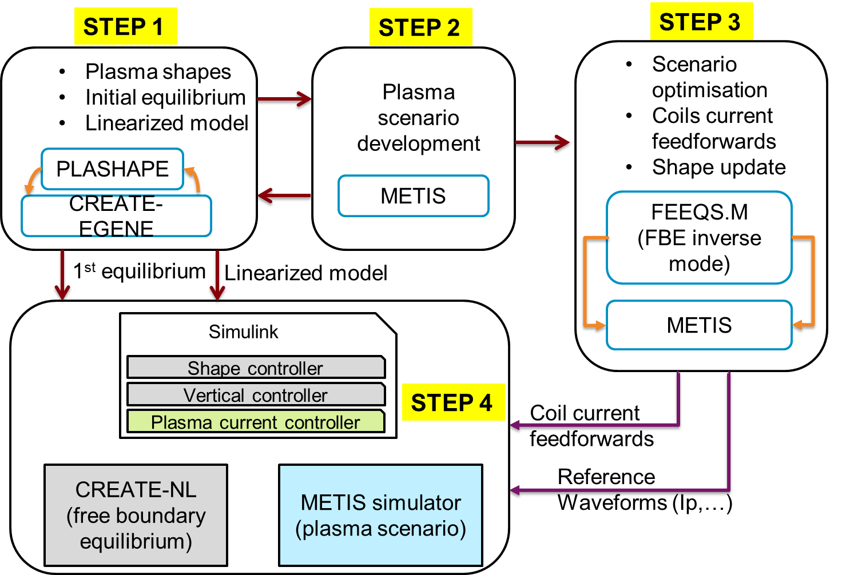
JT-60SA discharge simulator
Wed 7th 14h Topic session: Discharge simulator and scenario modelling
Discharge Simulator & user group on the EUROfusion Gateway
EGENE, METIS and FEEQS have been installed on the Gateway
Calculations for scenario 2 and 4.2 (priorly done with METIS NICE - local platform)
“Strong coupling” development for better description of the Ip, recent work for implementation of controllers CREATE/CEA
! Feasibility of the scenarios in the PID to be revised
(in interaction with QST)
Scenario 4.2,
issues with Ip ramps and EF4 saturation => more realistic tuning of the scenario is necessary

Slide 6
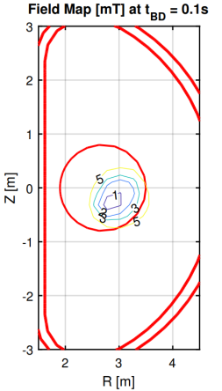
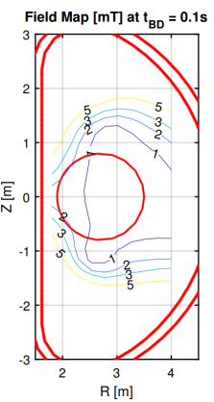
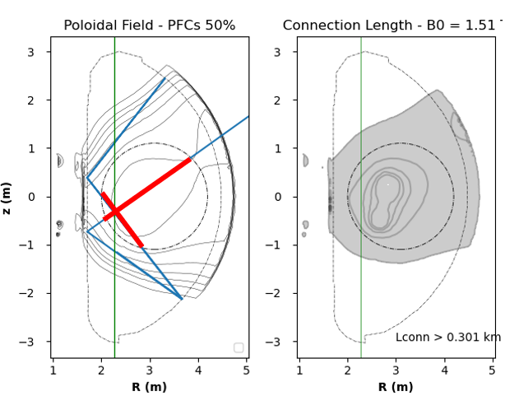
Breakdown simulations
Wed 7th @11h Topic session: IC 2023 preparation - First plasma
Investigations of BD scenarios in the presence of degraded performance of the CS coils (electromagnetic analysis)
Recent activity promoted by F4E / CM BD task extended / reoriented
by-weekly meeting during this summer
Scenario JT60SA_BD_HC_noCS1: Half current in the central solenoid but zero current in CS1 module, full maximum total voltage on coils (5kV).
=> electric field can be 0.6 V/m but the null region becomes very small and is shifted outwards. Plasma formation maybe possible but the ramp up would be quite difficult to achieve (1)
Scenario JT60SA_BD_HC_0d3_Vtot2kv: Half current in the central solenoid, reduced total voltage on coils (2kV).
=> The electric field can be max 0.3 V/m. The null region is ok and the plasma current ramp up seems doable (2)
EC absorption very low (3%@82 GHz, 1%@110 GHz) with the IC waveguide launcher
Other breakdown scenarios being explored (might introduce a decision point after the Global Paschen Test)
with and w/o Switching Network Unit, various EF settings, E// ~ 0.4V/m
with and w/o Booster PS (level of ripple in the present configuration harmful for coil insulation)
(1)
(2)
110 GHz 2x res

Slide 7
WPSA.CM Modelling Tasks 2022 (1)
TOPIC | Deliverable 2022 | Del Owner
Scenario development transport analysis | Integrated modelling of ramp-up of initial research phase scenarios with first principles transport models | L Garzotti D Taylor (UKAEA) P Strand D Yadikin E Fransson (VR) P Huynh (CEA)
MHD and control | MHD stability chain deployed to users | R Coelho (IST)
 | Application of CarMa-D model in state-space representation for developing RWM control time simulation and test controller concepts | L Pigatto et al (ENEA RXF)
 | Validation of disruption modelling tools (CarMa0NL-CARIDDI) on first JT-60SA mechanical data ! Pending IC postponed to 2023 | F Villone et al (ENEA CREATE)
 | Estimate of heat load levels and distributions caused by REs via a workflow coupling particle tracing codes to FLUKA. | J Caloud A Casolari E Macusova (IPP.CR)
Pedestal and edge | Report/publication on (JOREK) modelling of multiple pellet injection in self-consistently evolving pedestal profile | S Futatani (CIEMAT UPC)
Energetic Particle modelling | Demonstration of automated application of the EP workflow to the assessment of EP-stability in ramp-up and steady state plasmas. | Ph Lauber (IPP-Garching)
 | Provide ASCOT distribution function for beam ions | A Snicker (VTT)
 | Analysis of linear AE stability of initial research phase (H,D) scenarios | R Coelho (IST)
Wed 7th 14h-18h Topic session: Discharge simulator and scenario modelling:
core transport, MHD & Fast particles stability, RWM control, ELMs

Slide 8
Scenario simulation: modelling of ramp-up
Scenarios:
• Fully predictive (current density, ion and electron temperature predictive, density feedback controlled).
• Equilibrium (ESCO), power deposition ECE (GRAY) and NBI (PENCIL) and L-H transition (Martin scaling) calculated self-consistently.
• Temperature pedestal height after L-H transition set by self consistent HELENA/MISHKA stability analysis.
EC frequency used in Research Plan - to be revised?
assess if auxiliary power enough to access H-mode in H – extrapolated to D – to help ITER
Assessment of the shine-through
Assess if enough ECRH power to tailor the q-profile? Eg relevant for hybrid scenario 4.2
Impact of resistivity model on ramp-up. Effect of impurities can be assessed with ETS
Effect of ramp up speed on the profile
Relevant for hybrid scenario reversed q –profile during EC deposition ?
ECH during ramp-up (Ip=2.1MA, Bt=2T, 110GHz)
Te
ne
ECH
absorption
Ip

Slide 9
WPSA.CM Modelling Tasks 2022 (2)
TOPIC | Deliverable 2022 | Del Owner
Edge and divertor modeling | Sensitivity study of low n /current drive scenarios with C divertor, with SOLEDGE3X edge transport code, including impurity seeding impact | G Falchetto K Galazka (CEA)
 | Assessment of JT-60SA Initial research phase II scenario 2 via edge/divertor modelling integrated with core conditions (SOLEDGE) | L Balbinot (ENEA)
 | Modelling of C wall Scenario 2 with SOLPS-ITER. | P Chmielewski (IPPLM)
 | Report on the benchmark of SOLPS_ITER to SONIC. | G Rubino D Coster (ENEA, IPP)
Modelling support to Langmuir probe design assessment for Integrated Research Phase (WPDIV need)
26/07 Dedicated meeting WPSA CM ENH reporting to WPDIV F4E
Thu 8th 14h30-16h Parallel session: Edge/divertor modelling

Slide 10
WPSA.CM Synthetic diagnostics Tasks 2022
TOPIC | Deliverable 2022 | Del Owner / Team
 | Synthetic diagnostics development
Turbulent transport | Assessment of the JT-60SA PCI diagnostics measurement, on relevant high-beta gyrokinetic turbulence including fast ions | A Iantchenko (EPFL)
Visible imaging | Feasibility study of tomographic inversion for characterizing runaways in plasma conditions relevant for JT-60SA | J Cavalier J Svoboda (IPP.CR)
 | Improved EDICAM visualization tools | T Szepesi et al (EK)
FILD | Optimization of FILD detector head geometry using synthetic diagnostics | M Garcia-Munoz et al (CIEMAT Univ Sevilla)
Thu 8th 10h30
Topic session: FP9 Enhancements
Thu 8th 14h Parallel session: Preparation of the FP8 enhancements commissioning
new

Slide 11
Code management & simulation - elements of planning for 2023
No significant impact of the delayed IC on the development of tools for scientific analysis and in simulation activities in preparation of the experimental campaign.
The activities related to validation of modelling tools on IC data are postponed to 2023.
Trainings on the Discharge Simulator as well as on the released modelling tools in support to the scientific exploitation shall be planned respectively ahead of the IC and experimental campaigns.
Contribute to the analysis of the IC data in liaison with the Experiment Team.
Provide support for Diagnostics R&D
Progress towards the deployment of ​validated analysis and modelling tools ​
for operation and scientific exploitation​
Modelling to be defined in coordination with Experiment Team

Slide 12
Extend modelling using developments from TSVV ?
TSVV | Objective/topic | When
1. Physics of the L-H Transition and Pedestals | Interpretative and predictive capability of L-H transitions | Before/after first H mode plasma (2025?)
3. Boundary plasma modelling | neutrals/recycling modelling, impurities in edge turbulent codes | ~2025
8. MHD Transients | Disruption modeling, SPI and MGI mitigation, ELM triggering and pacing | Possibly from 2023
9. Dynamics of Runaway Electrons in Tokamak Disruptions | Validation of RE generation model | Possibly from 2023
10. Physics of Burning Plasmas | Energetic Particle stability and transport, N-NBI distribution function modeling, ramp-up scenario with NBI | Ongoing, data ~2025
- Proposals of EUROfusion Research Grants (ERG) welcome
Modelling aims and needs to be defined
in coordination with Experiment Team

Slide 13
This meeting CM sessions – 2023 activity planning
IC related topics:
ECWC, breakdown modelling, startup runaway detection
Scenario modelling - all aspects: discharge simulator, core transport/turbulence, MHD and fast particles stability
discussion shall focus on scenario revision to identify feasibility, limits and needs for advanced modelling
definition of use cases for trainings
Edge/SOL divertor modelling (including Langmuir probes design) interface to equilibrium
Disruption trigger alarm / disruption modelling
EDICAM & synthetic diagnostics (TPCI, FILD) will be discussed during the respective enhancement sessions
Wed 7th @11h
Topic session: IC 2023 preparation - First plasma
Wed 7th 14h-18h
Topic session: Discharge simulator and scenario modelling
Thu 8th 14h30-16h Room 2
Parallel session: Edge/divertor modelling
Thu 8th 16h30 Room 2
Parallel session: Disruption avoidance techniques
Thu 8th 10h30 & 14h Room 1 ENH sessions

Slide 14
BACKUP

Slide 15
Useful links wiki – EUROfusion Gateway – data repository
Please keep your Task wikipage up-to-date
https://wiki.euro-fusion.org/wiki/WPSA:_Code_Management_and_Simulation
The EUROfusion Gateway cluster is the home of WPSA code development work and shared simulation tools
Gateway access request please follow the procedure on: https://wiki.eufus.eu/doku.php
Gateway login (X2Go, NoMachine, ssh) g2username@login.eufus.eu
A training on the Gateway setup and use (as well as on IMAS) provided by ACH is available, links on:
https://wiki.euro-fusion.org/wiki/ACH-04
A gitlab has beeen setup: https://gitlab.eufus.eu/
A repository for WPSA Gateway users has been created : /afs/eufus.eu/gw/wpsa
you can request access to admins: mail to rcoelho@ipfn.ist.utl.pt; CC gloria.falchetto@cea.fr
Previous JT-60SA modelling data is stored here:
/afs/gw/wpsa/groupoffice/users/MODELING
Documentation tutorials on discharge simulator METIS / CREATE_EGENE
https://wiki.euro-fusion.org/wiki/WPSA_CM:_Discharge_simulator
Gateway repository : /afs/gw/wpsa/applications/

Slide 16
Reference CM deliverables 2022 - modelling (1)
Deliverable ID | Deliverable title | Deliverable Owner | Beneficiaries
SA-SE.CM.M.01-T003-D001 | MHD stability chain deployed to users | R Coelho | IST
SA-SE.CM.M.01-T004-D001 | Application of CarMa-D model in state-space representation for developing RWM control time simulation and test controller concepts | L Pigatto | ENEA
SA-SE.CM.M.01-T005-D001 | Report/publication on the modelling of multiple pellet injection in self-consistently evolving pedestal profile | S Futatani | CIEMAT
SA-SE.CM.M.02-T003-D001 | Report/publication on integrated modelling of ramp up of initial phase Scenario 2 with first principles transport models | L Garzotti | UKAEA
T003-D002 |  | P Strand | VR CEA
SA-SE.CM.M.02-T004-D001 | Assessment of the JT-60SA PCI diagnostics measurement, on relevant high-beta turbulence including fast ions. | A Iantchenko | EPFL
SA-SE.CM.M.03-T003-D001 | Final report on the modelling of initial research phase II scenarios with edge/SOL transport code | G Falchetto | CEA
SA-SE.CM.M.03-T003-D002 | Assessment of JT-60SA Initial research phase II scenario 2 via edge modelling integrated with core conditions. | L Balbinot | ENEA
SA-SE.CM.M.03-T003-D003 | Final report on the modelling of C wall Scenario 2 with SOLPS-ITER. | P Chmielewski | IPPLM
SA-SE.CM.M.03-T004-D001 | Report/publication on the benchmark of SOLPS_ITER to SONIC. | G Rubino | ENEA MPG

Slide 17
Reference CM deliverables 2022 - modelling (2)
Deliverable ID | Deliverable title | Deliverable Owner | Beneficiaries
SA-SE.CM.M.04-T002-D001 | Demonstration of automated application of the EP workflow to the assessment of EP-stability in ramp-up and steady state plasmas. | Ph Lauber | MPG
SA-SE.CM.M.04-T002-D002 | Report/publication on linear AE stability of JT-60SA initial research phase H and D scenarios | R Coelho | IST
SA-SE.CM.M.04-T002-D003 | Provide ASCOT distribution function for beam ions | Antti Snicker | VTT
SA-SE.CM.M.05-T004-D001 | Estimate of heat load levels and distributions caused by REs at JT-60SA via a workflow coupling particle tracing codes to FLUKA. | J Caloud | IPP.CR

Slide 18
Reference CM deliverables 2022 : Operation and synthetic diagnostics (3)
Deliverable ID | Deliverable title | Deliverable Owner | Beneficiary
SA-SE.CM.OP.01-T002-D001 | Verified JT-60SA pulse simulator including implementation of current, gaps and vertical stabilization controllers | Joffrin (CEA) | CEA
SA-SE.CM.OP.01-T003-D001 | Provision of discharge simulator select test cases | William Bin | ENEA
SA-SE.CM.OP.03-T002-D001 | Documentation on runs on JT60-SA breakdown using a nonlinear optimization technique. | Daria Ricci (ENEA-CNR) | ENEA
SA-SE.CM.OP.04-T002-D001 | Plan for the implementation of IDAV for JT-60SA scientific exploitation | Rainer Fischer (IPP-Garching) | MPG
SA-SE.CM.OP.05-T002-D001 | Proposal for building parsimonious disruption mitigation/avoidance triggers_CIEMAT | Jesus Vega | CIEMAT
SA-SE.CM.OP.05-T002-D002 | Proposal for building parsimonious disruption mitigation/avoidance trigger_ENEA_IAP | M Gelfusa | ENEA
 |  |  | IAP
SA-SE.CM.OP.05-T002-D003 | Proposal for building parsimonious disruption mitigation/avoidance triggers_NCSRD | Fotis Bairaktaris | NCSRD
SA-SE.CM.SD.01-T003-D001 | Feasibility study of tomographic inversion for characterizing runaways in plasma conditions relevant for JT-60SA | Cavalier (IPP.CR) | IPP.CR
SA-SE.CM.SD.01-T004-D001 | Improved EDICAM visualization tools | Szepesi (EK) | EK-CER
SA-SE.CM.SD.02-T001-D001 | Optimization of FILD detector head geometry using synthetic diagnostics | Manuel Garcia-Munoz | CIEMAT

Slide 19
Changes in CM tasks
Deliverable ID | Deliverable title | Deliverable Description | Deliverable Owner | Resources Beneficiary | PM | Comments(issues, goals, any relevant update, risk of delay, staff difficulties)
SA-SE.CM.M.05-T003-D001 | Preliminary report on the validation of disruption modelling tools (CarMa0NL-CARIDDI) on first JT-60SA mechanical data | Validation of disruption modelling tools (CarMa0NL-CARIDDI) using JT-60SA halo current and strain gauges measurements | Villone (CREATE) | ENEA | 2 | Move task to 2023. Move resources to SA-SE.CM.OP.03-T002-D001
SA-SE.CM.OP.02-T001-D001 | Report on the validation of TOMATOR-1D code on the first data from JT-60SA Integrated Commissioning | Validate TOMATOR-1D code on the first data from commissioning. | Johan Buermans | LPP-ERM-KMS | 2 | Move task to 2023
SA-SE.CM.OP.03-T002-D001 | Documentation on runs on JT60-SA breakdown using a nonlinear optimization technique. | Optimization and Simulation of 4 BD scenarios for JT60-SA (full and half CS current combined with full and half toroidal field) using a nonlinear optimization technique. | Daria Ricci (ENEA-CNR) | ENEA | 4 | Extend scope in support of modelling for IC after Paschen test - use FP8 funding from SA-O.A06-T003-D002 (2 PMs)

