Slide 1



JT-60SA remote participation tools Update
6 September 2022
G. De Tommasi^{1,2}
Task contributors : H. Ancher (CEA), F. Imbeaux (CEA),
C. Fuchs (IPP), A. Winter (IPP), G. Manduchi (RFX)
¹Consorzio CREATE
²Department of Electrical Engineering and Information Technology, University of Naples Federico II, Italy

Slide 2
Contents
Review of the available tools for remote participation

Slide 3
Available tools
Remote Computer Access to the Naka Analysis Server
  via NoMachine or ssh
  it gives access to data visualization tools (eDas) and – in the future – to modelling codes (e.g., MECS → the QST «flight simulator»)
  it gives access to Data access library available on the Naka server (documentation available only in Japanese, but example available on FP8 wiki)
Web access to the JT-60SA Research Management Site (wiki-based intranet) – (LINK - works only if logged to the QST VPN)
HMI client (discharge editor + limited plant monitoring HMIs)
Live Live Streaming of cameras or PC screens accessible via http (once logged to QST VPN)
Remote Data Access (aka Web API)

Slide 4
Available tools (cont’d)
~35 EUROfusion colleagues have access to the tools (other are coming soon)
  only 5 beta users have access to Web API at the moment (2 F4E + 3 EUROfusion)
The access to any tool (in any form) requires the login to the QST VPN (via a keyfob, HW/SW), which is very strict → cuts down most of the external connections
  cannot surf internet
  Cannote send emails
  Cannot print files
  …

Slide 5
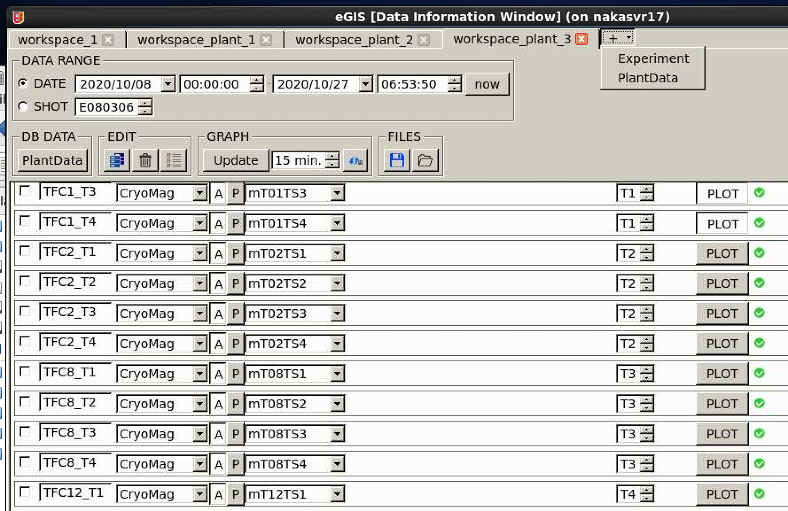
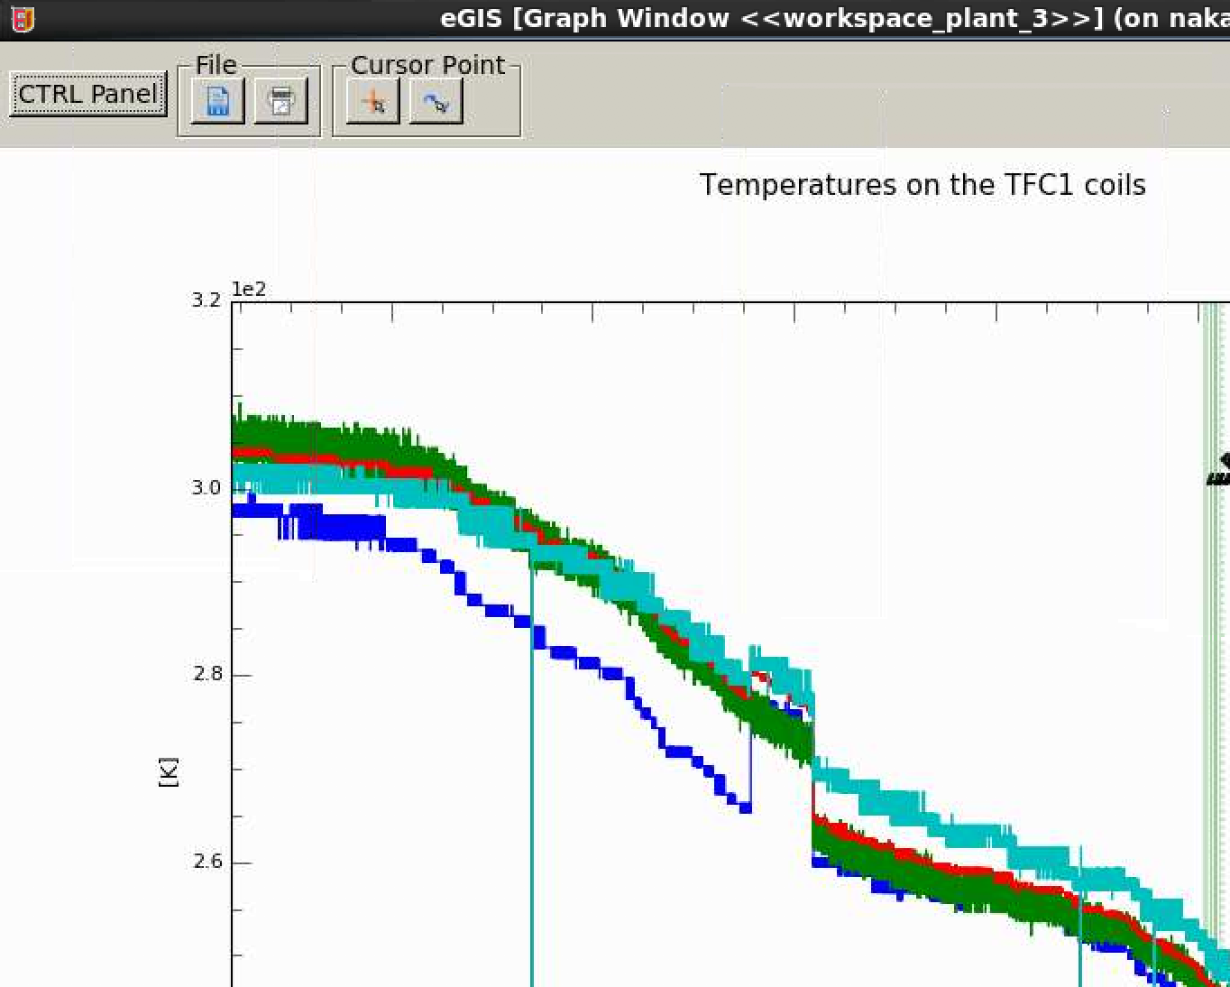
Naka Analysis Server
Standard access via NoMachine (through the nakafs17 server) or via ssh
It gives access to:
  Data access tools (eDas tool suite)
  Developing tools (Python, Matlab, IDL C/C++, Fortran)
  JT-60SA Research Management Site
  In the future to QST codes (MECS,…)

Slide 6
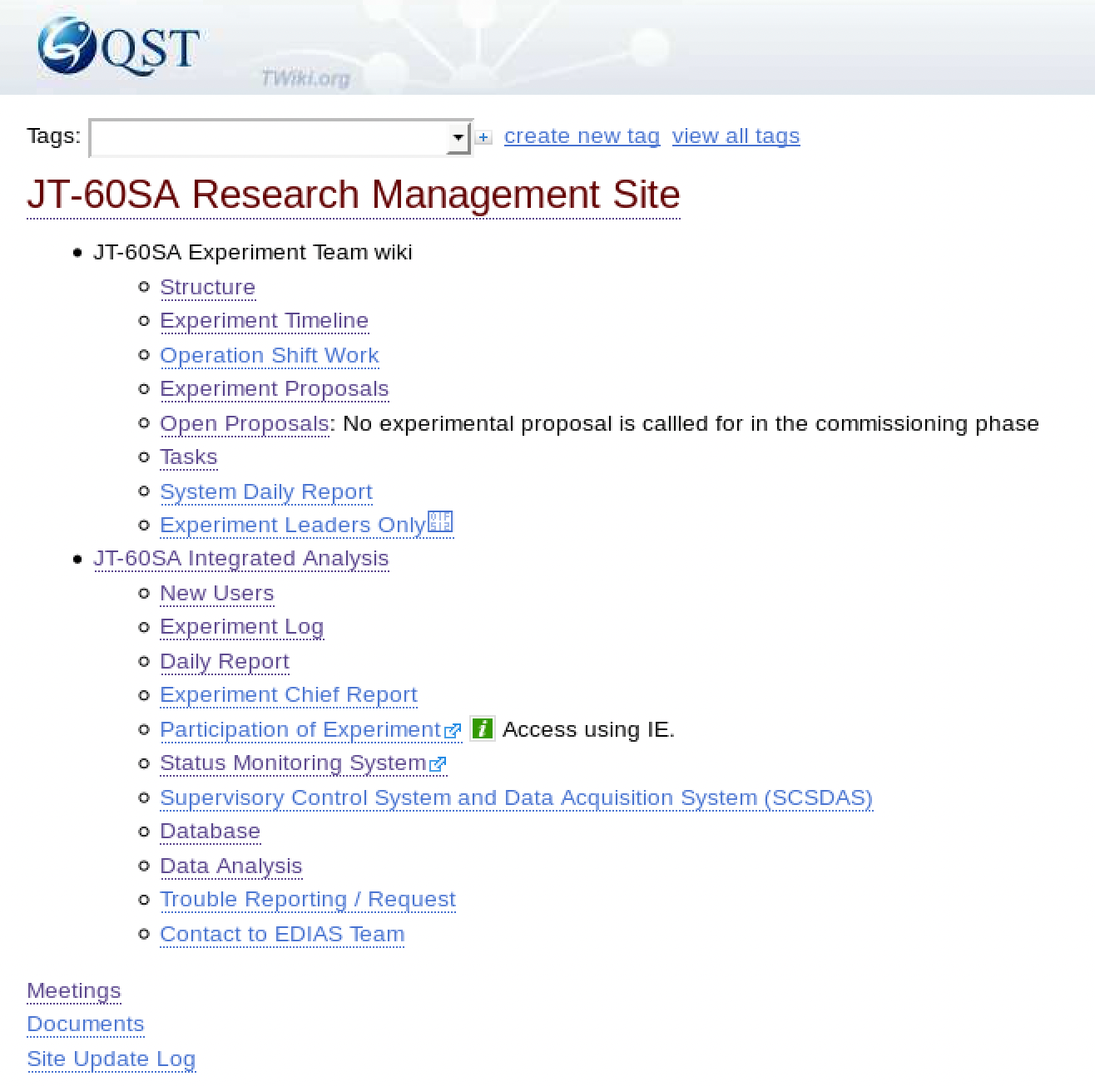
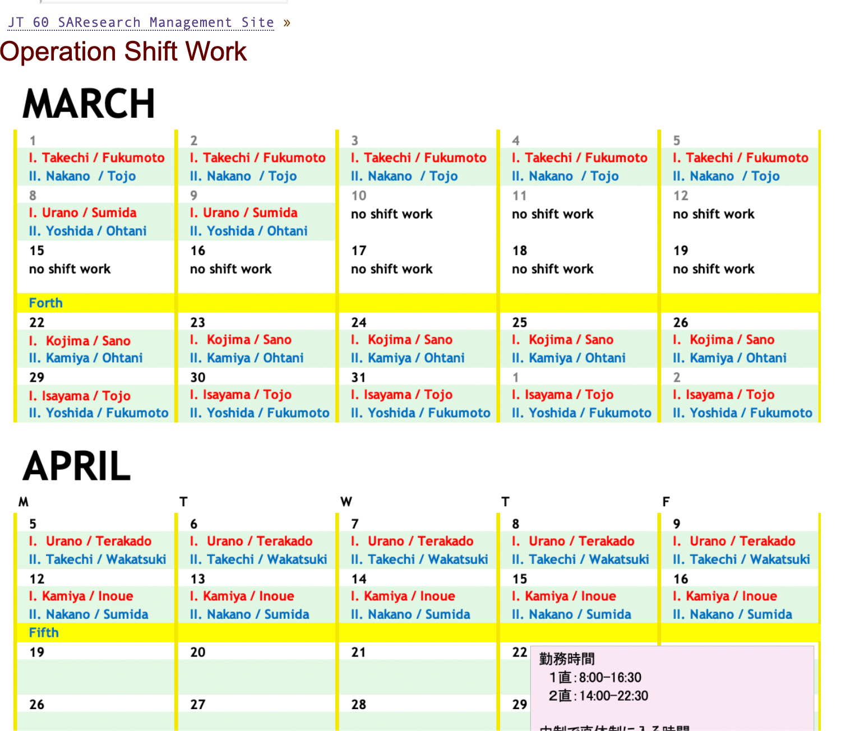
JT-60SA Research Management Site
Wiki-based intranet
Contains information about
  the structure of the Experiment Team
  the procedure of the experiment proposal and approval
  the daily reporting during operation
  the data access tools and software
  (including Data Handbook)
  Shift manning
  Some of the links are just placeholders

Slide 7
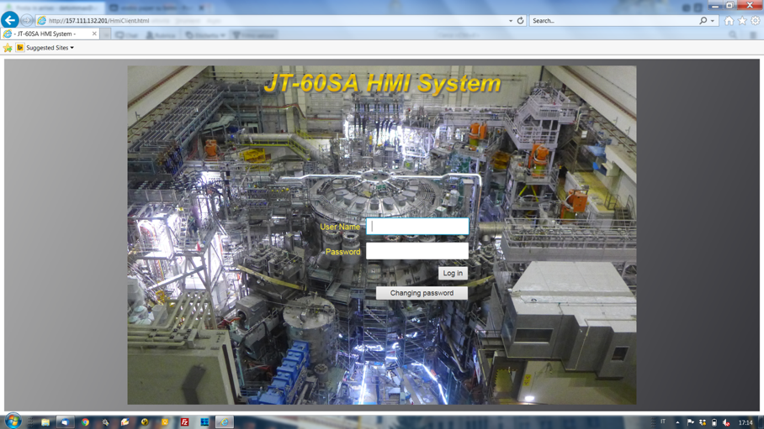
HMI client
It gives you access to the Discharge Editor and to the status of some plant systems
Based on all technology (java applet…)
Official documentation requires Windows (7 or 10) and Internet Explorer to run the HMI client
  Once the Java Runtime Environment is installed and correctly configured HMI client can be launched as a stand-alone application on any Windows and Linux machine (see instruction here
  QST announced that a new version will be develop using a different
  IT technology (available after IC?)

Slide 8
Live streaming
Live stream of cameras or PC screens accessible via http
  Live streaming camera of JT-60SA central control room
  Desktop of power supply system PC (following F4E request)

Slide 9
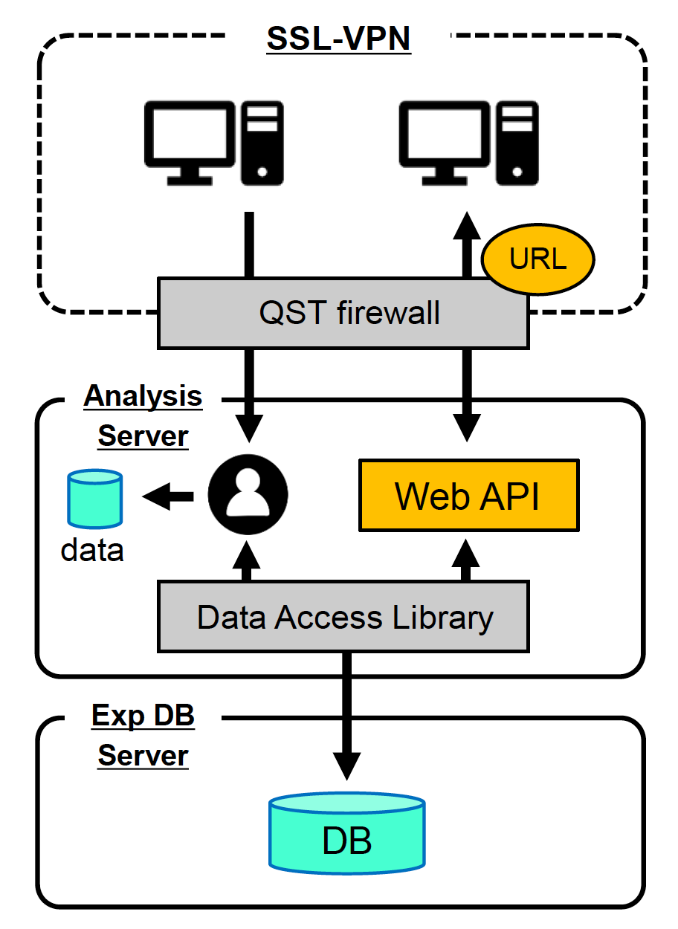
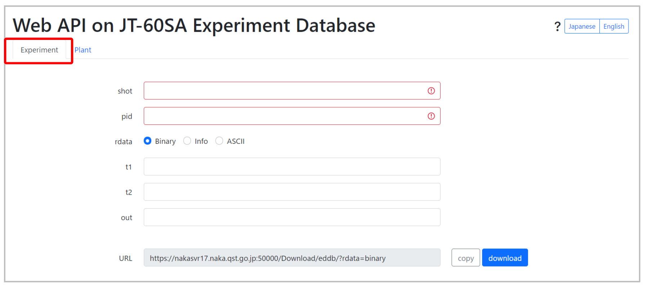
WebAPI
Released in September 2021 to a small group of beta testers (M. Verrecchia, V. Tomarchio, G. De Tommasi)
→ E. Belonohy and M. Iafrati have access
Connection to SSL-VPN needed anyway
English documentation provided
An additional authorization from QST is needed to use this service

Slide 10
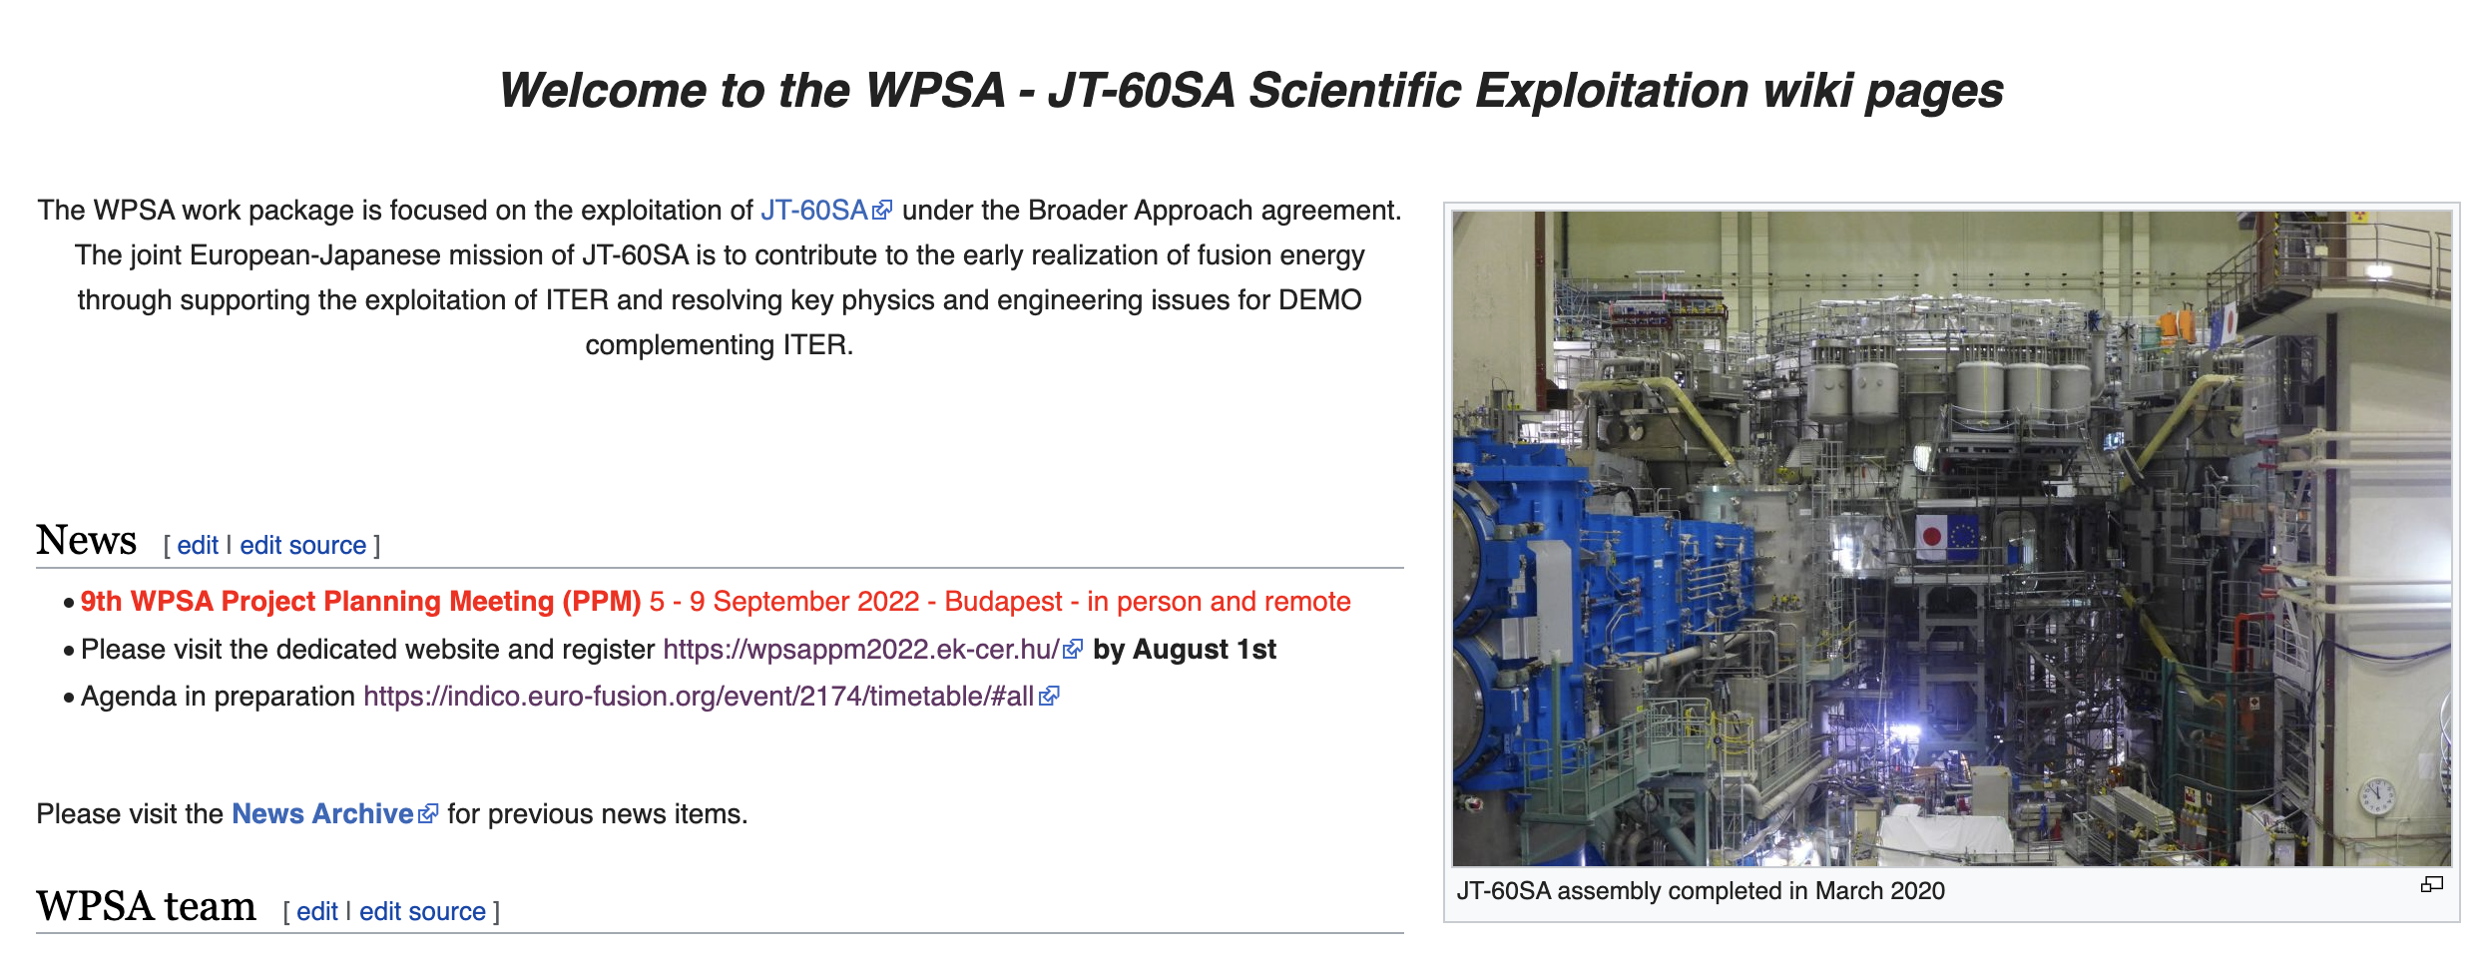
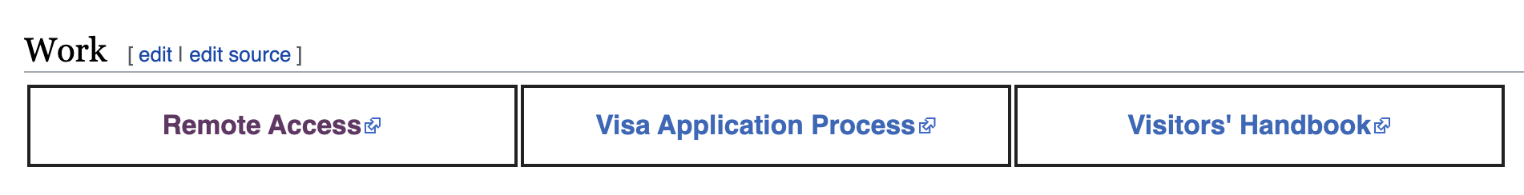


Once you get the fob
FROM https://wiki.euro-fusion.org/wiki/WPSA_wikipages:_JT-60SA_Work_Package

Slide 11
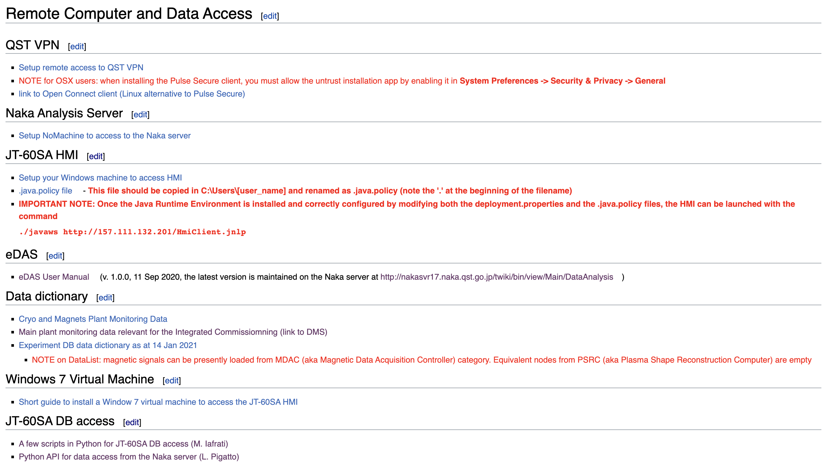
Once you get the fob (cont’d)
First connection and setup of the VPN client
Setup the NoMachine connection to the nakafs17 server
Setup the HMI client
eDAS manual (also available on the JT-60SA Research Management Site)
Data dictionary (but Data Handbook available on JT-60SA Research Management Site)
Data access examples using python (Iafrati & Pigatto)

Slide 12
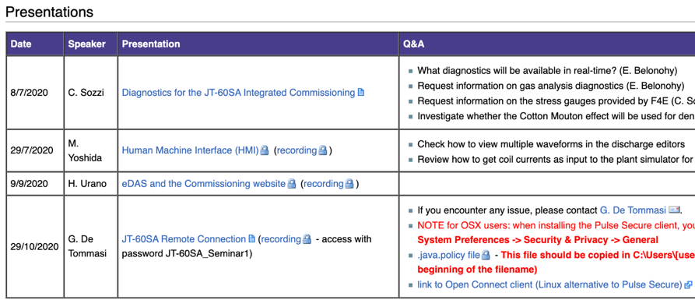
Additional resources
  SEMINARS page on the FP8 SA wiki
  https://users.euro-fusion.org/iterphysicswiki/index.php/JT-60SA_Seminars
Yoshida’s and Urano’s presentation at the PTM (recording available)

