Slide 1



2022 Remote Experimentation Centre Activities
6 September 2022
G. De Tommasi^{1,2}
Task contributors : H. Ancher (CEA), F. Imbeaux (CEA),
C. Fuchs (IPP), A. Winter (IPP), G. Manduchi (RFX)
¹Consorzio CREATE
²Department of Electrical Engineering and Information Technology, University of Naples Federico II, Italy

Slide 2
Contents
REC activities in 2022
  Task 1 - Support to the development of the JT-60SA remote participation tools (Task 1)
  Task 2 - Actions needed to setup effective remote participation to JT-60SA (by Frédéric Imbeaux)
Possible plans for 2023 (after Frédéric presentation)

Slide 3
REC 2022 Tasks
Task 1 - Support to the development of the JT-60SA remote participation tools
  Assessment of usability and performance of the JT-60SA remote participation tools
  Development of wrappers for the remote data access tools
  Review QST proposal for the upgrade of the Naka server HW (support to F4E)
Task 2 - Actions needed to setup effective remote participation to JT-60SA
  Review of the final report of the EU-REC working group
  Guidelines to setup effective remote participation to JT-60SA
  Assessment of the capabilities of “La Bergerie” in Cadarache to be used as EU-REC

Slide 4
Task 1 - Activities
Assessment of usability and performance of the JT-60SA remote participation tools
  This is a continuous activity
    Participation to the so called data access meetings
    (F4E and QST + 1 EUROfusion representative → G. De Tommasi)
    Antti Jokinen (F4E), former IFERC member in Rokkasho, now at Naka
    → he could join these meetings → a catch-up meeting planned in 2 weeks from now
    Various data transfer tests have been performed (also in collaboration with F4E)
      tested WebAPI (end 2021 - beginning 2022)
      tested Live Streaming (July/August 2022)
    CEA, IPP and RFX task contributors still have no access to QST tool (account requests sent)
Support of development of wrappers for the remote data access tools
  Prototype of a Matlab wrapper for the webAPI

Slide 5
Task 1 – Activities (cont’d)
Review QST proposal and support F4E decision for the funding of the Naka server HW
(EU in-cash contribution)
  G. De Tommasi, H. Ancher & F. Imbeaux revised QST proposal
    Final cost about 80 MY → 0.6 M€ (initial proposal was ~2 M€)
    QST procedures started at end of August and will take 3-4 weeks
    Japanese government procedures can take up to 4 month, however QST estimation is that everything should be ready by end of the year
    Estimated Delivery Feb-Mar 2023

Slide 6
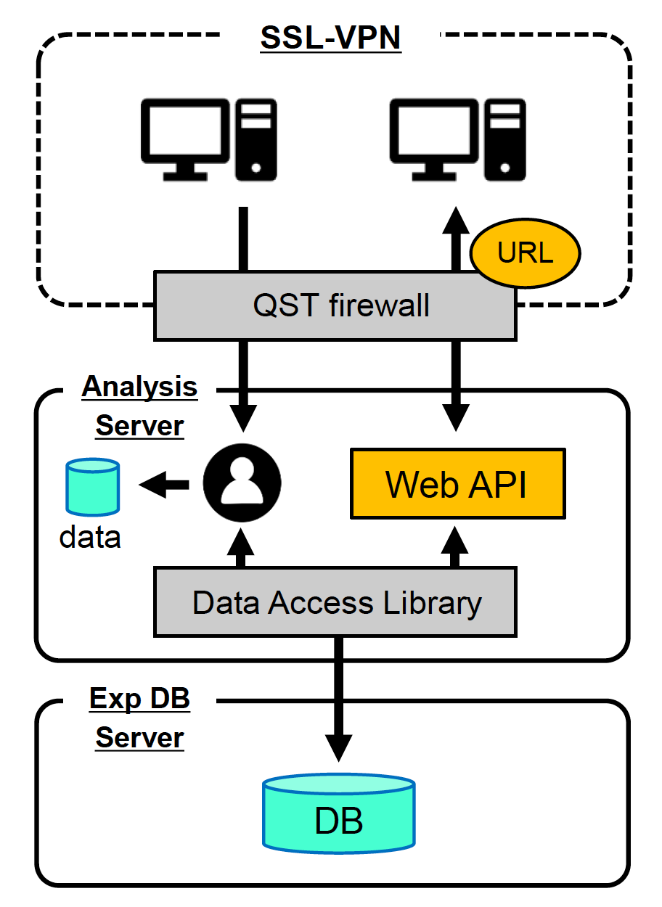
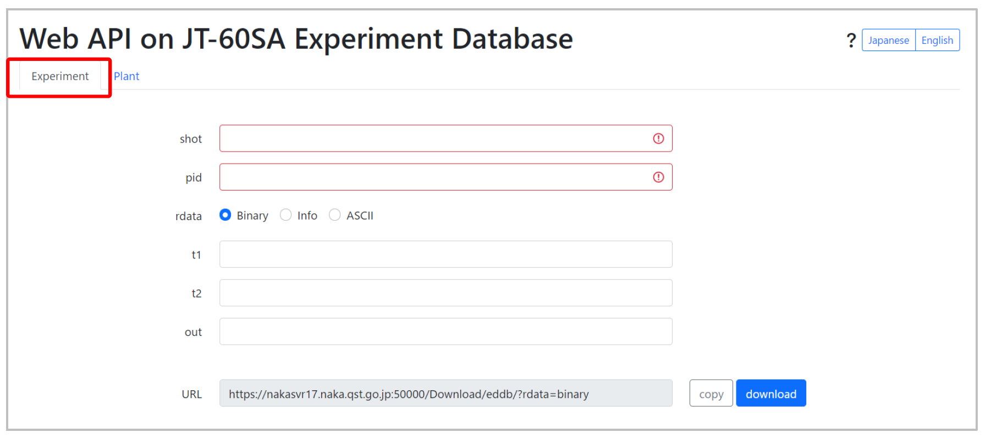
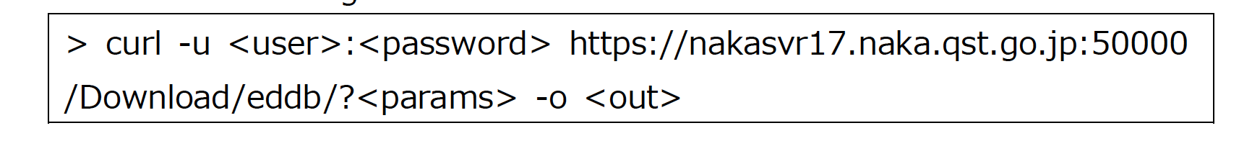
WebAPI

Slide 7
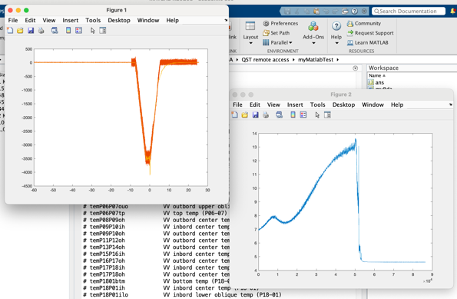
Matlab wrapper for webAPI
By using the command line syntax wrappers can be developed in any programming language
Prototype of a Matlab class developed
Shared with QST but no feedback received
Code will be made available on the FP9 wiki (LINK)

Slide 8
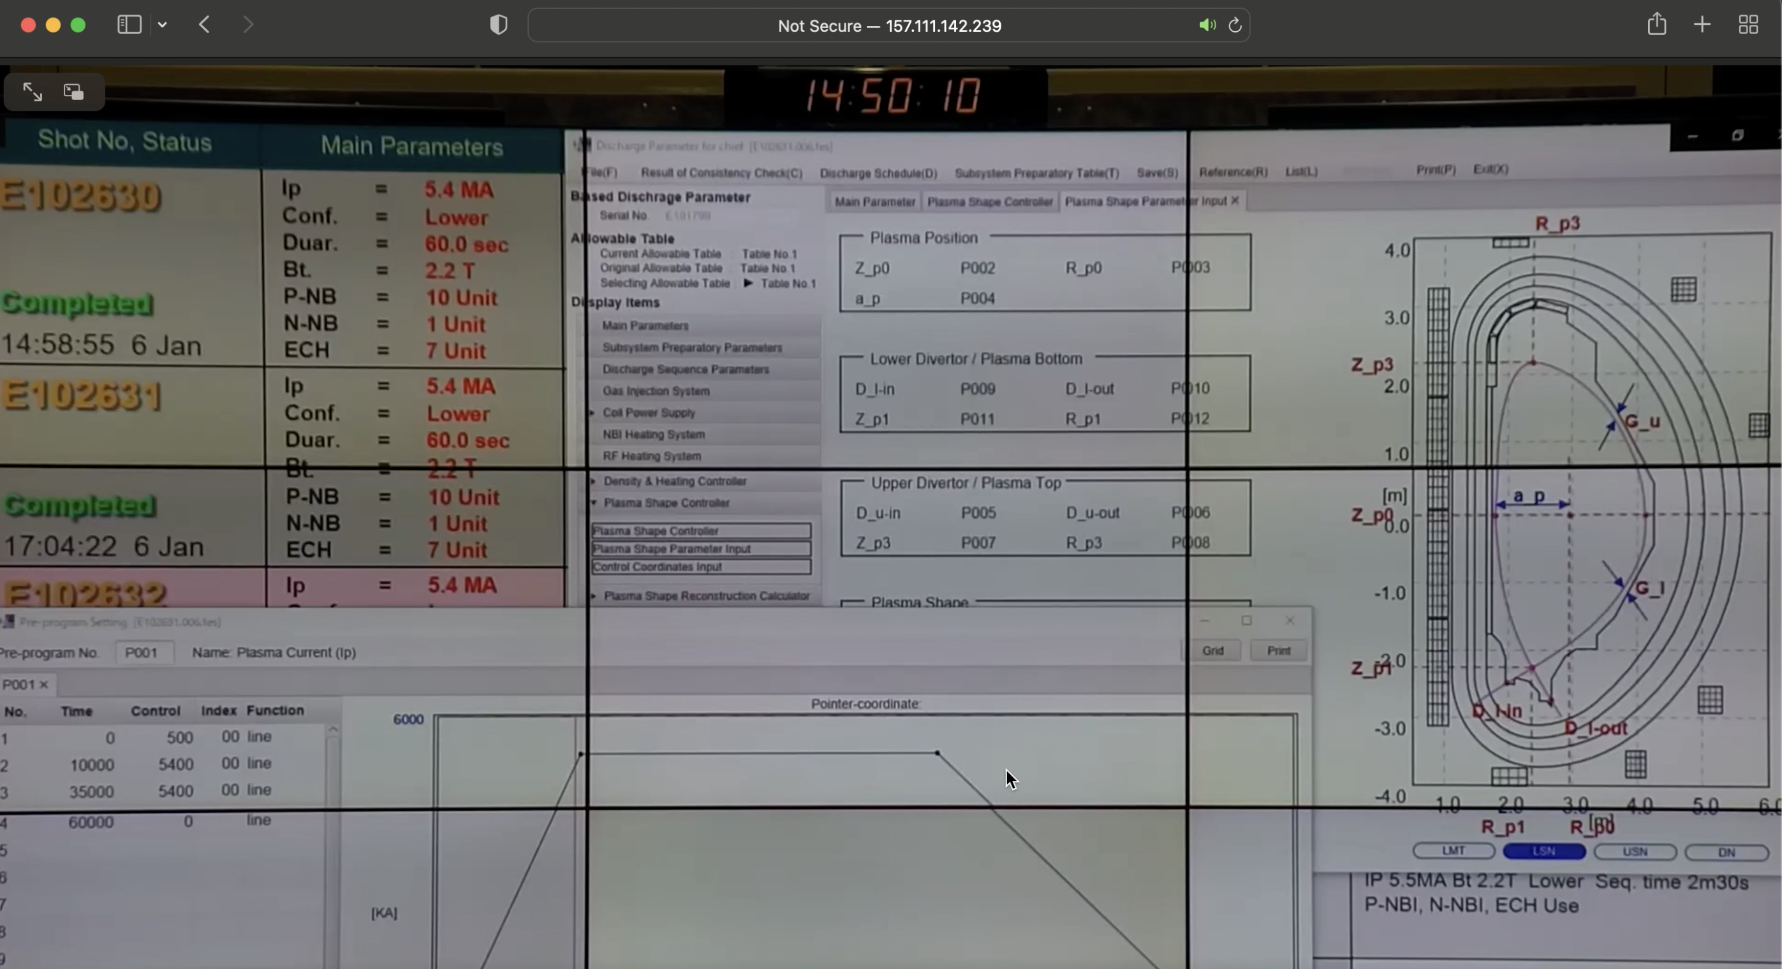
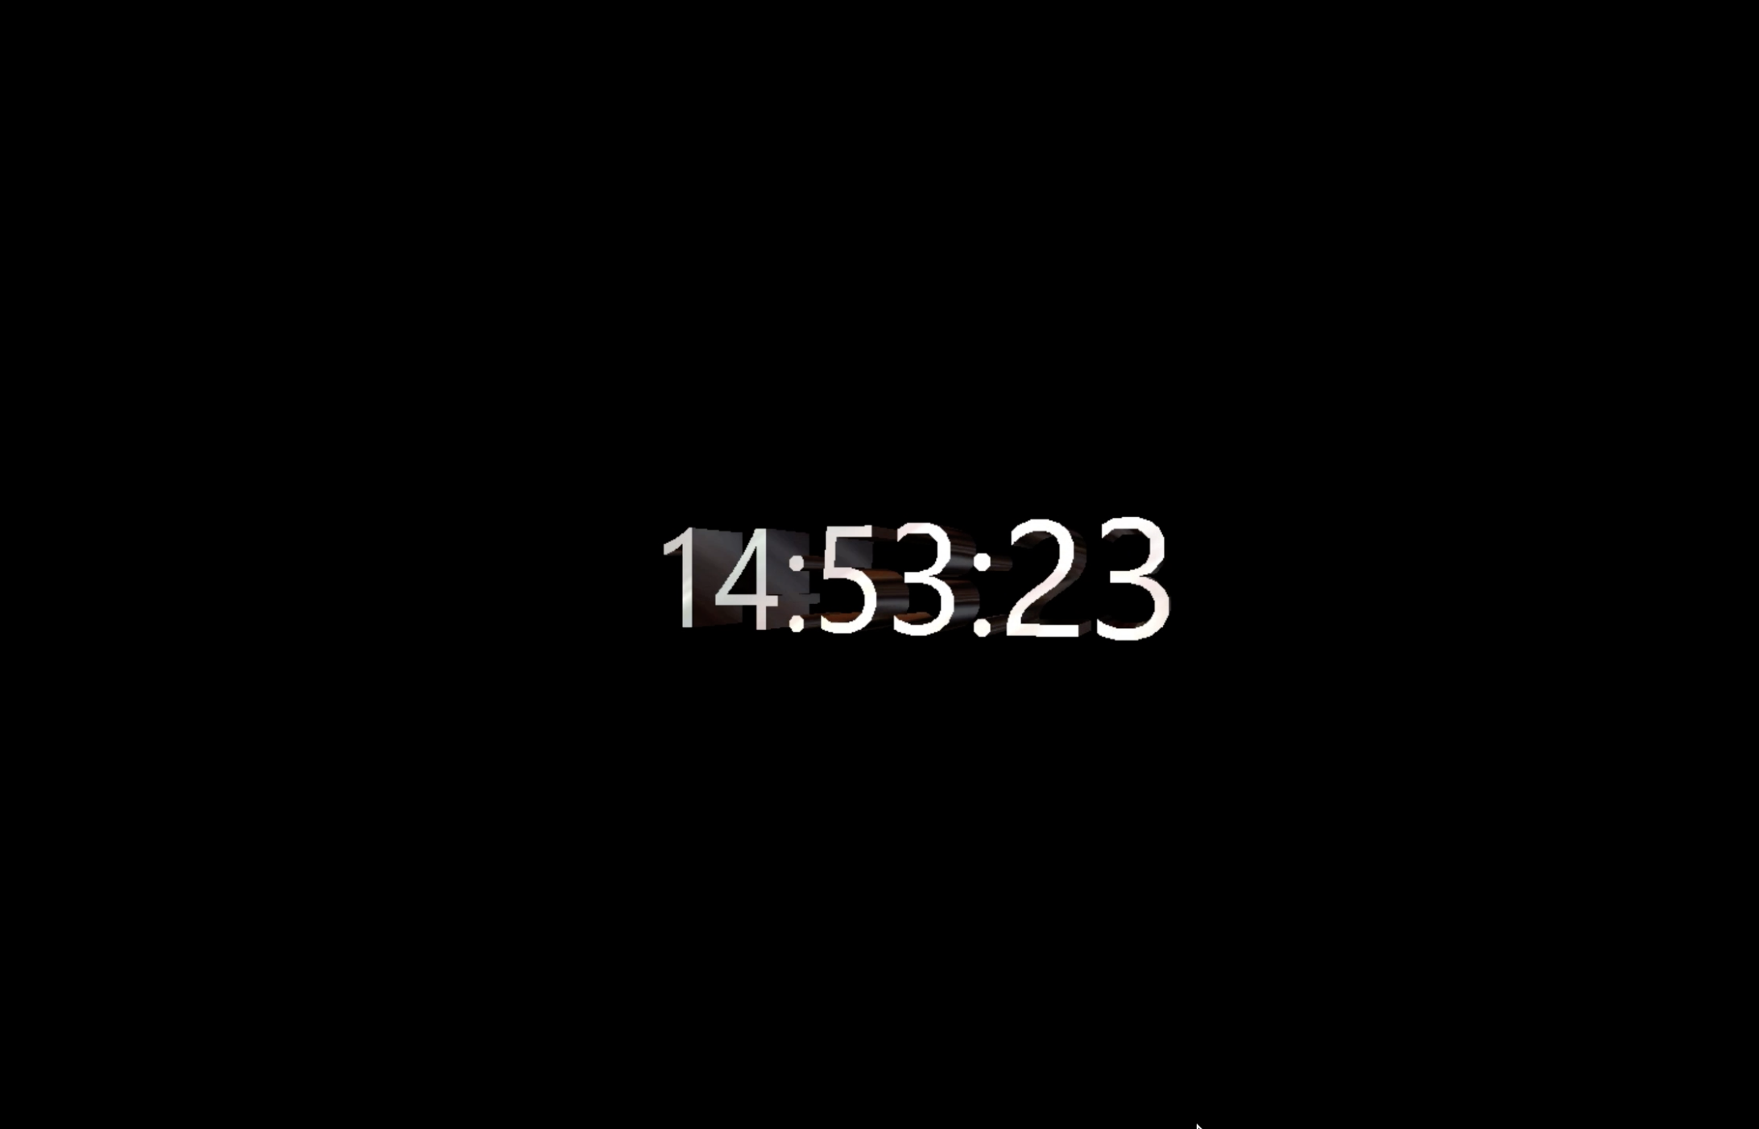
Live Streaming
Live stream of cameras or PC screens accessible via http (once in the QST VPN)
  Live streaming camera of JT-60SA central control room
  Desktop of power supply system PC (at the time of the test → screen saver broadcasted)
  …rather old fashion solution for desktop sharing

Slide 9
Discussion points
Open points for remote participation: we recommend starting discussing these points before the end of 2022, since they are key to achieve an efficient participation of the EU researchers to the analysis of the results of the IC phase and of the first plasmas that should occur in 2023
La Bergerie could be used to validate the Grant deliverable about the EU-REC
→ define and carry out the final tests
Facilitate data access by prototyping an IMAS interface to JT-60SA data

Slide 10
Possible plan for 2023
Keep supporting F4E in revising the solution proposed by QST for remote participation
  Possibly get more EU experts involved in the discussion with QST!
Start a discussion with QST to test remote participation from “La Bergerie” (even during IC?)

