Slide 1
JT-60SA International Fusion School (JIFS) G. Giruzzi, E. Belonohy, T. Bolzonella, G. De Tommasi, C. Piccinni

Slide 2
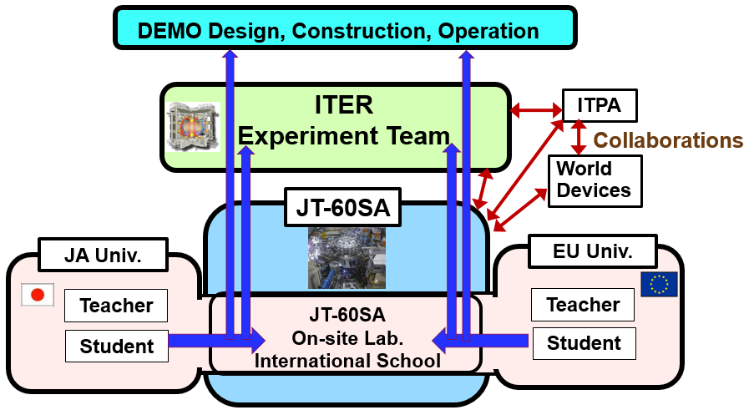
Why another summer school ?
JT-60SA missions:
supporting ITER exploitation
contributing to DEMO machine and scenario design
fostering new generations of fusion physicists and engineers
⇒ connect the project with training initiatives
courtesy: Y. Kamada

Slide 3
JIFS objectives
Completing the training of selected students & young professionals by:
lectures on fusion physics, engineering, operation
group work using the JT-60SA facility, laboratories, modelling tools and data as an ideal playground for practical examples and applications
Creating links between students and young professionals from Japan and Europe*, who could then:
participate in JT-60SA operation, scientific exploitation and upgrades
be involved in Japanese and EU participation in the ITER programme.
*Note: here Europe means EU + countries associated to the EURATOM fusion programme

Slide 4
Main school characteristics
Fusion research involves a wide range of competences: theory, computing, experiments, diagnostics, engineering ⇒
JIFS should be a school addressing this variety of aspects: plasma physics, engineering, with special attention to tokamak operation
JIFS should include practical group activities, using JT-60SA lab facilities, data, codes and analysis tools.
JIFS should provide a permanent background of online information, pre- and post-school time and favour exchanges among students
Involvement of Japanese Universities, QST, F4E, EUROfusion and associated EU University network
Not only fusion PhD students, but also young fusion staff having a Master, in Physics or in Engineering
Number of students: 20 (maximum): 10 EU and 10 Japanese. Diversity, equality and gender balance promoted.

Slide 5
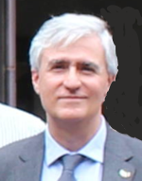
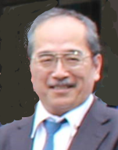
School organisation structure
JIFS is jointly funded and operated by QST and EUROfusion
Two co-directors, one from Europe and one from Japan, appointed by the JT-60SA Project Leader for three years →
G. Giruzzi Y. Kamada (CEA/EUROfusion) (QST)
School Advisory Board: 14 members, appointed by the Directors, from F4E, QST, EUROfusion, European and Japanese academia
School Organisation Committee: appointed by the Directors. In charge of :
logistics, administration, IT support (from QST)
website and social media (from Europe)
didactic aspects (with advice of the Board): programme, contacts with lecturers, organisation of visits and group work, documentation (from Europe and Japan)

Slide 6
1st edition programme elaboration
Present programme structure:
First week with general lectures on tokamak and its sub-systems, basics of plasma physics, visits
Second week with topical lectures and visits. Then splitting in groups, advanced lectures, practical exercises, presentations by students
1st edition now tentatively scheduled 28 August – 8 September 2023
Why tentatively ? Still connected with the machine commissioning schedule
Call for student selection: spring 2023
At present:
most lecturers selected (not all)
first discussions on lecture contents and practical work

Slide 7
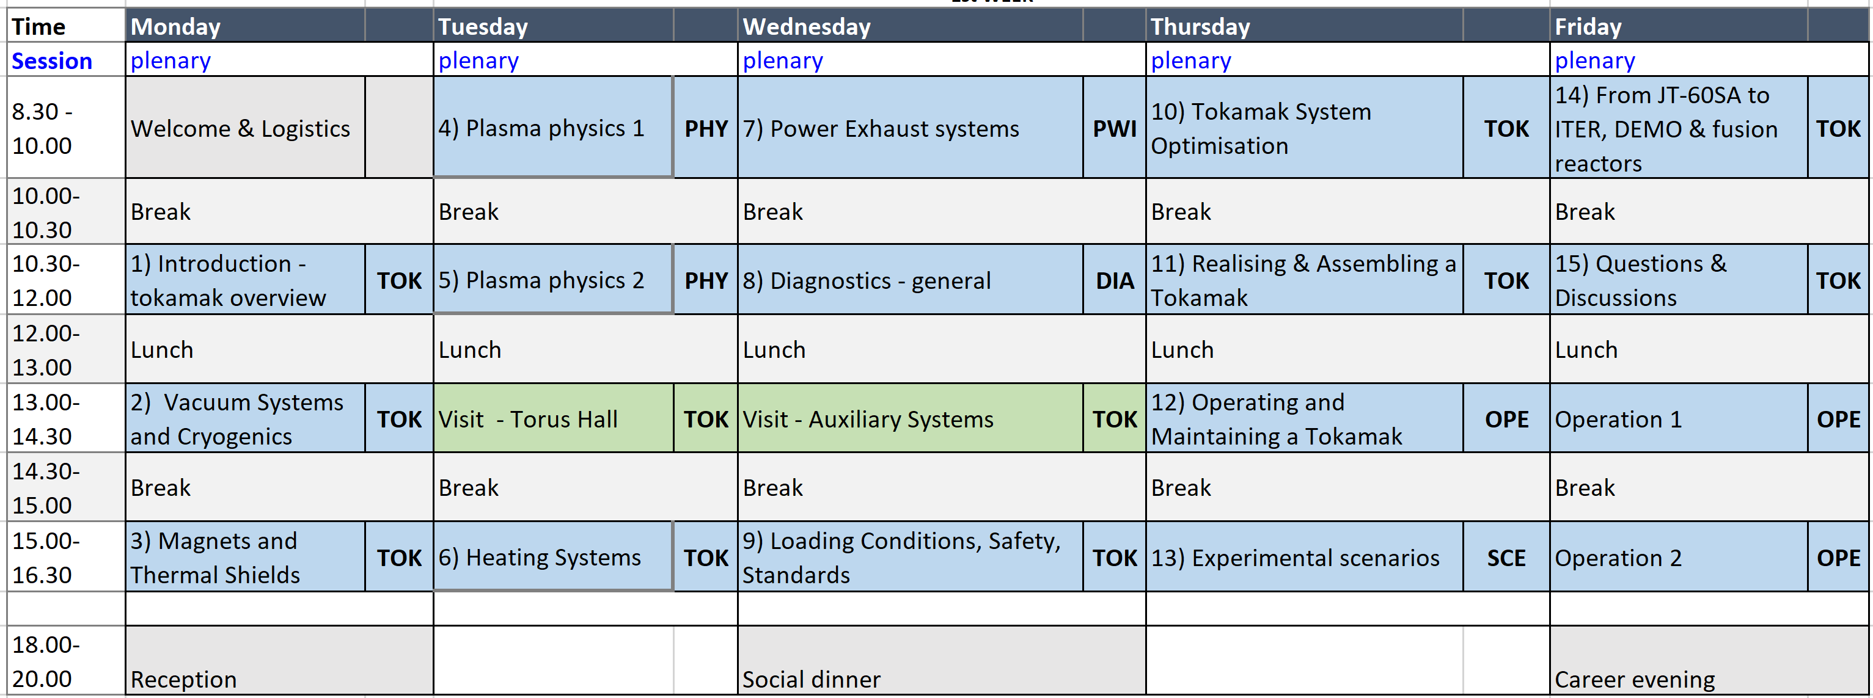
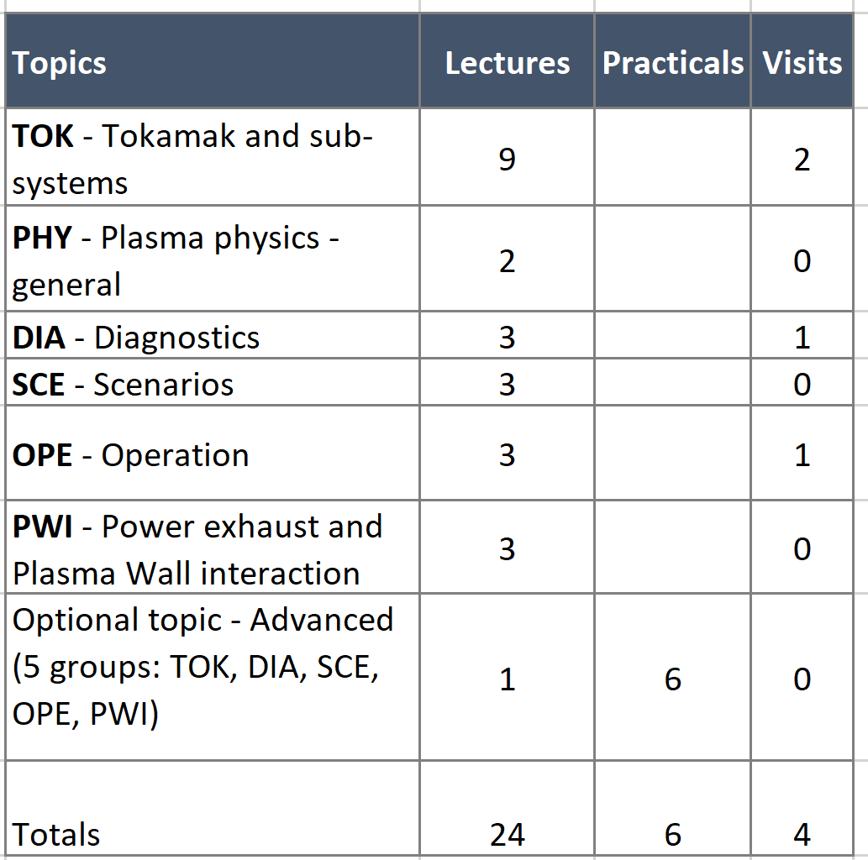
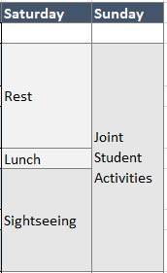
1st edition programme proposal: 1st week
Experienced scientists present their careers to students; Q&A
Self-organised student excursion or activity, considered as a project

Slide 8
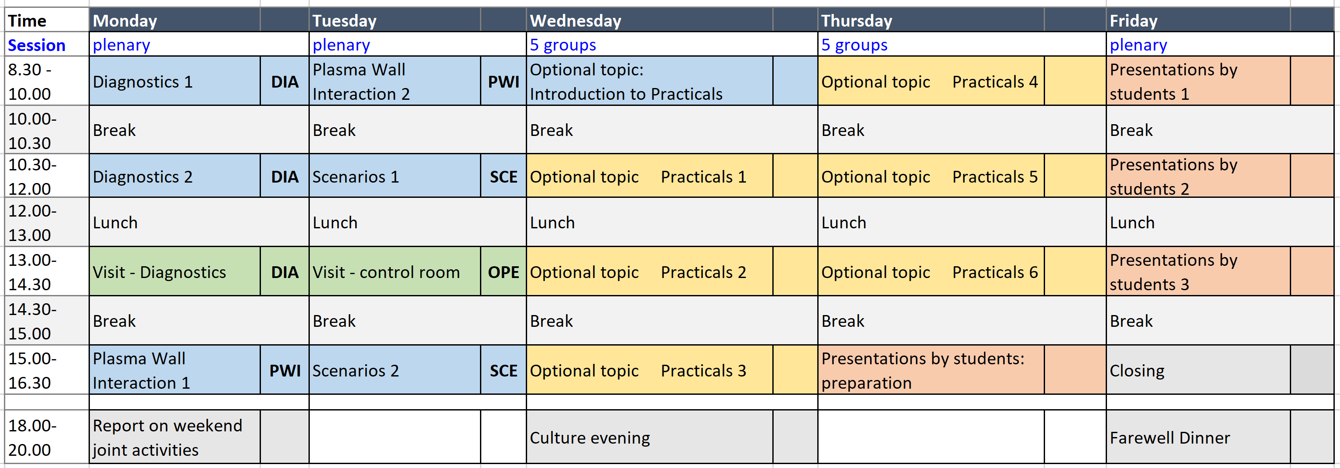
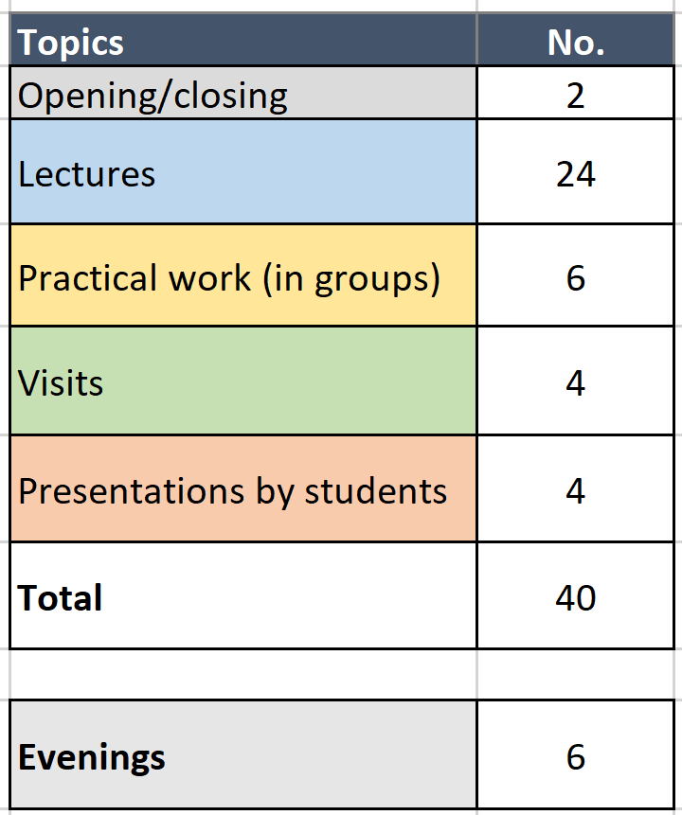
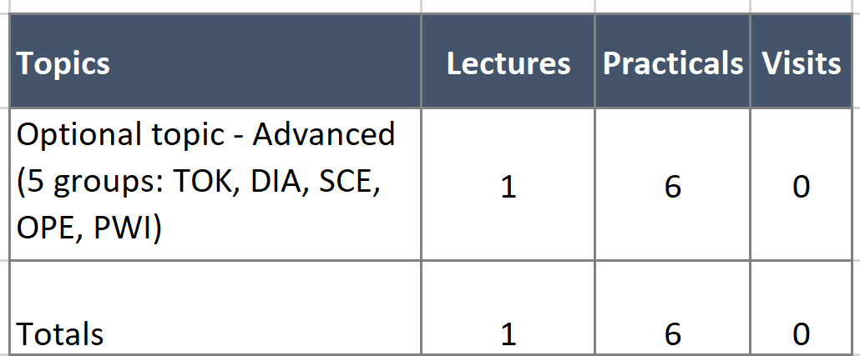
1st edition programme proposal: 2nd week
Report on the self-organised weekend activities project
Exchanges on cultural differences and student systems
Possible split of each topical practical in
two modules → students could combine modules of different topics

Slide 9
Practical exercises
5 groups of 4 students (2 Europeans – 2 Japanese)
Split of Practicals in 2 modules. Just as a possible example:
Tokamak sub-systems: "Designing a tokamak" and "Coil connections"
Diagnostics: "Diagnostic 1" and "Diagnostic 2"
Scenarios: "Integrated modelling" and "Building a scenario with fast simulator"
Operation: "Session leading" and "Plasma control"
Plasma-wall: "Edge modelling" and "PFC materials and design"
In any case: students will be informed, in both the calls and the interviews, that they can express their preferences, but they will not have the final choice →
It is a strong requirement that students be interested in learning ALL the subjects
The same group follows a combination of 2 Practicals, in the same or in different topics, if possible combining different aspects (e.g., modelling and laboratory).

Slide 10
Conclusions
Escalation of encouragements and interest on JIFS: BA Steering Committee, Japanese Ministry of Education & Research, EU commission
We hope that other Europe-Japan student-related initiatives will follow
1st edition delayed, owing to COVID and to compatibility with machine activities. Cannot be programmed before the end of commissioning. →
Now summer 2023 has been chosen → hopefully reasonable margin
JIFS inauguration together with JT-60SA inauguration ceremony: summer 2023
PhD students and young professionals: apply ! (spring 2023)
Expert physicists and engineers: volunteer to lecture ! (first and following editions, with different choice of topics)

