Slide 1
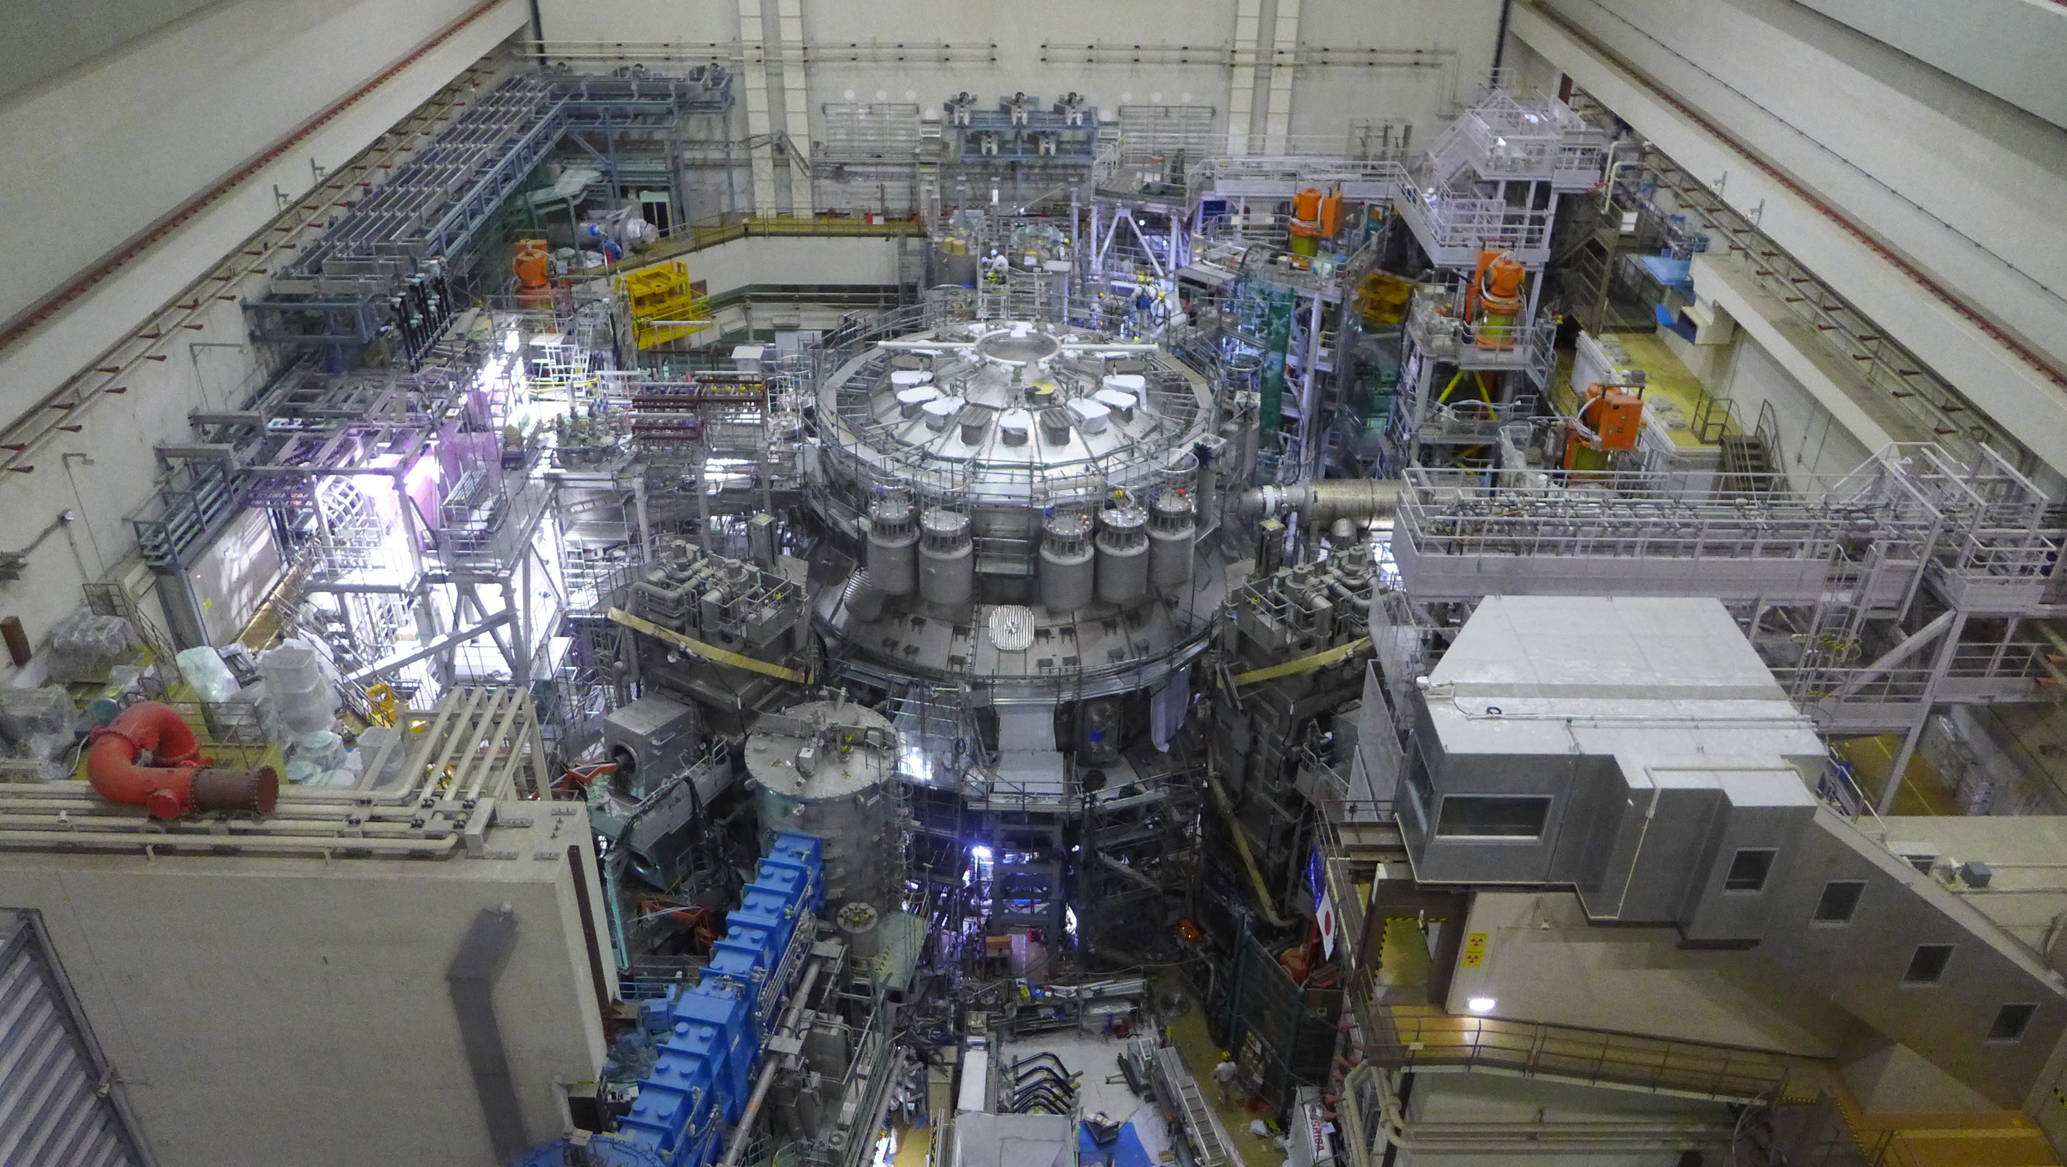
Experiment team → List of actions
JT-60SA Experiment Team Leaders
J. Garcia, M. Yoshida, H. Urano

Slide 2
List of actions
Clarify selection of participants for the IC analyses (and hence members of the ET)→ To be discussed in the ETL meeting
The Research Management System (RMS) should be ready for the IC analyses, the TGL will use it→ To be discussed in the ETL meeting
When a discussion about integrated data validation will be held with QST? Will IDA and IMAS be used? When the first data could be used → Discussions with QST about this topic are postponed until early 2023 when QST could have developed their own plans
Are the infrared cameras prepared by QST able to cover the divertor for lambdaq studies?→Specific meeting about the status of diagnostics will be held

Slide 3
List of actions
The use of plasma simulator could be advantageous for exploring initial phase of JT-60SA and provide optimum path to high current with and without power→ Dedicated presentation in scenario development TG meeting
Impact of fast ion modes of reduced N-NBI power or energy has to be investigated→ Discussion in energetic particle behavior TG meeting
Common discussion with QST about real time control is necessary→ working group about real time control to be called soon
Benchmark between Sonic and SOLPS-ITER requires in person work→ ETCM to be held in Naka in 2023 may be an opportunity
Edge activity requires stronger interaction with QST → To be discussed in the Edge and PWI TG meeting

Slide 4
Experiment Team: future meetings
ETCM(2) to be held end of September or early October → Joint discussion between ET and QST and WPSA experts
TG meetings will be held before the end of 2022
Working group meetings, real time control and disruption & RE to be held before 2022
Once the ET is fully formed, after the IC, there will be ET meetings with the full team.

Slide 5
Final considerations
QST is going through stressful times trying to start the machine
The priority is the first plasma and restart
EU requests should not overload the few QST staff → Concentrate on the essential
Once the first plasma is achieved and some IC is performed, much more time for collaboration will be available
The IC data analyses phase, coordinated by the ET, will provide a clearer structure under which stronger links between EU and QST will be formed

