Slide 1
9th WPSA Planning Meeting Budapest, 5-9 September 2022 WPSA Summary session – discussion and closing
C.Sozzi (PL)

Slide 2
A few points for further thinking
Preparation for proposals to the Working Groups/Topical Groups (Technical meetings?)
Training events
Data access for EU researcher
Use of the Gateway and data storage
Participation in and sharing of the responsibilities in the operations
Publication and conferences plan
Format/frequency of the meeting(s).
Expecting proposals for next in-person event (period: avoid interference with IC, JIFS)

Slide 3
Many thanks for your lively participation

Slide 4
Blank

Slide 5
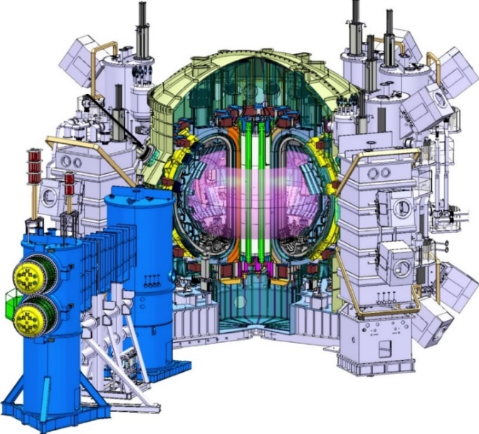
WPSA: Exploitation of JT-60SA – project objectives
EU Strategic priorities in the JT-60SA research program
1. Development and investigation of high performance scenarios compatible with future W-PFCs.
2. Avoidance and mitigation of disruptions and runaways
3. Fast ion physics
4. Development and validation of high level real-time control strategies
support the exploitation of JT-60SA through a high quality EU participation, fully integrated in the EU fusion programme within the Broader Approach frame
Maintaining/developing control room experience in a large superconducting machine in view of EU participation in ITER operation
play an active role in scientific exploitation and campaigns management
participation to the machine operations
contributing to an efficient access to data and analysis tools
contributing with the scientific support to the machine enhancements
Contribution to specific items of the ITER Research Plan
Start-up, Wall conditioning (w and w/o EC)
Disruption loads, mitigation, detection, triggering, avoidance…
H-mode, L-H transition, ELM control, plasma magnetic control, NBI shine-through
Topics in diagnostics R&D (high neutron flux resilience, very high temperature, in-situ calibration…)

Slide 6
Present time schedule
The hypothetical period of the next IC phase after the discovery of this last issue is indicated in Figure 1 with the yellow area.
Integrated commissioning may restart in early 2023, Including HV tests in air, Paschen conditions and under 4K operating vacuum (decision point after global Paschen test)
The possible impact of this on the start date and duration of the Machine Enhancement 1 period is not evaluated yet. Consequently, the start date of the scientific campaign OP.2 might fall outside or just inside the Grant Agreement period 2021-2025
This last assumption is taken in the following
Fig.1 JT-60SA time plan after the 31st Meeting of the Satellite Tokamak Programme Project Committee (March 2022). A further (indicative) delay of several months should be accounted for, due to the weaknesses discovered in the pancake joints of the EF coils.

Slide 7
JT-60SA S&T topics in the integrated commissioning phase
Main objective for the Operations area and the IC team
Superconducting coils
Manufacturing, testing, installation, commissioning and operation of the superconducting coils, its cryo and protection systems
-> Paschen testing procedures
Limited initial configuration, plasma breakdown, runaways:
Metallic wall with limited carbon first wall elements
No divertor, upper single null configuration
1.5MW ECRH to support plasma breakdown and burnthrough
Limited set of diagnostic (e.g. 1 interferometer line)
-> camera tomography (under EU lead) to provide profile measurement
Vacuum conditioning:
Baking, Glow-Discharge-Cleaning (GDC, no TF), Electron-Cyclotron-Wall-Conditioning (ECWC, with TF)
@ Large-size (JET < JT-60SA < ITER)
First EDICAM photo with the camera tomography calibration
Elements relevant to ITER, DEMO, DTT, STEP, …

Slide 8
Elements of the WPSA planning for 2023
Code Management
Continuation in the development of tools for scientific analysis and in simulation activities in preparation of the experimental campaign, taking into account the information (possible constraints) coming from the IC
Whereas, the activities related to IC moved from 2022 should be added to the 2023 planning. The CM area will also contribute to the analysis of the IC data in liaison with the ET
A training on the Discharge Simulator as well as trainings on the released modelling tools in support to the scientific exploitation shall be planned respectively ahead of the IC and experimental campaigns.
Support for Diagnostics R&D
Enhancements
Completion of the assembly and testing of the systems before shipping
preparation for installation and commissioning in JT-60SA of the procured subsystems (FP8), starting after the IC (second half 2023) (with the OP area)
The presently ongoing tasks (scoping studies for enhancements after 2025) will come to the end in 2022
Main objective is advancing the design of new subsystems (mainly diagnostics), following the scientific priorities being at this time discussed within the ET, and the subsequent selection/ordering taking into account the funding sources and capabilities. This process is related to the Grant Milestones SA.M.03, SA.M.04, SA.M.05 and to the Grant Deliverable SA.D.04.

Slide 9
High level objectives for 2024-2025
2024
Installation of the FP8 enhancements excluding FILD, according to the present planning of the ME1 and ME2 shutdown periods.
Completion of the REC project
Planning of the OP.2 campaign, including the commissioning of the EU-led subsystems and scientific objectives
Training for participation to the JT-60SA operations
Selection of the ET members in addition to the ETLs and TGLs
Training on the CM released modelling tools
2025
Commissioning of the FP8 enhancements (excluding FILD which will be commissioned in 2026 - OP3) according to the present planning.
Detailed planning and execution (start or completion?) of the OP.2 campaign, including the commissioning of the installed EU-led subsystems and connected scientific objectives
Participation to the JT-60SA operations

