Slide 1


EDICAM during IC 2023
Tamás Szepesi
Ö. Asztalos, A. Buzás, G. Cseh, G. Kocsis, Á. Kovácsik
Centre for Energy Research, Budapest, Hungary
NTI, Budapest University of Technology and Economics, Budapest, Hungary

Slide 2
Operation 2023
Operation of EDICAM in 2023
Prepare for operation
  ”wipe off dust” and check if system is operational
    EDICAM camera test images
    shutter open/close tests
    connection to raw data server
  during EF1 incident, significant water condensation in EDICAM port plug
    check for any degradation of the system
    an endoscope check was performed in 2022 by QST, no problems were found
    for 2023: keep in mind (in case something goes wrong in the future)

Slide 3
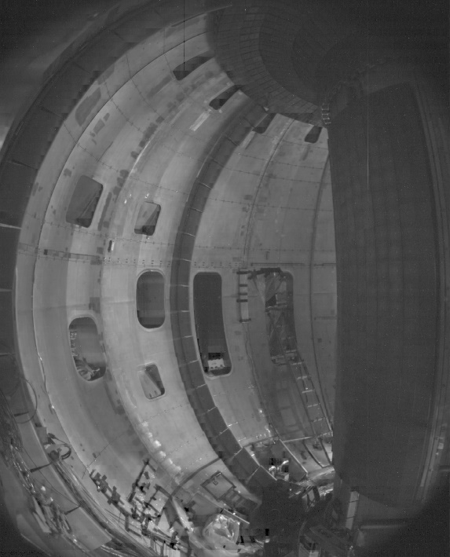
Operation 2023
Operation of EDICAM in 2023
Operate EDICAM during IC / plasma operation
  required staff: min. 2 persons (one for each shift) → practically 3 persons on-site
    ideally: 2 persons / shift, esp. during commissioning → results can be discussed
  develop use cases
  explore camera settings
  define regions of interest (ROIs)
Travel plan
startup: 4 persons for 4 weeks
  (1-2 weeks before plasma operation)
operation: 2 persons constantly
ROI #1: full frame, 100 fps
ROI #2
breakdown, 10 kfps
ROI #3: limiter, 1 kfps

Slide 4
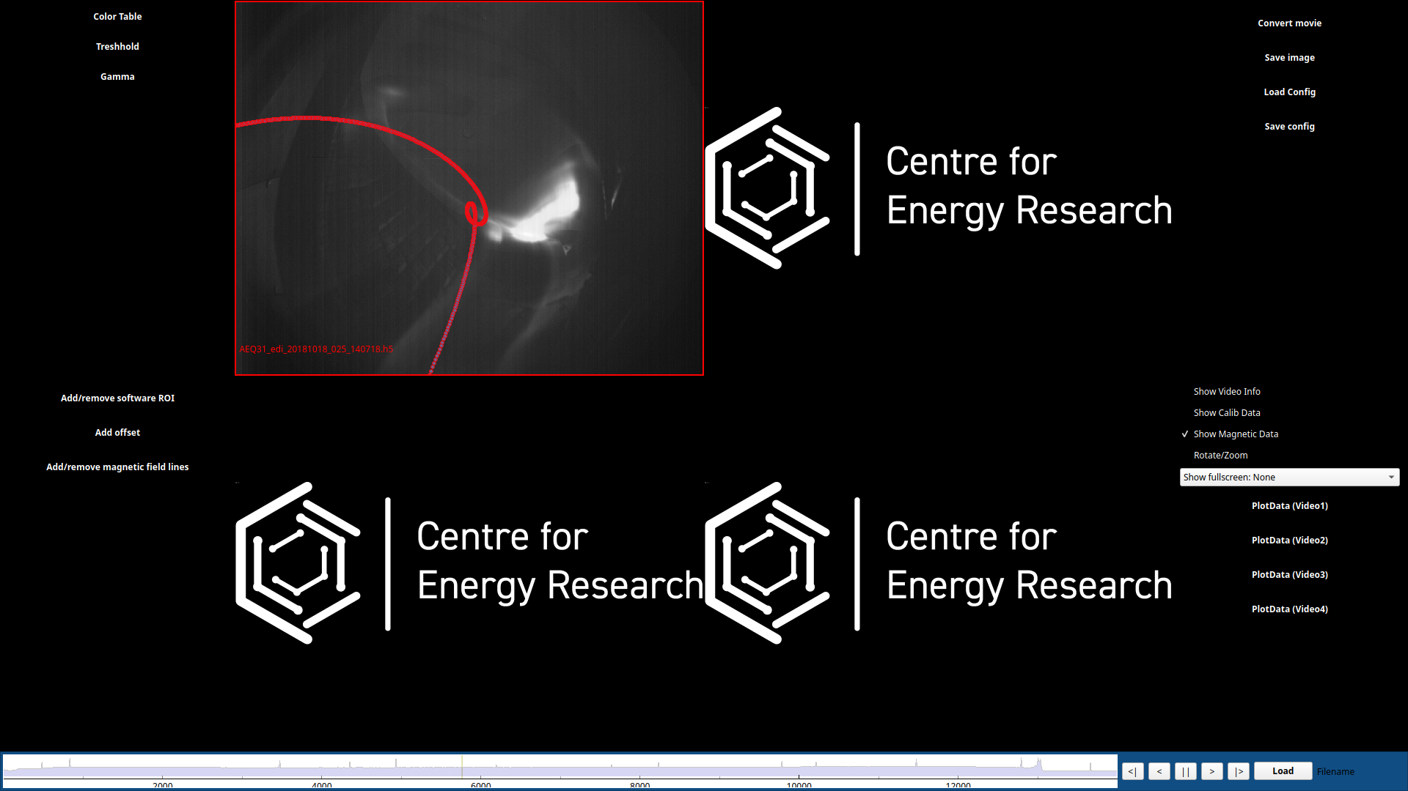

Operation 2023
Operation of EDICAM in 2023
First real use of EDVIS tool at JT-60SA
  visualize camera data
  supports EDICAM ROIs
  compare data from several diagnostics
  compare different discharges
example from W7-X

Slide 5
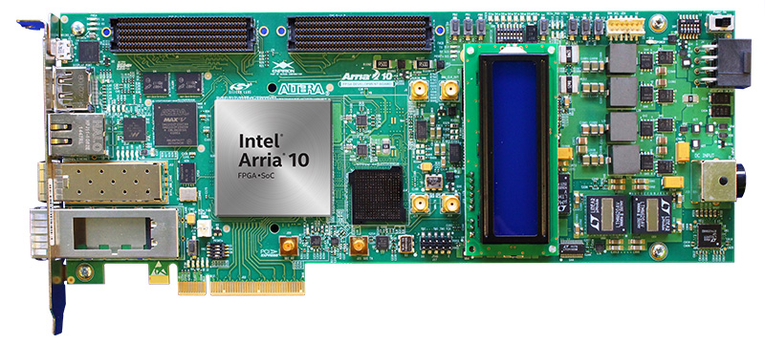
Procurement of spare parts, control hardware upgrade
Hardware procurements (FP8)
spare optics → after 3 years of administrative chaos, production was started in Aug 2022
new camera receiver card (Intel Arria10) with improved camera controls
  until now: global shortage of electronics, ”99 weeks” delivery…
  in Aug 2022, card available again → procurement started
  installation after IC (end 2023 / 24)

