Slide 1
JT-60SA Massive Gas Injection system Status and project plan
M. Dibon, G. Matsunaga, S. Nakamura, G. Phillips, C. Sozzi
Acknowledgement: G. Giruzzi, M. Hanada, M. Beck

Slide 2
System status

Slide 3
System status

Slide 4
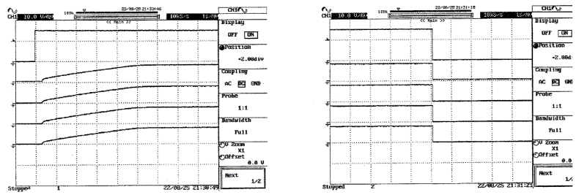
System status
Valves function test
Atmospheric leak test
No pressure drop
Piezo charge and discharge
Perfect charge and discharge curves for all piezo actuators

Slide 5
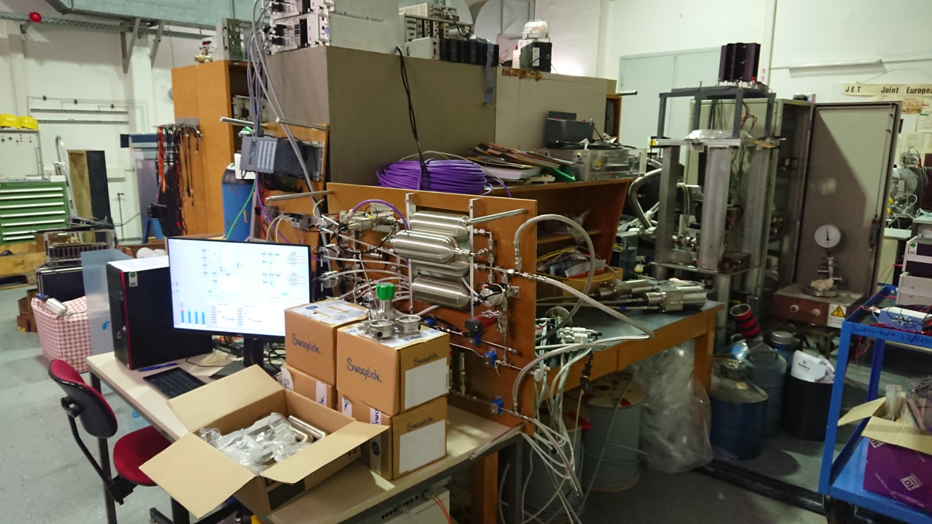
System status
Lab setup
Trigger
electronics
Profibus cable (110 m)
Central PLC <-> gas panel
MGI
valves
Central
PLC
Control
PC
Vacuum
Feed throughs
Pressure
regulators
Gas panel
Atmospheric trigger
and signal cables
(250 m) and (280 m)
In-vessel
fixtures

Slide 6
System status
Deliverables named in Annex B
2 MGI valves with mounting clamps and pipes to go through the stabilizing plate
2 feedthrough flanges ICF 114 with pressure gauges, pneumatic valves and potential breaks
2 mineral/PEEK insulated cable bundles for electrical supply in vessel (bundle diameter: 18 mm)
2 cables for electric supply from trigger modules in transfer room to vessel feedthroughs
1 gas preparation station with control equipment
2 trigger modules for the MGI valves
2 trigger signal selection modules
2 delay modules for timer signals
1 Siemens S7 PLC for controlling the gas preparation station and the trigger modules
1 control computer with monitor for control interface
1 Profibus cable from the gas preparation station under the torus hall to the PLC in the transfer room
2 signal cables (10x0.25mm) from two boundary boxes in the torus hall to the PLC in the transfer room
1 optical fibre cable from the PLC in the transfer room to the control computer in the control room
1 pressure booster for H₂ and D₂
4 pressure regulators for gas bottles
spare parts as defined in section 10
documentation as defined in section 12.1

Slide 7
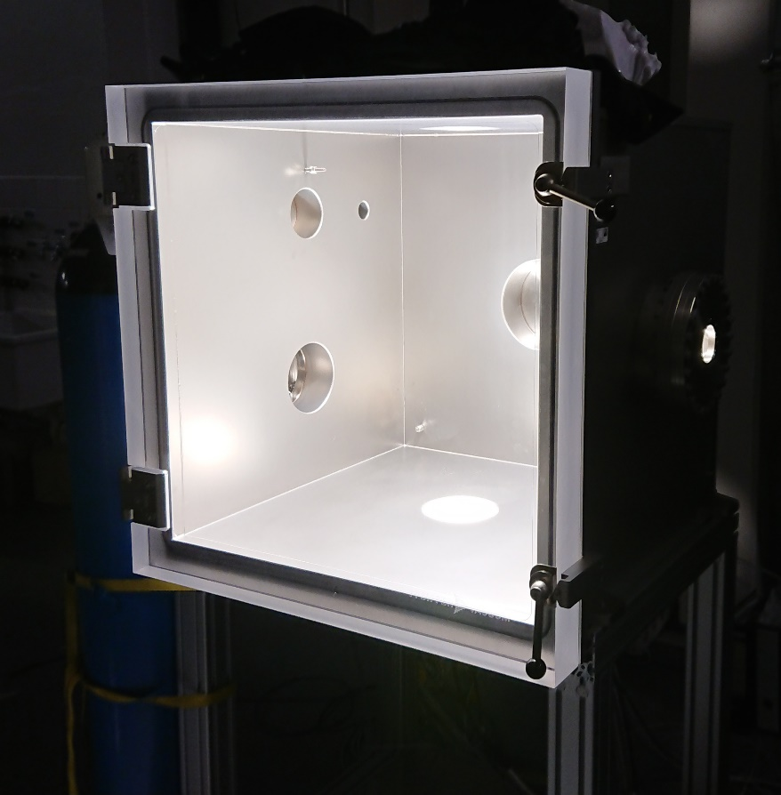
Future activities
Offsite testing
Valve testing at IPP (Sep. 2022 – Nov. 2022)
Function tests
Pressure test of front reservoir at 100 bar (1.25 times design pressure)
Pressure test of rear reservoir at 25 bar (1.25 times design pressure)
200 operation cycle tests
1st Vacuum leak test in hot and cold states
Baking at 200 °C for 10 days
2nd Vacuum leak test in hot and cold states
Outgassing test
Inspector from QST on site
System testing at IPP (Sep. 2022 – Dec. 2022)
Electrical insulation
Full setup of MGI system in the lab
Test of manual and automatic operation modes
Documentation

Slide 8
Future activities
Project plan
 | S 22 | O 22 | N 22 | D 22 | J 23 | F 23
MGI valves function tests
Pressure / leak tests
System tests
Packing and shipping
On-site system inspection
Packing and shipping (Dec. 2022 – Jan. 2023)
Transfer of ownership from IPP to F4E
F4E organizes packing and transport
System inspection on arrival in Naka (early 2023)
Unpacking and on-site inspection
Quick assembly of the system for function test if possible
Transfer of ownership from F4E to QST
Installation of the MGI system (Feb. 2024)

Slide 9
Future activities
Commissioning plan
Commissioning can be done directly after installation of the MGI system
No vacuum / plasma necessary for commissioning
Commissioning will include
System test
Inclusion of interlock signals
Inclusion of H2 alarm signal
Test of machine timer signals
Adjustment of system parameters (Filling time, pressure drop, etc.)
Final system test
Vacuum vessel has to be empty when valves are fired
Detailed commissioning plan has to be worked out together with QST colleagues

