Slide 1



FP8 enhancement commissioning –
Divertor cryopump system
Christian Day, Volker Hauer and the F4E-QST-CRP team

Slide 2
Contract status
Manufacturing contract (for 9 ident. cryopumps + 1 spare) awarded in Jan 2021.
The Annex B (Tech Spec) has been signed in Aug 2020
The PA + Annex A has been signed in July 2021.
The mirror Tech Spec between F4E and the manufacturer has been amended up to Sep 2021. In Mar 2022, the contract with the manufacturer has been re-baselined in view of manufacturing issues (welds, glue) that mainly evolved in Q4/2021. This will provide an 11th cryopump that undergoes special testing to demonstrate manufacturing procedures. Original delivery of 10 is unchanged, hence no impact on PA.
There are now 4 deliveries to QST:
  The in-vessel supports in September 2021
  The first batch (minimum 3 of the cryopumps) by Nov 2022
  The remaining cryopumps by Dec 2022 (is June in the PA)
  The 11th cryopump by Mar 2023.
But end of the manufacturing contract only by Easter 2023. This requires resources in 2023 for final follow-up of the contract (in particular ADP review).
BA_D_29VESF
BA_D_2AFTL3
BA_D_29SPDN
Full scope by end Dec 2022.

Slide 3
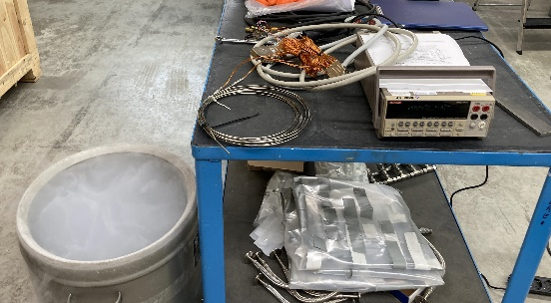
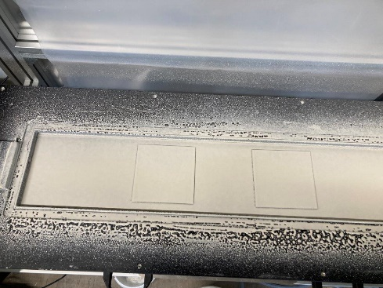
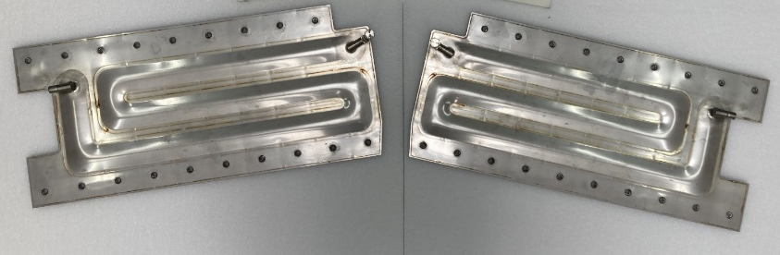
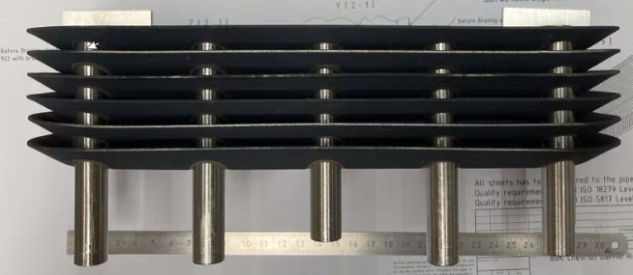
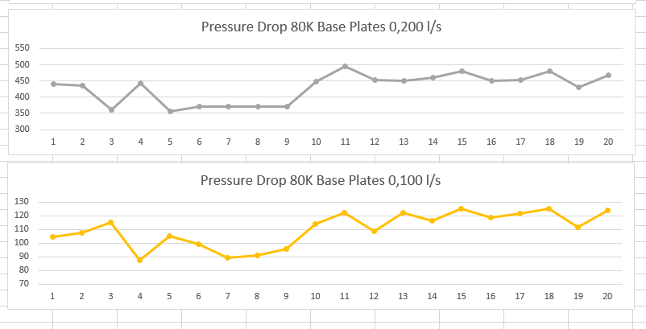
Current manufacturing status
Sensor calibration
Charcoal binder application
demonstration
Pressure testing of hydroformed
components
Dimensional check of the baffle blades
Uniformity of Pressure drop among 80 K base plates

Slide 4
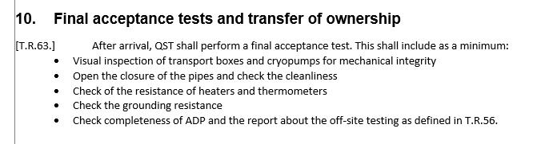
Project timeline 2023
(light) contractual acceptance testing on-site – QST had the intention to do additional tests, but this is not fixed yet.
2023
Jan 2023
10 cryopumps delivered to Naka
Mar 2023
11th cryopump delivered to Naka
Installation in M/E1
18 Sep – 7 Nov 2023
(official time slot, first discussion of installation procedure with Fukui-san last week (description is part of the F4E obligations under PA)
Functional system commissioning of the cryopumps requires cryo and vacuum, hence can only be done after installation and closure of the vac vessel (i.e. late 2024 at best).

Slide 5
Project plans - 2023
Resources associated to close the original FP8 work:
closing off the work on the cryopump system manufacturing:
Manufacturing follow-up, ADP review, etc.
[Acceptance testing is not expected to require a dedicated expert on site. ]
Resources associated with commissioning and system operation:
Finalise and complete the (draft) commissioning procedure by Q1/2023 (when all pumps will have arrived at Naka).
This is the continuation of the running task SA-SE.OP.SSO.04-T001-D001.
The final document will
  define the minimum scope for commissioning the system.
  define the minimum scope for integrated commissioning.
  outline a scientific programme to quantify the system performance so that it can be employed in particle balance studies and divertor neutral gas dynamics simulations and measurements.
Resources associated with system installation on site:
This may require an expert on site (at least during installation of the first cryopump(s)).
2 PM under SA.ENH ?
3 PM under SA.OP
tbd

Slide 6

Status of commissioning plans
Three meetings organized by Eva (Feb, Mar, July 2022).
Discussions focused on
- Discuss Commissioning plan template.
- Consider examples from other cryopump projects.
- Proposal: De-risk the late commissioning by an early commissioning of the already
installed system but not requiring machine cryo and machine vacuum (seems to be a
very high effort).
- Define operational modes and how to reflect them in the commissioning.
- Identify # tests (i.e. commissioning schedule) and requirements on other systems
necessary to perform these.
The design and manufacturing of the pumps will be presented at SOFT: P2-27.
Thank you!

