Slide 1
VUV divertor Spectrometer for JT-60SA: status of the project
Alessandro Fassina for the team
WPSA General Meeting May 2022 (remote)
CRFX : L Carraro, A Fassina , M Valisa
ENEA: F Bombarda , C Cianfarani
IAP: S Soare
IPPLM: M Czernyshova, M Dobrut
UKAEA: I Coffey K Lawson S Scully

Slide 2
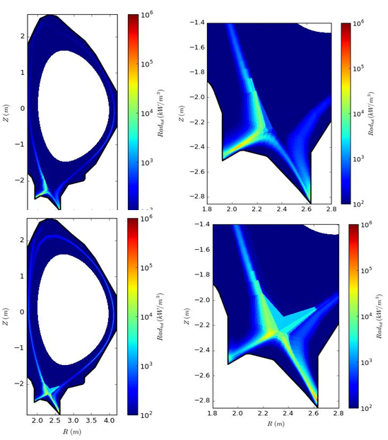
Scientific scope
Monitor the space-resolved emission @ Inner/X point/ Outer divertor
( Sample of ) Synthetic version of the spectra from one LOS in Ar doped case (scenario 2)
Carraro et al., Simulation of the VUV spectral emission
from the JT-60SA divertor
47th EPS Conf 2021
http://ocs.ciemat.es/EPS2021ABS/pdf/P4.1005.pdf
Soledge simulations of JT-60SA scenario#2

Slide 3
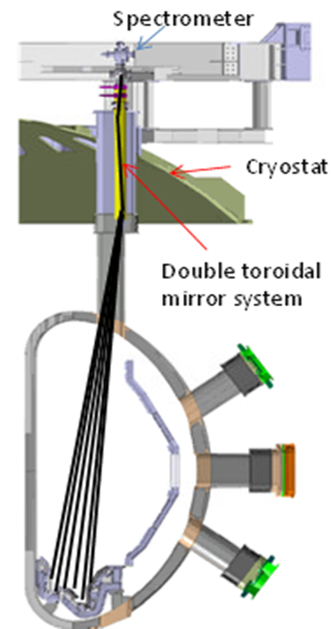
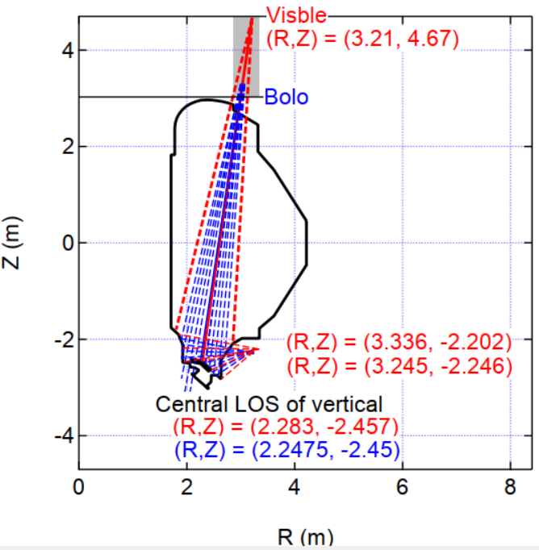
Layout
Good overlap of VUV VIS
and bolometer LOS important
for physics studies
Courtesy of T. Nakano

Slide 4
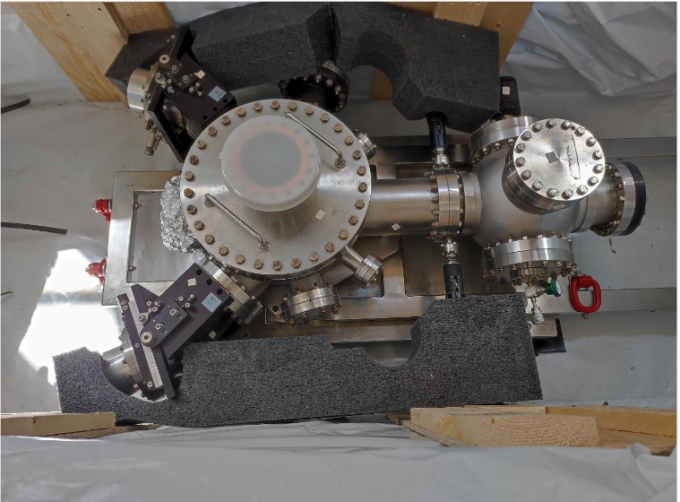
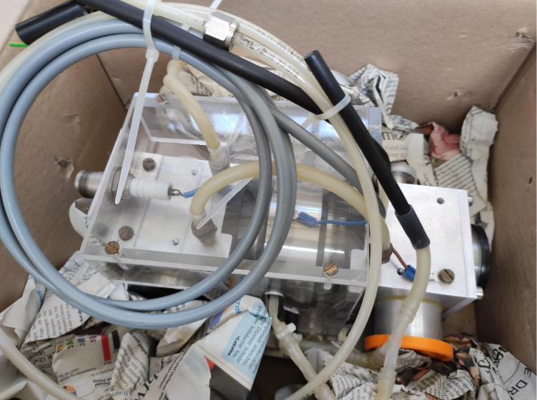
Spectrometer
Model 251 McPherson Dual Spectrometer , SHIPPED from Julich to Frascati at the end of July to be refurbished with imaging grating , new detectors and new pumping system
together with a VUV calibration source
(Thanks own to Juelich for making the Spectrometer available and F4E for organizing the shipment)

Slide 5
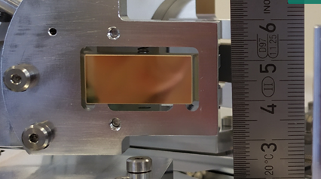
Gratings
Specially designed to cover the specific wavelength range and fit the spectrometer ( W Biel) are being manufactured at ZEISS (Germany) .
10 – 48 and 44 - 125 (nm) wavelength ranges and imaging capability
Most delicate elements . Suffered of problems at the firm manufacturing the blanks.
Delivery exected by the end of the year with some probability to protrude into first days of January.

Slide 6
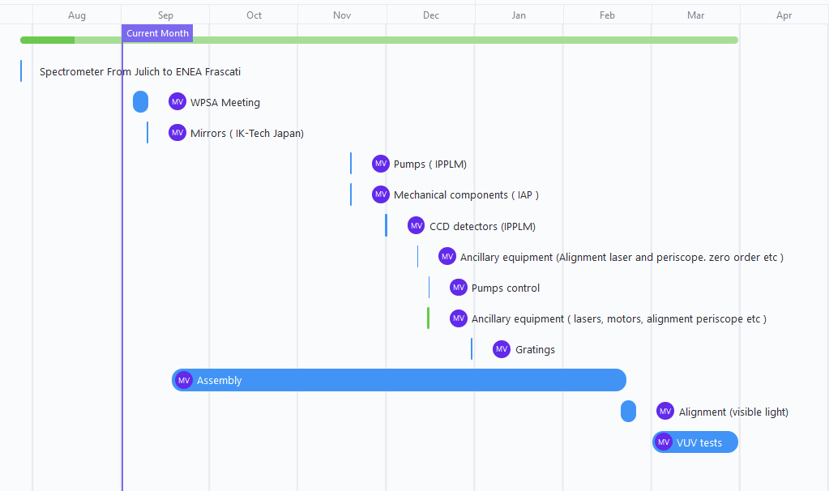
Procurement Schedule

Slide 7
Working on Radiation screening
Possible radiation shield designed ( Borated Polyethylene + Lead)
Jet solution (few cm of SS) as alternative being considered
Neutron analysis by F4E /CNR Milan to evaluate screen efficiency and needs for first years of operations.

Slide 8
Thanks

