Slide 1

9th WPSA Project Planning Meeting
CEA Cryo & magnets Activities
Budapest, 05-09 September 2022
Sylvie NICOLLET, A. Torre, F. Bonne, F. Michel

Slide 2
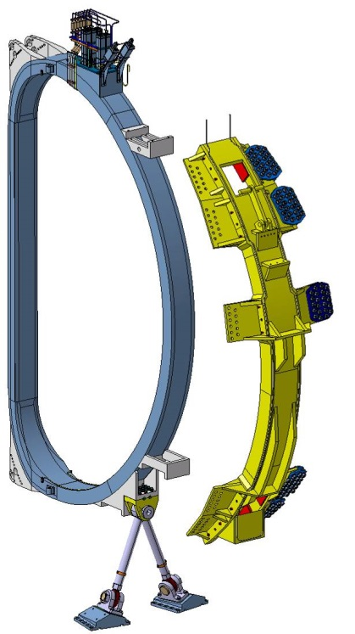
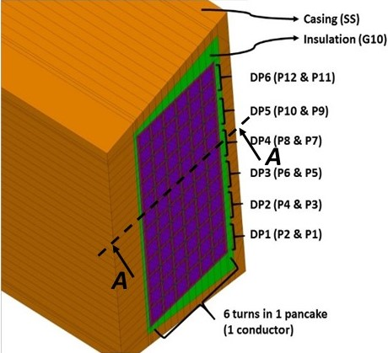
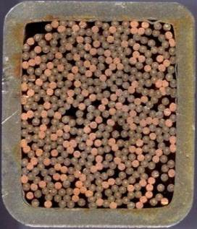
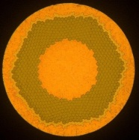


JT-60SA TF COIL AND QUENCH IN CICC
Copper matrix
22 mm
0,8 mm
26 mm
≈8 m
Central DP
Inner DP
NbTi filaments
Side DP
Strand
CICC
(Cable-In-Conduit-Conductor)
cooled by supercritical helium forced-flow
WP (Winding Pack)
TFC (Toroidal Field Coil)
  Quench: Irreversible transition from superconducting state to normal resistive state.
  If not quickly detected, it may lead to possible permanent damage of the magnet.
Starting from a local perturbation, the normal (quenched) zone propagates and generates a large resistive power by Joule effect.
He inlet
He outlet
113 m
PhD Q. Gorit: CHATS 2021 Presentation, 20/09/2021
2

Slide 3
CEA TOOL & TEAM
ITER TOOL:
- SUPERMAGNET Reference Code, Only one tool maintained → Important Risks on Calculations Results
CEA TOOL:
on MATHWORKS Environment (Matlab, Simulink, Simscape, etc…..): only one platform
For OPERATION (Simcryogenics, ST-AM) as well as QUENCH & SAFETY (STREAM, potentially Upgraded Simcryogenics)
Tool based on modules: basic & elementary functions & “bricks” (for modeling some Cryogenics components, THermohydraulics phenomena, Electrical Properties, Quench Propagation, etc…..) → “bricks” exchangeable in CEA Team
Tool submitting to evolution & upgrades (with additional phenomena, ex: radial transverse heat transfer from Case to WP)
Tool with rapid execution time duration (useful for Magnets Operation with Cryogenic System & Refrigerator models)
Already existing partly applied models (for JT-60SA or EU-DEMO)
Models Consolidation for applied operation and safety modelling (comparison of CEA Tool Results & SuperMagnet Results with Measurements)
→ RAPID EXECUTION TOOL (Aim: Once minute)
CEA TEAM
for JT-60SA WPSA Modelling: DSBT (F. Bonne & F. Michel) & IRFM (S. Nicollet)
Competences in Cryogenics, Thermohydraulics, as well as in Superconducting Magnets

Slide 4
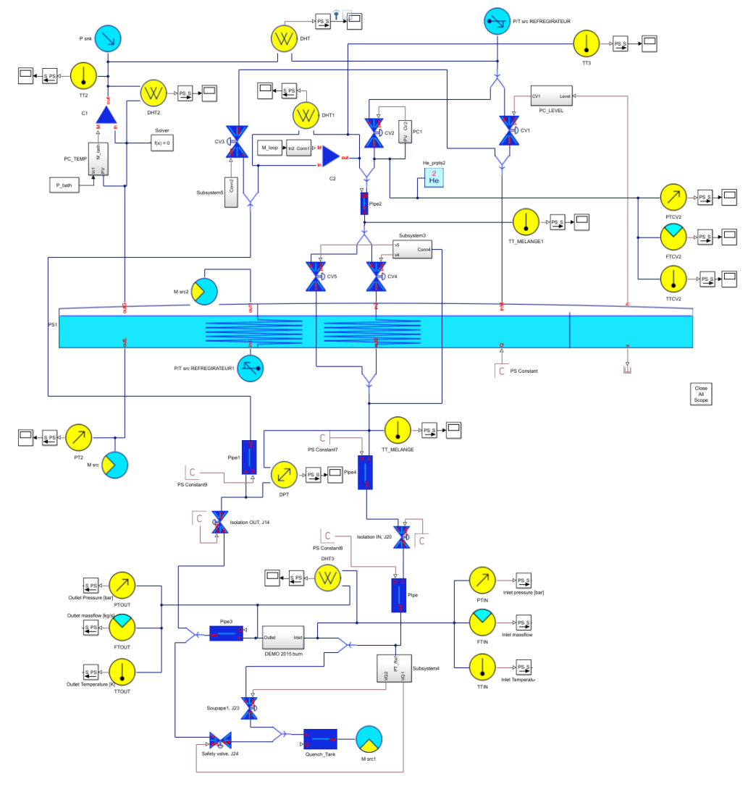
SIMCRYOGENICS Models
SIMCRYOGENICS (Matlab-Simulink, CEA/IRIG/DSBT)
Advantages:
More realistic than Flower (SuperMagnet) for operation
Control modelling by PID Control of P, T, M (CTF and Tokamak)
Simcryogenics models of JT-60SA Refrigerator and Cryodistribution
E
A
F
G
A’
      CTF developed model Bloc description:
      A: injection valve – pressure control
      A’: extraction valve
      B: mixing valves – temperature control
      C: pipe with thermal losses
      D: Cable in Conduit Conductor (CICC)
      E: pump (circulator)
      F: bath level controlling valve (JT-valve)
      G: gas compressor
      H: quench tank – pressure release
B
He
D
C
SIMCRYOGENICS already used by DSBT for JT-60SA Cryogenic Plant and Cryodistribution Model for transients (except Quench)
→ Cool down / Warm up, Daily Operation with control system, heat loads on ACB estimation, Cryogenic Plant simulator.
→ Developments of electrical modules (EU-DEMO Task 2022 → Operational Tool for 2023)
Possibility of Stability studies (with determination of Temperature margin, Minimum Quench Energy estimation to quench)
Leading to Magnets operation domain as a function of plasma heat loads
Possibility of Quench modelling (mid-term)
RST, JT-60SA Résultats Tests & Modélisations TFC, 20/05/2019, S. Nicollet
| PAGE 4

Slide 5
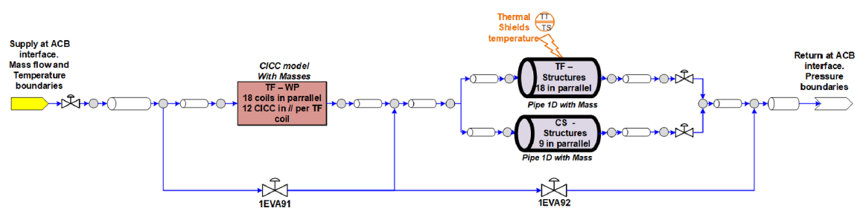
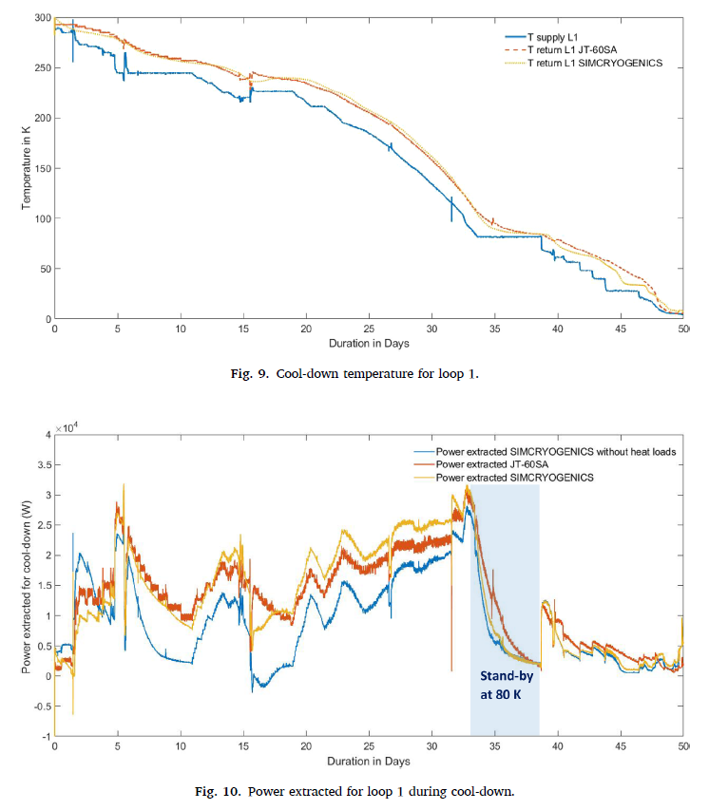
SIMCRYOGENICS Models RESULTS FOR COOL DOWN
SIMCRYOGENICS (Matlab-Simulink, CEA/IRIG/DSBT)
Example: Cool down simulation of JT-60SA magnets cool down
Modelling of the loops + magnets
Simulation and prediction of the behavior
F. Michel et al. Cryogenics 126 (2022) 103537

Slide 6
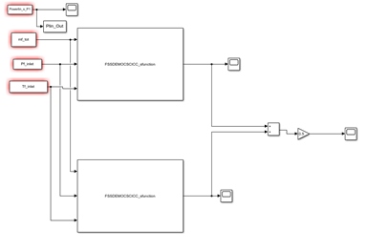
ST-AM Model
ST-AM Models: Superconductors Thermohydraulical – Analytical Model (SimuLink, S. Nicollet)
Advantages:
For Cryodistribution Model Operation (with temperature margin on conductors & delayed cryogenic heat loads on ACB)
Simulink user friendly interfaces
Extremely simple with validated hypotheses (constant helium properties, etc…) → even more rapid execution tool
Possibility to model radial Transverse heat transfer & delay time from Casing to Winding Pack
      ST-AM MODEL & HYPOTHESES:
      MODEL
      Electrical (Jc & current sharing temperature,) and themohydraulical models of 1-D CICC
      Possibility to determine the operation conductor temperature margin
      Rapid interfaces description on Nuclear Heat Loads in Winding Pack (WP) and Casing
      Possibility (middle term) of rapid radial evaluation of heat loads transfer from Casing to WP
      HYPOTHESES
      Helium at constant pressure and temperature properties (only small variation)
      Stiationnary & imposed mass flow at inlet of CICC
      Additional heat loads corresponding to circulating compressor
      First approach with “ideal” heat exchanger, but efficiency implementation possible
First Application for EU-DEMO TFWP4 heat loads on ACB, Task 2022→ Operational tool for 2023

Slide 7
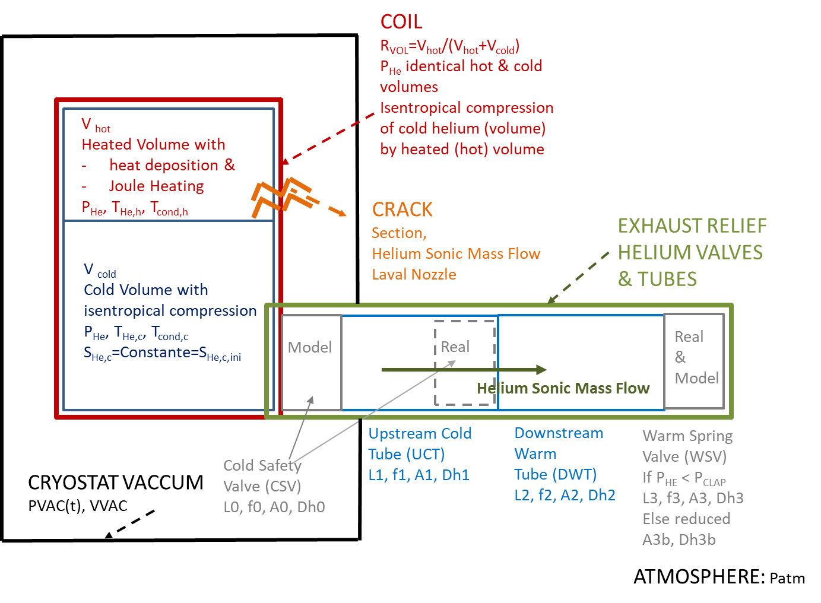
STREAM MODEL
S. Nicollet & WEST Team, Superconductor Thermohydraulical and Resistive Electrical Analytical Model (STREAM) applied to WEST TF Coil Quench Analysis, Cryogenics, Volume 125, July 2022, 103493 / Q. Gorit, S. Nicollet et al., JT-60SA TF Coil Quench Model and Analysis: Joule Energy Estimation with SuperMagnet and STREAM, Cryogenics 2022, CHATS Proceedings
      OBJECTIVES : ANALYTICAL MODEL WITH EXPLICIT RESOLUTION MORE RAPID IN EXECUTION TIME
      VALIDATION WITH EXPERIMENTAL QUENCH RESULTS, CROSSCHECK WITH SUPERMAGNET
      MODEL AS WELL ALL QUENCH MACRO-PARAMETERS & LOVA INCIDENT MACRO-PARAMETERS– ENGINEERING APPROACH
STREAM: SUPERCONDUCTOR THERMOHYDRAULICAL AND RESISTIVE ELECTRICAL ANALYTICAL MODEL (CEA-IRFM, Matlab, S. Nicollet)
STREAM describes electrical, thermodynamical (thermal) & hydraulical analytical equation during quench or LOVA Incident
Electrical model, describes evolution of quenched length L_{q}, Joule heating in conductor (>T_{cs}), resistance, voltage and decrease of current (from voltage threshold criteria).
first thermal and thermodynamical phase describes/calculates evolution of fluid pressure & temperature inside closed volume (0-D, Coil or Tank), with heated part (V_{h} with external energy deposited) & other cold part submitted to isentropic compression (V_{c} remains adiabatic): needs initial conditions of P and T (single phase with negligible vaporisation energy compared to applied energy) and heat flux inputs (volumetric heat load)
second hydraulical phase describes helium mass flow expulsion, from given pressure drop threshold, through relief circuit with limitation at given relief pressure or Mach = 1. Calculates Pressure & Temperature evolution (in single phase – gas or supercritical- in space & time) along the exhaust circuit (with the condition that safety valves are located as near as possible to the tank) with length, section, friction factor and wall temperature of the different components of exhaust circuit (including safety valves)
STREAM additional model implemented:
STREAM could also calculate the pressure increase in Cryostat Vacuum in case of LOVA incident (Laval Nozzle), with main parameter the cross section of the leak or « crack » with gas/supercritical fluid flow

Slide 8
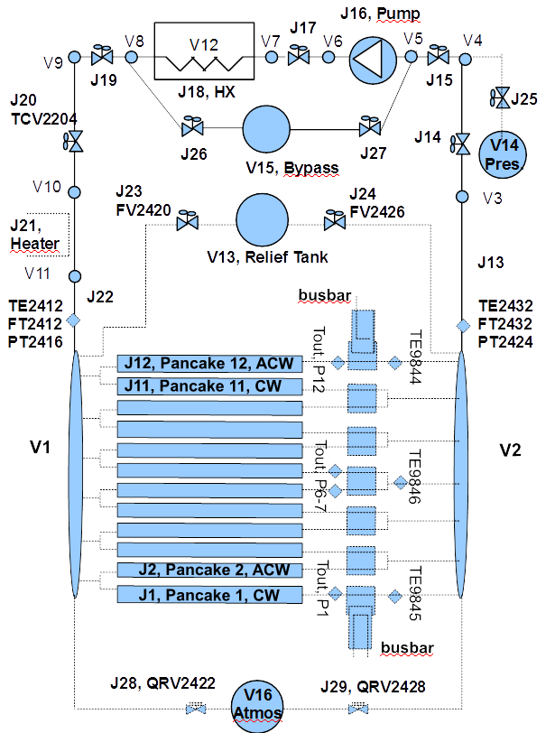
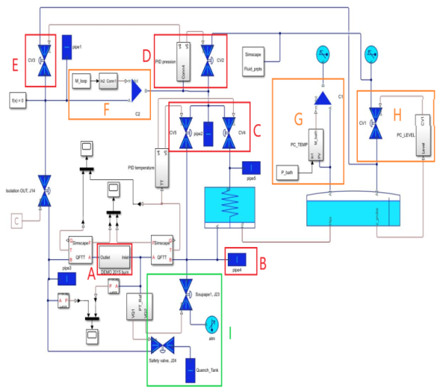
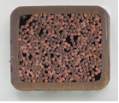
CEA TOOL - SUPERMAGNET
OPERATION: TRANSIENTS
      QUENCH INCIDENT: FAST TRANSIENTS
Simcryogenics, STREAM, ST-AM
      SUPERMAGNET (CERN, L. Bottura, Ref ITER)
Advantages:
- More realistic tool for normal operation
- PID control (P,T, M)
JT-60SA Refrigerator Simcryogenics models (old)
Valid for TRANSIENTS Except Quench
Current development of 1 CICC Electrical Model
Potentially Quench modelling in Simcryogenics
Disadvantages
Coupling difficulty with THEA (Quench Modelling)
      THEA: 1-D CICC Model
      FLOWER: Cryodistribution Model
      Advantages:
      Precise Thermal, Hydraulic and Electric Analysis of Superconducting Cables, and Cryogenic components
      Finite element model in space, finite difference in time
      Disavantages:
      Large calculation time consuming
      Forced flow CICC Quench: few hours
      Bath cooled coil Quench: 5 days
Q_{He,St} (p_{st}, h_{st})
Strand (T_{st})
Helium (P, T_{He}, v)
Q_{He,jk} (p_{jk}, h_{jk})
Q_{St,jk} (p_{St,jk}, h_{St,jk})
Jacket (T_{jk})

Slide 9
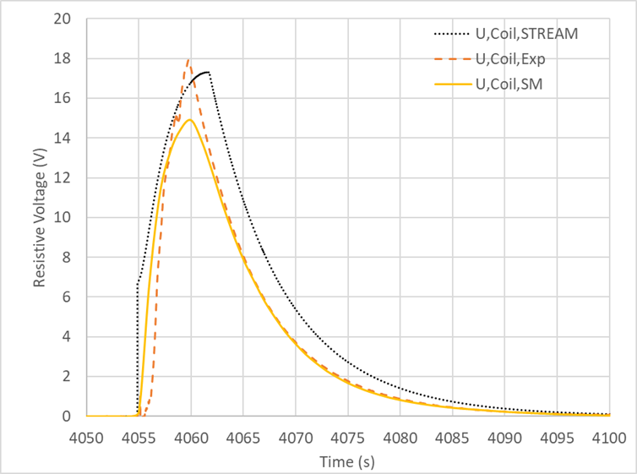
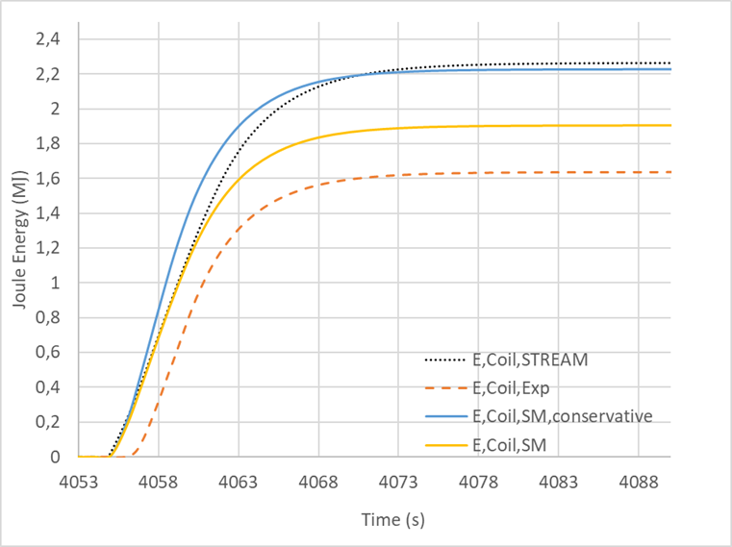
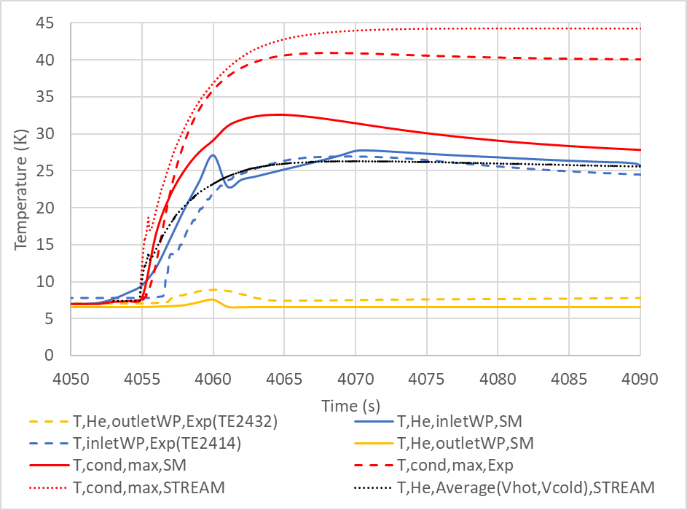
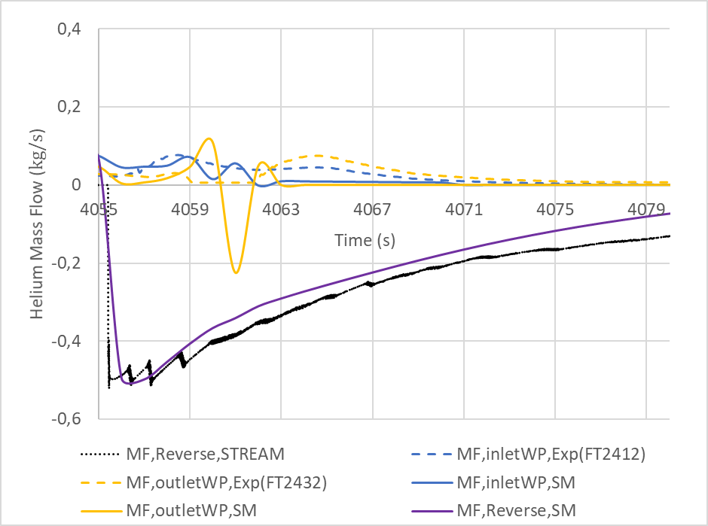
SUMMARY - TFC02 ACCEPTANCE QUENCH TEST RESULTS:
THERMOHYDRAULICAL & ELECTRICAL WITH SUPERMAGNET & STREAM CALCULATIONS
$$U_{Coil,max,SM}=14.9 V<U_{Coil,max,STREAM}=17. 3 V<U_{coil,max,Exp}=17.8 V$$
$${E_{coil,Exp}=\text{1.64 }\text{MJ} \text{< }E_{coil,SM}=1.90 MJ\text{<} E}_{Coil,STREAM}=2.21 MJ$$
Hot Spot Temperature ~ 40 K (with STREAM & SuperMagnet)
Reverse Mass flow at inlet ~ -5 kg/s (with STREAM & SuperMagnet
STREAM Upgraded & Validation for JT-60SA TF coils cooled in supercritical helium Quench with SuperMagnet Calculated results
STREAM important interest (Calculation ~10 min / SuperMagnet Calculation for WEST ~hours/days)
WARNING: STREAM Valid for supercritical helium flow (no diphasic flow)
Q. Gorit, S. Nicollet et al., JT-60SA TF Coil Quench Model and Analysis: Joule Energy Estimation with SuperMagnet and STREAM, Cryogenics 2022, CHATS Proceedings

Slide 10
CONCLUSION THERMOHYDRAULICS MODELS:
PREPARATION OF JT-60SA OPERATION
1) 2023: For operation temperature margin determination: Needs Further updated “real” Plasma NH loads ? Contact Person
CEA TOOL on MathWorks (SimCryogenics –ST-AM) : basic & elementary functions & “bricks” for common operation use (see roadmap)
Model of Magnets & Cryodistribution for rapid feed-forward loop/process (Plasma NH loads, transverse & radial conduction delay, transfer from Casing to Winding Pack, delayed & pulsed heet loads on ACB- Auxiliary cold box- & Cryogenic Plant)
2) For up-graded operation temperature margin determination : with AC losses models
CEA TOOL on Mathworks (Simcryogenics & ST-AM)
Plasma Operation & Further implemented AC losses models (for superconductors with simple models, and structures in case of current discharge with potentially radial heat transfer from case to WP)
3) 2023: For cool down & warm up studies: needs Mass of components & radiative heat loads
CEA TOOL on MathWorks (Simcryogenics & ST-AM)
Model of delay time caused by heat transfer from Casing to WP, Simcryogenics use for cryoplant control during cool down/warm up, valves controls during operation
4) Cryogenic System Operation Model: Cryodistribution & Cryogenic Plant Refrigerator Simulator
Continuing the Simcryogenics of the JT-60SA cryodistribution + Magnets to simulate the cool down / operation
Modeling of the JT-60SA refrigerator (according to measurements) to simulate the cool down / operation
Coupling the two model to obtain a plant Simulator (without PLC)
5) Potentially Competences for Operation of CS & EF: needs a lot of input (design, operation procedures, etc…) from QST Team with Contact Person & cross-check with QST Results ? → SuperMagnet & CEA TOOL modelling of CS & EF with Cryosdistribution

Slide 11
CONCLUSION THERMOHYDRAULICS MODELS:
JT-60SA QUENCH ANALYSIS, SAFETY & AVAILABILITY
1) 2023 For Stability studies and Minimum Quench Energy (MQE) determination: Needs of Plasma disruption heat loads ? (runaway electrons, neutrons, gammas – see TS/WEST Quench Study) with Contact Person, Comparison with MCNP Nuclear codes
SuperMagnet & CEA TOOL
Coils & Cryosdistribution model (with additional electrical modules, permitting stability study, & mid-term quench studies)
2) For Quench Modelling of TFC
SuperMagnet & CEA TOOL
Further Quench modelling with SuperMagnet of TFC for Tokamak configuration and conditions with the objective: see the criticity of “severe” and “smooth” quench (localisation high or low field, high or reduced current), Joule energy, energy on Cryoplant and see the possibility of secondary thermohydraulical quench detection (if interest ?)
3) Potentially Competences for Quench Modelling of CS & EF: needs a lot of input (design, operation procedures, etc…) from QST Team with Contact Person & cross-check with QST Results ?
SuperMagnet & CEA TOOL modelling of CS & EF with different quench initiation parameters
4) Potentially Competences to Determine & Model MCI “Maximum Credible incident” (feedback of cumulative CERN-LHC incident)
Generalised quench of all coils simultaneously (vaccum loss when all coils energetised and plasma with potentially voltage noises and difficulty to detect by primary (voltage) detection)→ Find way of mitigation
Assessment of estimation of heat ingress in case of LOVA incident in Cryostat (helium leak, air, etc….)
SuperMagnet Quench Model with this applied heat loads

Slide 12
Merci de votre attention

Slide 13
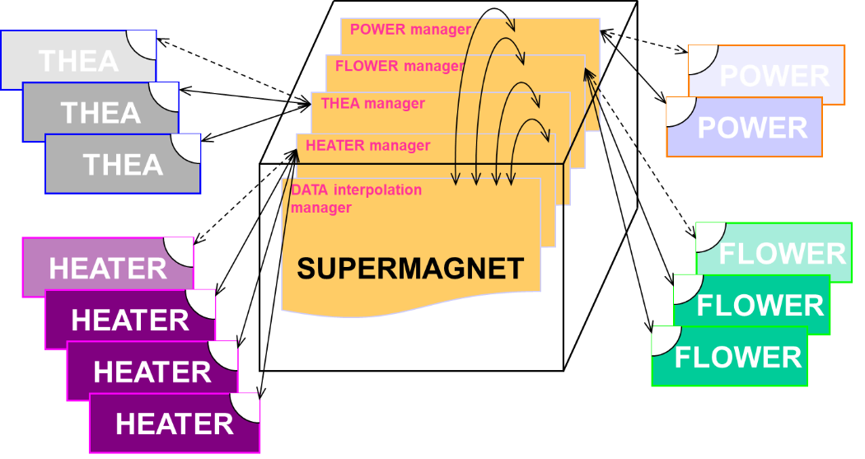
SUPERMAGNET CODE
SuperMagnet Code [1] and commercialized by Horizon Technology
The CryoSoft suite of codes THEA [2] (Thermal, Hydraulic and Electric Analysis of Superconducting Cables), FLOWER [3] (Hydraulic Network Simulation), POWER (Electric Network Simulation of Magnetic Systems), and HEATER provides a basis for well optimised and flexible tools for the analysis of specific issues in superconducting magnet systems. SUPERMAGNET is the manager application that launches two or more of the above codes, schedules their communication and terminates execution as appropriate.
The codes communicate through a data exchange mechanism that achieves the desired physical coupling and makes it possible to describe a series of processes such as:
effect of helium expulsion during thermal transients on the proximity cryogenics;
evolution of the coil current during quench, including the effect of quench resistance;
cooling of a coil with thermally coupled parallel channels;
Numerical Scientific codes to be used as references for normal operation and quench studies
Only code maintained by ITER-IO (previously also Vincenta & Venecia, Russian code)
Important execution time consuming (THEA, Flower, HEATER)
Possibility to use other platform for calculations ?
[1] Bagnasco M et al. Progress in the Integrated Simulation of Thermal-Hydraulic Operation of the ITER Magnet System. IEEE Transactions on Applied Superconductivity 2010; 20-3: 411-414.

Slide 14
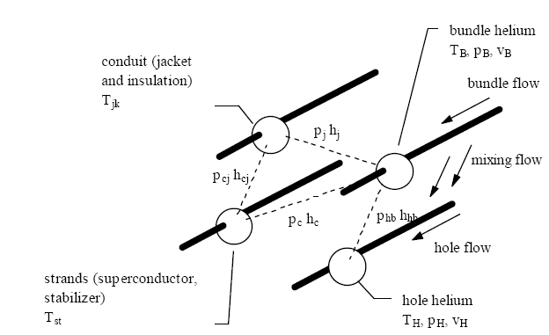
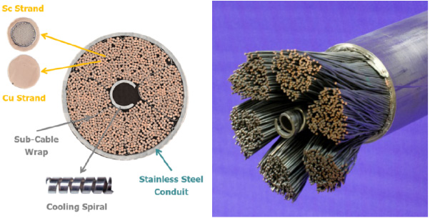
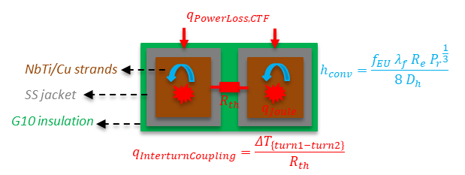
JT-60SA TFC THEA CODE & MODELS
      Geometrical Description of Cable-In-Conduit Conductor (A, Ub, Dh)
      Implementation in subroutines:
      CICC friction factors from measurements at room temperature on each conductor
      CICC Heat exchange coefficient Colburn
      Pancakes Magnetic Field (field.dat)
      Strands Performances NbTi Jc (B, T) with L. Bottura Law, strands of average performances (identical)
      Heat load (from casing) to Pancakes (lateral + first and last turn of central in W/m via power.dat)
      Intern-turn coupling
      Eventually, Initiation of Quench by local perturbation in W/m over given length and duration via perturb.dat
      Coil Current (nominal & fast safety discharge decrease via current.dat)
      Parameters of electrical quench detection (DV=0.1 V and Tda=0.1 s) trigger current discharge
THEA Parameters
THEA Code [3]: numerical implementation of a 1-D model for the thermohydraulic simulation of Cable In Conduit Conductor :
→ Mass, momentum and energy balance with Compressible fluid
→ Model of 4 independent components: strands, conduit, bundle helium and central helium.
→ I, B (x,t) during quench, Joule heat generation computed consistently with the non-linear critical current density correlation.
→ solver decides whether a quench or a recovery has taken place.
$H_{conv}=λ_{He}∗\left(0.023∗{Re}_{He}^{0.8}\right)∗{Pr}_{He}^{\frac{1}{3}}/{Dh}_{He}$
[2] L. Bottura et al., A numerical model for the simulation of quench in the ITER magnets, Journal of Computational Physics 125, 26-41, Article N°0077, 1996.

Slide 15
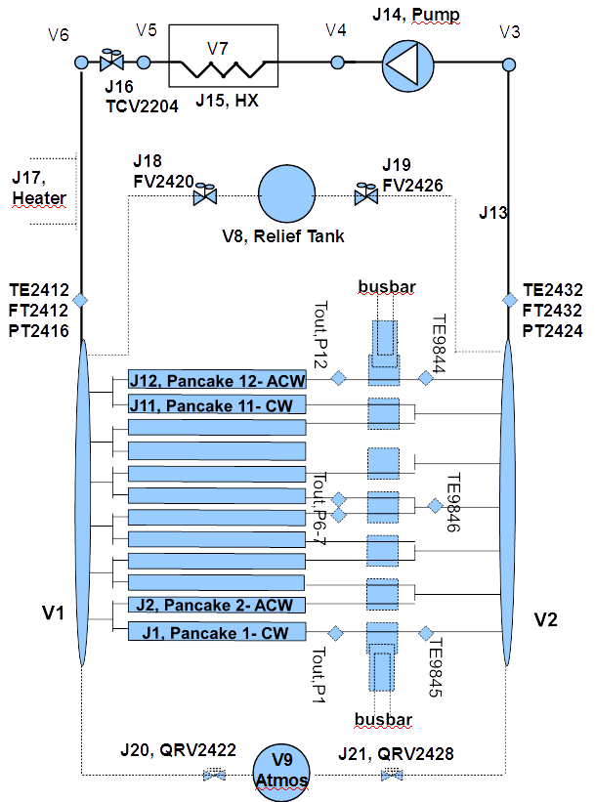
JT-60SA TFC FLOWER CODE & MODELS
      FLOWER Code [4] Implementation & Description of Cryogenic Components:
      JUNCTIONS (1-D with compressible fluid) defined by (P, T, v)
      Cryolines, manifolds & tubes
      Control Valve, quench relief valve (Burst Disk with pressure set), check valve
      Heat exchangers
      Pumps
      Possibility of a additional heater (JT-60SA CTF: increase of The,inlet until T=7,5 K) implemented in subroutines
      VOLUMES (0-D) defined by (P, T)
      Tank (relief)
      Additional “connection” volumes between 2 Junctions
      Each Junction is connected to 2 Volumes
      Each Volume is connected to minimum 2 Junctions
      → Power of Heater to obtain the increase of The,in until quench at 7,5 K
[3] Bottura L, Rosso C. Flower a model for the Analysis of Hydraulic Networks and Processes. CHATS Workshop, Cryogenics, 2003; 43: 215-223.
      1 THEA / Pancake

Slide 16
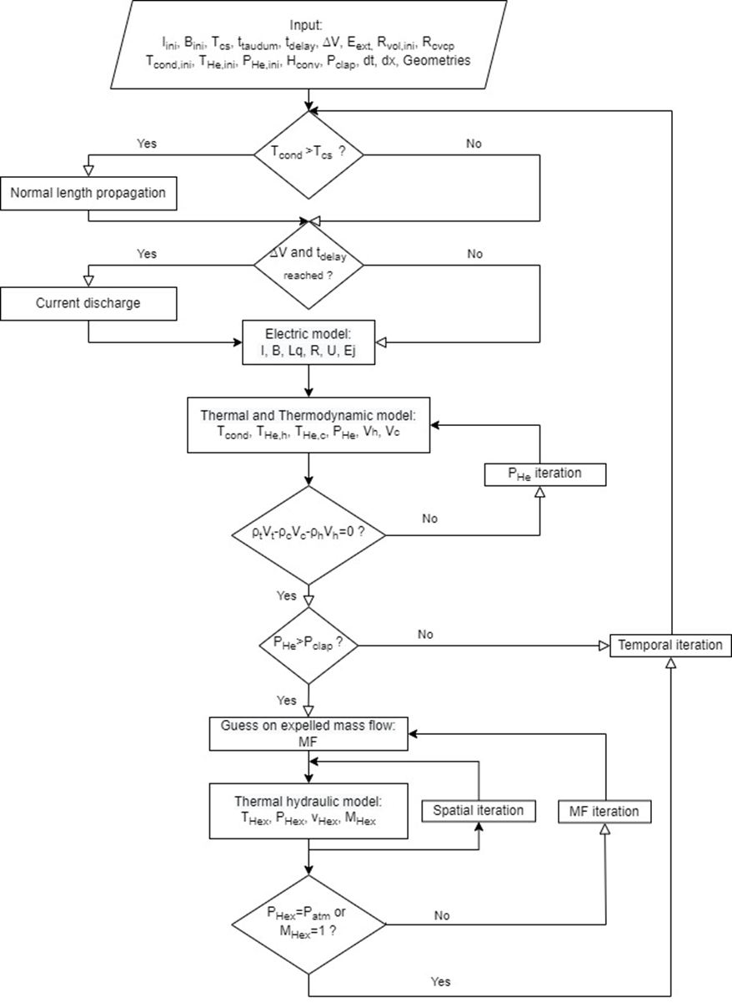
STREAM MODEL
S. Nicollet & WEST Team, Superconductor Thermohydraulical and Resistive Electrical Analytical Model (STREAM) applied to WEST TF Coil Quench Analysis, Cryogenics, Volume 125, July 2022, 103493
STREAM: SUPERCONDUCTOR THERMOHYDRAULICAL AND RESISTIVE ELECTRICAL ANALYTICAL MODEL
STREAM Model Main Characteristics
Computer code used for thermodynamic helium or hydrogen properties.
STREAM model: 0-D model (no space discretization in coil or Tank). Only two volumes « hot » and « cold » considered with corresponding temperatures.
The resolution is explicit
The final (or next time step) heated and non heated volume (inside the coil) are at the same pressure:
P_{He,c} (t) = P_{He,h} (t) = P_{He} (t)
Safety valves models: P_{CLAP} = pressure set of safety valves
for P < P_{CLAP}, MF = 0 (Fluid Mass Flow) for P > P_{CLAP}, valve is open. If P < P_{CLAP} after valve opening, reduced section for spring valve
The code can take into account a shock wave
Pressure drop & heat transfer coefficients in exhaust pipe determined using experimental results.
S. Nicollet & WEST Team, Superconductor Thermohydraulical and Resistive Electrical Analytical Model (STREAM) applied to WEST TF Coil Quench Analysis, Cryogenics, Volume 125, July 2022, 103493

Slide 17
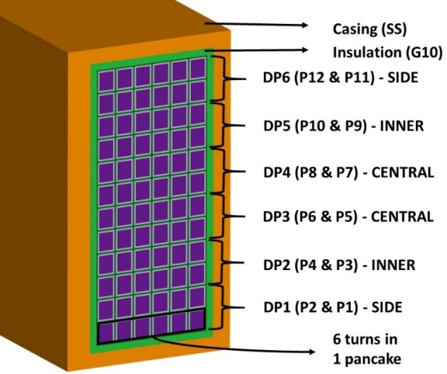
SUMMARY - ATA’S COMPLEMENTARY TESTS MEASUREMENTS ANALYSES
Parametric deviation
Color =Quench DP
Different Quench localisation on the 18 Coils
For one coil TFC02: different tests conditions → Different DV Results (Quench location)
→ Remark : Propagation to other DP = positive factor for quench detection
Trends
M_{HE} increases → quench on central DP // M_{HE} decreases → quench on lateral D
current decrease → no influence on quench DP & T_{HEMAX} decrease (except for I=50 %, smoother quench)
t_{DA} increase → T_{HEMAX} increase
T_P6-7 > T_P12 before quench → Quench on DP3 // on the contrary → Quench on DP6

Slide 18
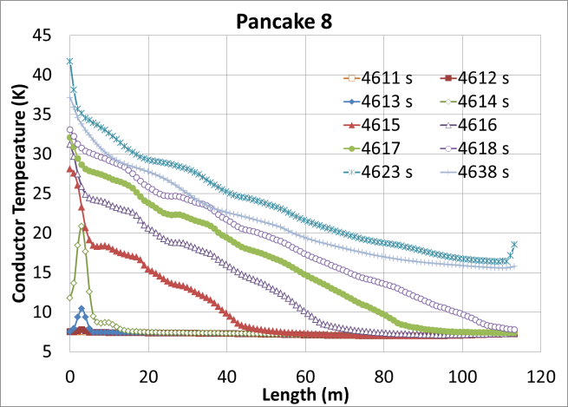
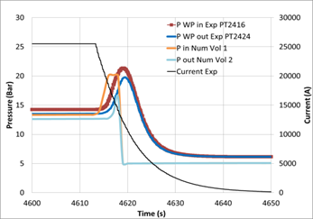
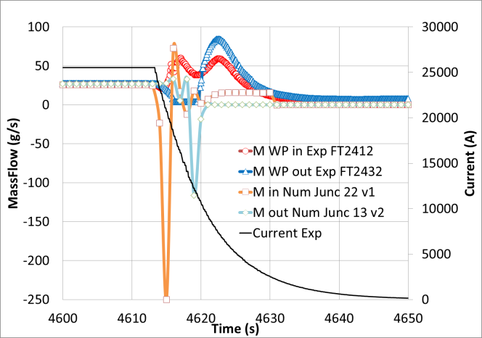
SUMMARY - ACCEPTANCE & COMPLEMENATRY QUENCH TESTS (TFC11 & TFC02):
THERMAL-HYDRAULICS RESULTS (Measurements with SuperMagnet & STREAM)
HOT SPOT TEMPERATURE : SuperMagnet Calculated = 40 K
CALCULATED EXPULSED REVERSE MASS FLOW: -0.5 kg/s at inlet
GOOD AGREEMENT
BUT difficulty to measure reverse mass flow at CTF Tests (instrumentation)
Good agreement of maximal Pressure (20 bar) BUT difficulty to observe « dynamics » of pressure decrease in manifolds at end of quench: need Csi factor (& Section) of quench relief Valves adjustment (data)

Slide 19
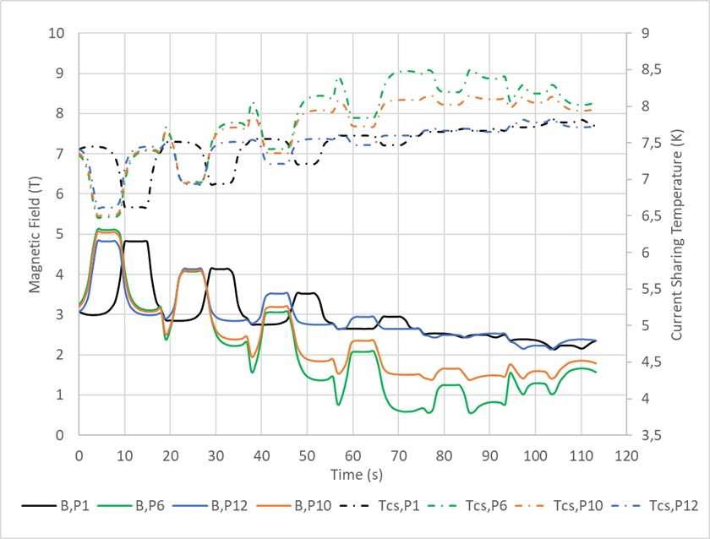
JT-60SA TFC IN TOKAMAK CONFIGURATION
Study in collaboration with A. Louzguiti in the framework of WPSA
$$T_{cs,min}$$
Name | Tokamak | CTF | Unit
TF Coil
TF stored magnetic energy | 58 | 20.5 | MJ
Maximum magnetic field | 5.65 | 3.05 | T
Minimal Current Sharing Temperature | 6.47 | 7.45 | K
Current discharge time constant | 14 | 8 | s
Helium Coolant
WP Helium inlet temperature | 4.5 | 4.7 | K
WP Helium inlet pressure | 0.53 | 1.038 | MPa
WP Nominal mass flow rate | 48 | 24 | g/s
29 m
48 m
JT-60SA TFC in Tokamak configuration, Magnetic field and current sharing temperature profiles
Hydraulical coil protection:
The quench incident during Tokamak operation is simulated without isolating the coil from cryogenic plant at the quench detection time. For this configuration quench relief valves with pressure threshold of 20 bars are the only hydraulical protection for the coil.
Quench initiation:
The resistive transition is induced by Minimum Quench Energy deposition of 30 W/m during 5 s over each pancake first turn, precisely at absissa 5<x<19 m. The quench begins at the helium inlet of the central pancake 6 where the minimal current sharing temperature belongs.
PhD Q. Gorit: CHATS 2021 Presentation, 20/09/2021
19

Slide 20
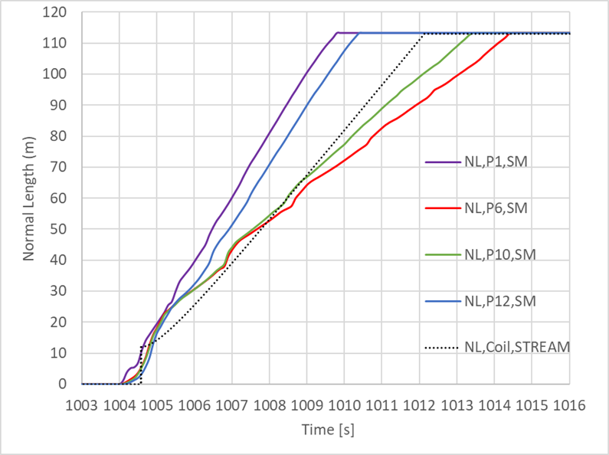
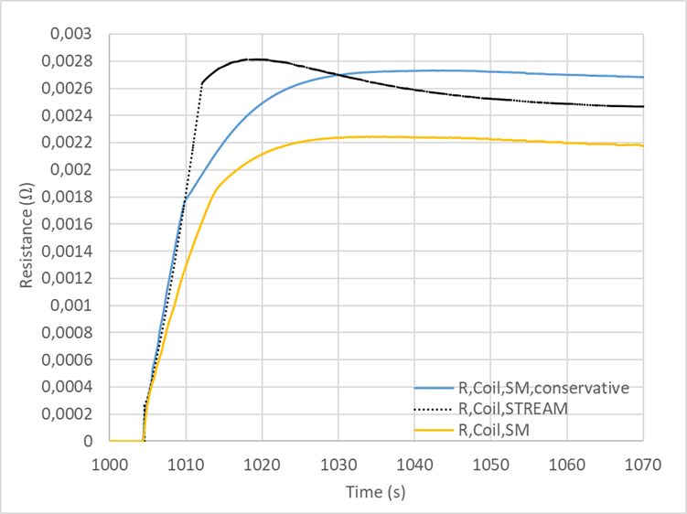
JT-60SA TFC IN TOKAMAK: QUENCH PROPAGATION VELOCITIES & RESISTANCES
$$v_{q,P1,SM}=19.5 m/s$$
$$R_{Coil,max,STREAM}=2.8 mΩ$$
$$v_{q,P12,SM}=17.7 m/s$$
$$R_{Coil,max,SM}=2.2 mΩ$$
48 m
29 m
JT-60SA TFC in Tokamak configuration, calculated normal zone propagation (SM, STREAM)
JT-60SA TFC in Tokamak configuration, calculated coil resistance (SM, STREAM)
Magnetic field distributions induce significant thermal margin and quench propagation velocity differences between central, inner and side double-pancakes:
$0 m<NL<29 m$ $29 m<NL<48 m$ $48 m<NL<113 m$
$v_{q,P6,SM}=v_{q,P10,SM}{=v}_{q,P12,SM}$= $15.7 m/s$
$v_{q,P6,SM}=v_{q,P10,SM}=12.3 m/s$ ${<v}_{q,P12,SM}$
$v_{q,P6,SM}=9.4 m/s$ ${<v}_{q,P10,SM}=10.9 m/s$ ${<v}_{q,P12,SM}$
The analytical quench propagation velocity ($v_{q,STREAM}=14.7 m/s) \text{allows} \text{to} \text{predict} \text{a} \text{coil} \text{resistance} \text{dynamic} \text{match}\text{ing} \text{the} \text{SuperMagnet} \text{calculation}\text{.}$
PhD Q. Gorit: CHATS 2021 Presentation, 20/09/2021
20

Slide 21
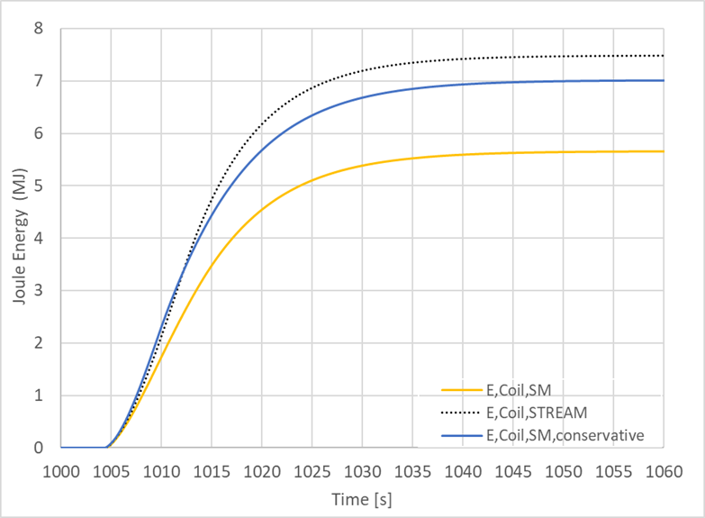
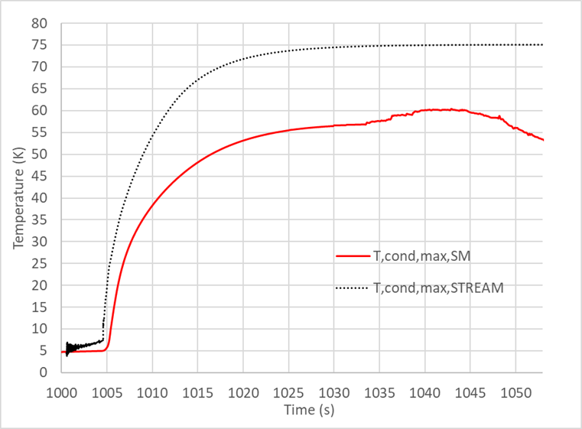
JT-60SA TFC IN TOKAMAK : CALCULATED JOULE ENERGY & TEMPERATURE
$$E_{Coil,STREAM}=7.48 MJ$$
$T_{cond,max,STREAM}=$75.09 K
$$E_{Coil,conservative,SM}=7.02 MJ$$
$$E_{Coil,SM}=5.65 MJ$$
$T_{cond,max,SM}=60.29$ K
JT-60SA TFC in Tokamak configuration, calculated coil Joule energy dissipation
(SM,STREAM)
JT-60SA TFC in Tokamak configuation, calculated maximal conductor temperature
(SM, STREAM)
Heat loads on JT-60SA cryogenic plant:
+ 7 MJ Conservative Joule energy dissipated during the quench of one TFC (12 % of the TF stored magnetic energy)
+ 11 MJ Joule energy dissipated in the 18 TFC thick casings by Eddy currents induced during the Fast Current Discharge
Quench maximal conductor temperature criteria:
$Tcond,maximal,numeric=$ 60.29 K$<$150 K (criteria for non-adiabatic conductor exchanging heat with helium and jacket)
Quench criticality: $v_{q,P1,SM}=19.5 m/s$ → $E_{P1,SM}=0.585 MJ$→ $T_{cond,P1(inlet),SM}=60.29$ K
[5] M. Wanner, “JT -60SA Plant Integration Document (PID),” V4.2
PhD Q. Gorit: CHATS 2021 Presentation, 20/09/2021
21

Slide 22
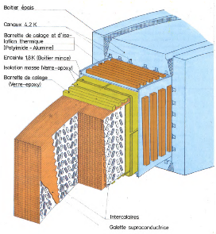
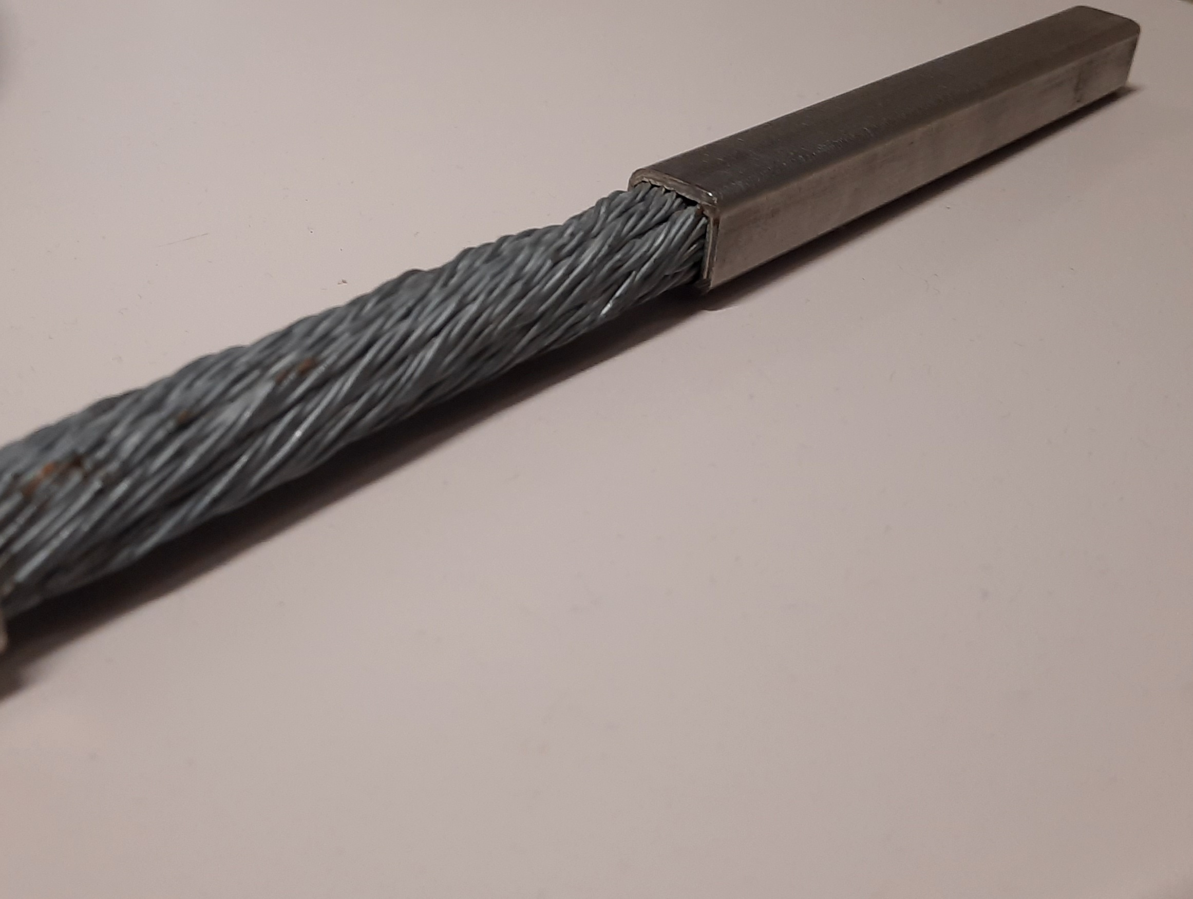
CONCLUSION : SUPERMAGNET & STREAM QUENCH MODELS
WEST TFC QUENCH & JT-60SA CTF ACCEPTANCE & COMPLEMENATRY TESTS MODELS
WEST TFC QUENCH RESULTS & MODELS
confirms criticality and possible occurrence of « smooth quench » (small heat deposition length at low field region).
SuperMagnet Quench modelling needs drastic time step reduction (imposed at 10 ⁻⁶ s to converge)
High computation duration (nearly 5 to 7 days)
SuperMagnet Difficulty to perform THEA input (MQE) and Flower components parametrical studies (reduced section and better modelling of warm spring valves when Phe < P_{CLAP}): only possible, with uncorrelated/independant parameters
Development of STREAM rapid execution Quench modelling analytical tool
STREAM permits to better understand the influence of different parameters
WEST TFC cooled by superfluid helium bath
CICC cooled by supercritical helium forced-flow
JT-60SA TFC QUENCH IN CTF & TOKAMAK
SuperMagnet Quench modelling needs sevral hours (up to 8h) to model 100 s quench (min adaptative time step=10⁻⁶ s during quench)
SuperMagnet difficulty to perform flower components parametrical studies & follow real tests procedures (high computation duration): ex: helium pressure decreased dynamics (exhaust valves Cv parametrical calculations)
SuperMagnet directly from Nominal Operation to incident→ All transients control processes could not be modelled
Existing and developed SuperMagnet Model of TFC: SuperMagnet used as reference (for ITER-IO) but with necessary high computation duration (needs of platform)
STREAM were upgraded from superfluid helium bath to Cable-In-Conduit-Conductor cooling process.
MODELS VALIDATION
Large scale models of the JT-60SA TFC and its cryodistribution simulated the TFC02 quench acceptance test in Cold Test Facility using the numerical code SuperMagnet as well as the analytical STREAM model.
They proved their robuthness and capacity to simulate the quench phenomenon against experimental data.

Slide 23
CONCLUSION THERMOHYDRAULICS MODELS:
JT-60SA WPSA WORK PLAN (2023-2025)
2023

