Slide 1
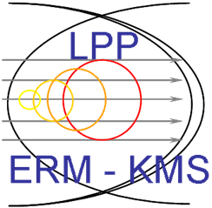
ECWC and modelling for JT60-SA
Johan Buermans

Slide 2
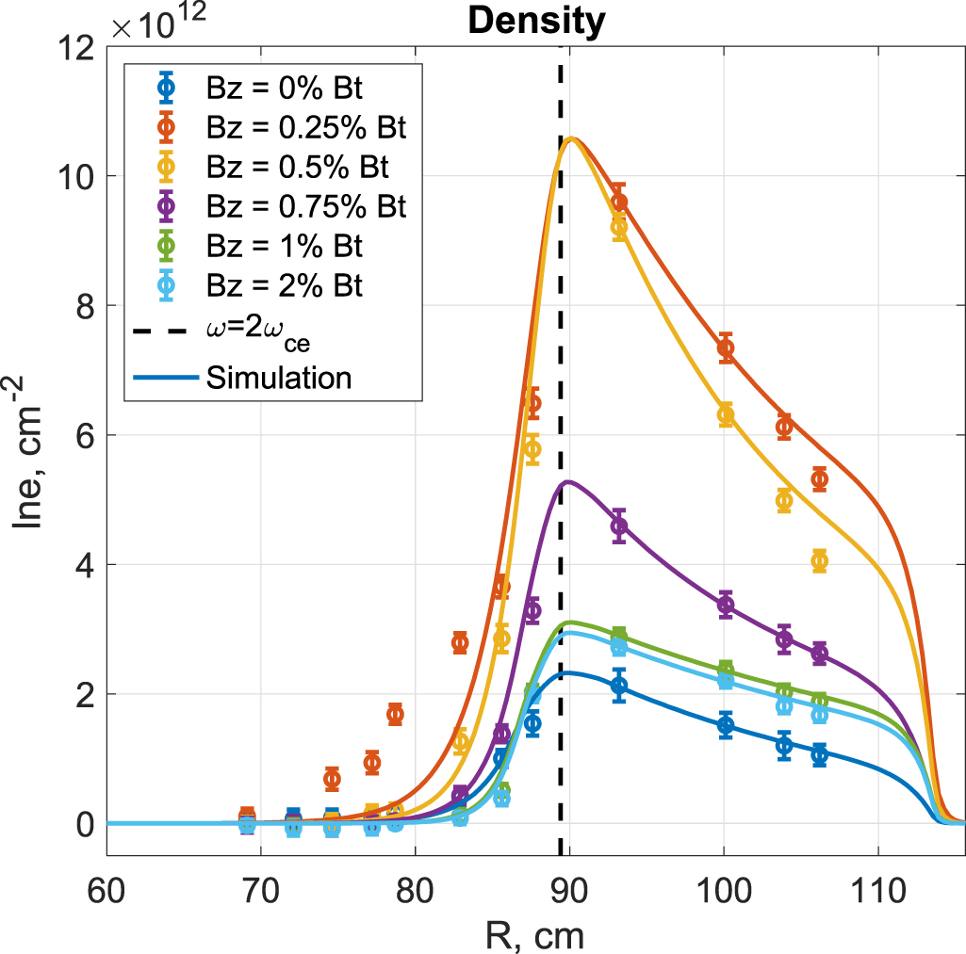
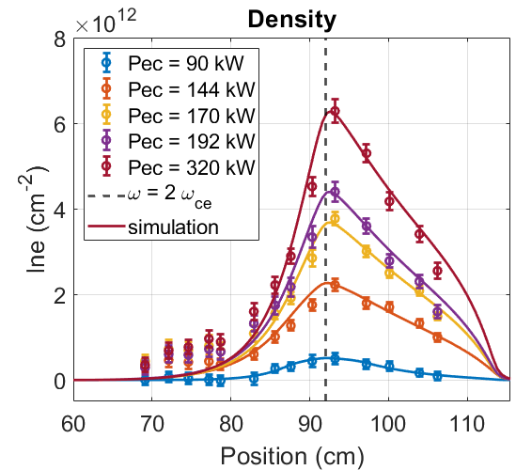
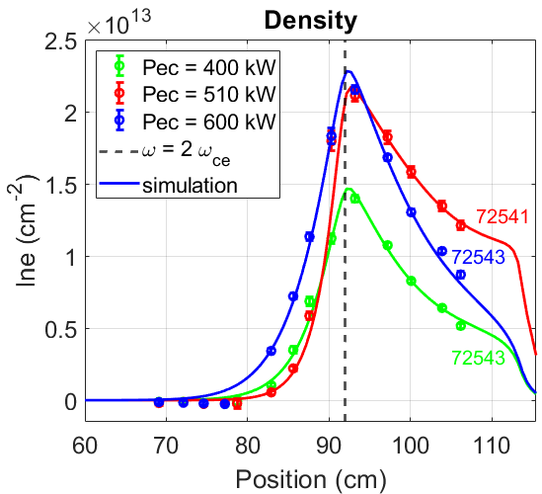
Modelling
Modelling
ECWC
Needs & Plans
The model reproduces the density profiles using conventional assumptions on anomalous diffusion and outward convection and provides insight on the fraction of absorbed EC power. A value for the latter is hard to obtain from experimental data.
TCV^{1,2}
Density profiles matched with interferometry data
Transport coefficients are estimated
Code has been benchmarked for TCV He and D plasmas
He
AUG³
Density profiles matched with TS and MILS data
Estimates of peak density and temperature through characteristic radiation
Transport coefficients are estimated
He
D
D
Johan Buermans - LPP-ERM/KMS
2

Slide 3
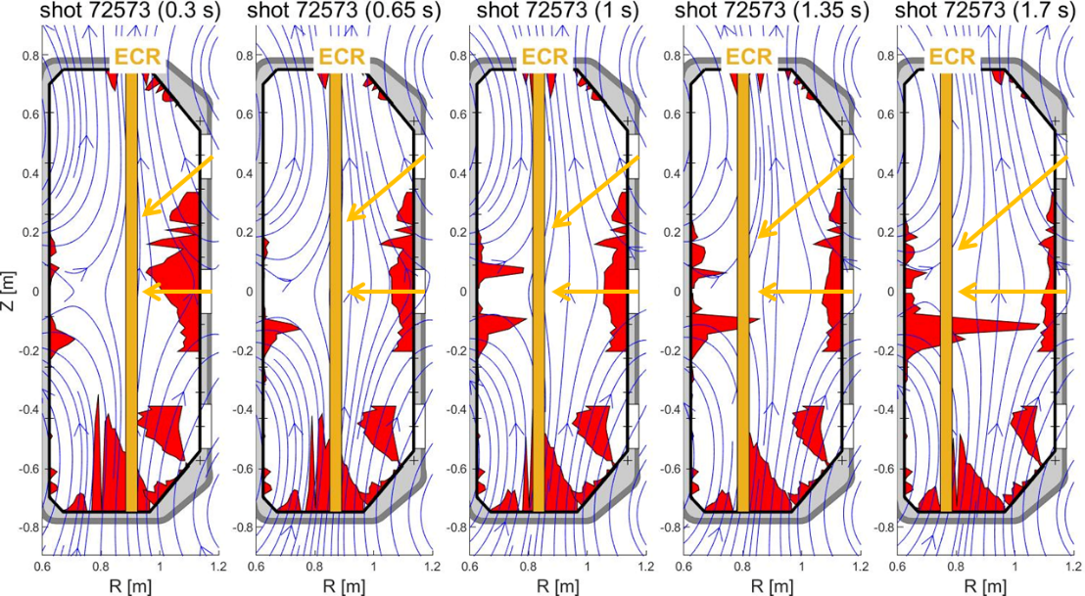
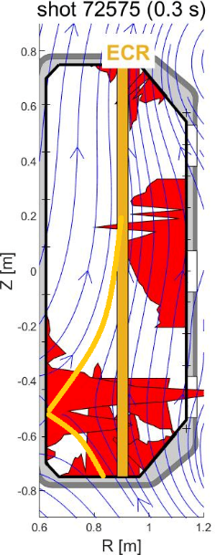
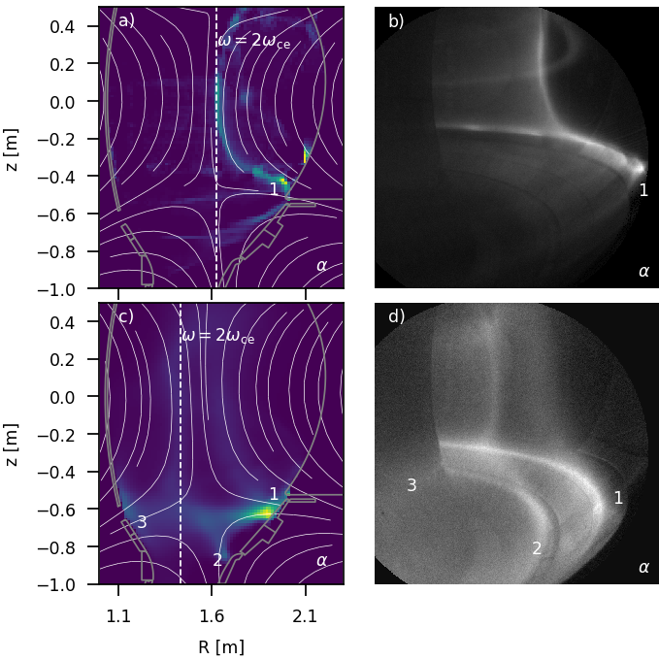
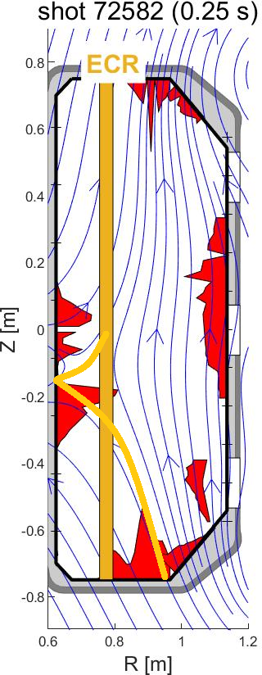
ECWC
Modelling
ECWC
Needs & Plans
AUG³
Confirms TCV experiments
Plasma follows the field lines
Convection directs the plasma to the LFS
Magnetic mirror reduces the plasma flux to the HFS
TCV^{1,2}
Vertical field optimizes plasma density
ExB drift guides the plasma to the LFS
Plasma can be guided to desired areas on HFS using dedicated magnetic configurations
Magnetic mirror reduces the plasma flux to the HFS
Camera tomography
Helps visualizing the plasma flows
Can help to determine density and temperature
Johan Buermans - LPP-ERM/KMS
3

Slide 4
Needs & Plans
Modelling
ECWC
Needs & Plans
Analysis of wall conditions:
Evolution of outgassing after discharges + effect of conditioning on outgassing
Particle balance for all discharges : contribution of wall fueling
Gas content, mass spectrometry: impurity content
Langmuir probe measurements for PWI ?
Modeling of ECWC to complement experimental observations:
Pressure gauges, magnetic field configuration, injected power
Availability of density profiles:
Use of EDICAM camera data for ECWC modelling
Tomographic reconstruction
Ratios of the emission intensities of various atomic spectral lines
Interferometry, Thomson scattering, spectroscopy to complement the density profiles?
TCV¹ Tom Wauters et al, RF plasma simulations using the TOMATOR 1D code: case study for TCV helium ECRF plasmas, Plasma Phys. Control. Fusion 62 (2020), 105010 doi: 10.1088/1361-6587/aba767
TCV² Johan Buermans et al, ECWC experiments and modeling on TCV, 48th EPS Conference on Plasma Physics, 2022, Maastricht
AUG³ Tom Wauters et al, Characterisation of Electron Cyclotron Wall Conditioning Plasma in ASDEX Upgrade, Nucl. Fusion: NF-105694 submitted
Johan Buermans - LPP-ERM/KMS
4

