Slide 1


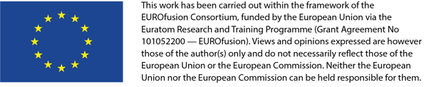
Equilibrium control – Plan for 2023
7 Sep 2022
G. De Tommasi^{1,2}
on behalf of the CREATE team
¹Consorzio CREATE
²Department of Electrical Engineering and Information Technology, University of Naples Federico II, Italy

Slide 2
Contents
Tools available in EU
Activities in support to IC 2020-2021
2022 activities and plan for 2023

Slide 3
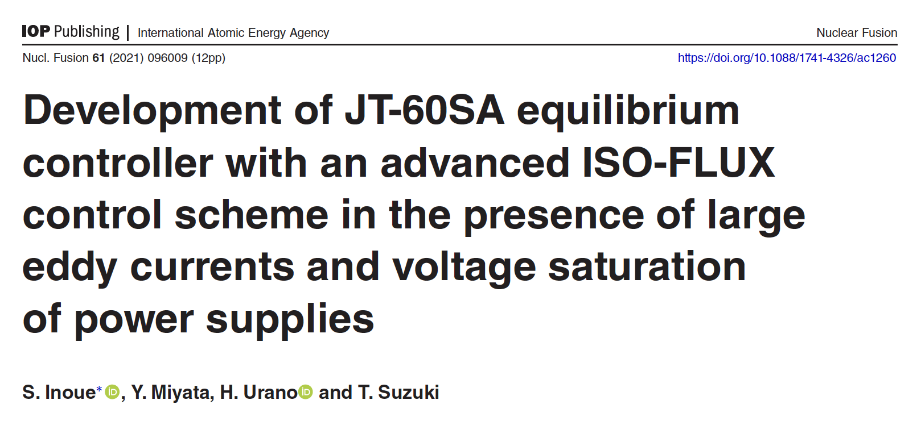
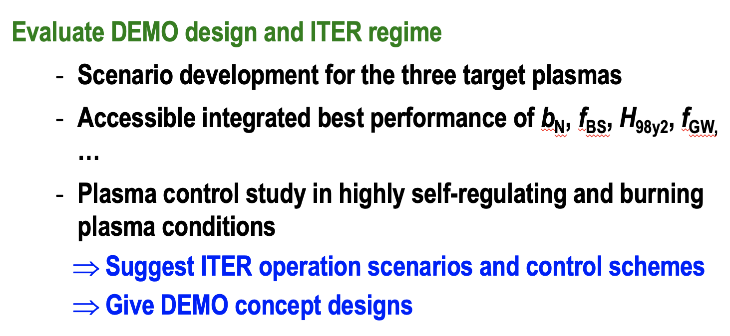
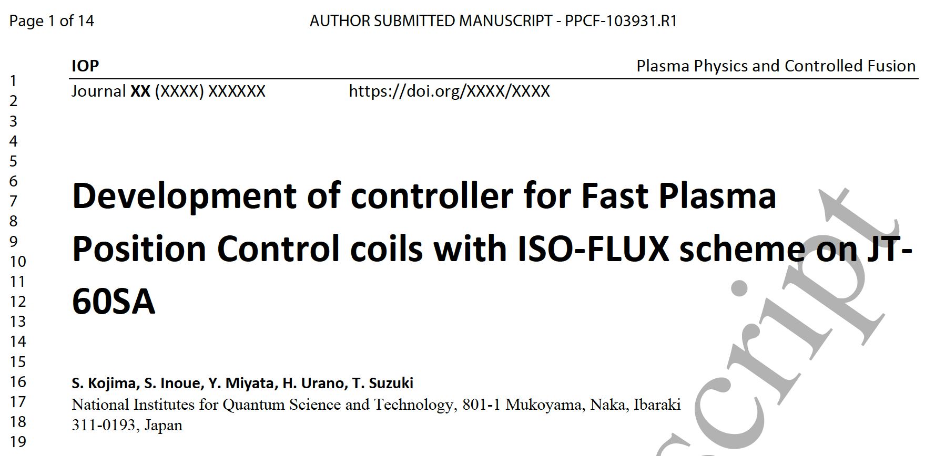
Context
Collaboration with QST on Equilibrium control has been not very effective during IC

Slide 4
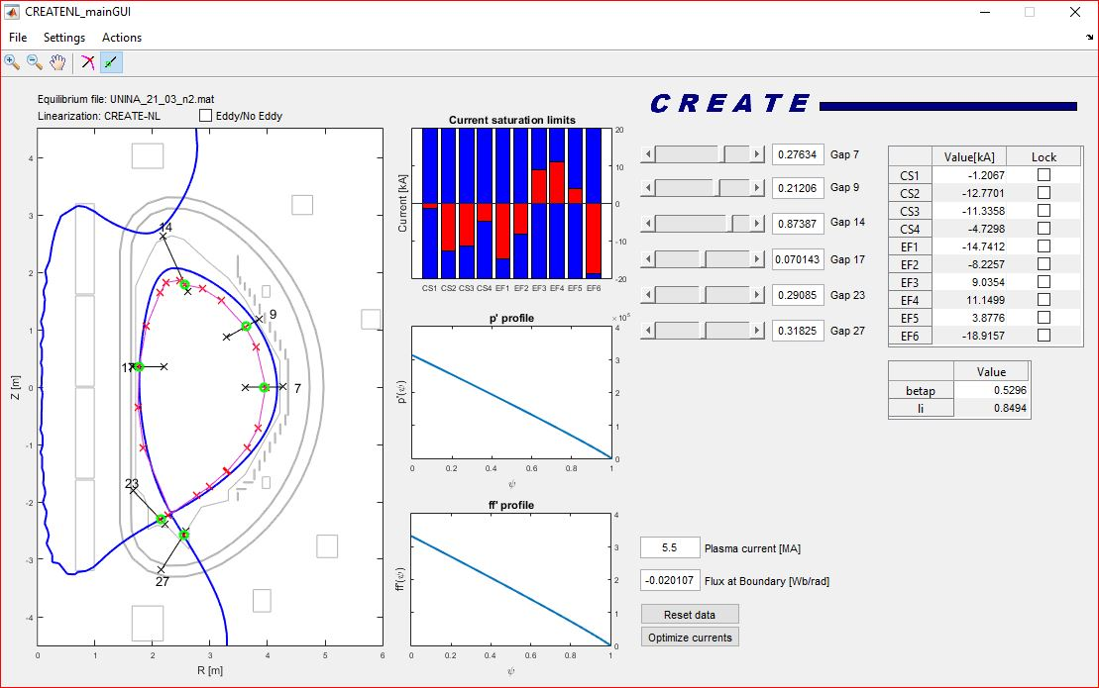
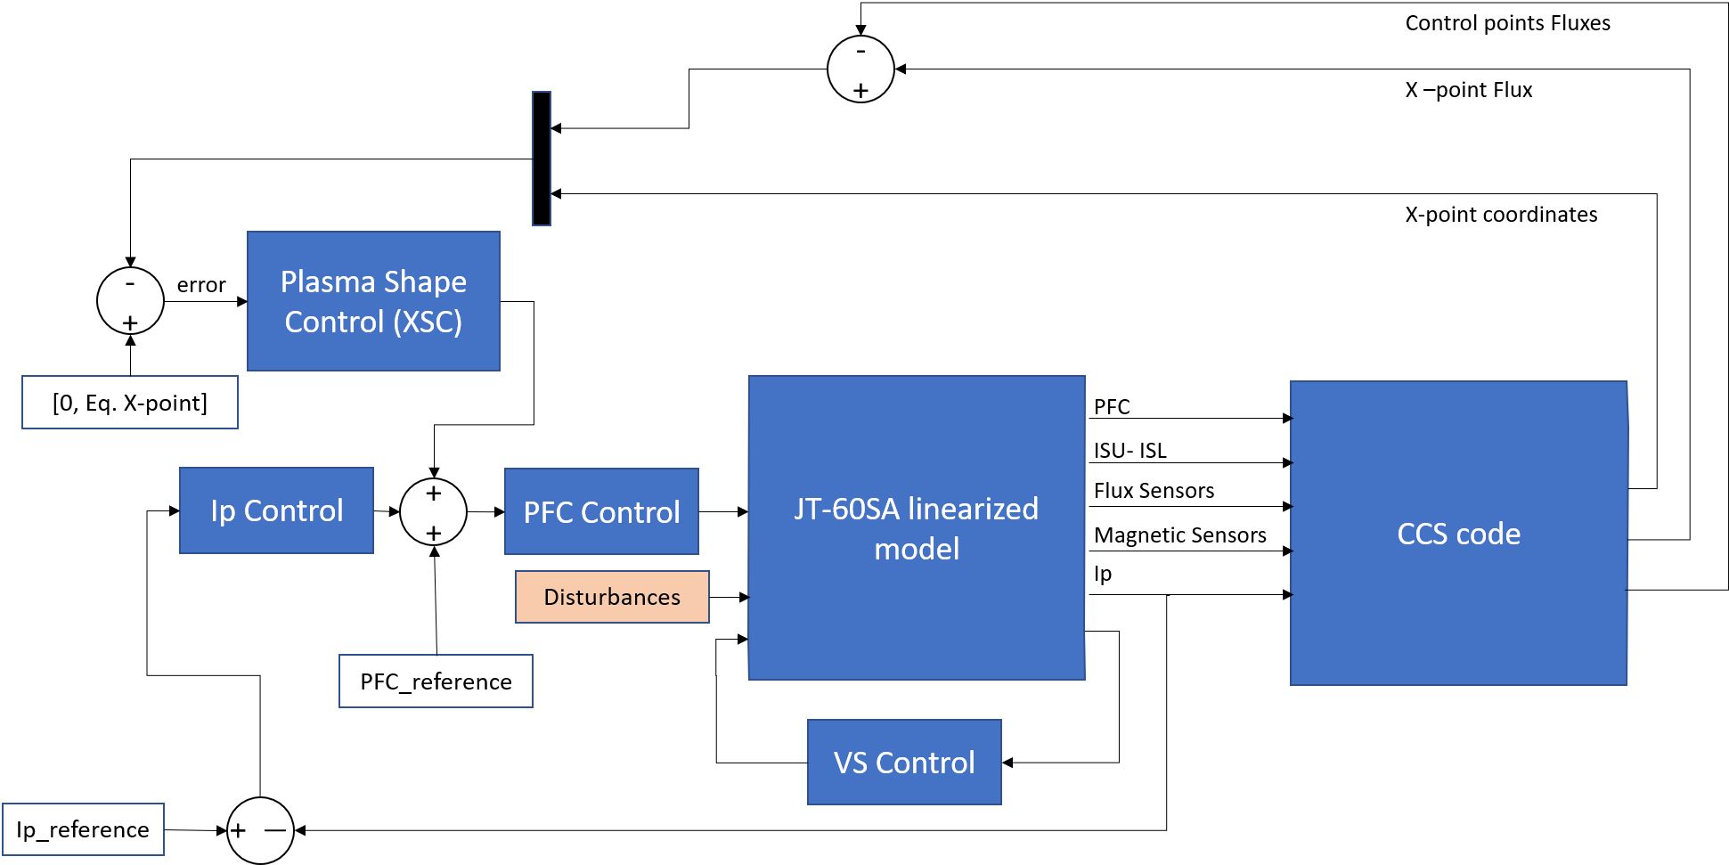
Tools for Plasma Magnetic Control Design & Validation
  2D control-oriented modelling tools (CREATE-L and CREATE-NL) → capability to generate linear models to be exploited for model-based control design
  The same tools have been also coupled with the QST CCS (plasma boundary reconstruction) and FBC (Flux-boundary control) codes

Slide 5
Support to IC 2020-2021
The main support action to IC would have been the onsite participation to the commissioning of the plasma (magnetic) equilibrium control system - D. Abate (RFX) + M. Bonotto (RFX) + support from CREATE team
Open-loop plasmaless model validation (CREATE + RFX) → DONE
Assessment of overall stabilization capabilities in absence of internal coils for the IC upper-single-null configuration → this activity will be completed in 2022 (FP8 final report – due by early Dec 2022)

Slide 6
Plan for 2023
Add the capability to generate equilibria starting from experimental data in CREATE EGENE (original envisaged in 2022 → to be postponed)
Once experimental data will be available → open and closed-loop plasma linear model validation (original envisaged in 2022 → to be postponed)
Participate to the IC of the plasma magnetic control system

