Slide 1




Breakdown Modelling without Boosters
9th WPSA Project Planning Meeting
^{5-9th September, Budapest}
Massimiliano Mattei^{1,2}
L. di Grazia^{1,3}, L. Figini⁴, D. Ricci⁴, C. Sozzi⁴
¹ Consorzio CREATE
² Department of Electrical Engineering and Information Technology, University of Naples Federico II
³ Dipartimento di Ingegneria, Università della Campania L.Vanvitelli
⁴ Istituto per la scienza e tecnologia dei plasmi, CNR, Milano

Slide 2
Presentation content
General procedure to optimize magnetic BD configurations
New configuration analyzed (no boosters and reduced voltage/current)
Comparison of the proposed approach with QST results
Numerical results on the new configuration w/o boosters
BKD0/Gray simulation results
Open issues and future work
Collaboration with F4E (Cavinato, Di Pietro and others)

Slide 3
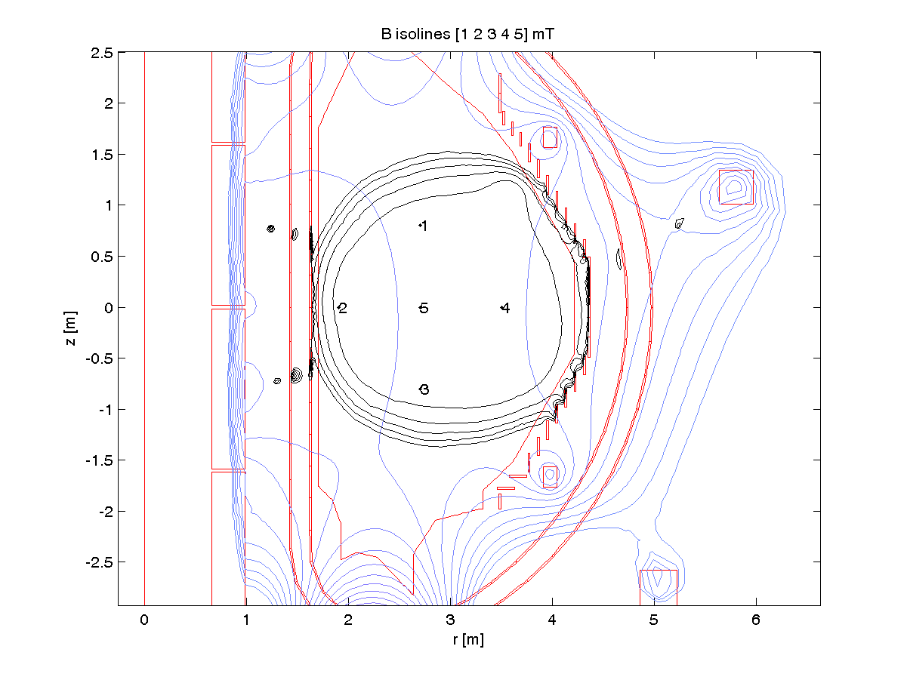
General Assumptions for magnetic BD studies
Axisymmetry
Central breakdown (control points in a circular region)
Plasma simulated with a massive conductor occupying the BD region with a given plasma resistance for the initiation phase
Single configuration of SNR (no switching)
Set of constraints
  Currents and voltage limits
  Energy dissipated in the
    the SN resistor module
Optimization of the following quantities:
Voltages on converters. Voltage waveforms are optimized assuming piecewise linear functions (time step = 10 ms) – this is a plus w.r.t. QST procedure
Initial current in the PF coils. The distribution of currents in the active coils at time 0 is left partially free for possible optimizations
Switching Networks Resistors modules
Breakdown time t_{BD}
5 control points
Example of isofield and isoflux lines at the BD time

Slide 4
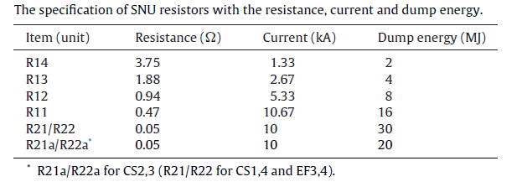
Nominal configuration without radial plates
Maximum current in circuits: 10kA in CS circuits (for half charged CS simulations) and E2 and E3 circuits, 10 kA in E1, E2, E5, E6 circuits
Power supplies can guarantee 1kV on E3, E4, CS1, CS2, CS3, CS4, 5kV on E1, E2, E5, E6.
SNU Circuit for CS, EF3, EF4
E3
E2
CS1
E1
CS2
No RP
CS3
CS4
E6
Limitation on the energy dissipated in the SNR units
Maximum voltage on coils was 5kV
E5
E4

Slide 5
New Magnetic Optimizations
Case A – to compare with QST calculations
Aimed at obtaining E = 0.4 V/m
CS1-4 EF3,4 (PS with SNU)
Vcoil <= 3kV
Icoil <= 3kA
EF1,2,5,6 (PS without SNU, with Booster)
Vcoil <= 4kV
Icoil <= 4kA
Max VPowerSuppy
CS1,4, EF1,6 - 1.0kV
CS2,3, - 1.3 kV
EF2-5 - 0.97 kV
Case B – constraints from presentation "First Plasma Feasibility Study" No boosters
CS1-4 EF3,4 (PS with SNU)
Vcoil <= 3kV
Icoil <= 3kA
EF1,2,5,6 (PS without SNU, no Boosters)
Vcoil see VPowerSupply
Icoil <= 4kA
Max VPowerSuppy
CS1,4, EF1,6 1.0kV
CS2,3, 1.3 kV
EF2-5 0.97 kV

Slide 6
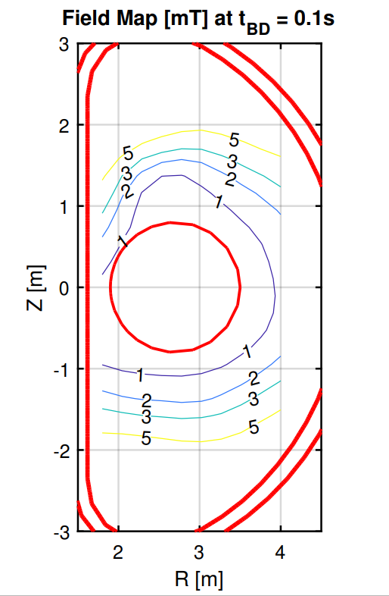
Case A – comparison with QST
FIELD MAP @ BD time
1 mT
CREATE

Slide 7
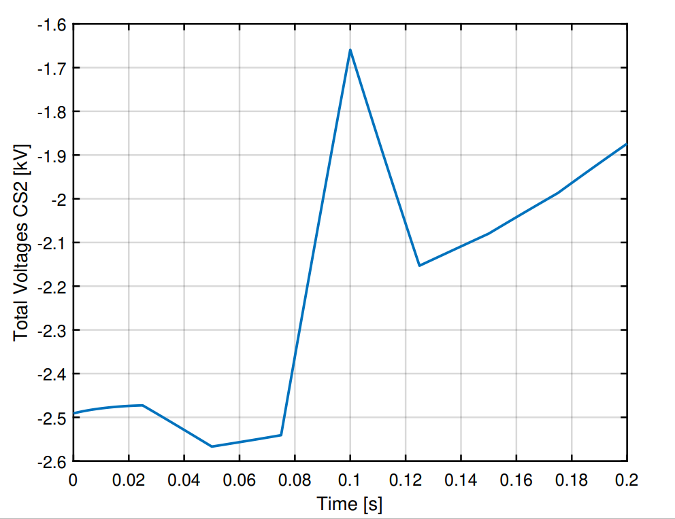
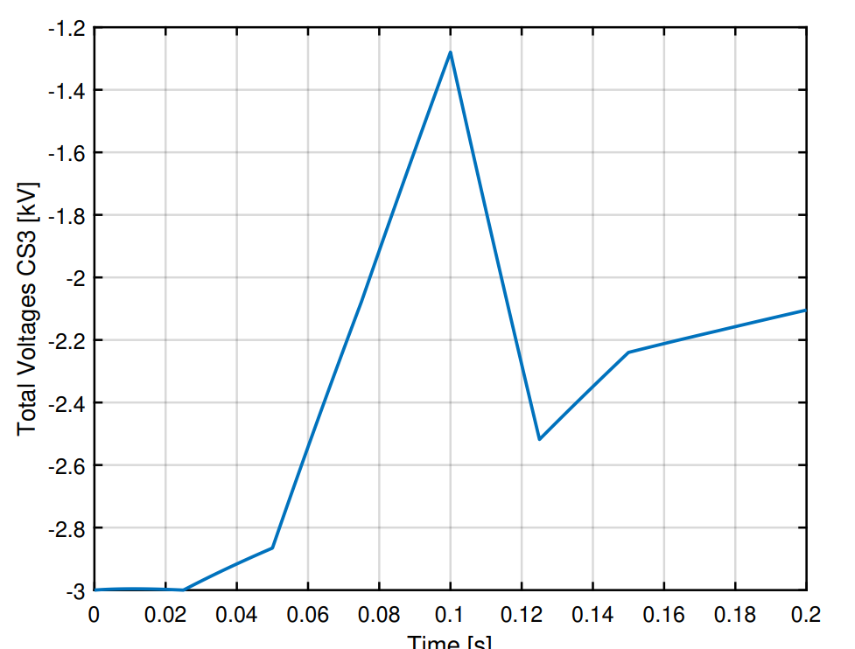
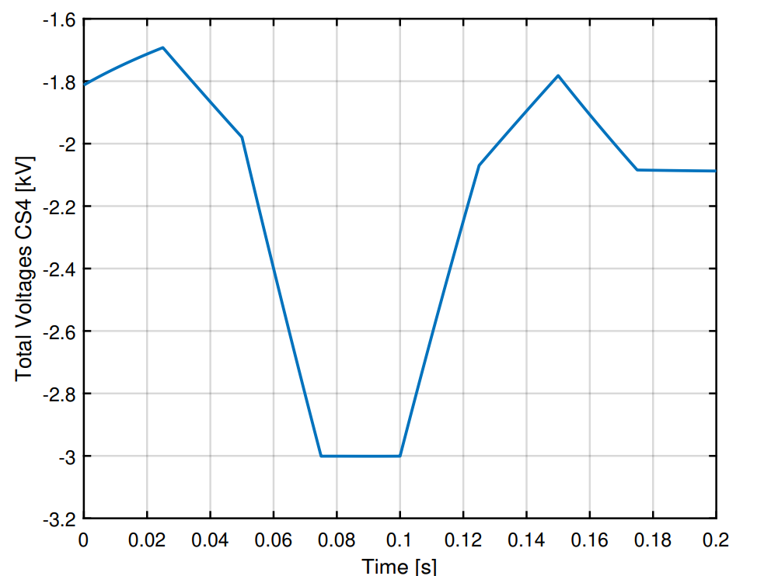
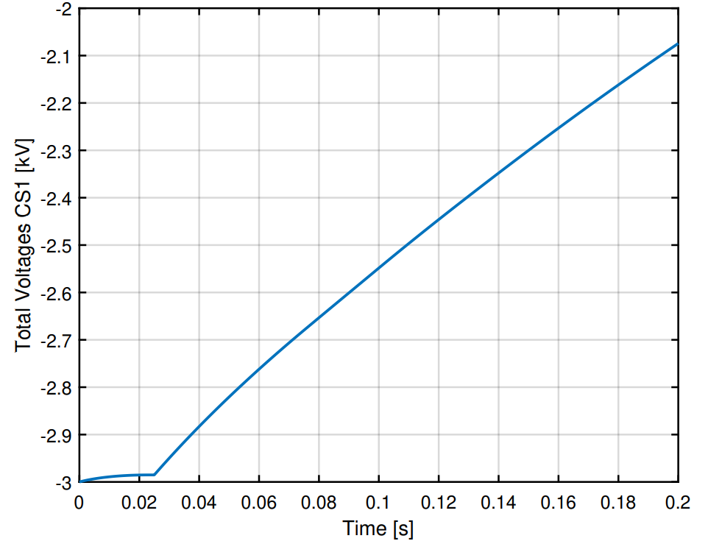


Case A – comparison with QST
Circuits with SNUs
QST

Slide 8
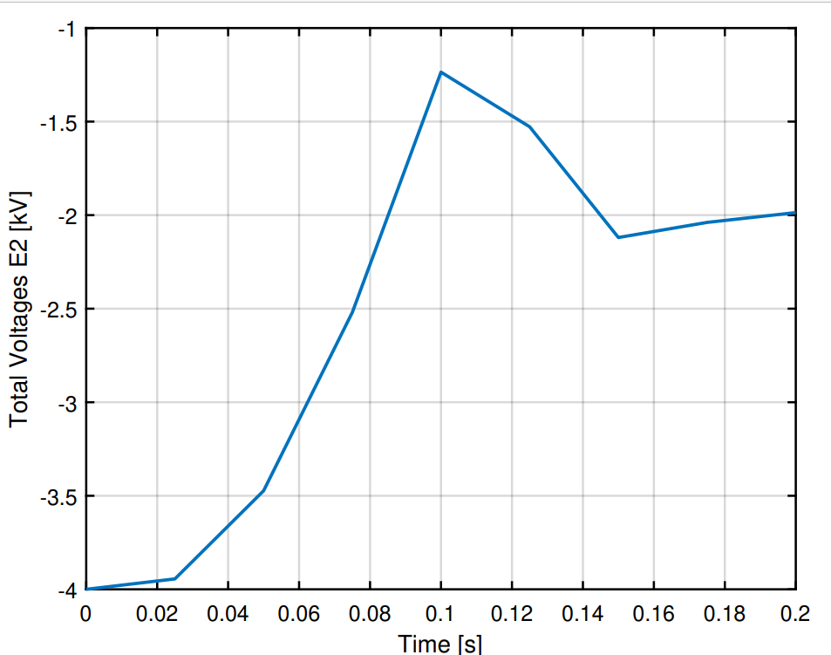
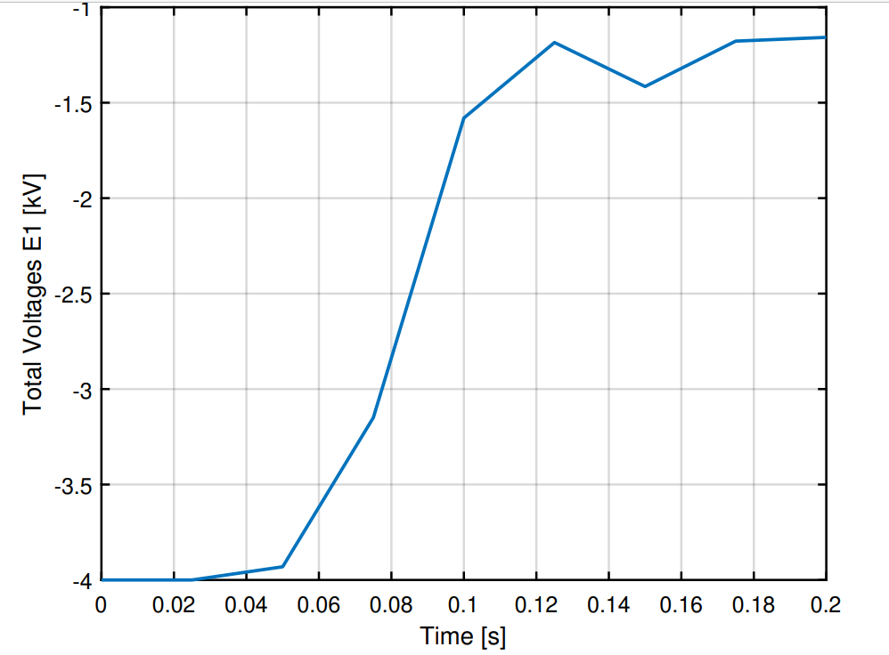
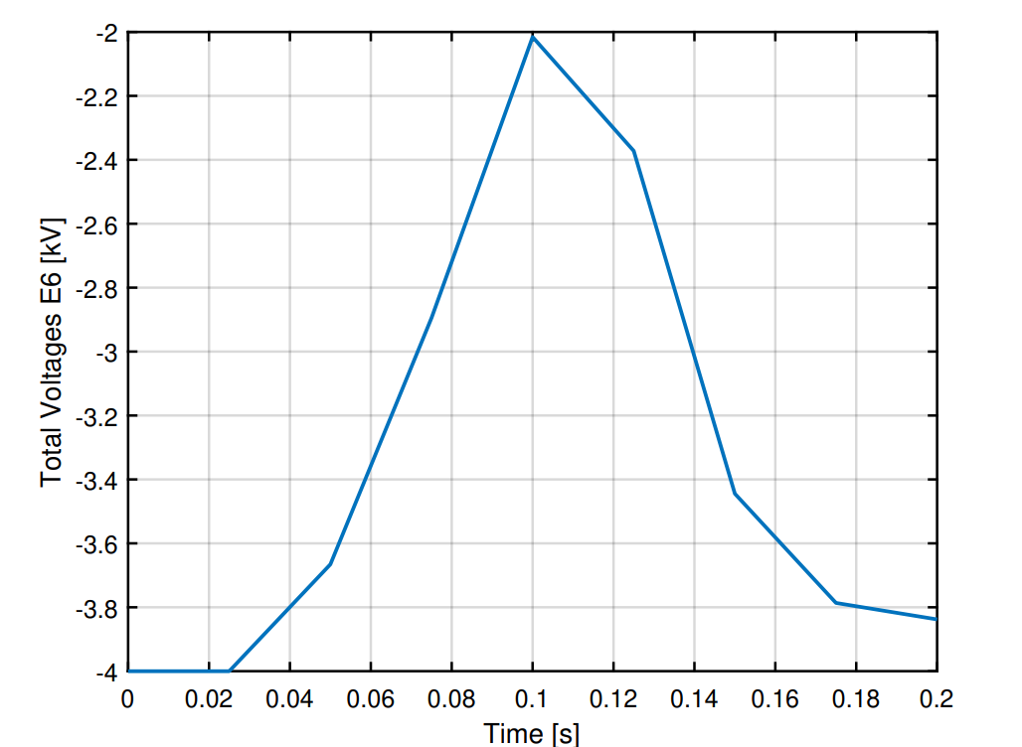
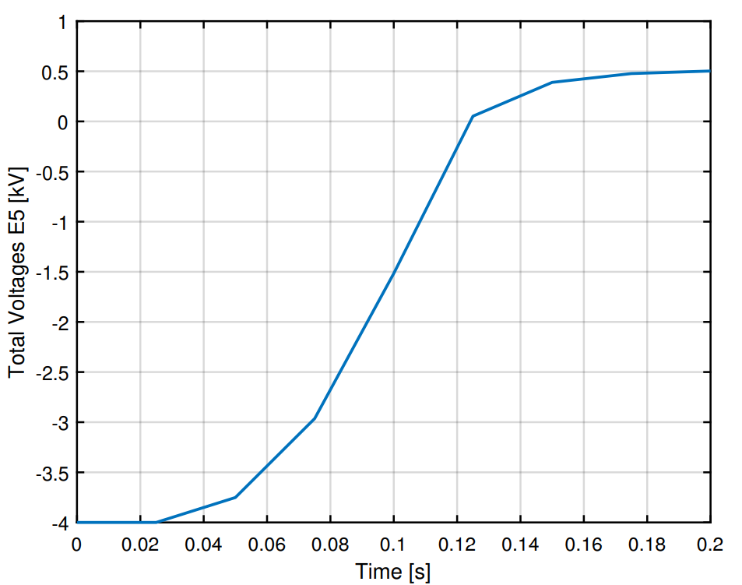
Case A comparison with QST

Slide 9
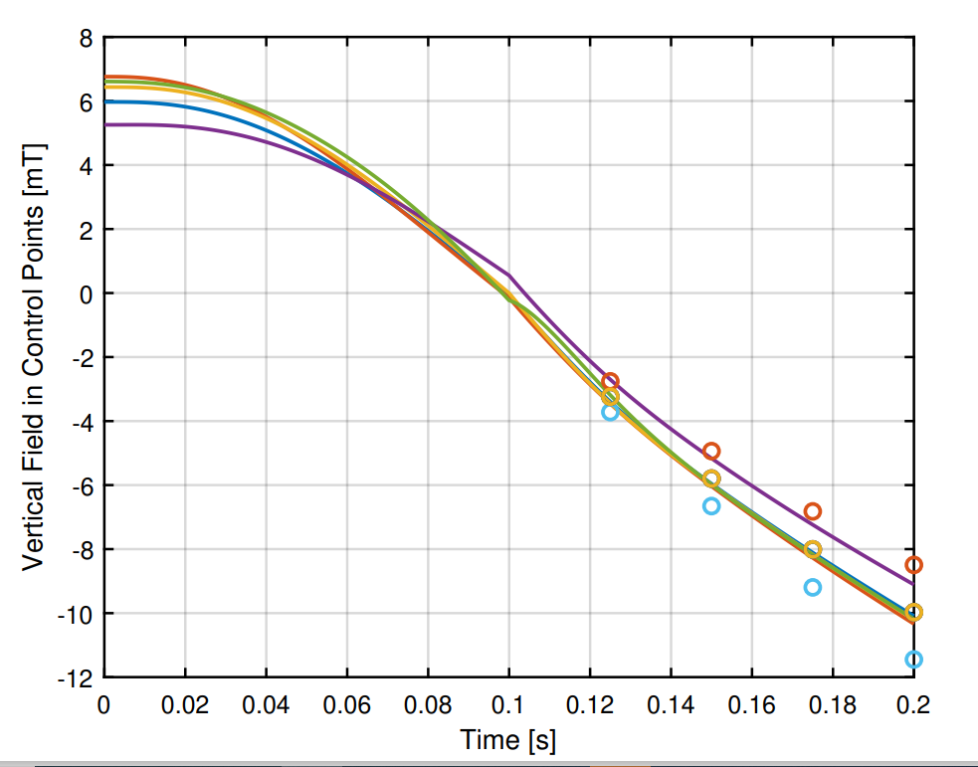
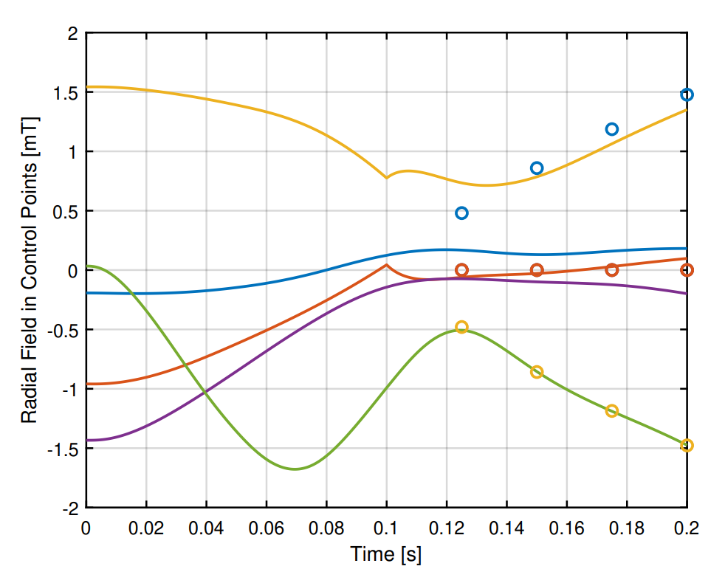

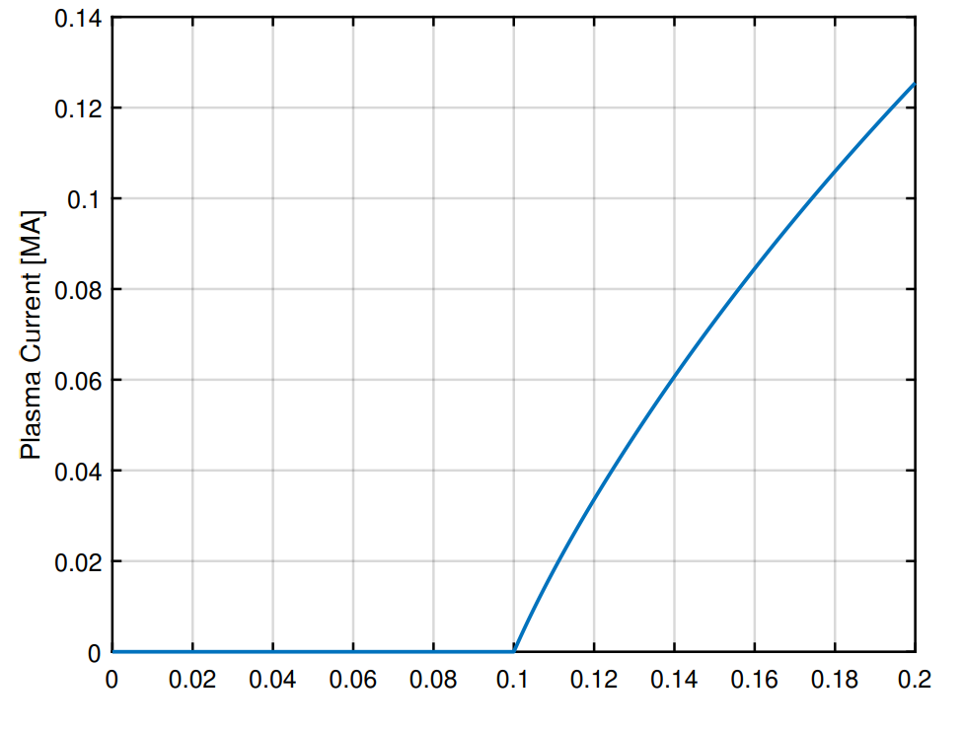
Case A – Other quantities
CREATE calculations
Radial and Vertical field in the control points
Plasma current
Electric Field in the center
of the BD region

Slide 10
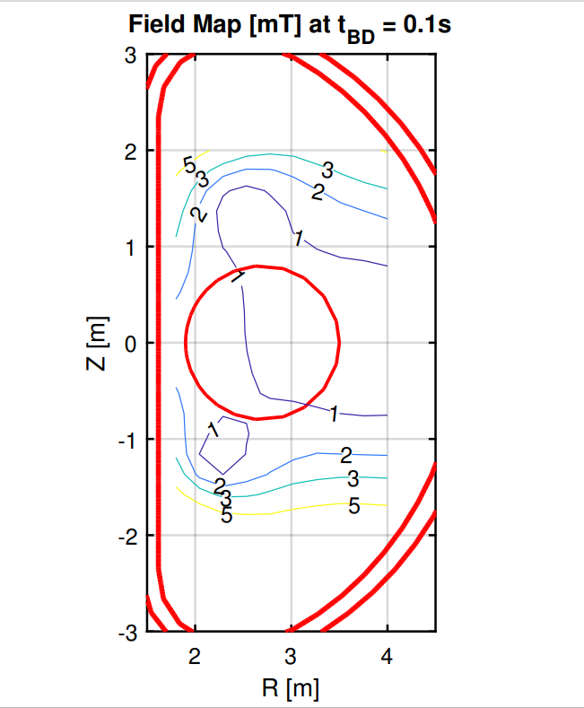
Case B – Optimization w/o boosters

Slide 11
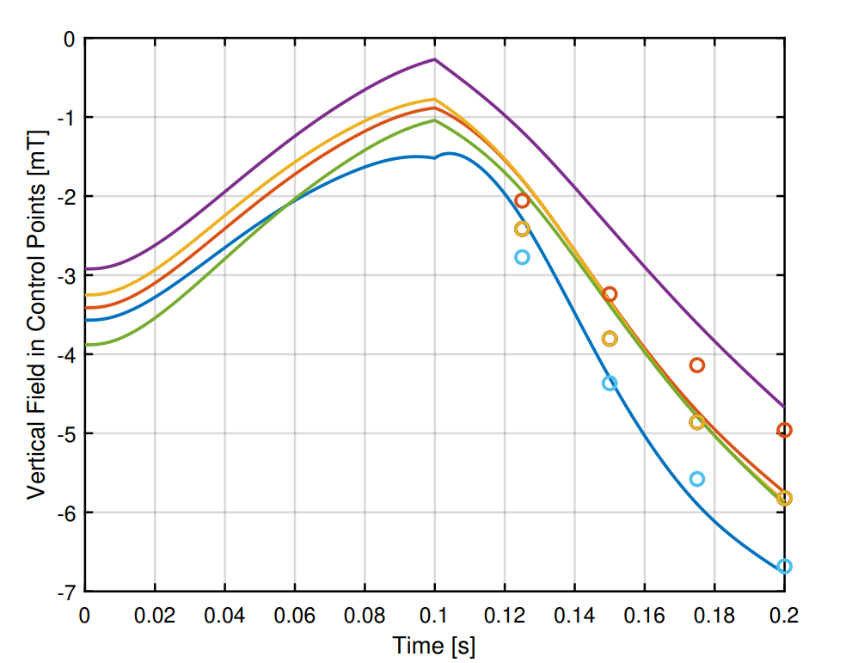
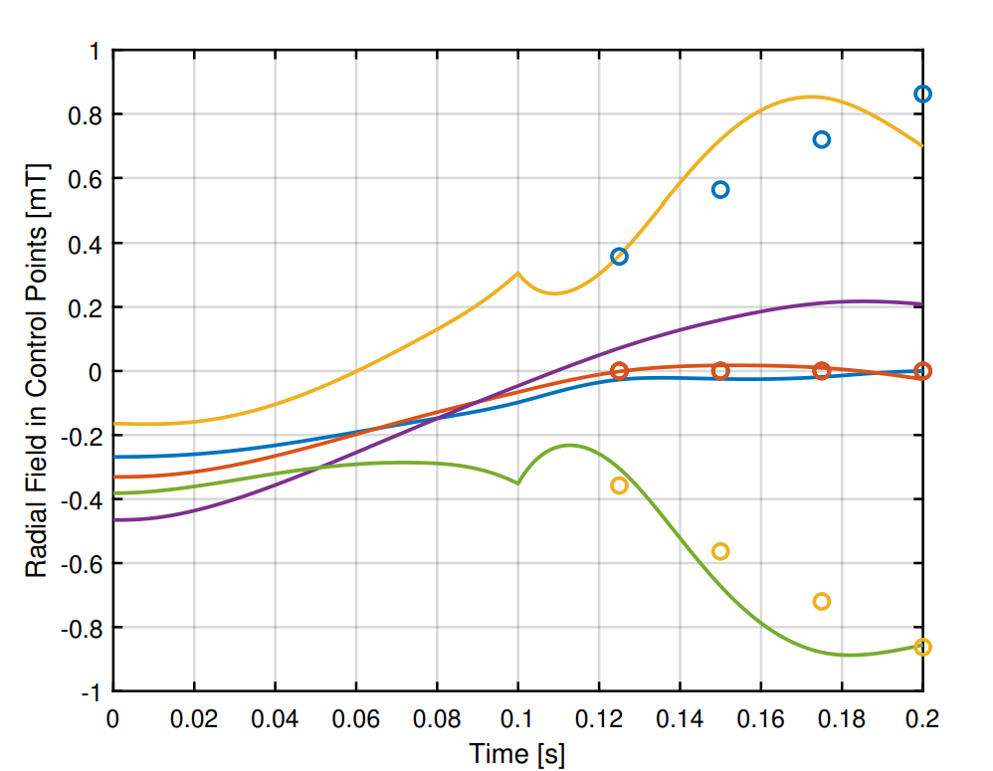


Radial and Vertical field in the control points
Plasma current
Electric Field in the
center of the BD region

Slide 12
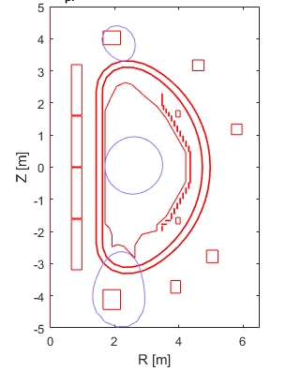
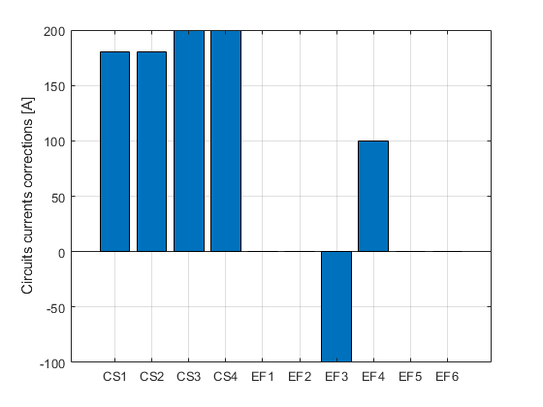
Case B – FB Equilibrium at Ip = 73kA
Pattern of correction currents w.r.t. those computed for the BD scenario

Slide 13
BKD0/Gray Simulation results
Weak coupling between BKD0 and CREATE-BD
Breakdown time fixed from the magnetic optimization at 100 ms.
EC absorption calculated by GRAY code
  82 GHz
  multi-pass calculation
  waveguide launcher

Slide 14
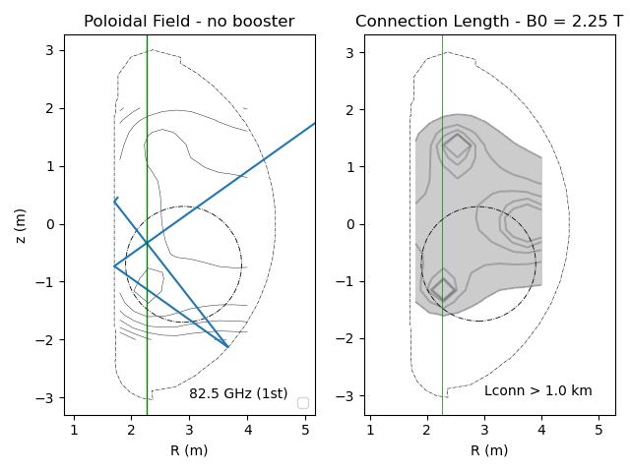
EC absorption at 82GHz: input
Launching coordinates and angles in GRAY
INPUT DATA
X0 (m) | Y0 (m) | Z0 (m) | a (º) | b (º) | w (m)
5.214 | 0.0 | 1.772 | 35.5 | 0 | 0.0194
(left) Contour plot of poloidal field at tBD.
green line corresponds to the cold EC resonance for 82GHz
dashed circle in black is the simulation region used in GRAY for EC absorption
red lines corresponds to passes into the plasma of the beam trajectory, from the launching point to the wall and after wall reflection;
(right) Connection length with B0 = 2.25T on axis.
GRAY - Multi-pass calculation
Bpol from the magnetic analysis (case B – no boosters)

Slide 15
EC absorption at 82GHz: result
82.5GHz, B=2.25 T on axis, Rec= 2.27m
C
EC absorption ~10% at Te,ne in the first phase of the discharge
(similar to result at 110GHz, B=1.51 T on axis, Rec= 2.27 m)

Slide 16
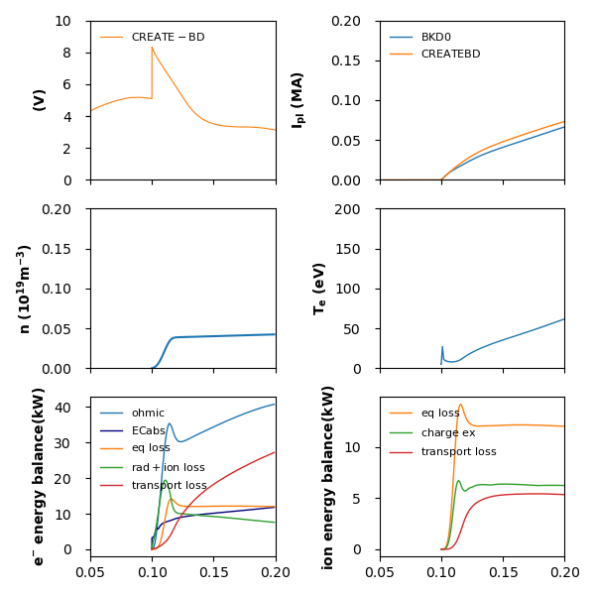
Plasma parameters evolution in BKD0
Pressure 0.5 mPa
Power 0.5 MW from 0.1 s
no impurities

Slide 17
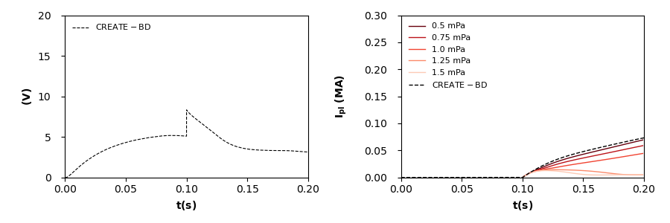
Parameter space
Plasma current evolution with different prefill pressures
BKD0 simulation at different prefill pressures with loop voltage calculated by CREATE-BD:
As the prefill pressure increases, the current ramp rate decreases up to failure of start-up.

Slide 18
Next Steps in this Study
Discussion with QST colleauges (mid of september)
Sensitivity analyses (to be defined)
  Effect of impurities
  Effect of pre-ionization due to EC (significant at O1-82 GHz)
  Effect of use of EC at double frequency 82+110 GHz
Possible activities for 2023 under IC
Ready to use tools to iteratively optimize BD magnetic fields in three steps
  Off-line optimization
  Intrashot correction tools based on field map reconstruction
  Possible closed loop actions on radial and vertical field
Advanced modelling and optimization tools (results from modelling taks)

Slide 19
Procedure to compensate for 3D effects at BD and other possible uncertainties
2D Modelling
(CREATE-L)
Activities in view of the commissioning campaign
Model Tuning
Waveform optimization
NO
Refinement of the optimization objectives
Experiment
YES
Simulated/experimental
performance ok?
Magnetic Reconstruction
Code Tuning
Small correction of current waveforms CURCOR
Magnetic Reconstruction

Slide 20
Integrated Commissioning – Overview of the activities
Topic
Homework
On site
Plan experiments for model identification
Experiments preparation, data download and interpretation
Model Tuning
Procedures to tune models
Procedures to tune estimators
Data download and interpretation
Reconstruction
Trial and error procedures to be implemented on site
Optimization and Control
Tools for optimization

