Slide 1
9th WPSA Project Planning Meeting
Runaway Electrons on FTU: generation, dissipation, suppression and control
Gianluca Pucella
ENEA, Fusion and Nuclear Safety Department, C.R. Frascati, Italy

Slide 2
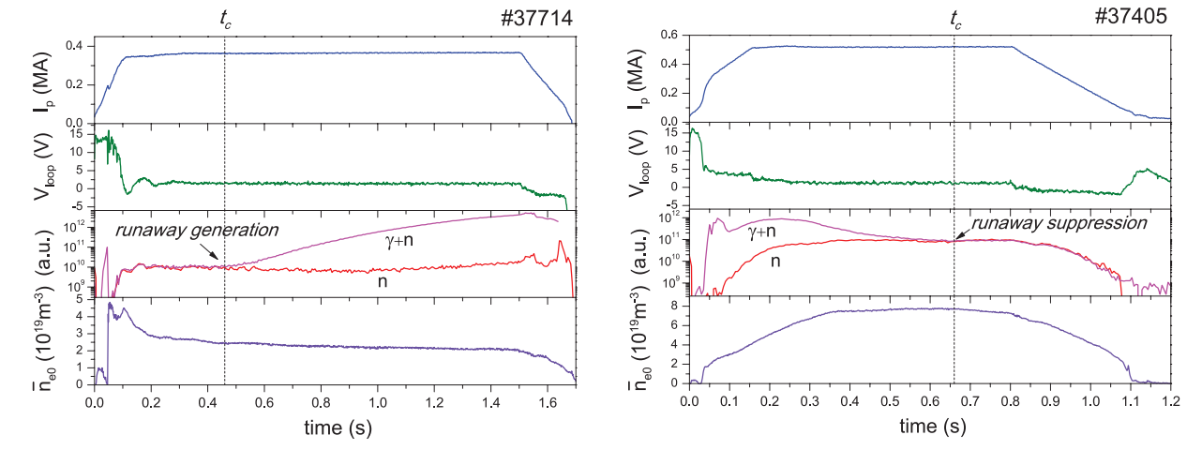
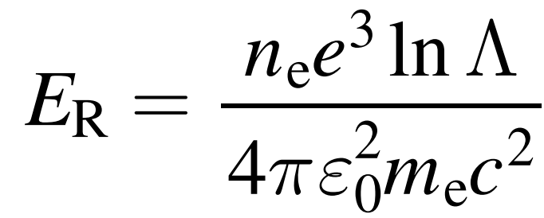
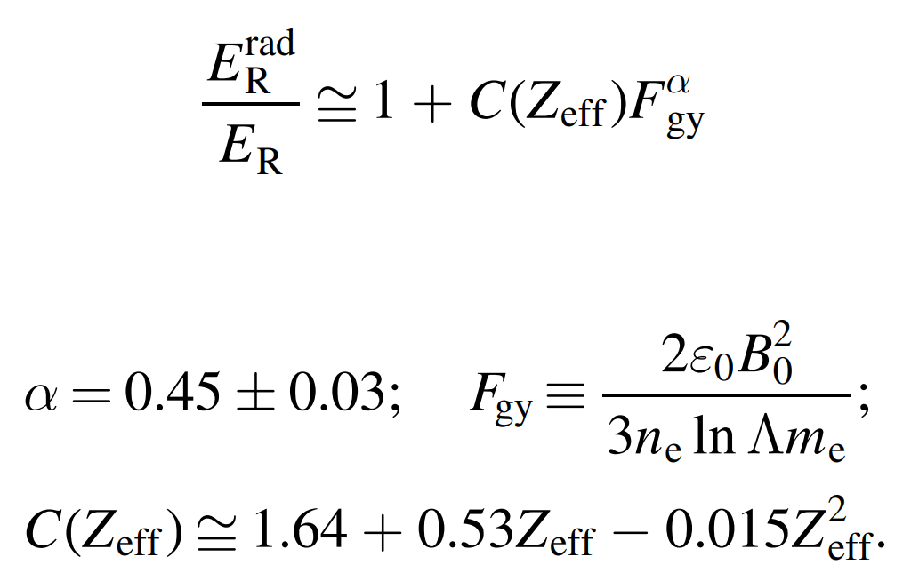
Generation
Experimental observation of increased threshold electric field for RE generation due to synchrotron radiation losses in the FTU tokamak.
E >
(relativistic collisional theory)
Liquid organic scintillator (NE213): n + γ
BF₃ chambers: n
[Martin-Solis J R et al 2010 Phys. Rev. Lett. 105 185002]

Slide 3
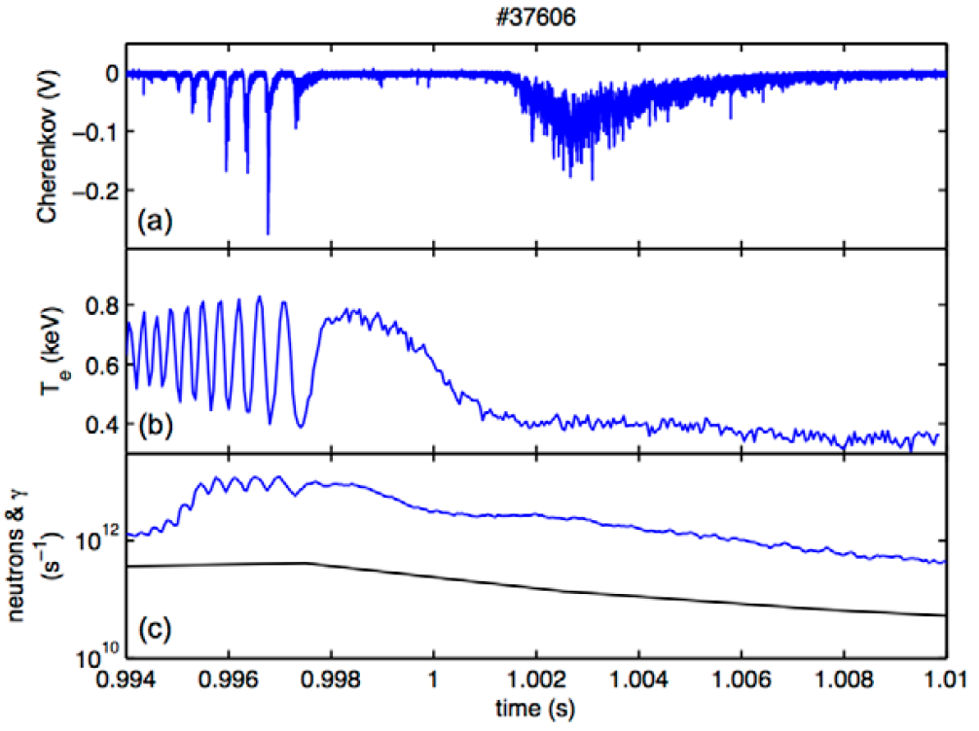
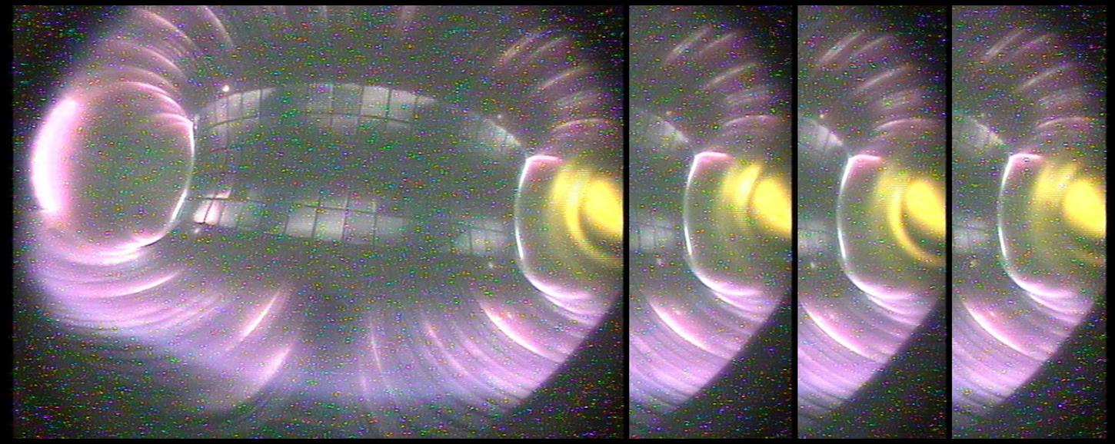
Dissipation
RE losses enhancement by interaction with large magnetic islands.
# 42540
Diamond-based Cherenkov probe measuring runaway electrons escaping from the plasma.
[F. Causa et al 2015, Nucl. Fusion 55 123021]
γ + n
n

Slide 4
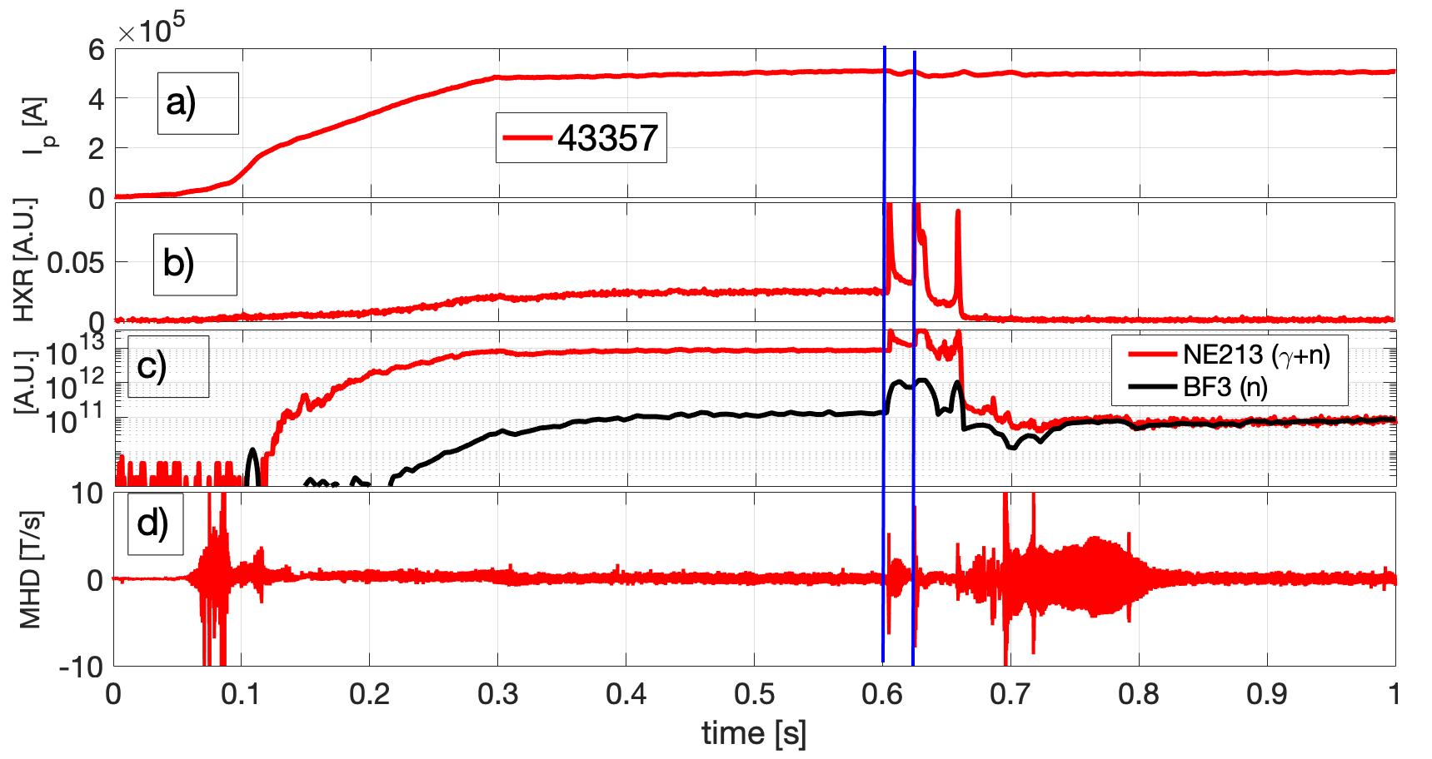
Suppression
Pellet injections lead to complete suppression of REs by triggering bursts of MHD activity.
Fast electron bremsstrahlung camera for HXR measurements.
[D. Carnevale et al 2021 Nucl. Fusion 61 116050]

Slide 5
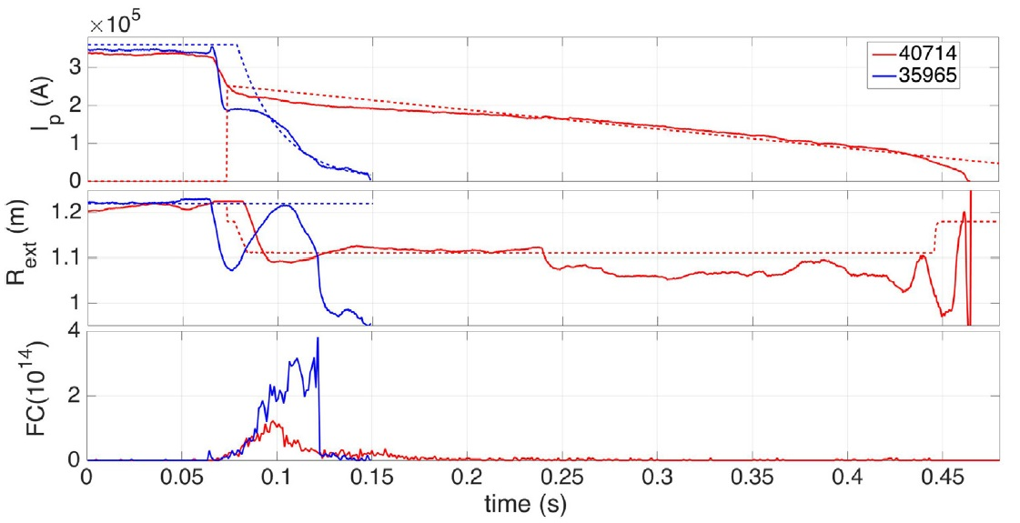
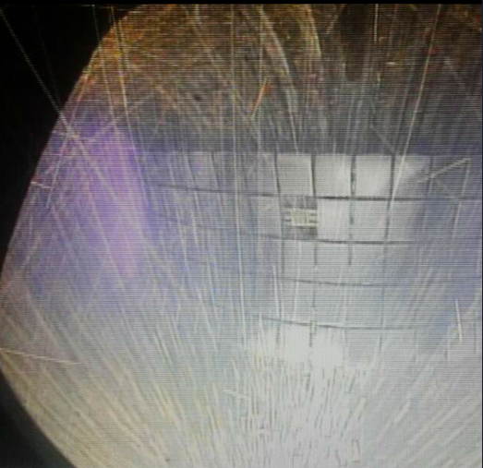
Control
Control system acting on the central solenoid to reduce the RE beam current, while the RE beam is kept away from the vessel through feedback on magnetic coils.
[L. Boncagni et al 2013, Fusion Eng. Des. 8 1109]
[D. Carnevale et al 2018, PPCF 61 014036]
²³⁵U fission chamber:
photoneutrons & photofission

Slide 6
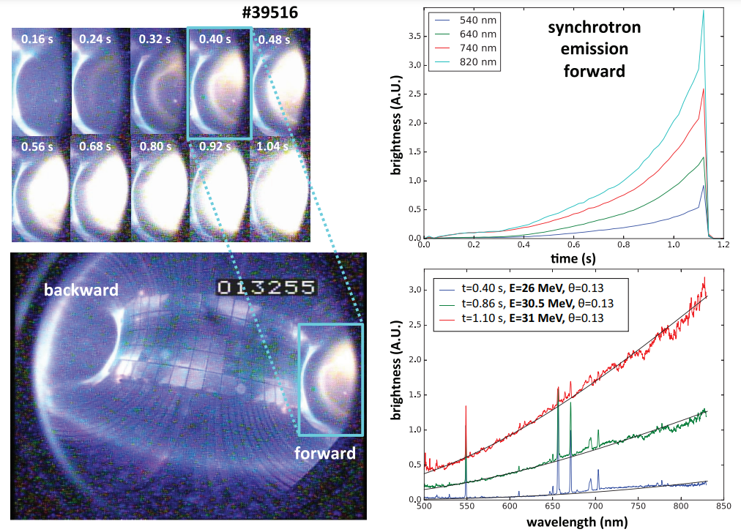
Runaway Electron Imaging and Spectrometry
Measurement of synchrotron radiation spectra emitted by RE. The REIS-E (extended) system (500-4000 nm) is composed of four different spectrometers: visible, near infrared, mid-infrared spectrometers for the forward view and a visible spectrometer for the backward view.
Synchrotron radiation intensity at several wavelenghts.
Synchrotron radiation visible spectra fitted assuming monoenergetic RE energy distribution.
[F. Causa et al 2019, Rev. Sci. Instrum. 90 073501]

Slide 7
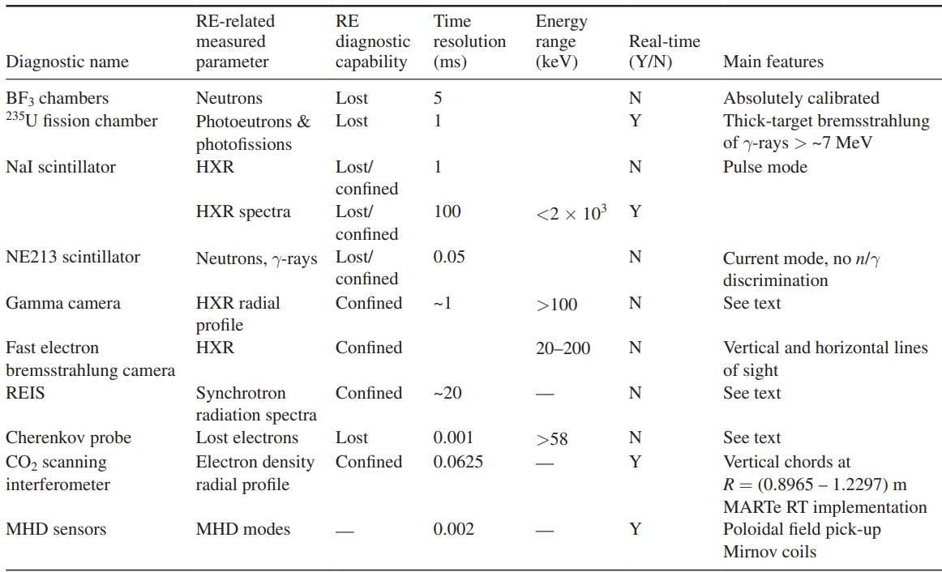
Summary of diagnostics used for RE studies in FTU

