Slide 1
FP9 Enhancements – including synthethic diagnostics Report on 2022 activities on dosimetry systems
E. Łaszyńska, K. Mikszuta-Michalik
Institute of Plasma Physics and Laser Microfusion (IPPLM), Warsaw, Poland

Slide 2
Status of 2022 Deliverable
SA-EN.FE.03-T002-D004: Report on 2022 activities on dosimetry systems
1. Selection of the irradiation ends locations;
2. Activation simulations for the selected dosimetry foils that will be irradiated in selected irradiation ends locations.
3. Gamma spectrometry measurements – optimization of measurements sequence and the sample-detector distance for considered HPGe detector.
4. Evaluation of the possibility of triton burn-up studies due to variations in the 14 MeV neutrons quantity;
5. Analysis of the neutron spectrum deconvolution possibility based on activation measurements (testing of different algorithms);
6. Preparation of the recommended calibration procedure based on the activation system.

Slide 3
Neutron Activation System
Absolutely calibrated time integrated measurement of the total neutron yield with possibility of separation the DD and DT neutron fluxes
Total neutron yield determination
– burn control, evaluation of α particles production, determination of the energy production
– neutron loads studies,
– calibration of the neutron diagnostics
– validation the theoretical models and simulation codes
– control of the neutron limit, evaluation of the safety risk
Separation of the total neutron yield connected to the DD and DT neutrons
– triton burn-up studies
– fuel ratio monitoring
Comparison of neutron loads in different positions (if various irradiations ends will be available)
– studies neutron emission asymmetries connected to the ion transport
Neutron emission spectroscopy by means of unfolding (application of different deconvolution methods)
– studies the behavior of fast ions
– triton burn up studies
– detection of neutrons associated with runaway electrons
Study of the different materials behaviour in the fusion reactor environment.
PFC’s materials irradiation
ITER materials testing
Testing new materials behaviour

Slide 4
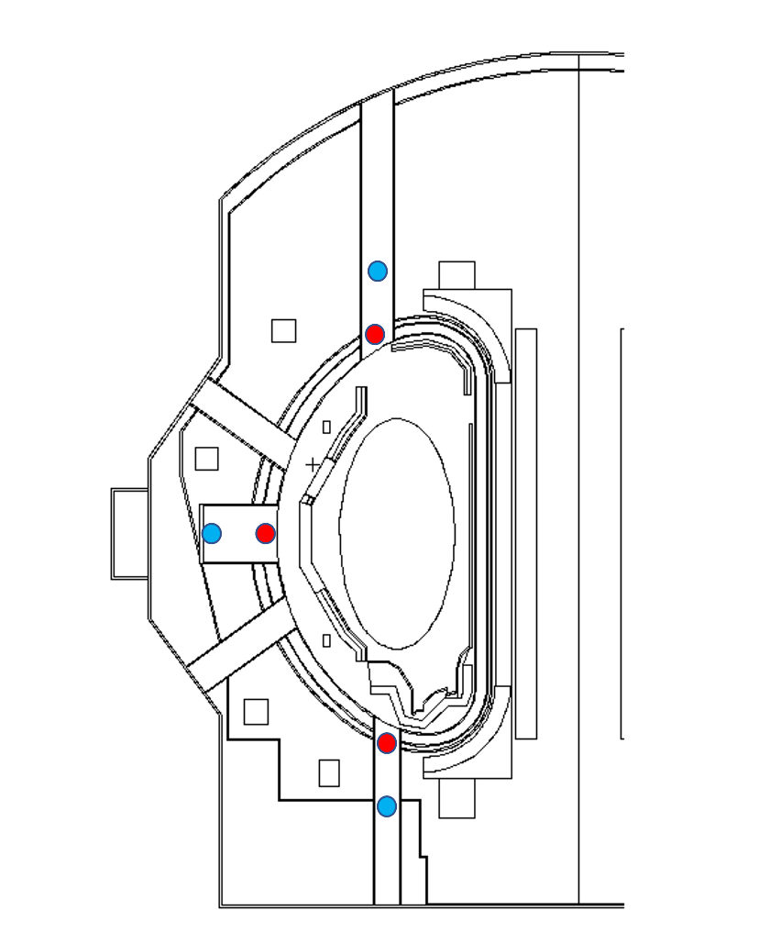
Status of 2022 Deliverable
1. Selection of the irradiation ends locations
To choose the most efficient irradiation end positions of neutron activation system, activation calculations using FISPACT-II have been performed for the following positions: 2 irradiation positions in upper, equatorial and lower ports in Octants P6, P10 and P18.
The neutron spectra have been calculated for each of selected irradiation positions by Nicola Fonnesu (ENEA):
MCNP neutronic model of JT-60SA was used;
Neutron flux is sampled in small spheres of 3 cm in diameter around the specified locations.

Slide 5
Status of 2022 Deliverable
2. Activation simulations for the selected dosimetry foils that will be irradiated in selected irradiation ends locations.
Activation simulations have been performed using FISPACT-II code for all selected irradiation ends and previously selected dosimetry foils. JENDL data library was applied. Assumed total neutron yield 4.5·10¹⁶ n/s.
Results of activation calculations for equatorial port in P10.
Foil | Reaction | Front of the port |  |  |  |  | Inside port
 |  | Activity [Bq/g] |  |  |  |  | Activity [Bq/g]
Foil | Reaction | 1 s | 5 s | 10 s | 50 s | 100 s | 1 s | 5 s | 10 s | 50 s | 100 s
Ti | 47Ti(n,p)47Sc | 1,045 | 5,226 | 1,05E+01 | 5,23E+01 | 1,05E+02 | 3,39E-01 | 1,696 | 3,392 | 1,70E+01 | 3,39E+01
 | 46Ti(n,p)46Sc | 1,23E-02 | 6,31E-02 | 1,23E-01 | 6,13E-01 | 1,226 | 0 | 1,86E-02 | 3,72E-02 | 1,86E-01 | 3,72E-01
Fe | 54Fe(n,p)54Mn | 1,71E-02 | 8,56E-02 | 1,71E-01 | 8,56E-01 | 1,712 | 5,37E-03 | 2,69E-02 | 5,37E-02 | 2,69E-01 | 5,37E-01
 | 56Fe(n,p)56Mn | 3,38E+01 | 1,69E+02 | 3,37E+02 | 1,68E+03 | 3,36E+03 | 1,01E+01 | 5,07E+01 | 1,01E+02 | 5,06E+02 | 1,01E+03
Ni | 58Ni(n,p)58Co | 1,445 | 7,225 | 1,45E+01 | 7,23E+01 | 1,45E+02 | 4,57E-01 | 2,287 | 4,574 | 2,29E+01 | 4,57E+01
 | 58Ni(n,2n)57Ni | 0 | 2,09 | 4,18 | 2,09E+01 | 4,18E+01 | 0 | 6,11E-01 | 1,221 | 6,106 | 1,22E+01
Zn | 64Zn(n,p)64Cu | 2,74E+01 | 1,37E+02 | 2,74E+02 | 1,37E+03 | 2,74E+03 | 8,5 | 4,25E+01 | 8,50E+01 | 4,25E+02 | 8,49E+02
Y | 89Y(n,n')89mY | - | - | - | - | - | - | - | - | - | -
Cd | 111Cd(n,n')111mCd | - | - | - | - | - | - | - | - | - | -
In | 115In(n,n')115mIn | - | - | - | - | - | - | - | - | - | -
Au | 197Au(n,n')197mAu | - | - | - | - | - | - | - | - | - | -
Al | 27Al(n,p)Mg27 | 9,40E+02 | 4,69E+03 | 9,35E+03 | 4,56E+04 | 8,86E+04 | 2,88E+02 | 1,44E+03 | 2,87E+03 | 1,40E+04 | 2,71E+04
 | 27Al(n,a)24Na | 1,41E+01 | 1,04E+01 | 1,41E+02 | 7,03E+02 | 1,41E+03 | 4,228 | 2,11E+01 | 4,23E+01 | 2,11E+02 | 4,23E+02
Si | 28Si(n,p)28Al | 1,11E+04 | 5,51E+04 | 1,09E+05 | 4,93E+05 | 8,76E+05 | 3,38E+03 | 1,67E+04 | 3,31E+04 | 1,50E+05 | 2,66E+05
Co | 59Co(n,a)56Mn | 9,616 | 4,81E+01 | 9,61E+01 | 4,80E+02 | 9,58E+02 | 0 | 1,44E+01 | 2,87E+01 | 1,43E+02 | 2,86E+02
 | 59Co(n,2n)58Co | 2,89E-01 | 1,444 | 2,887 | 1,44E+01 | 2,89E+01 | 8,54E-02 | 4,27E-01 | 8,54E-01 | 4,271 | 8,542
Cu | 63Cu(n,2n)62Cu | 1,40E+03 | 7,00E+03 | 1,40E+04 | 6,81E+04 | 1,32E+05 | 4,14E+02 | 2,06E+03 | 4,11E+03 | 2,01E+04 | 3,90E+04
Zr | 90Zr(n,2n)89Zr | 1,862 | 9,312 | 1,86E+01 | 9,31E+01 | 1,86E+02 | 5,46E-01 | 2,731 | 5,461 | 2,73E+01 | 5,46E+01
Nb | 93Nb(n,2n)92mNb | - | - | - | - | - | - | - | - | - | -

Slide 6
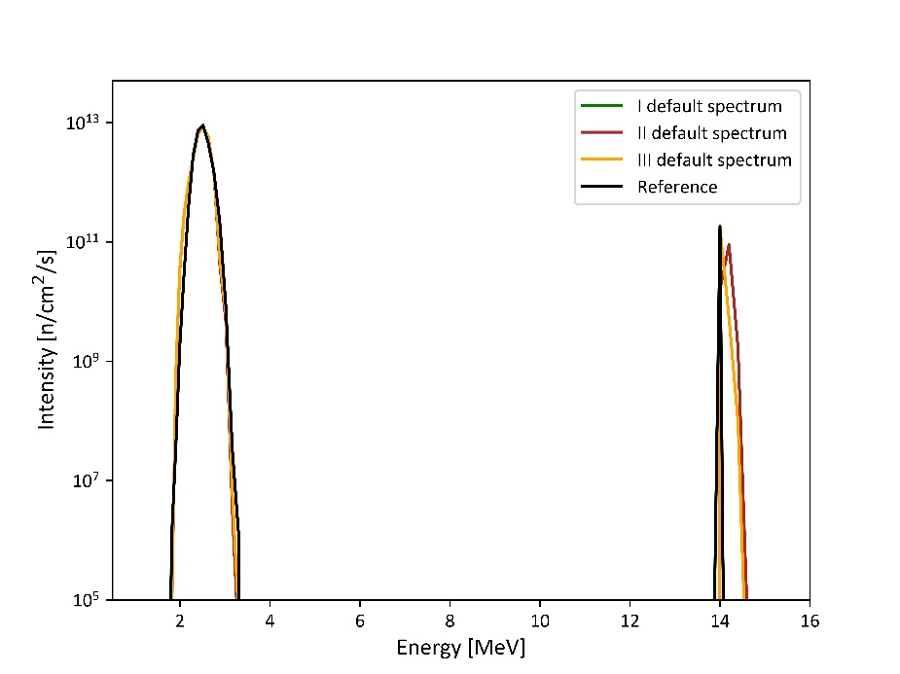
Status of 2022 Deliverable
3. Analysis of the neutron spectrum deconvolution possibility based on activation measurements (testing of different algorithms).
Codes based on the Tikhonov Regularization (TR), Minimum Fisher Information (MFI), Maximum Entropy (ME), and Maximum Likelihood (ML) methods were applied to the reconstruction of the neutron spectrum emitted on JT60-SA from synthetic activation measurement.
The activation data was obtained in simulation by FISPACT-II inventory code with JENDL-4.0 nuclear library and neutron spectrum calculated for Scenario 5.1 using ASCOT containing the triton burn-up neutrons at the level of 3% of total neutron emission. The activities were calculated for 5 s irradiation time and neutron flux 1.18e14 n/s/m^{2.}
The best results are obtained by the ML method and the lowest number of bins. In every case, this method reconstructs the main energy peak properly.
Results of deconvolution obtained by the ML method for the 96 bin structures and different default spectra.

Slide 7
Status of 2022 Deliverable
Tasks:
3. Gamma spectrometry measurements – optimization of measurements sequence and the sample-detector distance for considered HPGe detector – not started.
4. Evaluation of the possibility of triton burn-up studies due to variations in the 14 MeV neutrons quantity - in progress.
6. Preparation of the recommended calibration procedure based on the activation system – in progress.

Slide 8
Proposed tasks for 2023
Preparing of the irradiation end CAD model with capsule and dosimetry foils.
Integration of prepared model with neutronic model of JT-60SA – final selection of irradiation end location.
The MCNP calculations to calculate neutron spectra in dosimetry foils.
The activation simulations using FISPACT including triton burn up studies.
Comparison of activation simulation results performed using FISPACT-II and PHITS.

Slide 9
Thanks for your attention!

