Slide 1
Beam Emission Spectroscopy Örs Asztalos, Gábor Anda, Dániel Dunai Miklós Vécsei, Sándor Zoletnik, Péter Balázs

Slide 2
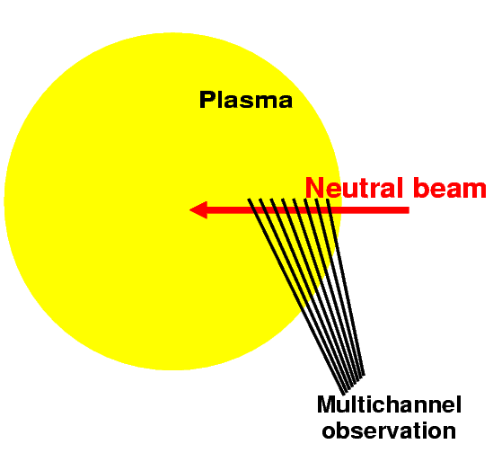
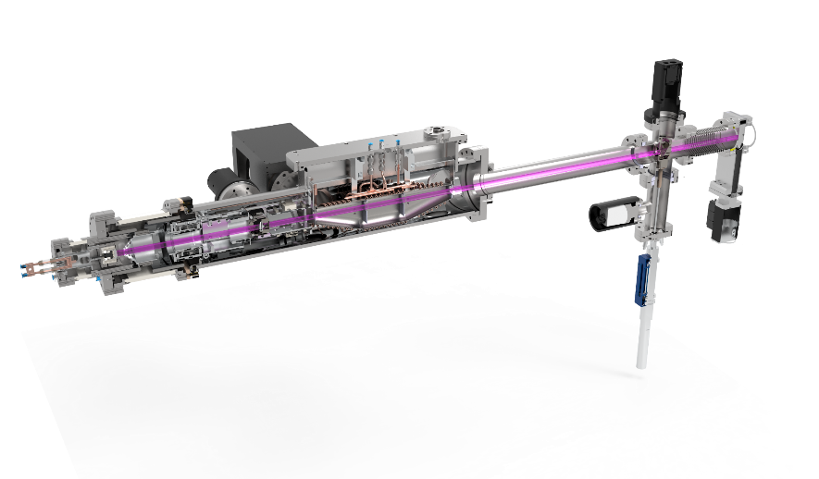
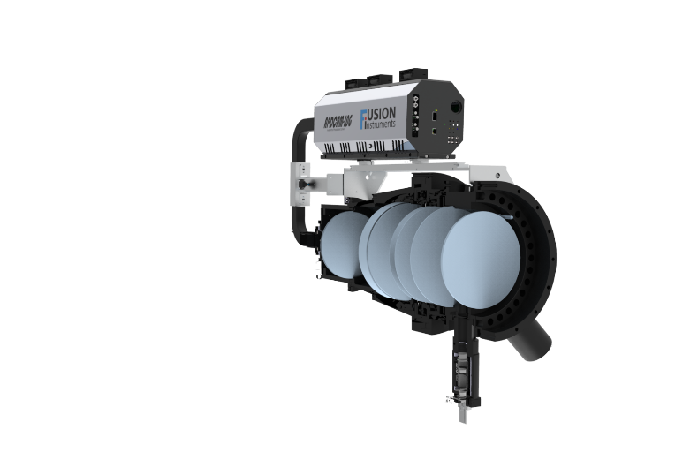
Beam Emission Spectroscopy - Basics
Beam Emission Spectroscopy
Collisionally-excited, Doppler-shifted neutral beam fluorescence (visible range)
~cm spatial and ~μsec temporal resolution aimed
Narrow alkali diagnostics beam
Few cm width
Limited penetration (SOL, edge)
Non-perturbative diagnostic
Installed on: JET, AUG, W7-X, KSTAR, EAST, Compass, DIII-D
Applications:
Density profiles up to 100 kHz
inter-ELM profiles.
Turbulence – SOL and edge
Density shoulder studies
Fast transient events – ELMs, ELM filaments, LH transition
High power wide heating Deuterium beam
15-40 cm width
Deep penetration (core, edge)
Only beam heated plasma scenarios
Installed on: MAST, KSTAR, EAST, DIII-D, LHD, NSTX
Applications:
2D Turbulence imaging - core and edge
Fast transient events – ELMs, ELM filaments, LH transition
2D flows

Slide 3
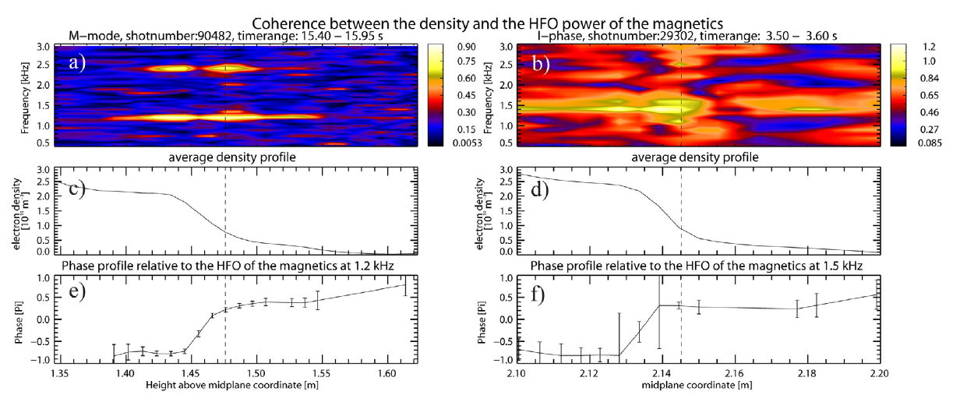
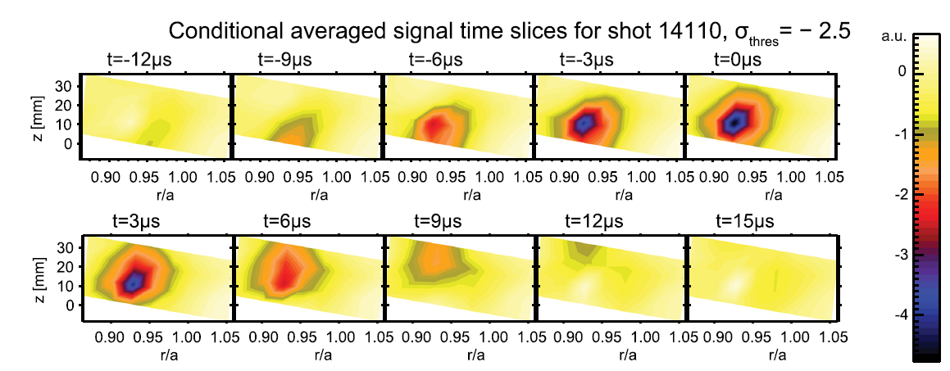
Beam Emission Spectroscopy – Applications in existing machines
Examples of BES studies of various physics phenomena
I-Phase and M-mode studieds on JET, AUG and EAST
Denisty shoulder formation and studiers on JET and AUG
ELM bursts studied on AUG, JET, MAST, KSTAR and EAST
SOL filament dynamics studied on AUG, EAST, KSTAR

Slide 4
Alkali beam - status
Diagnostics feasibility studies for Alkali beam and Heating beam Beam Emission Spectroscopy diagnostics were completed in 2016.
Deliverable – update the feasibility study with the latest scenario calculations
Update the feasibility study with synthetic diagnostics results from JOREK (may be from GENE, HESEL)
Project plan and cost estimate for a turbulence imaging BES diagnostic
Provide inputs for the update of the research plan based on the results of the feasibility study
JT-60SA – Alkali BES
Asztalos et al: Fusion Engineering and Design 123 (2017) 861–864
Giruzzi et al: Nuclear Fusion 57 (2017) 085001
JT-60SA team has experience with Li beam operation (JT-60U)
Lithium beam is in the Research plan
Japanese conceptual study has been done utilizing the old JT-60U system
Input and information was kindly provided by K. Kamiya in 2015:
It is planned to be developed after the first plasma (2-3 years later)
If there is sufficient fund EU could proceed to the detailed design

Slide 5
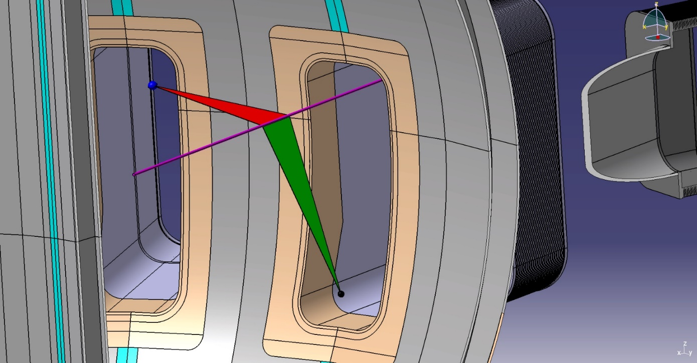
Alkali beam – Advanced Physics considerations
Performance of the LiBES observation system
Green Observation geometry: - Horizontal injection scenario (proposed) P-18 (1D measurement)
Red Observation geometry: - Toroidal observation scenario (proposed by EK) P-17 (2D measurement)
Was shown to have very good spatial resolution.
Was shown to be able to resolve ELM burst and assess mode numbers.
Was shown to be able to resolve SOL turbulence and related issues.
P-17
P-18

Slide 6
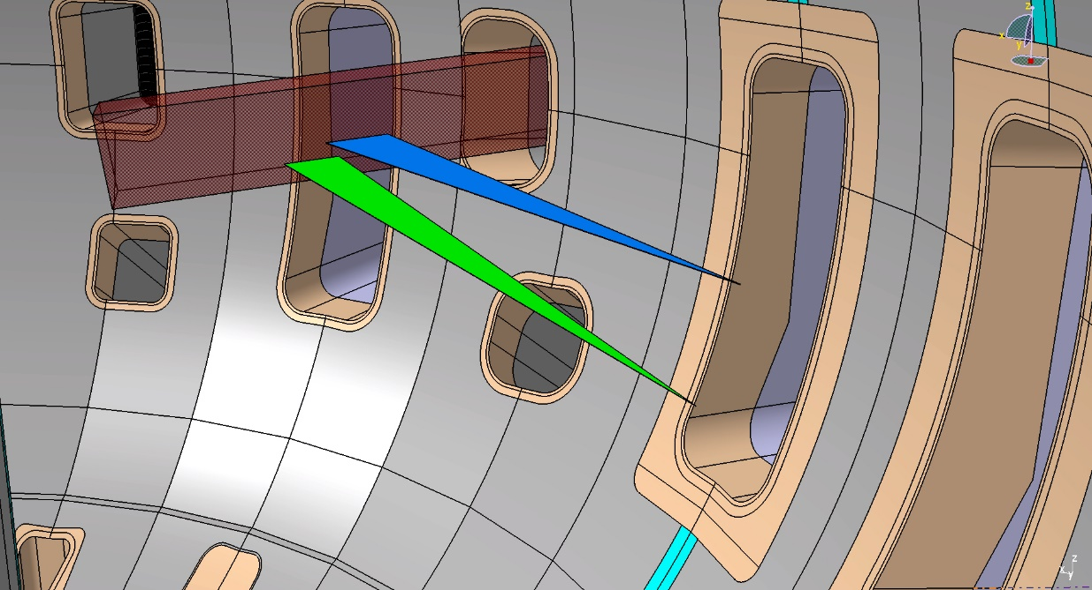
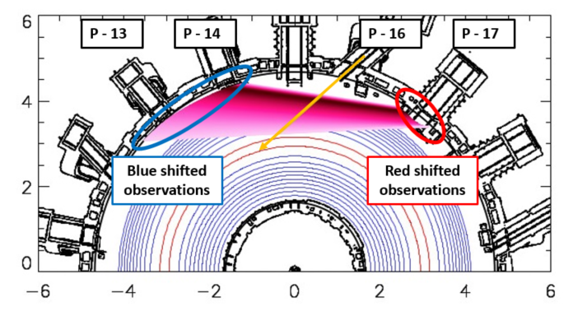
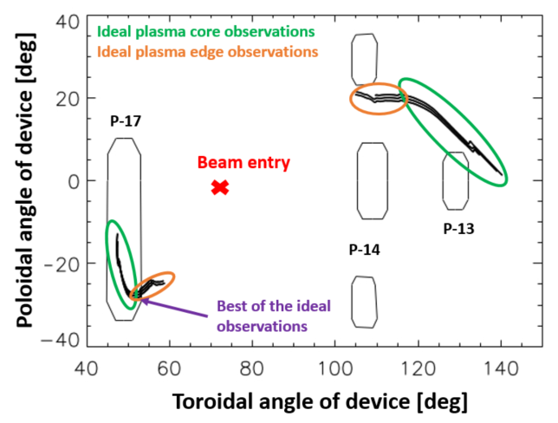
Heating beam - BES
P-17
Synthetic diagnostics was developed to calculate the achievable diagnostic quality to any beam any observation position.
There are possible options for a BES diagnostics
A less optimal position could be still sufficiently good for only edge or core measurements
Physics driven requirements are needed:
What is not good for ITG turbulence can be still OK for larger structures (ELM precursor, MHD modes, etc.)

Slide 7
Ideal heating beam - BES
All ideal Heating beam BES systems:
NBI system | Port for observation | Observed region of plasma | Spatial resolution [radial/vertical][mm/mm] | Doppler shift [nm] | Photon current [ph/s] | SNR [-]
T-NBI 7A | P – 17 | Core | 20.3 / 16.6 | 6.65 | 2.2 x 1E10 | 33.2
T-NBI 7B | P – 17 | Core | 15.1 / 6.6 | 5.85 | 2.8 x 1E10 | 37.4
T-NBI 7B | P – 14 | Edge | 3.9 / 4.1 | -5.12 | 2.6 x 1E10 | 36.1
T-NBI 8A | P – 17 | Core | 10.2 / 4 | 4.31 | 2.8 x 1E10 | 37.4
T-NBI 8A | P – 14 | Core | 20.8 / 16.3 | -5.89 | 6.4 x 1E9 | 17.9
T-NBI 8B | P – 17 | Edge | 13 / 5.3 | 4.93 | 2.2 x 1E10 | 33.2
T-NBI 9A | P – 3 | Core | 13.3 / 7.5 | 5.00 | 1.4 x 1E10 | 26.5
T-NBI 9A | P – 6 | Edge | 14.5 / 7.9 | -6.10 | 2.9 x 1E10 | 38.1
T-NBI 9A | P – 5 | Core | 12.8 / 13.5 | -6.89 | 6.9 x 1E9 | 18.6
T-NBI 9B | P – 3 | Core | 12.3 / 5.7 | 5.00 | 2.6 x 1E10 | 36.1
T-NBI 9B | P – 6 | Edge | 13.3 / 6.7 | -4.63 | 3.0 x 1E10 | 38.8
T-NBI 10A | P – 5 | Edge | 18.6 / 7.1 | -6.45 | 3.4 x 1E10 | 41.2
T-NBI 10B | P – 5 | Edge | 10.7 / 4.7 | -5.88 | 2.9 x 1E10 | 38.1
**
*
Our recommendations:
Fiscally conservative: if observation geometry sharing is possible with MSE then option: *
Ideal observation: Blue Doppler shifted observation on P-14 of beam T-NBI 7B: **

Slide 8
Summary
Summary and plans:
Alkali BES system:
For SOL + Edge observations Li is advised as beam material
P-18 observation geometry: Basic physics (fast density reconstruction) + limited Advanced physics
P-17 observation geometry: Basic + Advanced physics (fast density reconstruction + 2D view of non-linear MHD, turbulence and flows in the SOL + EDGE)
JOREK simulations show LiBES capabilities to resolve ELM bursts and Mode numbers.
Heating BES system:
13 ideal observation geometries were found.
EK Team recommends 2 observation geometries:
P-17 Edge observation of TNBI – 8B – possibly shared with MSE
P-14 Edge observation of TNBI – 7B
The final and more detailed results are presented and publish at 32nd SOFT:
Asztalos et al. “Feasibility of fluctuation BES measurements on JT-60SA” ,
Project plan and cost estimate for a turbulence imaging BES diagnostic

