Slide 1
Doppler reflectometer in the JT-60SA tokamak
Status Report
D. Carralero¹, T. Happel², T. Estrada¹, T. Tokuzawa^{3,4}, J. Martínez¹, E. de la Luna¹, A. Cappa¹, J. García⁵
¹Laboratorio Nacional de Fusi´on. CIEMAT, Madrid 28040, Spain
²Max-Planck-Institut für Plasmaphysik, Garching, D-85748, Germany
³National Institute for Fusion Science, 322-6 Oroshi-cho, Toki 509-5292, Japan
⁴SOKENDAI, 322-6 Oroshi-cho, Toki 509-5292, Japan
⁵CEA, Institute for Magnetic Fusion Research, Saint-Paul-Lez-Durance 13108, France

Slide 2
Intro: why a Doppler reflec in JT-60SA?
JT-60SA research strategy states that:
  “The validation of theoretical models and simulation codes with the aim of establishing a solid basis for the design of ITER and DEMO scenarios is one of the main objectives of the JT-60SA scientific program.”
JT-60SA Research Plan, v3.3 (2016)
Turbulent transport of heat, momentum and particles is a major uncertainty:
JT-60SA will provide not only an increased range of parameters (β, ν*, ρ*, etc), but also qualitatively different situations, closer to ITER/DEMO operational scenarios.
Transport-related extrapolations used by current codes must be validated.
Scientific proposal
  D. Carralero, T. Happel, M. Barnes et al., "A proposal for the development of a Doppler reflectometer system in the JT-60SA tokamak" (2019)
  Feasibility study
  D. Carralero, T. Happel, T. Estrada, et al., “A feasibility study for a Doppler reflectometer system in the JT-60SA tokamak” , Fusion Eng. Des. 173, 112803 (2021).
A DR is a particularly useful diagnostic for this job.
Our proposal covers diagnostic design and implementation, but also the whole diagnostic scientific exploitation (operation, data analysis, gyrokinetic modeling, etc).
It is being developed by an interdisciplinary, multinational team with well-established expertise in all those fields, including members from both the EU (CIEMAT, IPP, Oxford) and Japan (NIFS/SOKENDAI).
1 / 6
Notes:
2
2
2
2
2
2
2
2
2

Slide 3
Main Features of a DR system
Turbulence measurements
Good for quantitative analysis: k⊥-selective, radial scans of the amplitude of local density fluctuations.
Good coverage: by using an steerable mirror, a range of k⊥ values can be probed. Typical values are in the k⊥ρ_{s} ~ 1-10, appropriated to observe ITG and TEM turbulence.
Good temporal, spatial, spectral resolution: typical values are Δt_{turbulence} < 1 μs, Δr ~ 1 cm, Δ k⊥ ~ 1 cm⁻¹. Typical radial range covers SOL, edge and core (ρ > 0.5, see later).
Good comparison to gyrokinetic models: by implementing GK model output in a full-wave code, a direct comparison between simulation and experiment is posible.
Flow measurements
Besides turbulence measurements, DR provides radial scans of the u⊥ of turbulent structures. By estimating v_{phase} using simulations or assuming v_{phase} << v_{ExB} , E_{r} profiles can be obtained. This allows for direct comparison between turbulence amplitude and E_{r} shear.
Calculating neoclassical flow contributions in a tokamak, u_{toroidal} can be obtained from u⊥. By this, a DR system can be used to carry out studies in rotation and neoclassical viscosity (regardless of NBI penetration).
2 / 6

Slide 4
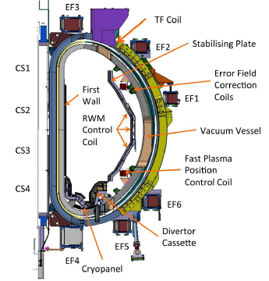
Feasibility study: starting hypothesis
In the feasibility study, ray tracing code TRAVIS is used to determine an optimal geometry for the DR, which would allow it to conduct the proposed observations under relevant scenarios foreseen in JT-60SA operation.
Three scenarios have been considered: high density, hybrid and high beta.
As a working hypothesis, a launching position at one of the lower ports of the P18 diagnostic flange has been considered, between the vacuum vessel and the stabilising plate. Final launching position still TBD.
  Selected launching position coordinates :
  R = 4500 mm, z = -640 mm
  Results do not depend strongly on the precise position of the antenna.
  Focus on edge and core. SOL is addressed by T. Tokihito Q-band system (see later).
R = 4216 mm
P18 port
+
R = 4954 mm
Launching position
N.Oyama, PID U2JYv4.0, 2018
3 / 6

Slide 5
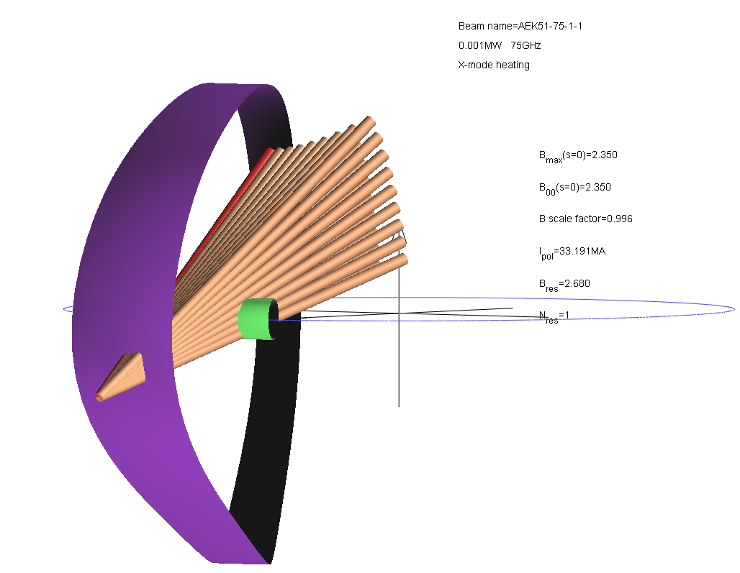
Feasibility study: starting hypothesis
In the feasibility study, ray tracing code TRAVIS is used to determine an optimal geometry for the DR, which would allow it to conduct the proposed observations under relevant scenarios foreseen in JT-60SA operation.
Three scenarios have been considered: high density, hybrid and high beta.
  To determine the validity of the solution, the following criteria were taken:
  Minimize k|| to at most, k||/k⊥ < 0.1 (required for acceptable S/N ratio)
  Reflection layers close to the OMP (ballooning character of turbulence suggest optimum S/N levels)
  Single-axis rotation in steering mirror (minimize complexity of mechanical system)
  k⊥ρ_{s} in the 1-10 range (ITG/TEM turbulence)
3 / 6

Slide 6
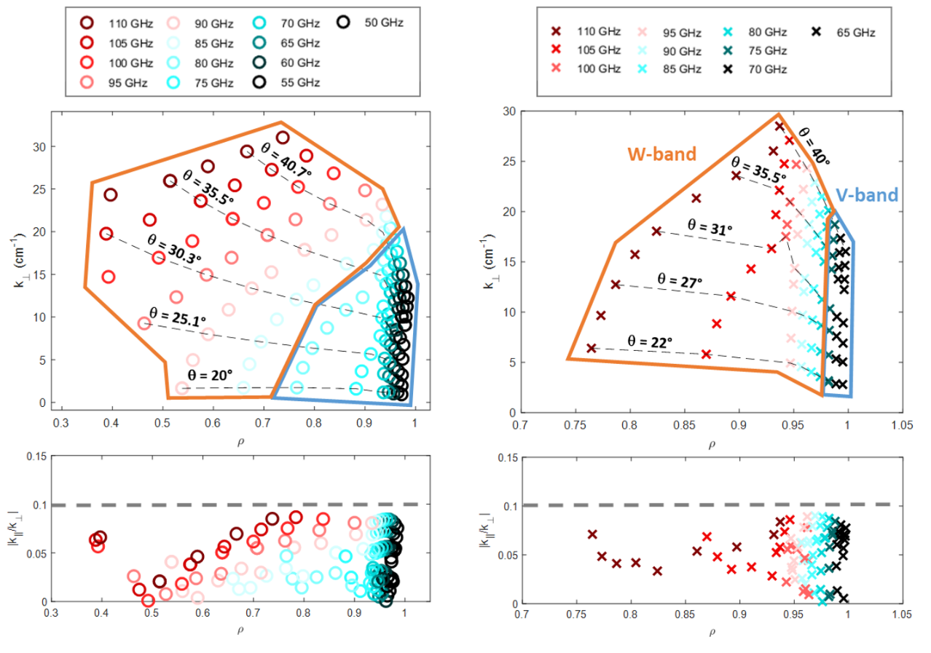
Feasibility study results (high density)
Two reflectometers, one mirror solution:
  Whole edge (up to SOL) can be covered by V-band in X-mode. Central region can be covered using O-mode polarization. E/W Band tbd.
  This way, k_{⊥, core} = 1-30 cm⁻¹ and k_{⊥, edge}= 2-20 cm⁻¹ can be obtained with k||/k⊥< 0.1 in high density and hybrid scenarios. k_{⊥, core} = 7-25 cm⁻¹ and k_{⊥, edge}= 1-20 cm⁻¹ in high β.
4 / 6

Slide 7
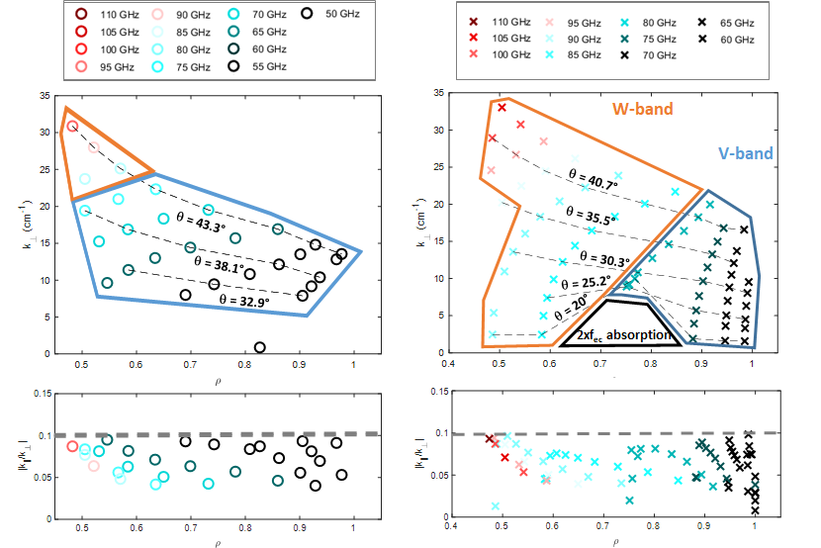
Feasibility study results (high β)
Two reflectometers, one mirror solution:
  Whole edge (up to SOL) can be covered by V-band in X-mode. Central region can be covered using O-mode polarization. E/W Band tbd.
  This way, k_{⊥, core} = 1-30 cm⁻¹ and k_{⊥, edge}= 2-20 cm⁻¹ can be obtained with k||/k⊥< 0.1 in high density and hybrid scenarios. k_{⊥, core} = 7-25 cm⁻¹ and k_{⊥, edge}= 1-20 cm⁻¹ in high β.
4 / 6

Slide 8
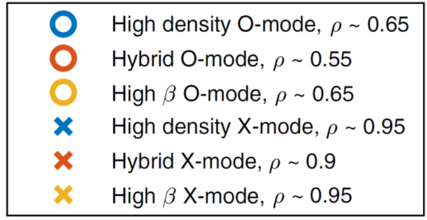
Feasibility study results (high β)
Two reflectometers, one mirror solution:
  Whole edge (up to SOL) can be covered by V-band in X-mode. Central region can be covered using O-mode polarization. E/W Band tbd.
  This way, k_{⊥, core} = 1-30 cm⁻¹ and k_{⊥, edge}= 2-20 cm⁻¹ can be obtained with k||/k⊥< 0.1 in high density and hybrid scenarios. k_{⊥, core} = 7-25 cm⁻¹ and k_{⊥, edge}= 1-20 cm⁻¹ in high β.
4 / 6

Slide 9
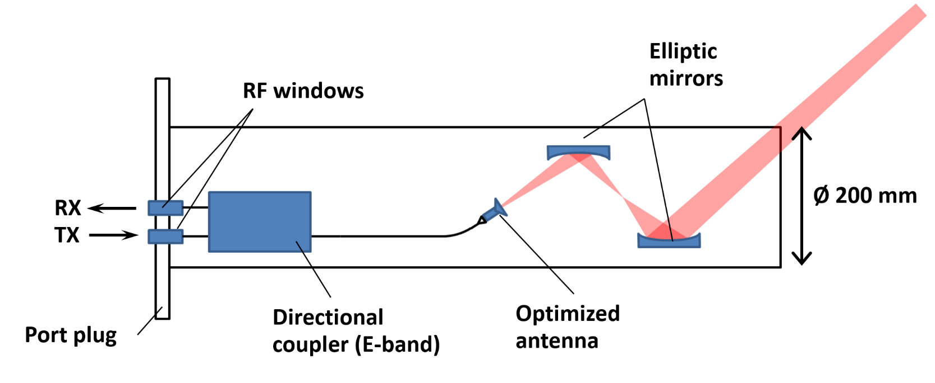
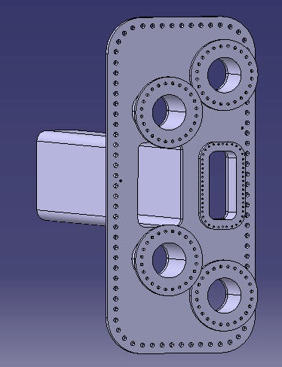
Conceptual design: MVS
D. Carralero et al., FED, 2021
A minimum viable conceptual design has been found for a V/W band DR:
Monostatic system. 30 mm beam waist @ cut off position for 90 GHz (1.4 m distance).
The whole system is contained in a 200 mm diameter port plug.
Q-band might be fitted in the second circular port (T. Tokuzawa)
Space limitations impose a number of critical restrictions:
The system only admits one polarization mode (O/X).
Optimization for certain scenarios and radial regions (core/edge) is then required.
There is not enough space for antenna steering (no spectrum measurements).
5 / 6

Slide 10
Conceptual design: Baseline
Scenario | Features | Main components | Cost
Minimum Viable System | V&W bands, single polarization. Fixed launching angle. | 2 reflectometers+ DAQ systems, 1 coupler, 1 set of antenna+mirrors. | 190 k€
Baseline | V&W bands polarized in O or X mode. Steering launching angle. | 1 coupler, steering components. | 30 k€
Extended A | Additional reflectometer for correlation studies. | 1 reflectometer+DAQ. | 70 k€
Extended B | Additional DR system in remote port for long range correlations. | 1 reflectometer+DAQ, 1 coupler, 1 set of antenna+mirrors, steering components. | 120 k€
  Port plug
From the MVS, improved designs have been considered. The most relevant is the “baseline” design, which is capable of covering the full k⊥ and ρ ranges:
Second directional coupler to allow simultaneous X & O-mode operation. Best polarization for V & E/W reflectometers can be selected remotely depending on the scenario.
A steerable mirror is used to control launching angle. DR k⊥ can be selected, allowing the measurement of wavenumber spectra.
The baseline design is not significantly more expensive than the MVS, but requires access to the whole 700-400 mm space.
Most likely the whole space wouldn´t be needed. Flexible solutions, involving aditional diagnostics, continuation of light guides would be possible.
5 / 6

Slide 11
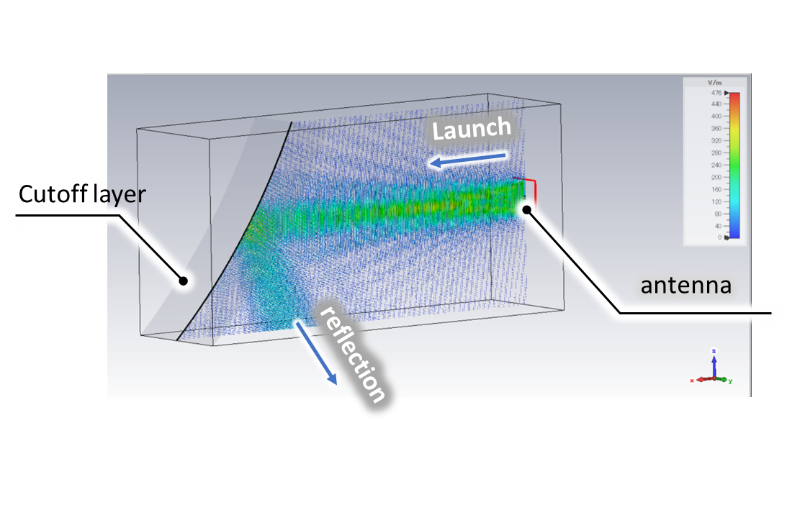
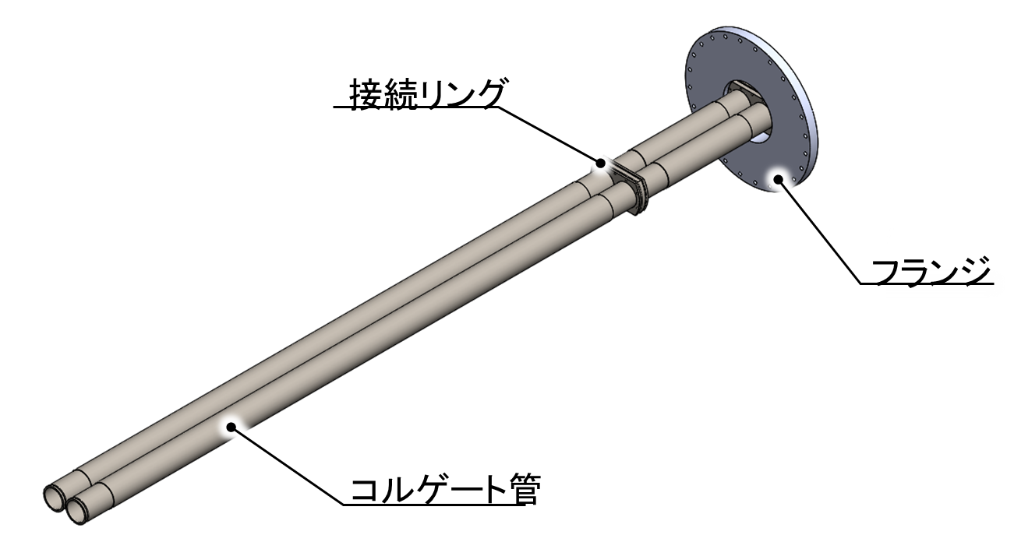
Conceptual design: Japanese proposal
In parallel to the conceptual design proposed in D. Carralero et al. FED 2021, a complementary proposal is being developed by T. Tokuzawa:
A multifrequency, bistatic system using O-mode MW in the Q/V band would be used based in the double comb concept developed and being tested in LHD (T. Tokuzawa et al., Appl. Sci. 2022).
This system would allow simultaneous u⊥ and fluctuation amplitude measurements in multiple radial locations at the SOL and edge of JT60-SA.
Currently, 3D simulations are being carried out in order to design the antennae.
Current design would fit in one of the 200 mm port plugs: compatible with MVD. In the baseline scenario, both concepts could be combined to provide a complete coverage of the plasma.
5 / 6

Slide 12
Summary
A feasibility study has been recently completed for the proposal of a Doppler reflectometry system for JT-60SA. The main conclusions are:
A Doppler reflectometry system would be a very relevant diagnostic for the accomplishment of the JT-60SA scientific program.
It is posible to build a Doppler reflectometer in JT-60SA capable of achieving its scientific objectives.
A MVS can be built in a 200 mm. port plug. The cost stands in the 200 k€ range, but it would be severly limited in the scope of the achievable scientific program.
The baseline design would achieve the full scientific program for a small price increment. However, it would require a fraction of a horizontal port to be allocated for this diagnostic.
A complementary multifrequency edge-SOL design is being advanced by the japanese team.
The baseline design could be most likely integrated with this and other similar diagnostics.
Thank you for your attention!
6 / 6

Slide 15
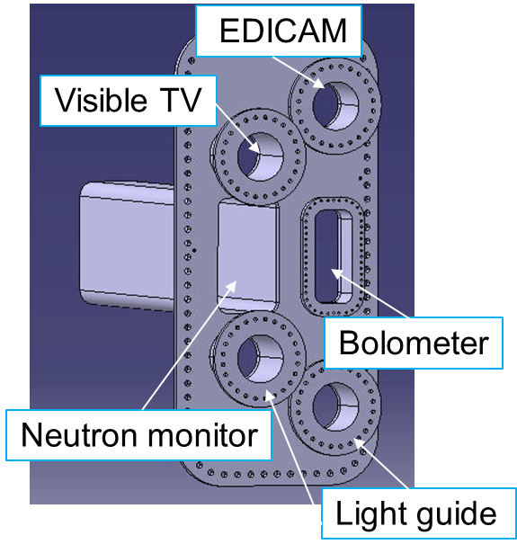
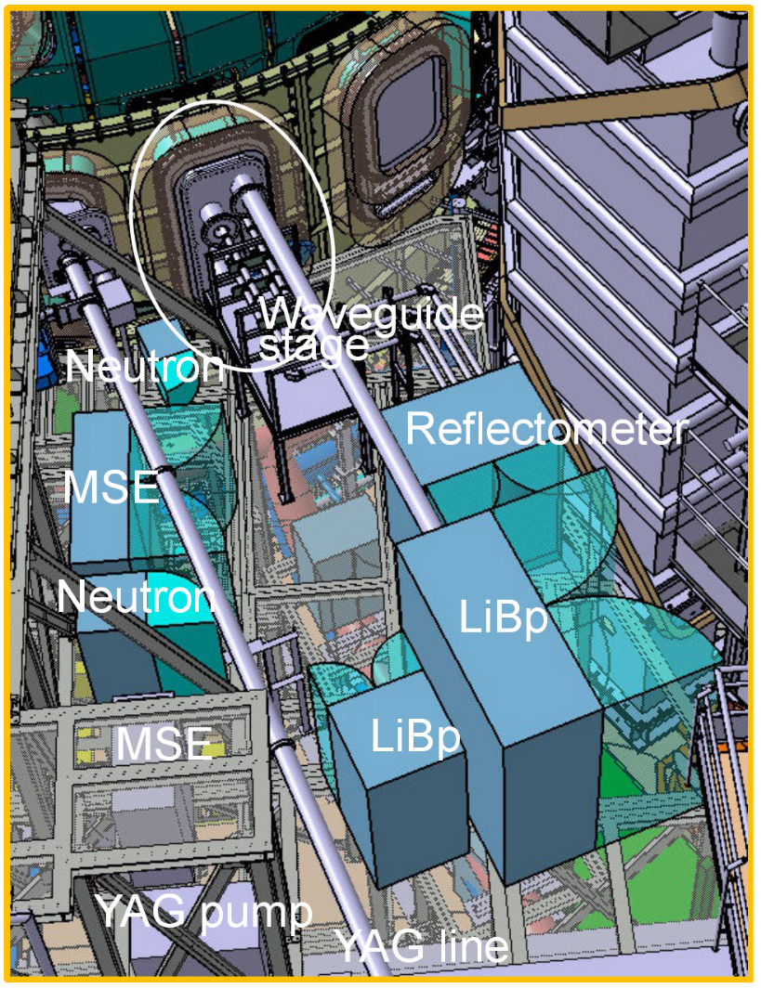
Preliminary system location
P18-Horizontal
Current uncertainties:
Launching position for the DR.
Volume available for the diagnostic components outside the vacuum vessel.
Volume available for the diagnostic components inside the vacuum vessel
Mechanical/volumetric constrains associated to the shape of the port plug used to install the diagnostic.
C. Sozzi, priv. comm., 2018
7 / 11

Slide 16
Optimal Angle
Figure 9: Optimal angle comparison. For each scenario, the optimal θ/φ pairs (leading to k|| = 0) are represented for a number of relevant polarization/frequency combinations, as indicated in the corresponding legend. The |k||/k⊥| < 0.1 regions are indicated as thin grey lines. The optimal probing space for the high density configuration (θ = 1.41φ + 20) is represented as a dashed red line. The intermediate probing space (θ = 1.64φ + 18.7) is represented as a dashed orange line.
5 / 7

Slide 17
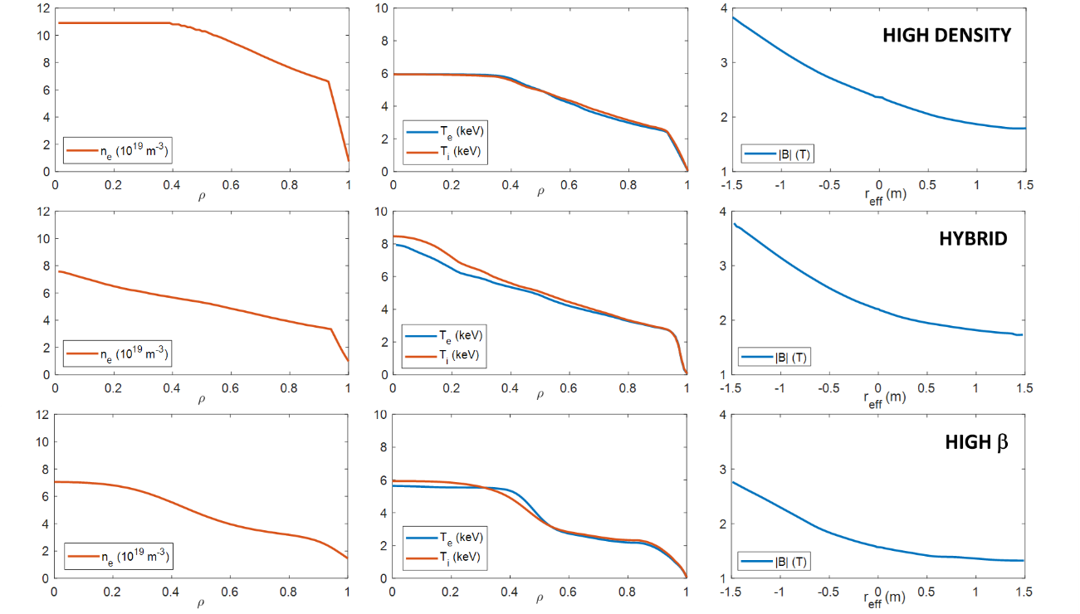
Scenarios
Full current inductive SN, high density scenario, featuring high Greenwald fraction and plasma current (in the following, high density scenario).
Advanced inductive hybrid scenario, featuring moderate densities and plasma currents with high q₉₅ values (in the following, hybrid scenario).
High β_{N} full CD scenario, featuring reduced toroidal field and high Greenwald fraction and q95 values (in the following high β scenario).
5 / 7

Slide 18
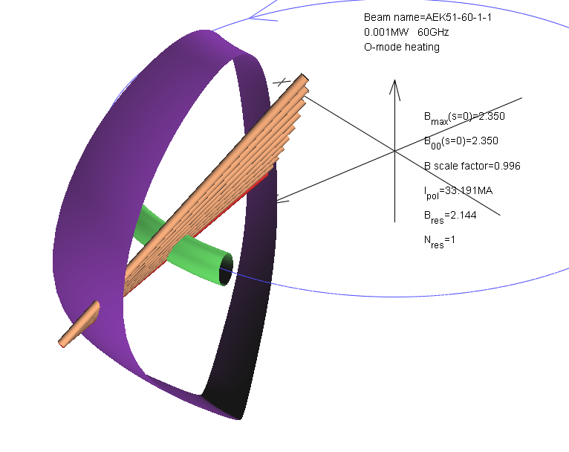
k-spectra characterization
A number of rays are launched on the optimal plane to simulate different launching angles from a steerable mirror.
  O-mode, 60 GHz
  elevation angle
  azimuth angle
  k||/k⊥ = 0.1
  k|| = 0
11 / 14

