Slide 1
Simulator for JT-60SA E. Joffrin J.F. Artaud, M. Mattei, G. Giruzzi, L. Di Grazia, A. Mele, M. Iafrati, W. Bin, D. Fratolillo, B. Faugeras, C. Boulbe

Slide 2
Purpose of the discharge simulator
Objective of the simulator
Tool for EU scientists or operators to develop their experimental/operation scenario before proposing or implementing an experiment on JT-60SA.
Light tool: accessible and « reasonable » CPU time.
Friendly interface
Capable of simulating a discharge from begining start of ramp-up to end of ramp-down, including X-point formation, heating, etc …
Includes the machine operational constraints (flux consumption, EF & CS current limits, controller, eddy current as an option etc …)
What the simulator does not do
The simulator is not aiming at describing transport (like ASTRA; CRONOS, etc). It uses METIS for « reproducing » plasma confinement from 0D scalings.
It is not a high fidelity model for plasma discharges (like TSVV11): does not contain disruption models or sophisticated edge or fast particle models for example.

Slide 3
JT-60SA simulator
STEP 1
STEP 2
STEP 3
GUI
GUI
GUI
Plasma shapes
Initial equilibrium
Linearized model
Scenario optimisation
Coils current feedforwards
Shape update
Plasma scenario development
PLASHAPE
METIS
CREATE-EGENE
FEEQS.M
(FBE inverse mode)
1st equilibrium
Linearized model
METIS
Simulink
Shape controller
Vertical controller
STEP 4
Coil current feedforwards
Plasma current controller
NICE
(free boundary equilibrium)
METIS simulator
(plasma scenario)
Reference
Waveforms (Ip,…)

Slide 4
Status and planned work (➔) for 2023
Numerical activities were set-up for Scenario 2 of JT60-SA. Static equilibria for the ramp-up and start of flat-top phases were designed with CREATE-EGENE code. Then, METIS simulations with many different heating mixing were performed. Results now on the gateway.
Further tuning is necessary in the current ramp-up (shape sequence, limiter-X-point transition) to optimize the margins of the scenario on flux consumption in particular.
Scenario 4.2 simulation has also been performed with full power and scenario made more realistic (see, G. Giruzzi’s talk) after discussion with the group.
More scenario should be developed on the gateway with new users using the same procedure as a training before using the full controller. Plan to be developed in the next weeks with different level of power (according to their availability in time).
METIS/EGENE/FEEQS are installed on the gateway for any users willing to use this suite of code.
➔ Workplan to be developed on the gateway for new/old users (like W. Bin, G. Girruzzi, etc …)
A new numerical method using NICE-METIS has been implemeted in the code. The CREATE controller (VS, SC, CC) has been coupled and test are on-going (see M. Mattei’s presentation).
Interaction needed between CREATE and CEA teams about the current oscillations during the flat top phase. This should be solved in the next weeks.
Test the ramp-up phase and deliver the simulator to the users for exploitation with documentation.

Slide 5
Slides in reserve

Slide 6
Reminder about the current work on the simulator
Develop test cases for the simulator: dynamic evolution for scenario 2 and 4.2 with additional power (NBI+ECRH) and assess the feasibility with regards of the machine parameters.
Set-up the CREATE-NL-METIS strong coupling approach on non ohmic scenarios and modify the controllers to get a more robust coupling. Assess computing time for the various configurations.

Slide 7
Development of test cases for the simulator
I- Test cases to be developed for scenario 2 (EGENE ←→ METIS
Case number | Type | Plateau Density in m⁻³ | Specie | Power NNB/PNB/ECH1/ECH2 | Comments
1 | Ohmic with ECRH | 4.5e10¹⁹ | H | 0 / 0 / 1.5 / 1.5 | ECH1 starting just before the X-point until the end of Ip plateau. ECH2 starting at the time of the current plateau
2 | Ohmic with ECRH | 4.5e10¹⁹ | D | 0 / 0 / 1.5 / 1.5 | ECH1 starting just before the X-point until the end of Ip plateau. ECH2 starting at the time of the current plateau
3 | Power | 4.510¹⁹ | D | 10 / 6 / 1.5 / 1.5 | Beam power increased in 2 steps of 200ms
4 | Power | 4.510¹⁹ | D | 10 / 13.5 / 1.5 / 1.5 | Beam power increased in 2 steps of 200ms
5 | Power | 4.510¹⁹ | D & H | 10 / 20 / 1.5 / 1.5 | Beam power increased in 2 steps of 200ms
Done
II- Carry out the checks (FEEQS)
Existence of the H-mode and PLH versus PIN
Beam shinethrough and first orbit losses: OK
For each case, FEEQS check: the flux consumption and current limits.
Check the Ejima coefficient: OK
Done
III- Design optimised current ramp with new shape sequences for reduced flux consumption: more work with EGENE needed here.
Existence of the H-mode
Run CREATE EGENE for the new shape with reduced triangularity and elongation (slow ramp of the shape) taking care that the X-point can be made.
Introduce the shape data into METIS and rerun the above cases in ohmic to check the gain in flux.
Run the case with power to check the gain.
To be completed

Slide 8
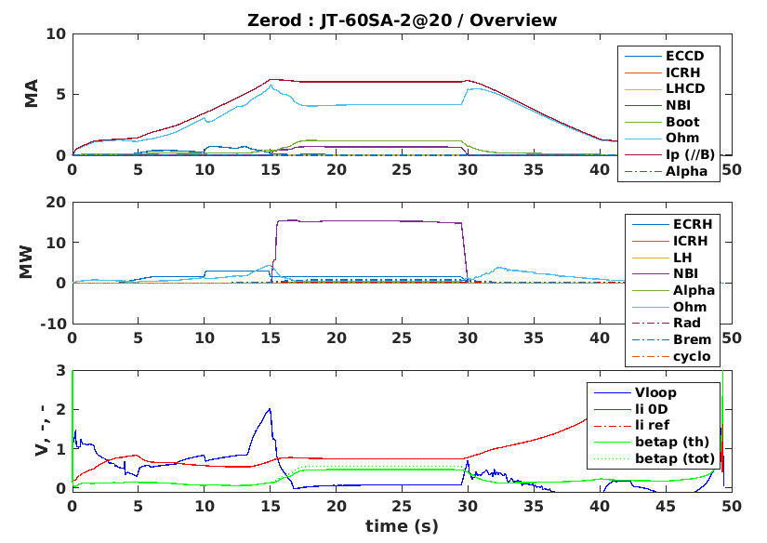
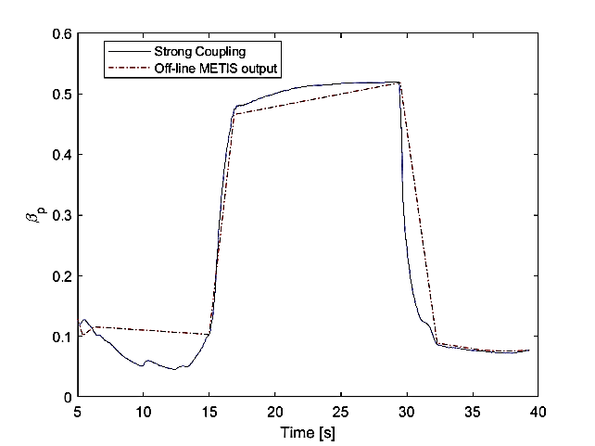
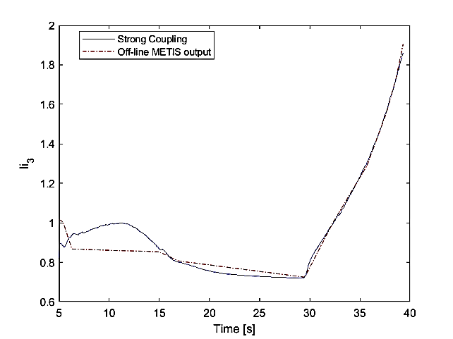
Scenario two in ohmic and with power used as test cases for strong coupling
The link between CREATE-NL and METIS implies the solution of two different sets of differential equations: the free boundary equilibrium + the current diffusion.
METIS-CREATE-NL coupling is managed via a Matlab routine implementing the following steps:
Run a first CREATE-NL equilibrium with assigned conditions
Run a first METIS equilibrium with assigned conditions
Run shape and VS control and update successively CREATE-NL (P’; FF’) and METIS with new equilibrium.
But: ill-posed problem: Ip not well defined with no clean derivation
New numerical method based on standard FEM methods + Poynting theorem
Method implemented in NICE/METIS - CREATE codes
Controller now being introduced.
Strong coupling
Off-line METIS (--)
β_{p}
li3

Slide 9
Tools installed on the gateway for users
User group to work on the gateway
The gateway became available in September 2021 with the adequate matlab routine
EGENE has been installed on the gateway (A. Mele)
METIS and FEEQS have also been installed on the gateway (JF. Artaud
Calculations for scenario 2 done before the installation on the gateway (M. Iafrati).
Calculations for scenario 4.2 have been done in the begining of 2022 (G. Giruzzi).
Scenario 4.2
Checked with FEEQS ➔ issues with Ip ramps and EF4 saturation
… and more scenario need to be modelled!

Slide 10
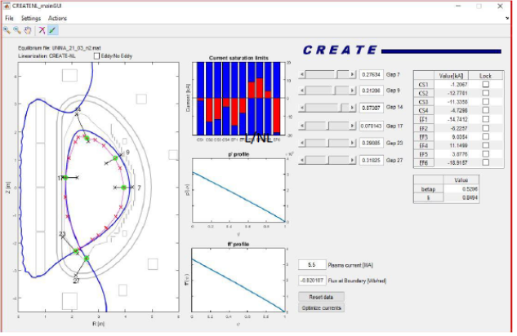
Prepare plasma shape sequence: CREATE-EGENE
CREATE-EGENE is a graphical user interface developed for the CREATE-L/NL codes
It has been designed as a control oriented tool for magnetic equilibria generation
Developed for JT-60SA and ITER and installed in Rokkasho
Visualize the poloidal flux map internal profiles and SOL geometry
Compare different plasma equilibria
Compute adjustements to current equilibrium
Optimize currents to obtain the desired shape
Launch CREATE-L/NL to compute free boundary equilibria and generate linearized models for the plasma/circuits varaitions.
Open linearized models in Simulink and build control schemes
Note: existing shape sequence exemples in the PID

Slide 11
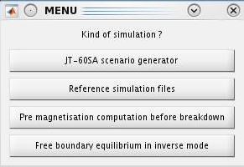
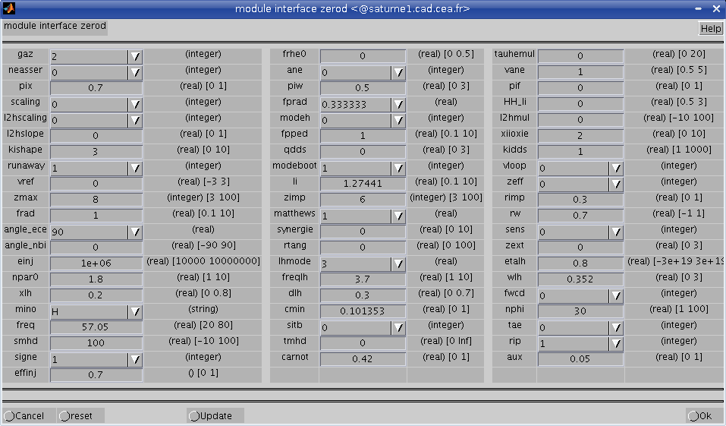
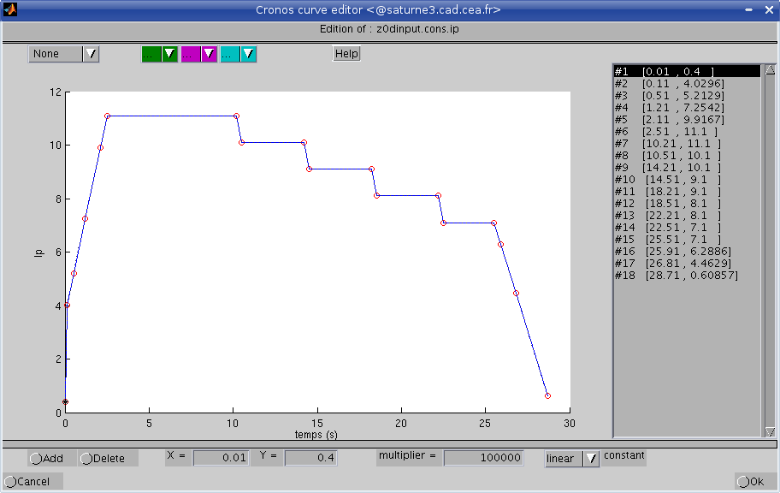
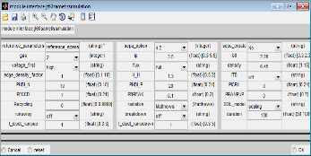
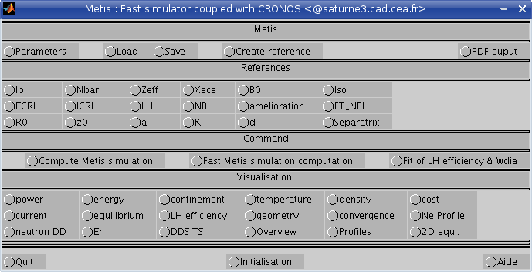
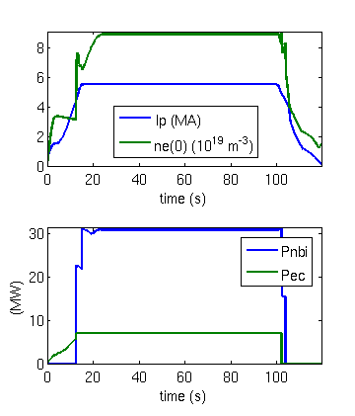
Run plasma scenario: METIS
Input from EGENE
Parameters
References
Scenario choice
METIS : main interface
Run
(~ 1mn)
Visualisation
Export to database
Results

Slide 12
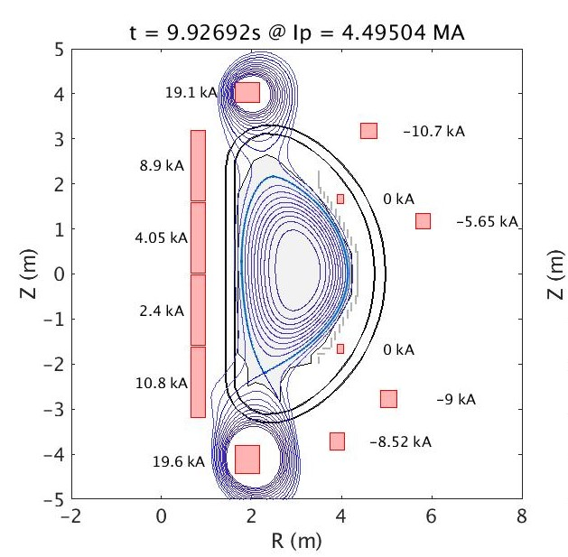
Scenario optimization and checks: FEEQS
FEEQS is a quasi-static free-boundary equilibrium code that computes the coils currents necessary to produce a given magnetic equilibrium.
Inputs:
P’ and FF’ profiles from METIS;
Plasma shape from METIS;
Plasma current;
LCFS poloidal flux;
Coils limits.
Outputs:
Updated LCFS shape as real solution of free-boundary equilibrium equation;
Waveforms of time dependent coil currents;
Forces and maximum magnetic field on coils;
Estimation of voltage on coils;
Estimation of current in passive structures.

Slide 13
Overview of the completed simulator
METIS simulator
Feedforwards
Simulink
Powers, density, …
Kinetic controller
Plasma shape, …
Shape controller
Plasma current
Vertical controller
Plasma current controller
CREATE-NL or
NICE
Observer: RAPTOR
NICE
Equilibrium identification
(formerly EQUINOX)
Synthetic diagnostics:
Magnetics, polarimetry, …

