Slide 1




Flight Simulator Development
Integration of Magnetic Control into NICE/METIS
9th WPSA Project Planning Meeting
^{5-9th September, Budapest}
Massimiliano Mattei^{1,2}
in collaboration with L. di Grazia^{1,3}, D. Frattolillo^{1,2}, A.Mele^{1,2}, G.DeTommasi^{1,2},
J.F. Artaud⁴, E. Joffrin⁴ , C. Boulbe⁵, B. Faugeras⁵, H. Heumann⁵, and others
¹ Consorzio CREATE
² Department of Electrical Engineering and Information Technology, University of Naples Federico II, Italy
³ Dipartimento di Ingegneria, Università della Campania L.Vanvitelli
⁴ CEA, IRFM, Cadarache
⁵ Universitè Cote d’Azur, CNRS, INRIA

Slide 2
Presentation content
How the flight simulator is structured and what is its role in the shot preparation and validation procedure
Magnetic control general philosophy
Validation of the CREATE Magnetic control philosophy with the CREATENL/METIS simulator
NICE/METIS: JT60-SA model implementation status
Cross validation of NICE/METIS with CREATE models
Open issues and future work

Slide 3
Tools and Procedures implemented in the past
CREATE
Step 1 – Scenario Definition
Also supported by F4E (Sartori F., Cavinato M.)
CEA
Shape Generator and Optimizer (CREATE-EGENE)
METIS Scenario preparation and optimization. Discharge analysis and flux consumption estimation
Tools tested by several scientists (Abbate D., Bin W., Giruzzi G., Iafrati M., Cruz N., Corona D., Bolzonella T., Piron C., Lennholm M., many CREATE colleaugues)
Step 2 – Limit Assessment and Waveforms optimization
Tools for nominal feedforward currents optimization in view of closed loop simulations
FEEQS Code
Poloidal currents and voltage optimization and force limits assessment
Full scenarios designed for weakly and strongly coupled dynamic simulations

Slide 4
Final Step under implementation and testing
Step 3 Opt. a – Closed loop coupled dynamic simulations
CREATE-NL
Closed loop dynamic simulator (FEM)
METIS
Light transport simulator
This solution does not provide answers in short computaton time and is now being used for cross-validation with the NICE-METIS solutions
Step 3 Opt. b – Closed loop coupled dynamic simulations
CREATE
Magnetic Controllers
NICE-METIS
Equilibrium + transport simulator
This option should have a more robust integration scheme for transport and free boundary equilibrium including current diffusion and should be faster

Slide 5

GUI
GUI
GUI
Scenario optimisation
Coils current feedforwards
Shape update
Plasma shapes
Initial equilibrium
Linearized model
Plasma scenario development
PLASHAPE
METIS
CREATE-EGENE
FEEQS.M
(FBE inverse mode)
1st equilibrium
Linearized model
METIS
Simulink
Shape controller
Vertical controller
Coil current
feedforwards
Plasma current controller
NICE
(free boundary equilibrium + current diffusion)
METIS simulator
(plasma scenario)
Reference
Waveforms (Ip,…)

Slide 6
Coupling of METIS-NICE with CREATE Controllers – Original Plan
General philosophy
1. Use Nice-Metis (Transport+FBE) with CREATE Controllers
2. Consider NICE-METIS as a real experiment
Step 1. Implementation of the JT60-SA Baseline in NICE-METIS and CREATE-NL - COMPLETED
  Implement JT60-SA configuration in NICE
  Test without plasma. Fluxes and fields in the presence of steady state and fast transients
  Implementation of a current control in vacuum
  Test current control in NICE-METIS

Slide 7
Step 2. Flat top control – VS
Identification of the unstable growth mode and of the effect of VS coils on this mode. Comparison between NICE-METIS and CREATE-NL (Completed)
Implementation of a VS controller (Completed)
Identification of gap response with stabilized plasma (Open issues)
Identification of Ip response (Open issues)
Implementation and testing of a Gap +Ip controller for flat top (Completed)
Transient studies (TBD)
Step 3. Ramp up Control (Diverted phase) (TBD)
Definition of the nominal scenario and of the reference currents
Comparison NICE-METIS - CREATE-NL on ramp up equilibria (CREATE define waveforms and conditions)
Tuning of the VS control on the ramp up
Open loop simulation (with VS)
Gap control implementation and testing
Sensitivity studies
Next steps
Discussed later

Slide 8
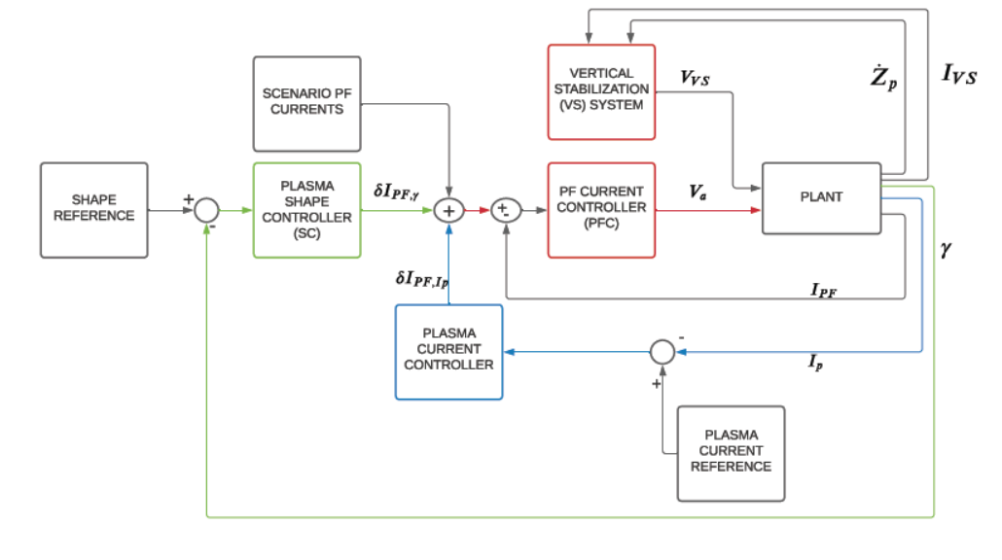
MAGNETIC CONTROL ARCHITECTURE
NAME | CONTROLLER TYPE | DESIGN METHODOLOGY
VS | PD – SISO | Optimization based design on a 05 s finite time horizon
PFC | P – MIMO | Linear Quadratic Integral Optimal
SC | PI – MIMO | XSC-like approach
PCC | PI - SISO | Trasformator current pattern approach

Slide 9
CREATE/NL-METIS coupling implementation scheme
CNL initial equilibrium
METIS initial equilibrium
Ip, profile shapes* and flux consumption at k0
Shape, Plasma current and VS control
Update CNL equilibrium
Update METIS equilibrium
k = k0+1
Shape &
position at k0
k = k+1
Ip, profile shapes or li-poloidal beta, and flux consumption at time k
Active voltages
at time k
Implemented
in MATLAB-Simulink
?
Shape &
position at time k
* ff’ and p’ functions

Slide 10
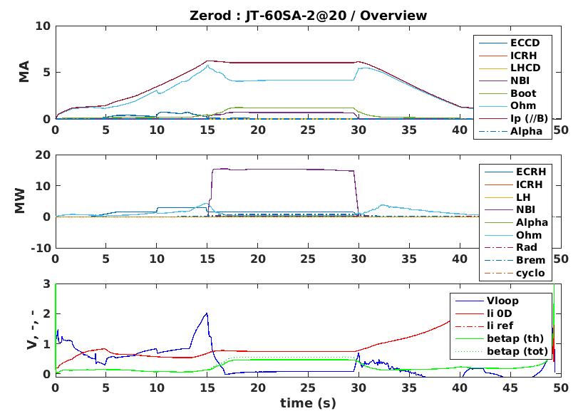
Control approach validated on CREATE-NL / METIS
Scenario ‘2_irpI_C7’provided by M. Iafrati (04/11/2020)
Simulation Options
Poloidal and li3 assigned in CREATE-NL (Option 1.B);
Plasma current computed by CREATE-NL (Option 2.B);
Controller on – (Option 3.B);
Eddy currents (Option 4.B);
Mesh size: 18000 nodes (Option 5.B);
Time step: 2.5ms for CREATE-NL (Option 6.B) but 100ms for METIS;
No alfa blending (Option 7.A).
gas | D
ne | 4.5e19 m-3
Ip | 5.5 MA
nbiP | 6 MW
nbiN | 10MW
PECCD | 1.5MW + 1.5MW
Pbreak | 0
Prampup | 0
Durations | 30s
No Mattew scaling
10

Slide 11
Controlled Gaps
Ten gaps controlled (XSC approach)

Slide 12
Controlled Gaps

Slide 13
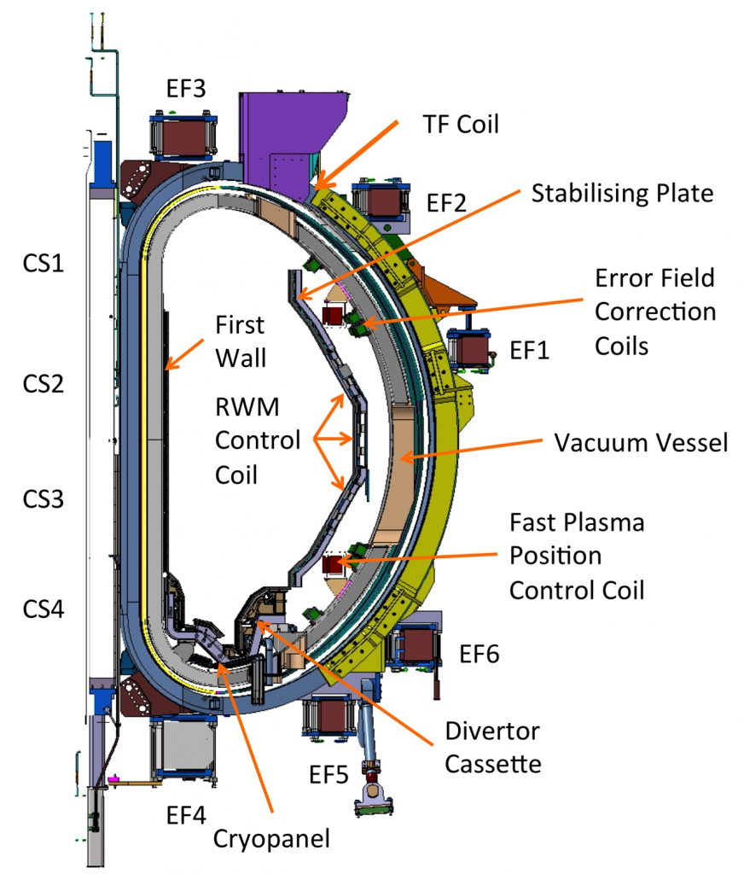
Control Currents CS
Coils Currents evolution

Slide 14
Control Currents EF

Slide 15
Plasma quantities

Slide 16
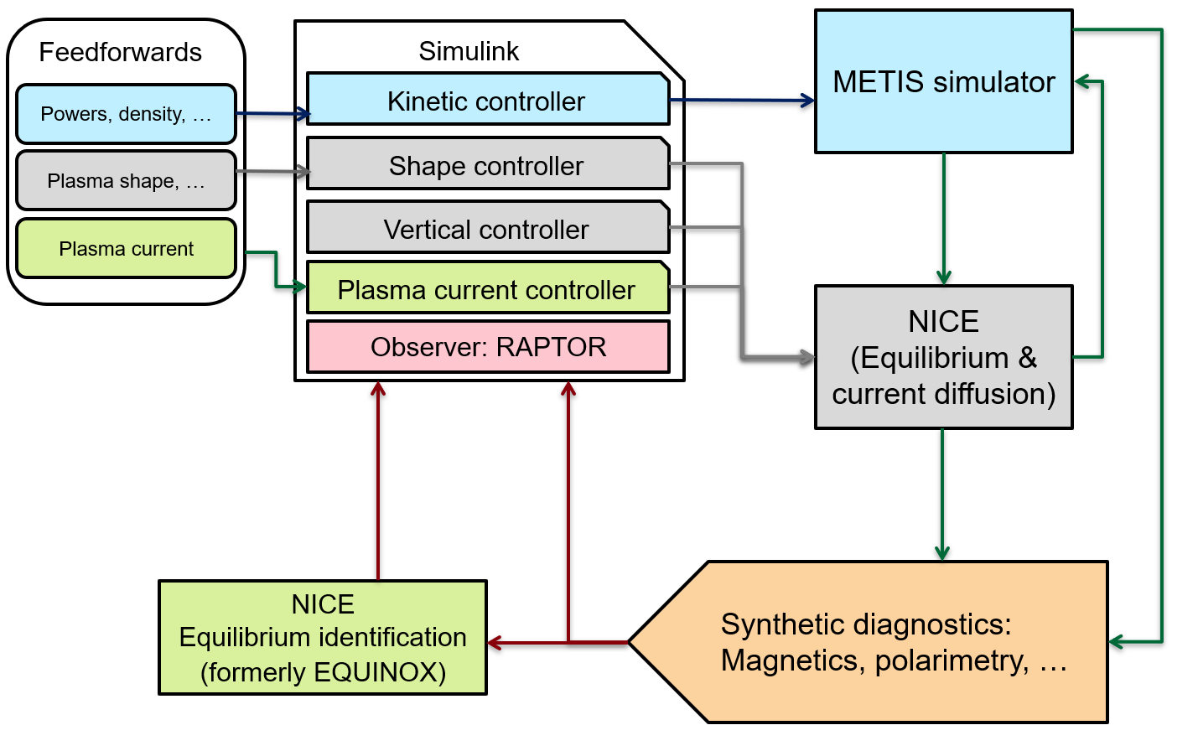

Slide 17
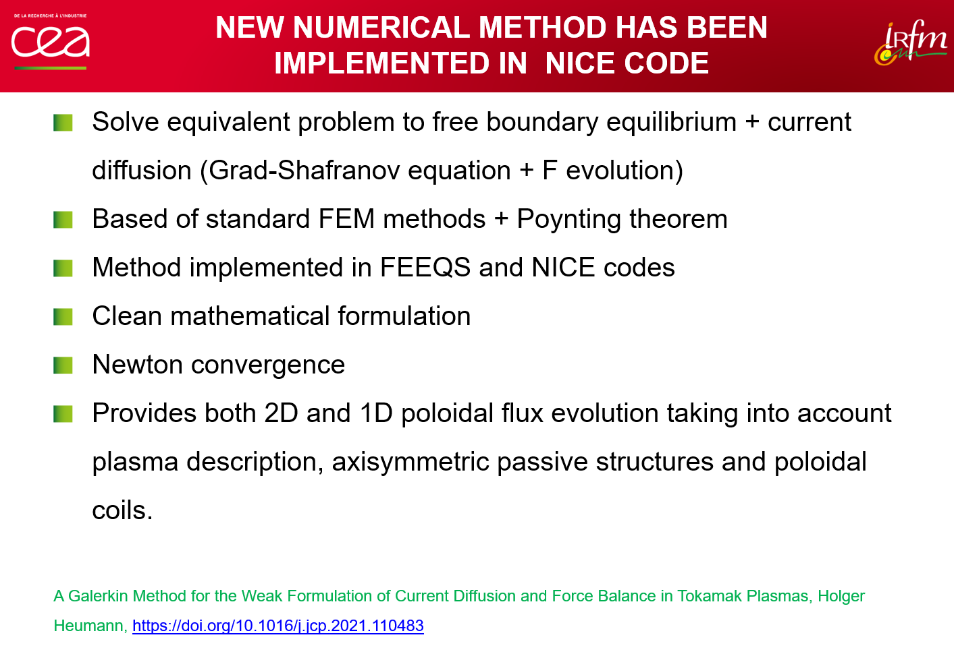

Slide 18
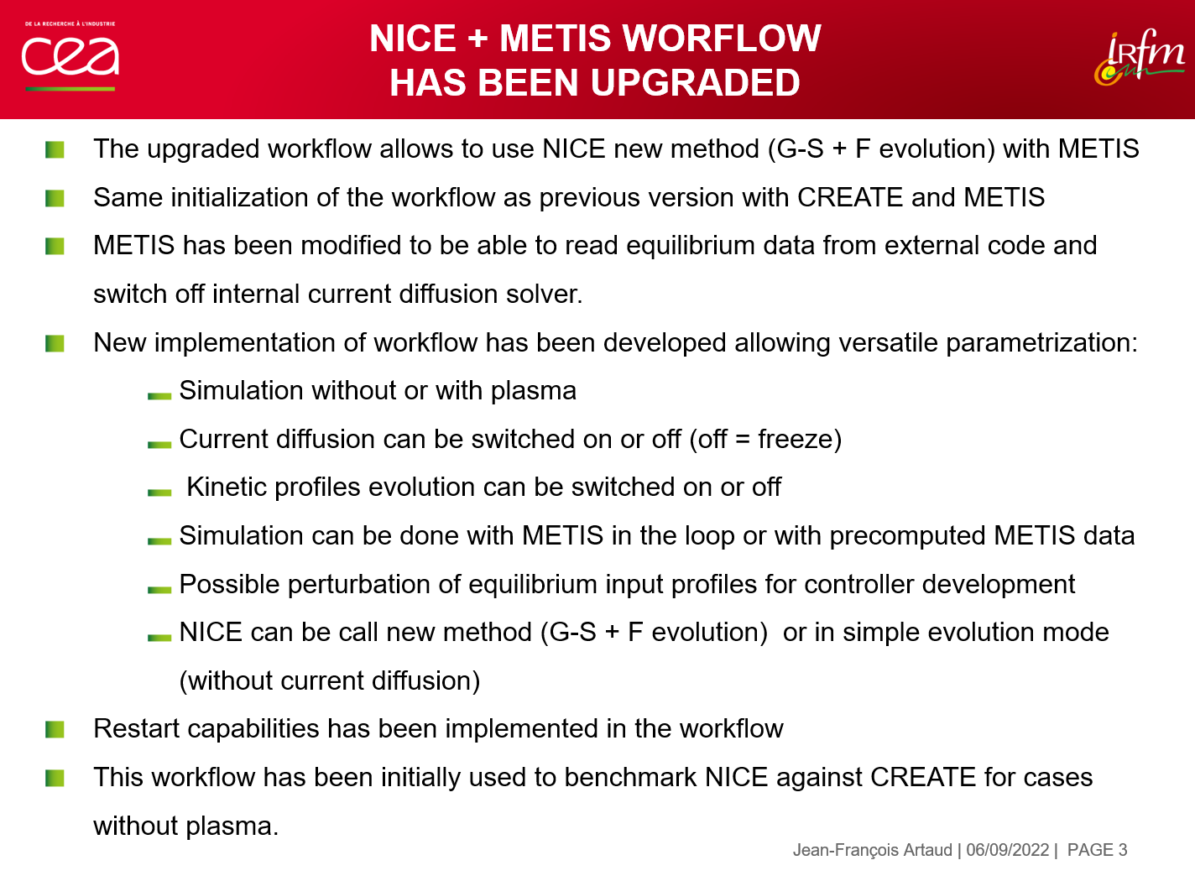

Slide 19
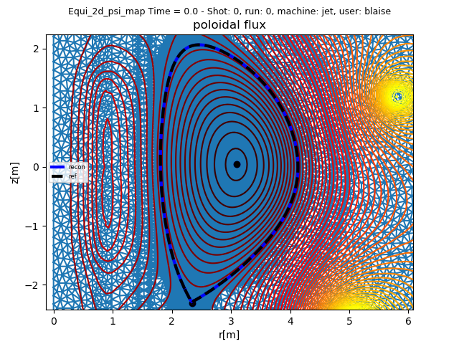
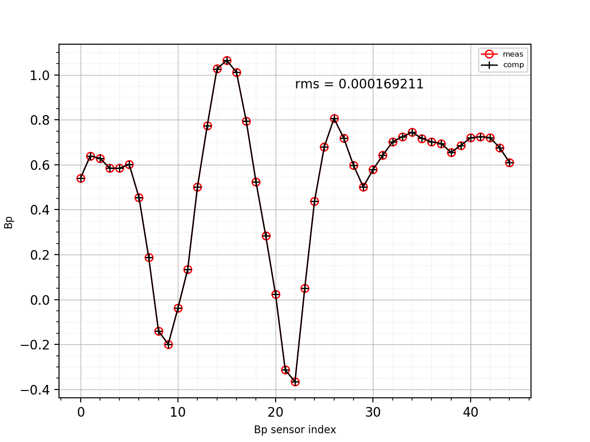
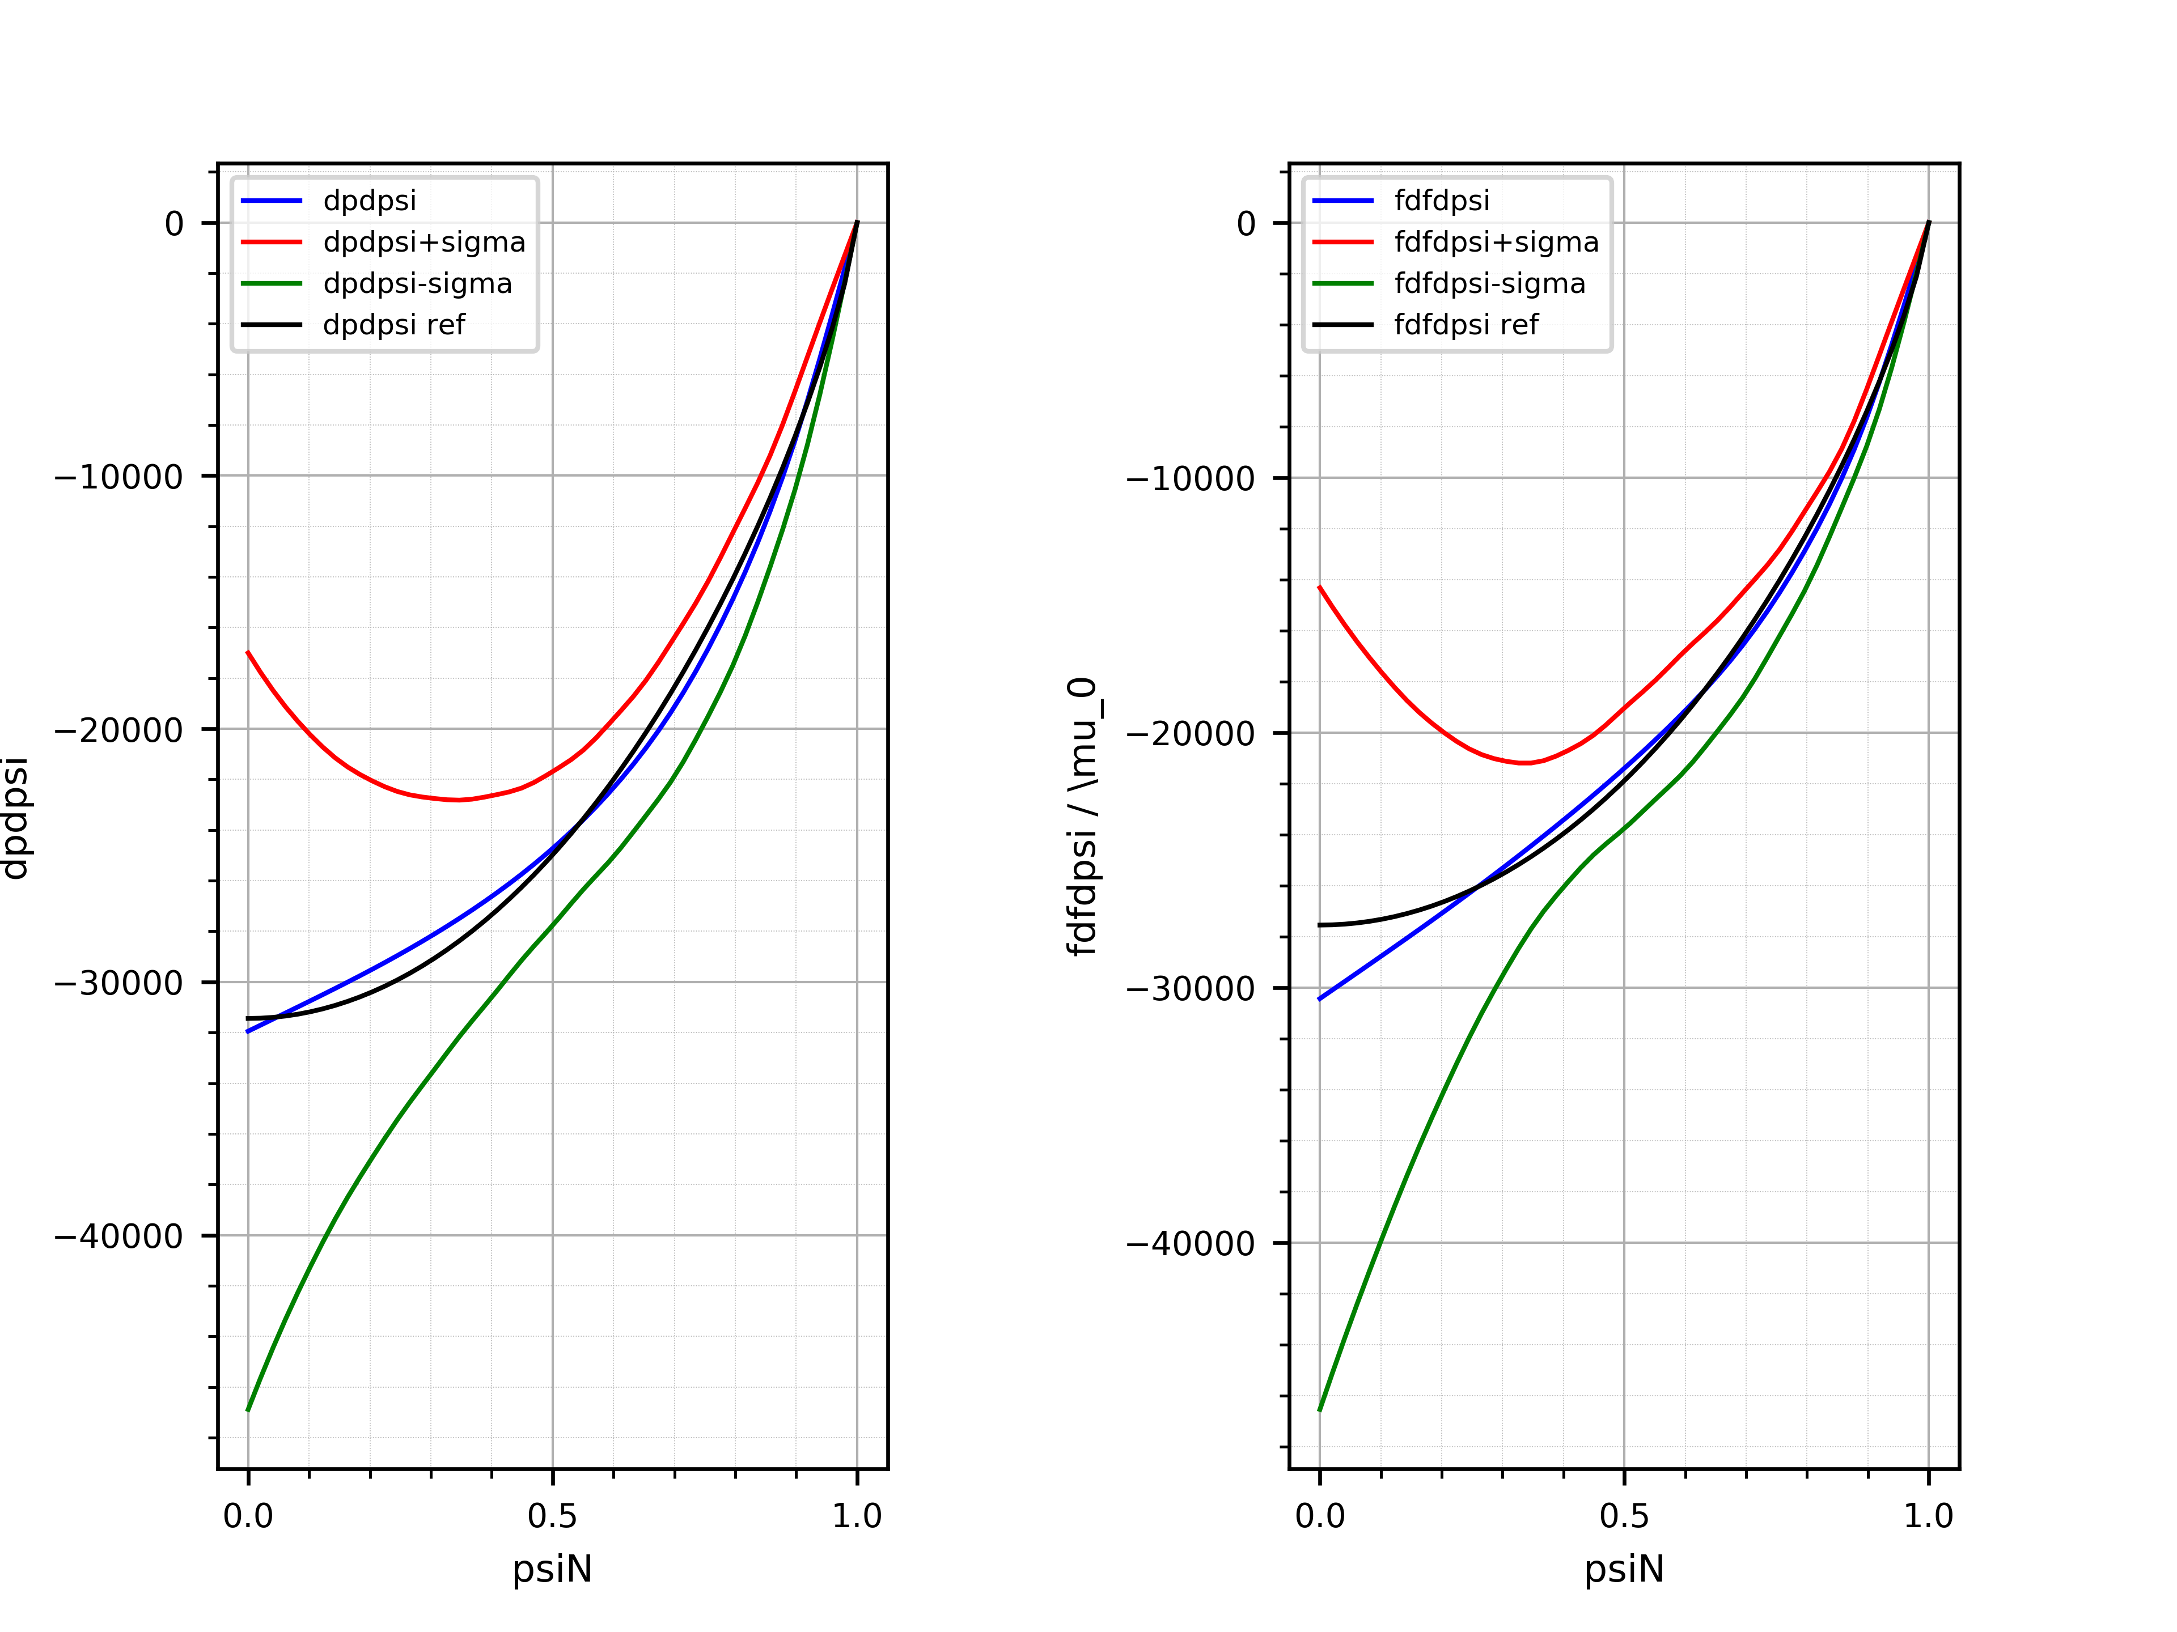
NICE : EQUIlibrium identification TEST made in 2021
Static Snaphots

Slide 20
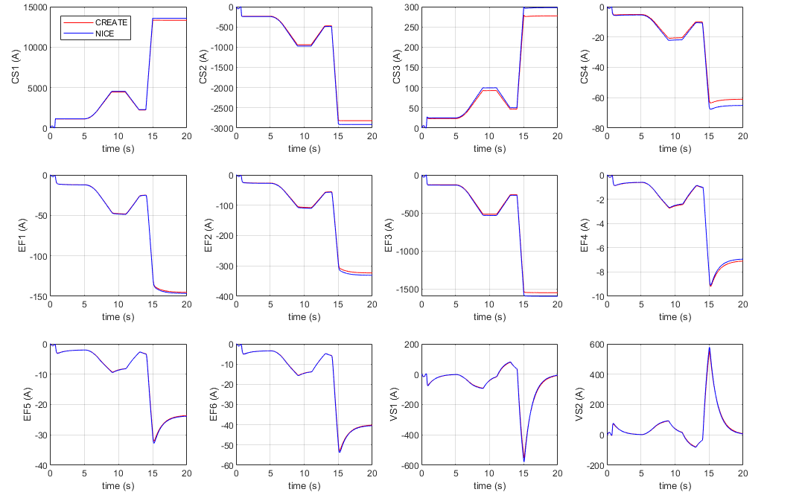
NICE-METIS dynamic cross validation with CREATE models
Simulations without plasma: satisfactory agreement of currents (both passive and active) and magnetic measurements)
Example: Voltage waveform applied to EF1 power supply

Slide 21
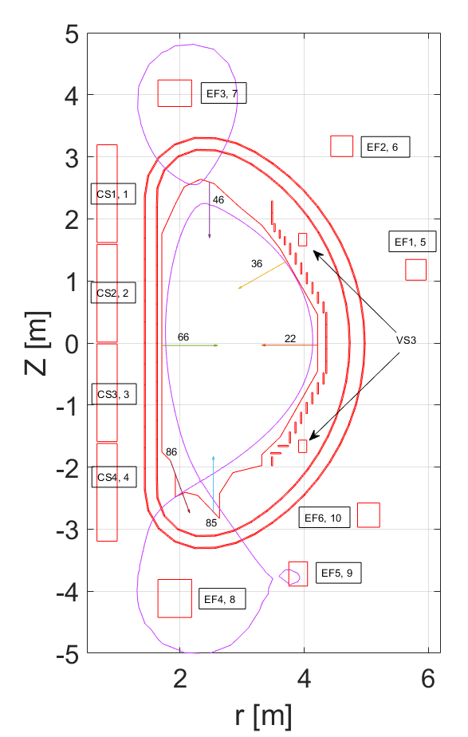
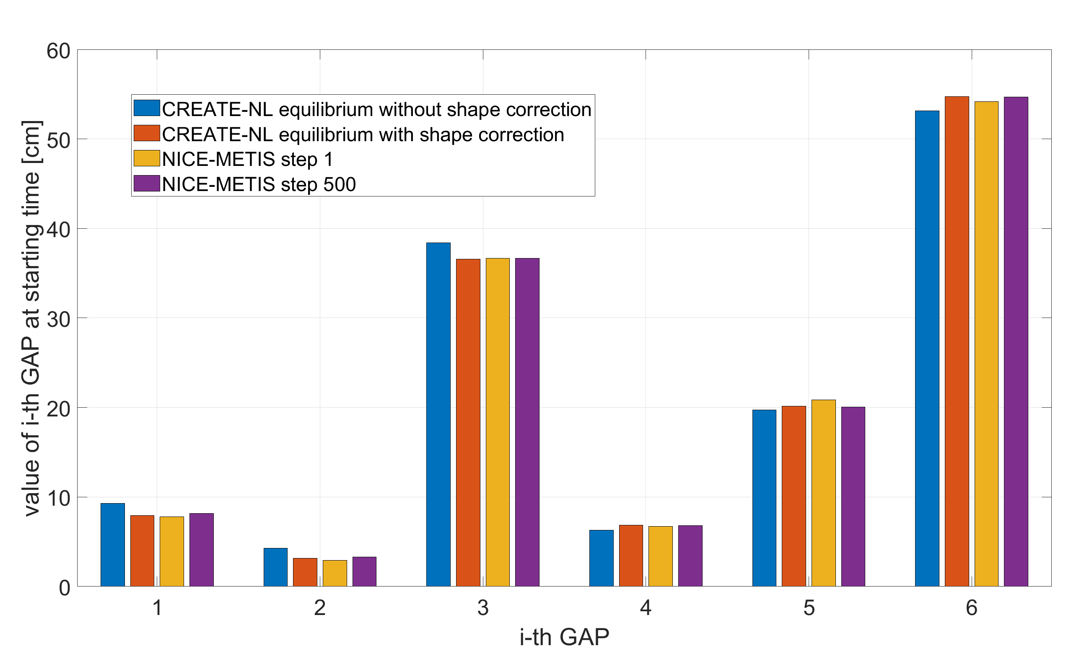
Example of starting equilibrium
Control gaps: [22 36 46 66 85 86]
Re-numbered as [1 2 3 4 5 6]
The controlled gaps choice
Controller gaps for the CREATE-NL reference equilibrium with and without active current correction to match the NICE-METIS starting conditions (initial transient always present)

Slide 22
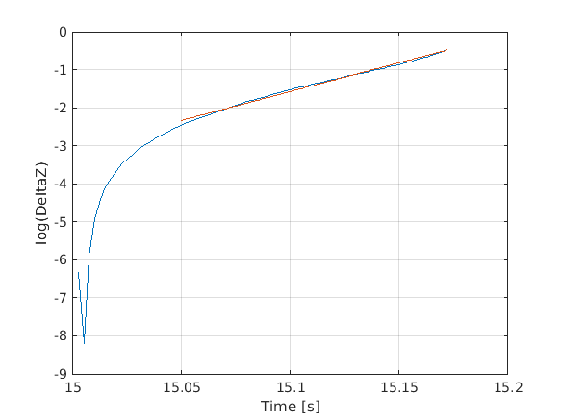
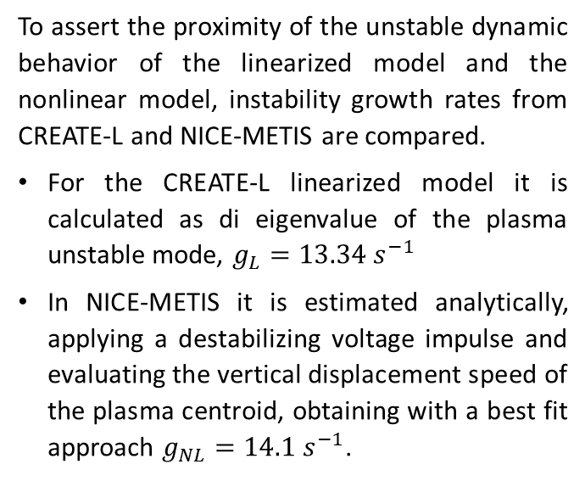
Growth Rate comparison
To assert the proximity of the unstable dynamic behavior of the linearized model and the nonlinear model, instability growth rates from CREATE-L and NICE-METIS are compared.
For the CREATE-L linearized model it is calculated as di eigenvalue of the plasma unstable mode, $g_{L}=13.34 s^{−1}$
In NICE-METIS it is estimated analytically, applying a destabilizing voltage impulse and evaluating the vertical displacement speed of the plasma centroid, obtaining with a best fit approach $g_{NL}=14.1 s^{−1}$.
Best fit in a logarithmic scale
NICE-METIS
22

Slide 23
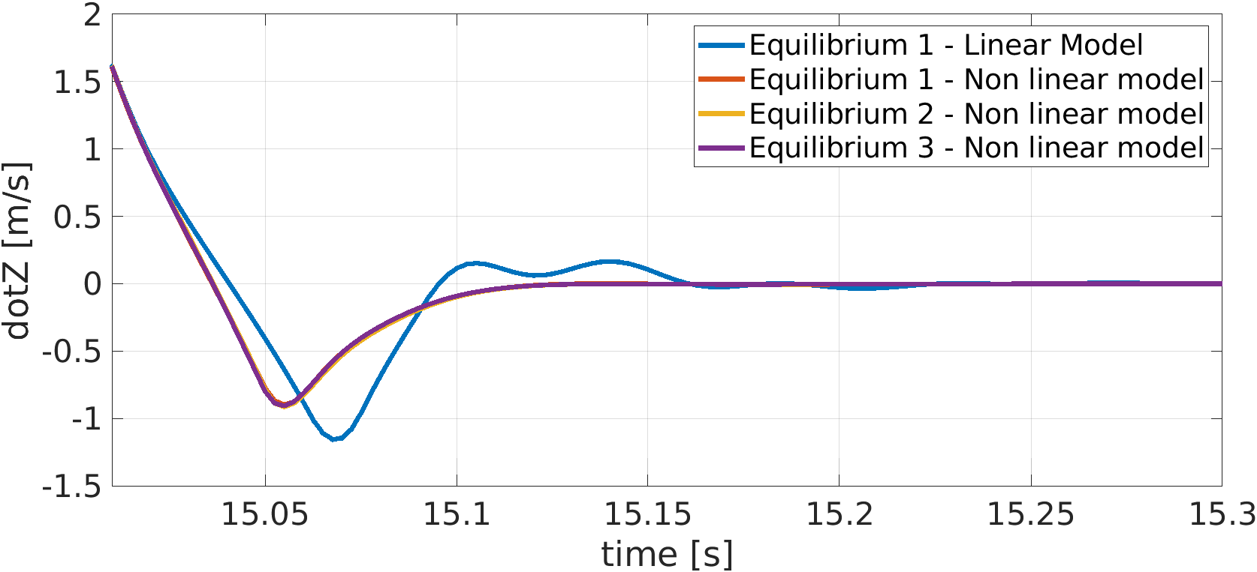
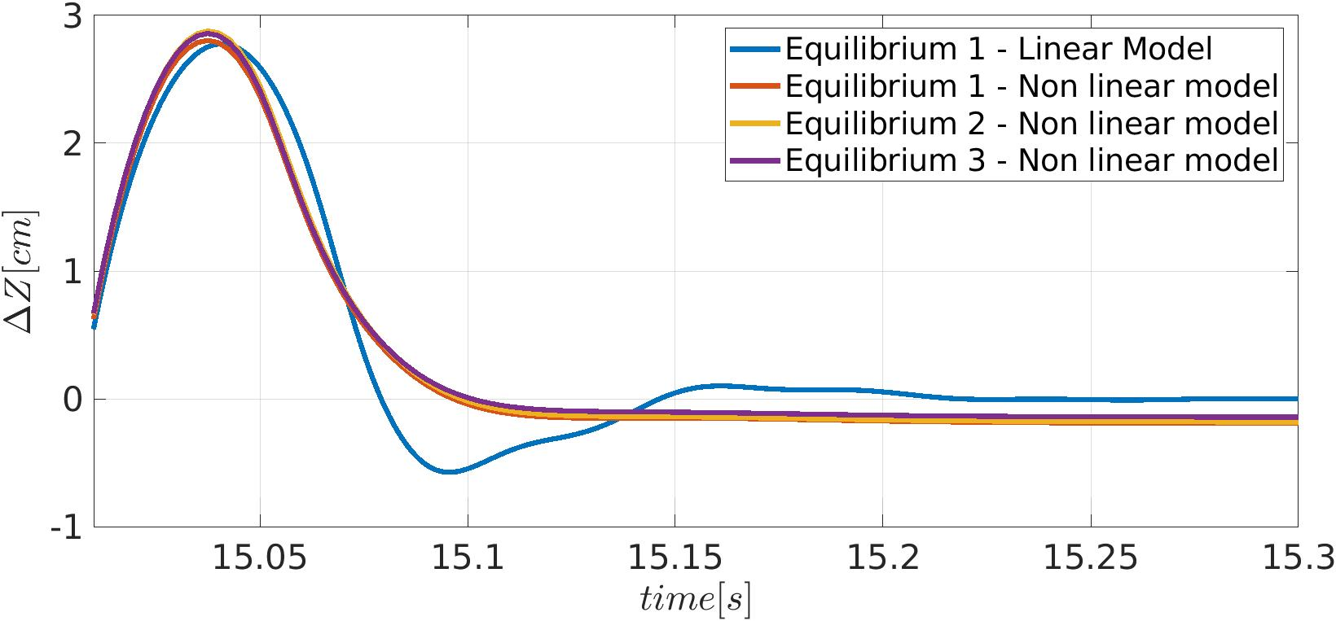
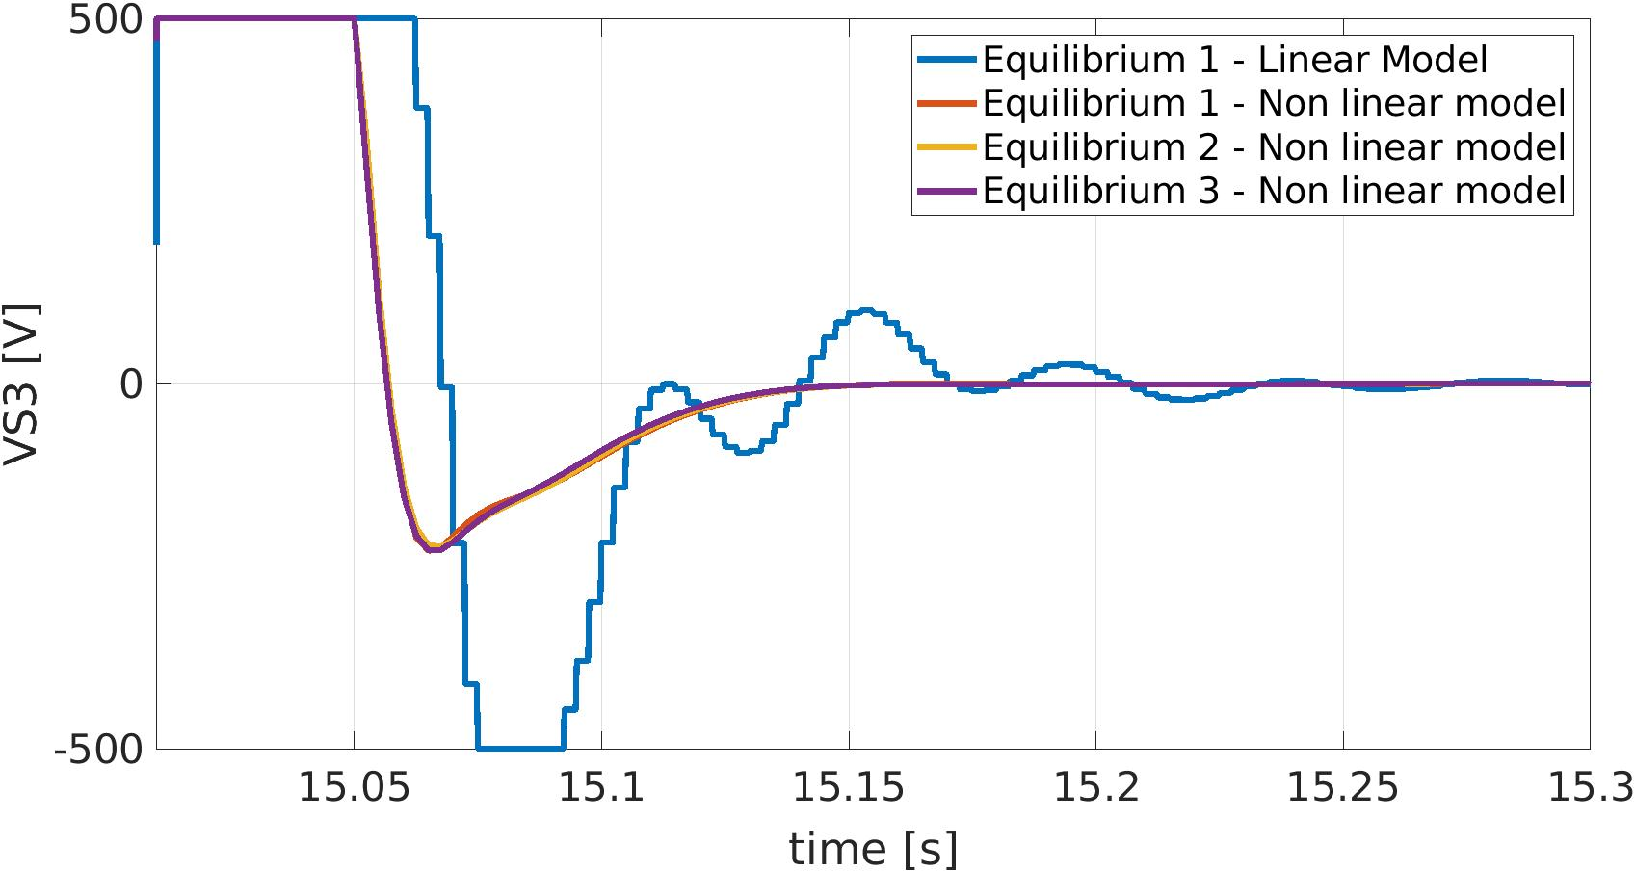
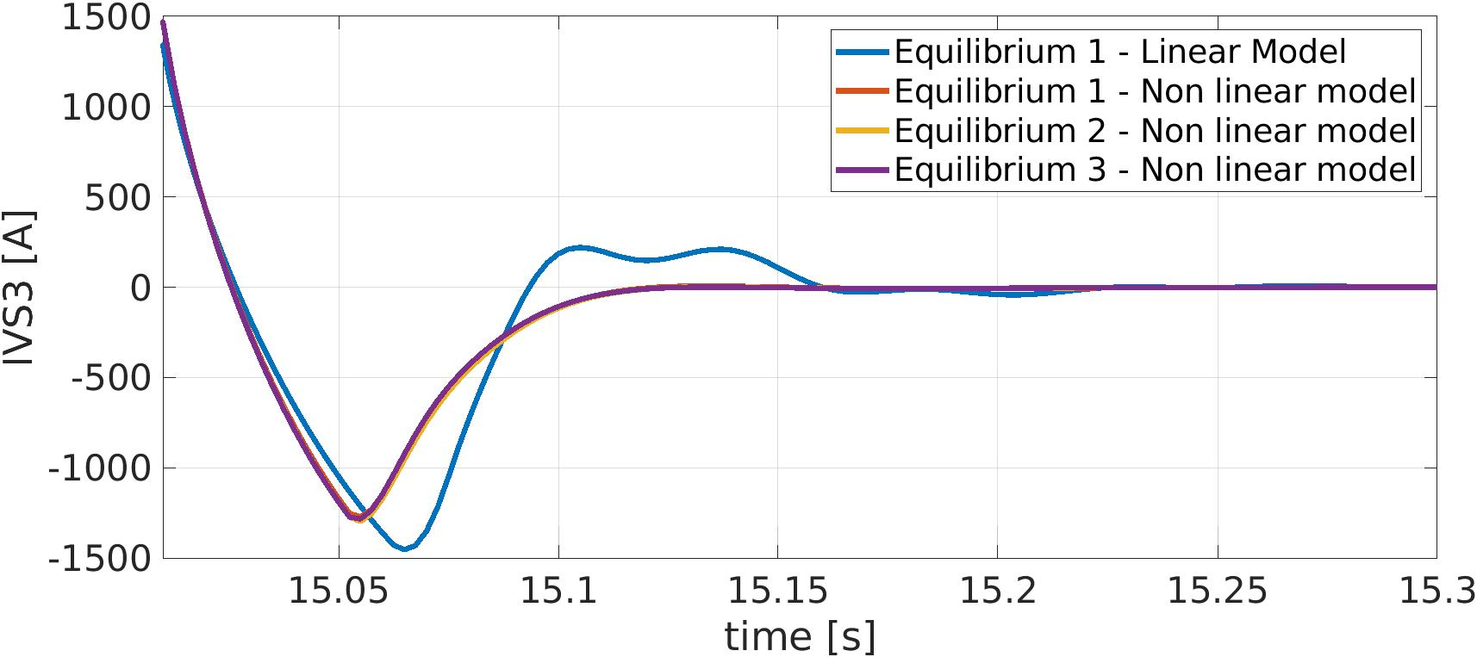
Controller VDE2 for different Equilibria
Figure 6 - Comparison of the vertical velocity time evolution
Figure 7 - Comparison of the vertical position time variation from the initial value
Figure 8 - Comparison of the voltage applied to the VS coil
Figure 9 - Comparison of the currents of the VS coils.
Results of D. Frattolillo’s mobility to Cadarache (3weeks)

Slide 24
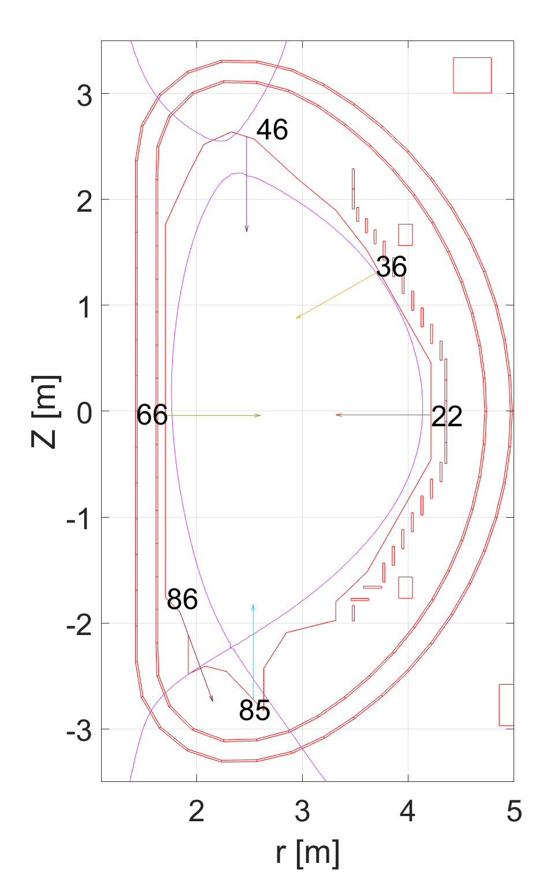
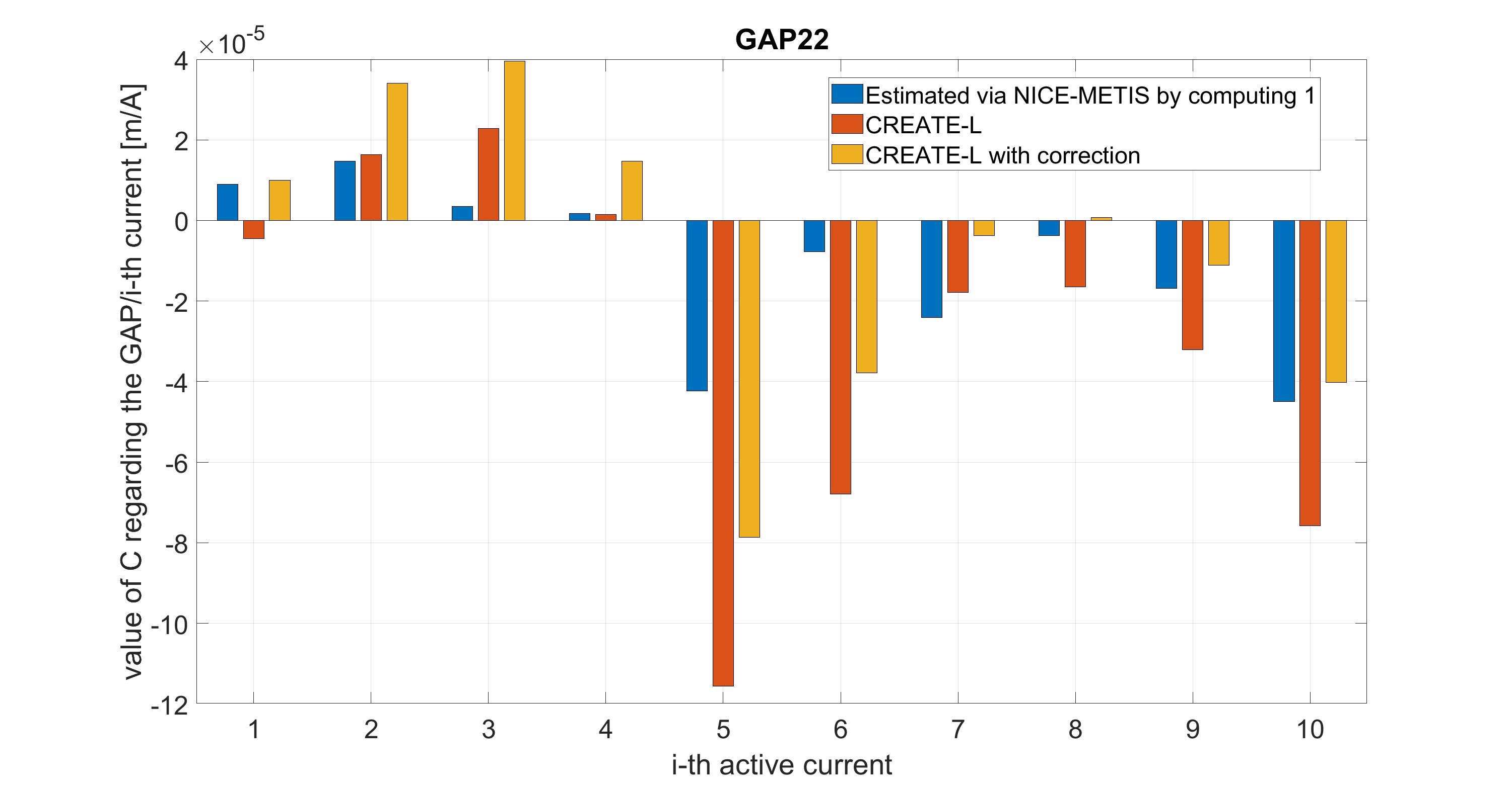
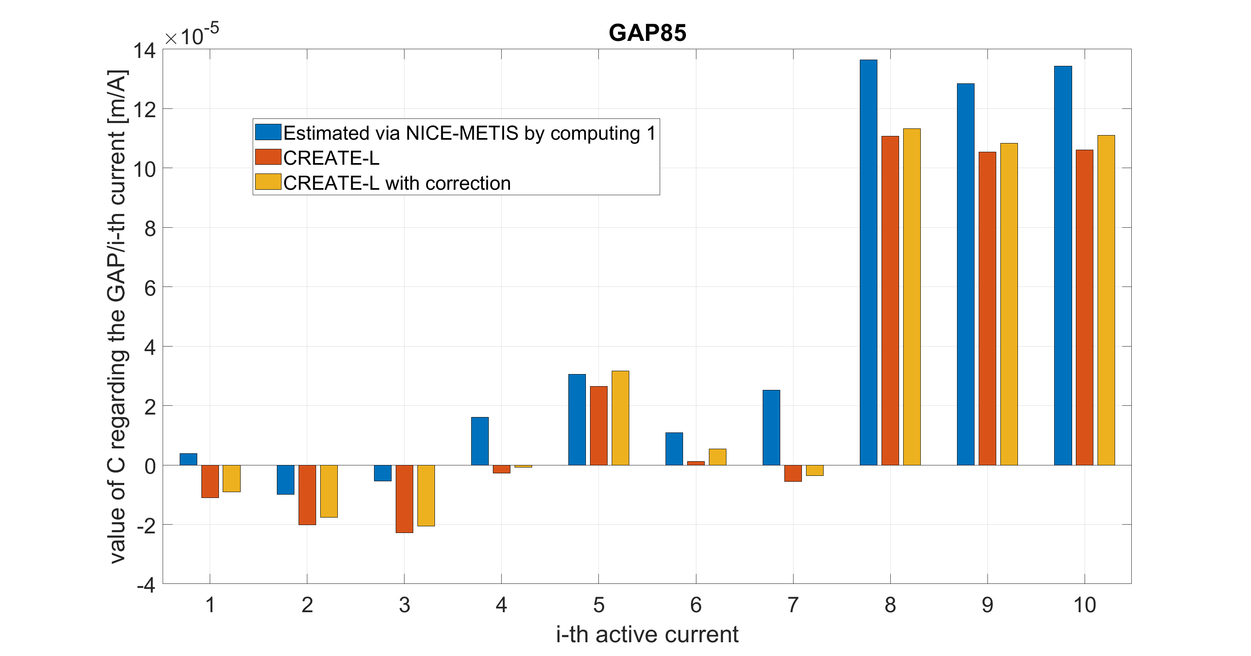
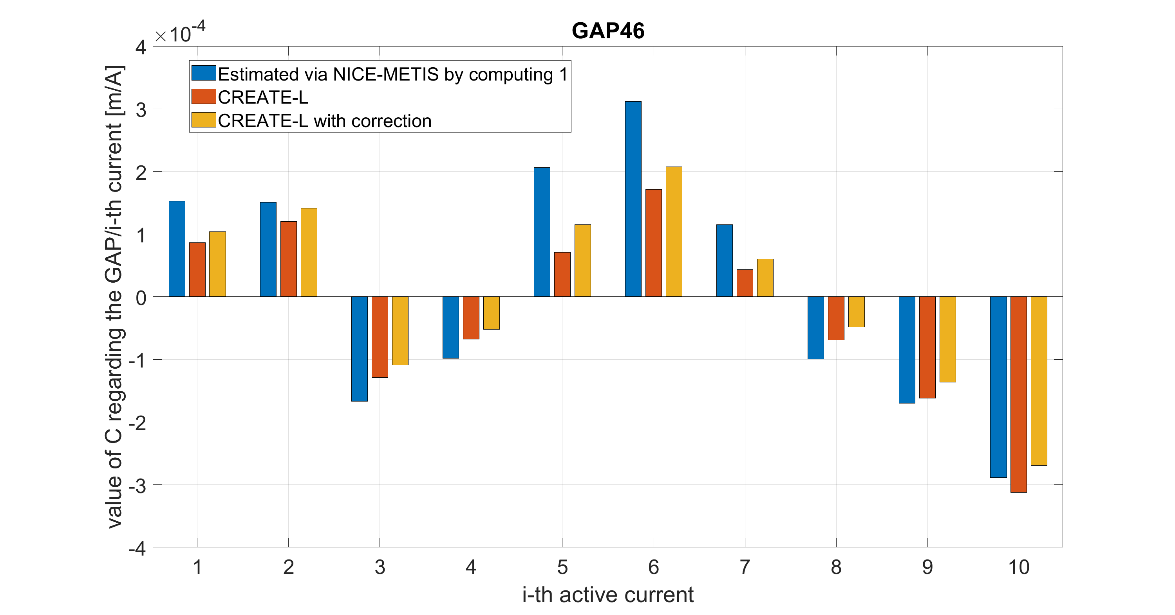
Comparison of the steady state current to gap response
Need to modify CREATE matrices to take into account variations of Ip in NICE-METIS
Results of D. Frattolillo’s mobility to Cadarache (3weeks)

Slide 25
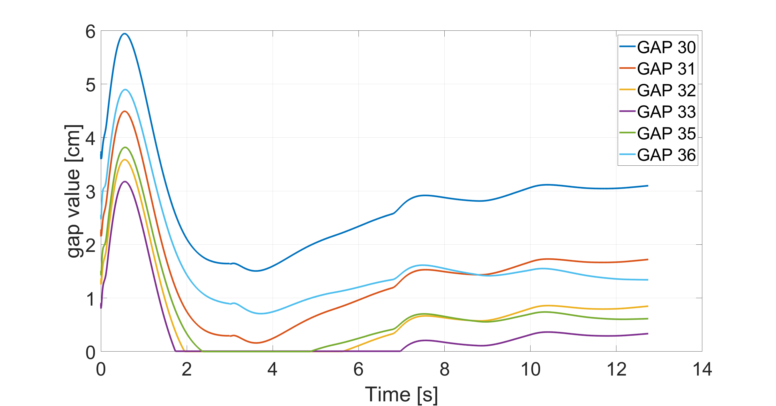
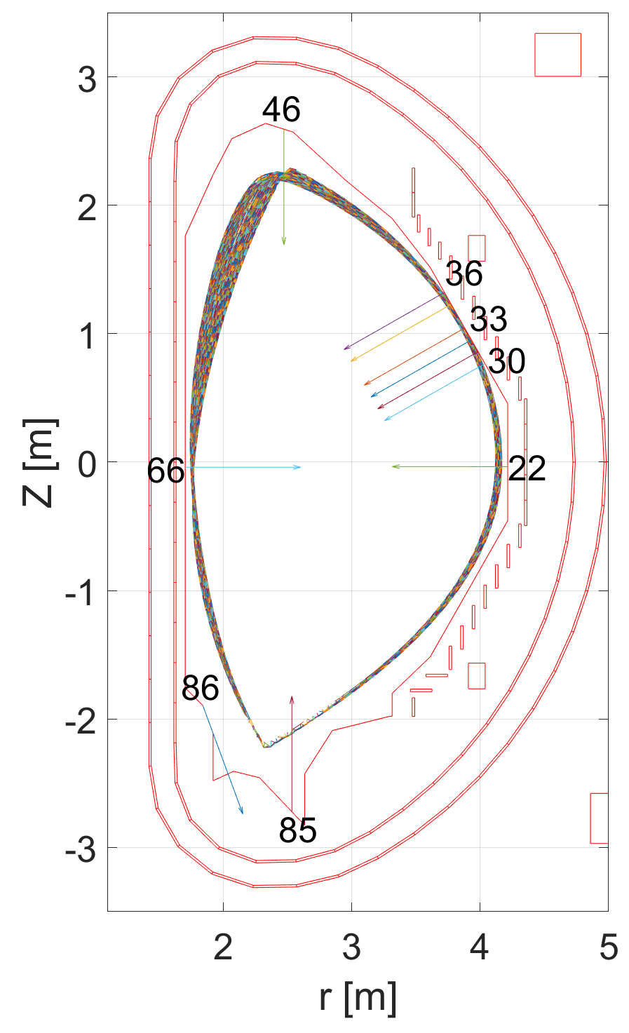
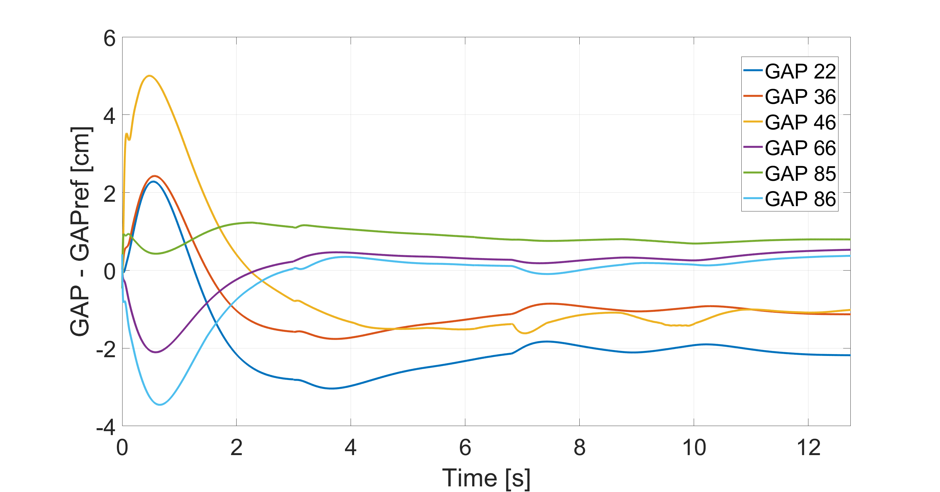
Closed loop simulations with SC, VS, CC and PCC
Results of D. Frattolillo’s
mobility to Cadarache (3weeks)

Slide 26
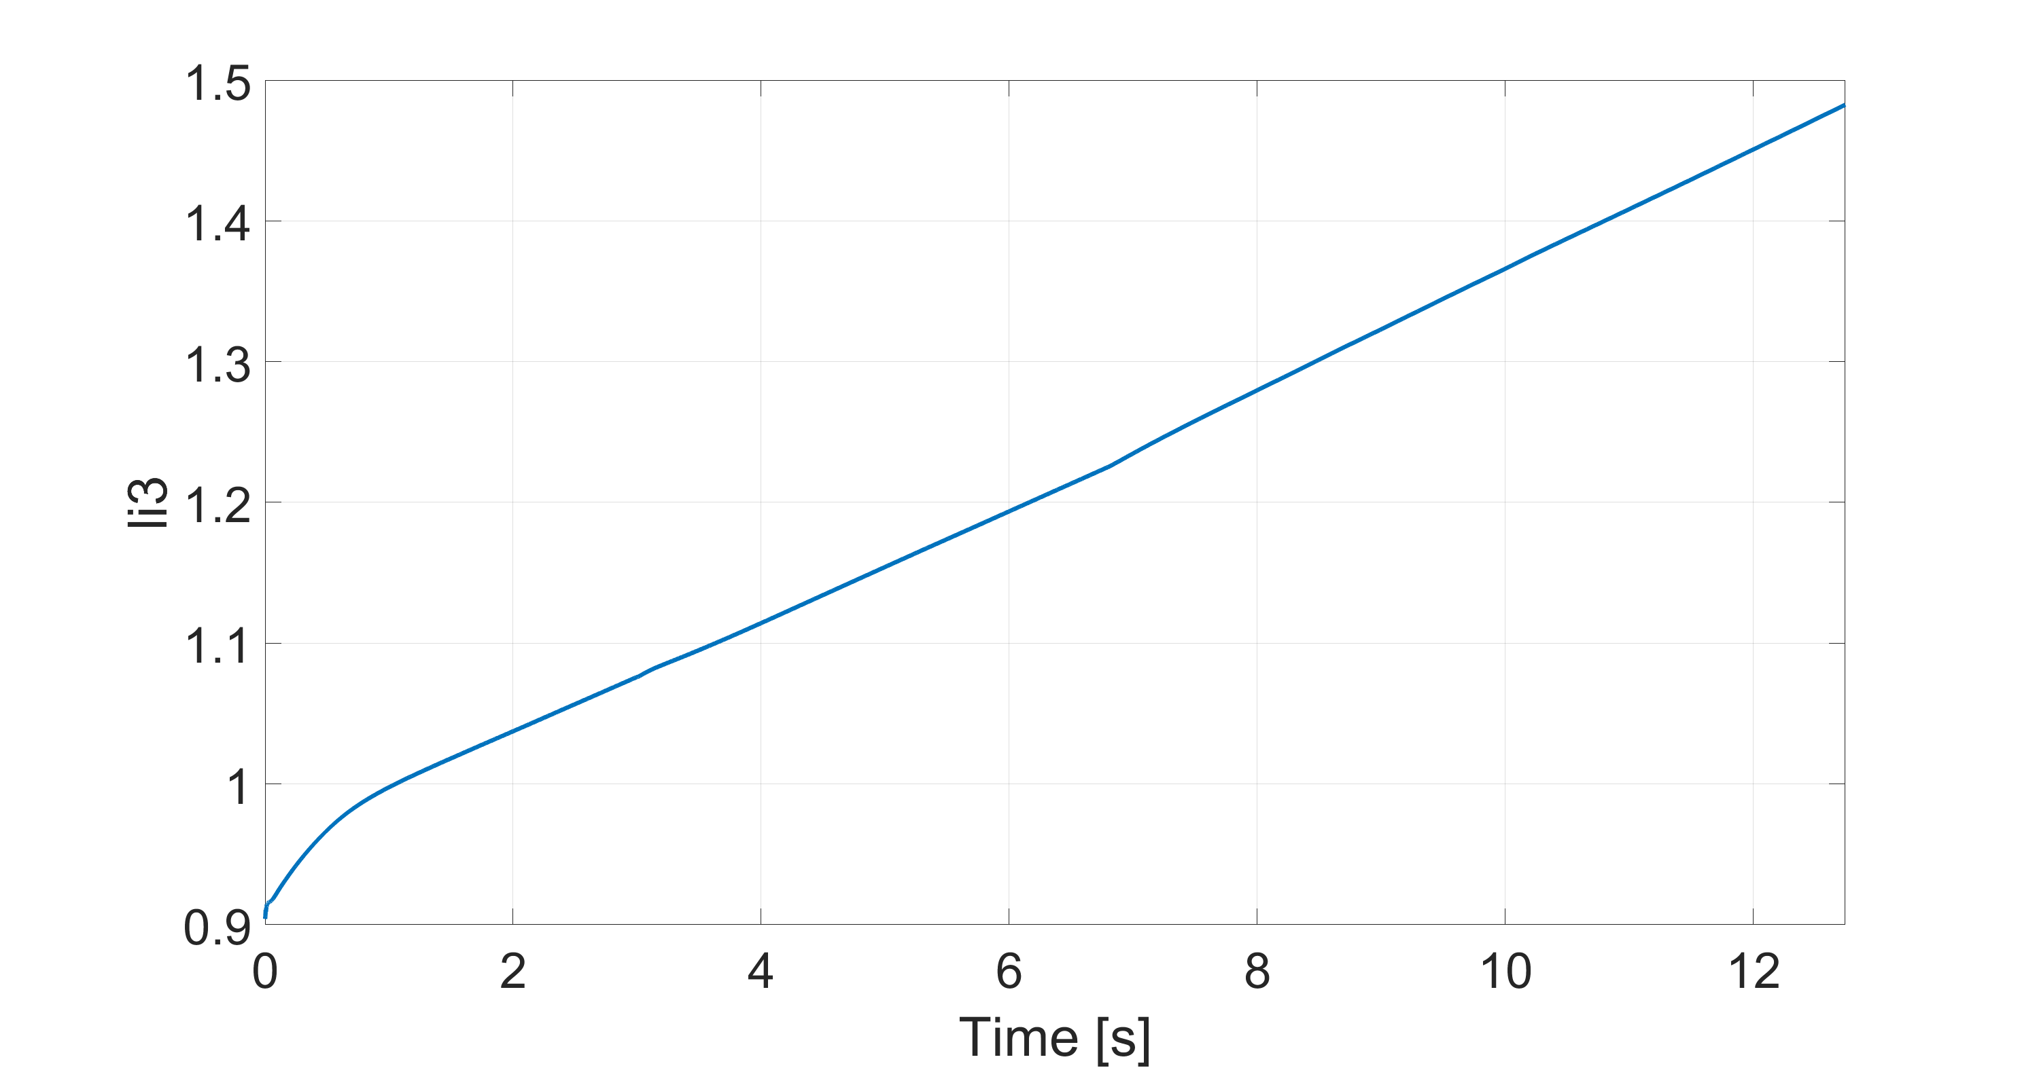
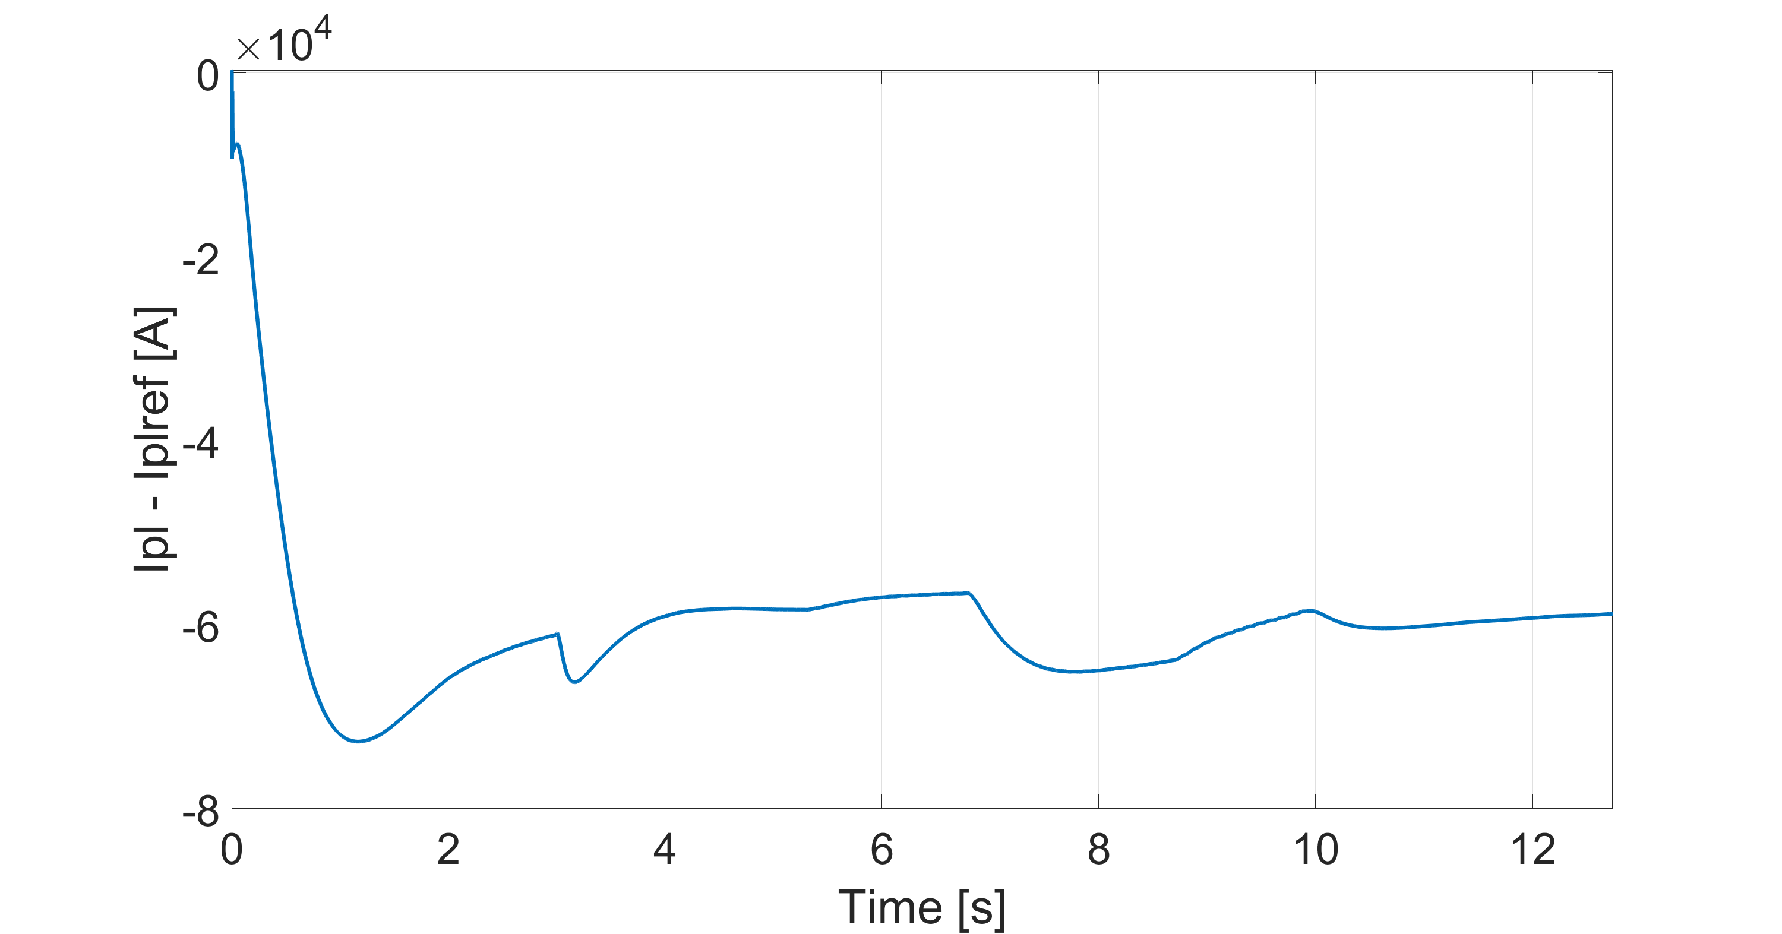
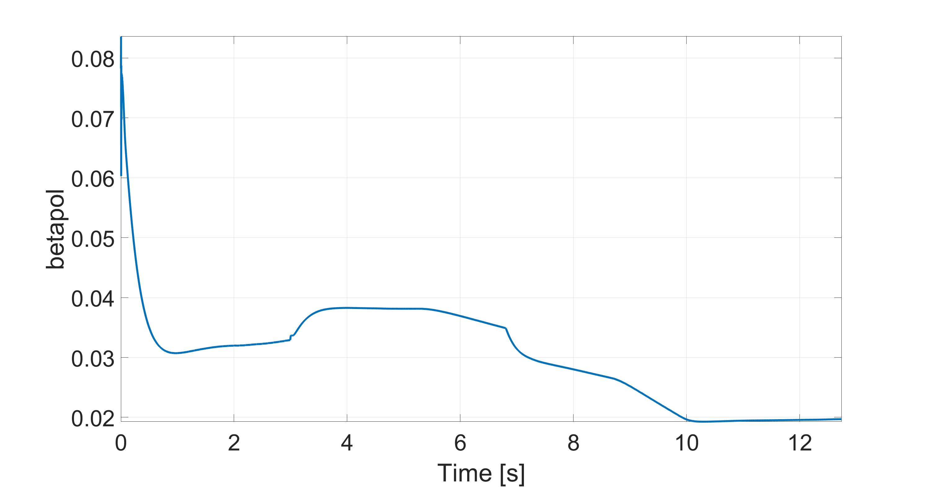
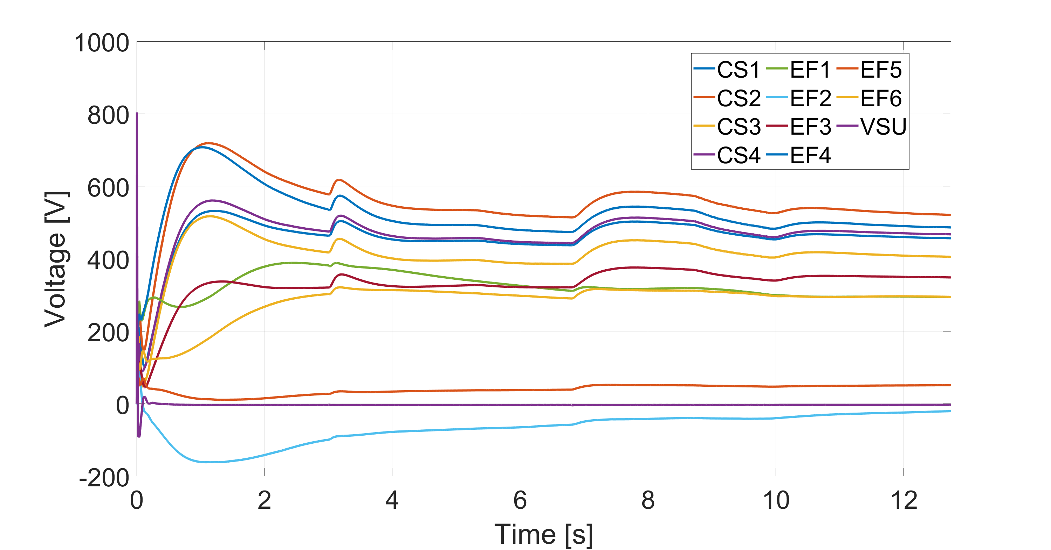
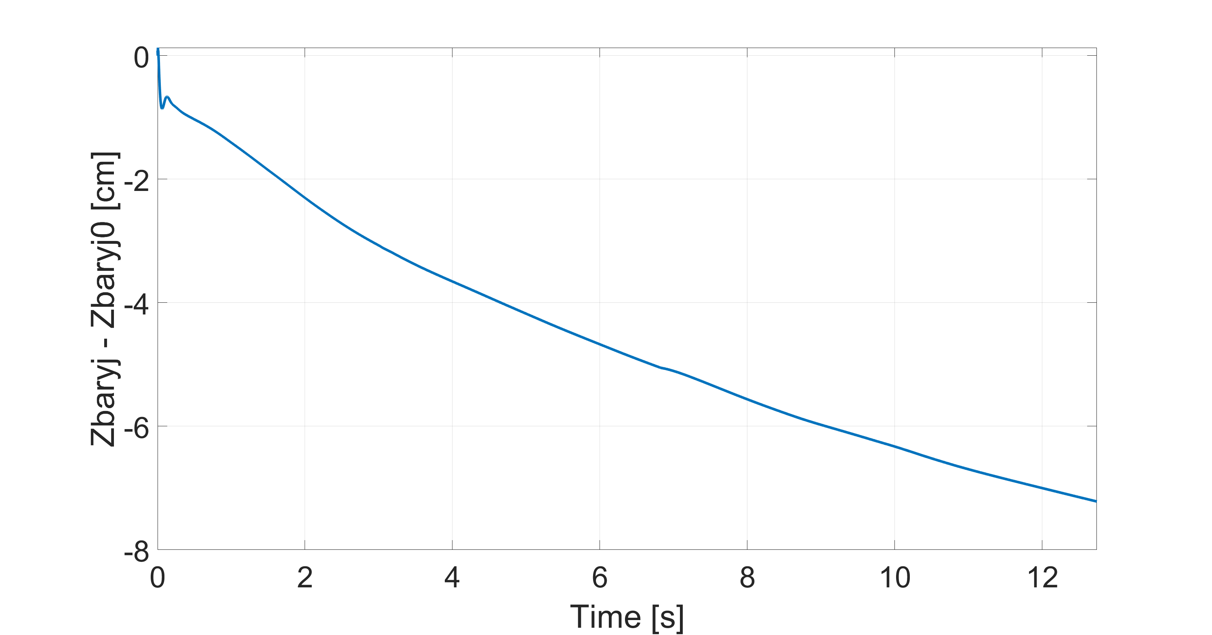
Closed loop simulations with SC, VS, CC and PCC

Slide 27
Open issues
Find the way to generate equilibrium conditions in NICE-METIS which do not imply an increase of li and profile oscillations
Verify resistive flux consumption
Shape control is confirmed to be sensitive to plasma shape especially those changes in shape due to li and poloidal beta variations. Scheduling techniques to be implemented
Future work to complete the plan
Step 2. Flat top Control
Identification of gap response with stabilized plasma (To be completed)
Identification of Ip response (To be completed)
Transient studies @ Flat top
Step 3. Ramp up Control (Diverted phase)
Definition of the nominal scenario and of the reference currents
Comparison NICE-METIS - CREATE-NL on ramp up equilibria
Tuning of the VS control on the ramp up
Open loop simulation (with VS)
Gap control implementation and testing
Sensitivity studies
Further developments
Try to speed up the simulation (solutions tests for NICE reconstruction operation mode)
Integrated control magnetic+kinetic
Write documentation

