Slide 1
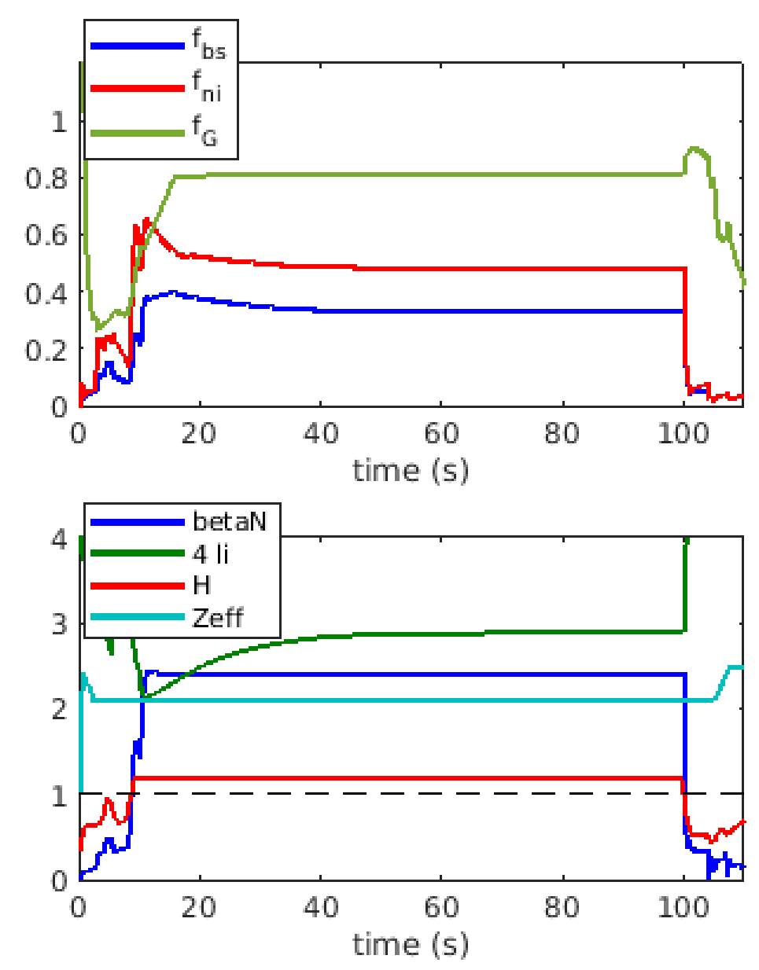
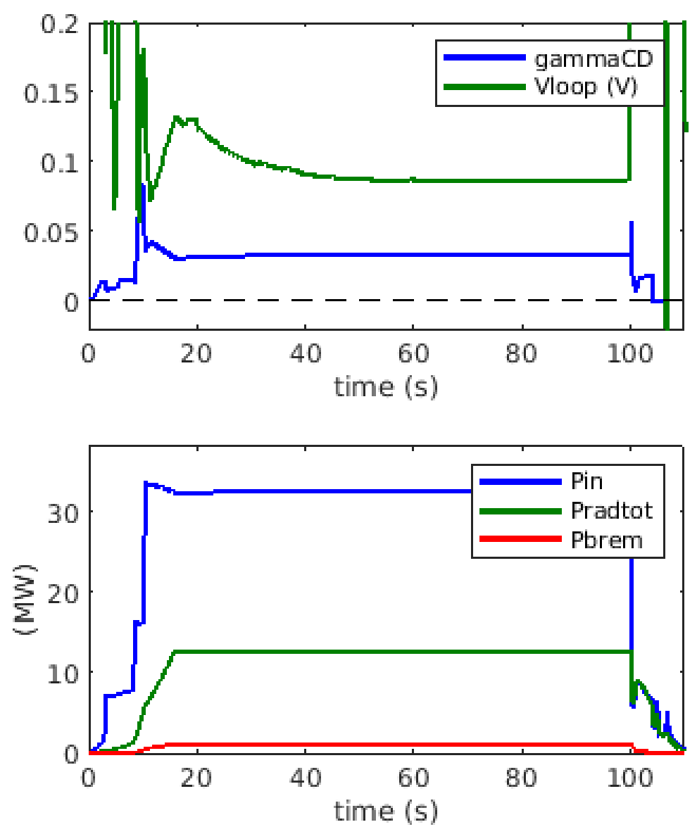
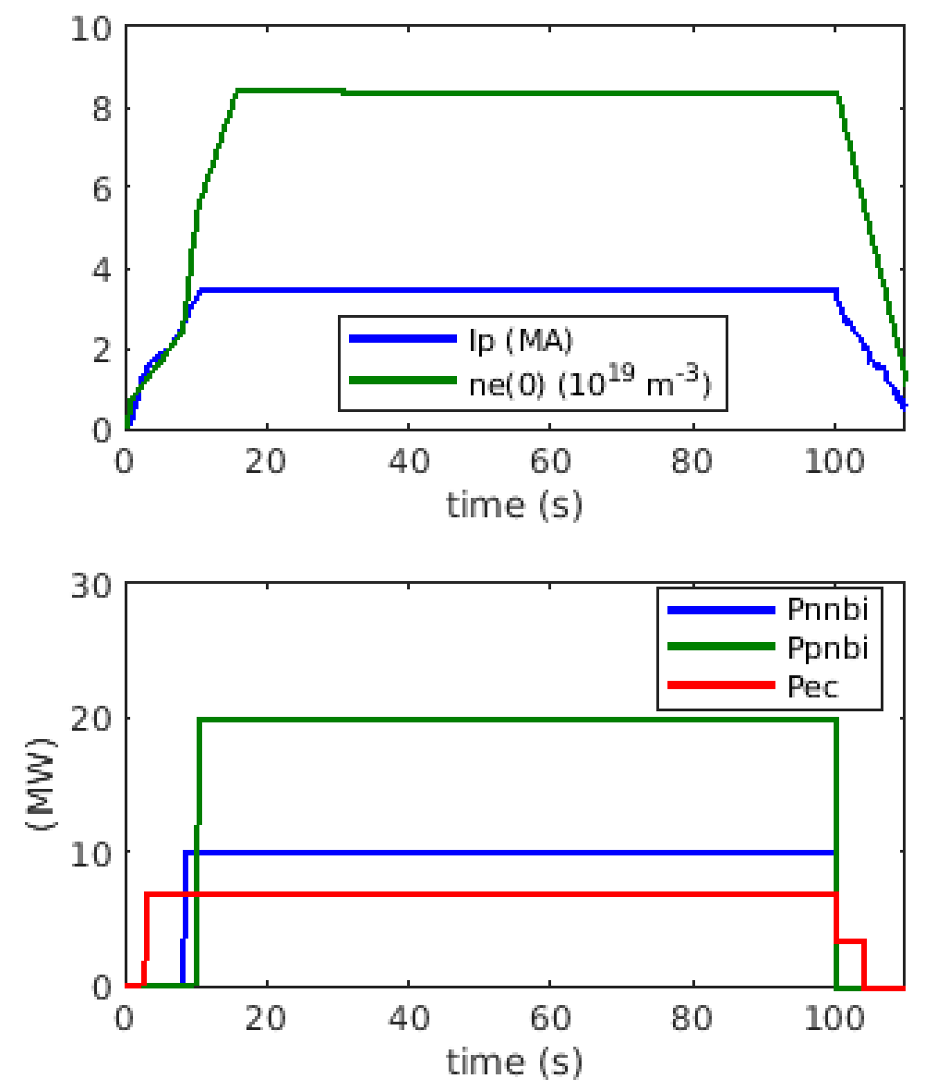
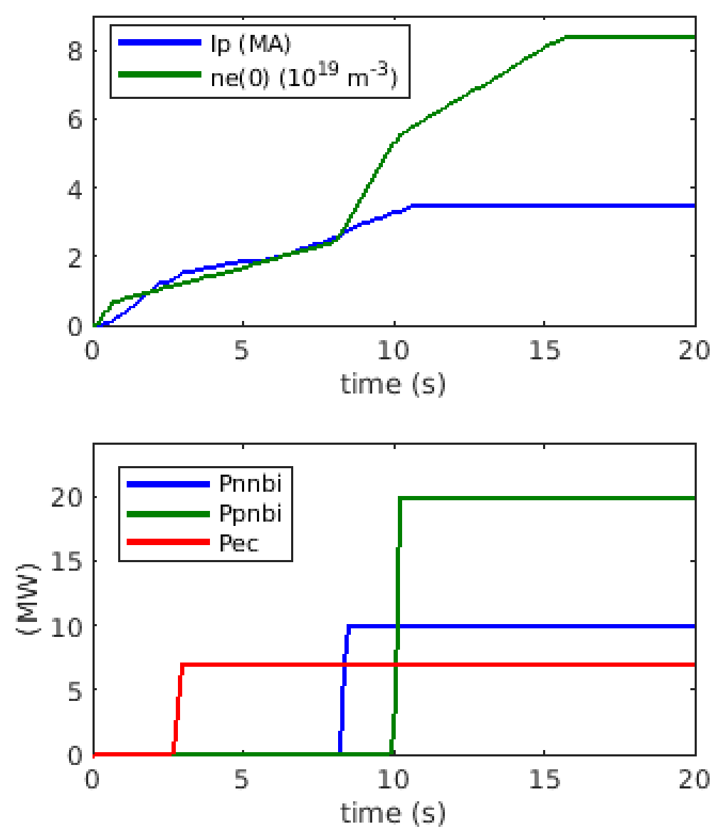
METIS+FEEQS Scenario 4-2. Time-dependent quantities
METIS and FEEQS installed and running on the Gateway
Scenario modelling by coupled METIS (fast integrated modelling) and FEEQS (free-boundary) codes
Model described in V. Ostuni et al. Nucl. Fusion 61 (2021) 026021 :
Run METIS with desired time-dependent separatrix and adequate waveforms
Run FEEQS and check the compatibility with coils limits (current, voltage, forces)
Modify METIS waveforms and separatrix evolution in order to fit within coils limits
Inject the separatrix computed by FEEQS into METIS and run again
Iterate if necessary
zoom

Slide 2
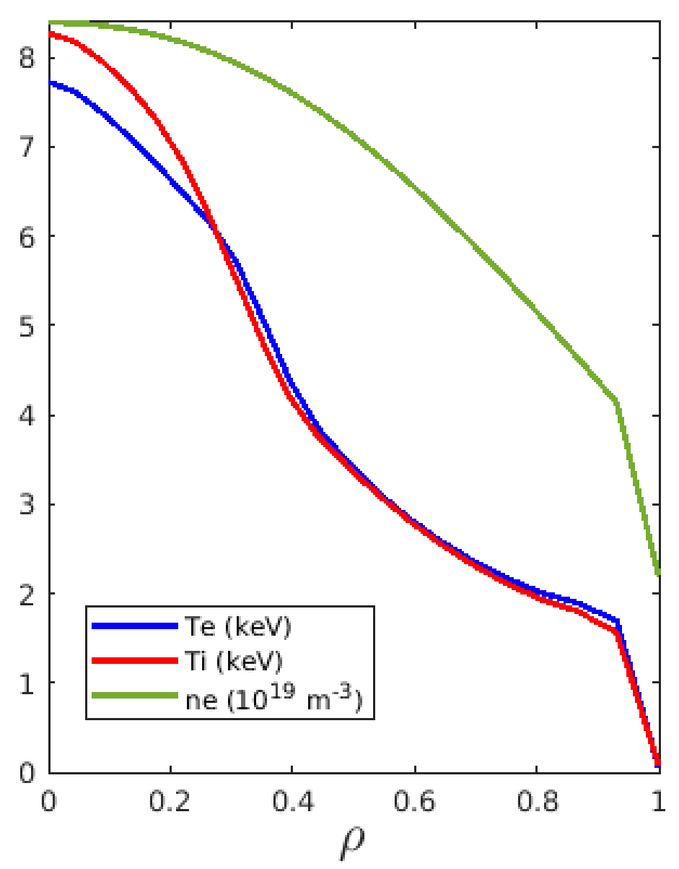
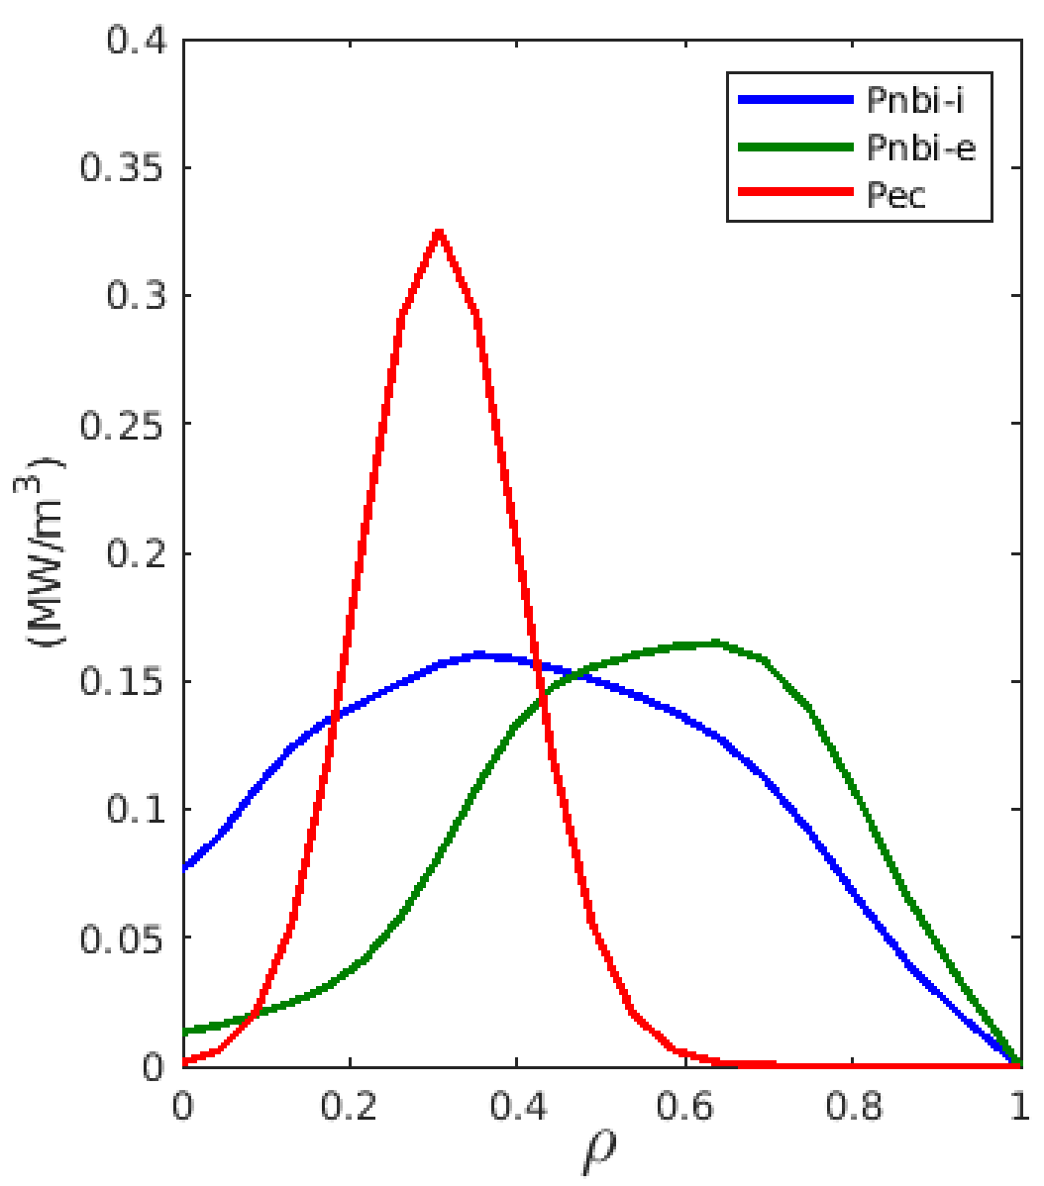
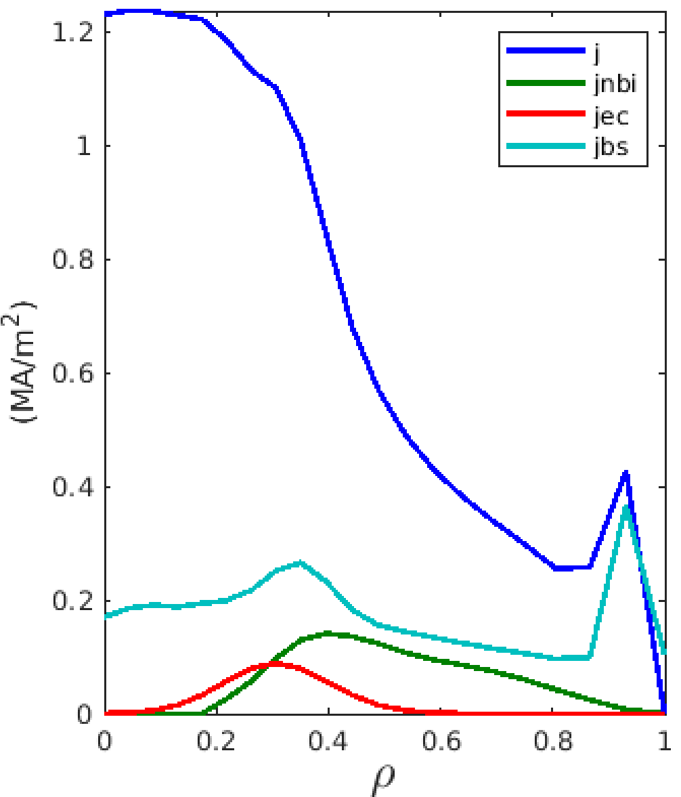
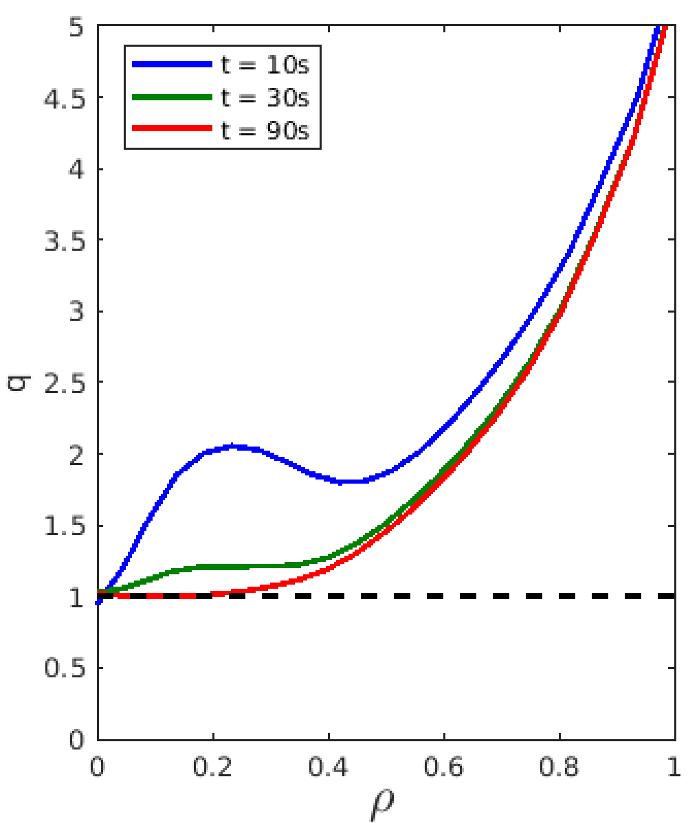
METIS+FEEQS Scenario 4-2. Profiles obtained by METIS
T_{e}, T_{i}, n_{e}
power deposition
current densities
safety factor

Slide 3
Free-boundary equilibrium from FEEQS: evolution

Slide 4
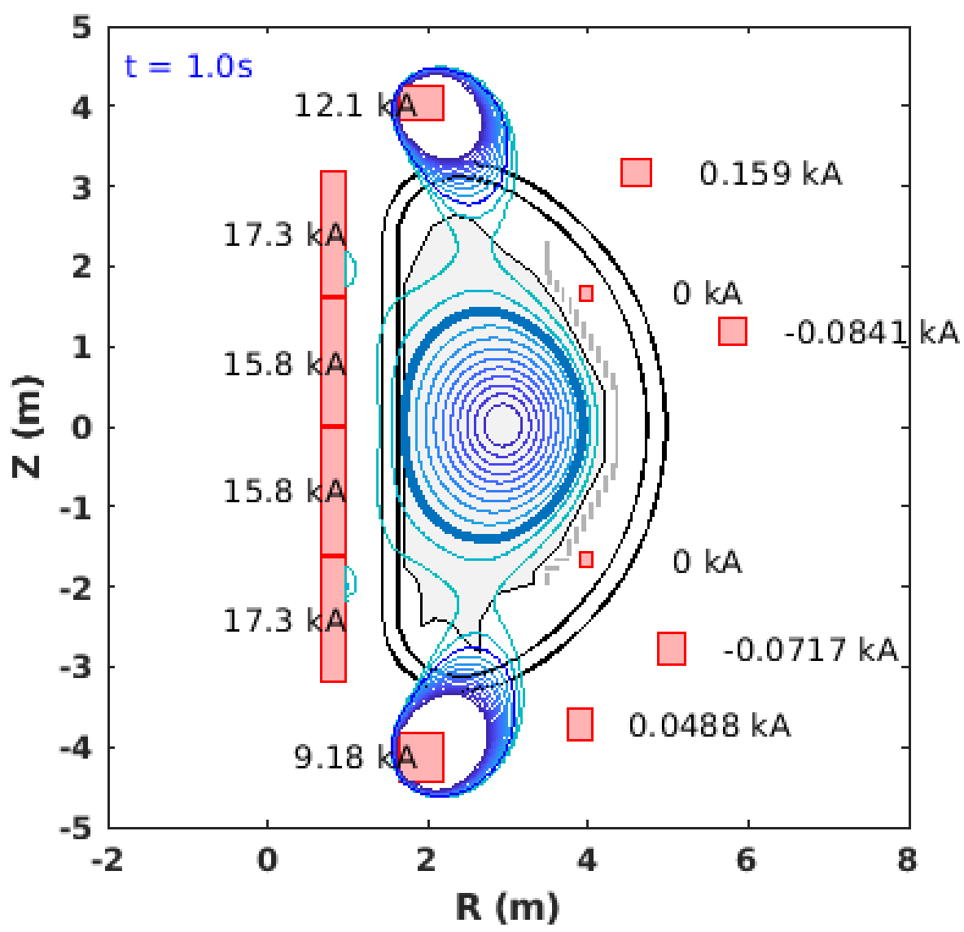
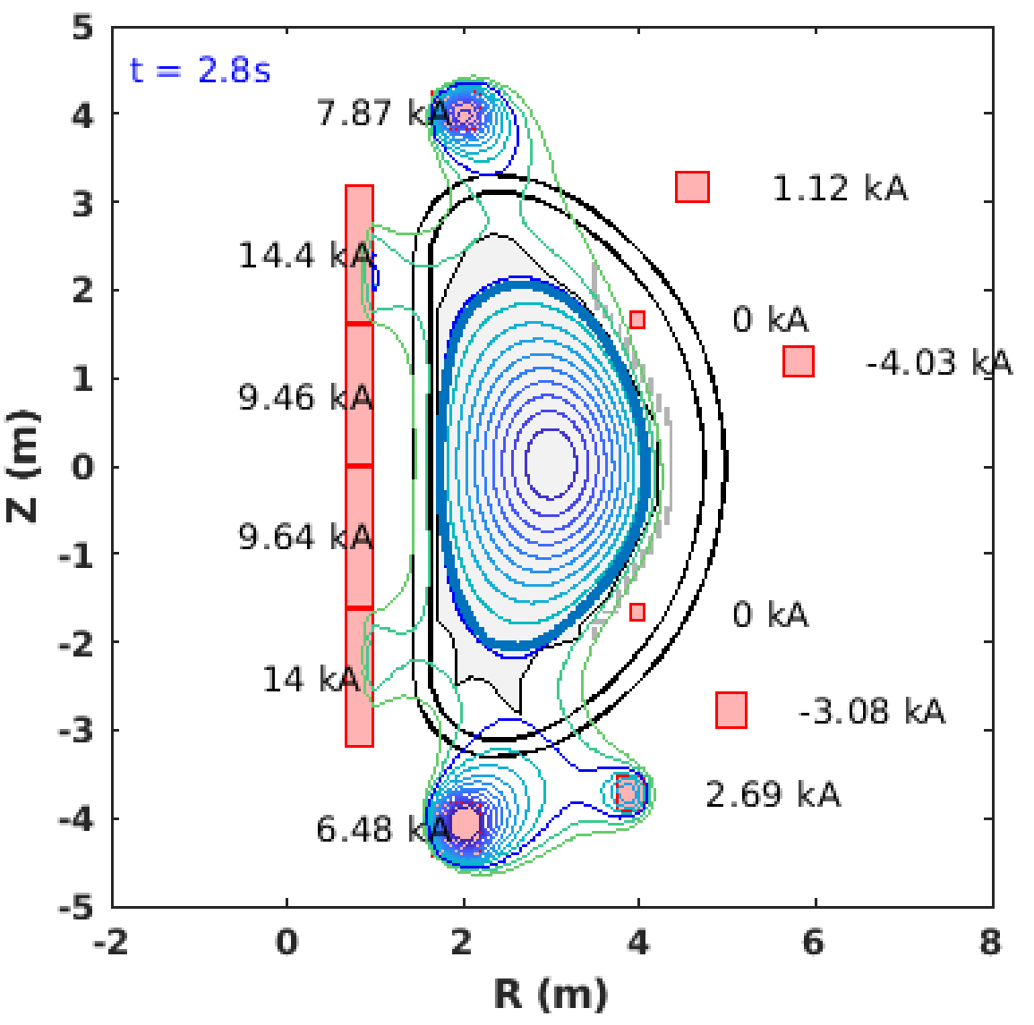
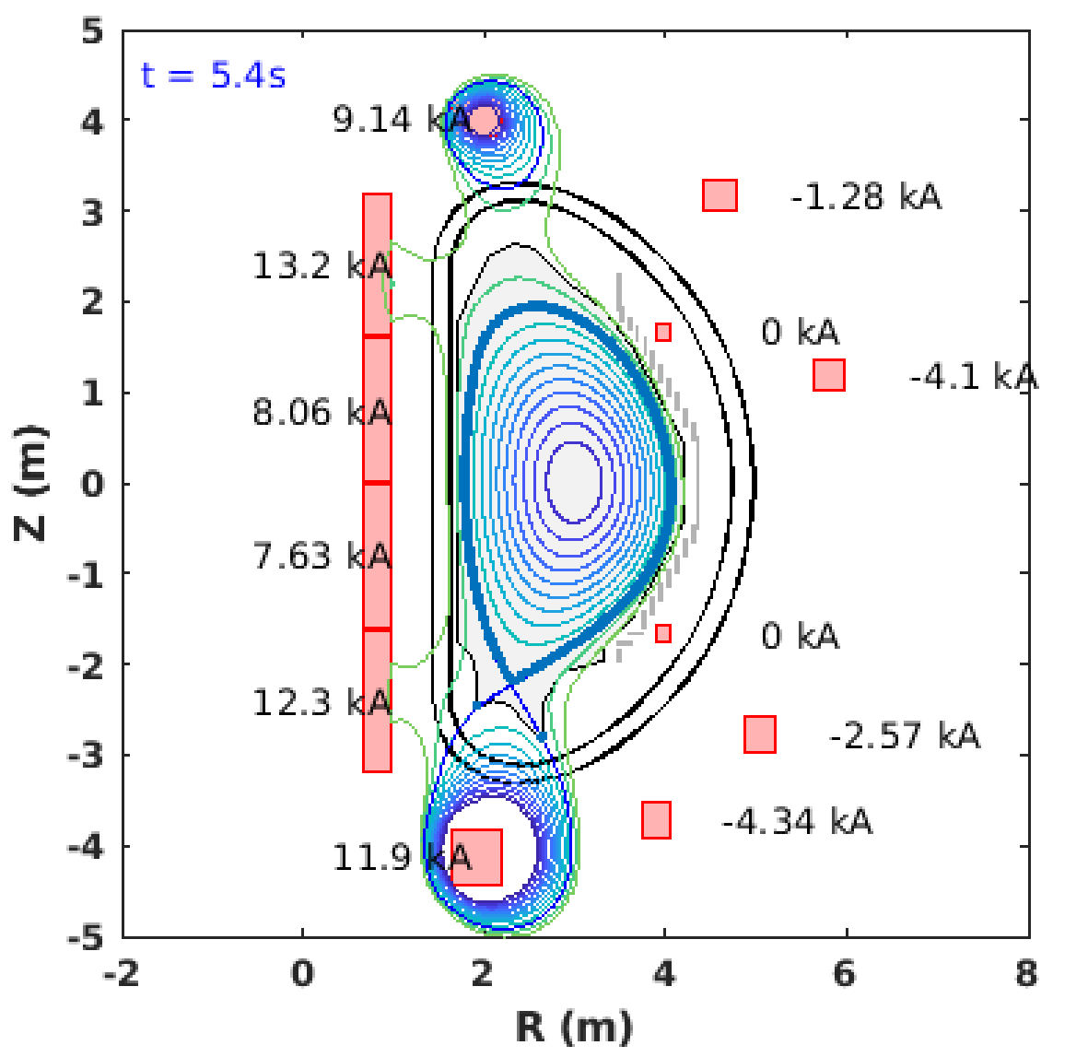
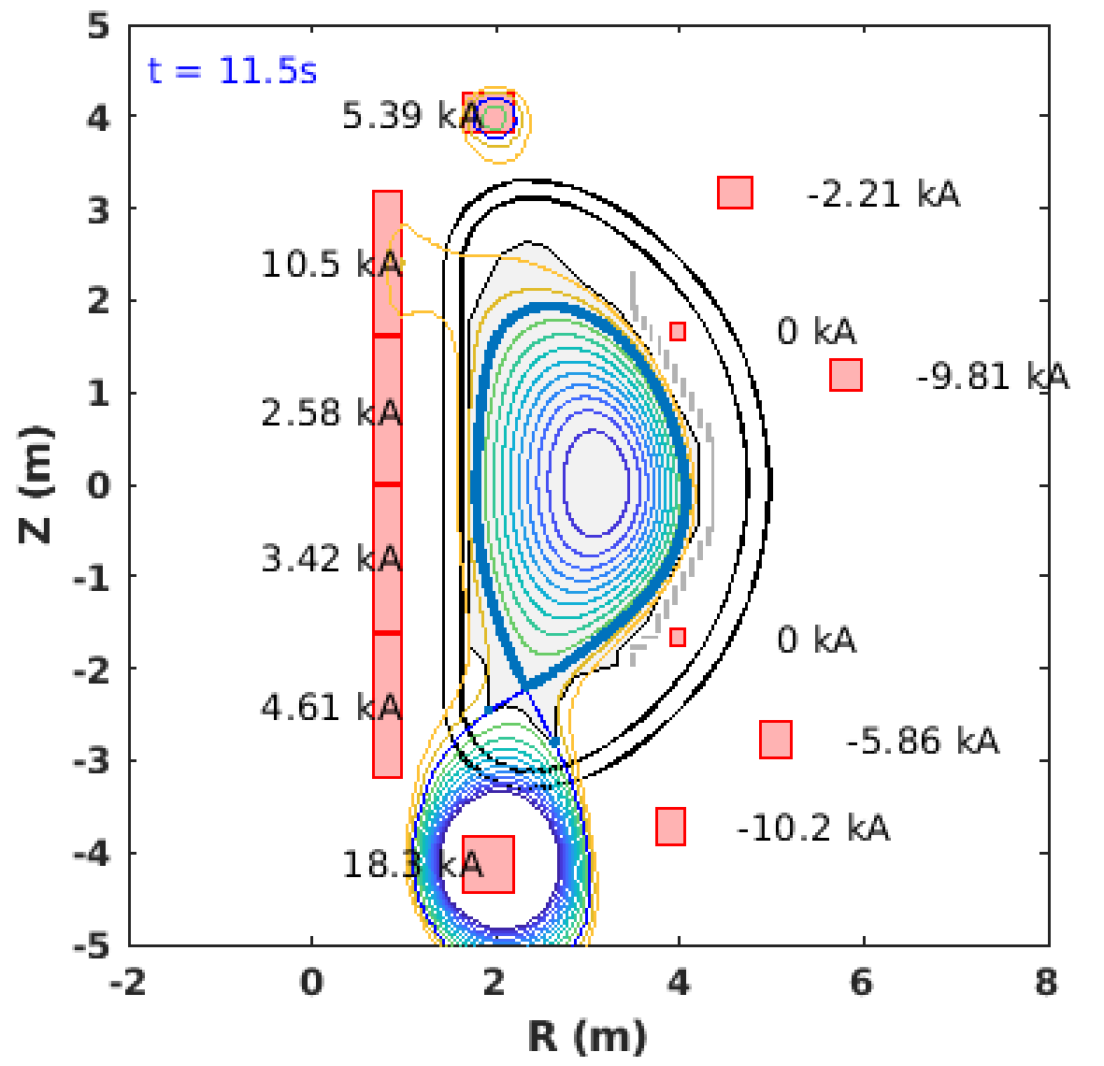
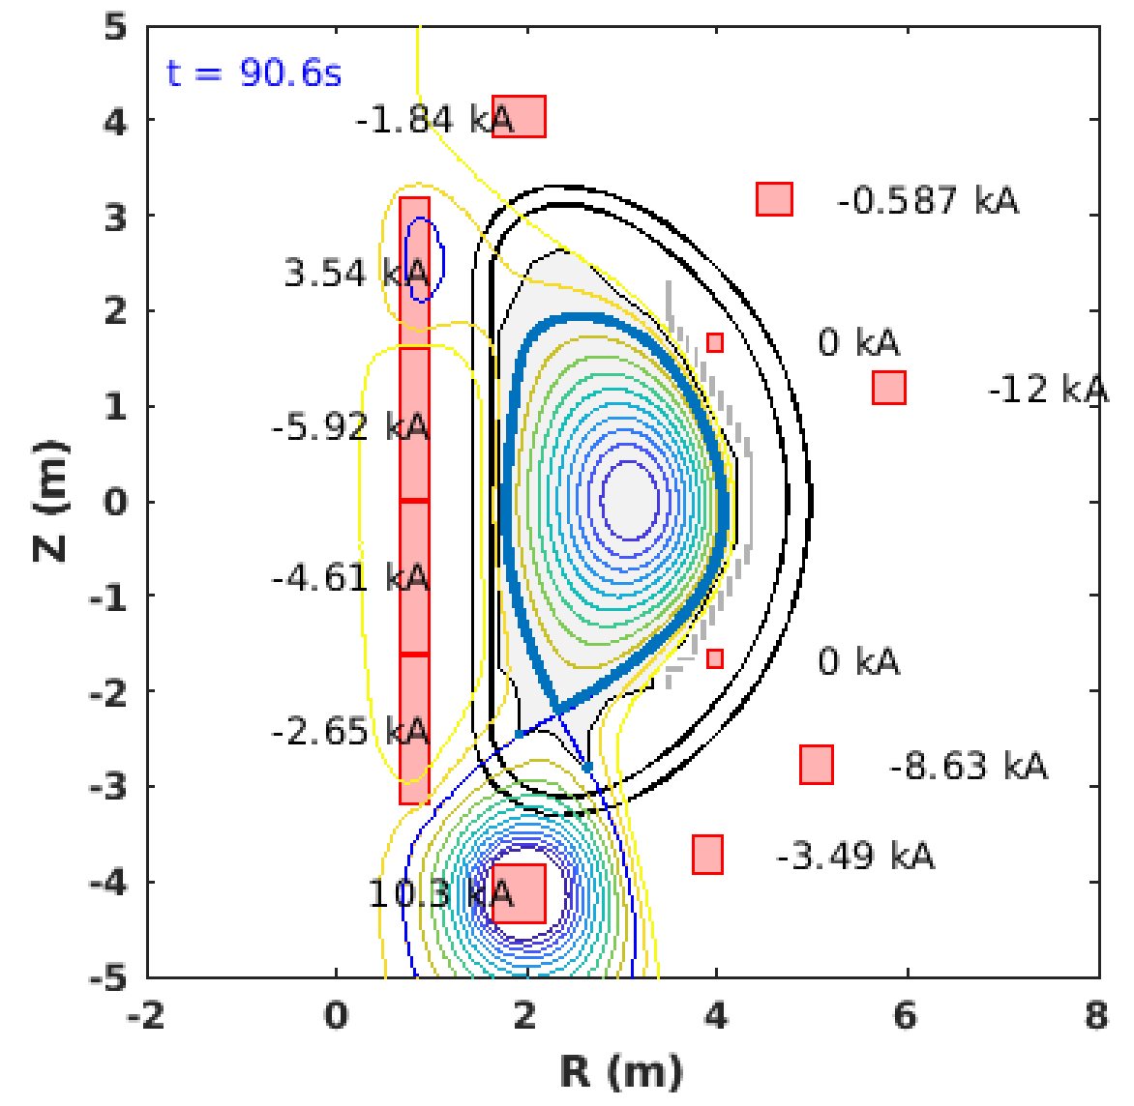
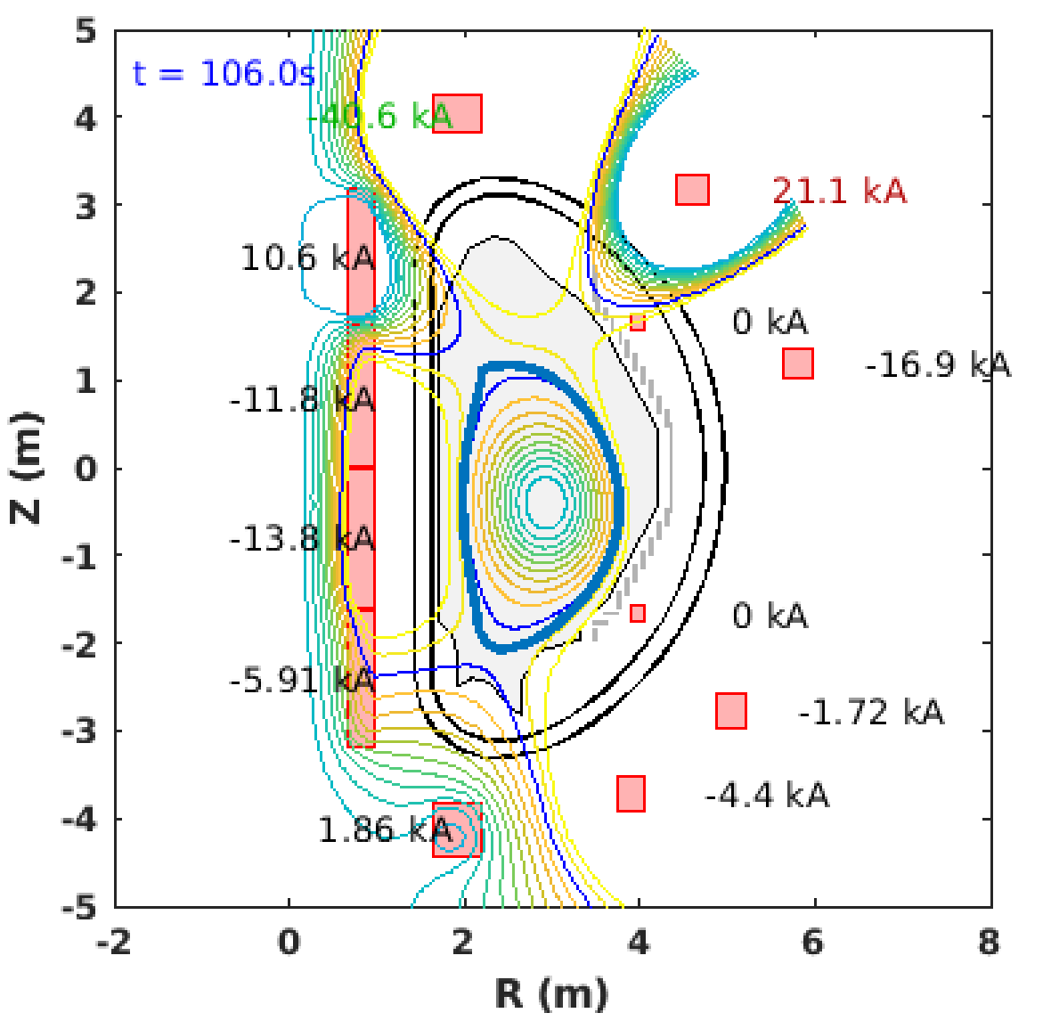
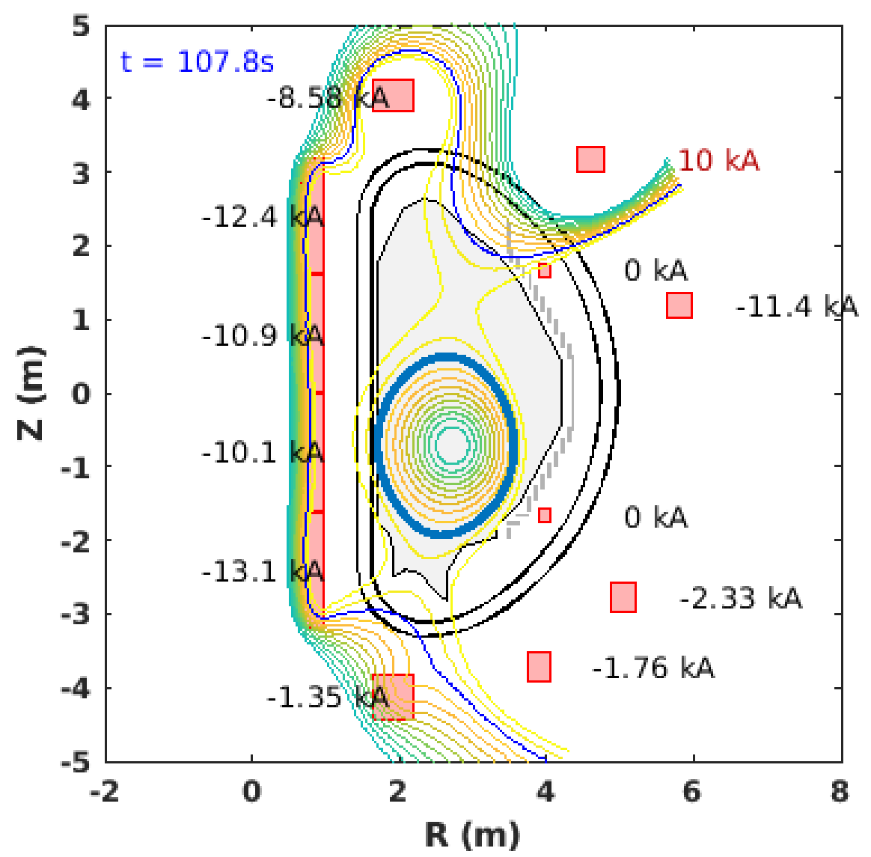
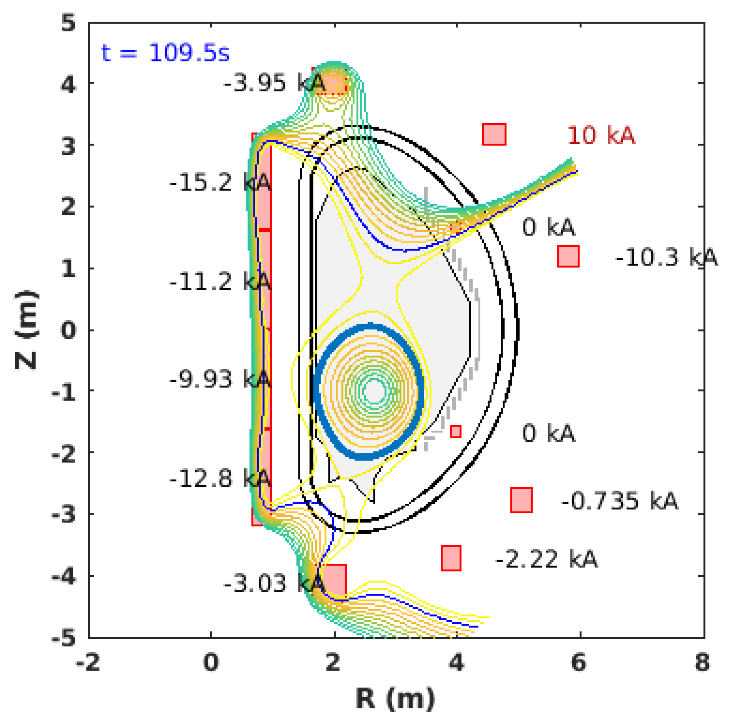
Free-boundary equilibrium: snapshots

Slide 5
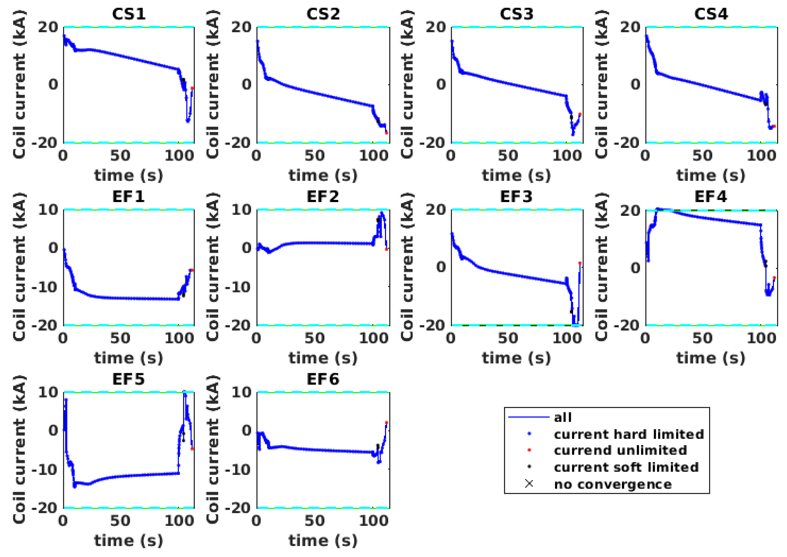
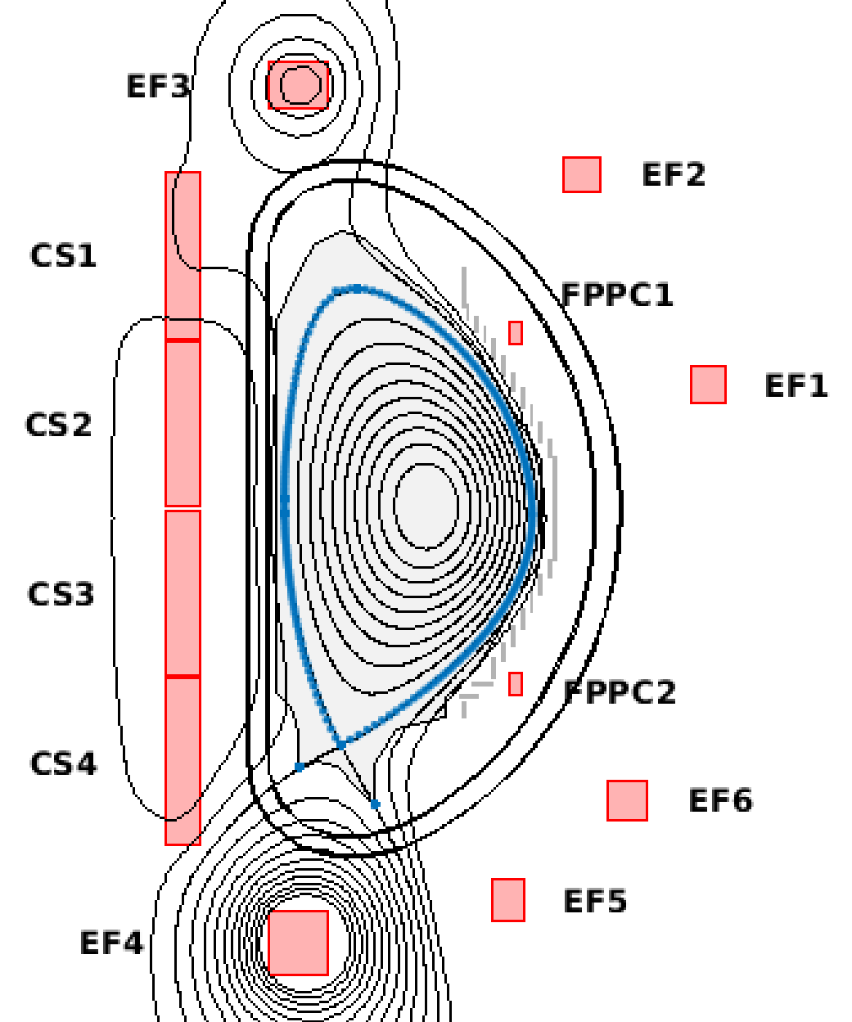
FEEQS output: coil currents

Slide 6
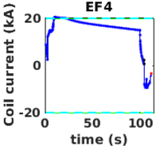
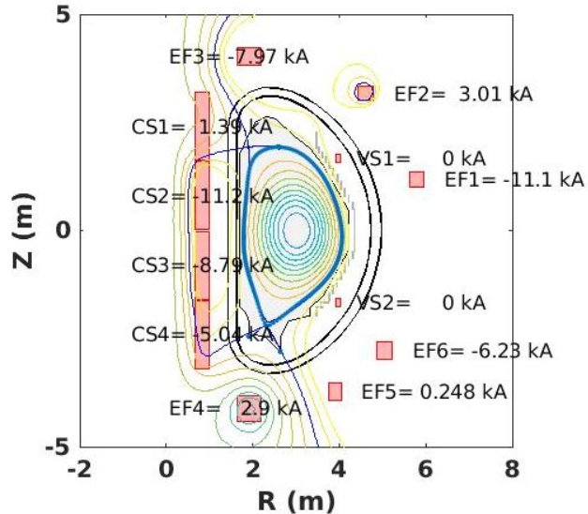
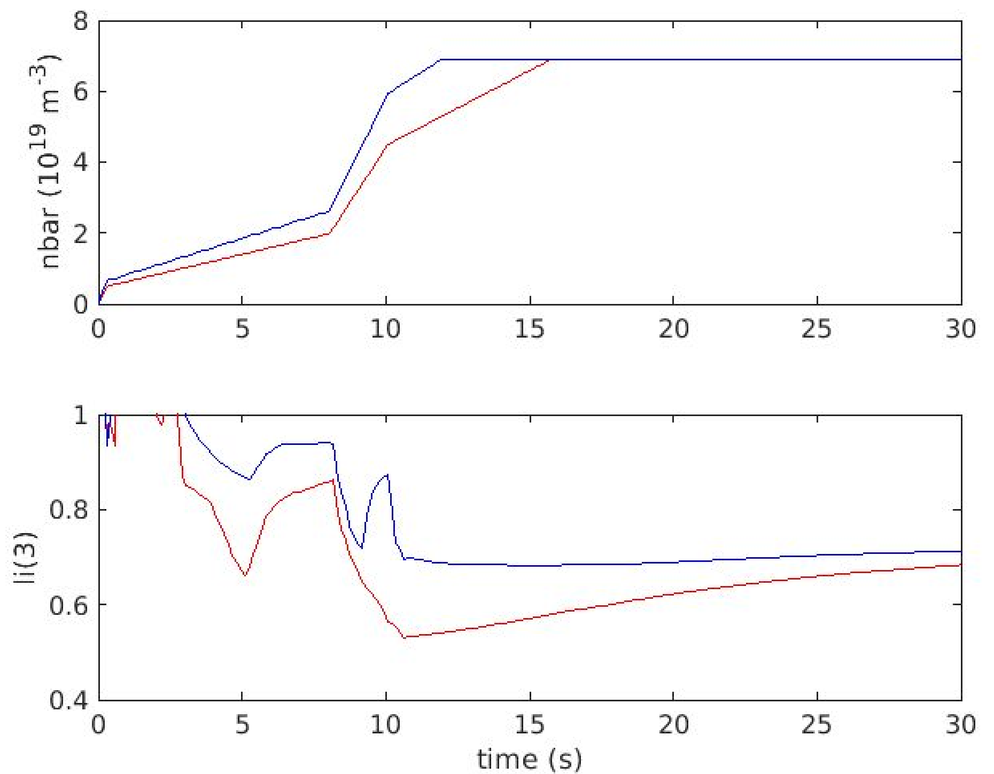
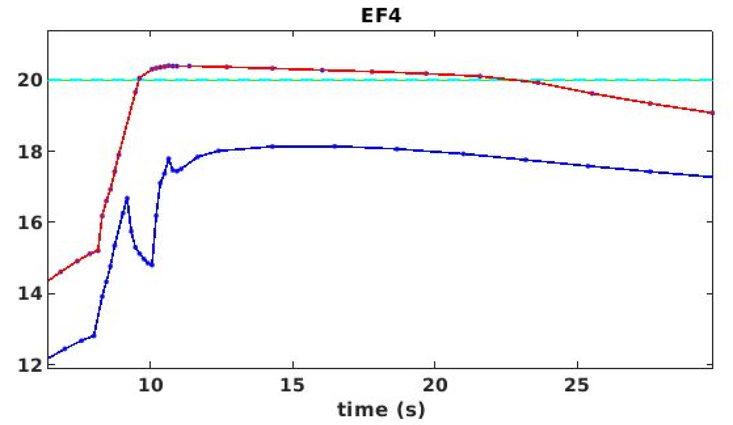
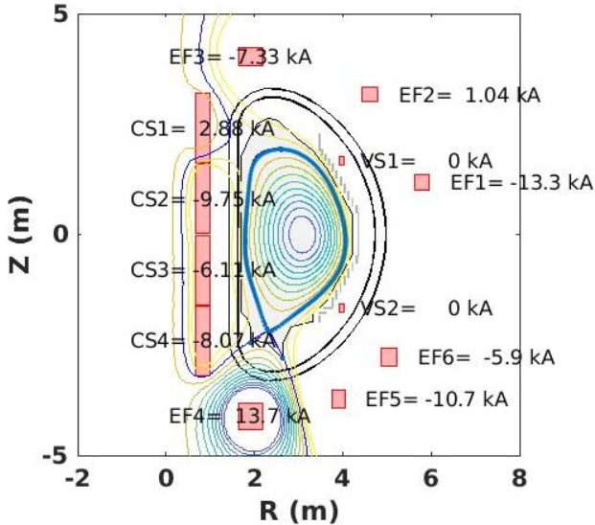
Examples of scenario issues and solutions
EF4 current limit exceeded at ~10 s (just after L-H transition)
unwanted secondary X-point generated at ~100 s (start of ramp-down)
Solutions:
faster n_{e} ramp → higher li
lower elongation at start of ramp-down

Slide 7
Further points in order to assess a scenario
Feasibility of density ramp: complex particle transport modelling with sources (gas puff, pellets)
Feasibility of H&CD waveforms (switch on/off of heating sources)
Detailed modelling of power deposition and driven current (ray-tracing, MonteCarlo…)
MHD stability limits
Fast ion distribution and impact on scenario
…
→ Luca Garzotti's talk

