Slide 1
Modelling the current ramp-up of scenarios 2 and 4.2
L. Garzotti, L. Figini, S. Gabriellini, G. Giruzzi, C. Sozzi, D. Taylor, V. K. Zotta

Slide 2
Introduction
Simulations of the ramp-up for scenario 2 and 4.2.
Full and reduced power version of scenario 2, full version of scenario 4.2 (for now).

Slide 3
Modelling condition
JINTRAC
Aiming a fully predictive simulations (j, n_{i}, T_{i}, T_{e}, V_{tor}).
PENCIL and GRAY for NBI and ICRH deposition.
Density ramp feed-back controlled (volume averaged density).
L-H transition either imposed at fixed time (after NBI switch-on) or according to Martin scaling.
Bohm/gyro-Bohm, EDWM and QuaLiKiZ transport models deployed (with different degrees of success…).
Time-dependent plasma boundary for scenario 4.2.
Modelling based on METIS simulations by G. Giruzzi and co-workers.

Slide 4
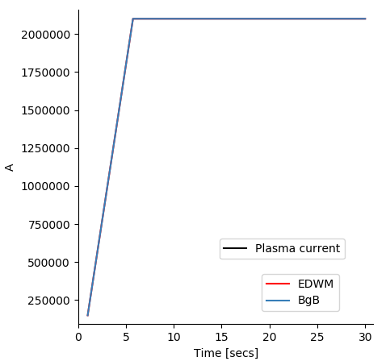
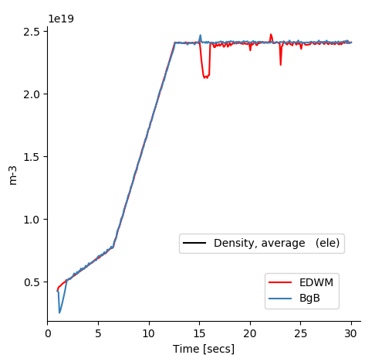
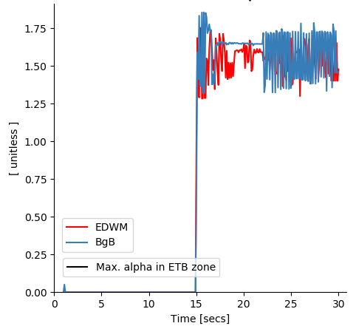
Scenario 2 baseline
2.1 MA / 1.8 T
Density scaled at constant n_{G}
Bohm/gyro-Bohm and EDWM (QuaLiKiZ still showing numerical problems, to be fixed)
EDWM gives low transport in the core
Reasonable agreement on average parameters differences in profiles (especially inside ρ =0.2)
D. Taylor, L. Garzotti

Slide 5
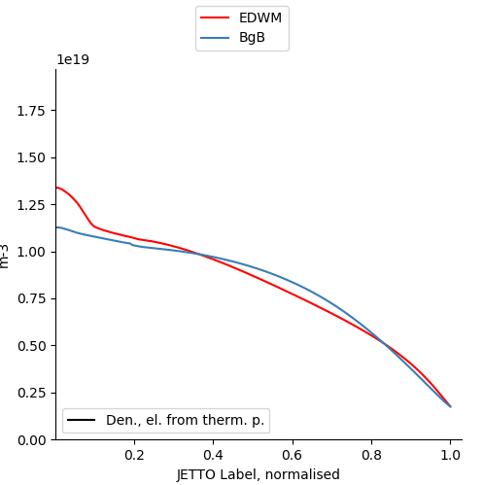
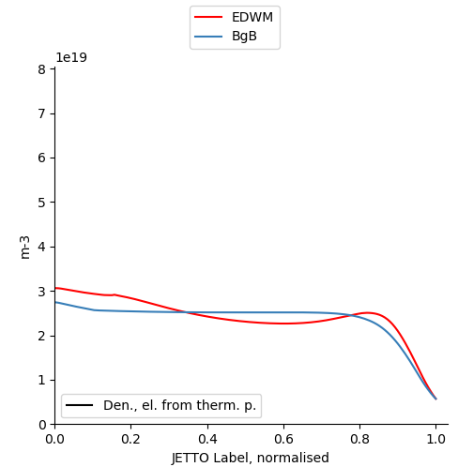
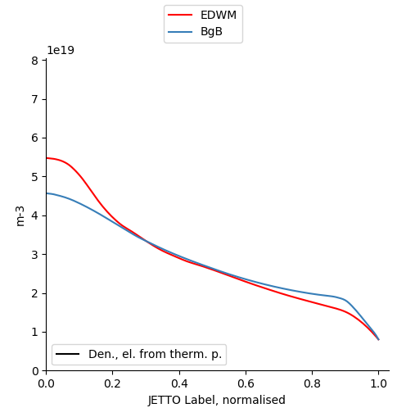
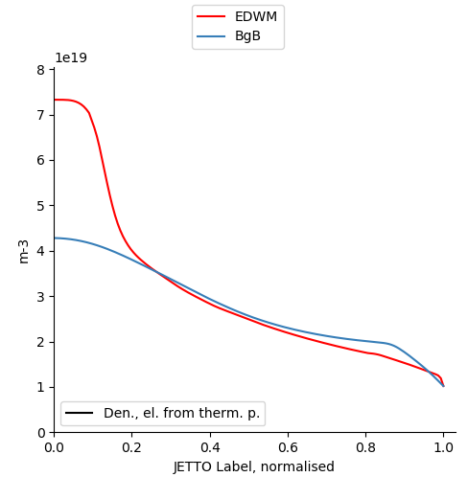
Density
t=5 s
t=12 s
t=17 s
t=30 s

Slide 6
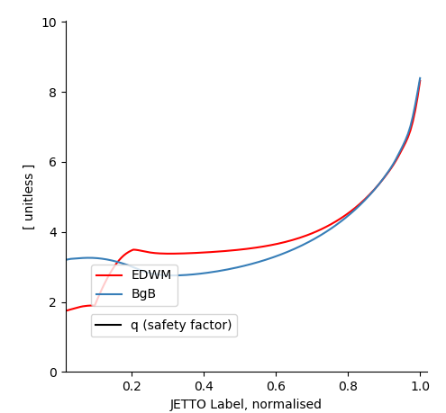
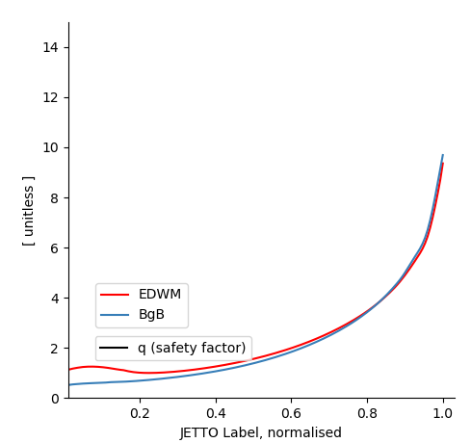
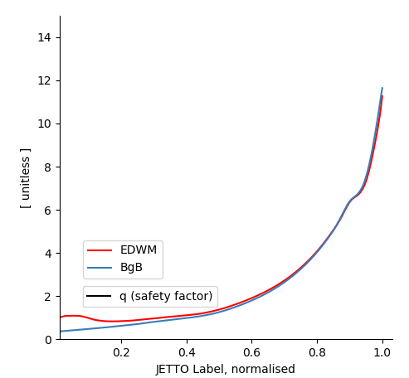
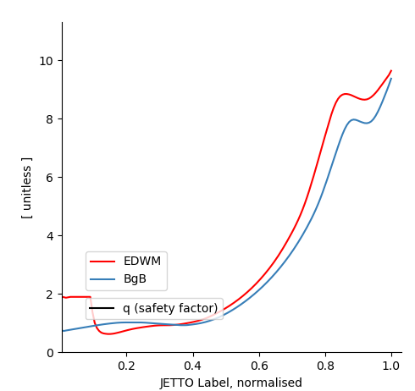
q profile
t=5 s
t=12 s
t=17 s
t=30 s

Slide 7
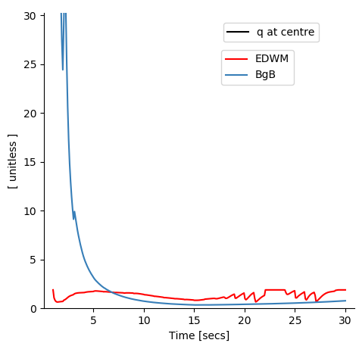
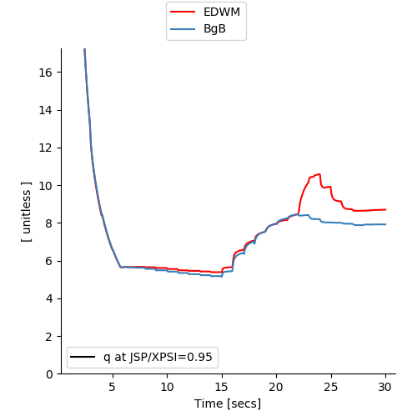
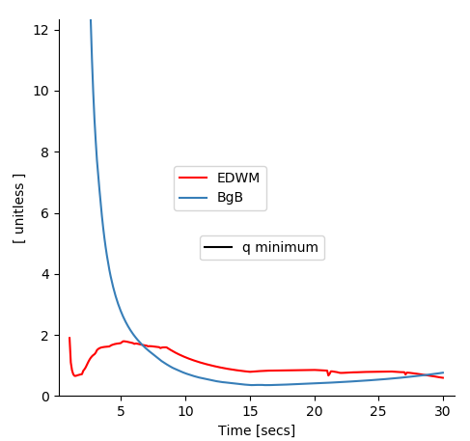
q evolution

Slide 8
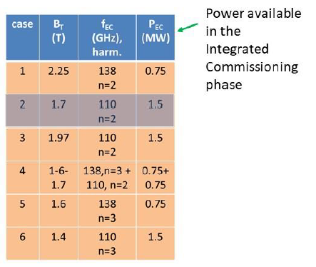
ECRF stray radiation studies
Modelled ramp-ups at 2.1 MA different levels of B_{T} and ECRH waveforms
ECRH can be used during ramp-up even at reduced plasma parameters (C. Sozzi et al. EC-21 conference 2022)

Slide 9
Scenario 4.2
Similar modelling conditions to scenario 2.
Successfully modelled j and n_{i}. Evolution similar to METIS simulations.
ECRH seems to induce L-H transition earlier than assumed in METIS (NBI switch on) according to Martin scaling.
Higher pedestal density in METIS.
Track pedestal density.
Reduce or delay ECRH power to inhibit early L-H transition.
Only Bohm/gyro-Bohm applied so far. Use QuaLiKiz and TGLF.

Slide 10
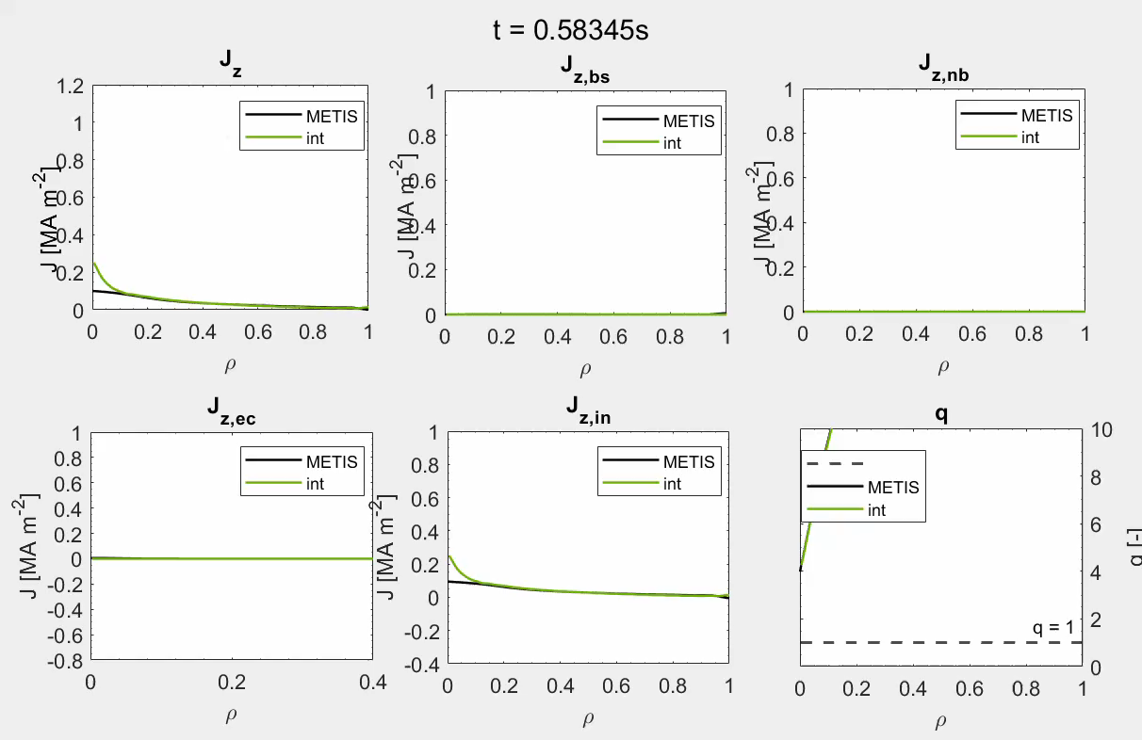
Interpretative simulation – current density profiles
S. Gabriellini, V. K . Zotta, L. Garzotti, G. Giruzzi

Slide 11
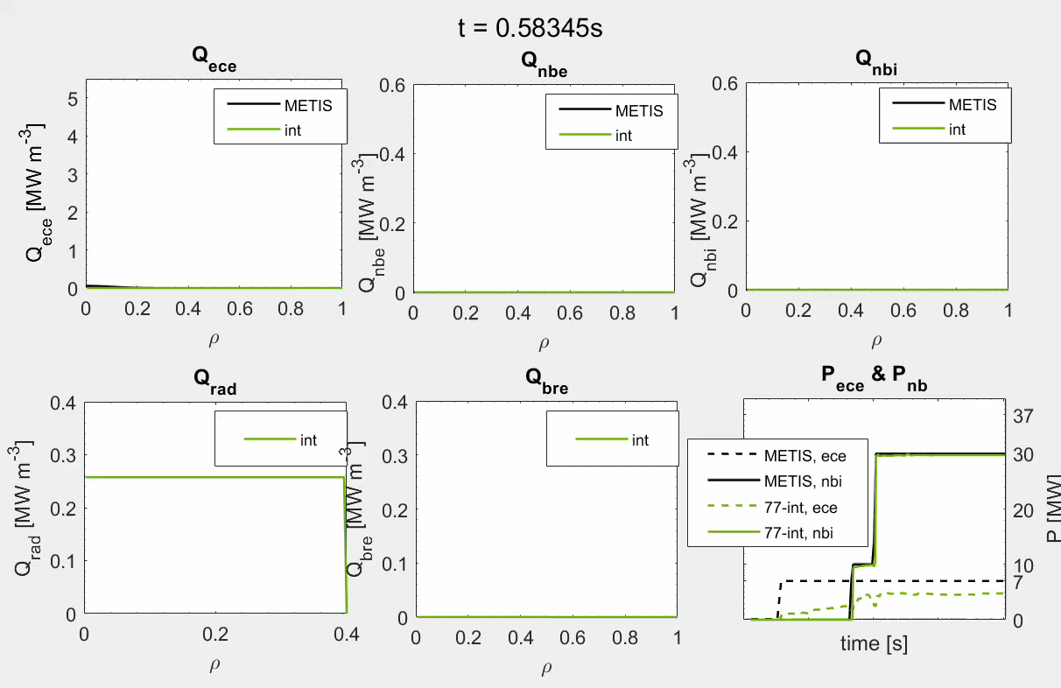
Interpretative simulation – power density profiles
Power density profiles computed by gray (in OM) and pencil

Slide 12
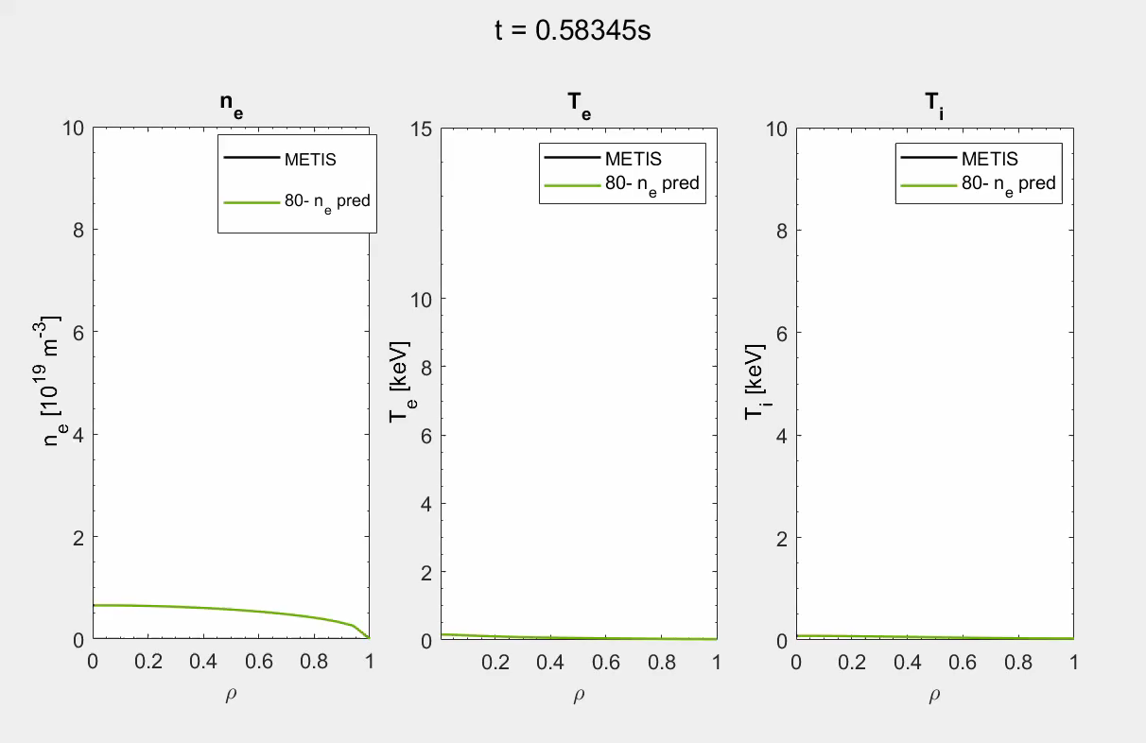
Predicting the density – kinetic profiles
L-H transition is imposed at 8.46s when the NBI power is turned on

Slide 13
Conclusions and future work
Progress has been made in modelling the ramp-up in JT-60SA scenario 2 and 4.2
More steps are necessary to complete the simulations.
Scenario 2
  Use QuaLiKiZ.
  (Re)introduce self-consistent MHD in the pedestal.
  Extend to other vauels of plasma current and toroidal field.
Scenario 4.2
  Use first-principle reduced models.
  Investigate behaviour of density and L-H transition.
  Predictively model T_{i} and T_{e}.
Interaction with other tasks (e. g. MHD stability of ramp-up?)

Slide 14
Reduced scenario
Catalogue tree: '/home/msutclif/cmg/catalog/jetto/jet/70000/’
dates=['nov1220/','nov1220/','nov1120/','dec1720/','nov1120/','nov1220/','dec1720/','nov1220/']
sequences=['6','7','2','3','1','2','1','5']
bvac=[1.5,1.5,1.77,1.77,1.77,2.25,2.25,2.25]

