Slide 1
9th WPSA Project Planning Meeting
Topic session: Disruption avoidance techniques
Gianluca Pucella
ENEA, Fusion and Nuclear Safety Department, C.R. Frascati, Italy

Slide 2
Plasma disruptions
The capability to carried out plasma pulses safely is an important goal towards the optimization of an operating scenario.
safety
thermal and electromagnetic loads, formation and impact of runaway electrons
Disruption
limits to the range of accessible plasma parameters
scenario
disruption prevention
plasma control throughout the evolution of the pulse
Prevention & shutdown
terminate the pulse in a controlled way or alleviate the consequences of unavoidable disruptions
emergency shutdown

Slide 3
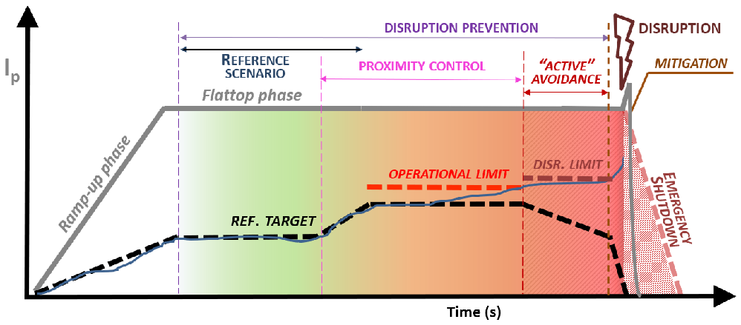
Disruption prevention & emergency shutdown
Disruption prevention is a multi-stage approach covering the full range of control regimes to prevent the disruption. Emergency shutdown involves the anticipated termination of a pulse.
“Disruption-free protocol” (ITPA-IOS)
[A. Pau, EPS 2022]
REFERENCE SCENARIO
PROXIMITY CONTROL
ACTIVE AVOIDANCE
EMERGENCY SHUTDOWN
Keep the target scenario stable again disturbances (ST, ELM, MHD modes, etc.)
Keep stability while pushing performance by regulating proximity to stability & controllability boundaries
Asynchronous response when crossing operational boundaries (danger levels)
Fast controlled
shutdown
Mitigation

Slide 4
Disruption prediction
Data-driven models (derived from machine learning methods, with high accuracy levels (success rate of above 95 %, false alarms rate of few %).
Supervised learning:
training dataset, allowing the model to learn over time
Unsupervised learning:
unlabeled data, helping to discover hidden patterns or data clustering
ML references
Physics-driven models based on physics understanding of the phenomenon involved in a particular class of disruptions.
Results easier to interpret in terms of plasma dynamics
Large amount of data for training is not required
Case study

Slide 5
Machine Learning for disruption prediction
Remarkable success in data-driven models for disruption identification and real-time control, including high-performance work models not limited to a specific device.
Neural Networks
B. Cannas et al 2007 A prediction tool for real-time application in the disruption prediction system at JET Nucl. Fusion 47 1559
R. Yoshino et al 2003 Neural-net disruption predictor in JT-60U Nucl. Fusion 43 1771
Support Vector Machines
J. Vega et al 2013 Results of the JET real-time disruption predictor in the ITER-like wall campaigns, Fusion Eng. Des. 88 1228
G. Rattá et al 2010 An advanced disruption predictor for JET tested in a simulated real-time environment, Nucl. Fusion 50 025005
Mapping and Manifold Learning
B. Cannas et al 2014 Overview of manifold learning techniques for the investigation of disruptions on JET Plasma Phys. Control. Fusion 56 114005
A. Pau et al 2019 A machine learning approach based on generative topographic mapping for disruption prevention and avoidance at JET Nucl. Fusion 59 106017
Statistical Learning
Y. Zhang, G. Pautasso et al 2011 Prediction of disruptions on ASDEX Upgrade using discriminant analysis, Nucl. Fusion 51 063039
S.P. Gerhardt et al 2013 Detection of disruptions in the high-β spherical torus NSTX Nucl. Fusion 53 063021
Deep Learning
J. Kates-Harbeck, A. Svyatkovskiy and W. Tang 2019 Predicting disruptive instabilities in controlled fusion plasmas through deep learning Nature 568 526
J.X. Zhu et al 2021 Hybrid deep-learning architecture for general disruption prediction across multiple tokamaks Nucl. Fusion 61 026007
Decision Tree, CART, Random Forest, GBM
K.J. Montes et al 2019 Machine learning for disruption warnings on Alcator C-Mod, DIII-D, and EAST Nucl. Fusion 59 096015
A. Murari et al 2020 On the transfer of adaptive predictors between different devices for both mitigation and prevention of disruptions, Nucl. Fusion 60 056003

Slide 6
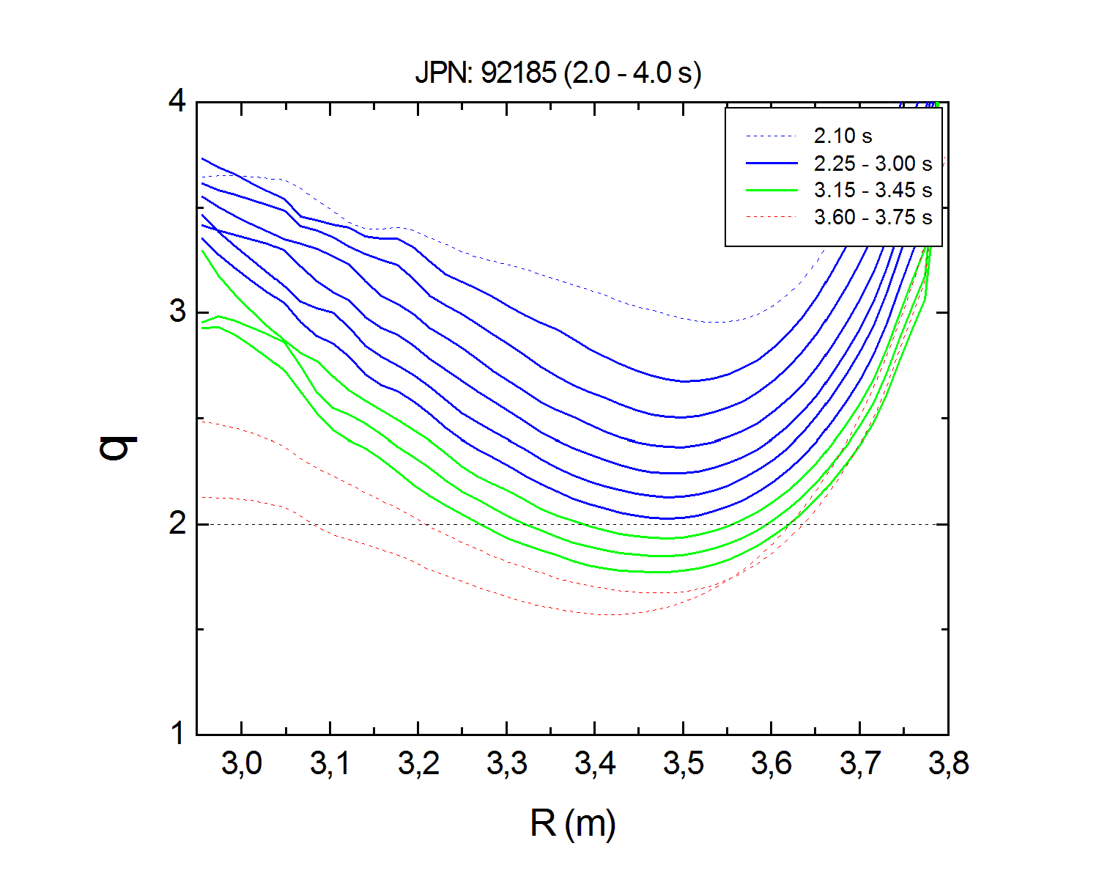
Current ramp-up of the hybrid scenario at JET
Physics understanding: double tearing modes in pulses with hollow Te-profiles [C.D. Challis, Nucl. Fusion 2020]
Slower current ramp-up and higher density led to a stable scenario (reference scenario)
[G. Pucella, to be submitted]
active
avoidance
Central heating
Density control
Te-profile peaking factor [M. Fontana FED 2020] included in the JET RT control system [L. Piron FED 2021]
Early pulse termination
(implemented)
emergency shutdown
JET MGI system, based on locked mode signals, can be triggered (mitigation)

Slide 7
Hints for discussion
Investigate the risk of developing double tearing modes in reversed shear plasmas during fast current ramp-up.
Investigate the risk of developing locked modes during the start-up phase of low density plasmas by residual error fields.
Stability of classical tearing modes during the plasma termination of pulses with anomalous temperature profiles.
Density limit studies in L-mode plasmas.
VDE study in high elongated plasmas.
Disruption prediction and mitigation using machine learning methods.
Development of real-time disruption avoidance/mitigation triggers from physics-driven models, based upon plasma profiles and MHD activity signals.
Test/application of an emergency shutdown procedure, by rapidly ramping the plasma current down in a controlled way.
Disruption mitigation and physics using massive gas injection.
Validation of disruption modelling tools.

