Slide 1
SOLPS-ITER / SONIC
Benchmark
08/09/2022
Giulio Rubino

Slide 2
Outline
Main goal and general overview
Previous study: mesh resolution assessment
Profiles comparison in pure D plasma
Current status and future work
G. Rubino | WPSA General Planning Meeting | 09 September 2022 | Budapest | Pag. 2

Slide 3
Main goal and general overview
SOLPS-ITER/SONIC benchmark with a step-wise approach
Pure D with
C wall (for reflection)
D + intrinsic C
D + intrinsic C
+ extrinsic Ar
Grid Sensitivy
study
Assessment of the
effect of different
impurity model
JT-60SA scenario-like
configuration
Partially detached
and attached
Comparison
G. Rubino | WPSA General Planning Meeting | 09 September 2022 | Budapest | Pag. 3

Slide 4
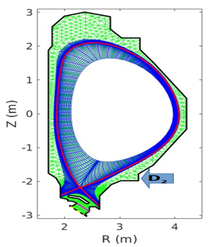
Mesh resolution assessment
3 different poloidal resolutions taken into account : 60x36, 120x36, 240x36
P_{SOL} ~ 6MW and n_{e,sep} ~ 2e19 m⁻³
Increase in the computational time (more than linearly) by increasing poloidal resolution
Assessment of discretization error ε_{discr} [K.Ghoos et al 2019 Nucl. Fusion]
Assessment of the poloidal resolution to gradient ratio: λ_{Ф} / Δx, λ_{Ф} = |Ф/▽Ф|
Trade-off between the accuracy of the solution and the computational time
120x36 grid resolution
 | Fluid neutral | Fluid neutral |  | EIRENE | EIEIRENE
 | Coarse | Ref. | Fine | Coarse | Ref. | Fine
εdiscr(%) | 51.8 | 32.8 | 20.7 | 56.8 | 38.7 | 26.8
G. Rubino | WPSA General Planning Meeting | 09 September 2022 | Budapest | Pag. 4

Slide 5
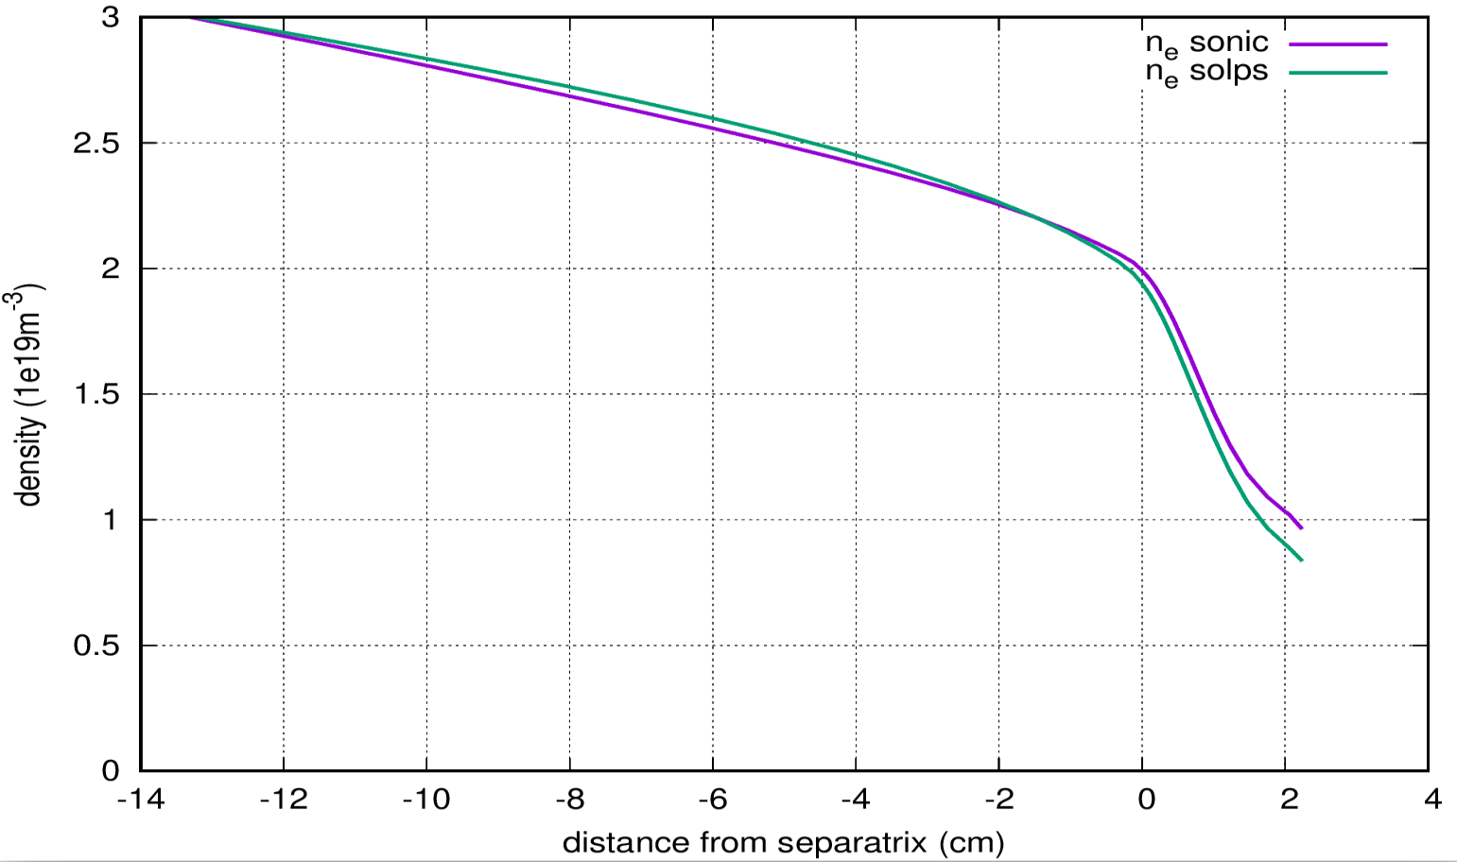
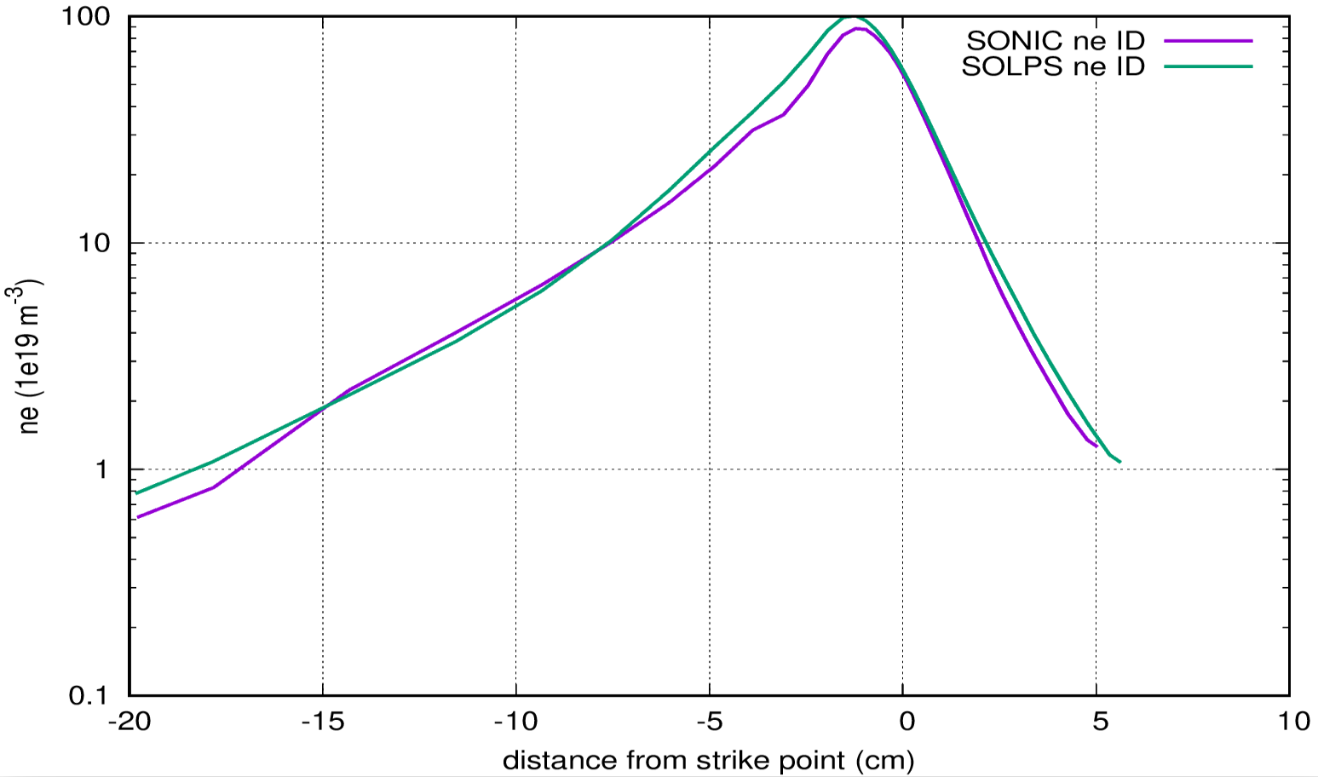
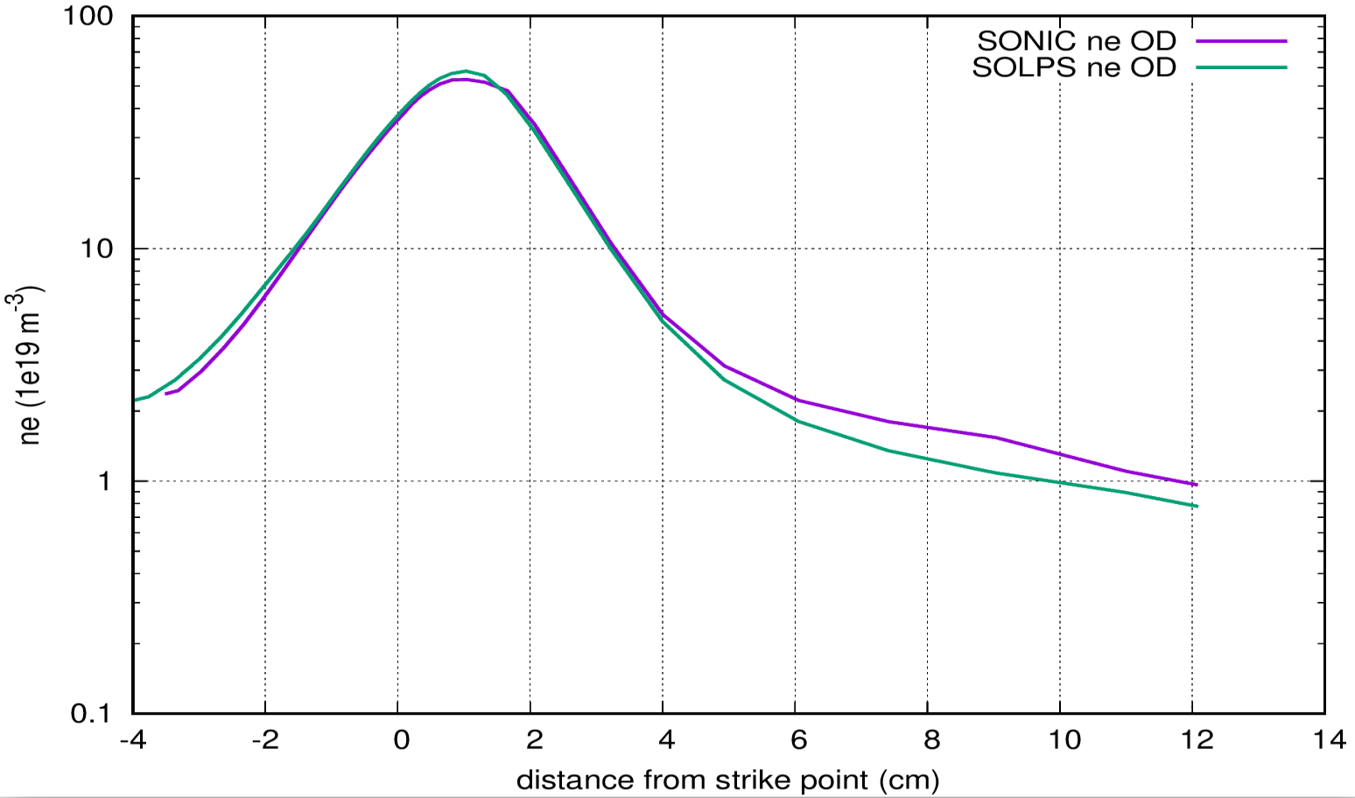
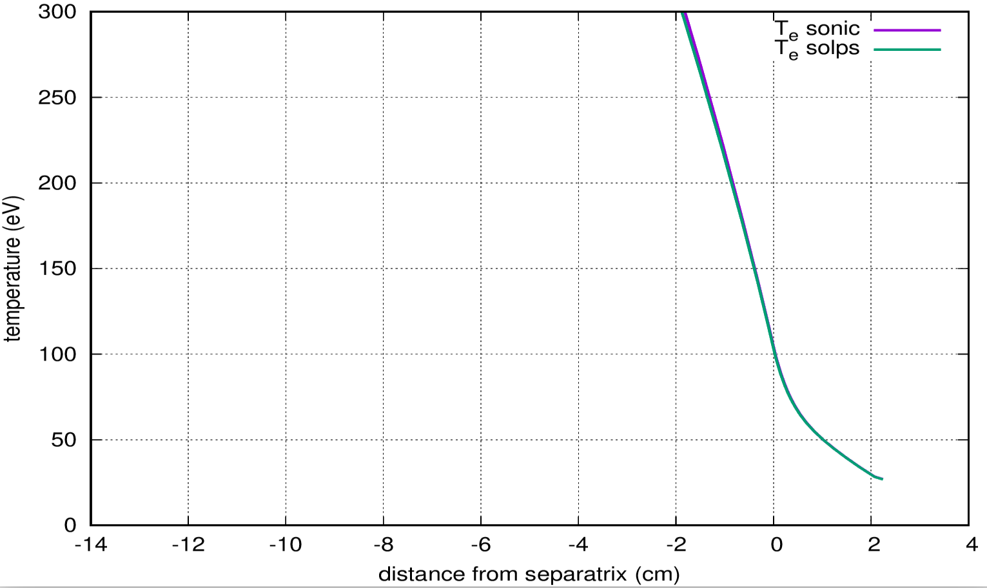
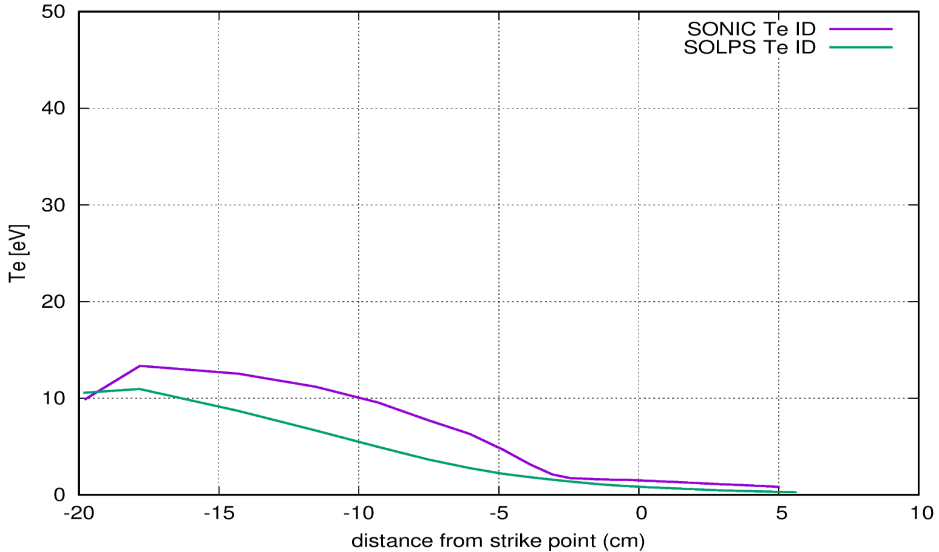
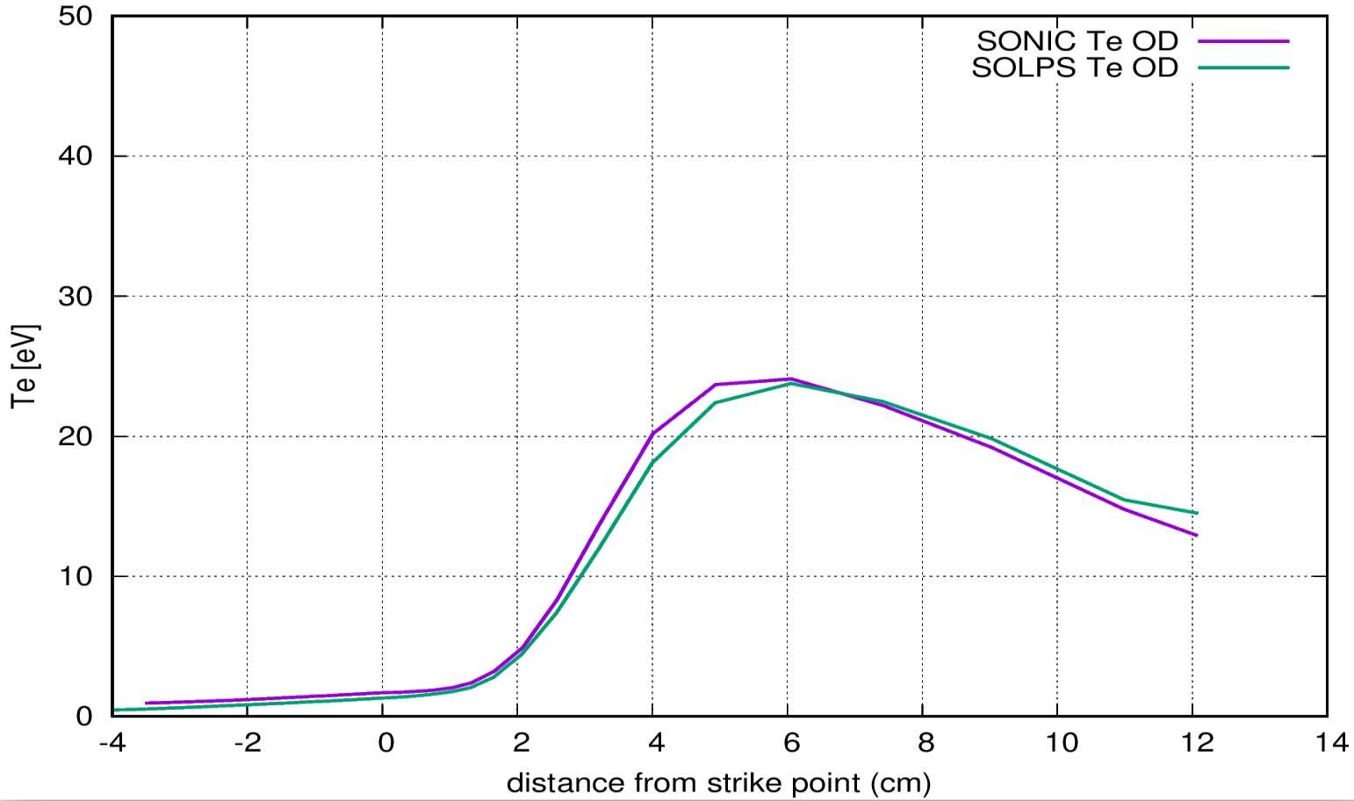
Partially detached pure D plasma
Same mesh in both codes (mesh convertor developed by Shohei-san)
Boundary conditions and inputs set as close as possible
No drifts, flat transport coefficients, no SOL currents
Very similar profiles both at midplane and target
Outer midplane
Inner target
Outer target
Thanks to Shohei-san
G. Rubino | WPSA General Planning Meeting | 09 September 2022 | Budapest | Pag. 5

Slide 6
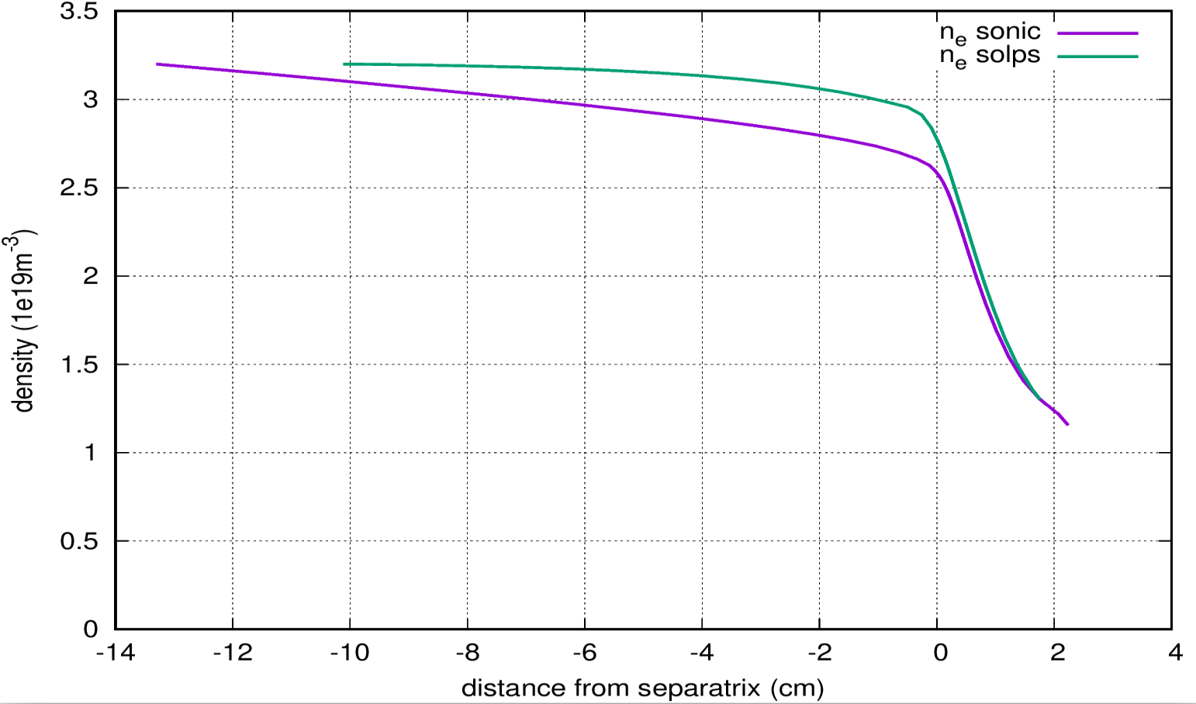
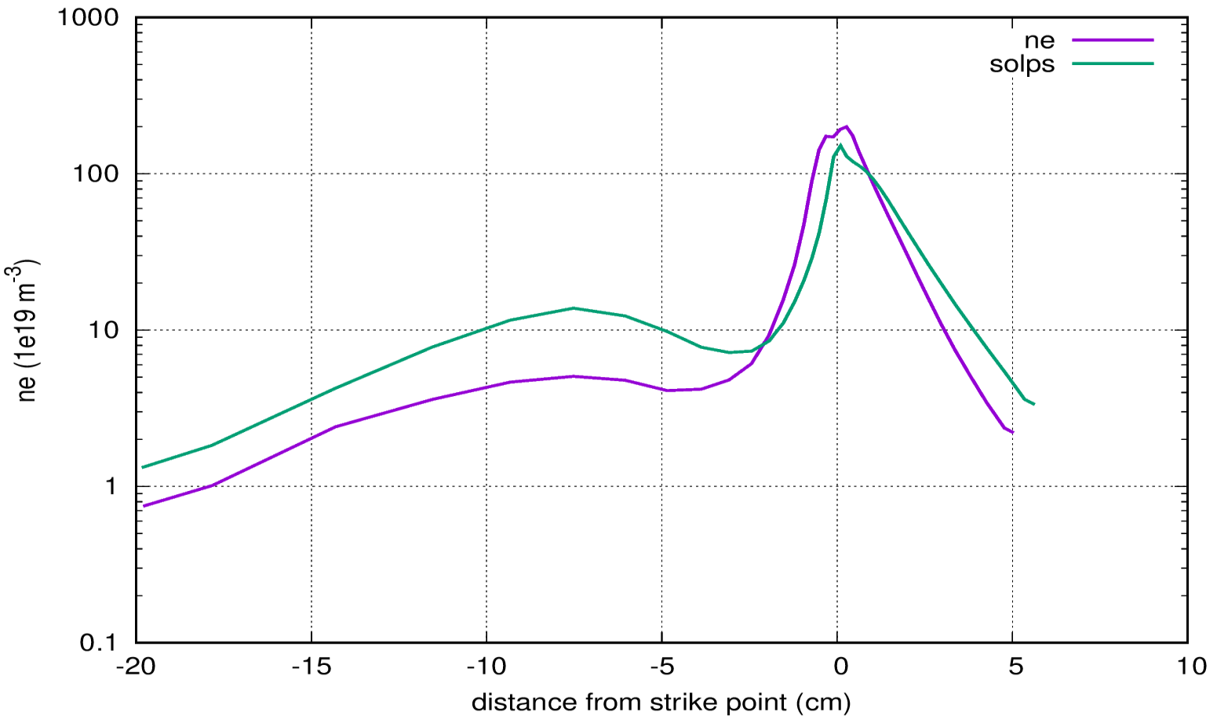
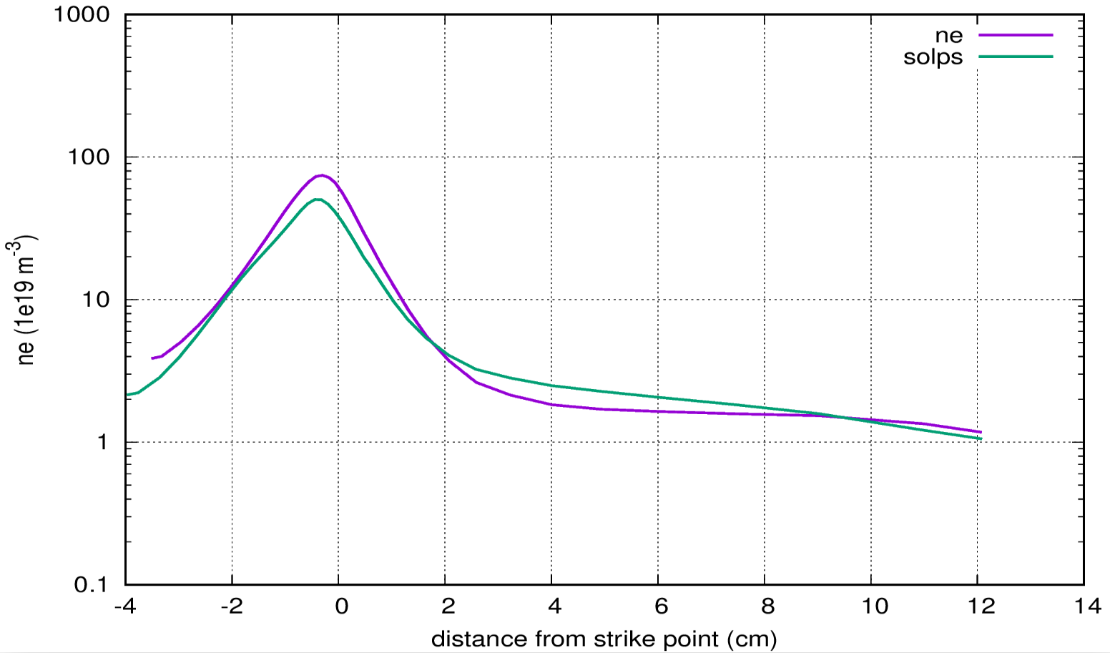
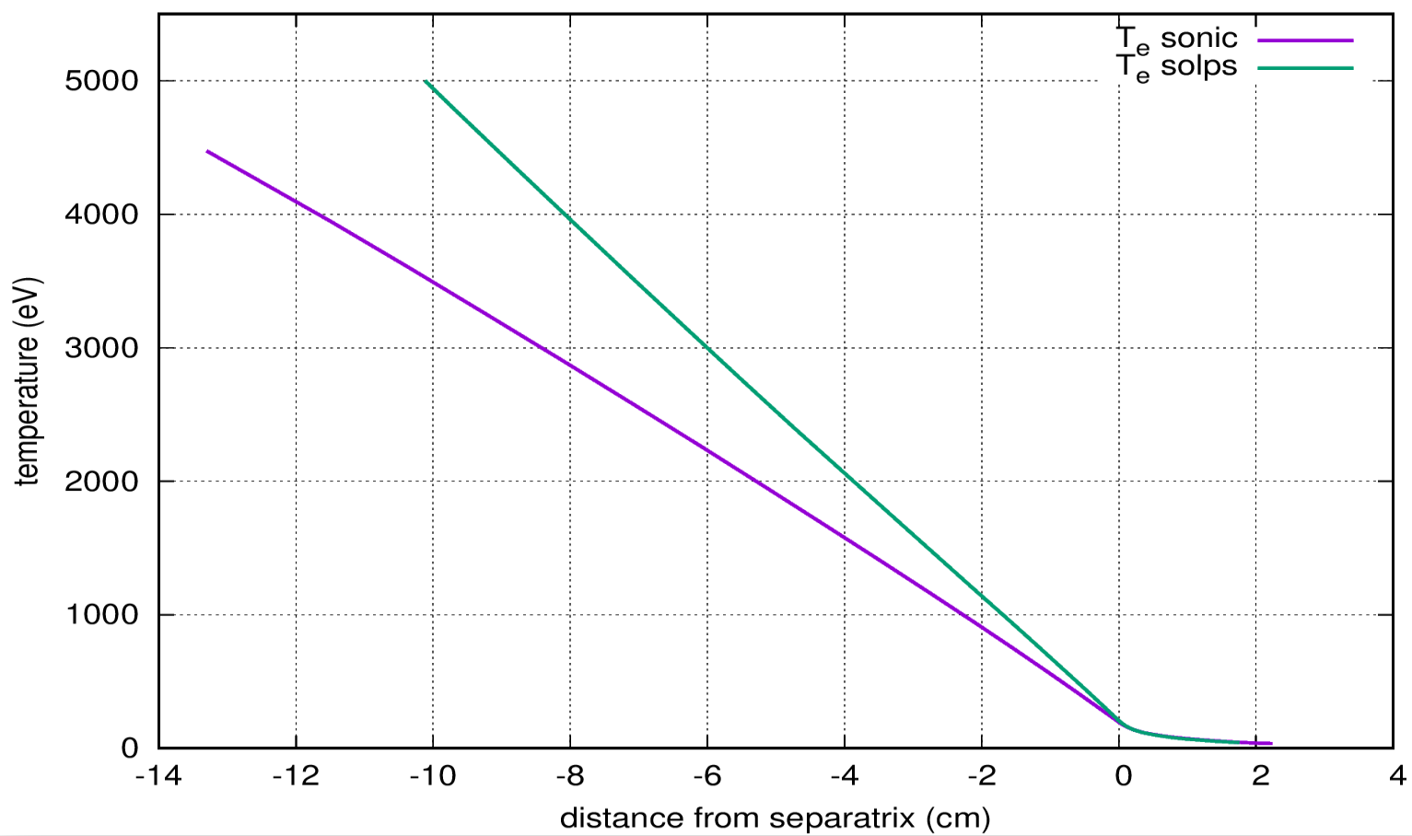
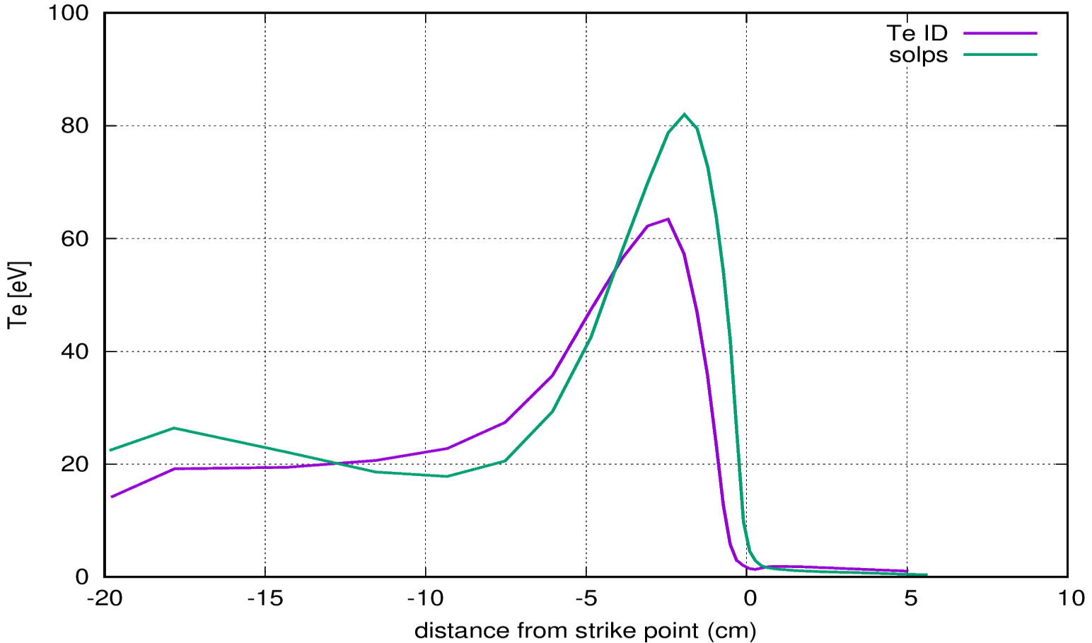
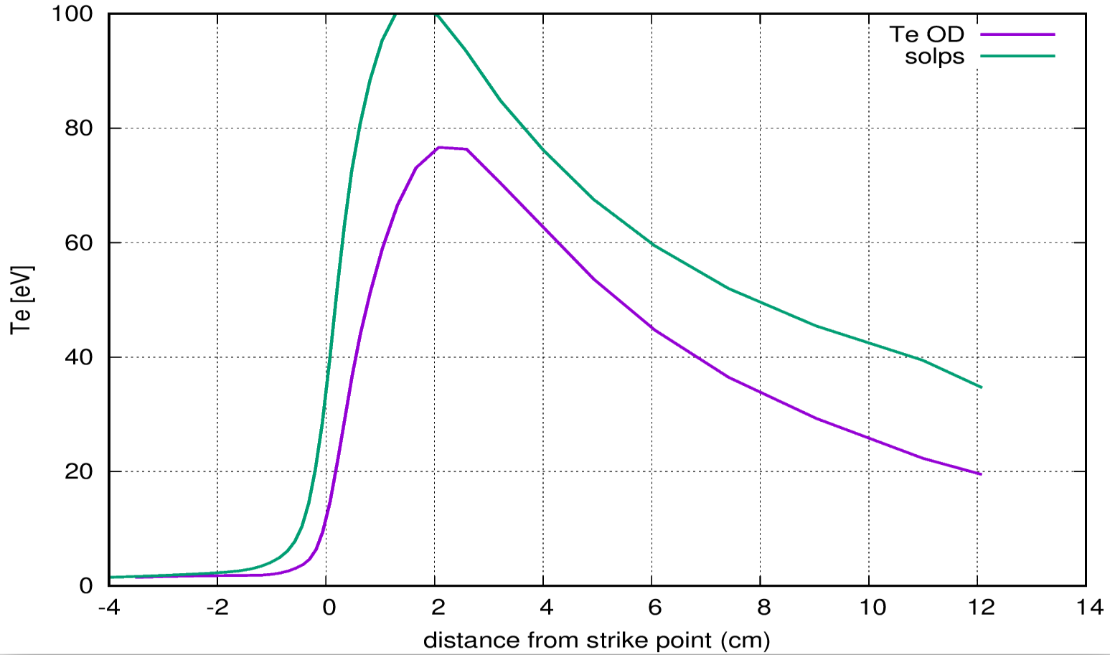
Attached pure D plasma
Different upstream mesh width: need to check the mesh cut level
Different upstream profile (n_{e,omp} and T_{e,core} )→ get same profiles for a better target comparison
Te differences are more pronouced → need to exclude the influece of the upstream conditions
Outer midplane
Inner target
Outer target
Thanks to Shohei-san
G. Rubino | WPSA General Planning Meeting | 09 September 2022 | Budapest | Pag. 6

Slide 7
Current status and future work
Pure D comparison in attached conditions:
Get the same upstream conditions →use the same core temperature boundary condition (ion end electron fluxes)
Check the external D puffing rate
Make energy balance and analysis of the different terms in the equations
Strong differences are observed in case of parallel SOL current (Current continuity equation is solved) → Investigations are ongoing
D + intrinsic C
Definition and verification of the setup ongoing:
Y_{chem} and Y_{phys}? Turn off physical sputtering?
Define wall properties, i.e. wall material → C+SS+Cu (problem of Ar on Cu reflection data) as suggested by Nakano-san
First assessment of C vs C+SS wall definition shows negligible differences
Simulations are ongoing
Future Plans
Setup impurity seeded cases (Ar) in collaboration with QST team
G. Rubino | WPSA General Planning Meeting | 09 September 2022 | Budapest | Pag. 7

Slide 8
Thank you
for your attention

