Slide 1

Research and development in nuclear safety, energy security, and materials science
Dr. Ákos Horváth
Director general
06/09/2022

Slide 2
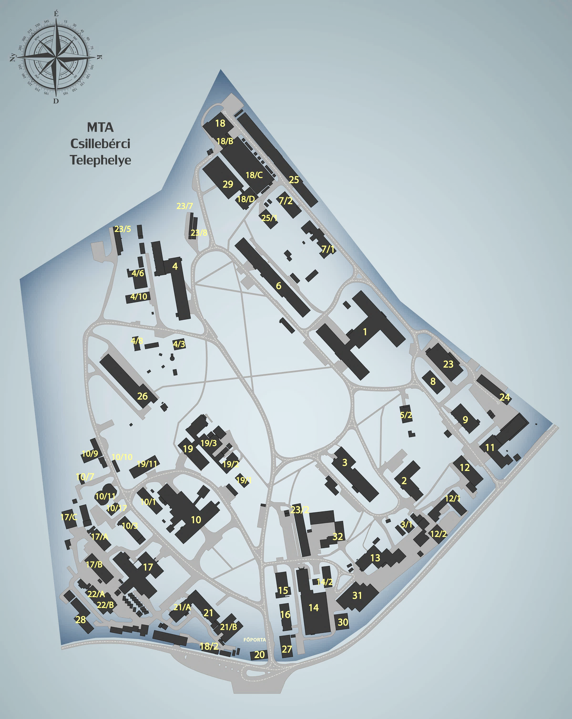
Centre for Energy Research
The Centre for Energy Research (EK or CER) is a member of the Eötvös Loránd Research Network (ELKH) since 2019.
EK is the strongest Hungarian institute in nuclear studies: nuclear safety, security and fusion engineering are in the portfolio.
The staff stabilized around 400 people, 75% researchers.
EK is the main consultant of Paks Nuclear Power Plant in nuclear safety related matters and one of the Technical Support Organisations of the Hungarian Atomic Energy Authority
EK is a Collaborating Centre in Nuclear Forensics for International Atomic Energy Agency.

Slide 3
Organisation
Centre of Excellence of the Hungarian Academy of Sciences since 2019
Director general
DDG for EKBI & MFA
Financial director
Scientific Council
Scientific &
Technical Support
Department
Environmental
service
Budapest
Research Reactor
Quality Assurance
Research Institute for
Atomic Energy
Research Institute for
Energy Security and Environmental Safety
Research Institute for
Technical Physics and
Materials Science
Fuel & Reactor
Materials
Reactor physics
Surface chemistry
& catalysis
Radiochemistry
NanoBio-
Sensorics
Thin film
physics
Reactor monitoring
& simulation
Thermo-
hydraulics
Environmental
Physics
Nuclear
Analytical &
Radiography
Microsystems
Nanostructures
Nanosensors
Nuclear security
Radioprotection
Neutron
Spectroscopy
Complex
Systems
Photonics
Fusion
Plasmaphysics
Space research
Fusion
Technology
3 Institutes, 23 research groups, 400 employees, ≈300 researchers

Slide 4
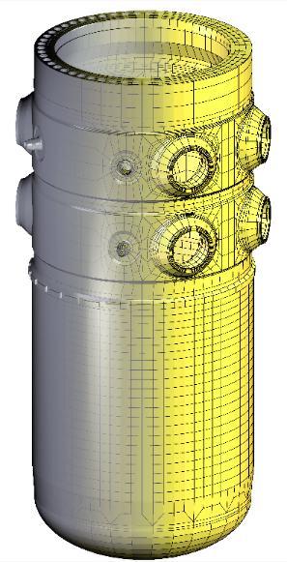

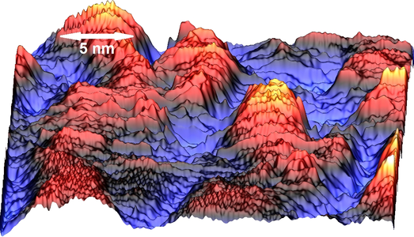
Directions in the energy science
Nuclear Safety
Research on the safety of Paks NPP: coupled code development, OECD NEA related projects
Closing the fuel cycle (long term international projects), ALLEGRO (Euratom)
Fusion energy (Diagnostics, plasma physics research), ITER (Eurofusion), JT-60SA, Wendelstein
Energy storage, hydrogen economy
Cathalitic water splitting, methane dry reforming (H2 and synthetic fuel)
Energy storage in the grid, stability of the electric network
Electric network topology analysis, study of transients
Materials sciences and energy saving
Sensor development on physical, chemical, biological phenomenon
Functional materials (think layers, 2D materials), ERA-NET
Heritage science (supporting museums with analyitical capabilities), H2020
Reactor presssure vessel structural integrity
Environment chemistry
Sewage water cleaning with advanced oxidation technology
Safe storage of radioactive waste (Euratom)
Space research (space dosimetry)
Development of radiation sensors and space weather, ESA
Power supply and I&C for satellites
Preparing the Hungarian astronauts for space mission
Graphene nanoengineering

Slide 5
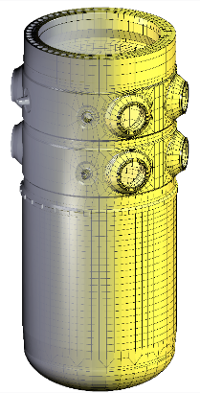
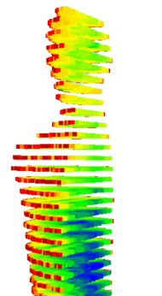
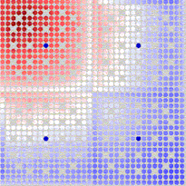
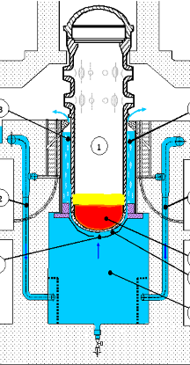
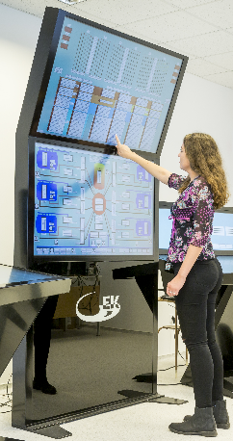
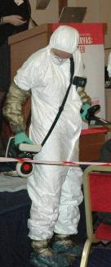
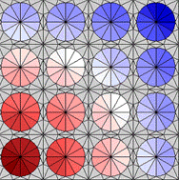
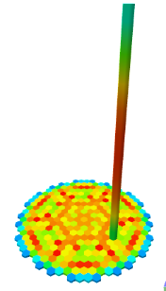
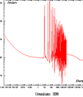

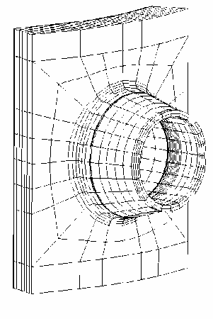
Nuclear safety research
Reactor physics,
Neutron transport calculations,
Reactor core design
Subcriticality analysis
Multi physics hot channel calculations
Thermal hydraulics,
Ex-vessel cooling tests
Computational Flow Dynamics
Severe accident simulations
Structure integrity analysis,
Fuel cladding thermo-mechanical properties,
Radiation damage studies
Digital I&C systems
Human-machine interface
Reactor training simulator
Core monitoring
Radiation protection,
Low dose effects, athmospheric dispersion,
Environmental monitoring

Slide 6
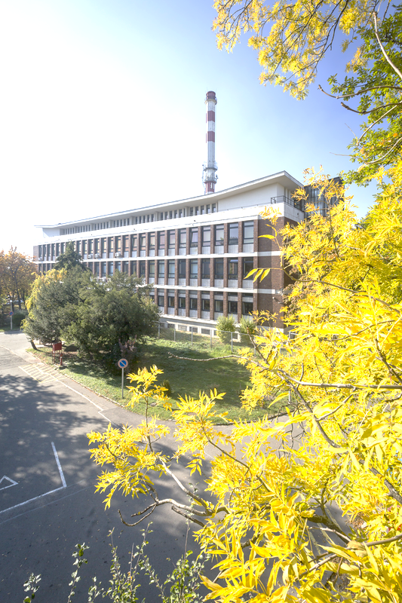
Nuclear Installations
Paks NPP – 4 Units VVER-440
Operational licences extended until 2032-2036.
Paks II. – Extending the nuclear energy capacities up to the end of the XXI.century
Rosatom will build two VVER-1200 units
Budapest Research Reactor and Budapest Neutron Centre (BNC)
Installed in 1959, licence will expire in 2023, licence extension is planned +10yrs
Operated by Centre for Energy Research, owner is the Hungarian Academy of Sciences
The research reactor is mainly used for beamline science (neutron physics, materials sciences). The facility is a member of the E-RIHS, CERIC, LENS networks.
Fresh fuel supply secured for the next 4-5 years, (TVEL, 2020.)
Roadmap is prepared for the future use of BNC
Training reactor at the Technical University (BME NTI)
Installed in 1971, 100kW power, (still using the original fuel assemblies)

Slide 7

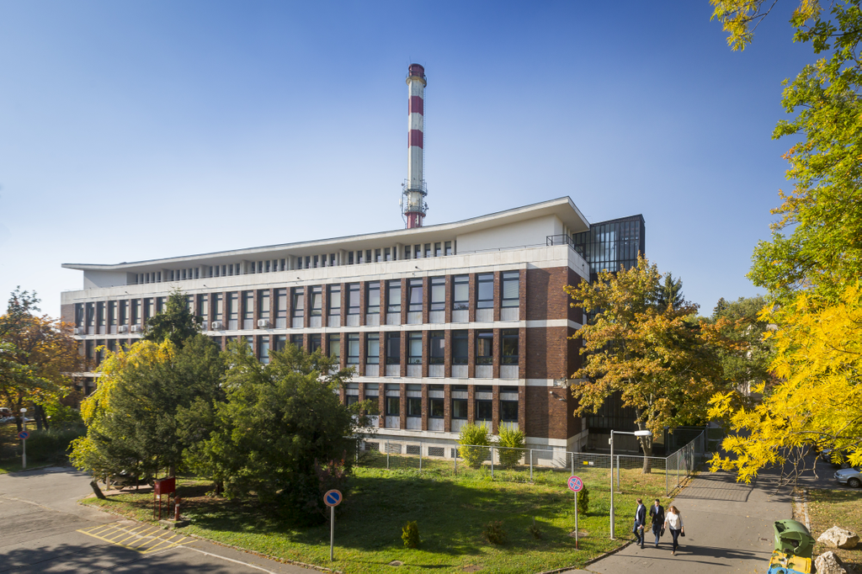
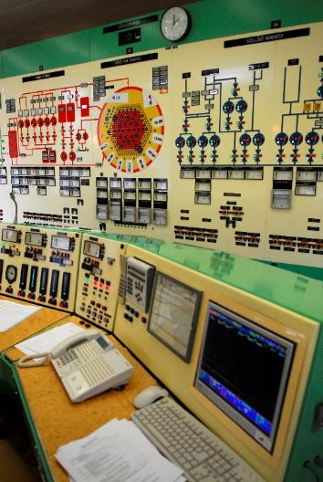
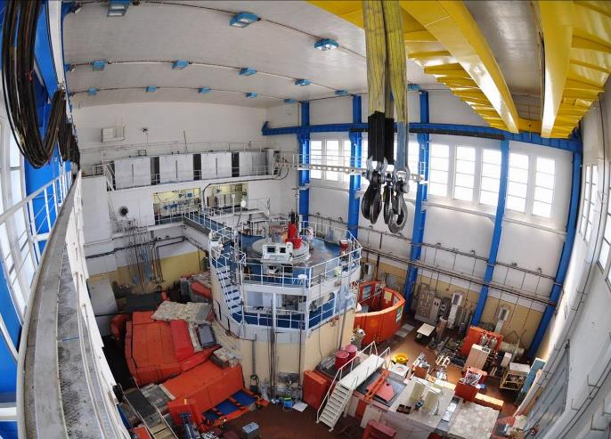
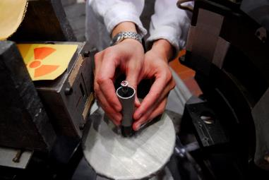
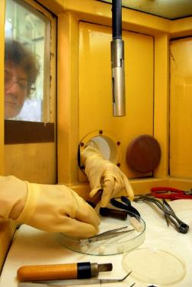
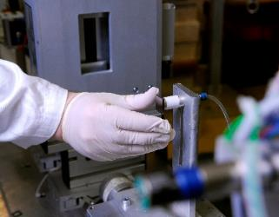
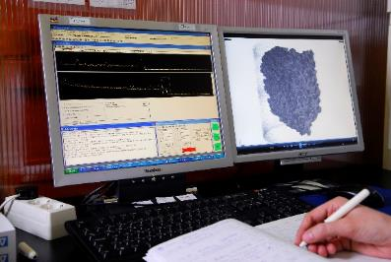
EK operates the Budapest Research Reactor - Budapest Neutron Centre
The research reactor provides neutron source for basic and applied neutron physics research
Reactor power:
10 MW, average 3500 h/year
- thermal neutron flux: 2.5*10¹⁴ n/cm²s
- fast neutron flux: 1*10¹⁴ n/cm²s

Slide 8

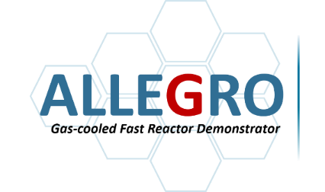
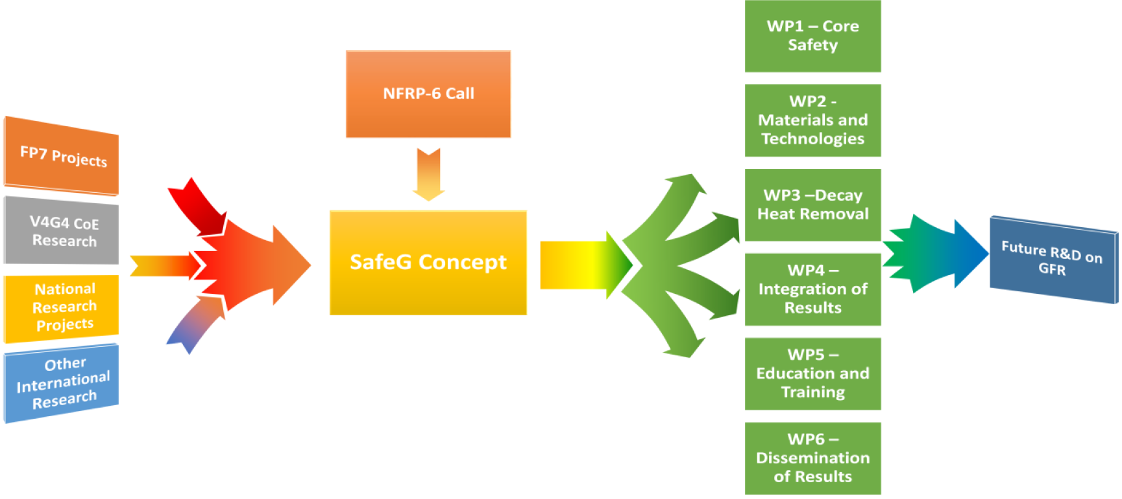















SAFETY OF GFR THROUGH INNOVATIVE MATERIALS, TECHNOLOGIES AND PROCESSES
DESIGN
THERMODYNAMICS
CORE DESIGN
V4 Collaboration

Slide 9
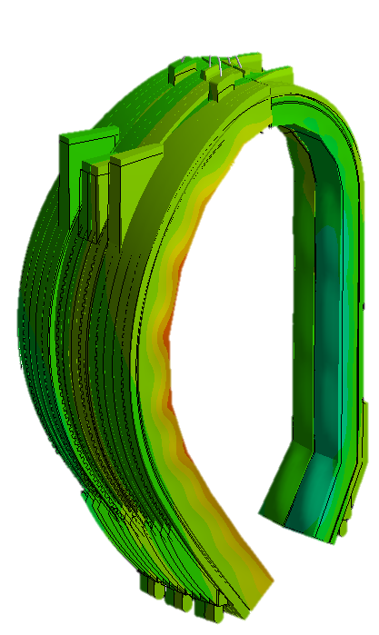
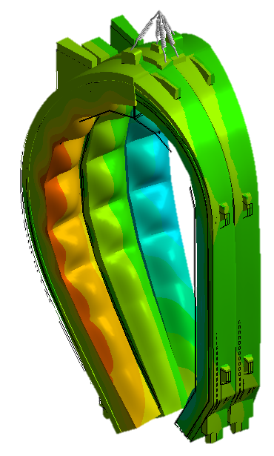
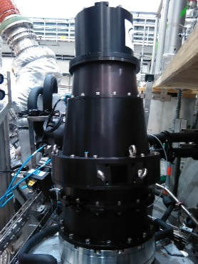
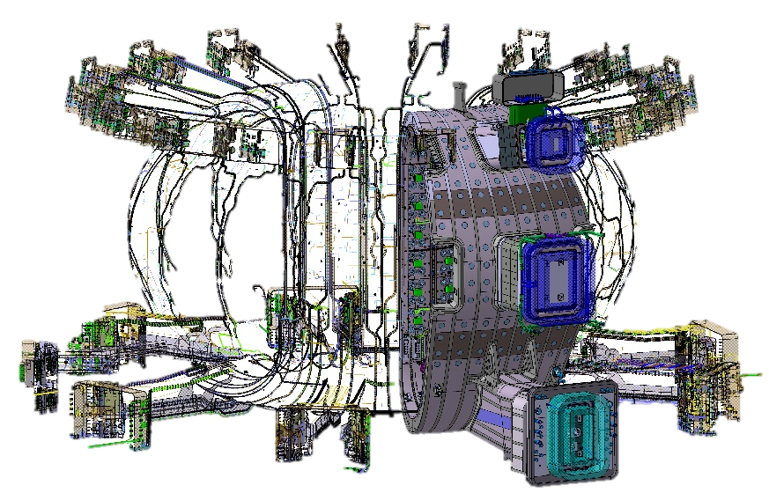
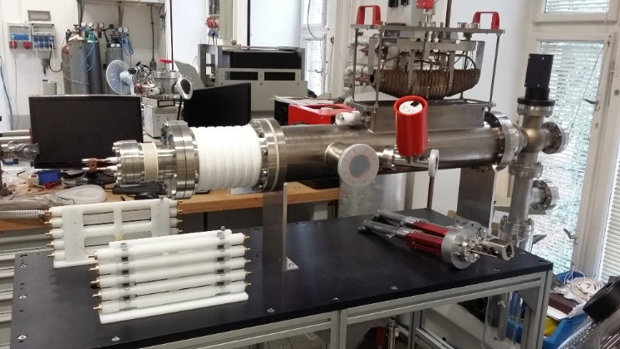
Fusion Plasmaphysics and Technology
Shuttered Pellet Disruption Mitigation – the Emergency shut-down system for ITER
Plasma diagnostics on tokamak (MAST, ASDEX, W-7X, etc.)
ITER Bolometer cells
IFMIF-DONES Test Cell
ITER, DEMO tricium breeder cells
ITER electrical diagnosis, signal transmitting line
Notes:
Az IFMIF-DONES egy nemzetközi projekt, amit az Eurofusion vezet - spanyol ,olasz, horváth, német, lengyel, magyar, francia, angol részvétellel. Ez hivatott a DEMO-hoz egy anyagvizsgáló neutronforrást készíteni.
Az MTA Wigner intézete fogja össze a magyar részvételt ebből a projektből, két további ipari partnerrel. A magyar részvétel elsősorban a Teszt-cellához kapcsolódik. Az ipari partnerek ezzel foglalkoznak:
C3D: végzi a Tesztcellában, a termikus hidraulikus szimulációk javítását. További termikus számításokat végeznek a belső hibrid vasbetonra azok tervezését és elemzését is végzik. Valamint a másodlagos hőelvonó berendezések koncepcionális tervezésével, méretezésével is foglalkoznak.
A Fuziotech: karbantartási eljárásokat dolgoz ki és a komponensek beszerelésével kapcsolatos jóváhagyási folyamatait dolgozzák ki, továbbá a komponensek logisztikájában is részt vesznek a gyártósortól az üzemig.

Slide 10


Thank you for your attention!

