Slide 1
Hungarian participation in
Eurofusion and ITER
Sándor Zoletnik
Head of Department
Fusion Plasma Physics Department

Slide 2
Hungarian fusion background
Hungarian Fusion activities started already in the 1970’s at KFKI:
MT-1, MT-1M tokamaks (1978-1998)
Collaboration with FZ Jülich, IPP-Garching 1990-
Diagnostic development, pellet ablation physics, laser blow-off, X-ray tomography
Hungary joined EURATOM in 2000:
Most of work at former KFKI: Wigner RCP, CER
Collaboration with the Budapest University of Technology and Economics
Beam Emission Spectroscopy, pellet observations, material irradiation
Engineering group established in 2005:
participation in 4 ITER diagnostics: core CXRS, bolometry, core TS, video
EDICAM development
diagnostics for various devices: AUG, JET, MAST, TEXTOR, KSTAR, EAST

Slide 3
Hungarian partners in Eurofusion
Beneficiary
Wigner Research Centre for Physics (Wigner RCP, -2020)
Centre for Energy Research (CER, 2021-)
Both institutes are located at the KFKI campus
CER:
Fusion Plasma Physics Department (~30 staff, 1:1 physicist and engineer)
Fusion Technology Department (~8 engineers)
Reactor Materials Department (~10 in fusion)
Budapest University of Technology and Economics
ATOMKI Debrecen: some atomic physics modelling

Slide 4
Hungarian participation in Eurofusion experiments
Wendelstein 7-X
Video survey diagnostic
Alkali Beam Emission Spectroscopy
Edge turbulence studies, pellet ablation measurements, services for W7-X team
ASDEX Upgrade:
Pellet camera system construction and operation
Fast Ion Loss Detector optics, detectors (FILD2, FILD3, FILD4, FILD5)
Imaging Heavy Ion Beam (iHIBP) probe development
MHD data analysis
MAST-U:
Beam Emission Spectroscopy (BES)
COMPASS:
Li-beam and Atomic Beam Probe (ABP or iHIBP) demonstration
JT-60 SA:
EDICAM video system
Concepts for Li-BES and H-BES

Slide 5
Hungarian participation in Eurofusion other than experiments
Material irradiation studies
Materials handbook for DEMO
DONES design:
Systems engineering
Test cell design
Li-system design and remote handling
DEMO remote handling methods and technologies
DEMO breeder blanket simulation
Runaway electron modelling
Socio-Economics

Slide 6
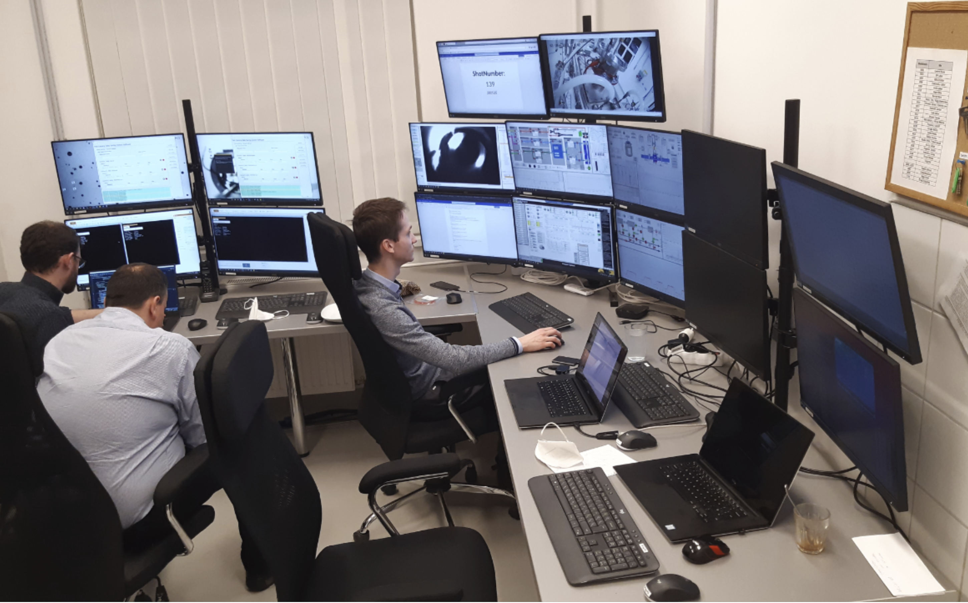
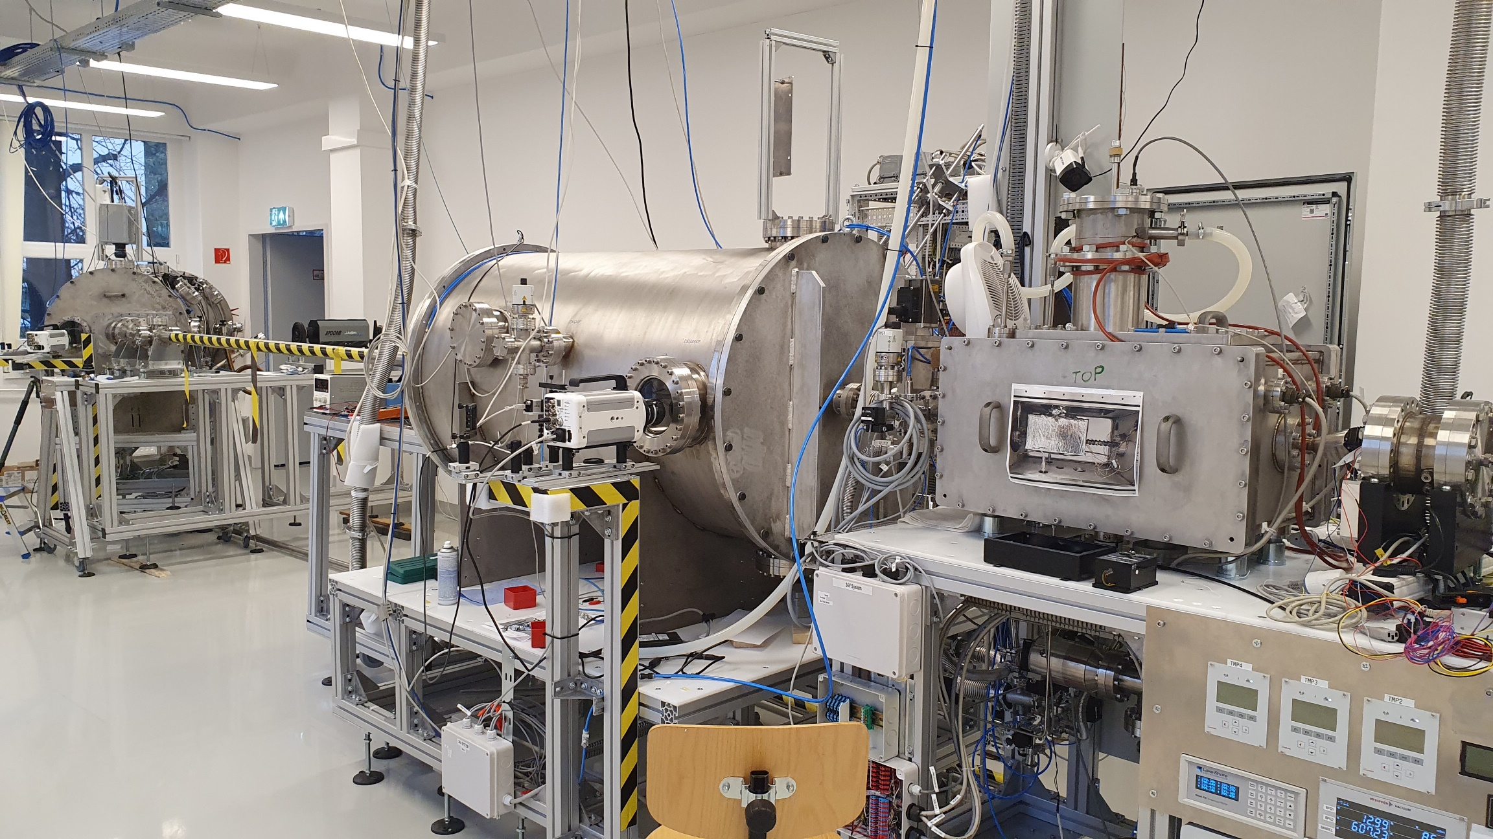
Hungarian participation in ITER
Disruption Mitigation System support laboratory (SPI technology development)
Design, construction of cryogenic SPI system (CER, H-Ion, VTMT)
Pellet launch and flight
Pellet shattering studies
Modelling: pellet production, cryogenics, pellet launch, gas flow
Diagnostic
chamber
Propellant recovery chamber
Flight tube
Propellant
valve
Injector

Slide 7
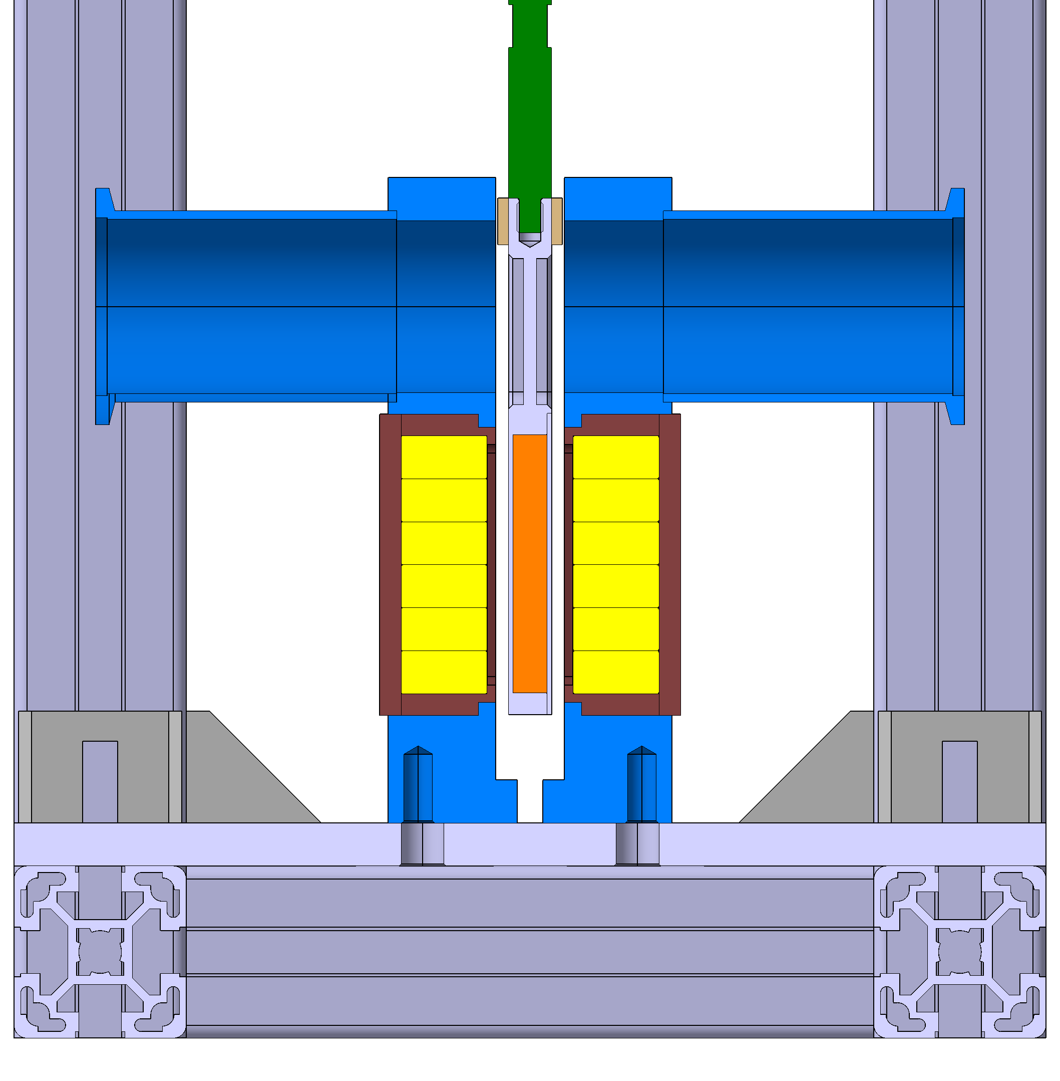
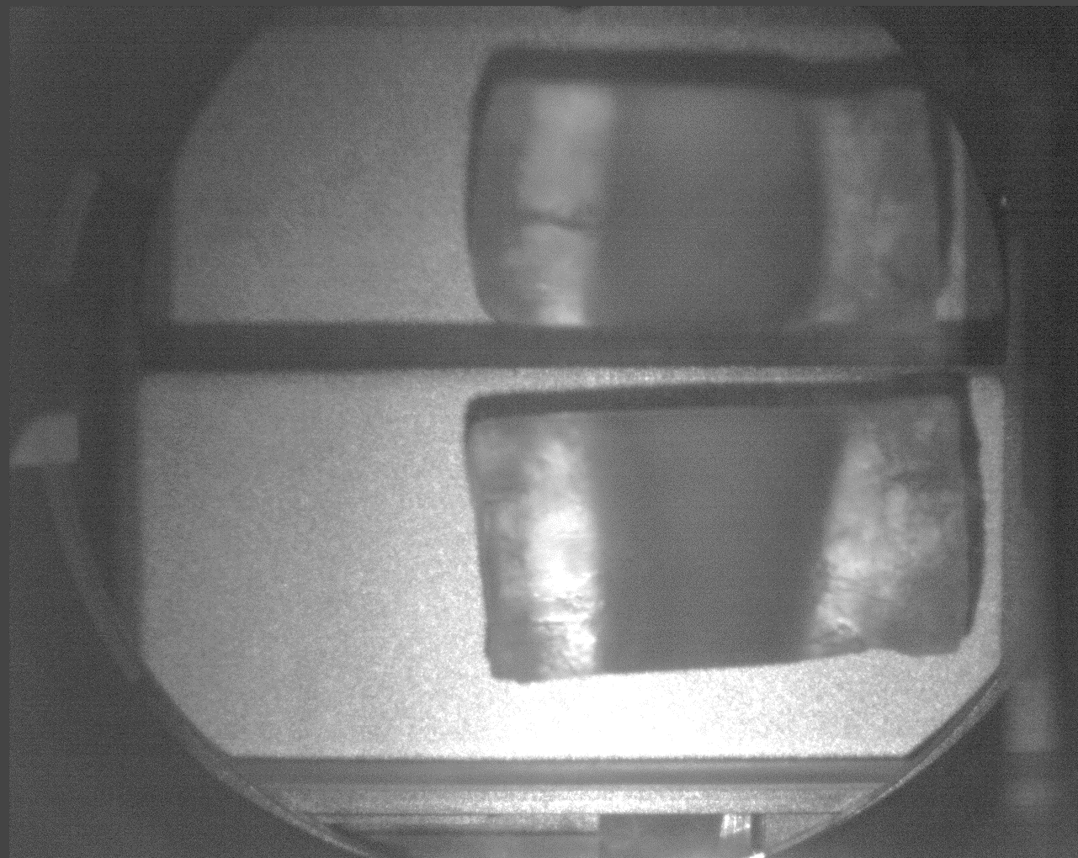
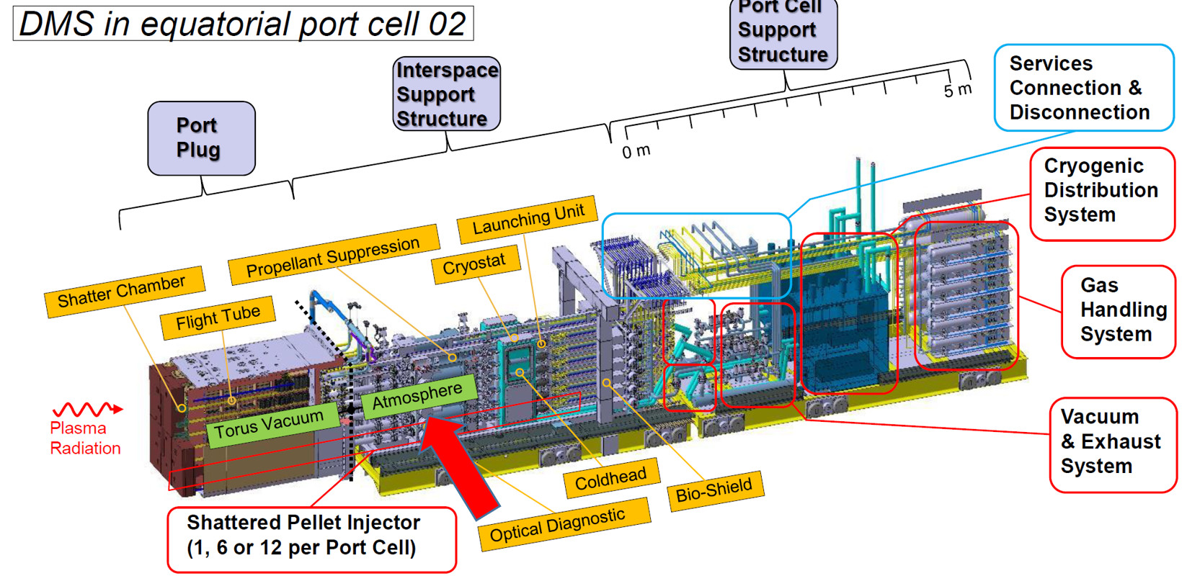
SPI related projects
Fast shutter development for ITER SPI (CER)
Aim is to prevent gas flow after pellet
Closing of 40 mm diaphragm in ~1 ms
First lab tests planned on October
Optical Pellet Diagnostic for SPI (Fusion Instruments)
Development and demonstration of ITER diagnostic
Measure SPI pellet quality, velocity, direction after launch
First demonstrations in DMS support lab
Single shot cameras for non-nuclear phase, APD detector signals for DT
Fast shutter concept with eddy current actuator and magnetic brake
Camera image of a 28.5 mm diameter Hydrogen pellet and image reconstructed from 20 sight lines in the OPD.

Slide 8
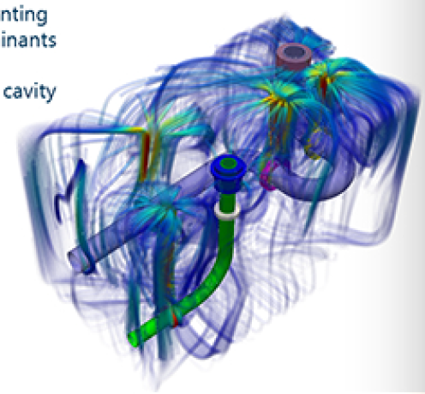
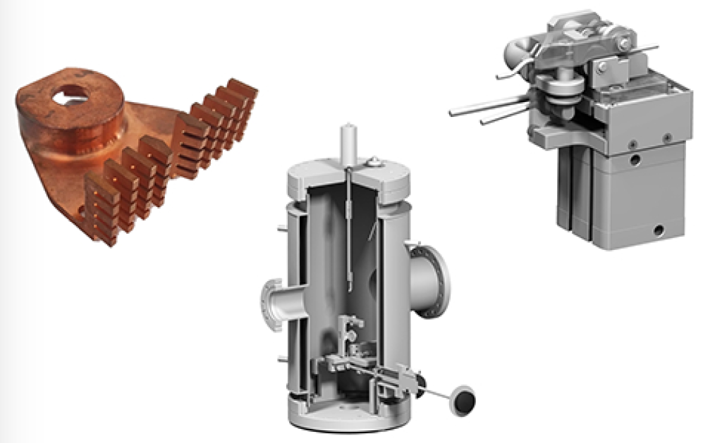
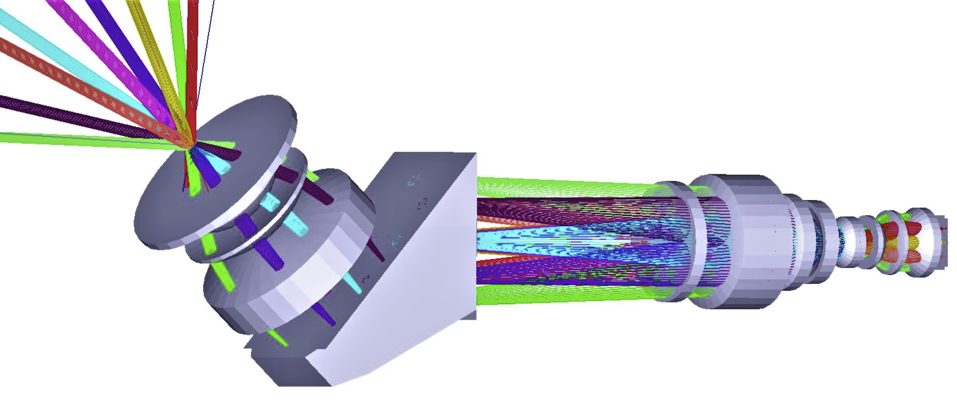
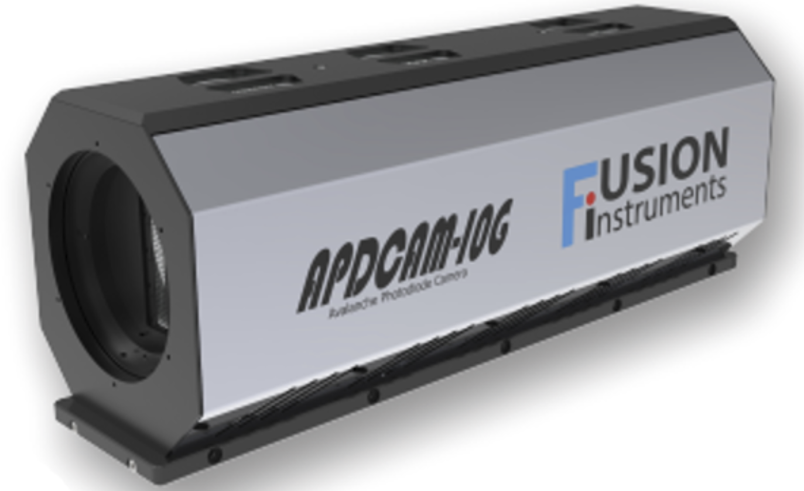
Industrial participation in ITER and Eurofusion
C3D
DONES design and modelling
ITER in-vessel cabling
Modelling of and design of diagnostic first wall cooling
Erosion deposition monitor diagnostic
GEMS
ITER in-vessel cabling
Design and manufacturing of various components
Optimal Optik
W7-X alkali beam diagnostic optics, EAST and MAST BES optics
Core CXRS optical design (ex-vessel)
SPI and erosion monitor optical design
OMI Optika
JT-60SA EDICAM optics
EAST Li-beam optics
Fusion Instruments
APDCAM detector family (AUG, W7-X, MAST, KSTAR, EAST, LHF, JET)

Slide 9
Laboratory visit
Please sign up for laboratory visit at the Centre for Energy Research on Friday:
ITER SPI laboratory
3D printed ITER model
EDICAM demo
ITER Optical Pellet Diagnostic
APDCAM demo
Fast shutter development

